Slide 1
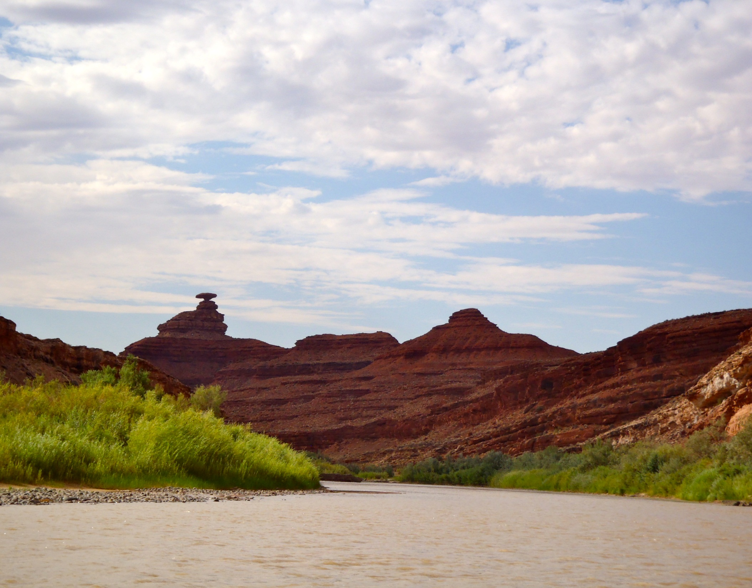
San Juan River:
Proposal to Issue Non-Commercial
Special Recreation Permits through Recreation.gov
Presented by Silas Sparks, Recreation Assistant
BLM-Utah Monticello Field Office
November 25, 2014

Slide 2
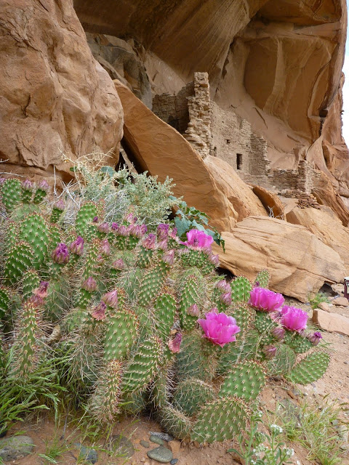
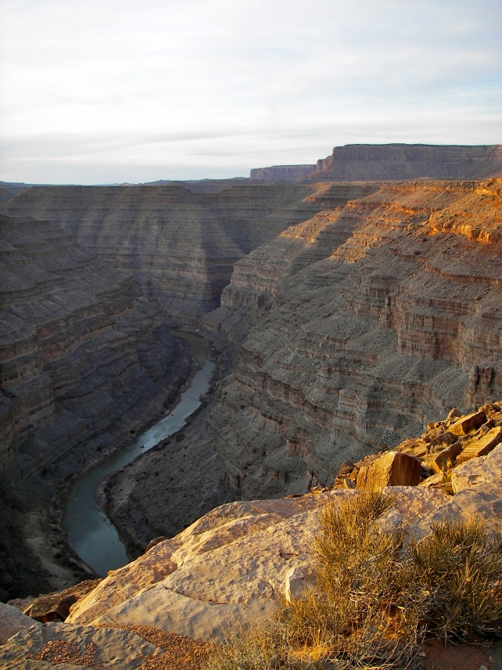
San Juan River Special Recreation Management Area
A float trip on the San Juan River in southeast Utah provides 11, 500 annual visitors with access to spectacular canyons rich in scenery, archaeology, history, remarkable geographic features, and desert wildlife.
Visitation Numbers
1 to 7+ day river trips
4,200 annual lottery applications
9,000 private visitors annually
12 commercial guides w/2,500 annual visitors

Slide 3
River Management
BLM administers Special Recreation Permits (SRP)s for boating on a 102 mile section of the river in San Juan County, UT;
38 river miles within Glen Canyon National Recreation Area through a General Agreement with the National Park Service.
The south bank of the river is Navajo Nation and separate recreation permits are required for camping and hiking on Navajo lands.

Slide 4
Fee Collection Authority: Special Recreation Permits
SRPs for non-commercial boating on the San Juan River have been required since 1981.
Federal Land Policy and Management Act, Section 302(b): Authorizes the BLM to manage the use of the public lands through permits.
Federal Lands Recreation Enhancement Act, Section 803(h): Authorizes the BLM to require Special Recreation Permits and fees associated with specialized recreation uses of federal lands and waters, such as group activities, recreation events, and motorized recreational vehicle use.
Notes:
Plan to quickly introduce and then skip over the fee authorities since we are not proposing any new fees and new fees were approved recently. Including them here just in case fee related questions come up.

Slide 5
Fee Collection Authority: Special Recreation Permits (continued)
Code of Federal Regulations, Title 43, Subpart 2931:
Special Recreation Permits may be required for use in “special areas” based on resource concerns, potential user conflicts, and public health and safety.
A “special area” is an area where the BLM determines that the resources require special management and control measures for their protection.
FR, Vol. 46, No. 191 - October 1981: Identified the San Juan River as a “special area”. SRPs for the San Juan River Special Recreation Management Area protect primitive recreation experiences, riparian ecosystems, and cultural and historic resources.
The 2008 Monticello Field Office Resource Management Plan reaffirmed permit requirements for all users of the San Juan River.

Slide 6
Current SRP Fee Schedule
A non-commercial SRP fee was initiated in 1983 (FR, Vol. 48, No. 51 - March 1983).
The current SRP fee schedule was approved by the RAC in February of 2013 and implemented for the 2014 river season.
 | Upper (Sand Island to Mexican Hat) | Lower (Mexican Hat to Clay Hills) | Combined (Sand Island to Clay Hills)
SRP Fee: Per Person/Per Trip | $10.00 | $20.00 | $30.00
An annual one-time $6.00 application fee is also collected.

Slide 7
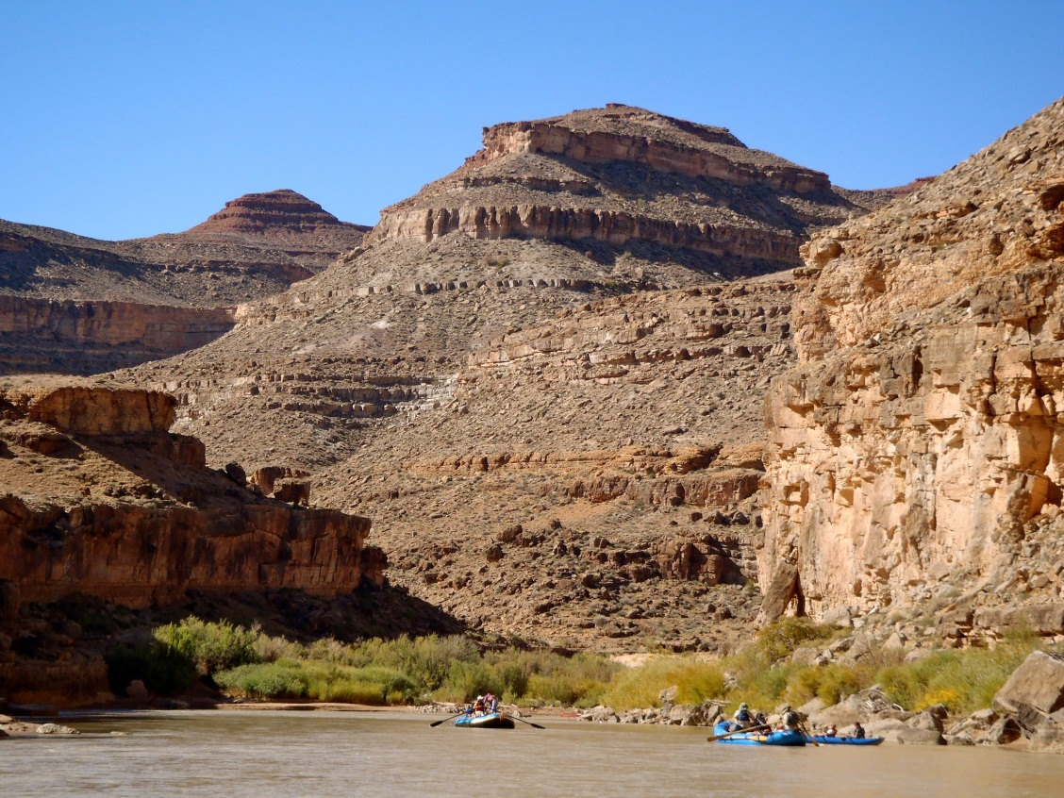
2013 Approved San Juan River Business Plan
Established current fee schedule and described priorities for future program spending.
Proposed to move to an online permitting system and to reduce the permit lottery season.
The 2014 amendment to the plan provides the public with the details of the proposed move to Recreation.gov and the associated changes to permit business rules.
Notes:
Quick recap of 2013 plan so RAC knows why were here and that current fees, move to online permitting system, and shortened lottery season have already been approved.

Slide 8
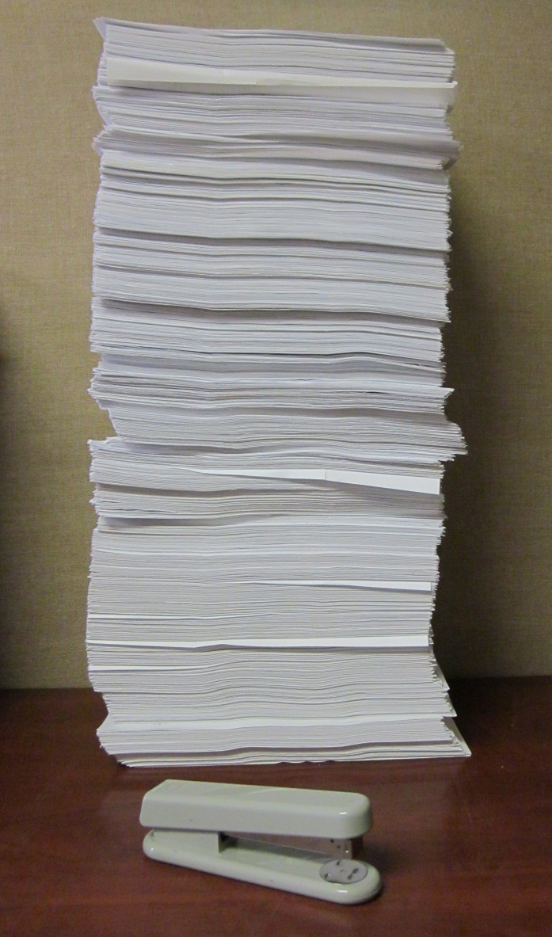
Current Mail-in Lottery
Labor intensive
4,200 paper applications received via U.S. Mail annually. Most within one week period. Plus 4,200 personal checks for each application.
Applications and payments must be entered manually into two separate databases.
Inconvenient Multi-step Process: Applicants must download, print, and mail application along with $6 payment
Notes:
Lottery takes 4 weeks of intensive labor by 4 staff members to process.

Slide 9
Current Call-in Reservation System
Single phone line, during limited business hours (8 – noon)
Phone is frequently busy and callers must redial repeatedly to get through during busy season.
Boaters who work during these hours are at a significant disadvantage in acquiring reservations for popular dates and must disrupt their work schedules to complete transactions.
Notes:
Added busy signal audio when mouse hovers over image for effect. Mention some experiences; teacher called while kids reciting pledge of allegiance in background, patrolman in car dispatched while obtaining a permit. People will redial for hours, only to find out the launch date they want has been booked already.

Slide 10
Proposal to Move to Recreation.gov
The BLM proposes to distribute non-commercial San Juan River SRPs and collect fees through Recreation.gov for the 2015 river season, beginning 12/1/2014.
Boaters will be able to apply for reservations in the permit lottery, reserve launch dates, make changes to permits, and make fee payments online 24/7.
Commercial SRPs will continue to be administered by the Monticello Field Office and will not be included.
Notes:
Due to level of complexity and intuition needed for commercial SRP administration, Rec. gov could not support.

Slide 11
About Recreation.gov
Online trip planning and reservation system that includes:
12 federal agencies,
2,500 federal areas,
over 60,000 facilities and activities
Regional rivers: Desolation-Gray (Green River), Middle and Main Salmon, Selway, Snake, Yampa and Dinosaur (Green River)…(more on the way)
Call-in services for small % of boaters who do not have internet access.

Slide 12
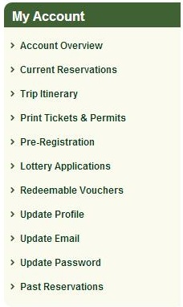
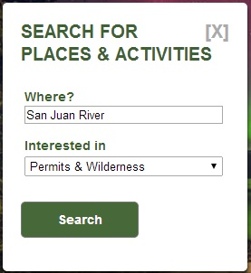
Rationale: Benefits to Public
Customer service
24/7 access to complete routine transactions
More fair and less frustrating system for obtaining coveted launch cancellations
BLM river office will be more readily available to answer trip planning questions and handle more advanced transactions.
Enhanced personal information security.

Slide 13
Rationale: Benefits to BLM and Resource
Will significantly reduce amount of staff time spent performing routine transactions (data entry, payment processing) and processing the lottery.
Will allow river staff to spend more time on other essential river program needs including; planning, interpretation, volunteer coordination, facility improvement projects, resource monitoring and protection.

Slide 14
Proposed Changes to SRP Business Rules
Permitting Element | Current Process | Proposed Change
Application/ Transaction Fee | A $6.00 “application” fee is collected once per applicant per year. | A $6.00 “transaction” fee would replace the application fee and would be collected per each new transaction.
Permit Fee Payment Due Date | 30 days prior to the launch date. | March 15th for all lottery winners or immediately at the time a non-lottery reservation is made.
Refund Policy | If a permit is cancelled or group size reduced a minimum of 30 days prior to the launch date, a credit is issued. | If a permit is cancelled or group size reduced a minimum of 31 days prior to the launch date, a full refund would be issued.

Slide 15
Rationale for Change to Transaction Fee
The cost of doing business online and providing the associated customer service benefits.
$6.00 transaction fee collected on the BLM’s behalf is the minimum transaction fee charged for all federal sites that Recreation.gov provides reservation services for, in order to cover the cost of those services.

Slide 16
Impacts of Change to Transaction Fee
Public: 350 to 400 unsuccessful lottery applicants would have to pay a second $6 transaction fee to book a reservation after the lottery.
100 boaters who book multiple trips would have to pay a $6 transaction fee for each new reservation.
Impact of change considered negligible when considering total costs of San Juan trip.
BLM: Will cost the Monticello BLM approximately $19,000 to $20,000 a year to provide online reservation services through Recreation.gov (paid for w/transaction fee).
These costs were factored into the determination of the 2013 approved fee schedule and will not impact the river program’s financial stability.
Costs will be offset by reduction in permit processing labor funded by river permit fee revenues.
Notes:
$19,000 to 20,000 = approximately $4.50 of every transaction fee

Slide 17
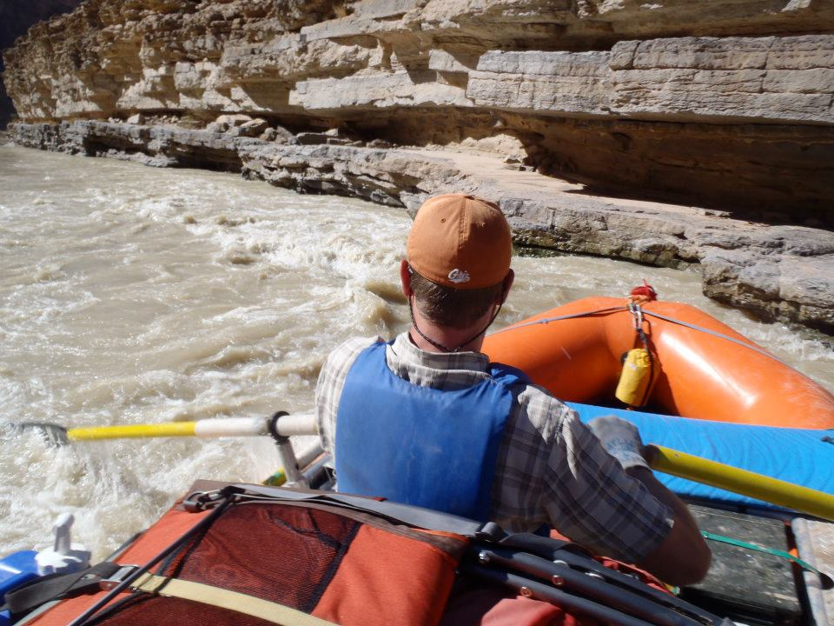
Rationale for Change to Payment Due Dates
Improved Reservation Availability:
Launch dates available to rebook sooner and more predictably after lottery execution.
Reduction in “abandoned” reservations (1 out of 5).
Consistency and Simplicity:
Reduce public confusion regarding various permit action and payment deadlines among regional rivers.
Consistent with payment timelines for other regional rivers using Recreation.gov permitting and lottery services.
Reduces steps and action deadlines for San Juan reservation holders.

Slide 18
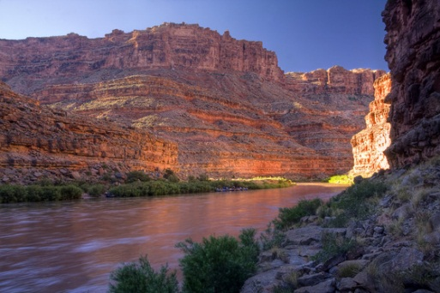
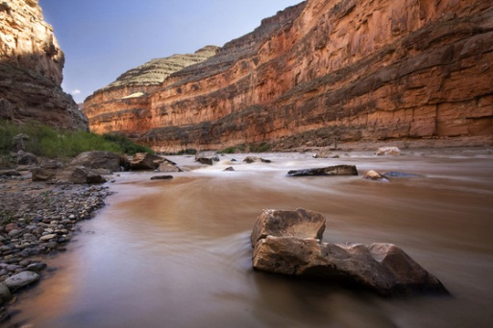
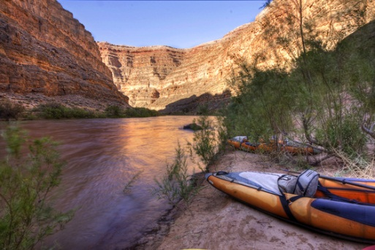
Impacts of Change to Payment Due Dates
Fee payment will be required sooner.
Proposed refund policy would provide a refund of those fees until 31 days in advance of the launch date.
More initial investment, but no additional financial risk by requiring reservation holders to pay sooner.
More launch reservations available sooner for unsuccessful lottery applicants to make trip planning more feasible.

Slide 19
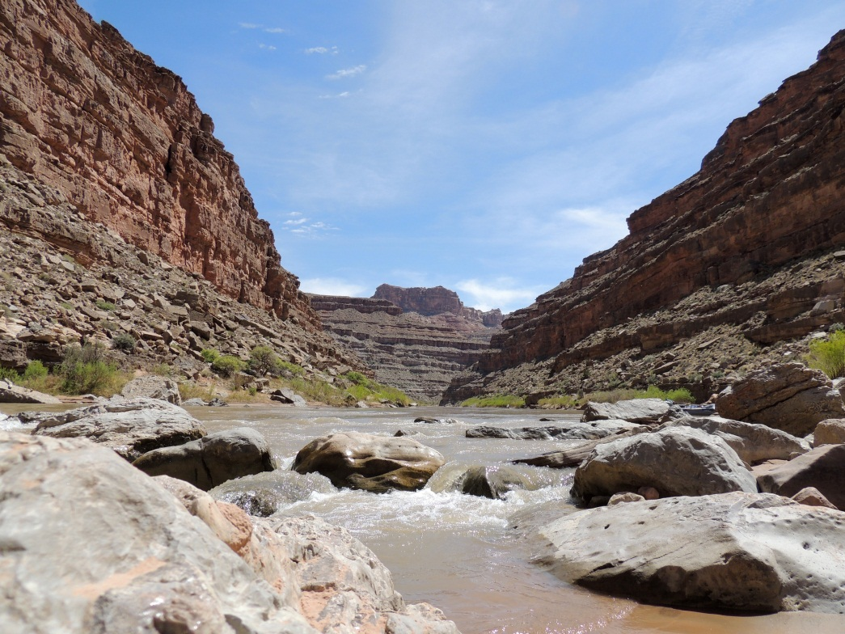
Rationale for Change to Refund Policy
Refunds not previously offered because of BLM cost and labor associated with difficult processing.
Recreation.gov provides simple refund capability at no additional cost to agency.
Credits cannot be utilized by majority of boaters.
More incentive for boaters to cancel trips or reduce group size in timely manner.

Slide 20
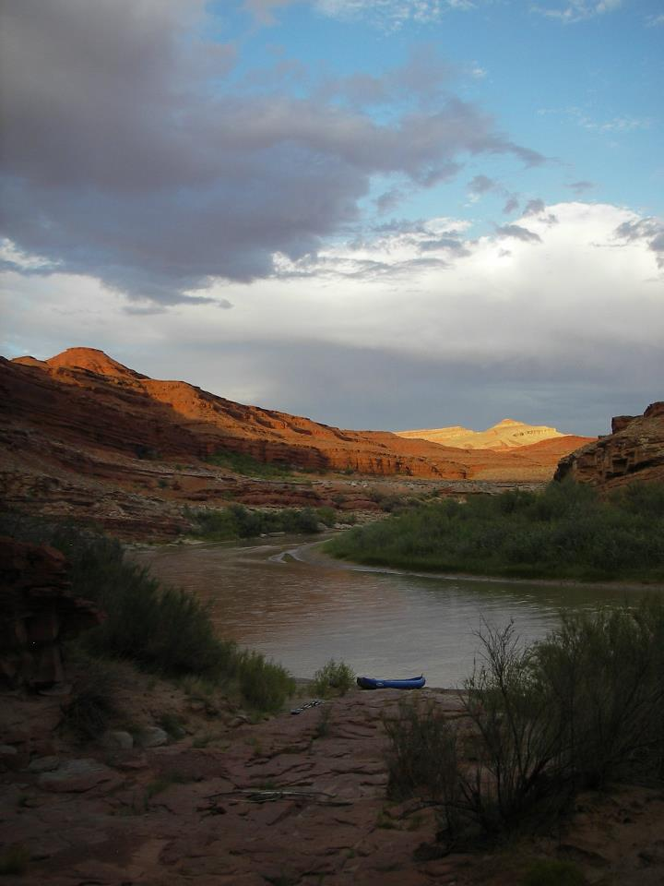
Impacts of Change to Refund Policy
Public:
Will benefit boaters who are unable to apply credit to a trip later in the season.
Added cancellation and group size reduction incentive will create more space for other boaters.
BLM:
Will have a negligible impact on fee revenues and program financial stability.
Few reservations are cancelled prior to 31 day deadline.
Timely cancellations are rebookable.

Slide 21
Public Outreach Efforts
Posted Amended Business Plan on the BLM-Utah and Monticello Field Office websites;
Issued a News Release to statewide print and broadcast media;
Posted notices at the San Juan River informational kiosks;
Posted links to the Amended Plan on the BLM Utah Facebook, Twitter, and other social media websites and on popular river running websites such as Mountain Buzz and Utah Rafters; and
Notified all San Juan River commercial SRP holders of the amended plan via email.

Slide 22
Results of Public Outreach Efforts
Mountain Buzz notification post had 397 views.
BLM San Juan River Permits webpage had 1,362 visits and BLM Monticello homepage had 624 visits while plan and press release posted.
3 comments received: 2 comments in favor of changes and 1 comment against.
Commenter “against” felt that Rec.gov was more complicated and harder to get a cancellation and enjoyed being able to talk to knowledgeable individual.
Commenter “in favor” said Rec.gov was easy to use, fair, and worked well for other regional rivers.
7 comments for 2013 business plan were in favor of online permitting, 0 were against

Slide 23
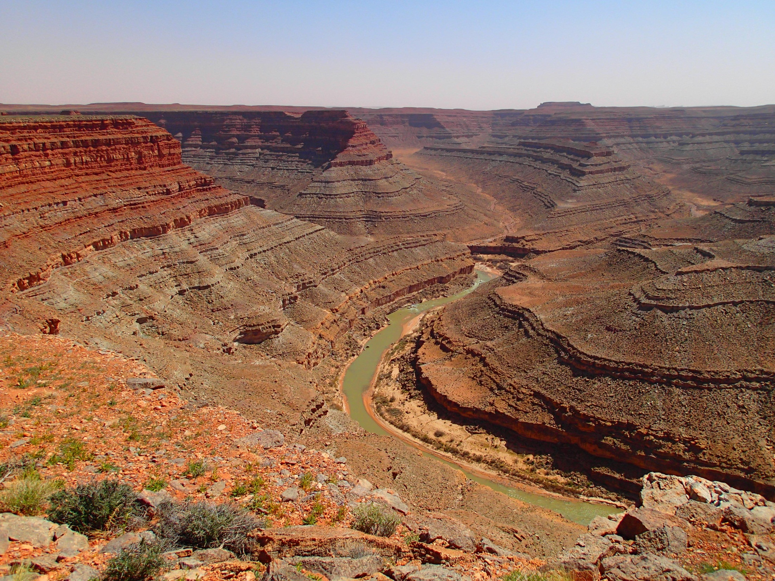
Questions?

Slide 24
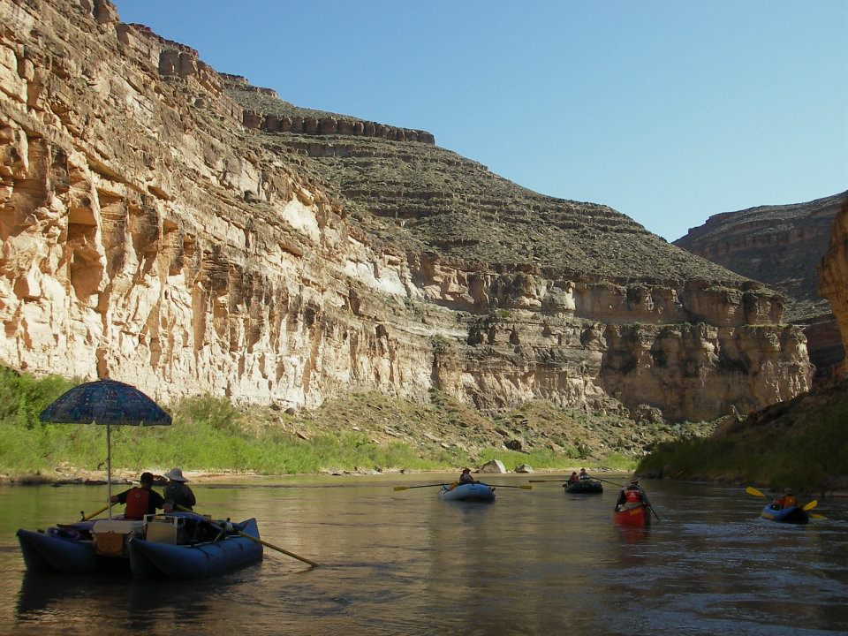
We request that the Recreation RAC pass a motion that the move to Recreation.gov demonstrates general public support and recommend that the BLM implement the changes to the fee program as proposed immediately.

