Slide 1
Science & Society: A “Working Group” Role Playing Activity
Grade 8

Slide 2
Big Idea: Science and Society
As tomorrows citizens,
students should be able to identify issues about which society could provide input, formulate scientifically investigable questions about those issues, construct investigations of their questions, collect and evaluate data from their investigations, and develop scientific recommendations based upon their findings.

Slide 3
Concepts
Concept 1:
Science is one of the processes that can be used to inform decision making at the community, state, national, and international levels.
Concept 2:
Political, social, and economic concerns can affect science, and vice versa.
SC.8.N.4.1 &4.2

Slide 4
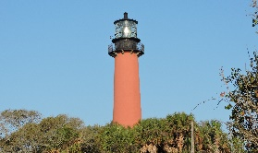
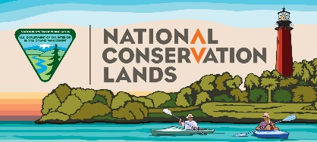
Big Idea: Science and Society
In this activity you will be role playing a member of a “Working Group” representing a specific agency or group.
You will do the following:
1.
2.
1. Review background and learn about the ONA.
2. Tour the ONA to make observations.
3.
4.
3. Role play of a member of a “Working Group”.
4. Meet with the other members of your “Working Group” to complete a report regarding the status of the ONA and make suggestions regarding its use.

Slide 5
Jupiter Inlet Lighthouse Outstanding Natural Area Study
The following facts are important and significant to the current status of the ONA.
Artifacts suggest that humans have been living on the site for thousands of years.
1819 The “Public Domain” land was ceded to the United States from Spain.
From the 1850’s through 1989 land was used by the Army, Navy, Air Force and the Coast Guard.
After nearly 140 years of military use, the site was transferred to the Bureau of Land Management (public lands) with some parts still under the control of the U. S. Coast Guard.
In 1994 the Loxahatchee River Historical Society (non-profit) opened the Lighthouse for public tours. The Historical Society operates and maintains the Lighthouse and Museum facilities.
2008 – The U. S. Congress designated (by law) the site as an “Outstanding Natural Area”.

Slide 6
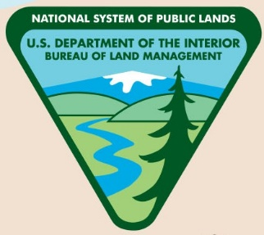
Partners of the ONA “Working Group”
NON-PROFITS:
Loxahatchee River Historical Society
Jupiter Community High School
FEDERAL:
Bureau of Land Management (BLM) &
U.S. Coast Guard
LOCAL:
Palm Beach County
Town of Jupiter
Village of Tequesta

Slide 7
Partners of the ONA “Working Group”
Two years of work by representatives of the “Working Group” partners, resulted in Congress passing and the President singing Public Law (PL-110-229, section 202) The Consolidated Natural Resource Act designating and protecting the Outstanding Natural Area (ONA).
(see 16 slide ONA Accomplishments.)
The Jupiter Inlet Lighthouse Outstanding Natural Area is now part of the National Landscape Conservation System which conserves, protects and enhances the unique and nationally important historical, natural, cultural, scientific, educational, scenic and recreational values of the ONA including an emphasis on the restoration of native ecological systems.
This act requires (by law) that the Secretary of the Interior work with the “Local Partners” do the following on the ONA:

Slide 8
Requirements of the 2008 The Consolidated Natural Resource Act
Protect and preserve the resource values.
Restore native plant communities and estuaries with an emphasis on the conservation and enhancement of
healthy, functioning ecological systems in perpetuity (forever).
Maintain or recreate historic structures.
4. Implement a program of interpretation and public education about the natural and cultural resources of the
Lighthouse, the public land surrounding the Lighthouse, and associated structures.
5. Proposal for administrative and public facilities to be developed or improved that are compatible with
achieving the resource objectives for the ONA and would accommodate visitors.
6. Consult with appropriate departments of the State, the Local Partners, and the Commandant, with an
emphasis on resource conservation in the ONA and the interpretive, educational, and long-term scientific
uses of the natural and cultural resources.
7. Develop Recreational use strategies, in consultation with the Local Partners, appropriate
departments of the State, and the Coast Guard, with an emphasis on passive recreation.

Slide 9
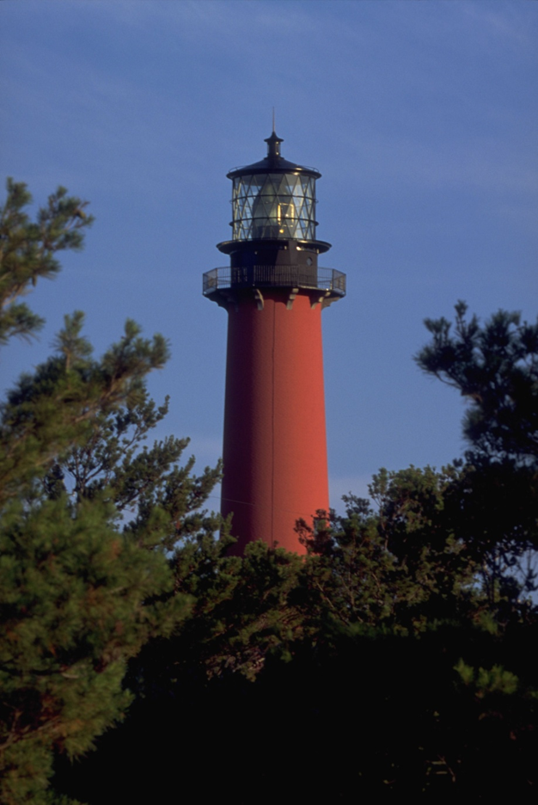
JUPITER INLET LIGHTHOUSE
OUTSTANDING NATURAL AREA
COMPREHENSIVE MANAGEMENT PLAN
and
ENVIRONMENTAL ASSESSMENT
Things You Should Know:
The “Comprehensive Management Plan” was created and signed by the “Working Group” partners in 2010 as the guiding document.
The Plan (based on research and studies) includes:
Location of ONA – Other relevant plans & laws – ONA Partners
Resources – Current Management Strategies – Socio-economic Conditions
Management Guidelines – Management Issues – Public Use - Protection
Management Practices – Cultural & Historic Resources – Recreation
Environmental Assessment & Impacts – Cumulative Impacts
Master Species List – Natural Resource Monitoring Protocol
Link to management Plan (200 page pdf file)

Slide 10
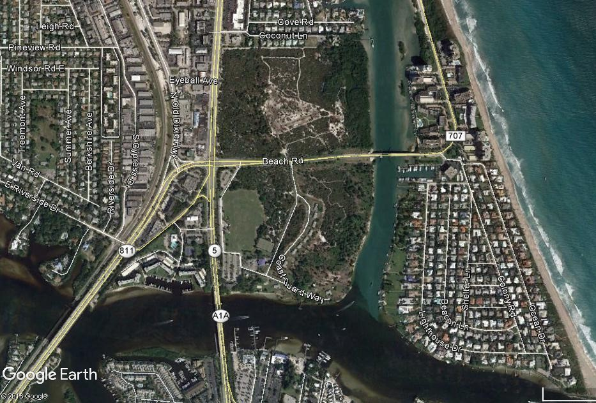
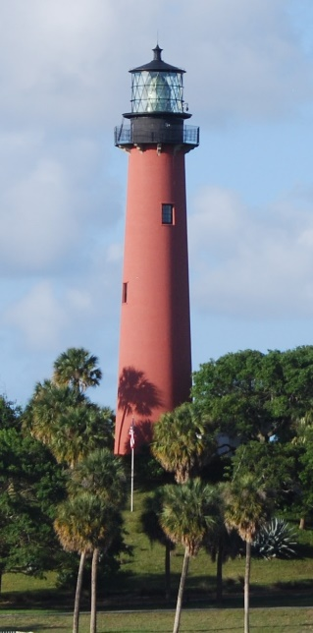
Things You Should Know: Location of the ONA
Intra-Coastal Waterway
Beach Road
U.S. Highway 1
Jupiter Inlet

Slide 11
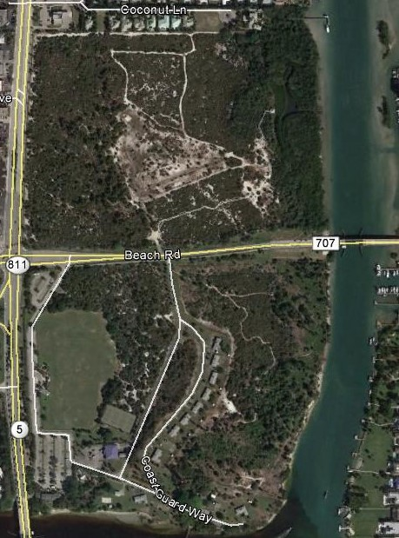
Things You Should Know: Location of the ONA
The ONA is entirely inside Palm Beach County with parts of the ONA in three different municipal limits,
The Village of Tequesta
The Town of Jupiter
Jupiter Inlet Colony
Village of Tequesta limits
Palm Beach County
Town of Jupiter limits
Jupiter Inlet Colony limits

Slide 12
Things You Should Know: Location of the ONA
The ONA was not an “Outstanding Natural Area” until 2008 as a result of several years of collaborative efforts by the working Group Partners. (Link to ONA Case Study) 1 page
Today:
The ONA is managed by the Bureau of Land Management
The Lighthouse & Museum is operated by the Loxahatchee River Historical Society
The recreation facilities, fields, and tennis courts are operated by The Town of Jupiter
Law enforcement is provided by FWC, PBC Sheriff, Village of Tequesta & Town of Jupiter
Research is done by local Schools, Universities and visiting Scientists.
Visitors to ONA come from all over the world

Slide 13
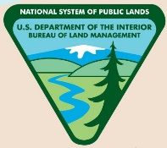
Things You Should Know:
On the field trip, for the Role Playing activity, the class will be divided into groups of five or six students.
Each “Working Group” of five students will have the following roles:
BLM Site Manager (Federal level)
Environmental Resource Management Representative (County level)
Town Representative (Local level)
Historical Society Representative (non-profit)
Citizen (visitor/user of the ONA may be 1 or 2 students)

Slide 14
Things You Should Know:
Each “Working Group” will tour the site then meet (Role Play) to create a “Final Report” answering the following:
What types of activities will or won’t be permitted (increased or reduced) on the ONA
What is the rational/basis for each of the Group’s suggestions
What studies would you suggest to support your group’s suggestions
Rating the importance of several aspects of the ONA
Determining the current status of the ONA (is it meeting the requirements of law?)

Slide 15
CULTURAL,
HISTORICAL and
NATURAL RESOURCES
MUST BE
PROTECTED, MAINTAINED & ENHANCED
PUBLIC USE,
EDUCATION,
SCIENTIFIC STUDY and
RECREATION
MUST BE
ALL ASPECTS OF THE ONA MUST BE MANAGED TO PROVIDE THE MOST PUBLIC USE WHILE PROTECTING, MAINTAINING & ENHANCING THE RESOURCES.

