Slide 1
Producers, Consumers & Decomposers of the ONA
Grade 7

Slide 2
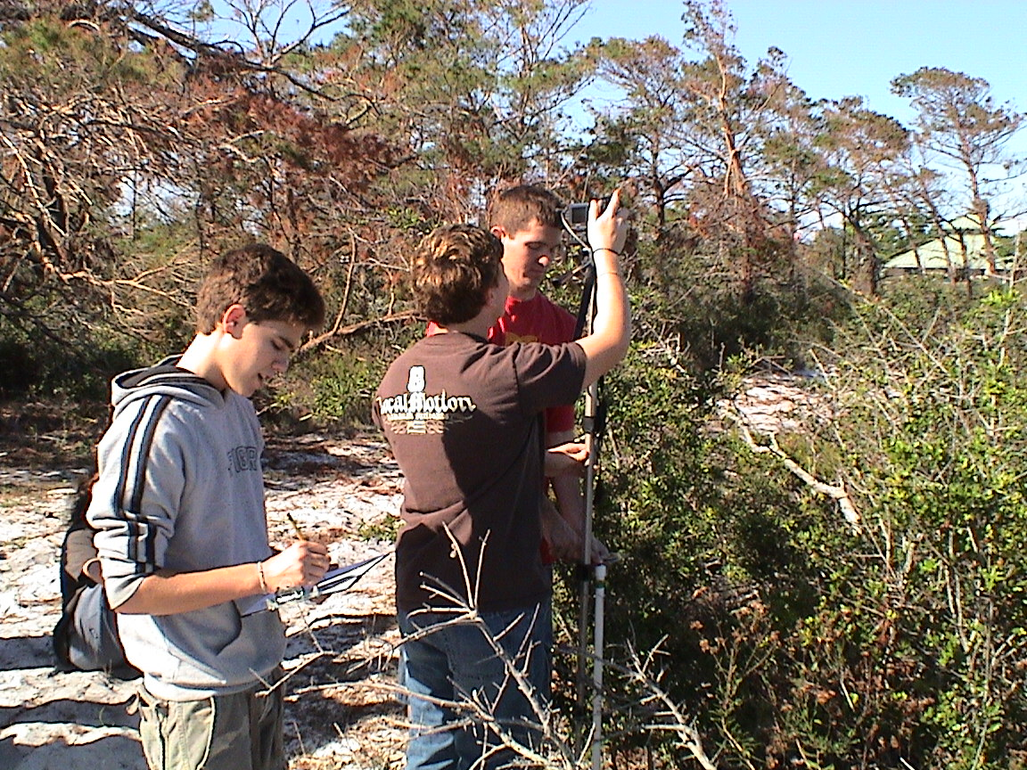
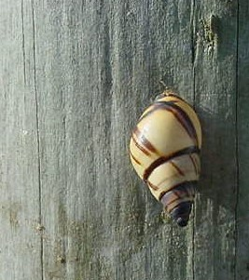
Ecology:
The study of the interactions between organisms and their environment.

Slide 3
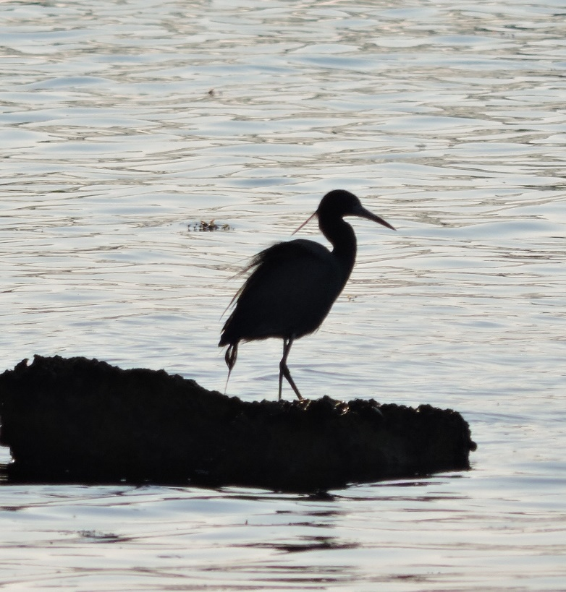
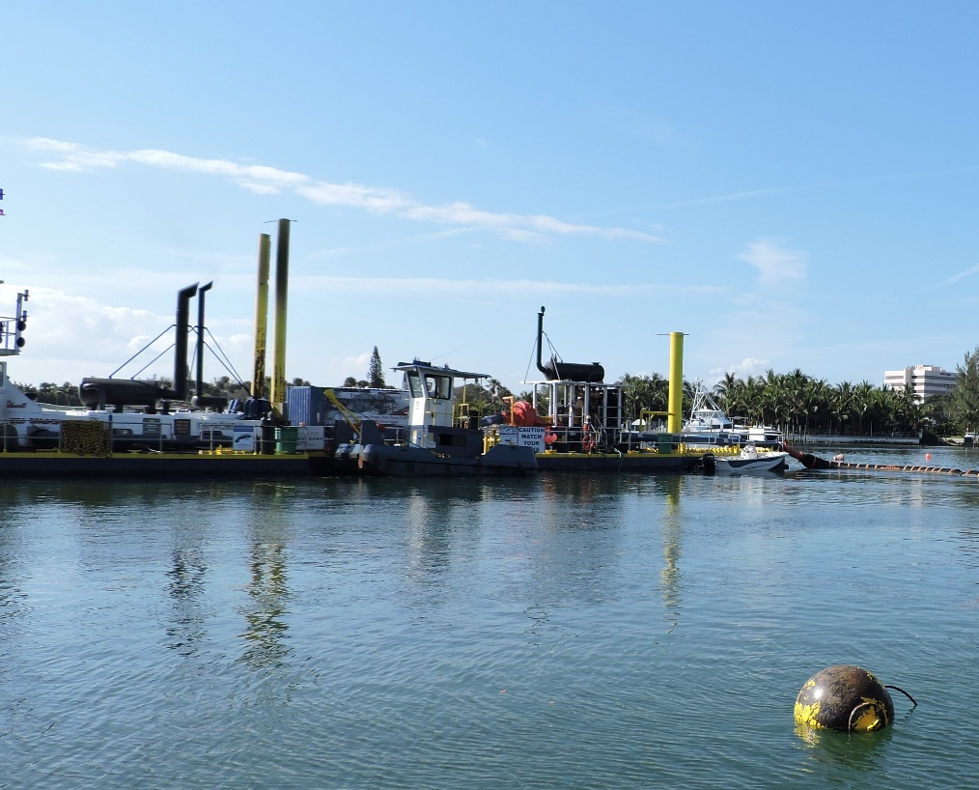
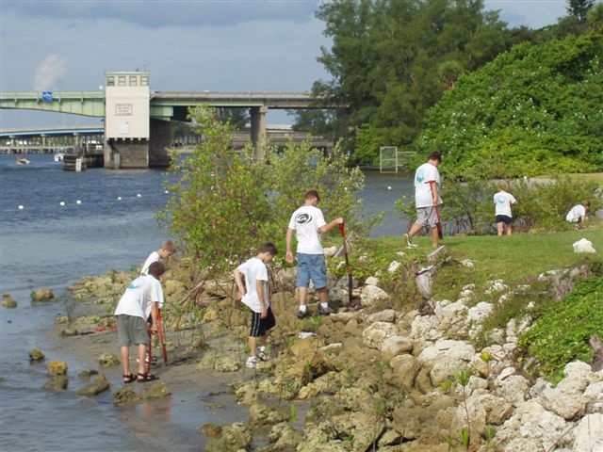
Ecosystem
A complex system of the interactions between all living things and their physical environment in a particular area. (Includes humans and human impacts.)

Slide 4
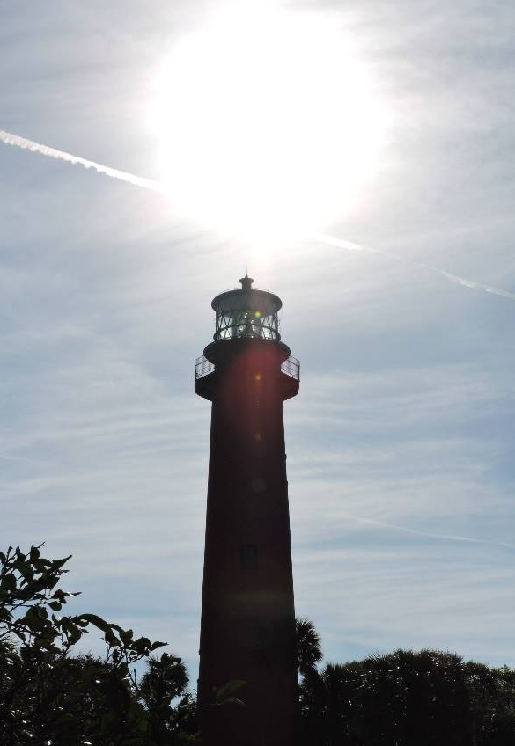
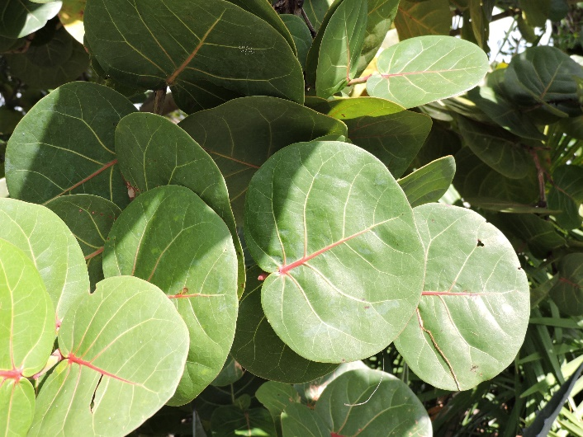
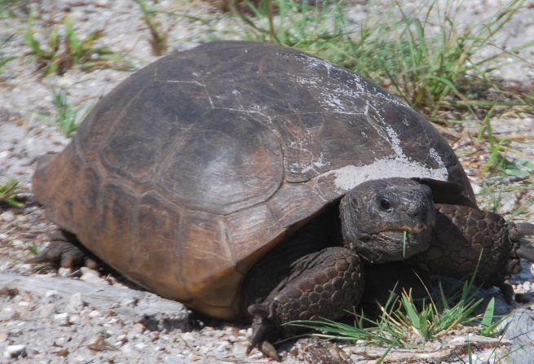
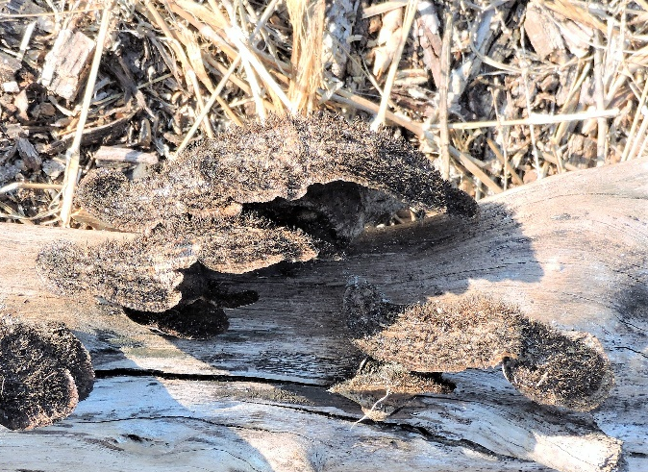
Trophic Levels
Energy flows through an ecosystem from (trophic levels)
the Sun, through Producers on to Consumers and Decomposers.
Green Plants and organisms that make their own food from the sun’s energy.
Fungi, bacteria, invertebrates that break down organic material.
Organisms that eat other organisms.

Slide 5
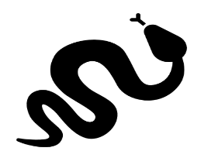
Transfer of Energy in Food Chains and Food Webs
A Food Chain shows a simple one to one relationship. | A Food Web shows many complex relationships.
*DECOMPOSERS: (Bacterium, Fungus, Invertebrates) Are always at work to break down organic material. | *Some plants eat bugs.
The SUN provides energy to Producers.

Slide 6
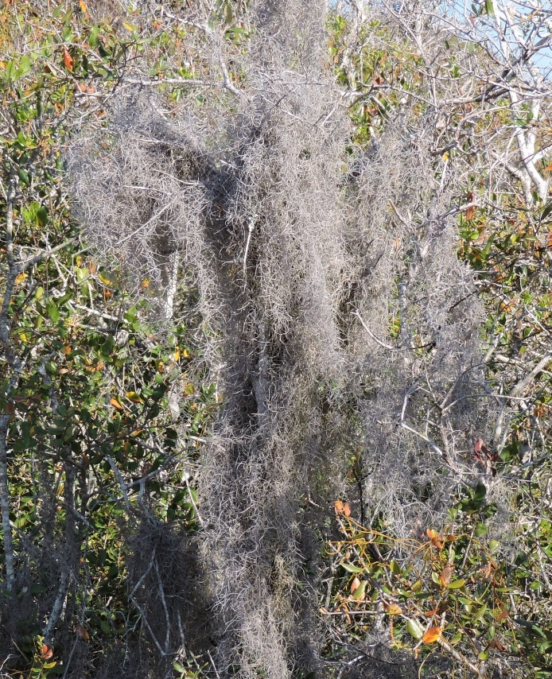
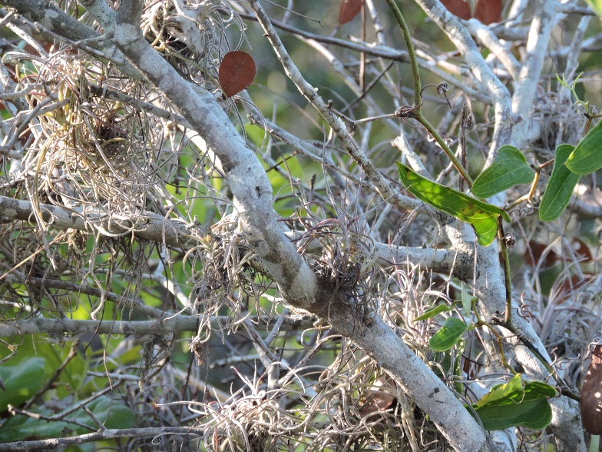
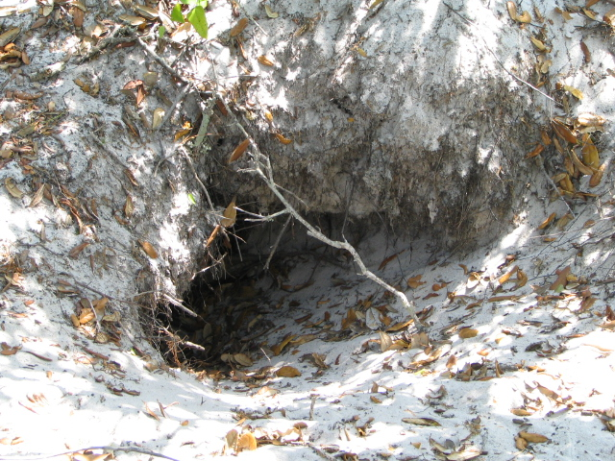
Ecological Relationships
Commensalism: One organism benefits with no impact to the other.
Spanish Moss & ball mosses in trees/shrubs elevated off the ground.
Snakes, lizards and other animals using a Gopher tortoise burrow.

Slide 7
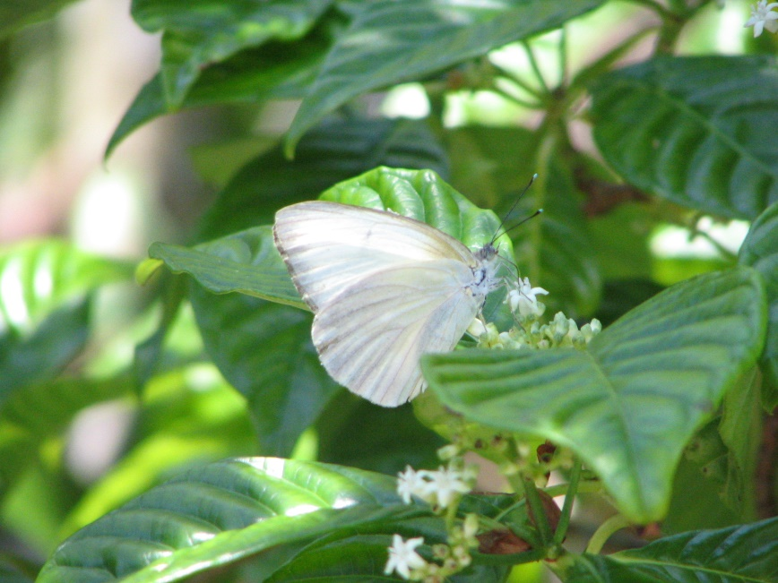
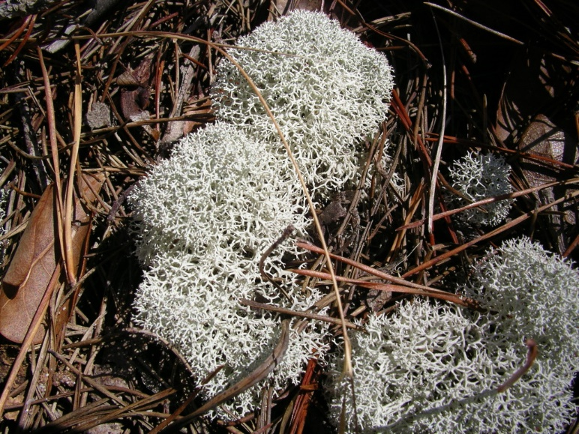
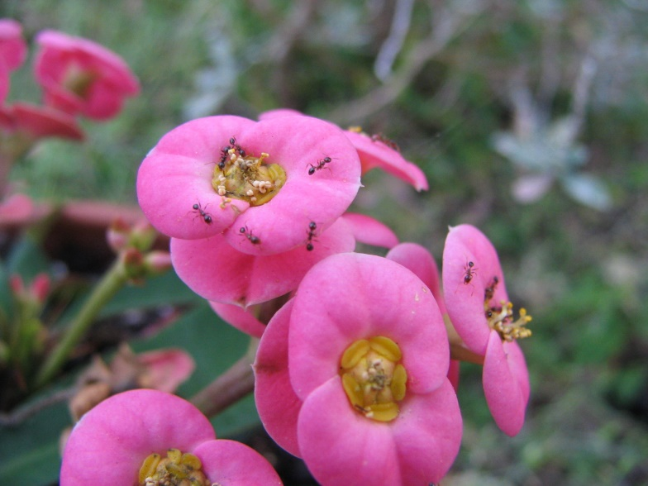
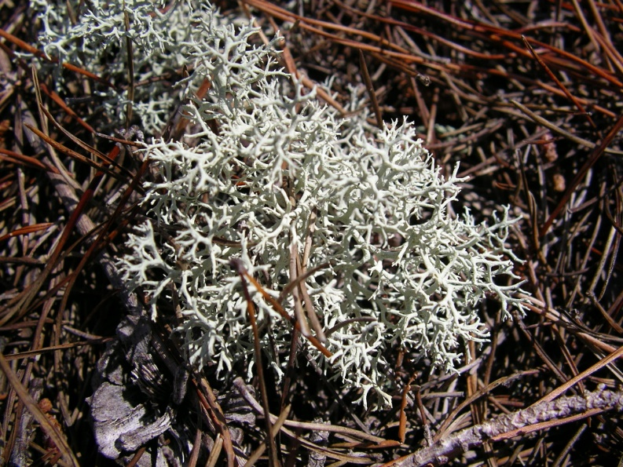
Ecological Relationships
Mutualism: Both organisms benefit.
Lichens are organisms made up of two or more of the following: algae, fungi and bacteria.
Insects gathering nectar and pollinating flowers.

Slide 8
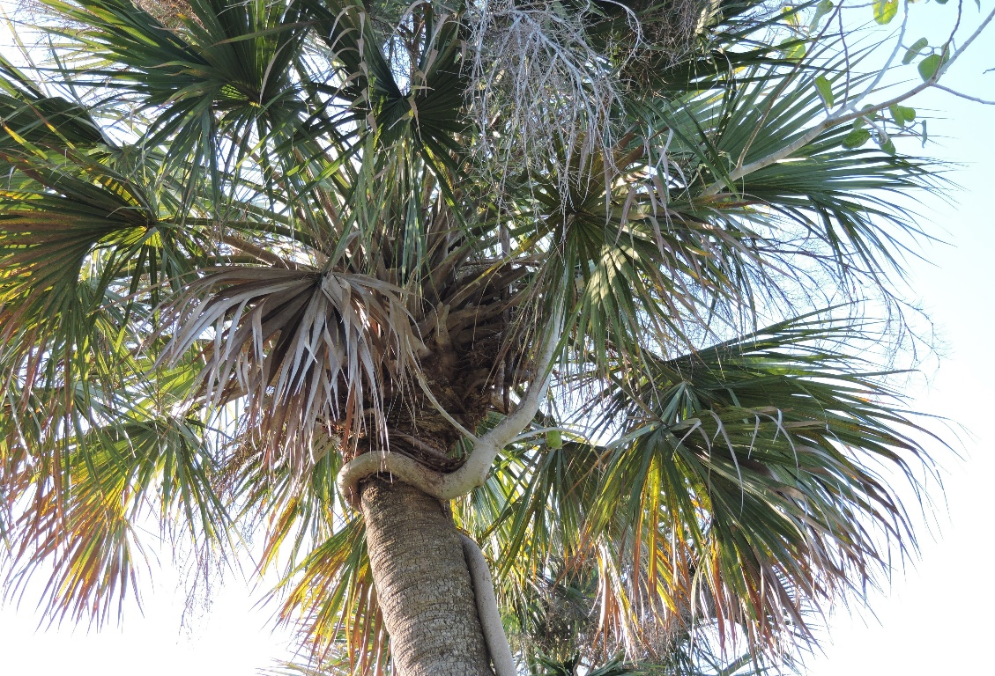
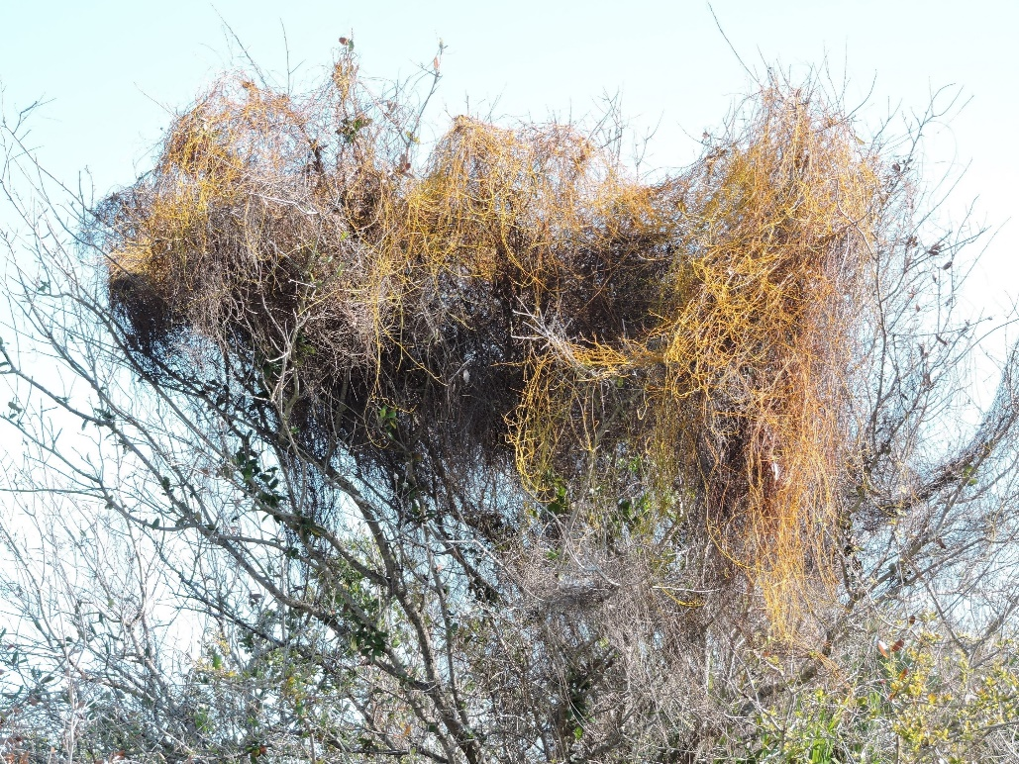
Ecological Relationships
Parasitism: One organism benefits and the other is harmed.
Strangler fig grows on Cabbage Palm eventually choking it .
Love vine (Dodder sp.) smothers oaks and other shrubs.

Slide 9
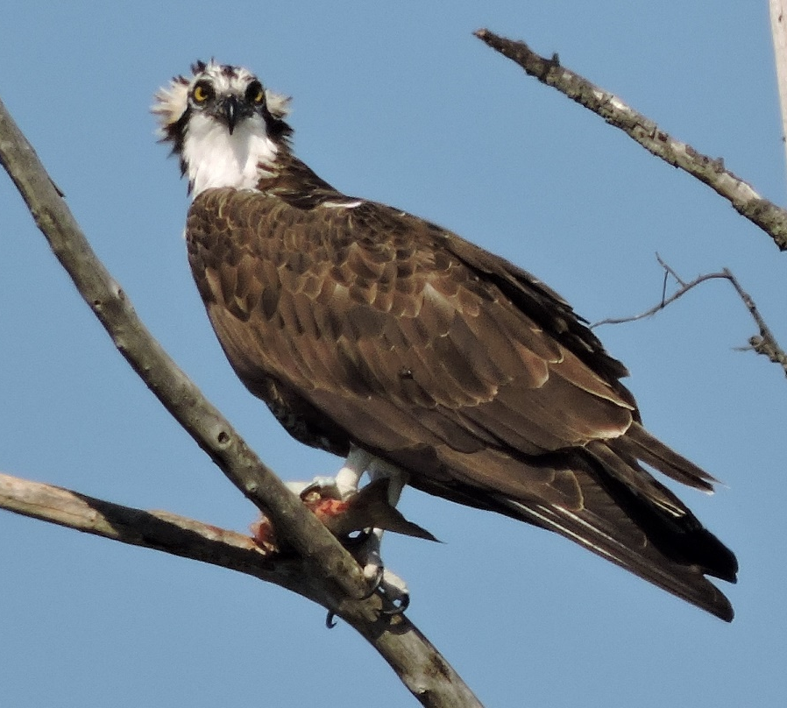
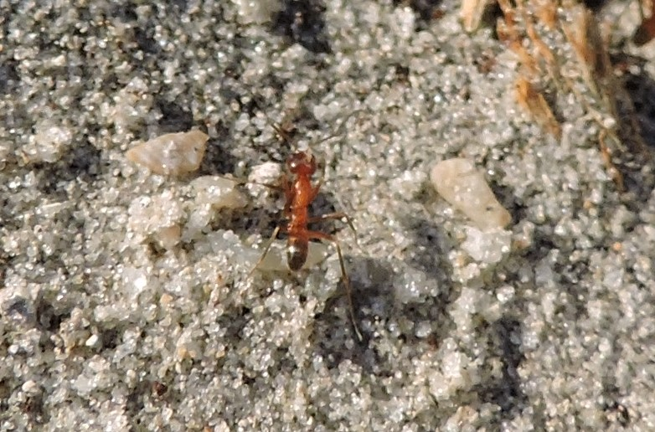
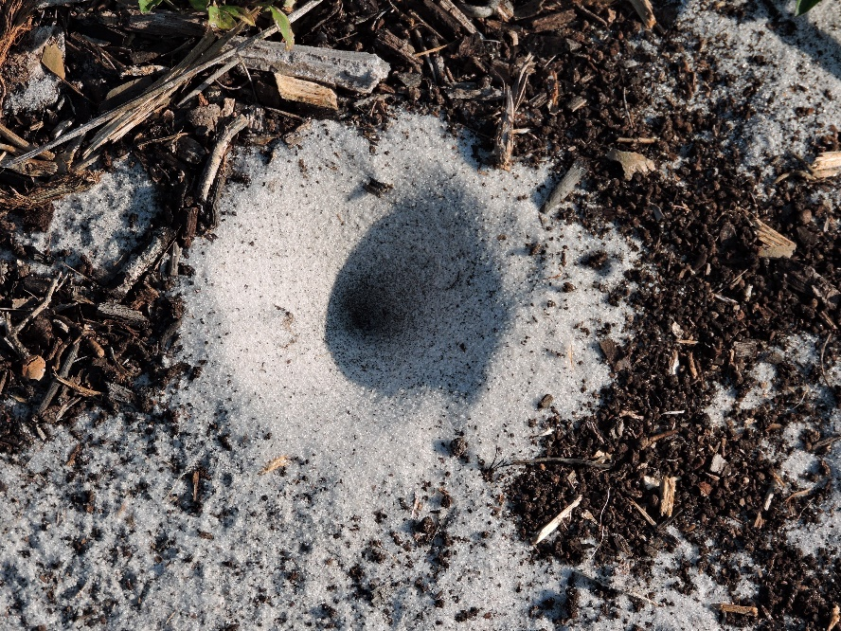
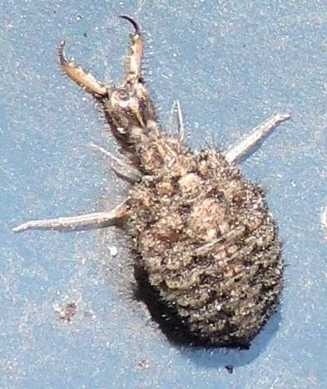
Ecological Relationships
Predation: One organism (predator) eats part or all of the other (prey).
The Antlion is in the bottom of their funnel/trap and the ant falls in the funnel.
Osprey (predator) eating a fish (prey).
Ants (prey) are eaten by Antlions (predator).

Slide 10
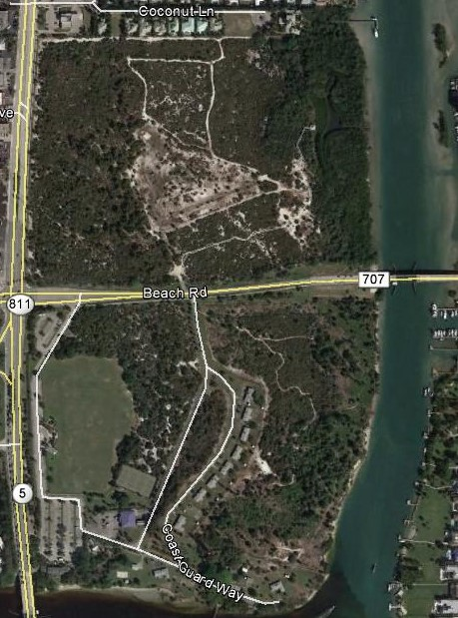
The ONA: Study Site
Limiting Factor – Living or non-living parts of an ecosystem that impacts the number of organisms that can live in that ecosystem.
(You will be determining the limiting factors of the ONA)
The ONA your study site is about 120 acres. (10 football fields long by 6 football field wide) [1000 yards by 600 yards]
It is bordered on the North by homes,
Bridge road passes through the middle
on the West by U.S. Highway 1,
on the East by the Intercostal Waterway,
and on the South by the Loxahatchee River.
The site has no fresh water other than rain fall.
The site has tennis courts, soccer fields, walking trails and historic buildings & Lighthouse.

Slide 11
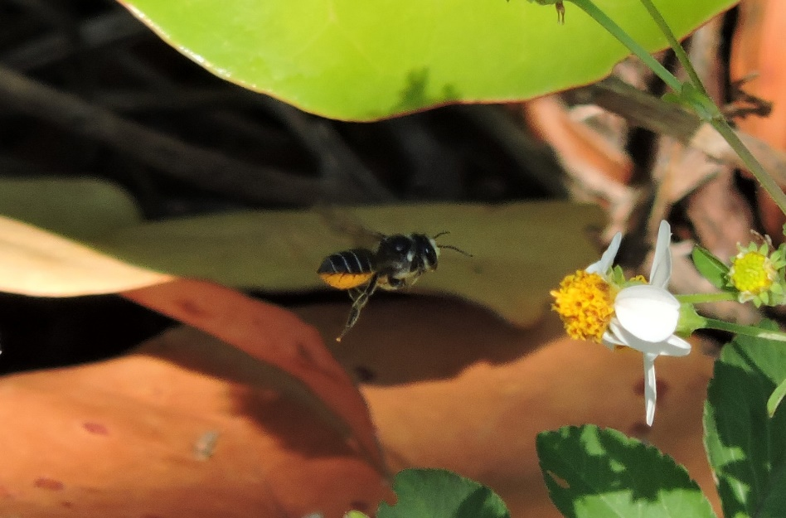
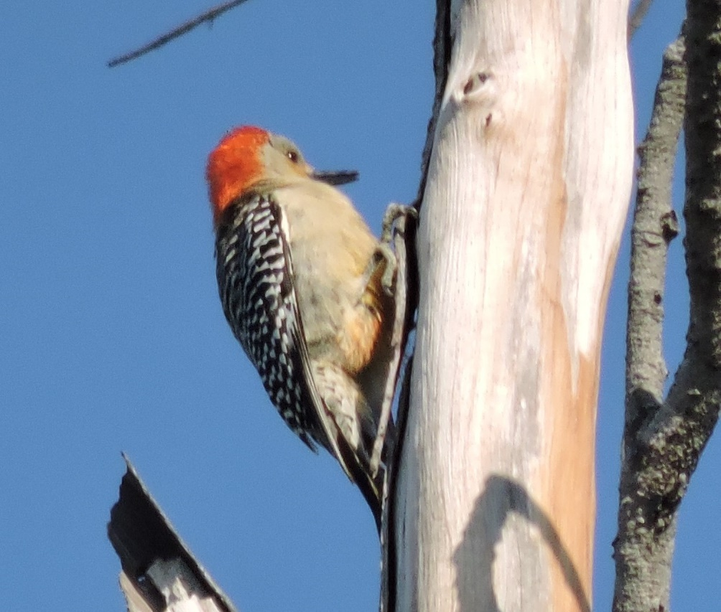
Review: Identify the Following
Example of what
relationship:
Predator / Prey
What is the Predator?
Woodpecker
Example of what relationship:
What is the Prey?
Mutualism
Insects

Slide 12
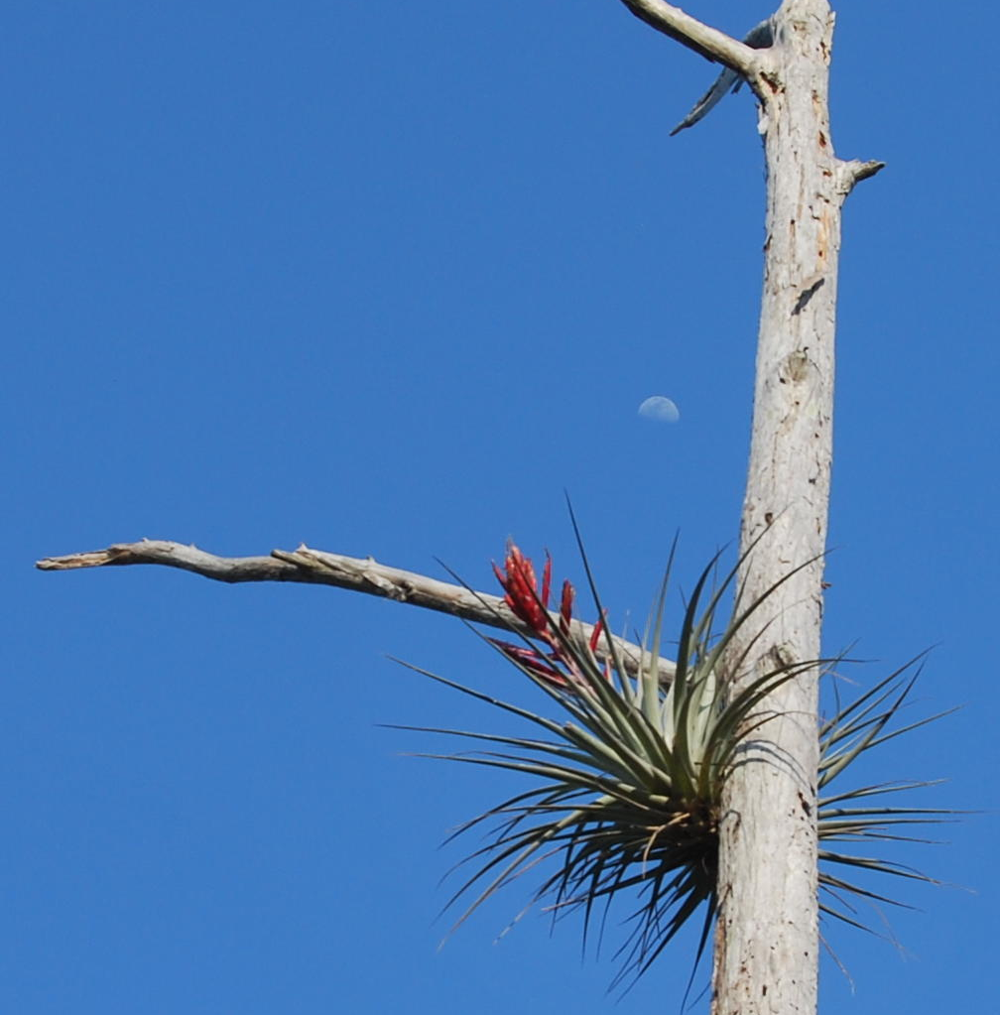
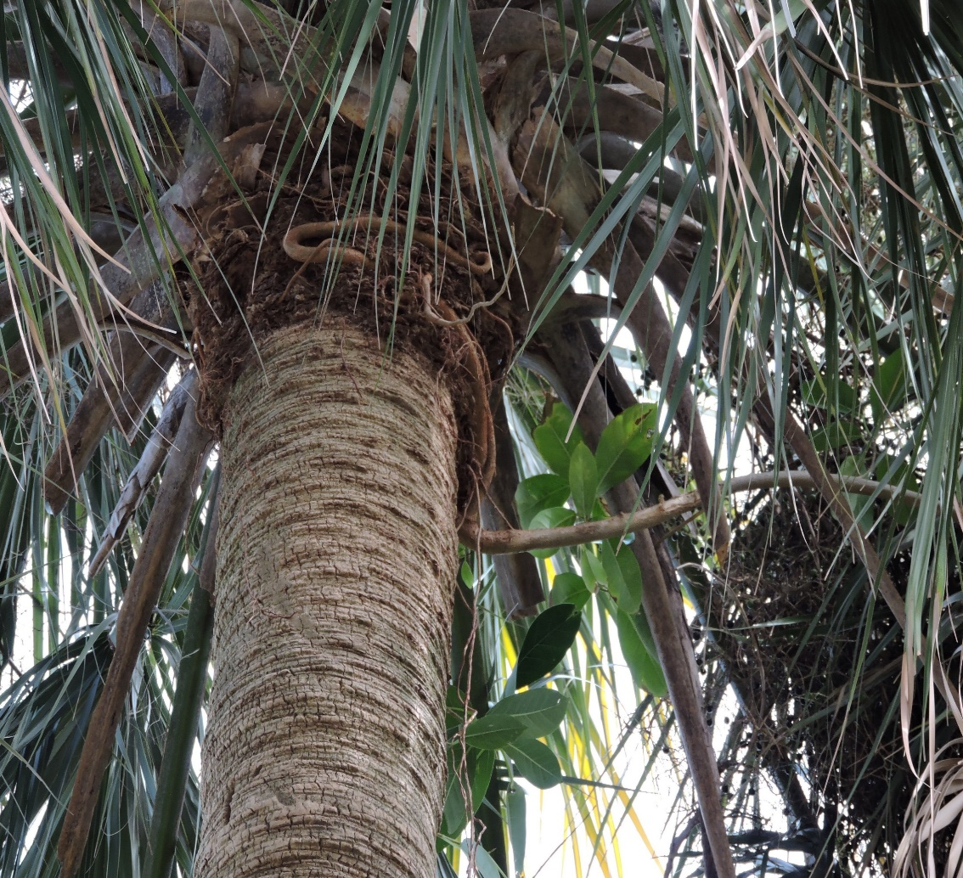
Review: Identify the Following
Example of what
relationship:
Parasitism
Example of what relationship:
Commensalism

Slide 13
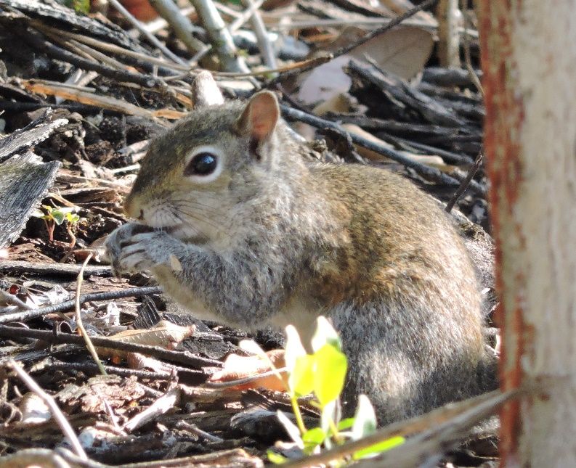
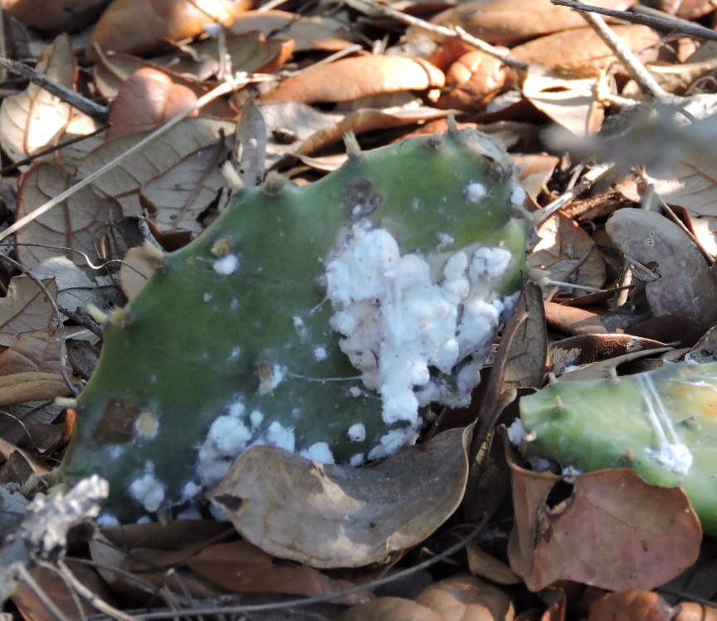
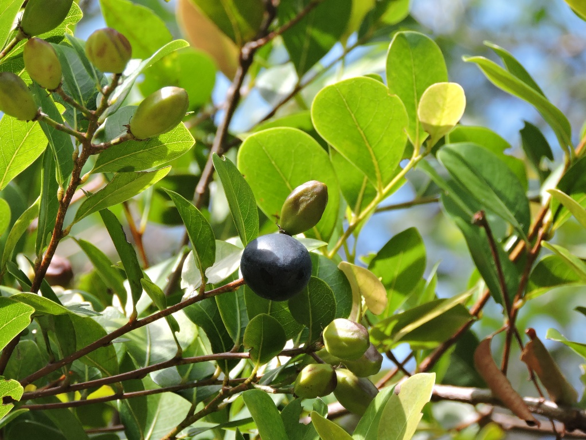
Review: Identify the Trophic Level of Each Organism
Producer
Consumer
Decomposer

Slide 14
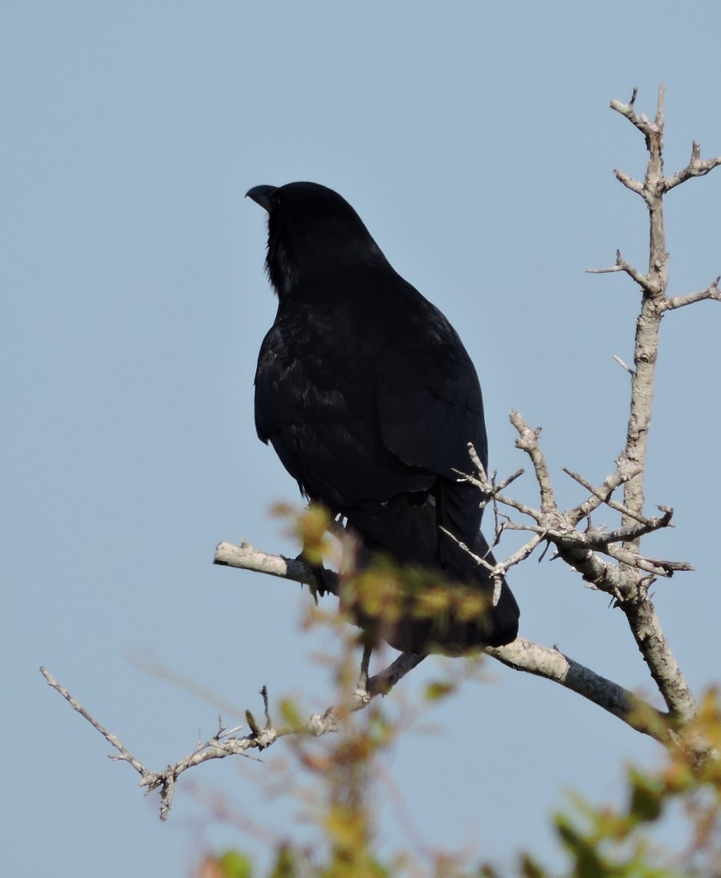
Review: Predator or Prey?
Predator or Prey?
Predator

Slide 15
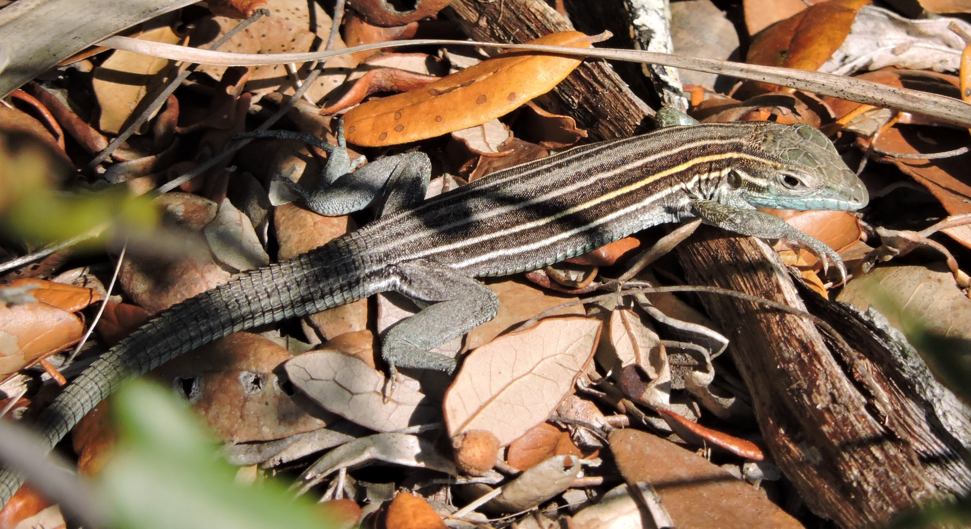
Review: Predator or Prey?
Predator or Prey?
Could be EITHER

Slide 16
Review: Predator or Prey?
Predator or Prey?
Could be EITHER

Slide 17
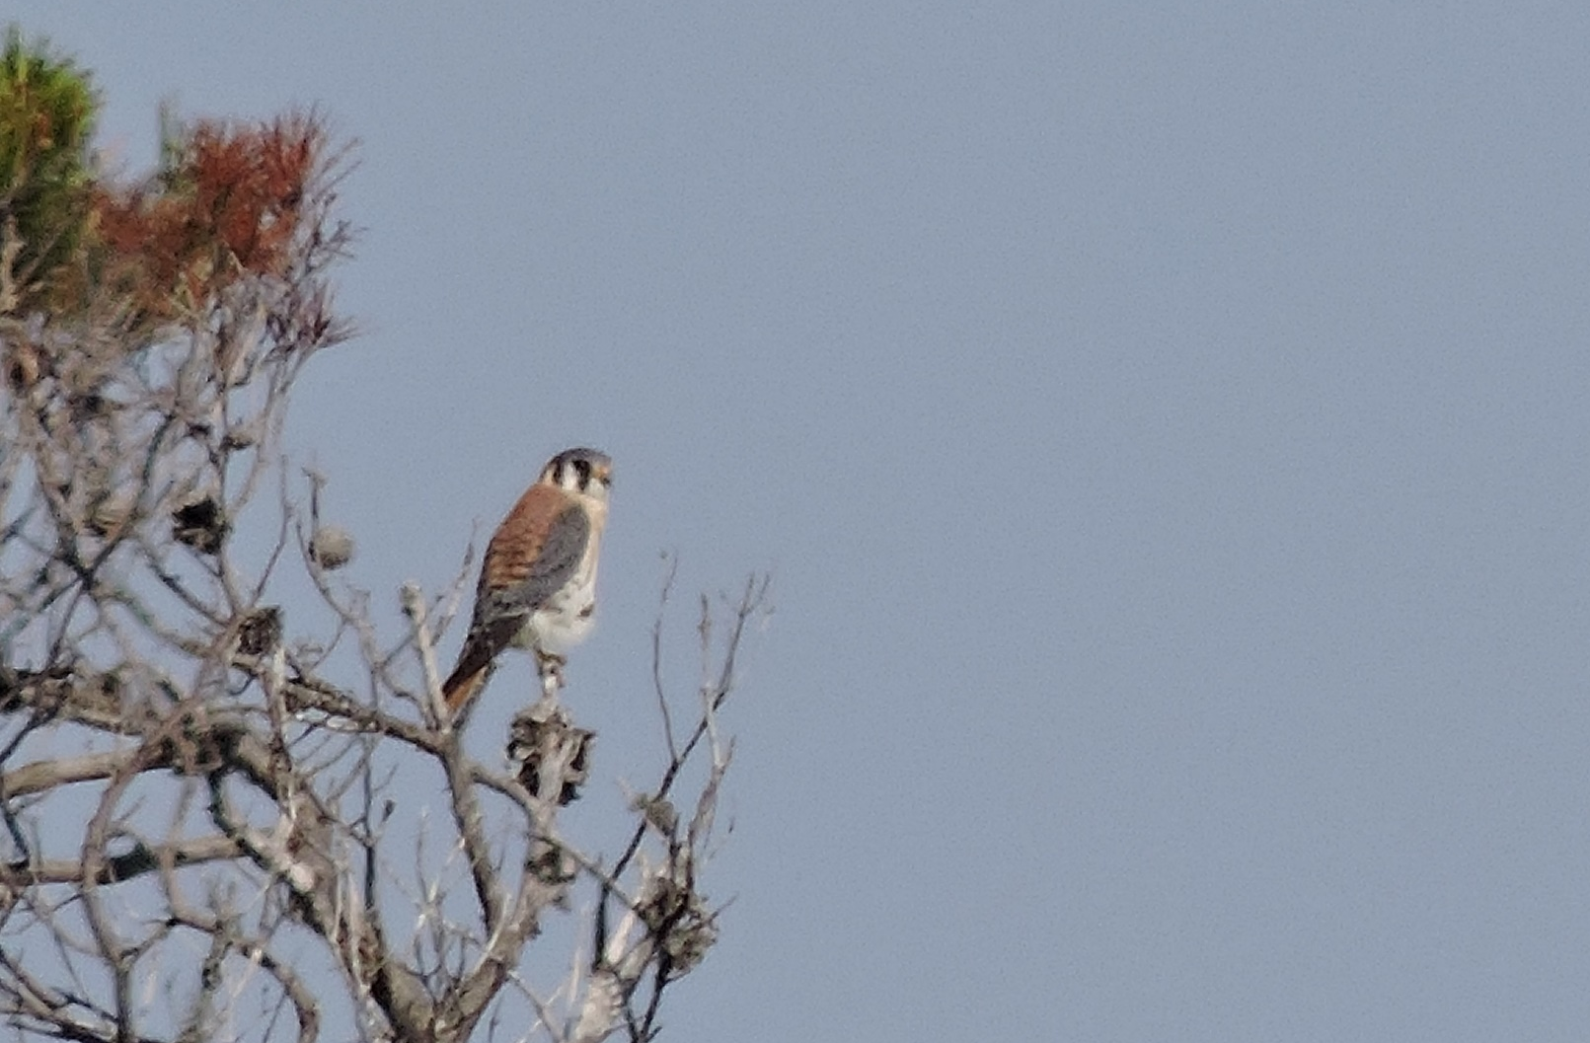
Review: Predator or Prey?
Predator or Prey?
Predator

Slide 18
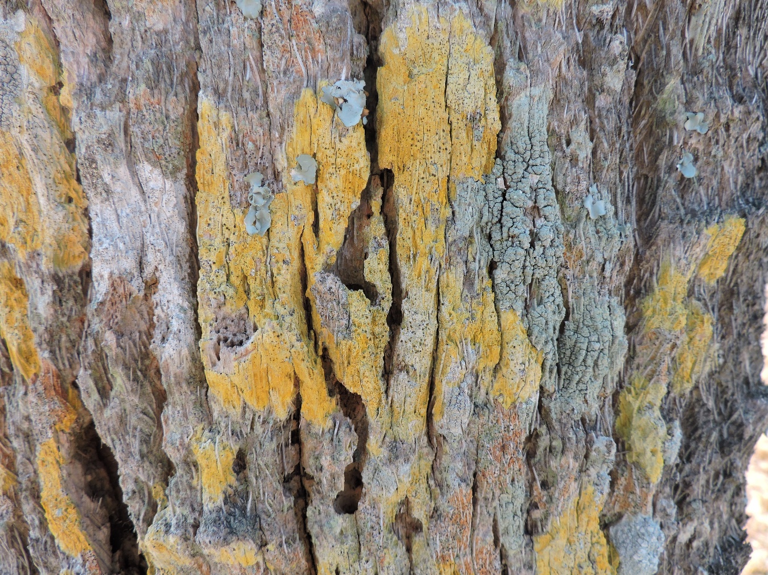
Review: Identify the Producer, Consumer & Decomposer
LICHENS (3 different species)on a Cabbage Palm trunk.
Lichens can function as both Producers and Decomposers.
The palm tree is a Producer.
*No consumer is visible in this photo.

Slide 19
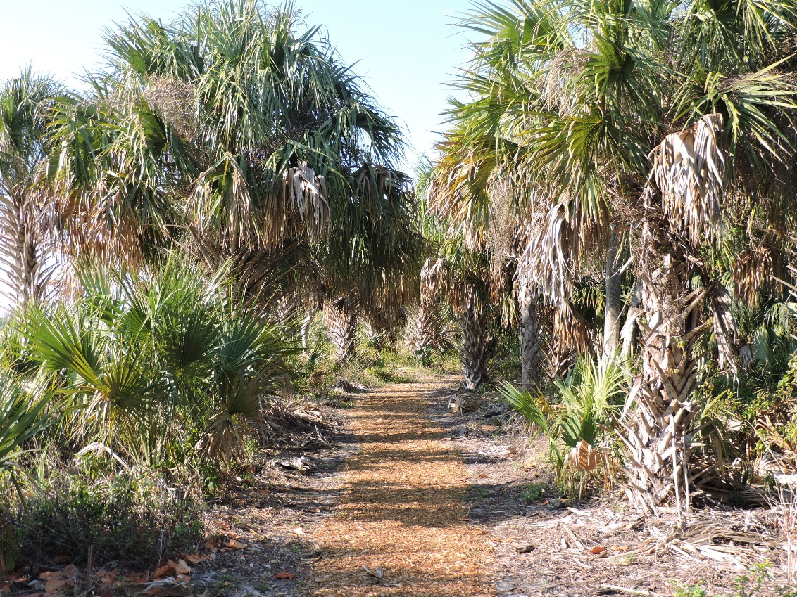
On Your Visit to the ONA, Identify the Following:
Ecological Relationships:
Commensalism
Mutualism
Parasitism
Predation (predators & prey)
Trophic Levels:
Producers
Consumers
Decomposers
Limiting Factors

