Slide 1
Weathering, Erosion & Deposition
Grade 6

Slide 2
The Earth’s Surface is Built Up and Torn Down
Physical Weathering – the breaking up of earth’s surface into smaller pieces by some mechanical/physical force.
Chemical Weathering – the breaking down of earth’s surface by a chemical process (oxidation, dissolved by acids or water)
Erosion – the movement of soil or rock from one place to another (usually by wind or water)
Deposition – the place where eroded rock or soil is deposited.

Slide 3
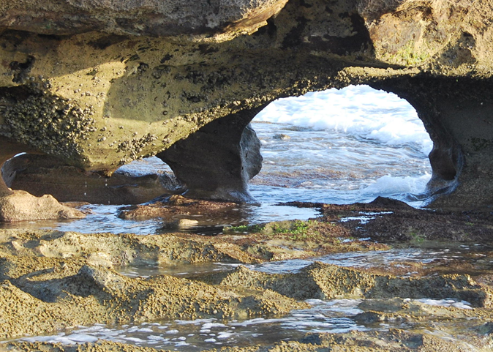
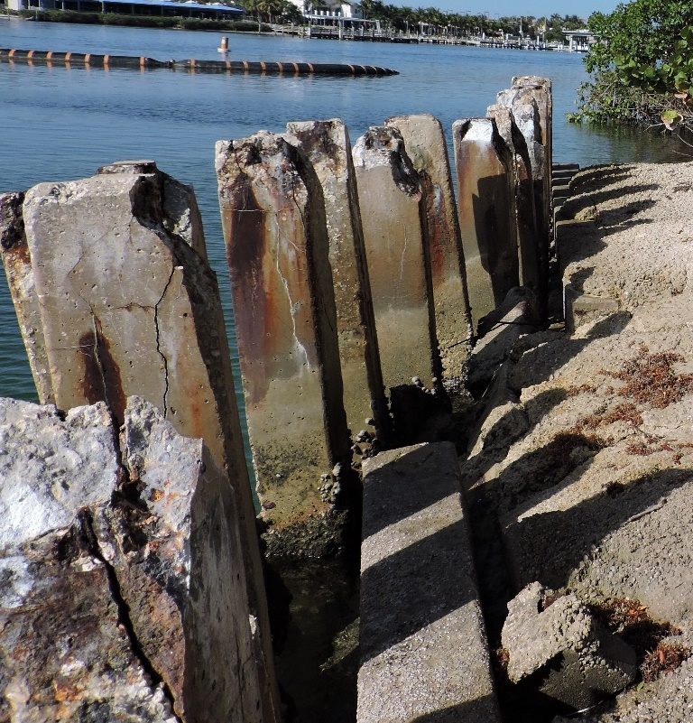
Weathering
Chemical weathering by oxidation.
The salt in the water corrodes the steel in the concrete and caused cracks.
Physical weathering by wave action.
The waves carrying sand, pound the soft rock.

Slide 4
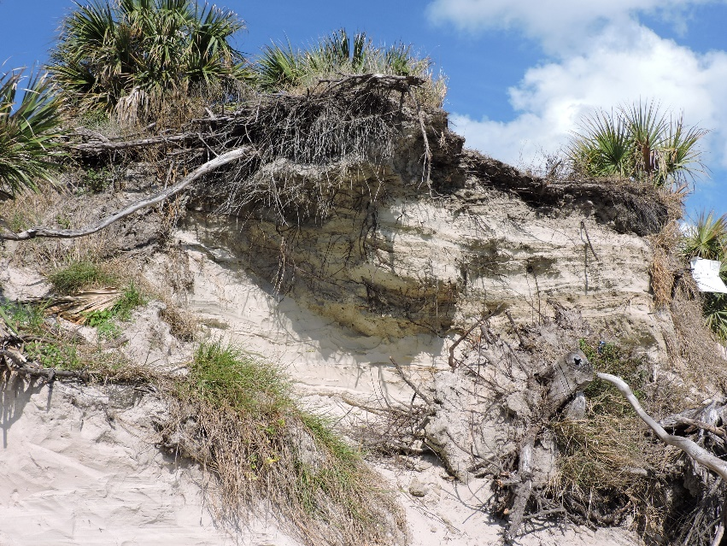
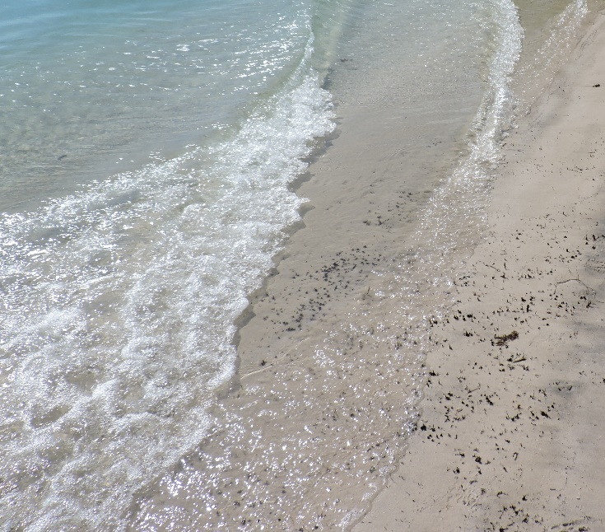
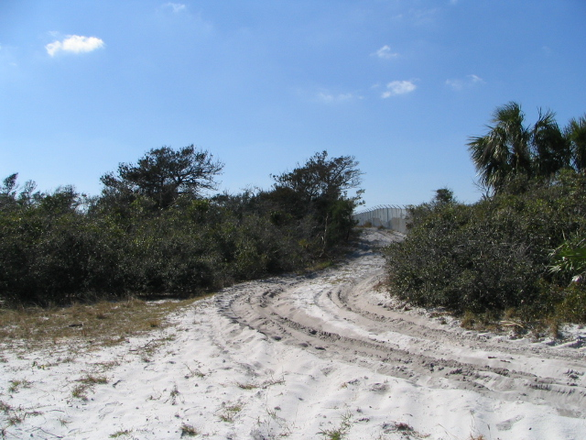
Erosion
By People
By Wind
By Water

Slide 5
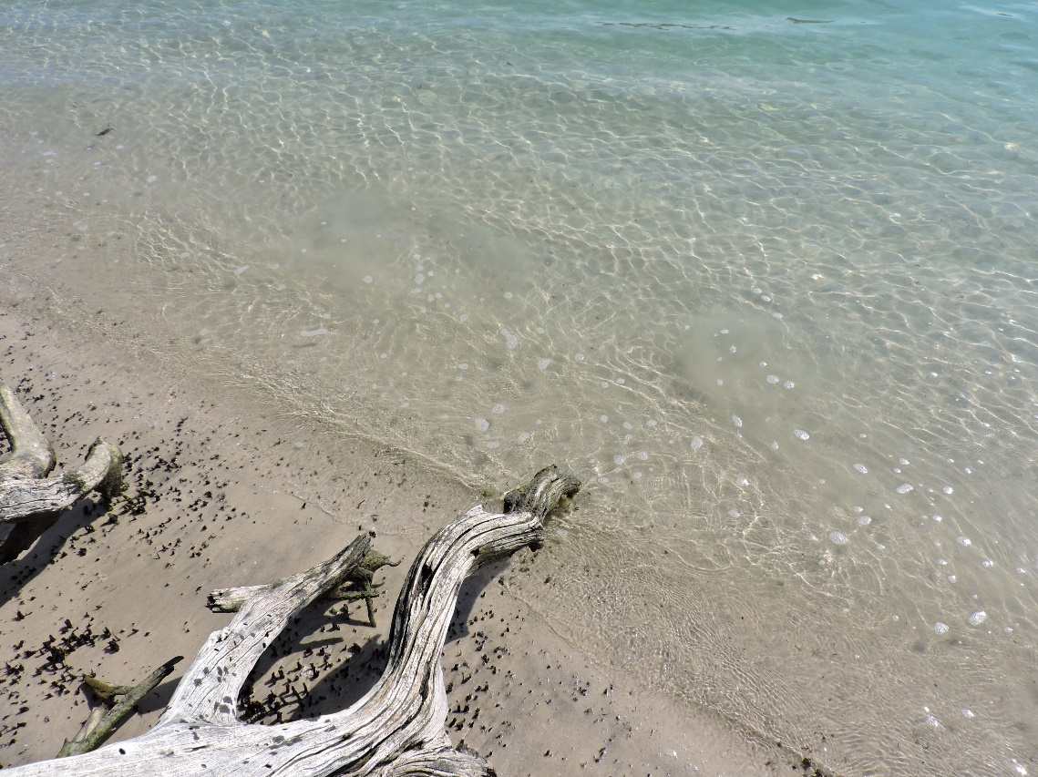
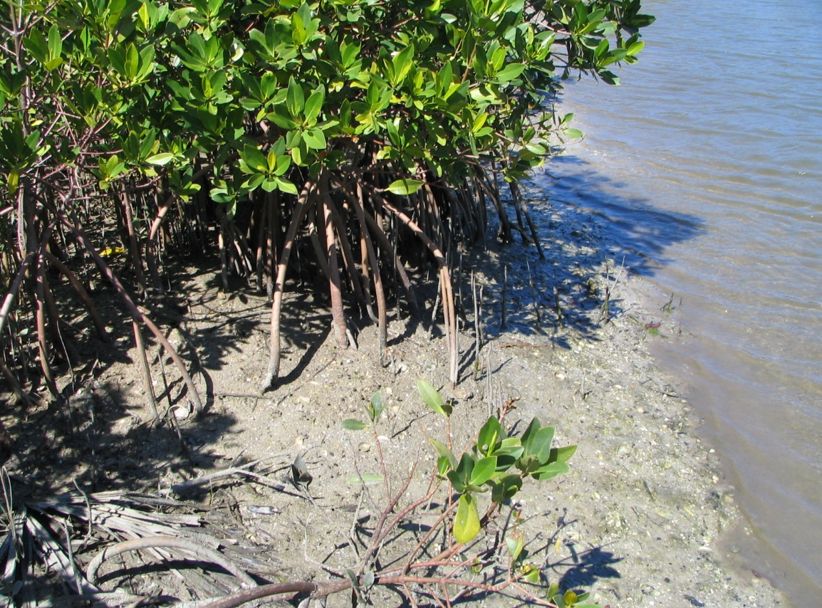
Deposition
Fine sand particles and silt is transported by water and trapped by mangroves creating new land or holding existing land.

Slide 6
Earth’s Surface is Made of a Variety of Landforms
Coastlines – where land meets water (usually and Ocean)
Dunes – a hill or ridge of sand pile up by erosion
Rivers – a large flowing body of water usually ending in an ocean
Mountains – large natural elevations in the earth’s surface
Glaciers – a large body of ice moving slowly across land.
Deltas – land formed by sediment deposited at the end of a river.
Lakes – large body of water surrounded by land.

Slide 7
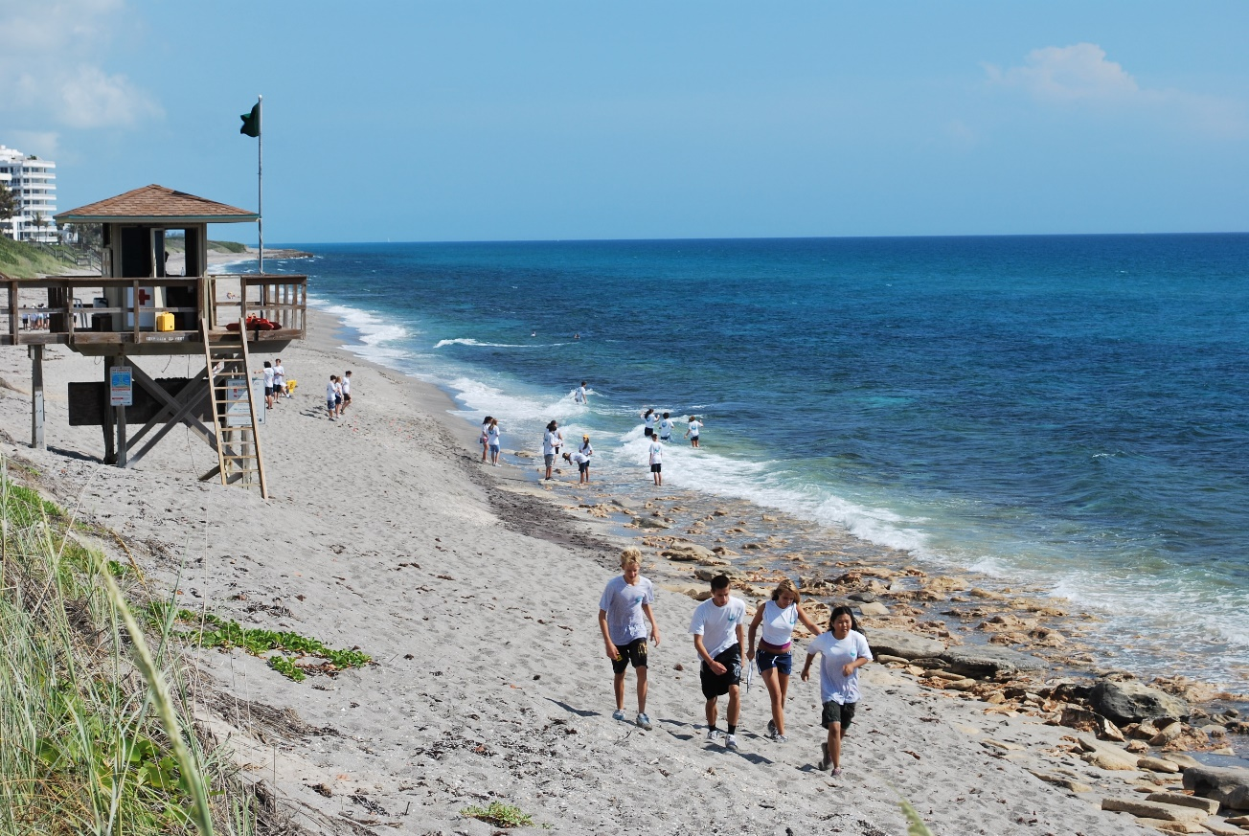
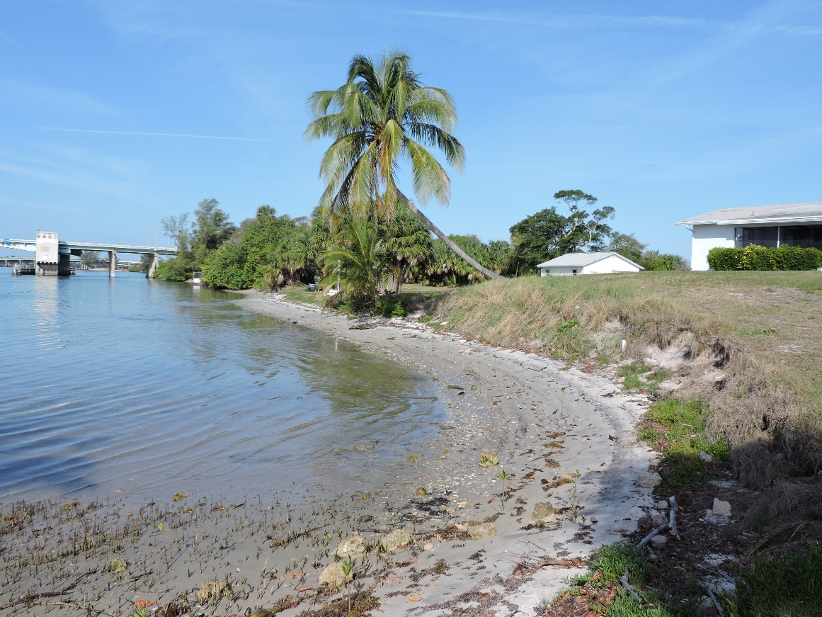
The Earth’s Surface: Coastline and Shoreline
Coastline
Shoreline

Slide 8
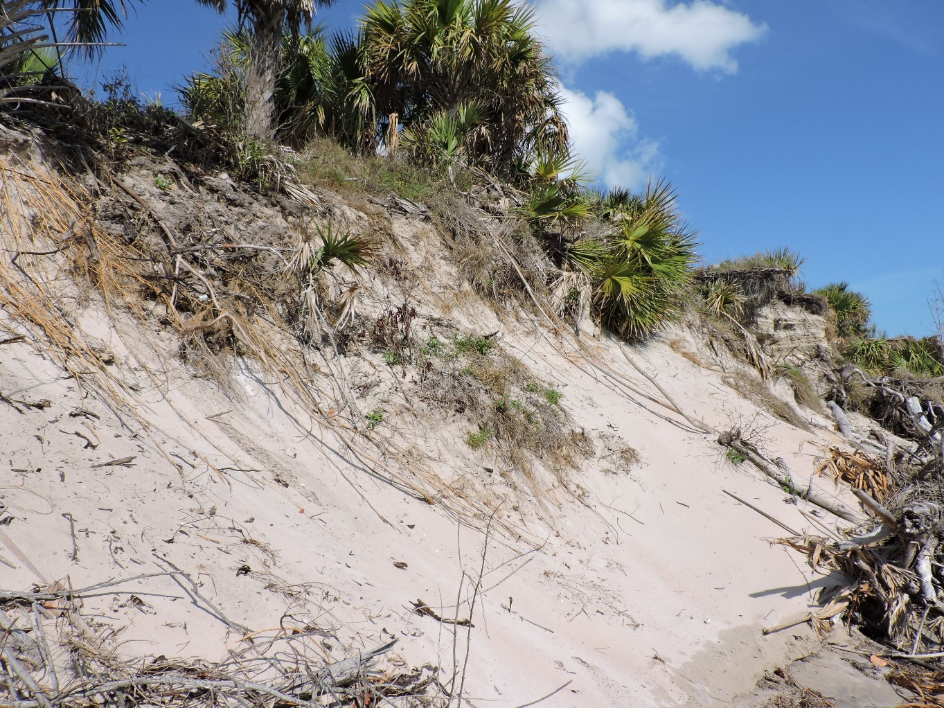
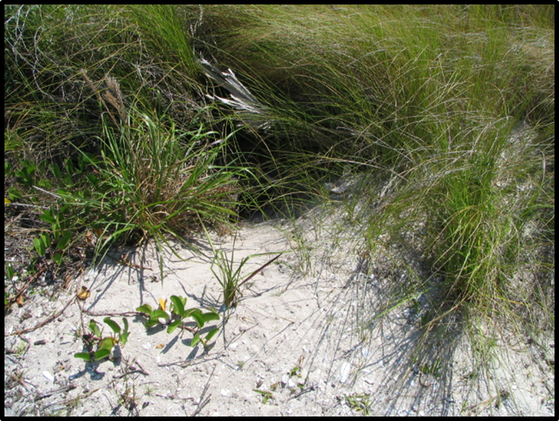
The Earth’s Surface: Dunes
Soil piled by: wind, water, or animals.

Slide 9
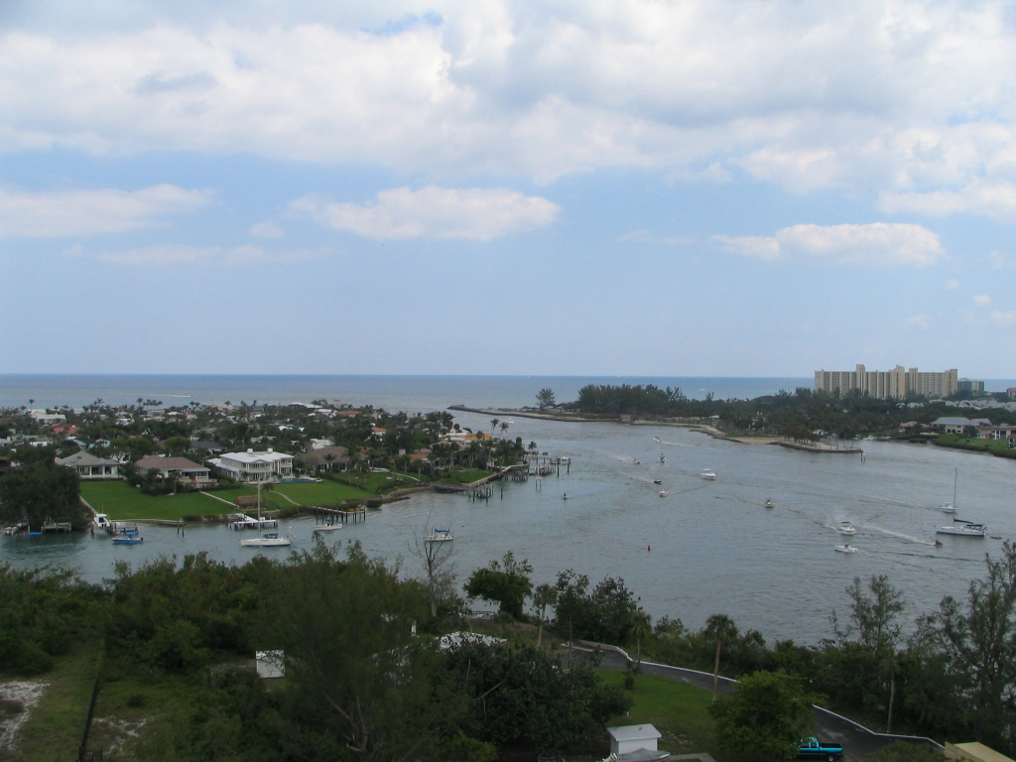
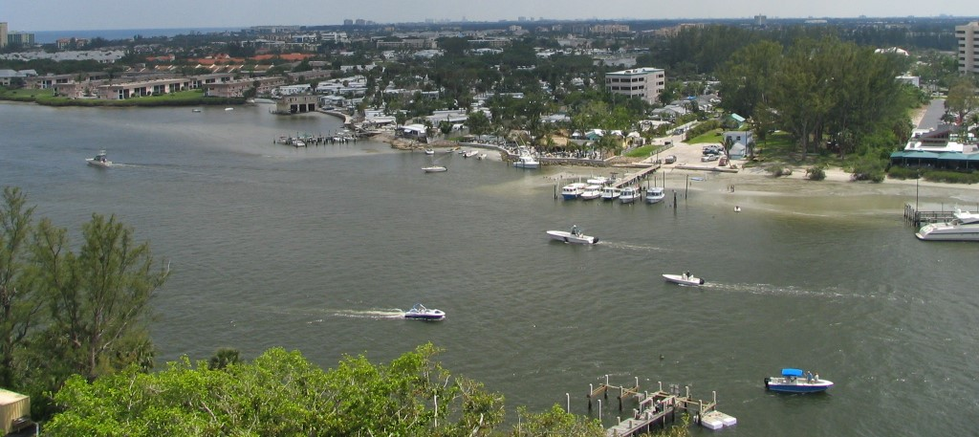
Earth’s Surface: Rivers
Loxahatchee River to the Jupiter Inlet

Slide 10
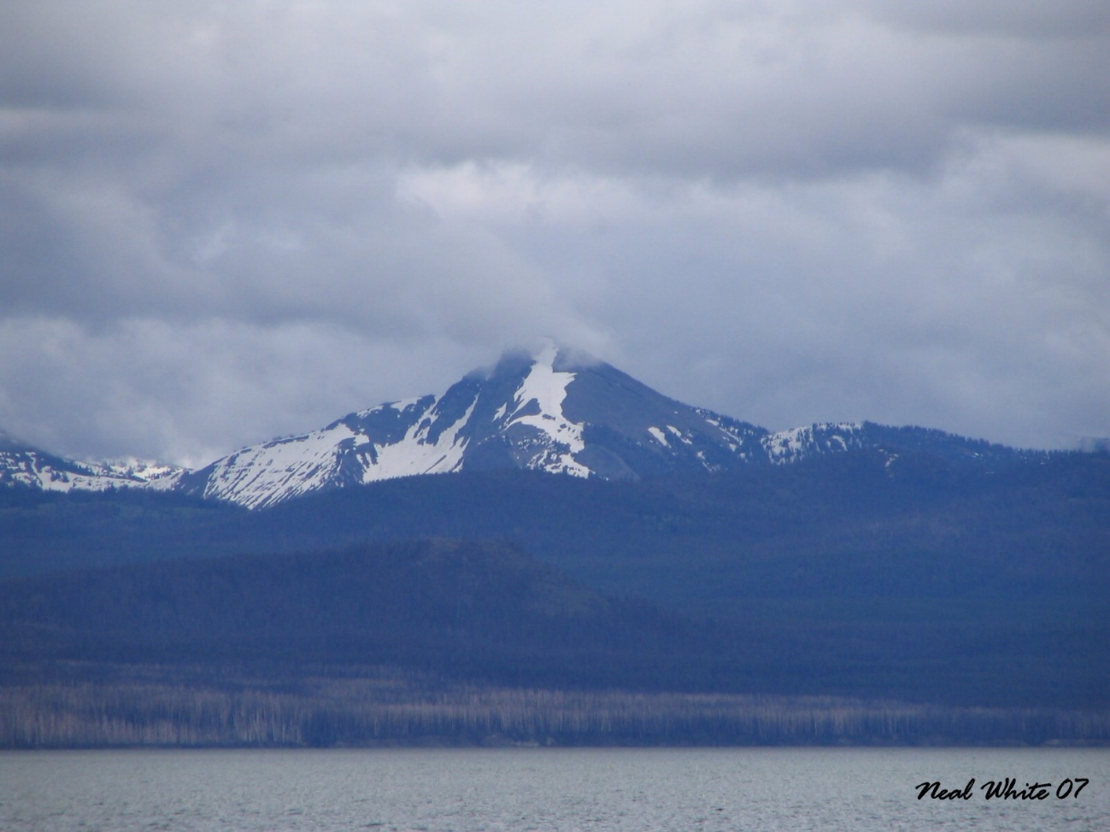
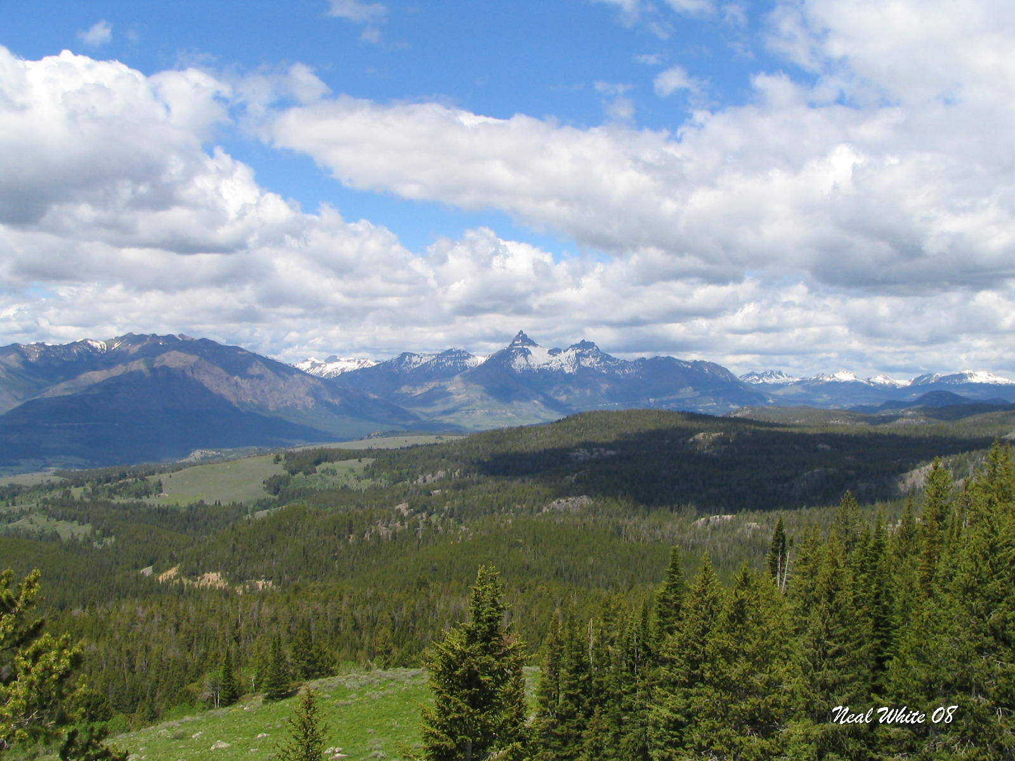
Earth’s Surface: Mountains
Rocky Mountains: Montana

Slide 11
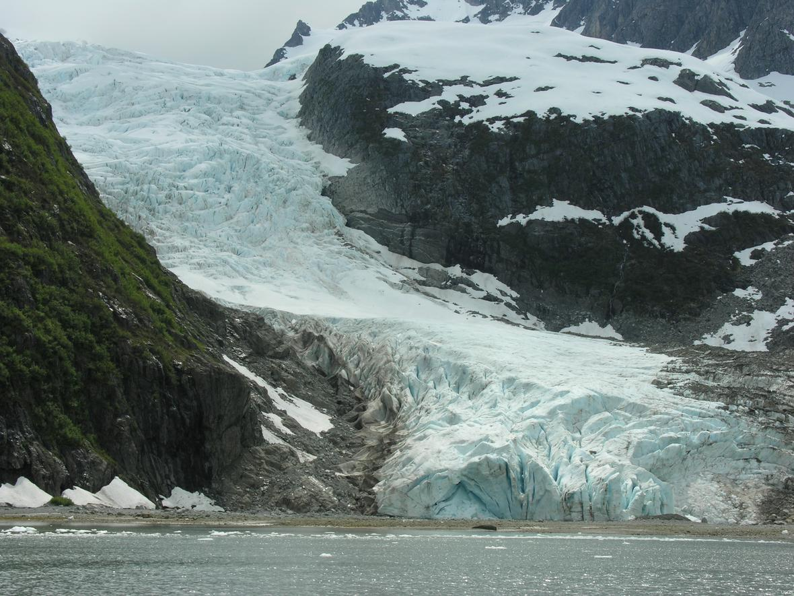
Earth’s Surface: Glaciers
Alaskan Glacier
(Credit: Dennis Demcheck, U.S. Geological Survey. Public domain.)

Slide 12
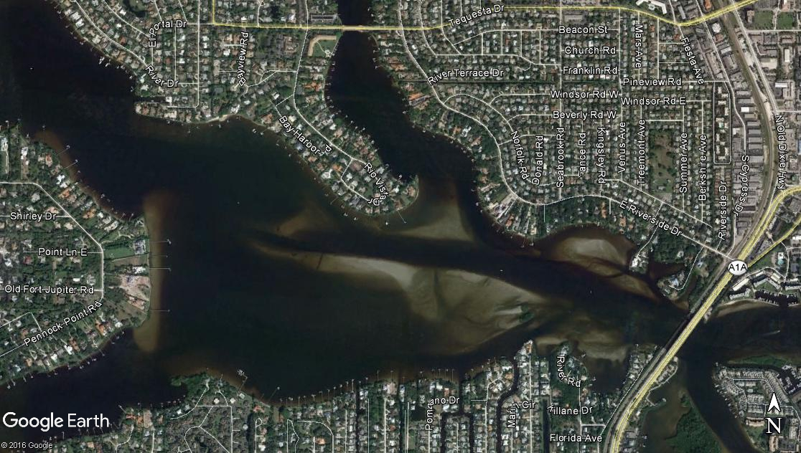
Earth’s Surface: Deltas
This is a Google image of the Loxahatchee River showing where sand is deposited as the water flows from each of the three river branches.
Water moves faster in narrow channels then slows down in open areas depositing the sediment.

Slide 13
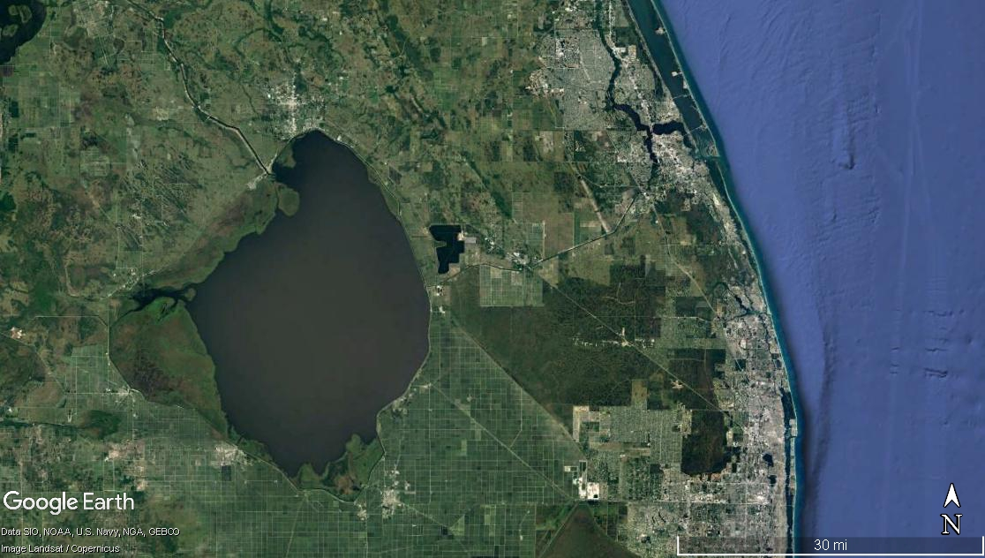
Earth’s Surface: Lakes
Lake Okeechobee is about 720 square miles of water.
Located about 30 miles west of the Jupiter Inlet Lighthouse Outstanding Natural Area.
Jupiter
Lake Okeechobee

Slide 14
ONA
The Jupiter Inlet Lighthouse Outstanding Natural Area does not have all the geologic land forms however the geological processes that create the various land forms have worked over time to create both the State of Florida and the ONA.
As you tour the ONA, you will map and describe evidence of geologic processes, efforts to slow or stop some of these processes and evidence of land forms on the site.

