Slide 1
Plants of the ONA
Fourth Grade Activity

Slide 2
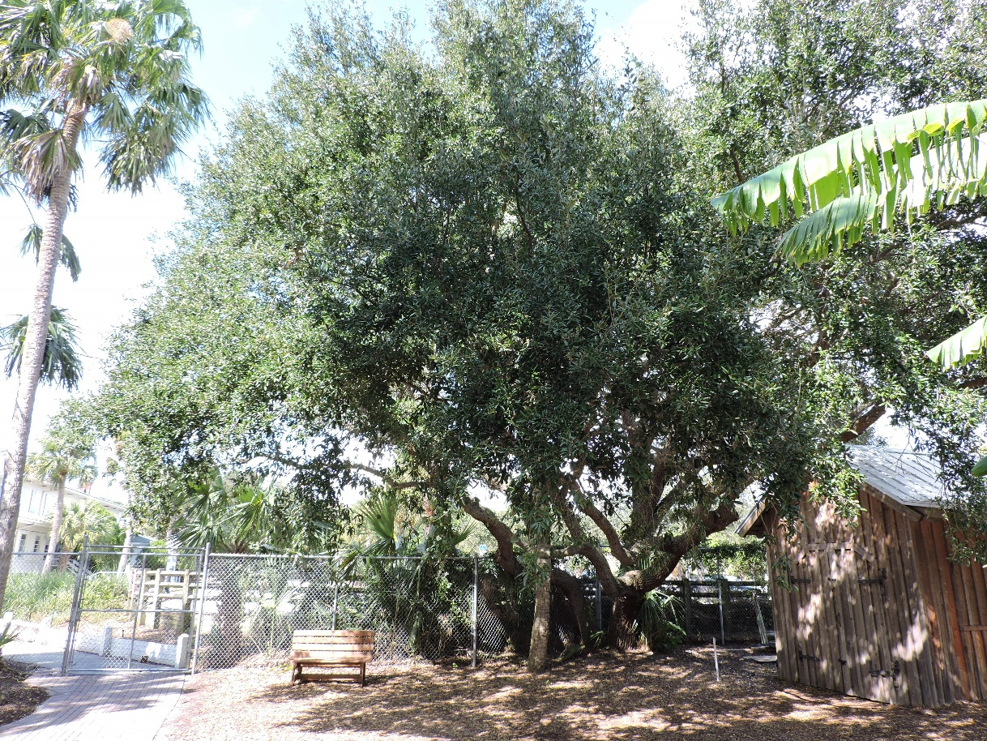
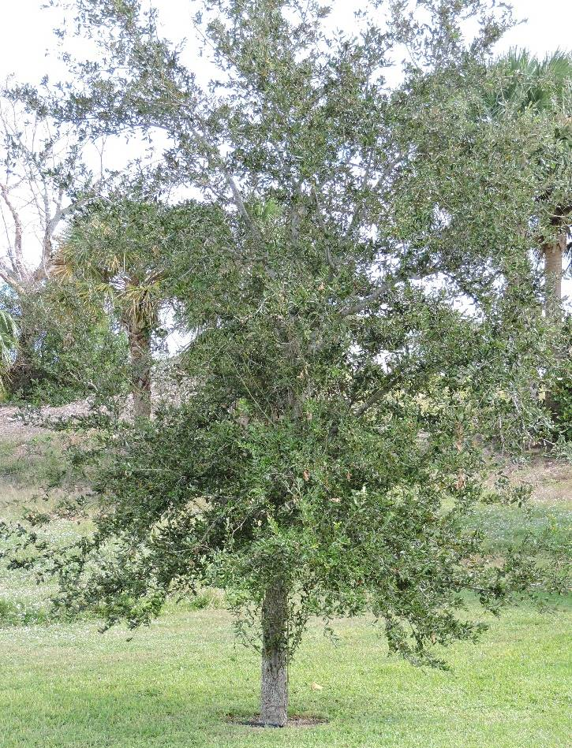
Plants of the ONA: Oak (Native)
Three different species on site.

Slide 3
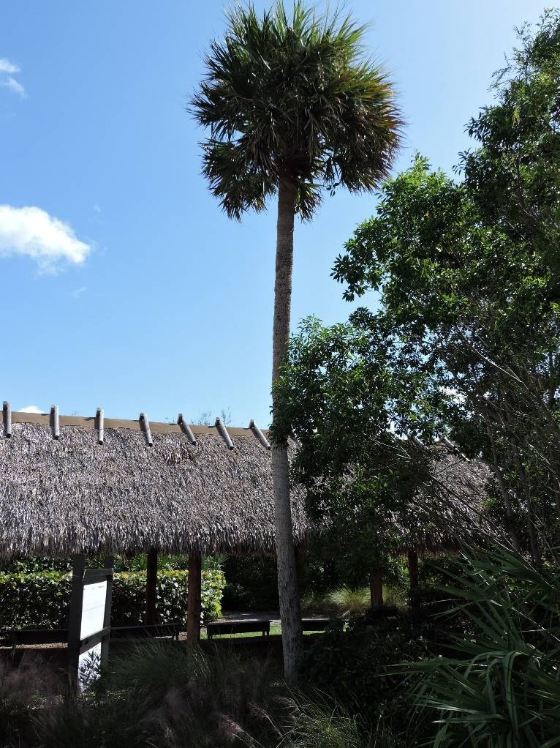
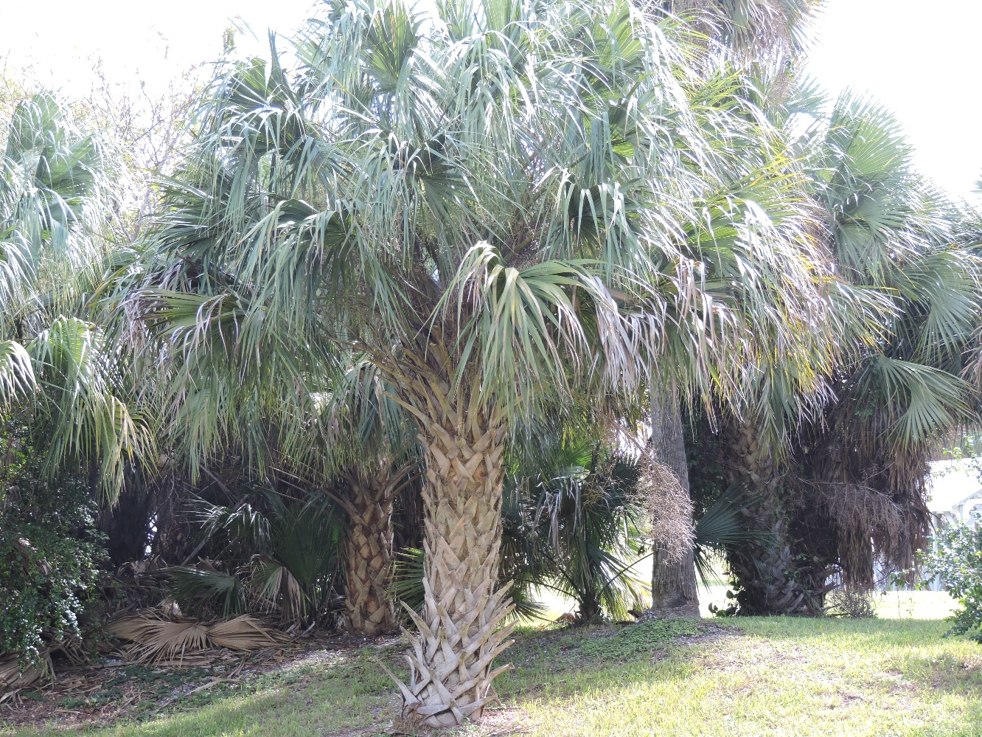
Plants of the ONA: Cabbage Palm/ Sabal Palm (Native)
No
“boots”
“Boots”

Slide 4
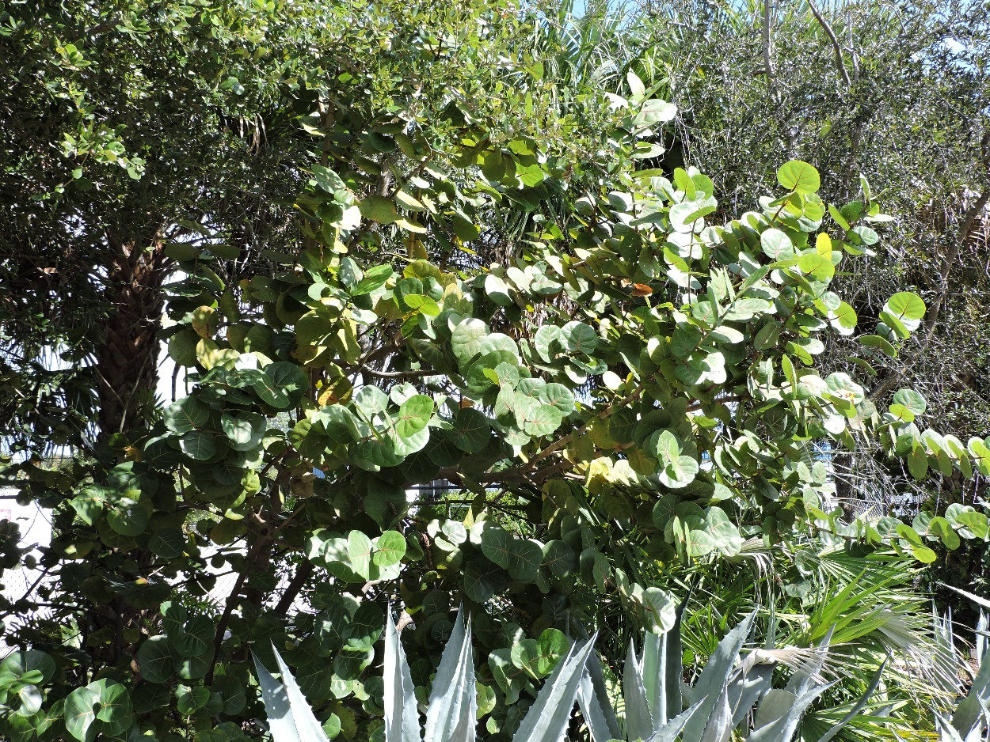
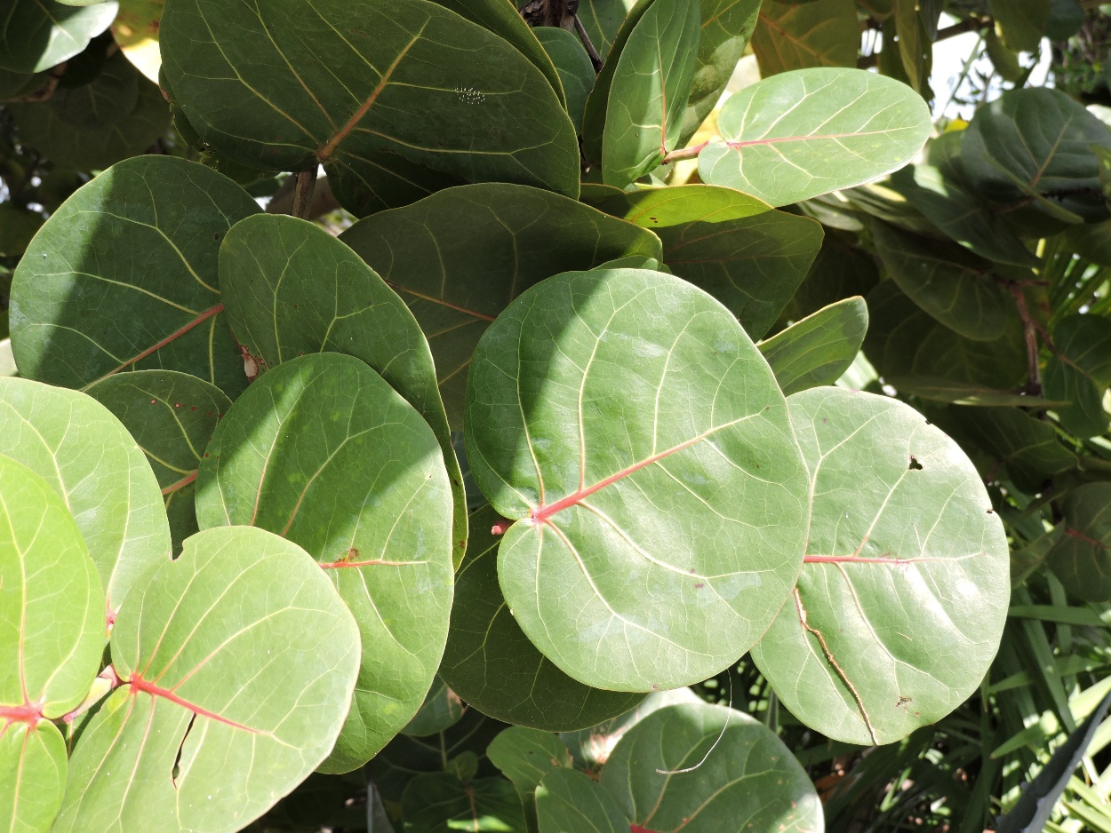
Plants of the ONA: Sea Grape (Native)

Slide 5
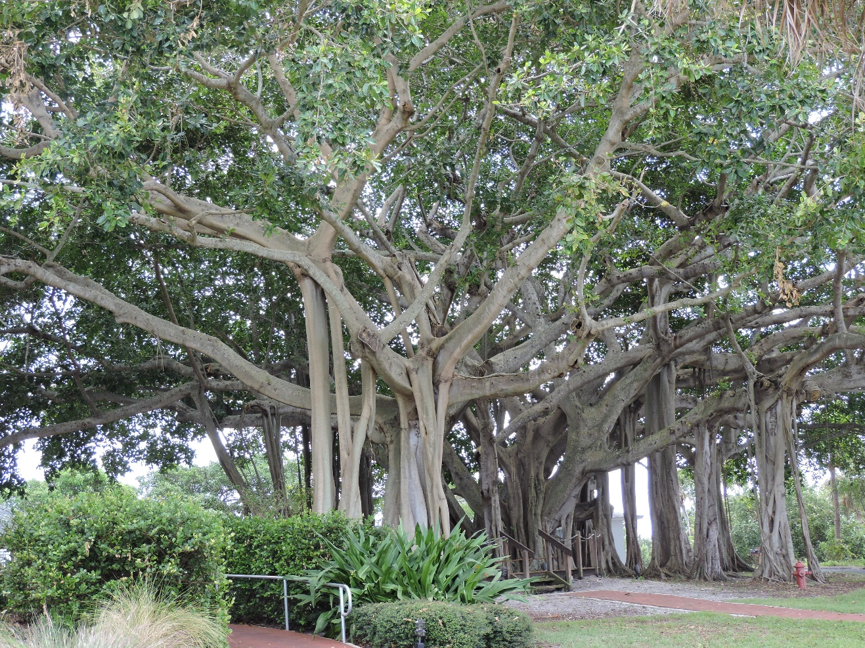
Plants of the ONA: Banyan/Ficus Tree (Exotic)
Referred to as both Banyan & Ficus.
Hundreds of species, most are exotic.

Slide 6
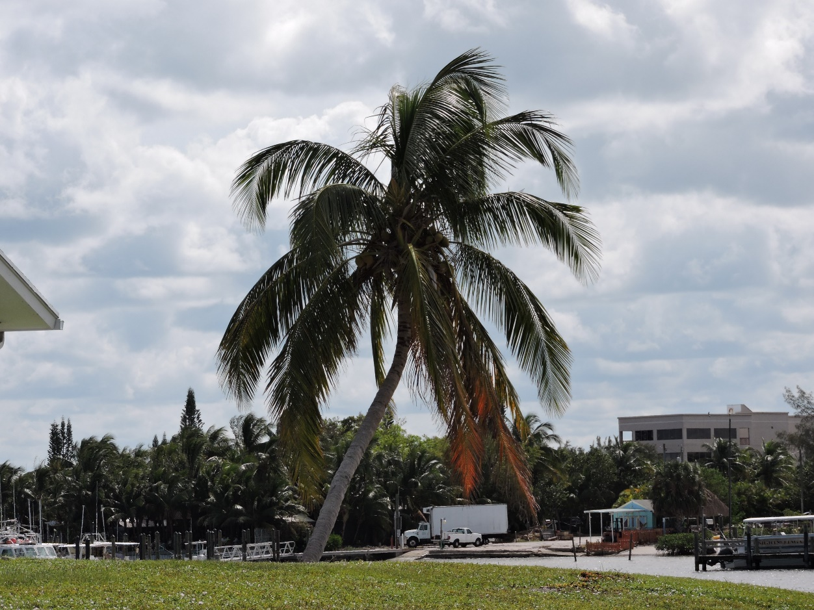
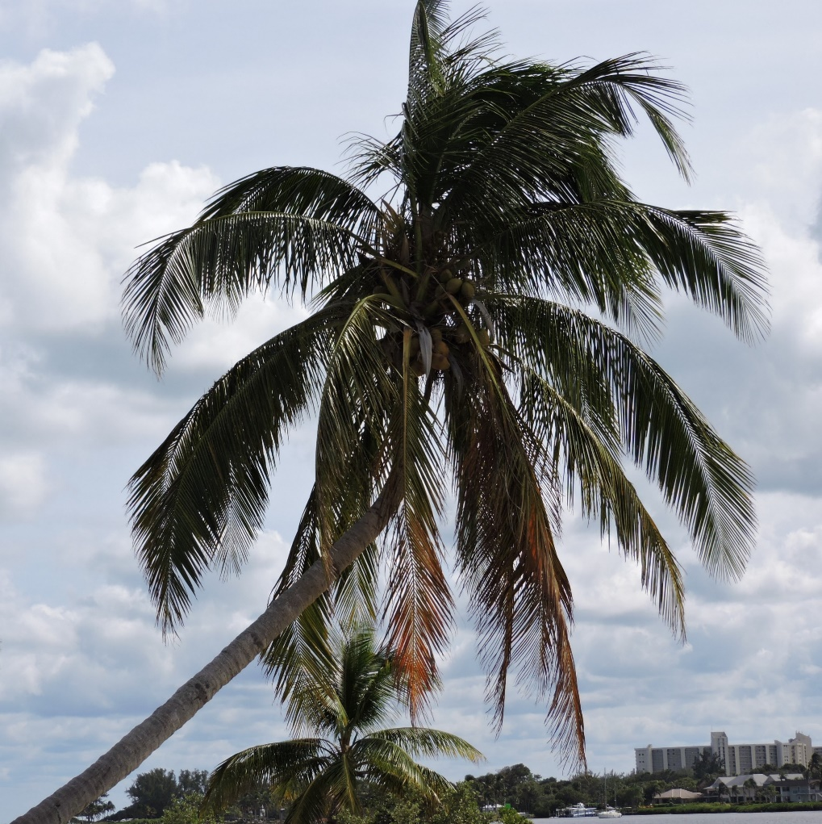
Plants of the ONA: Coconut Palm (Exotic)
Exotic – floated here and planted.

Slide 7
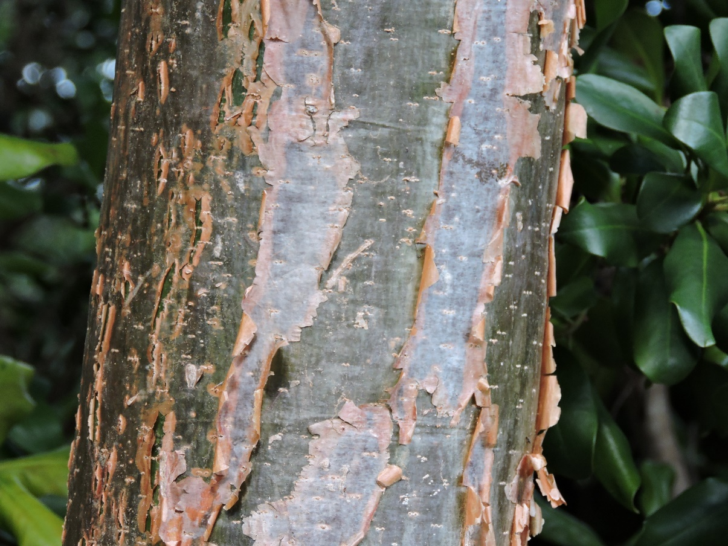
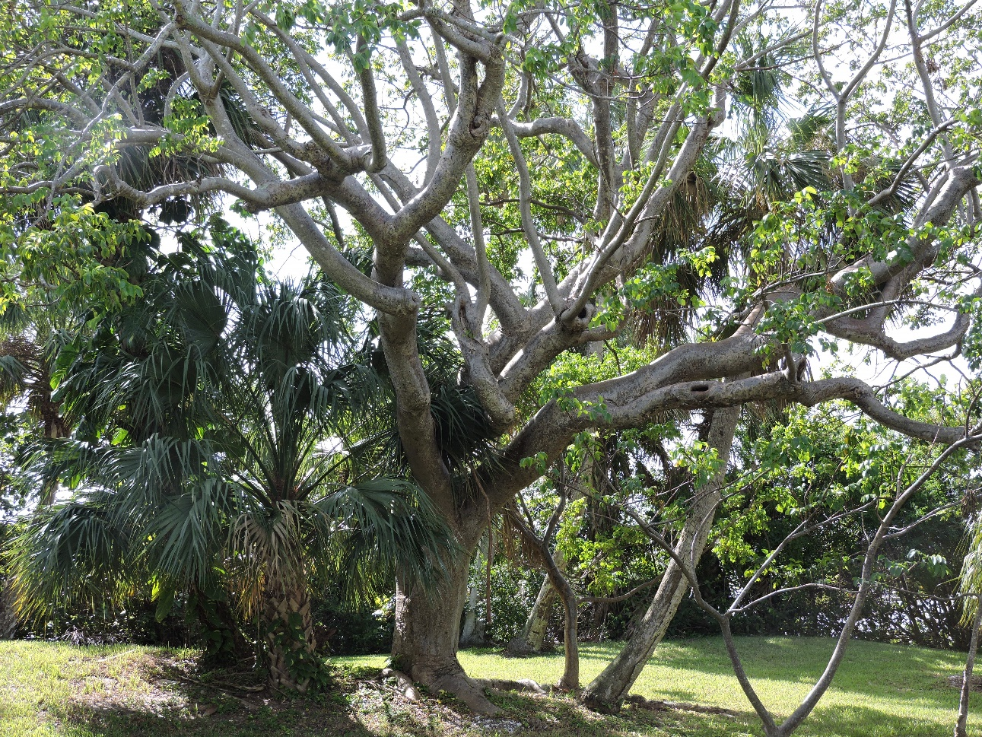
Plants of the ONA: Gumbo Limbo Tree (Native)
Flakey reddish bark

Slide 8
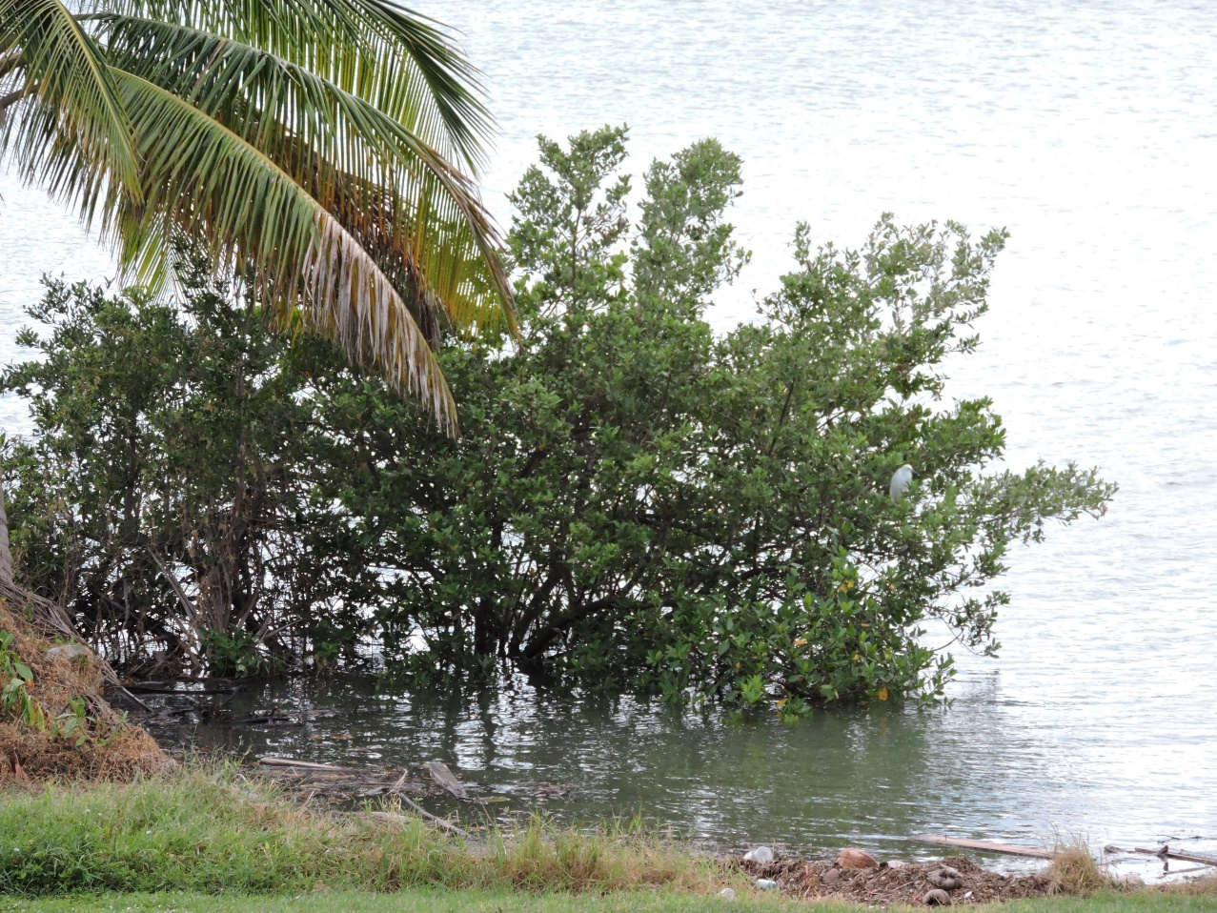
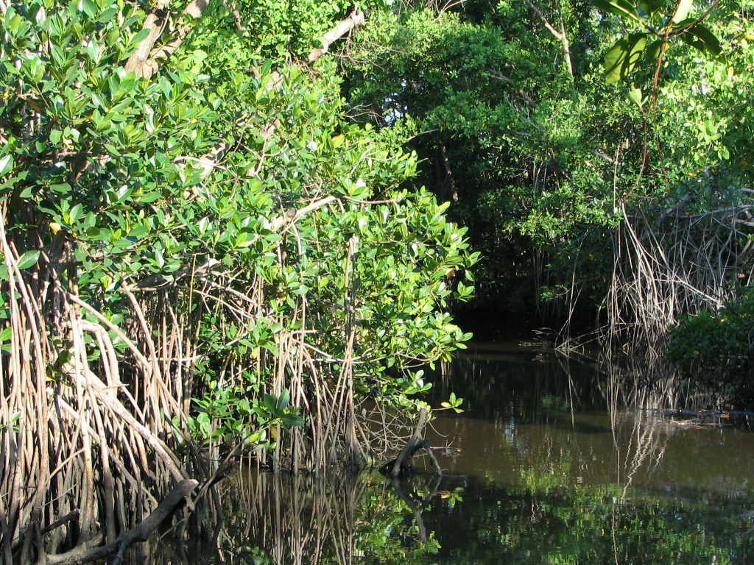
Plants of the ONA: Mangroves (Native)
Native – Three species; White, Red and Black.

Slide 9
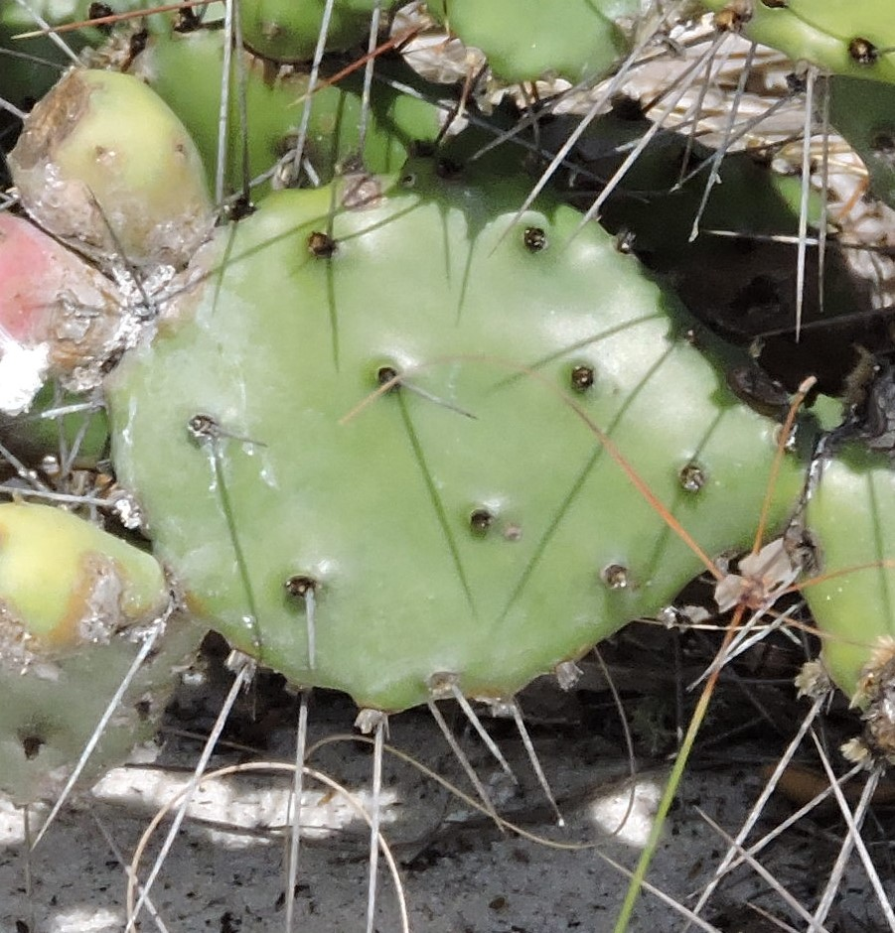
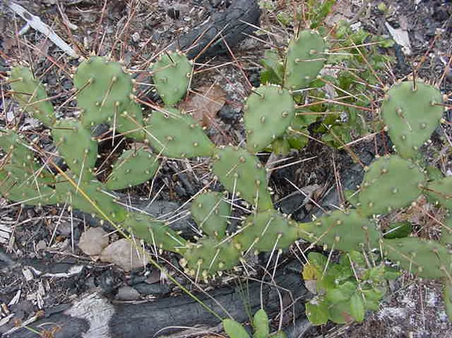
Plants of the ONA: Prickly Pear Cactus (Native)

Slide 10
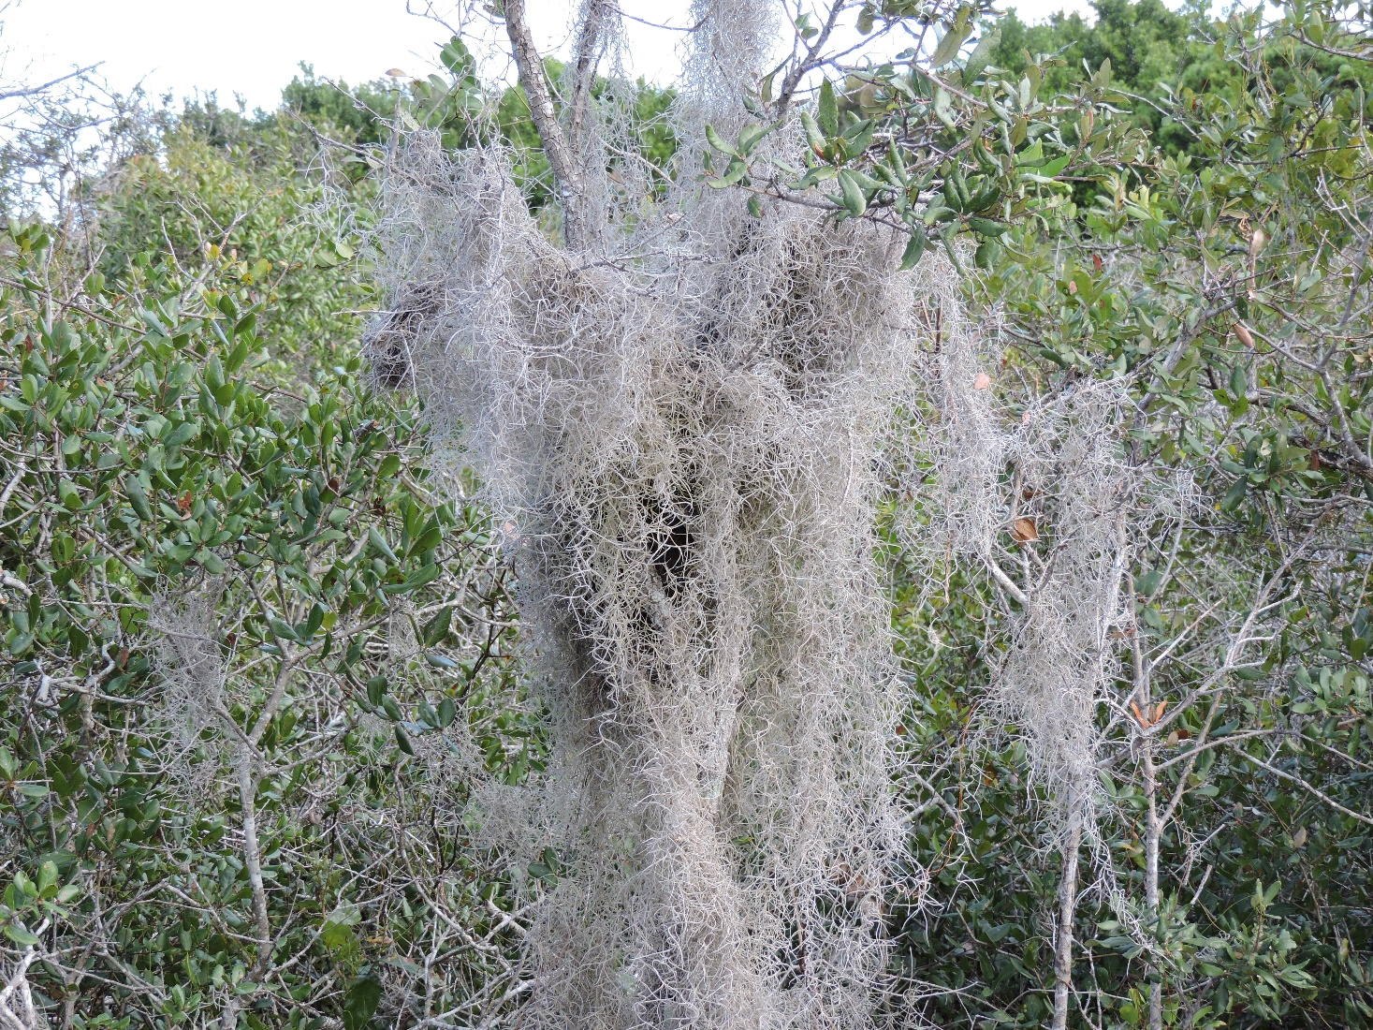
Plants of the ONA: Spanish Moss (Native)
Native Bromeliad

Slide 11
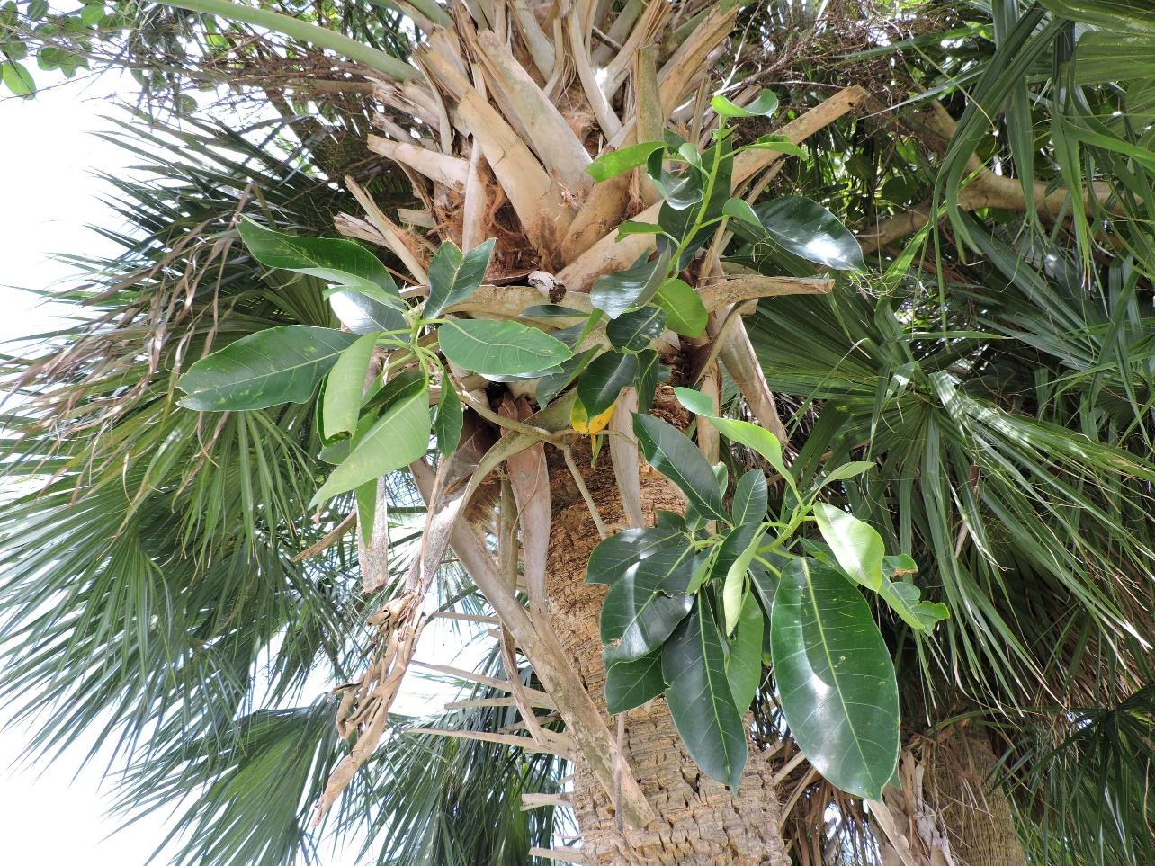
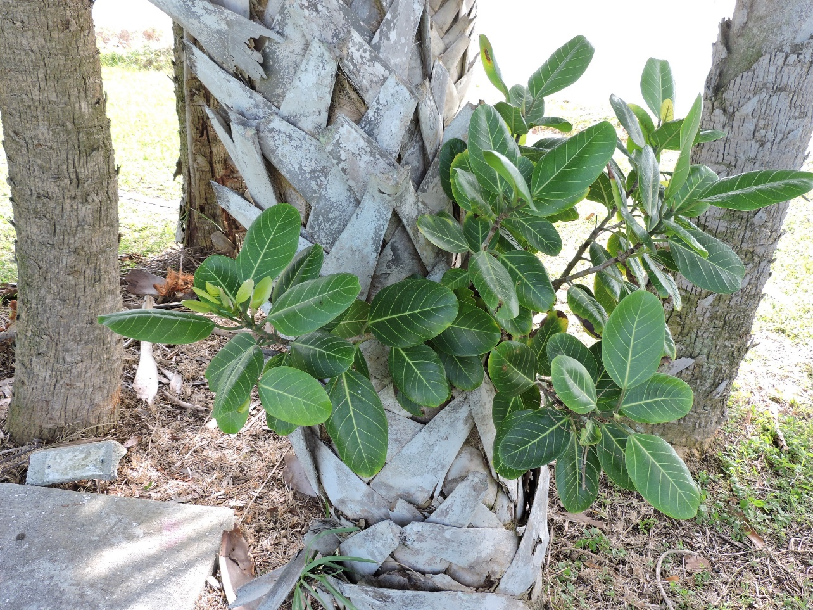
Plants of the ONA: Strangler Fig (Ficus aurea) (Native)

Slide 12
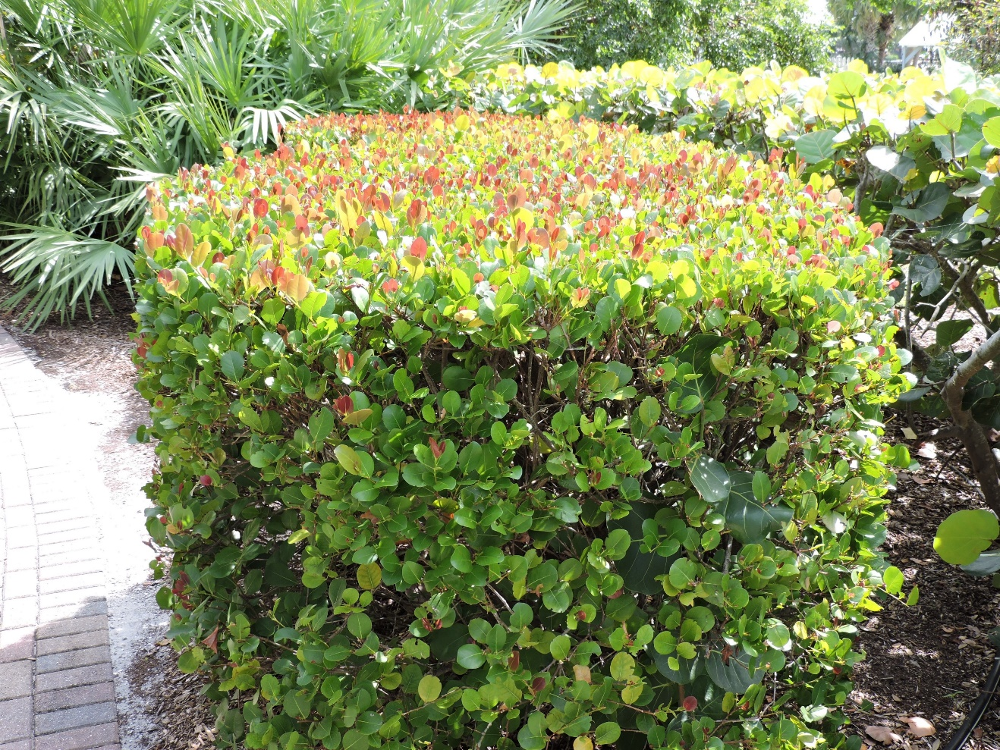
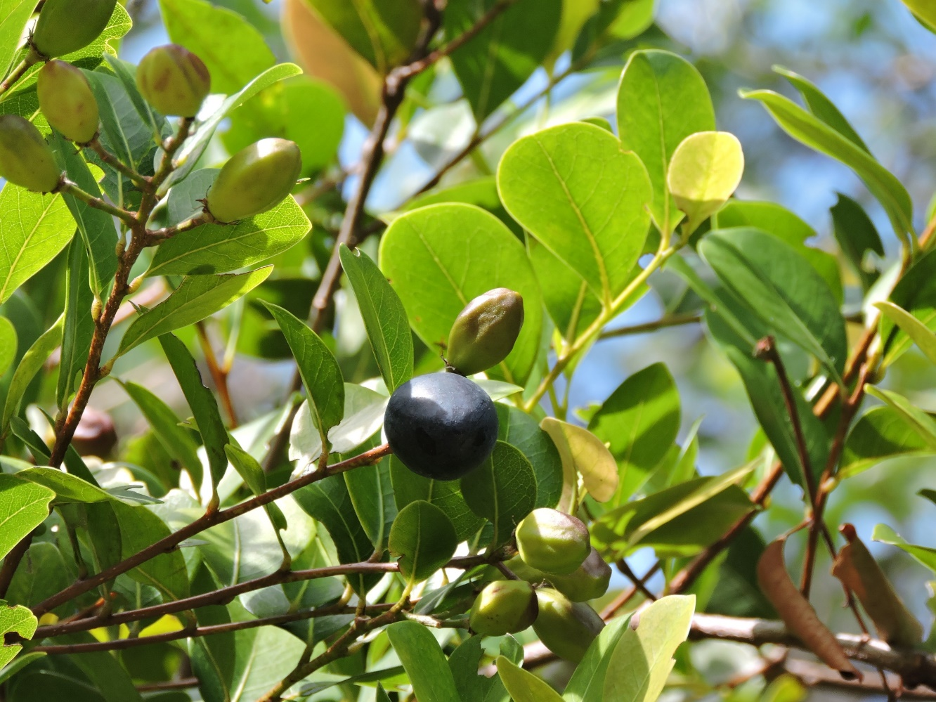
Plants of the ONA: Coco-Plum (Native)

Slide 13
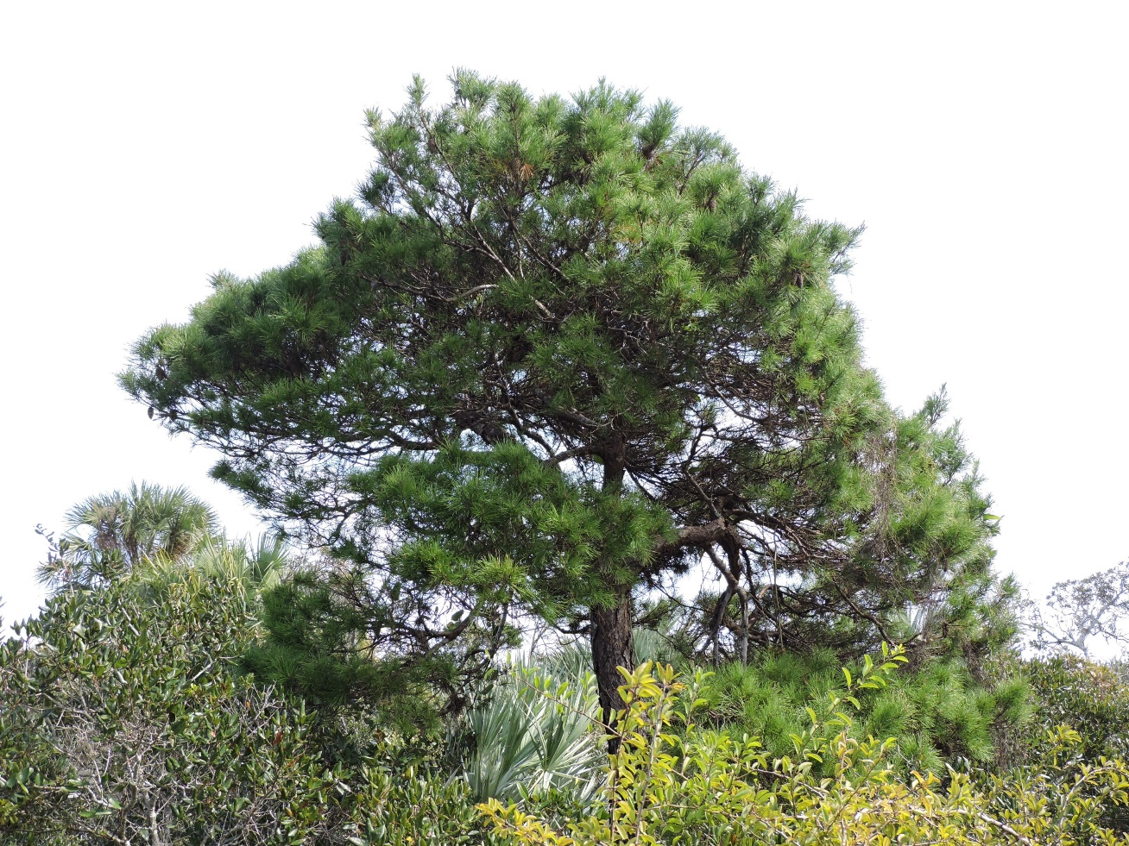
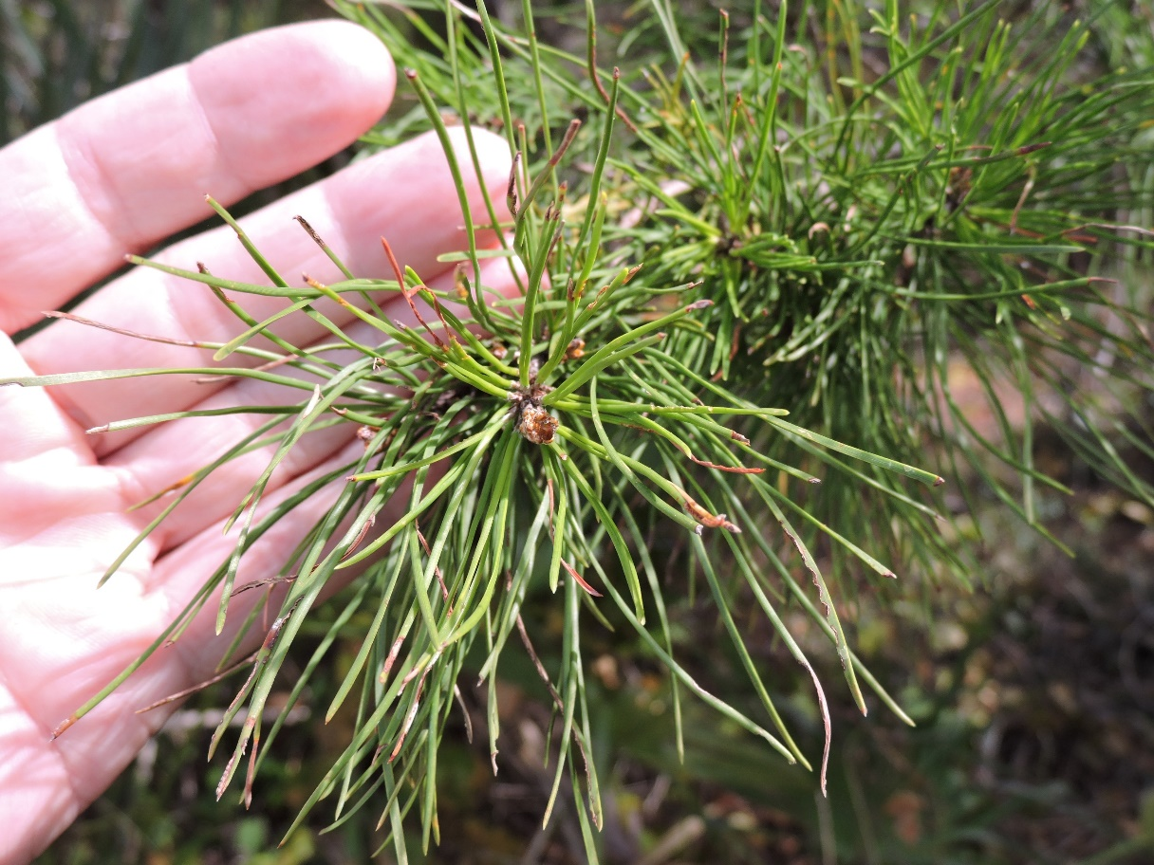
Plants of the ONA: Sand Pine (Native)

Slide 14
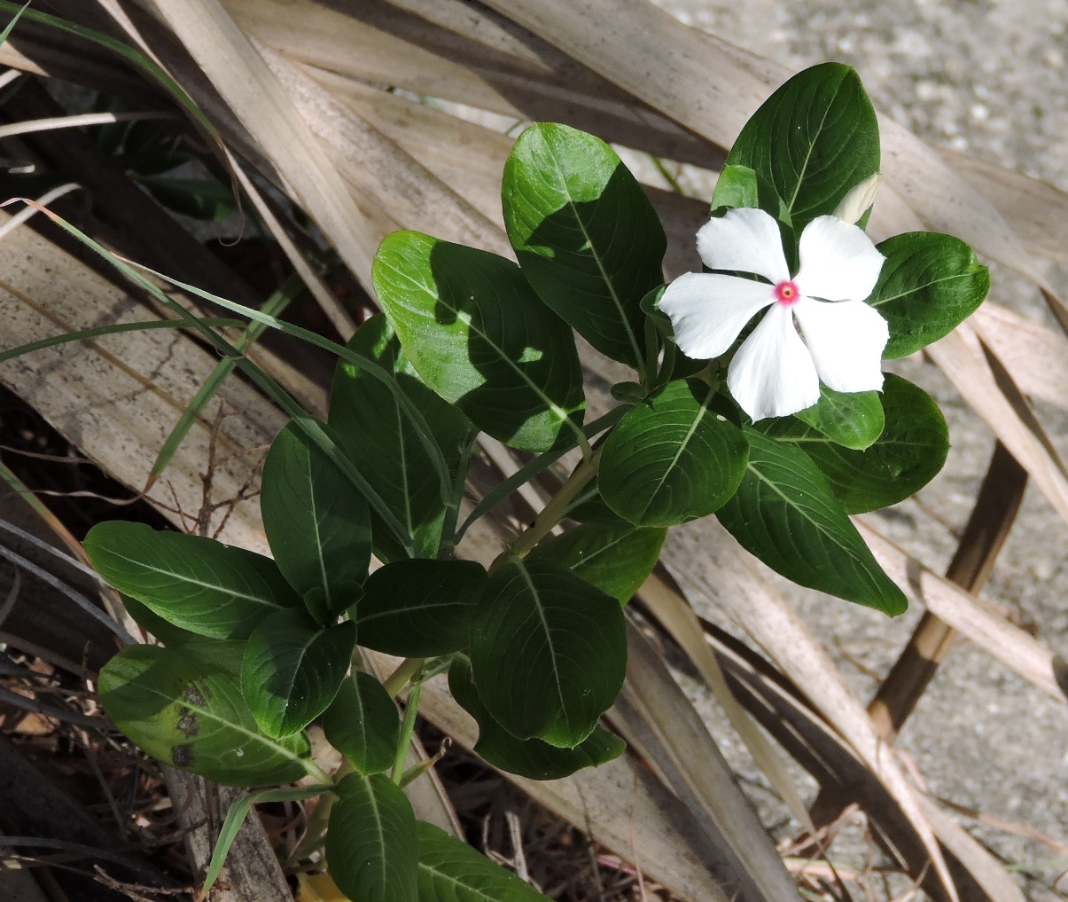
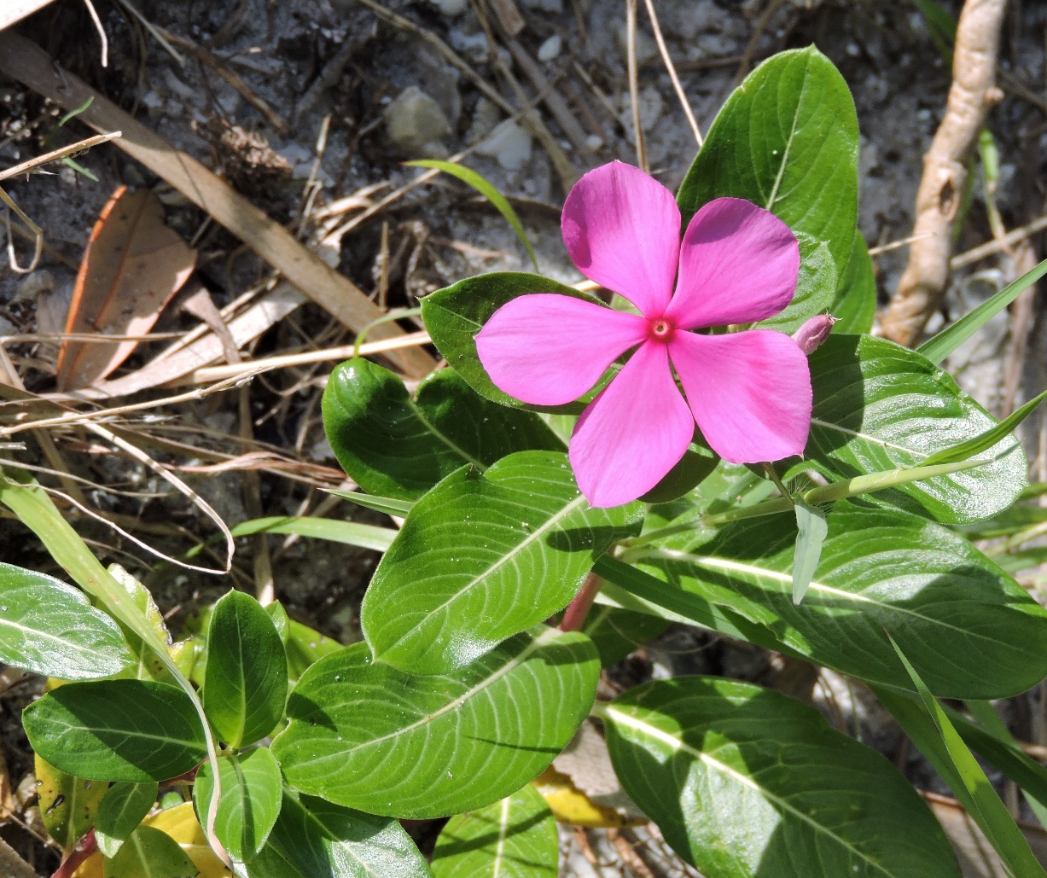
Plants of the ONA: Madagascar Periwinkle (Exotic)

Slide 15
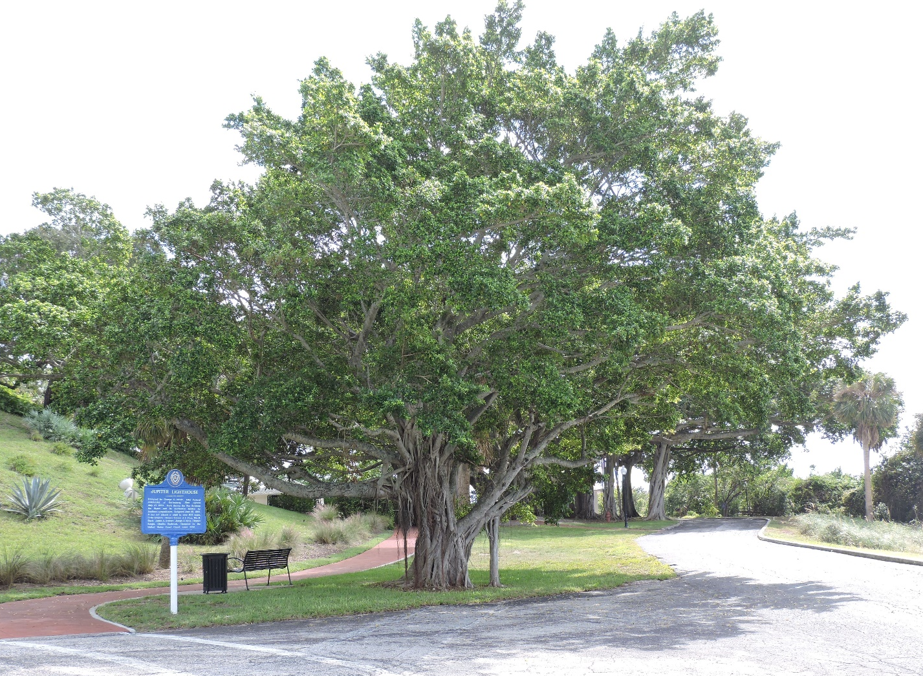
Plants of the ONA Review:
What Is It?
Banyan/Ficus tree
Native or exotic?
Exotic

Slide 16
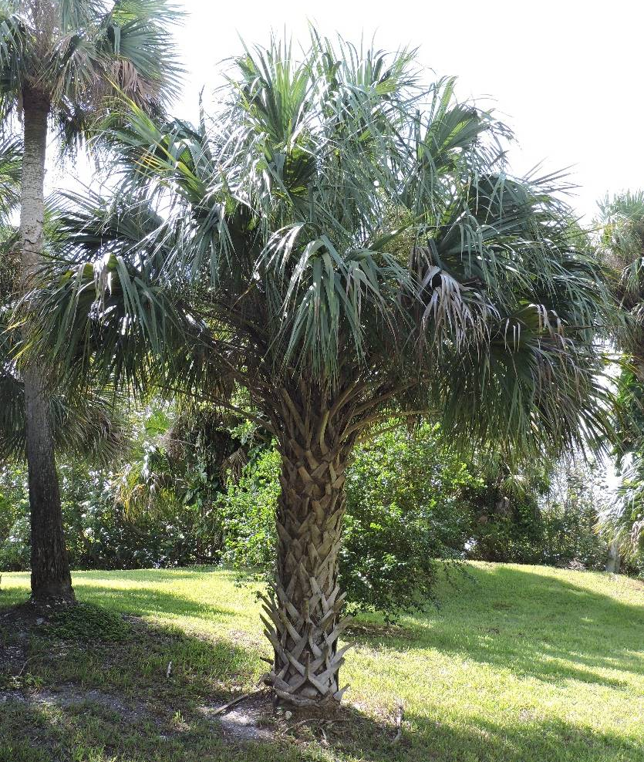
Plants of the ONA Review:
What Is It?
Cabbage or
Sabal Palm
Native or exotic?
Native

Slide 17
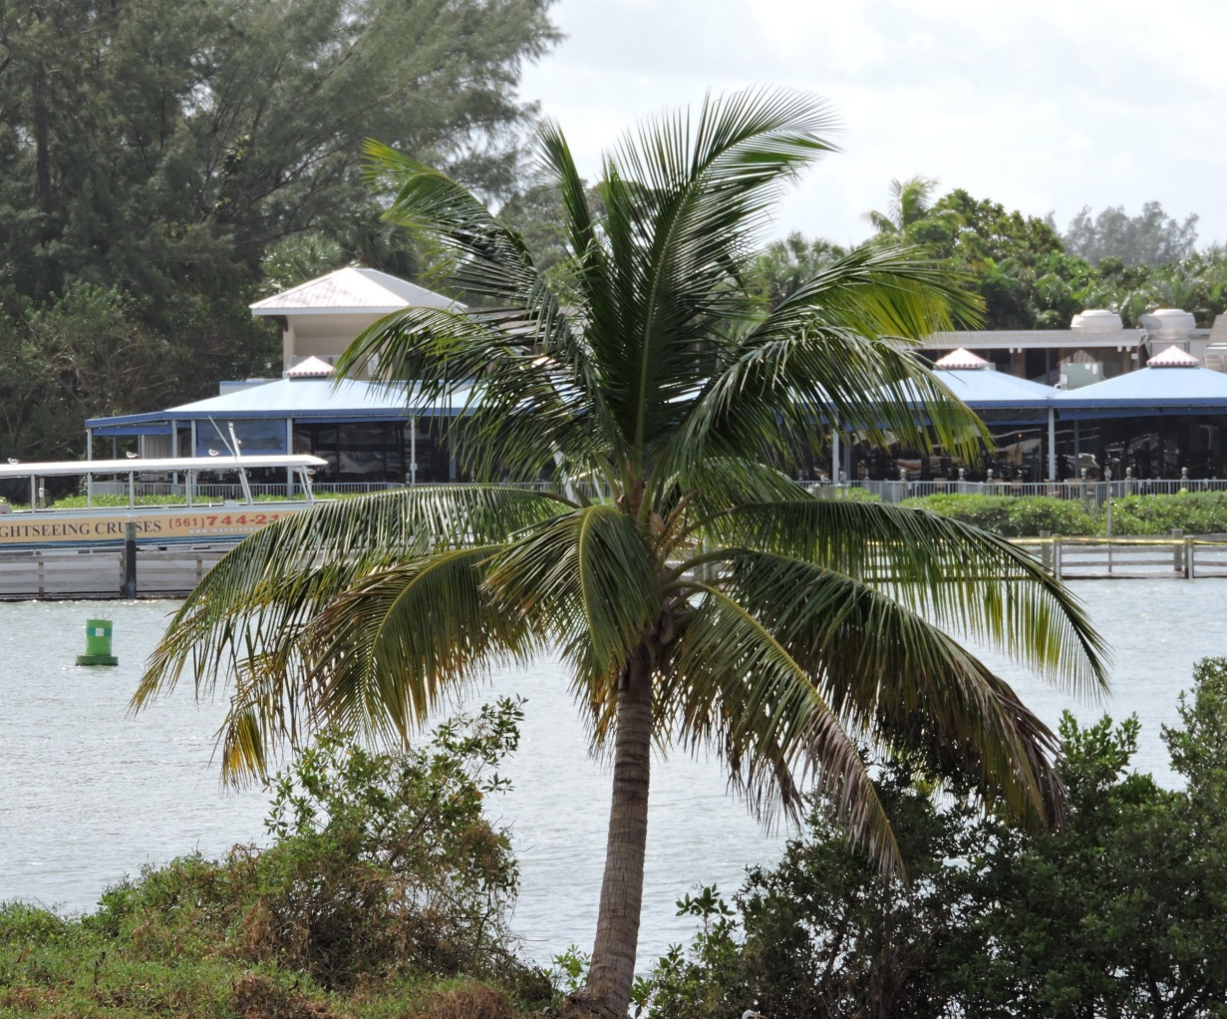
Plants of the ONA Review:
What Is It?
Coconut Palm
Native or exotic?
Exotic

Slide 18
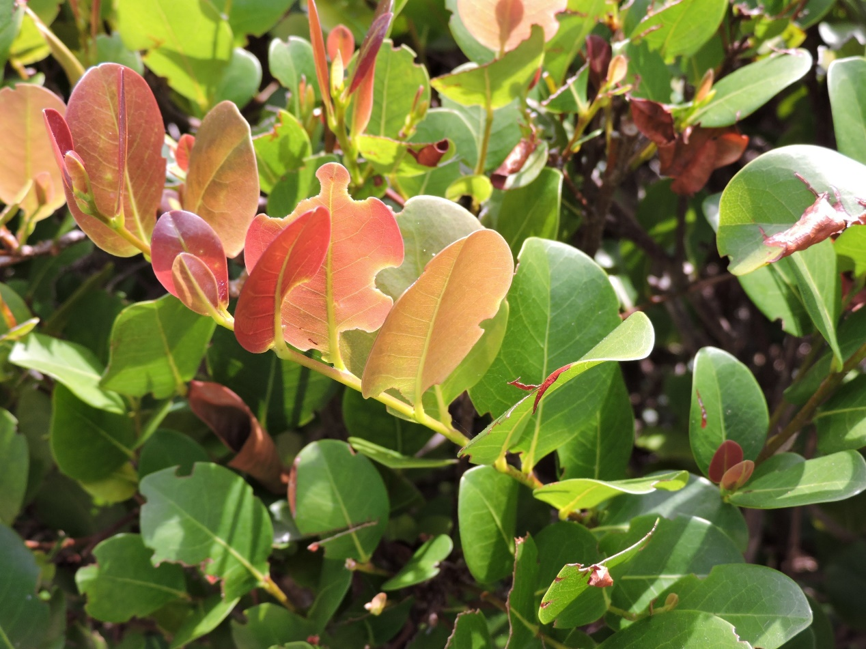
Plants of the ONA Review:
What Is It?
Coco-plum
Native or exotic?
Native

Slide 19
Plants of the ONA Review:
What Is It?
Gumbo Limbo
tree
Native or exotic?
Native

Slide 20
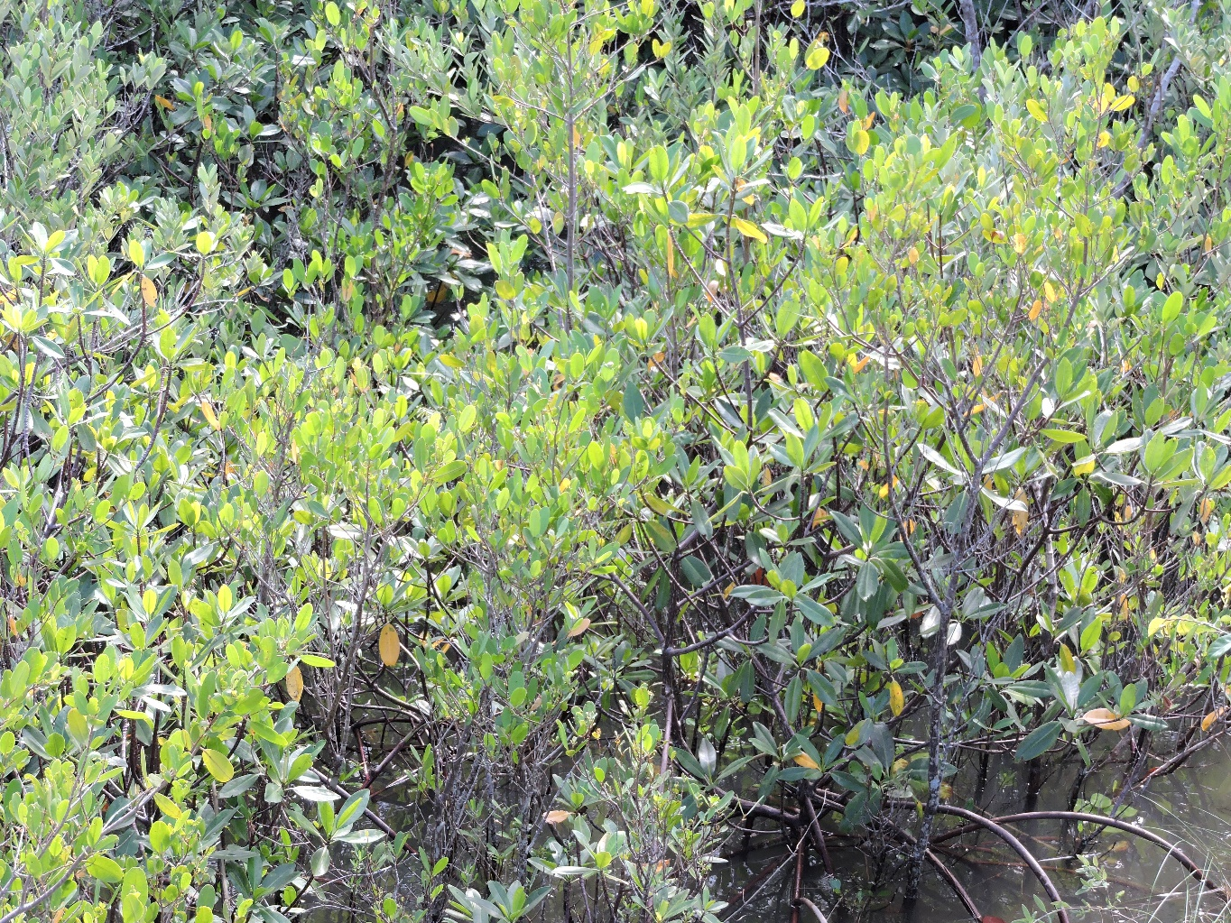
Plants of the ONA Review:
What Is It?
Mangrove
Native or exotic?
Native

Slide 21
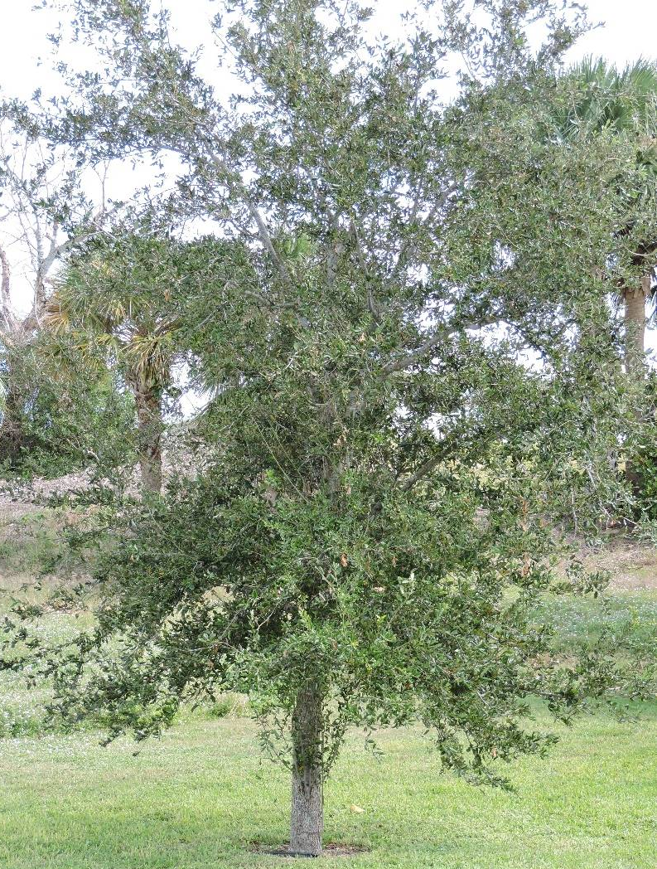
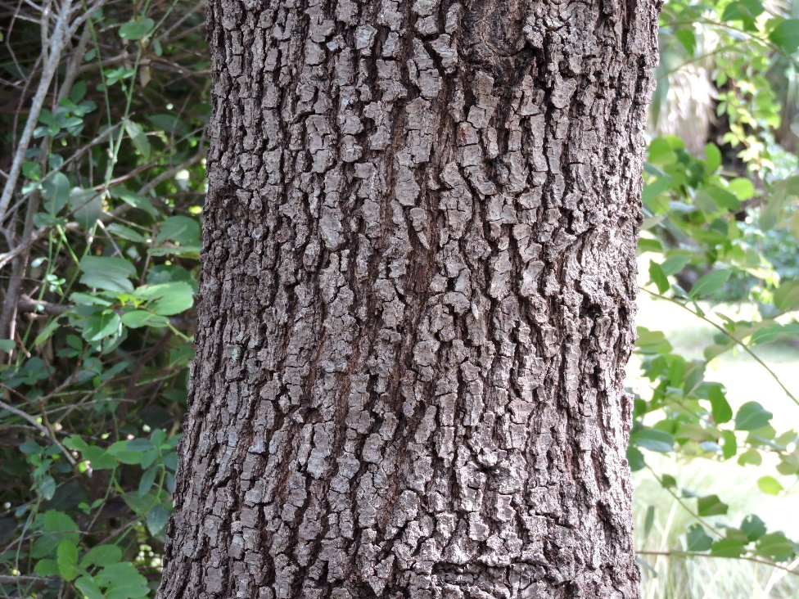
Plants of the ONA Review:
What Is It?
Oak Tree
Native or exotic?
Native

Slide 22
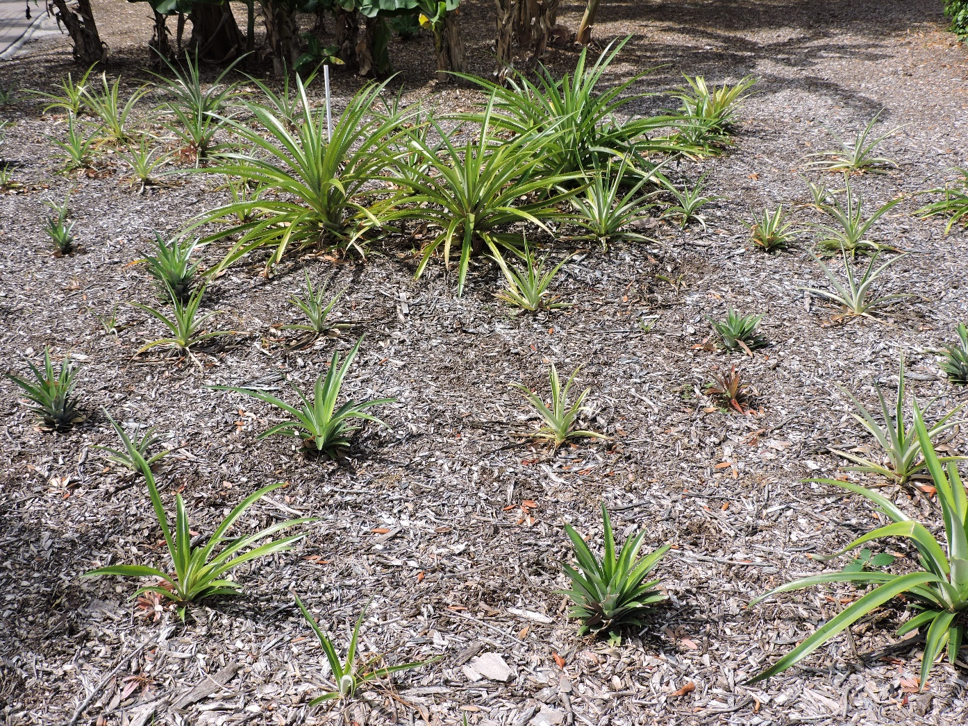
Plants of the ONA Review:
What Is It?
Pineapple
Native or exotic?
Exotic

Slide 23
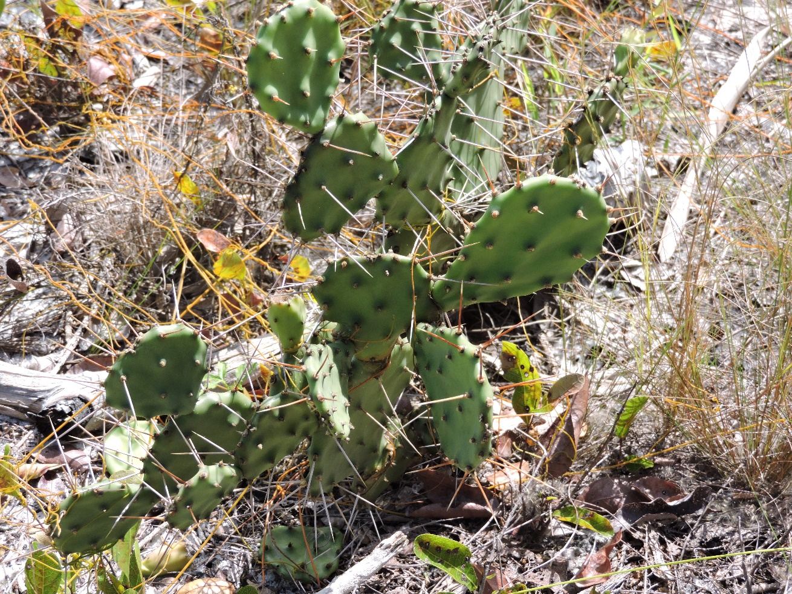
Plants of the ONA Review:
What Is It?
Prickly-pear
cactus
Native or exotic?
Native

Slide 24
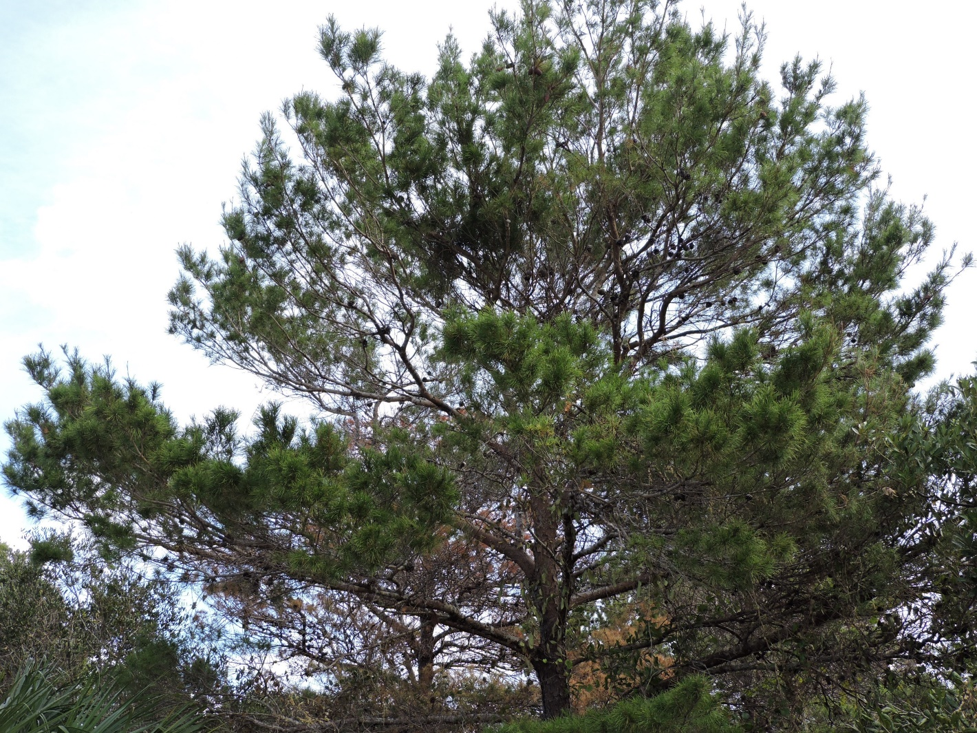
Plants of the ONA Review:
What Is It?
Sand Pine tree
Native or exotic?
Native

Slide 25
Plants of the ONA Review:
What Is It?
Sea Grape
Native or exotic?
Native

Slide 26
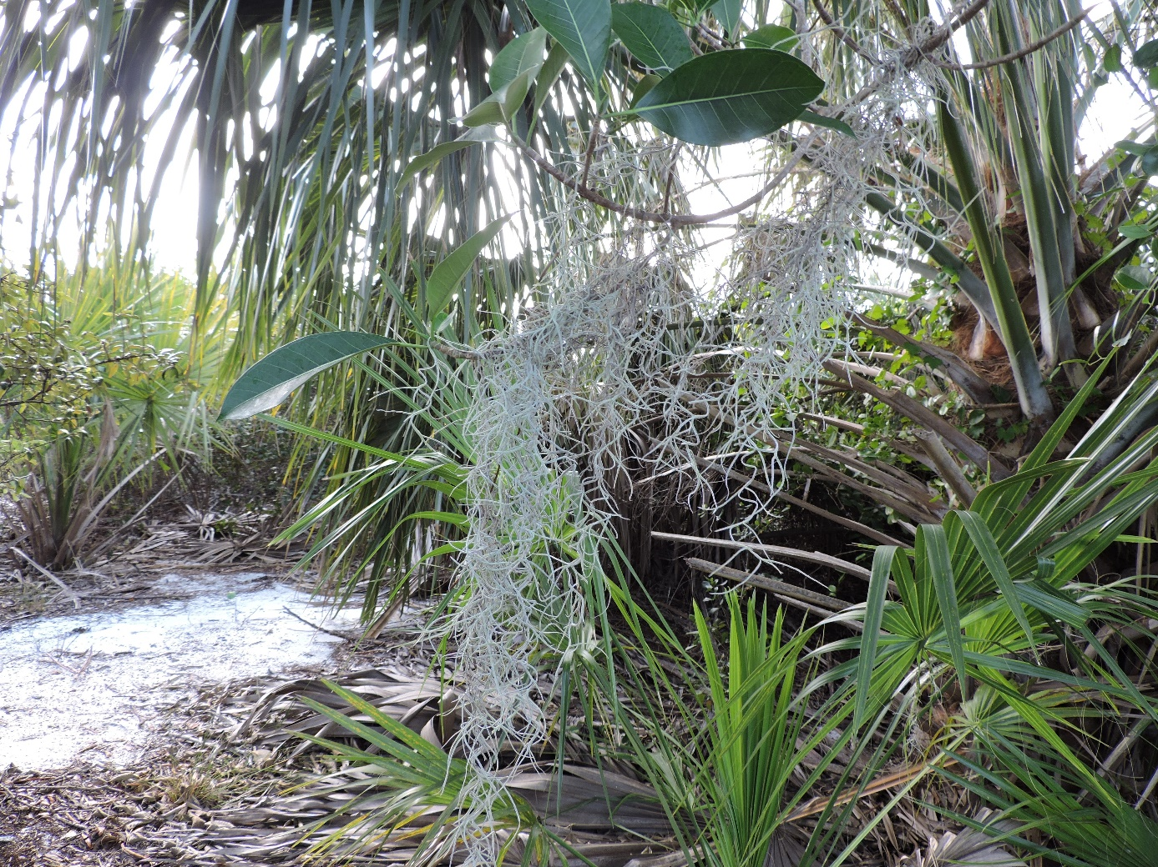
Plants of the ONA Review:
What Is It?
Spanish Moss
Native or exotic?
Native

Slide 27
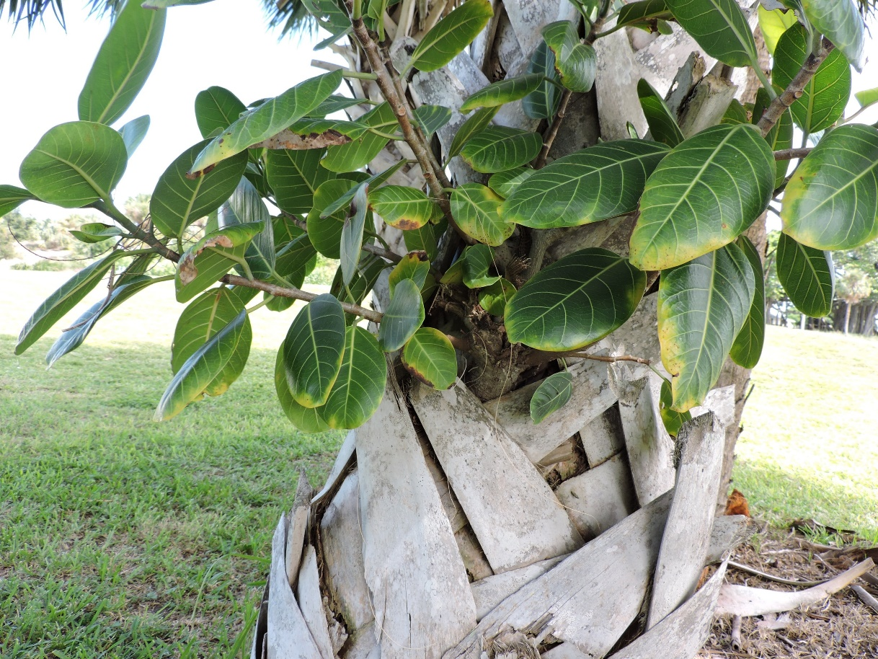
Plants of the ONA Review:
What Is It?
Strangler Fig
Native or exotic?
Native

Slide 28
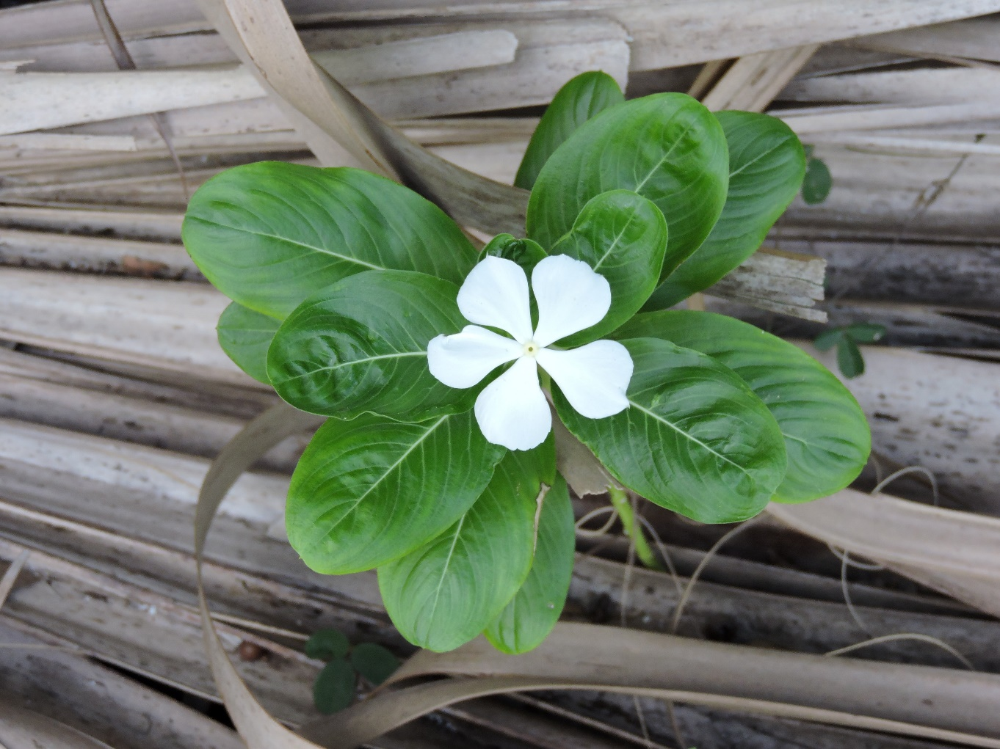
Plants of the ONA Review:
What Is It?
Madagascar Periwinkle
Native or exotic?
Exotic

