Slide 1
BIRDS of the ONA
Fourth Grade Activity

Slide 2
Birds of the ONA: Anhinga
Anhinga have pointed bills.
Female Anhinga
Male Anhinga

Slide 3
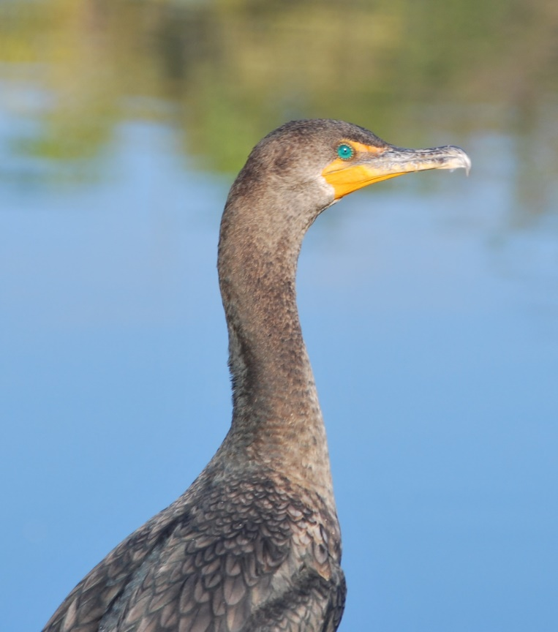
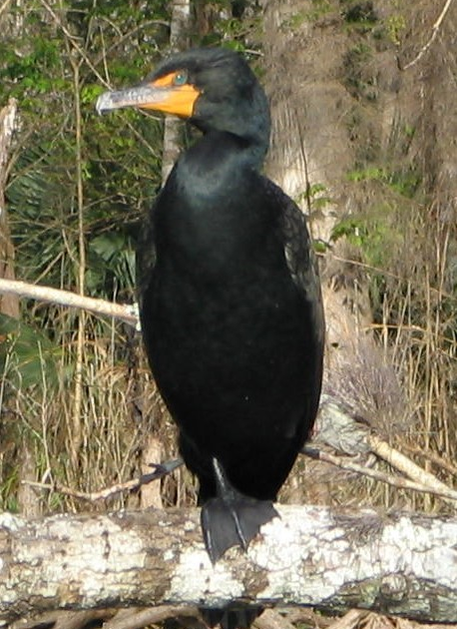
Birds of the ONA: Cormorants
Cormorants have
a hooked bill.
Cormorant
(Double-Crested)

Slide 4
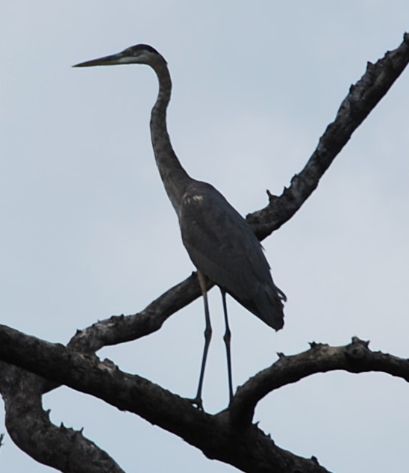
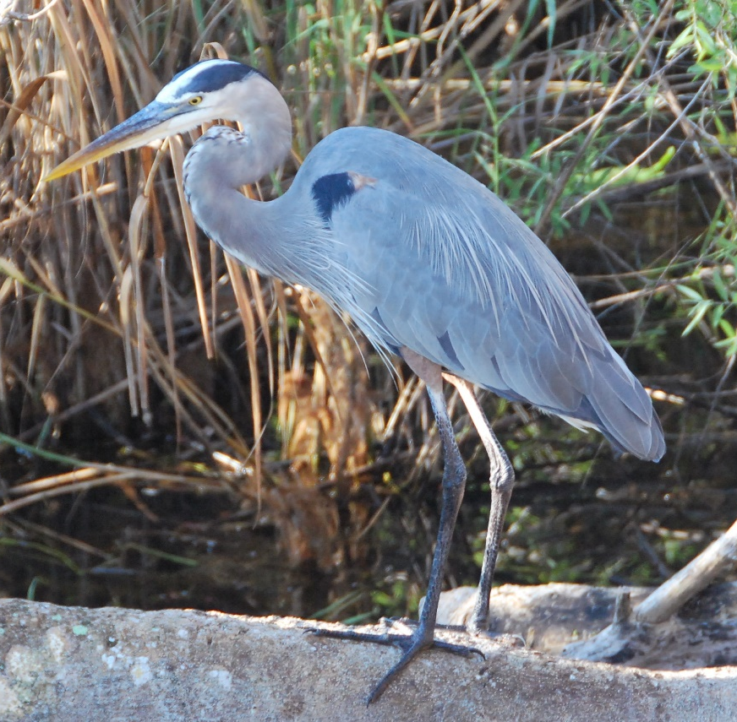
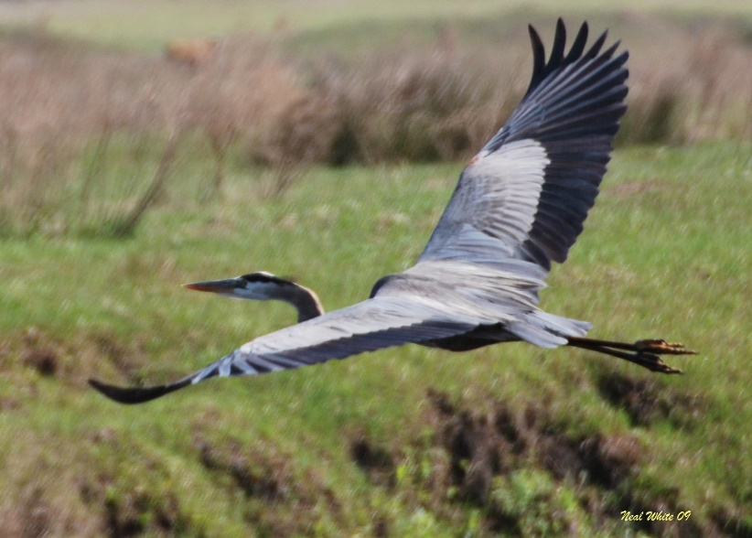
Birds of the ONA: Great Blue Heron
Large (46 inches), grey/blue, heavy yellowish pointed bill, black above eye, light colored legs.
Breeding adults have plumes.

Slide 5
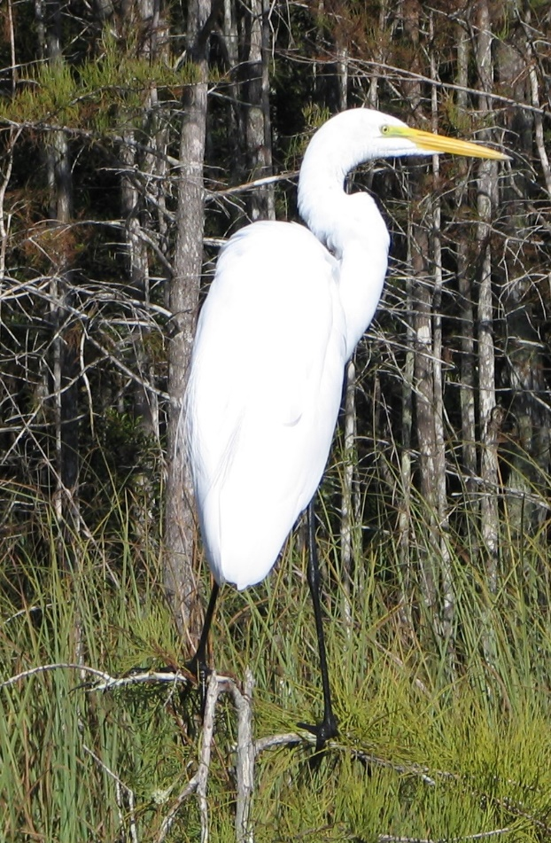
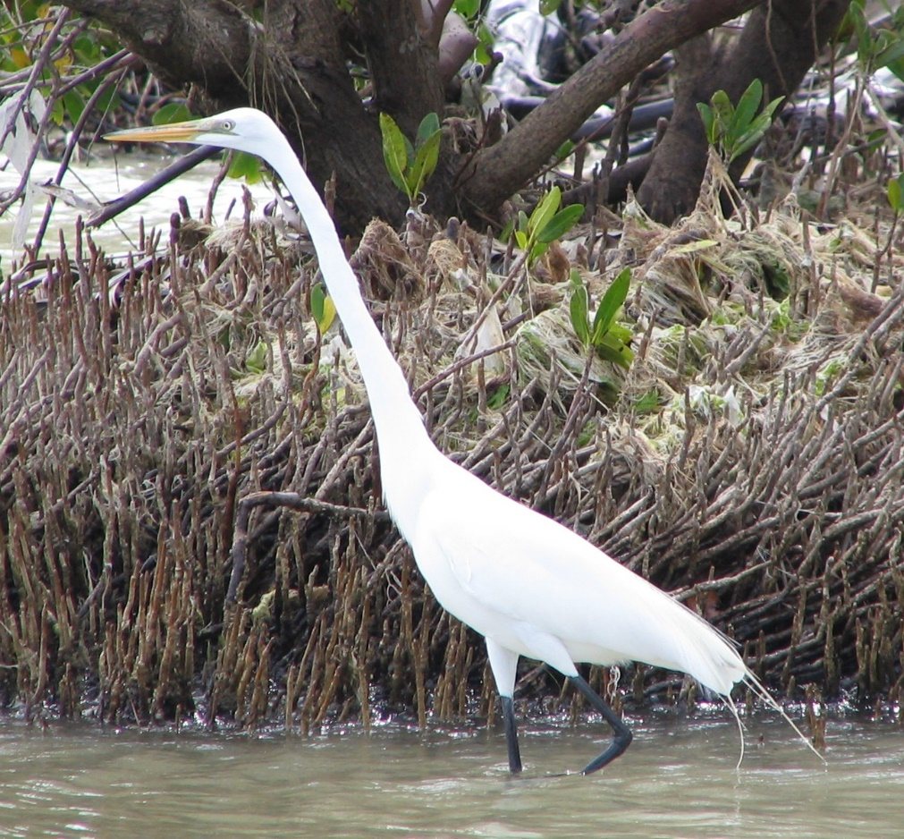
Birds of the ONA: Great Egret
Large (39 inches tall)all white,
yellow bill, blackish legs.
Breeding adults have plumes.

Slide 6
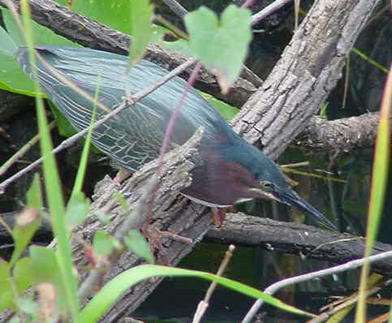
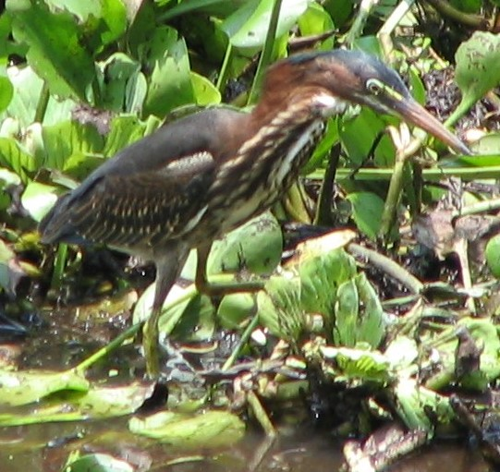
Birds of the ONA: Green Heron
Small (18 inches),
back and sides are brown,
Green on upper parts, legs are yellow.
Male has bright orange breeding plumes.

Slide 7
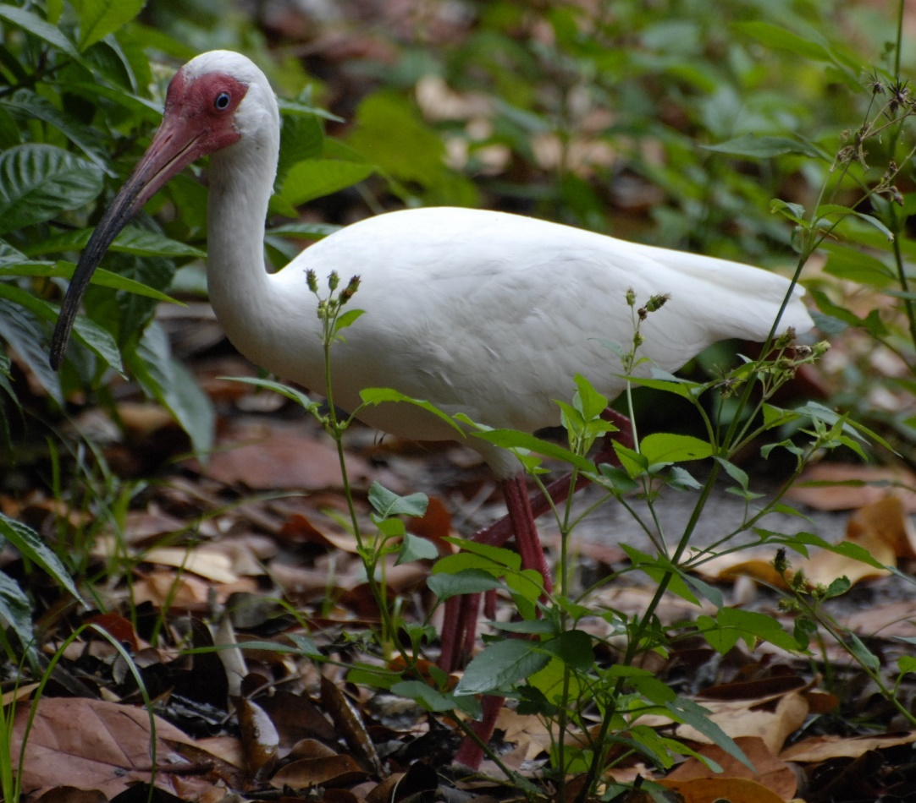
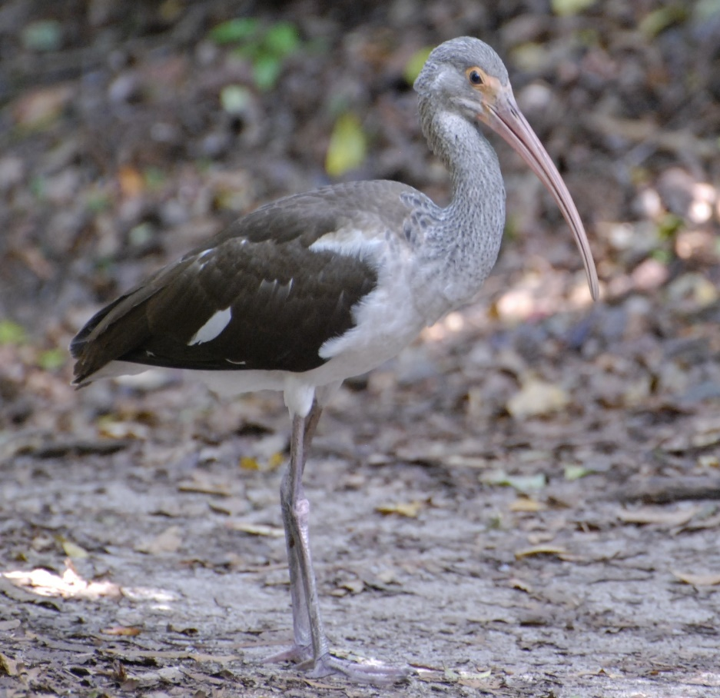
Birds of the ONA: White Ibis (Species of Special Concern)
Adult all white, medium size (25 inches)
pink face and legs, curved pink bill with dark tip.
Immature birds have brown on back and neck.
T. Ramsey
Immature is brown

Slide 8
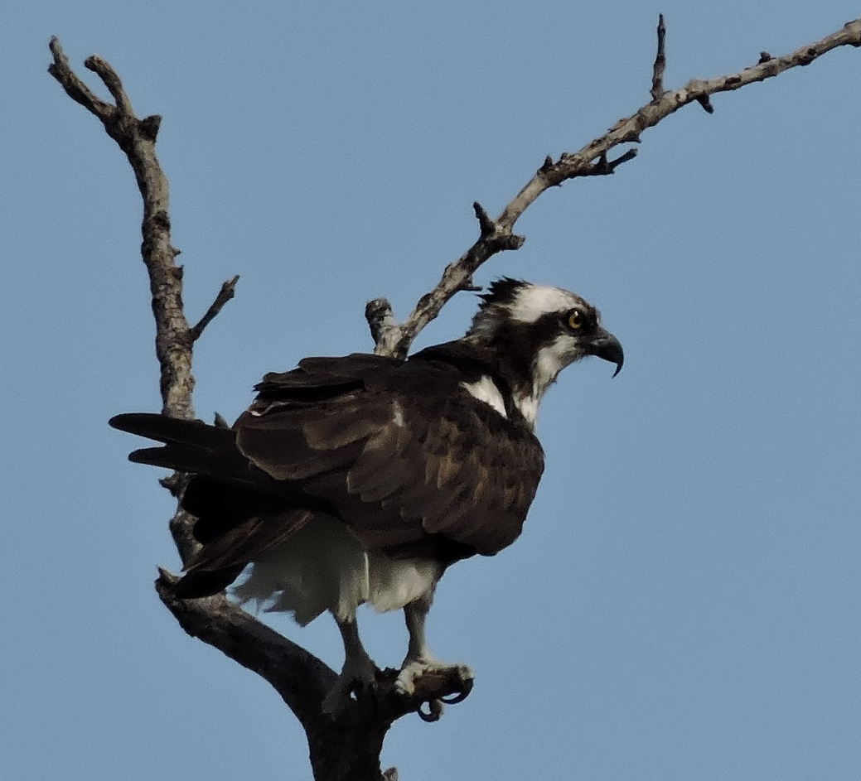
Birds of the ONA: Osprey (SSC)
Dark brown back,
white underside, (25 inches tall),
White head with dark eye stripe.

Slide 9
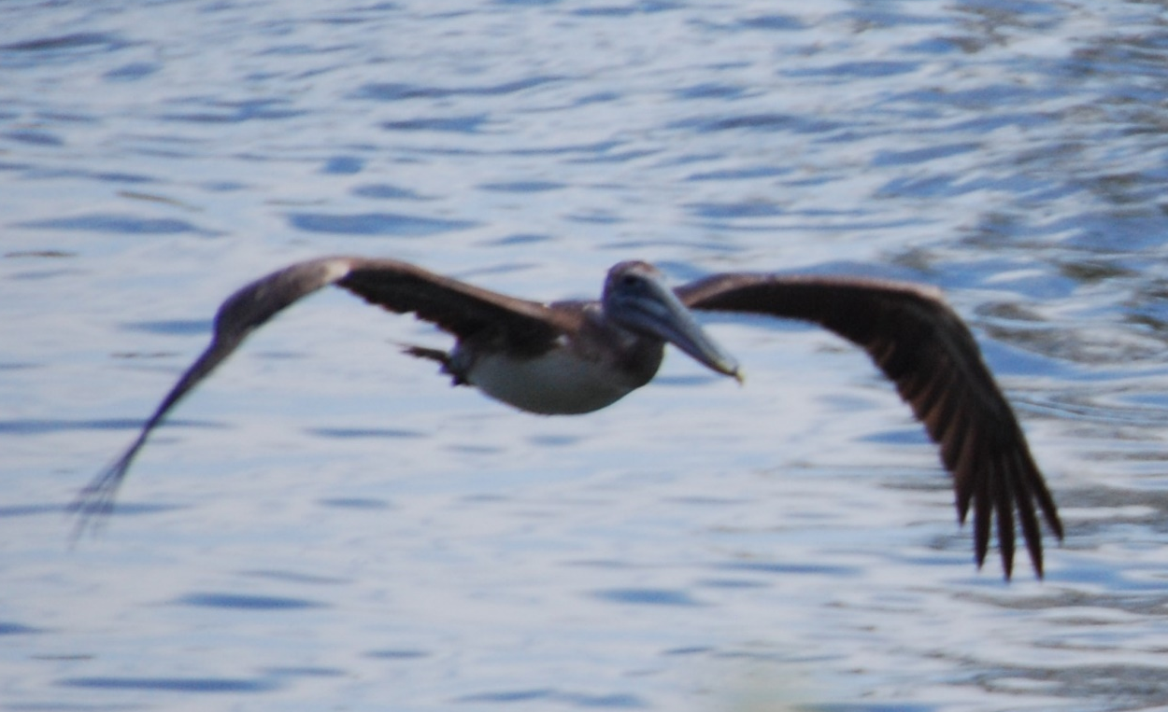
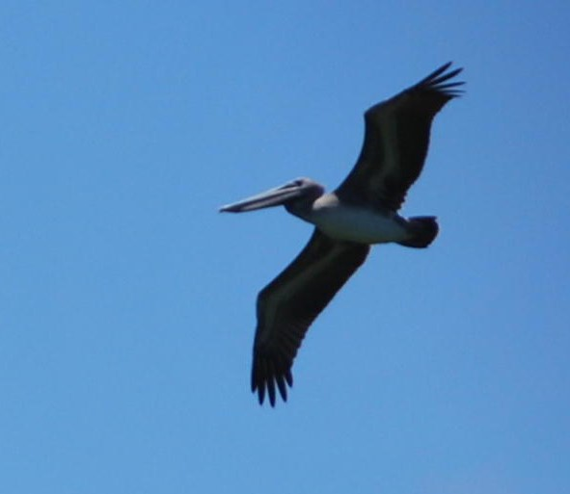
Birds of the ONA: Brown Pelican (SSC)
Large bird (48inches), white or yellowish head, grey/brown body,
white neck, dark underside, large bill with pouch.

Slide 10
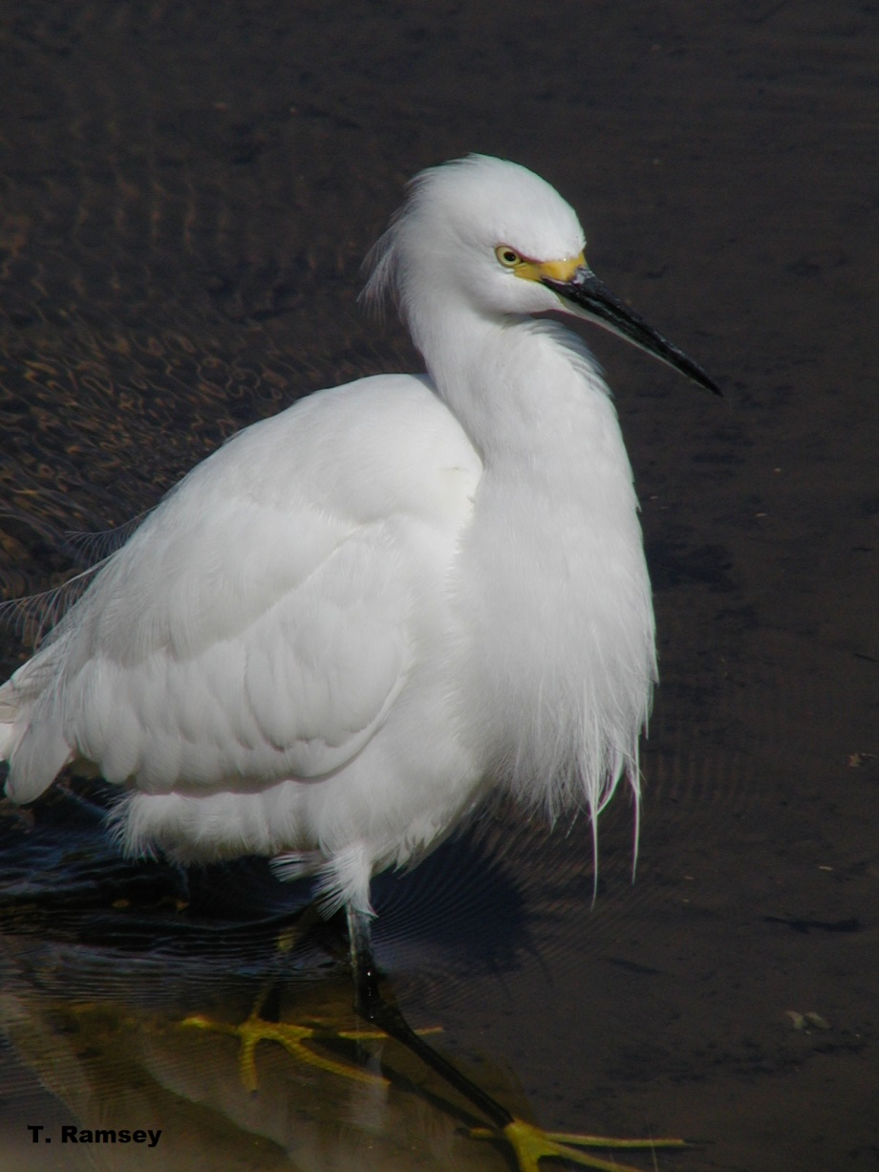
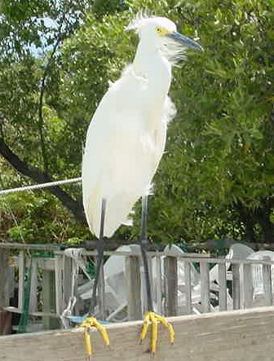
Birds of the ONA: Snowy Egret (SSC)
Medium size (24 inches), all white, black bill, black legs with yellow feet.
Plumes on head, neck and back.

Slide 11
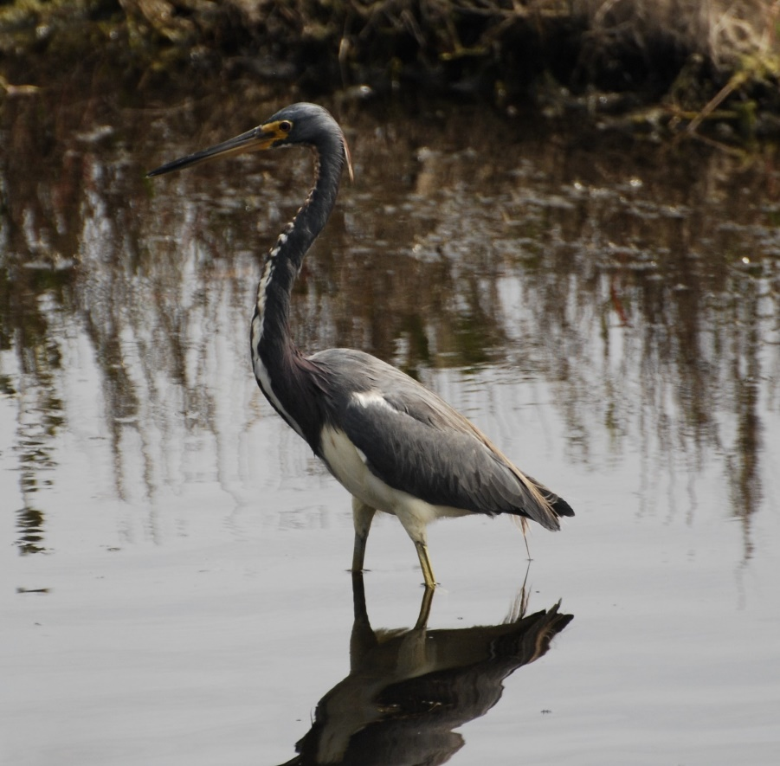
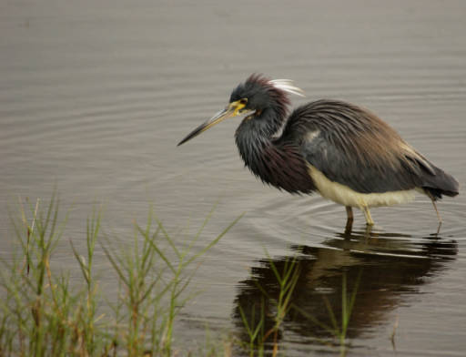
Birds of the ONA: Tricolored Heron (SSC)
Medium sized (24 inches), dark blue
upper, white underside of neck and body,
slender dark bill, light colored legs.
T. Ramsey
(Previously called Louisiana Heron)

Slide 12
Birds of the ONA: Review
What is it?
Male Anhinga

Slide 13
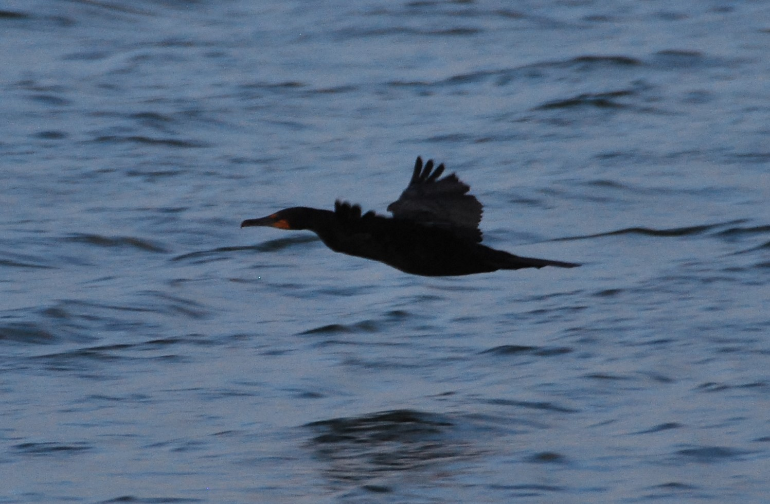
Birds of the ONA: Review
What is it?
Cormorant

Slide 14
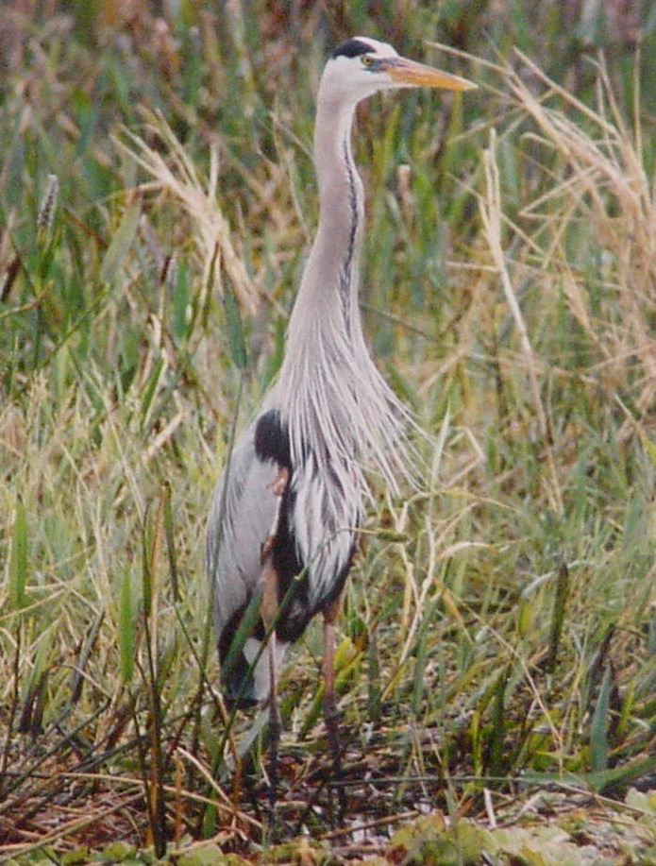
Birds of the ONA: Review
What is it?
Great Blue Heron

Slide 15
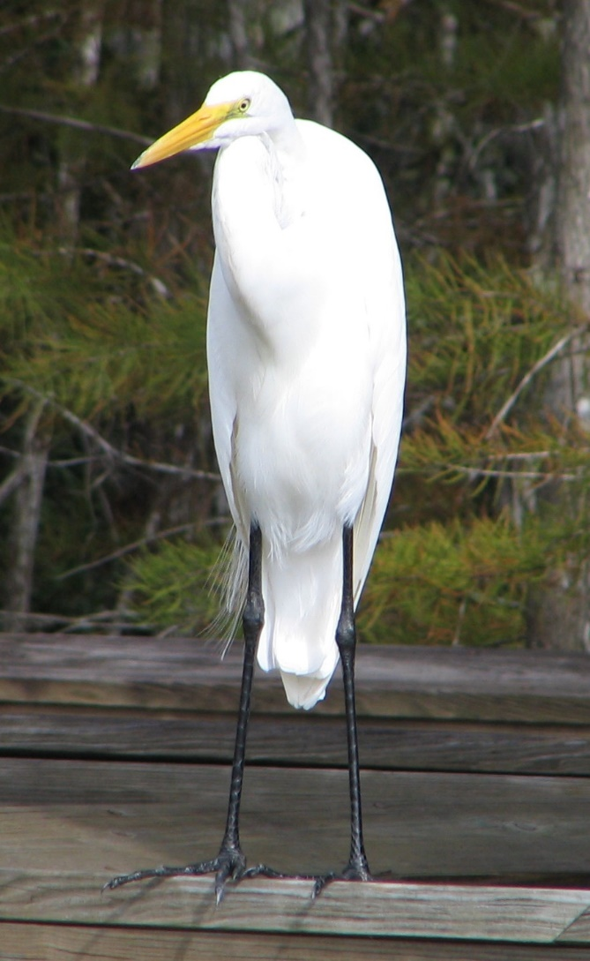
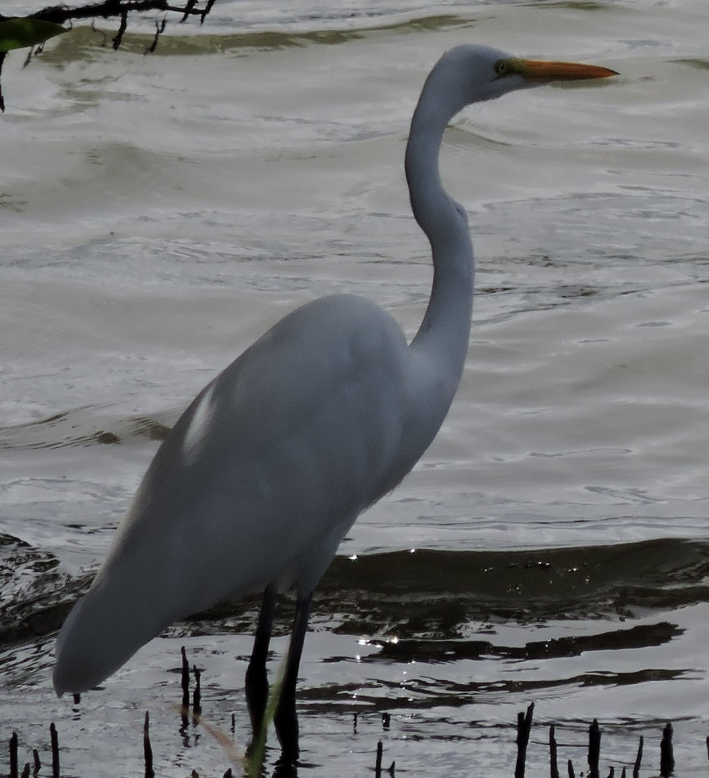
Birds of the ONA: Review
What is it?
Great Egret

Slide 16
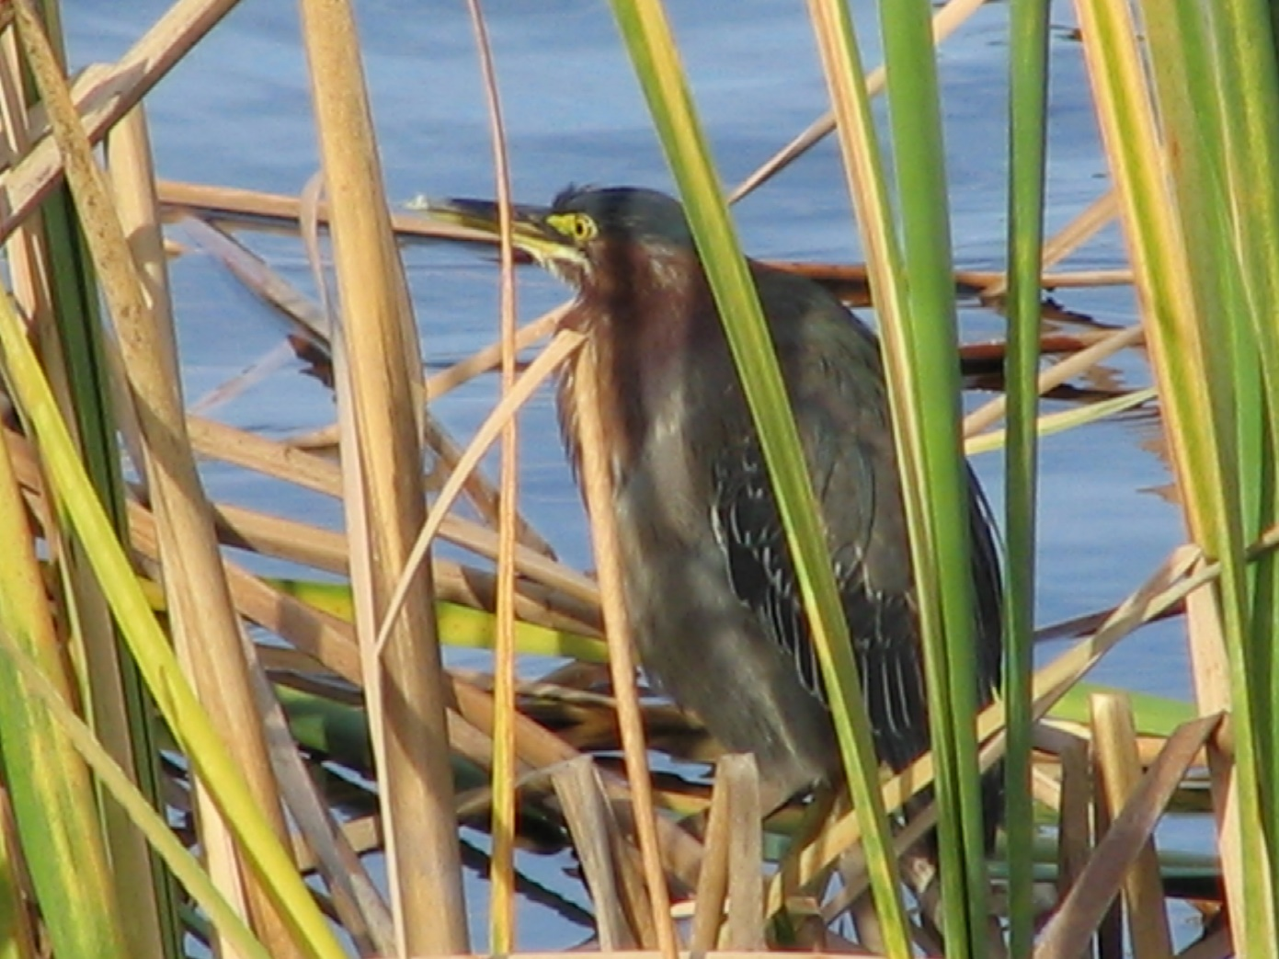
Birds of the ONA: Review
What is it?
Green Heron

Slide 17
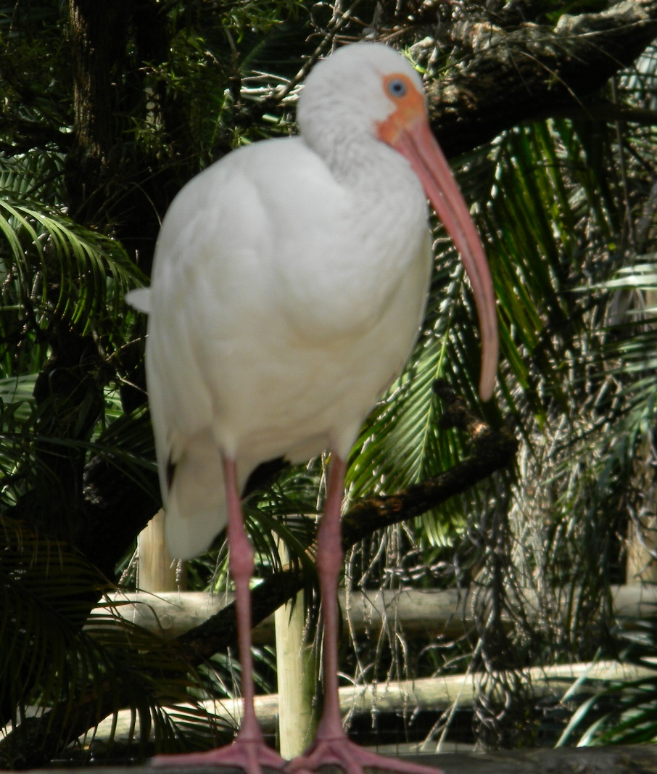
Birds of the ONA: Review
What is it?
White Ibis

Slide 18
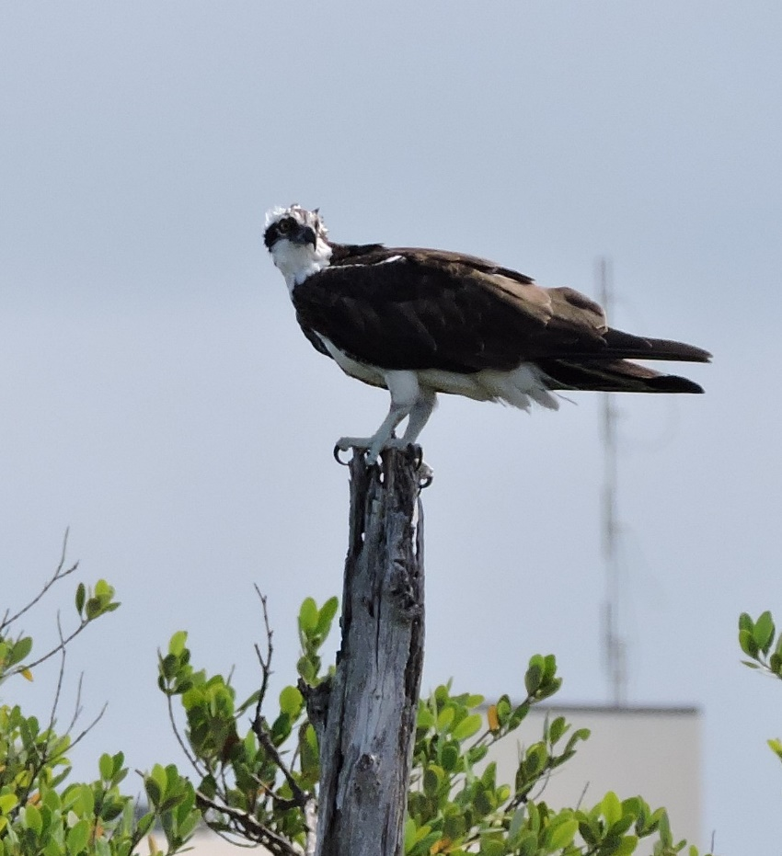
Birds of the ONA: Review
What is it?
Osprey

Slide 19
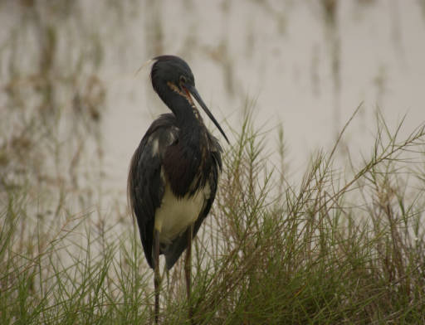
Birds of the ONA: Review
What is it?
Tricolored Heron

Slide 20
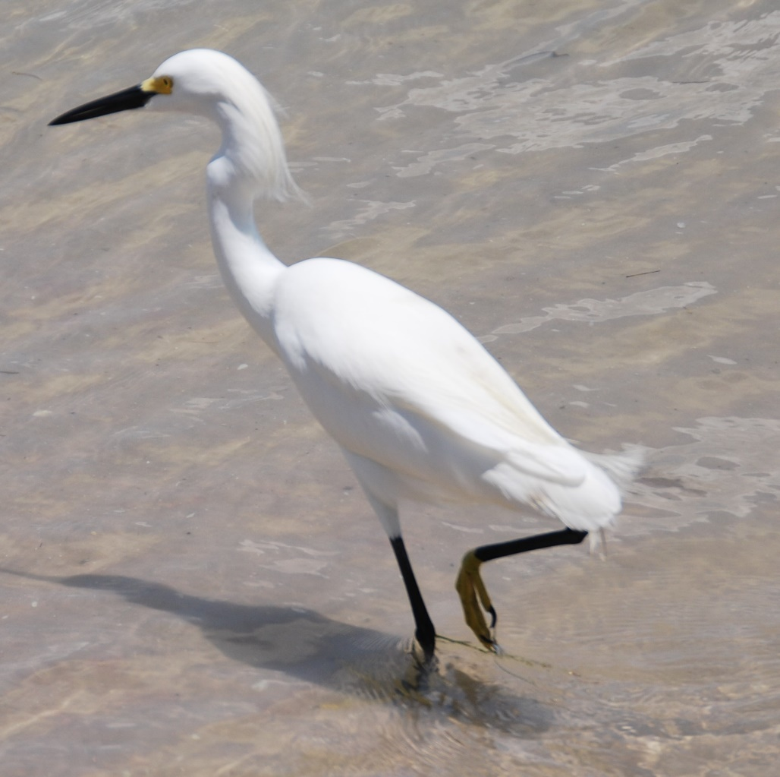
Birds of the ONA: Review
What is it?
Snowy Egret

Slide 21
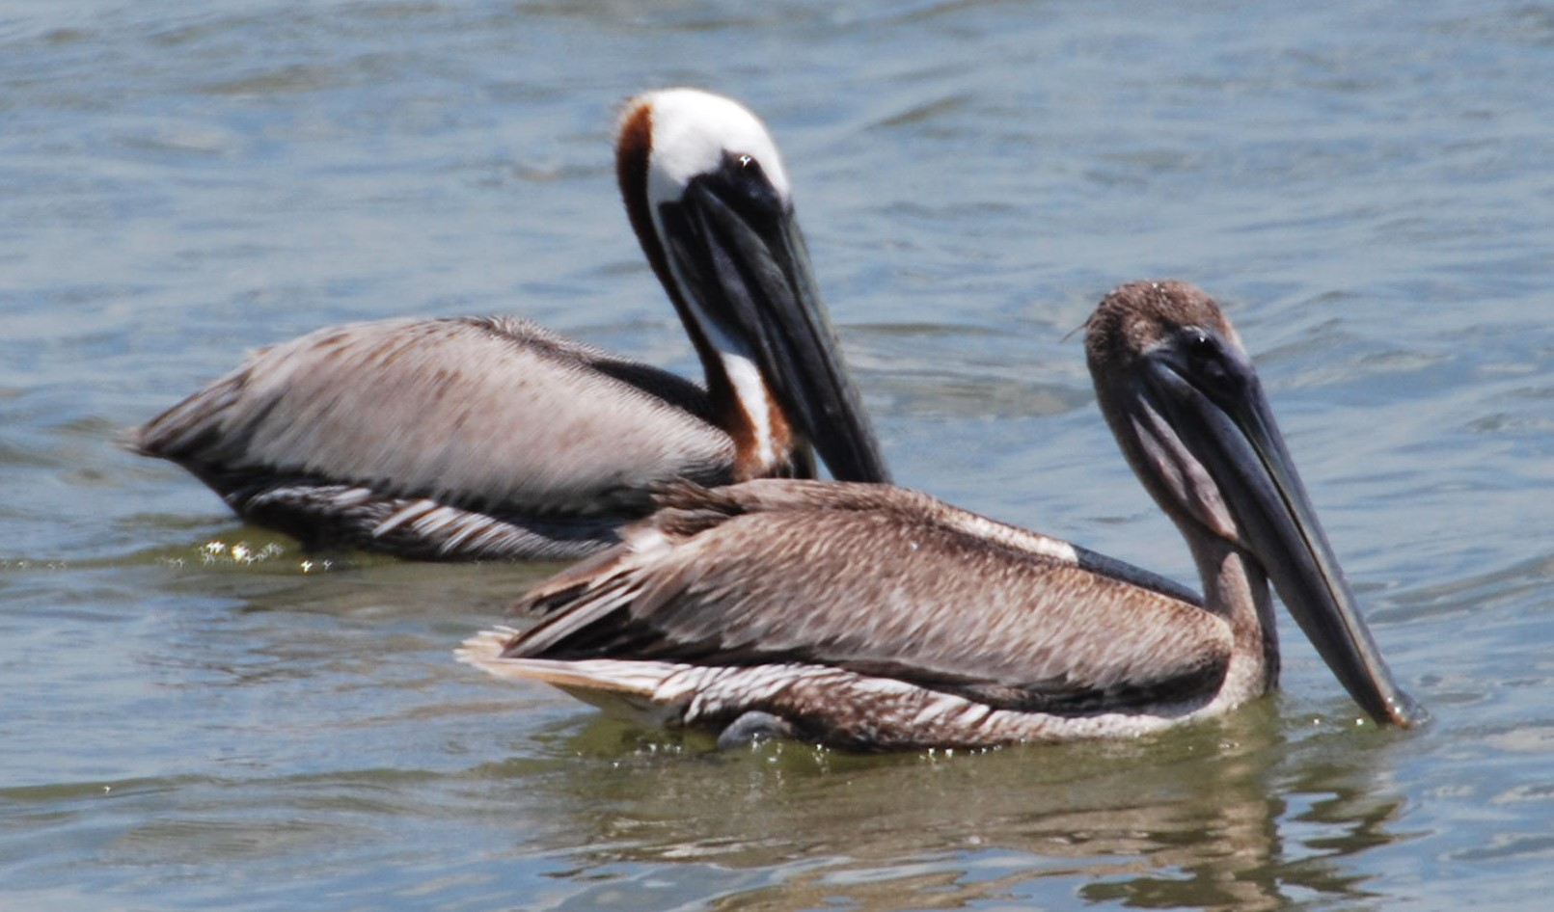
Birds of the ONA: Review
What is it?
Brown Pelican

Slide 22
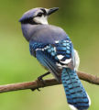
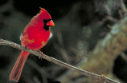
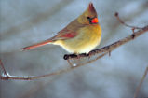
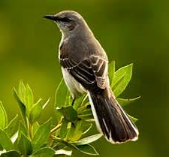
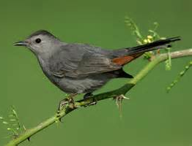
Other Common Birds on the ONA site:
Blue Jay
Male
Female
Northern Cardinal
Mocking Bird
Gray Cat Bird

