Slide 1
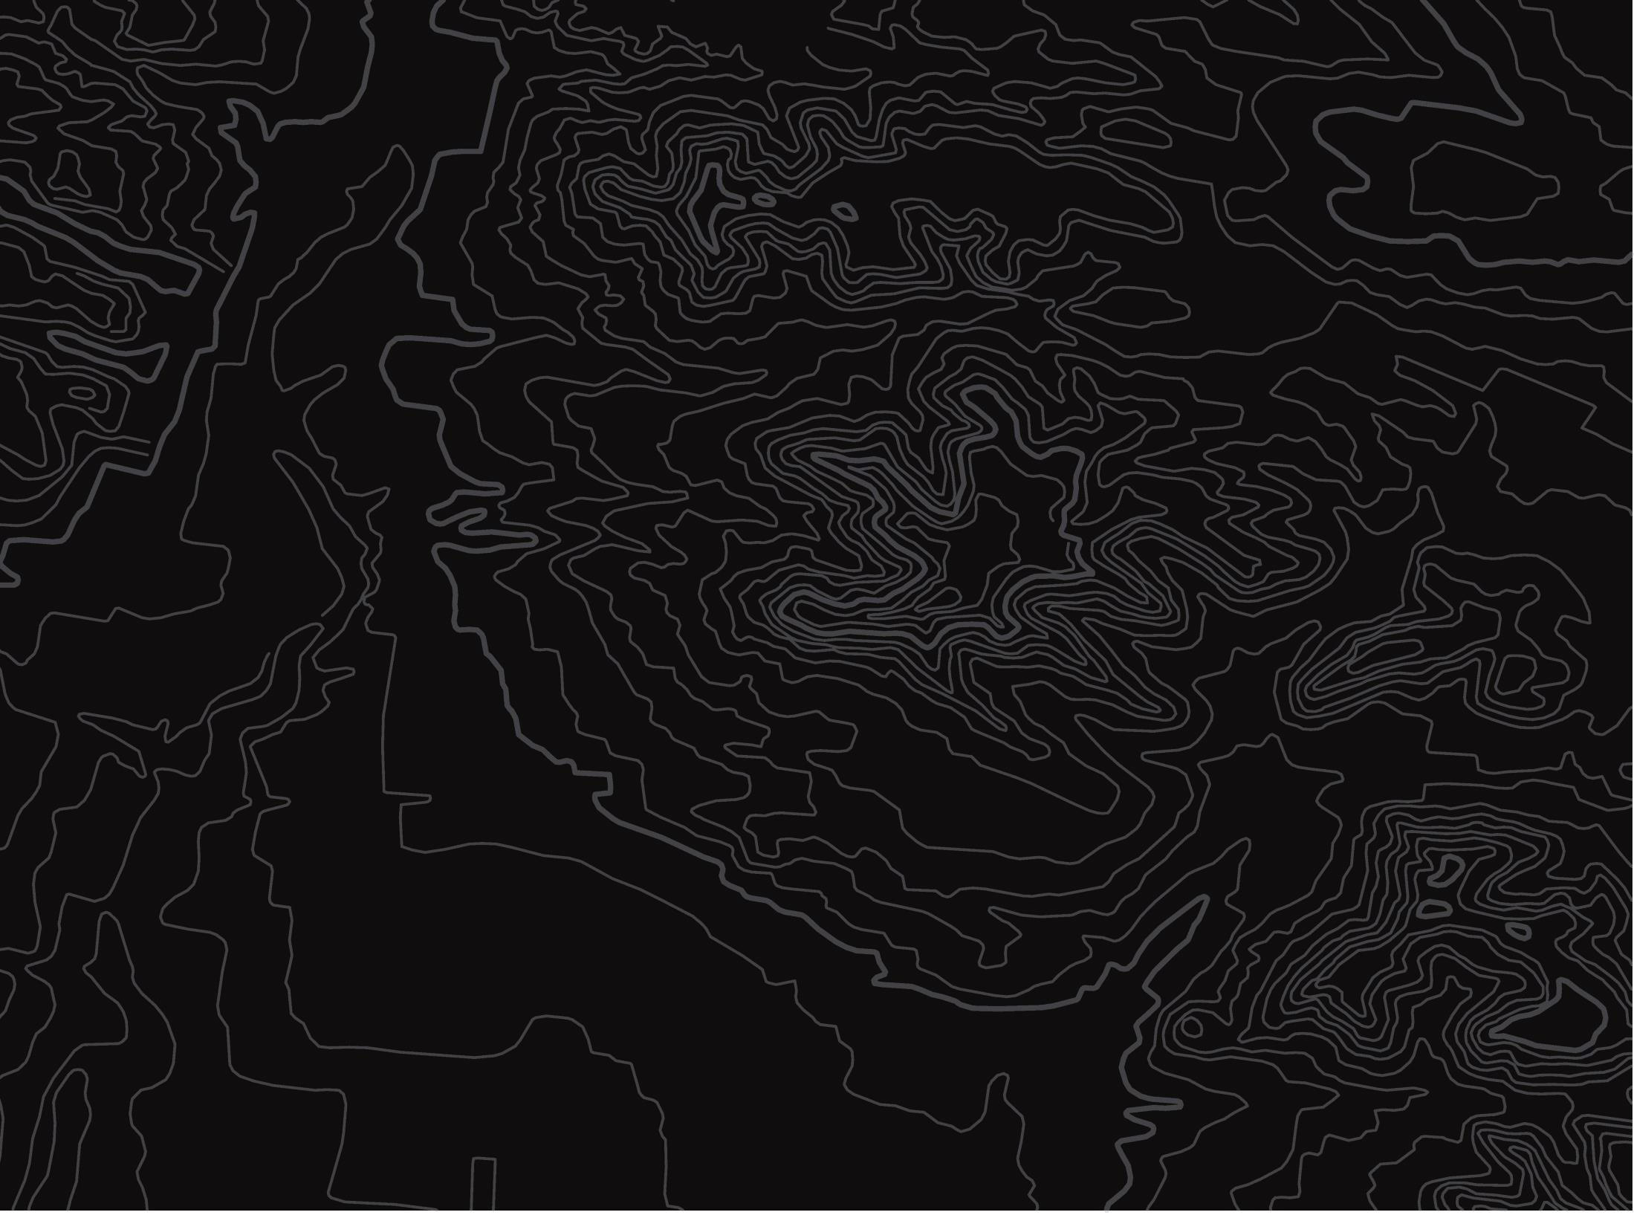
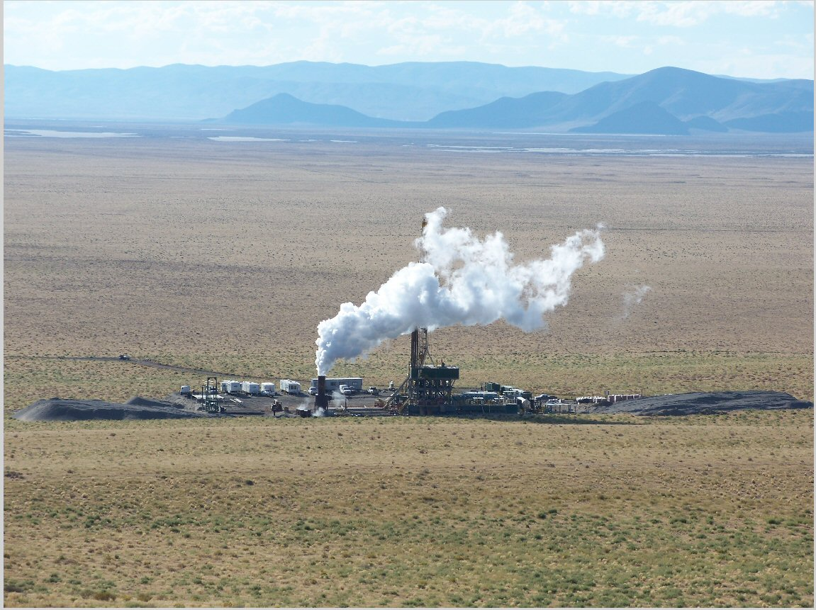

BLM Idaho Geothermal Program Overview
U.S. Department of the Interior
Bureau of Land Management
2025
Blue Mountain Geothermal Power Plant Flow Test, Nevada.
Photo used with permission. 2010-2012.

Slide 2


Executive Order 14154 - Unleashing American Energy
Executive Order 14156 - Declaring a National Energy Emergency
Secretarial Order 3417 - Addressing the National Energy Emergency
Secretarial Order 3418 - Unleashing American Energy
Secretarial Order 3419 - Delivering Emergency Price Relief for American Families and Defeating the Cost-of-Living Crisis
Idaho Geothermal Leases Supports
the Administration's Priorities
BLM Idaho geothermal lease sales:​
​
​
Support domestic energy production
Benefit Idaho taxpayers
Financially boost local Idaho economies​
Notes:
An important first question: what is geothermal energy? There are a number of ways we use geothermal energy. The first is conventional
Conventional geothermal energy requires heat, fluid, and permeability (meaning water can move through the ground).
1. The hot water is brought to the surface using drilling, and the hot water is converted into steam at a geothermal power plant.
2. That steam turns turbines which generate power
3. The water is returned underground where it is reheated and used again, making it sustainable. This makes geothermal power is operational 24 hours a day, 7 days a week.

Slide 3
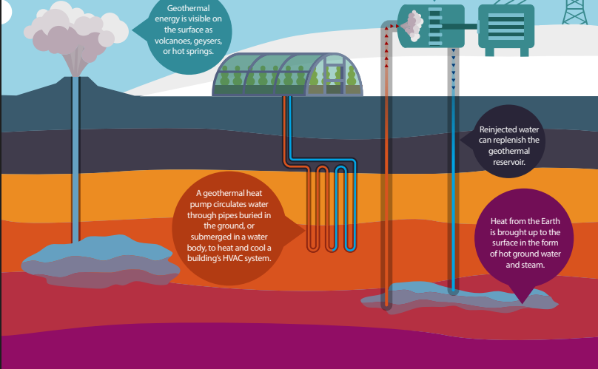
Conventional Geothermal
What is Geothermal Energy?
    Requires heat, fluid, and permeability (fluid can move through the ground)
    Hot water brought to the surface and converted to steam
    Steam turns turbines generating power
    Water is returned underground and reheated
    Sustainable
Source: Department of Energy

Slide 4
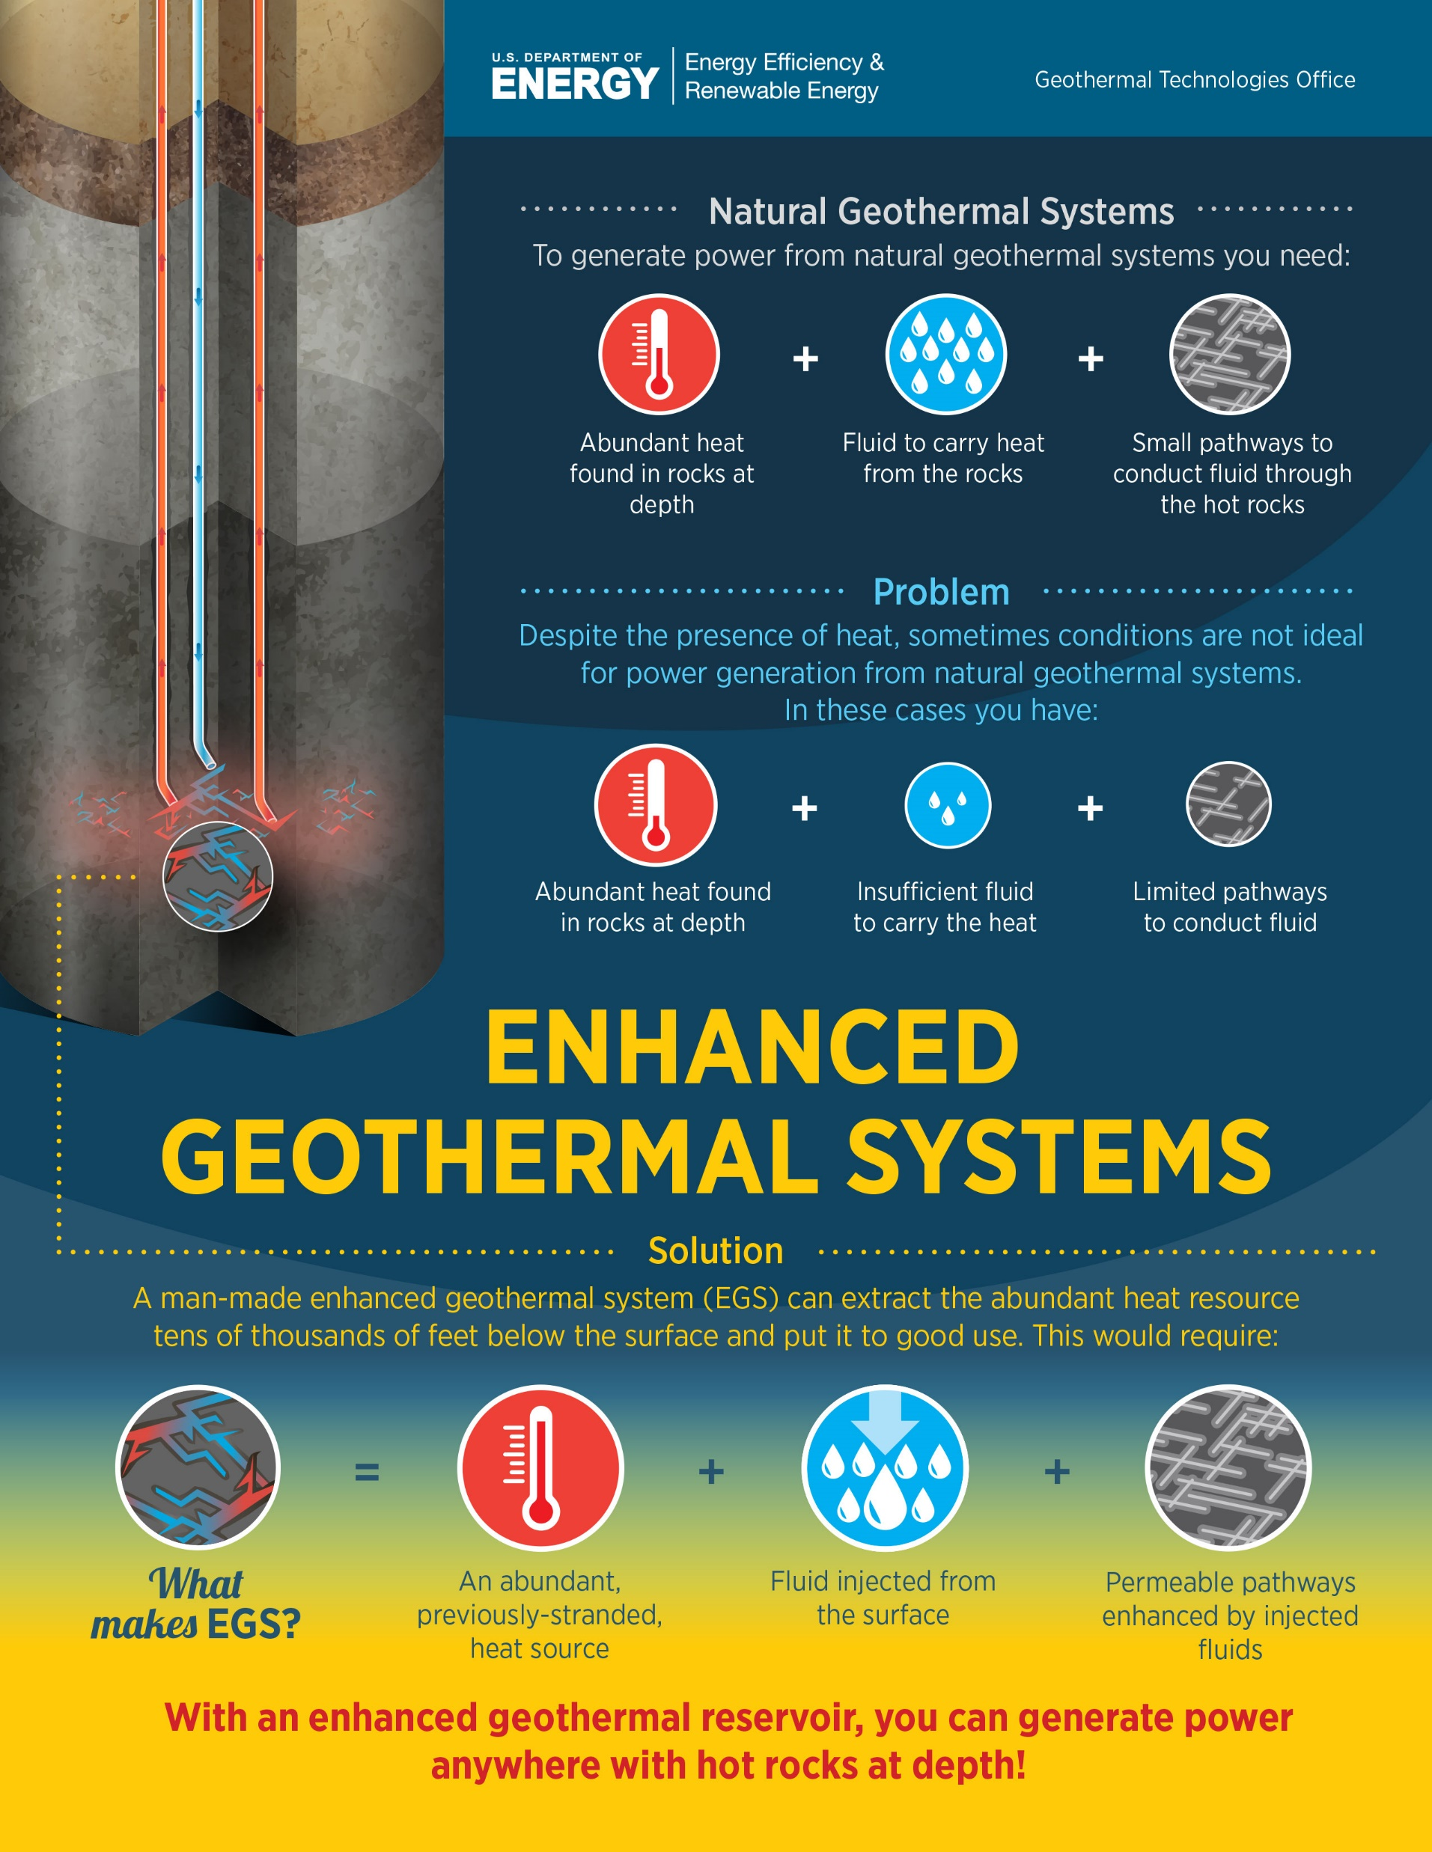
Unconventional
What is Geothermal Energy?
    Requires heat, but may not have: fluid and/or and permeability (fluid can move through ground)
    Fluid (water) is brought into the system and/or
    Permeability is introduced artificially.

Slide 5
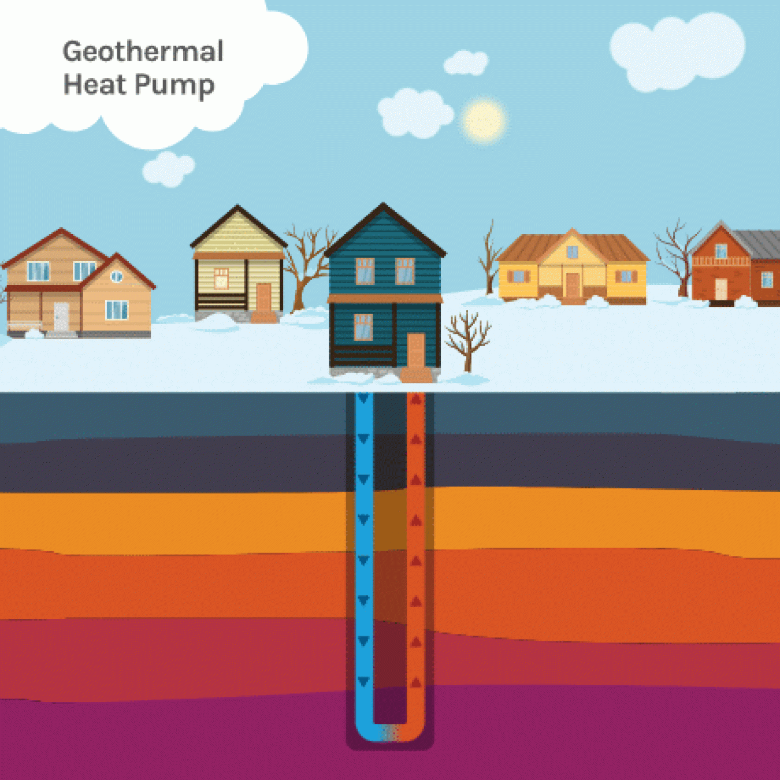
Direct Use
What is Geothermal Energy?
    Where heat, fluid, and permeability all exist, but near surface
    Just like conventional geothermal energy, the hot water is used to heat or provide energy
    One example is the Idaho State Capital: the only state capital that is heated by geothermal energy
Photo courtesy: Department of Energy

Slide 6
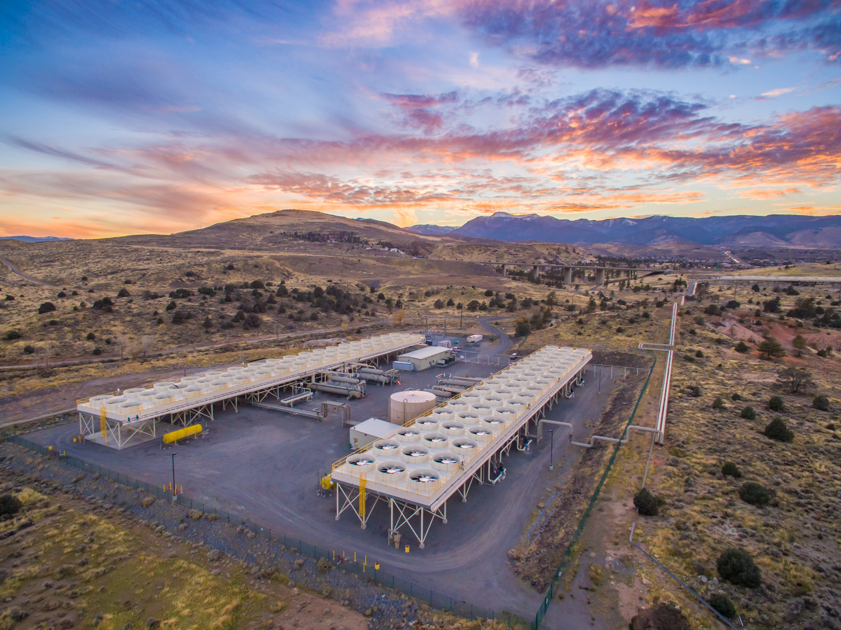
What does Geothermal Look Like?
What does Geothermal Look Like?
Puna Geothermal Plant, Puna, HI
Puna Geothermal Plant, Puna, HI
San Emidio Power Plant, Washoe Co., NV
McGinness Hills Geothermal Complex, Lander Co., NV
Salton Sea Geothermal Well, CA
Salton Sea Geothermal Well, CA
Photo courtesy: ORMAT. Steamboat Power Plant
Notes:
Presenter: Holly
So what does Geothermal look like?

Slide 7
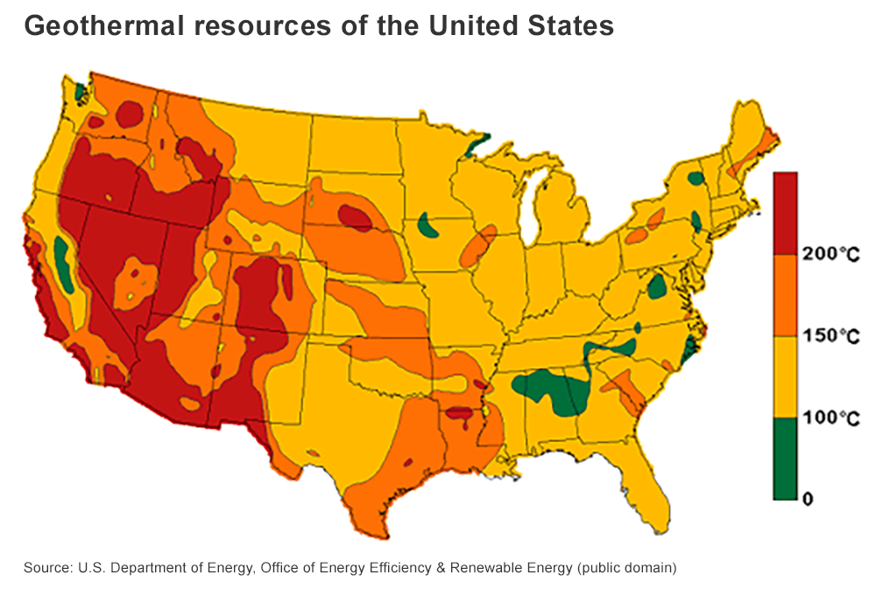
Where is Geothermal Possible?
Where is Geothermal Possible?
300 F

Slide 8

How Does a Land Use Plan Affect Geothermal Leasing?
How Does a Land Use Plan Affect Geothermal Leasing?
Resource Management Plans (RMPs) or Management Framework Plans (MFPs) guide all land use decisions, including geothermal leasing.
RMPs identify lands as
  Open
  Open with lease stipulations, or
  Closed to leasing.
Stipulation examples: No Surface
Occupancy (NSO), No surface
disturbing activities within x miles
of raptor nests.
Photo courtesy: Jim Shane, BLM
Notes:
Presenter: Kasey
One question we often get asked is: how does the BLM decide how to manage the land?
The BLM is required to put together a Resource Management Plan or Management Framework Plan (with input from the public) to decide how public land is managed.
That Plan is used for all land use decisions including geothermal leasing.
The Resource Management Plan identify lands as: open to leasing, open to leasing with stipulations, or even closed completely to leasing if leasing would not be compatible with other land uses or resource values or due to legal restrictions.
Some examples of lease stipulations may include No Surface Occupancy (NSO) which means the operator cannot cause any surface disturbance. Another example is that the operator cannot disturb the land during certain months that are important for wildlife migration. These are just a few ways the operator must follow the rules of the Resource Management Plan.

Slide 9
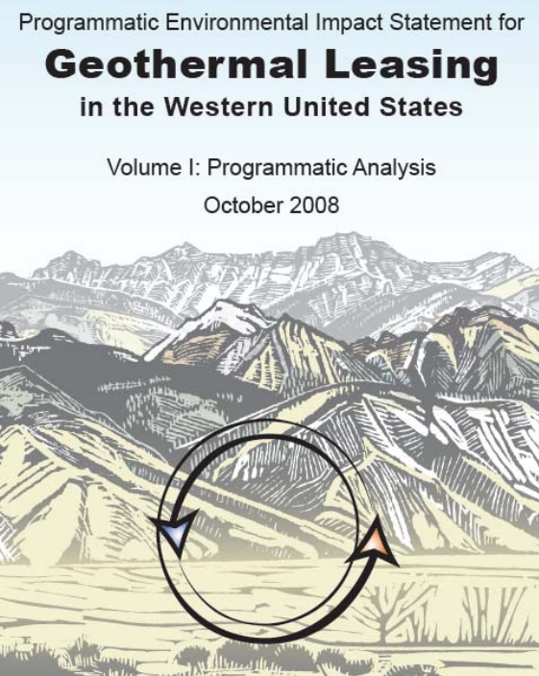
How Does a Land Use Plan Affect Geothermal Leasing?
How Does a Land Use Plan Affect Geothermal Leasing?
2008 Geothermal Programmatic Environmental Impact Statement (PEIS) and Plan Amendment
This document is foundational for determining land management decisions for geothermal leasing
These guiding documents determine where and how we authorize land use (open or closed to geothermal for example, or open with stipulations)

Slide 10
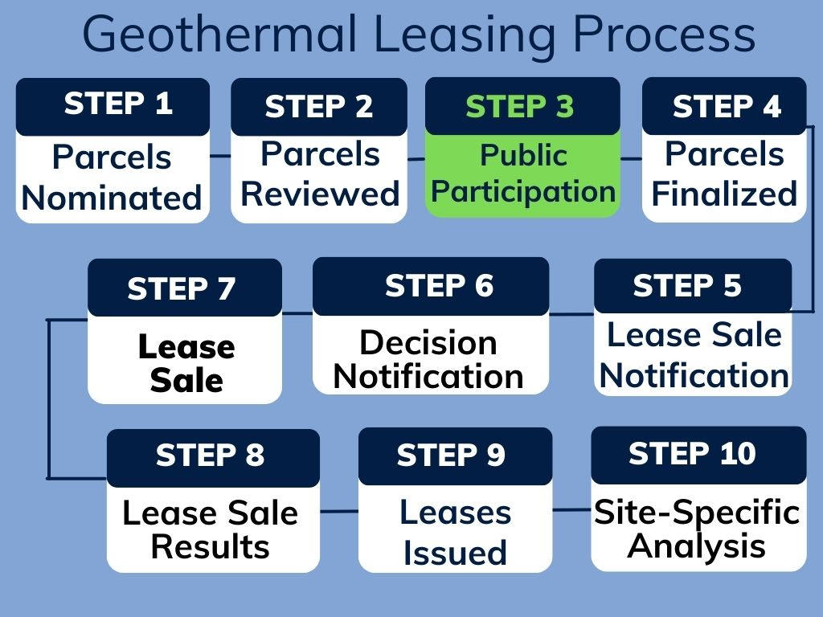
Geothermal Leasing Process
Geothermal Leasing Process

Slide 11
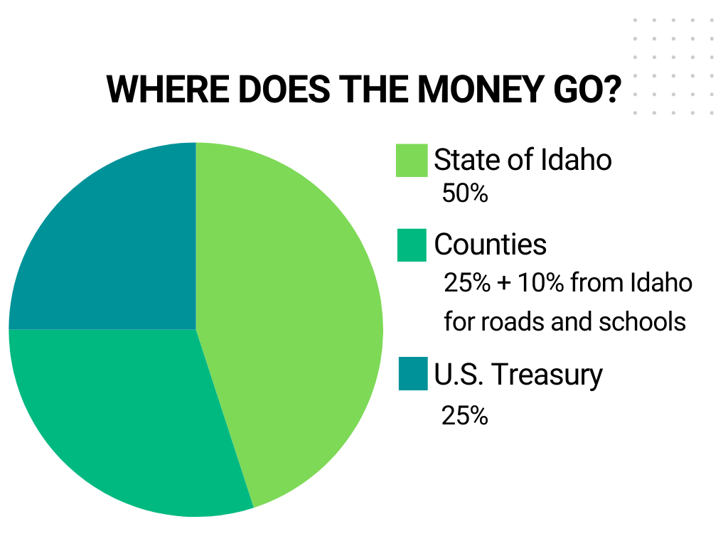
Where Does the Money Go?
Where Does the Money Go?
State of Idaho
50% (10% of which goes to counties to fund roads and schools)
Counties
25%
U.S. Treasury
25%

Slide 12

Geothermal Leasing Taxpayer Benefits
Geothermal Leasing Taxpayer Benefits
    Geothermal is a sustainable energy source
    In 2023, generated 10.2 million megawatt hours (MW/h)
      1 MW/h powers 500-1,000 homes for 1 hour
      DOI-managed lands power 930,000 homes per year
    FY 2024: > $20.6 million in revenue
    FY 2021: 7,400 jobs; $1.5 billion in economic boost

Slide 13
What Happens After Lease is Issued?
Lessee Rights & Responsibilities:
  Primary Lease term: 10 years (extensions possible with diligent exploration)
  Production Lease Extension up to 35 years if producing geothermal energy (extensions possible)
  Pay fees, comply with terms of lease or other applicable law
  Responsible for reclamation
Next Steps for Development:
  Site-specific permitting & NEPA review before drilling
  BLM oversees compliance throughout the lease term

Slide 14
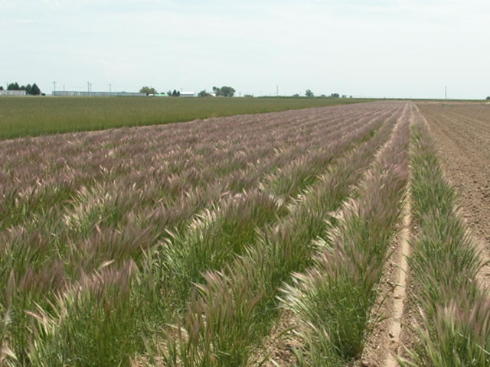
Bonding and Reclamation Requirments
Bonding & Reclamation Requirements
Every operator must hold:
  A reclamation bond
    The operator must either reclaim the land back to its original use, or
    Forfeit the bond
  A performance bond
    The operator must either meet the requirements of their lease, or
    Forfeit their bond
Photo courtesy: USDA Forest Service
Notes:
Emphasis: Operators are responsible for reclaiming any land back to its original use

Slide 15
Idaho Geothermal Nominations
Geothermal leasing nominations received within boundaries of field offices:
  –Four Rivers — Bruneau
  –Burley — Shoshone
  –Pocatello
2025 Lease sales: Fall and Winter
Follow https://ow.ly/T8fL50VB8kU
for geothermal leasing updates

Slide 16

How Can I Participate?
How Can I Participate?
    Field Office completes NEPA review - includes public participation period
    Public participation period for parcels within the boundaries of Four Rivers and Pocatello field offices starts tomorrow (April 18)
    To provide feedback please visit our
    website for more information:
    https://ow.ly/T8fL50VB8kU.
Public Comment

Slide 17
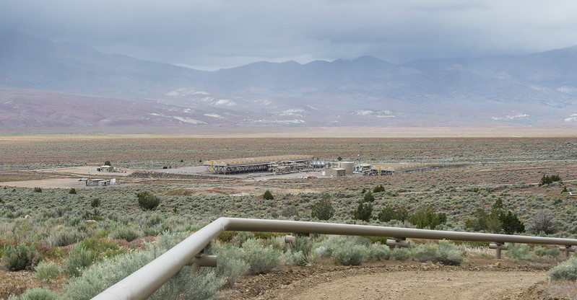
Questions?
U.S. Department of the Interior
Bureau of Land Management
Jersey Valley Power Plant, Nevada.
BLM photo.
Visit Idaho Geothermal Energy website for information: https://ow.ly/T8fL50VB8kU

