Slide 1
Healthy Communities Along the Rio Grande Corridor
By: Anna Lee Vargas

Slide 2
SLV Land Acknowledgement
Today, we gratefully acknowledge the indigenous peoples on whose ancestral homelands we gather. We acknowledge that our sustenance and prosperity is derived from the lands of our indigenous peoples and ancestors, who have been caretakers of this San Luis Valley for thousands of years. We honor and acknowledge these lands as the ancestral lands and territory of the Native American Paleo-Indian cultures, beginning with the Clovis and Folsom Complexes (13,000 years ago). We honor and acknowledge these lands as the ancestral lands and territory of the: Ute, Dine (Navajo), Comanche, Cheyenne, Jicarilla Apache, Kiowa, Arapaho, Hopi, and the Southern Pueblos of (Santa Clara, Picuris, Tesuque, Taos, Tiwa, and Tewa). We honor and acknowledge Kiowa Hill as a sacred hill and last battleground between the Kiowa and the Ute. We honor and acknowledge Mt. Blanca or Sisnaajini, as one of the four sacred mountains of the Dine (Navajo) and considered to be the Eastern boundary of the Dinetah, the traditional Navajo homeland. We acknowledge and honor the San Luis Valley as the sacred land of the Dine and Hopi.
We acknowledge and honor the lives and histories of these indigenous peoples, along with those of the citizens of more than 200 Tribal Nations now living in CO.
We honor and recognize the importance of tribal sovereignty and continue to stand in solidarity with our indigenous brothers and sisters, respect and honor their sacred grounds, and acknowledge their ancestral homelands. We will continue to honor our indigenous peoples, their elders both past and present, as well as future generations.

Slide 3
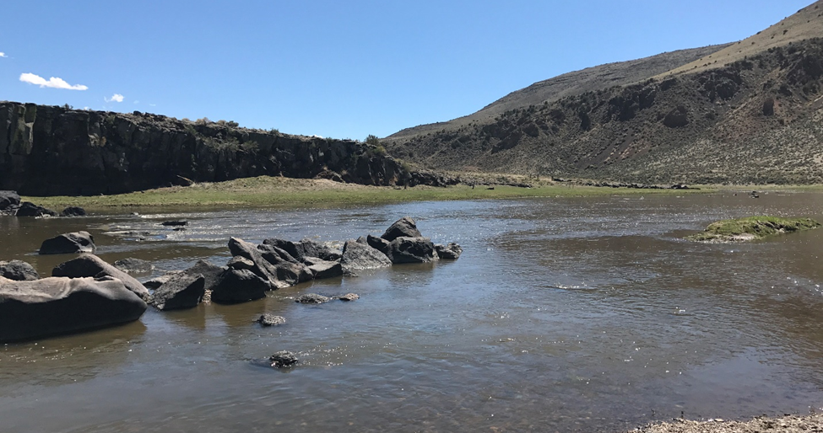

Slide 4
Ri0 Grande del Norte National Monument Expansion
Conejos Clean Water 2015-2016
  Gauging the feelings of the community about expansion
  Completely grass roots
Went door to door
Over 300 letters of support
Presented to Municipalities
  Resolutions in support of expansion:
    La Jara, Romeo, Antonito
Resolution in Support from Costilla County
Over 300 letter of Opposition
Community Wasn’t Ready
  Concerned about Presidential Proclamation/Executive Order

Slide 5
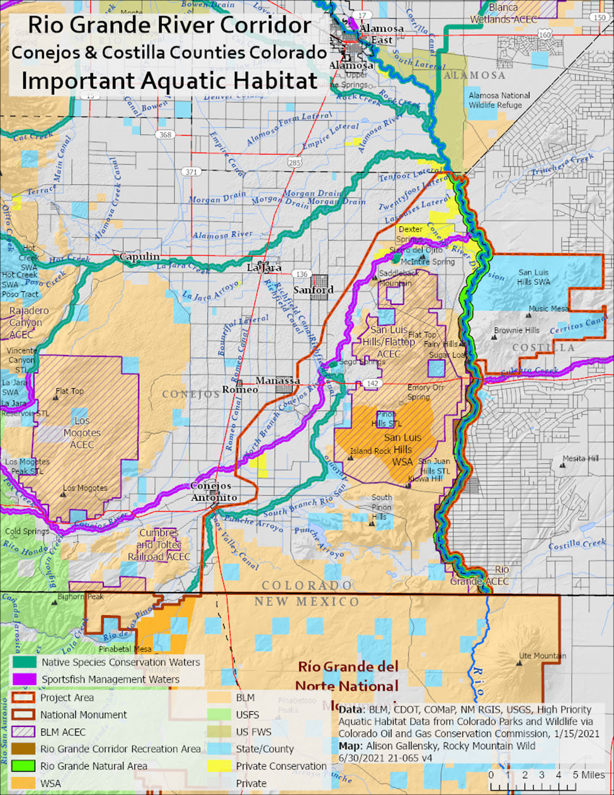
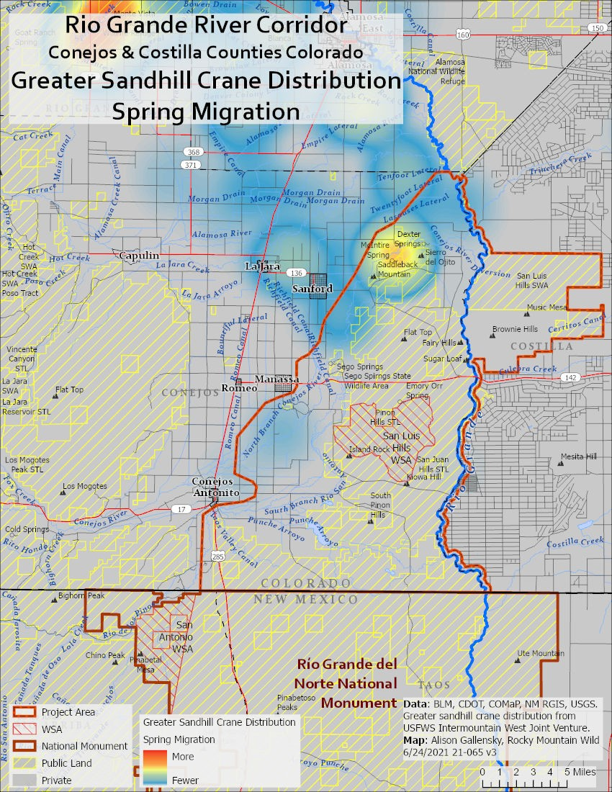
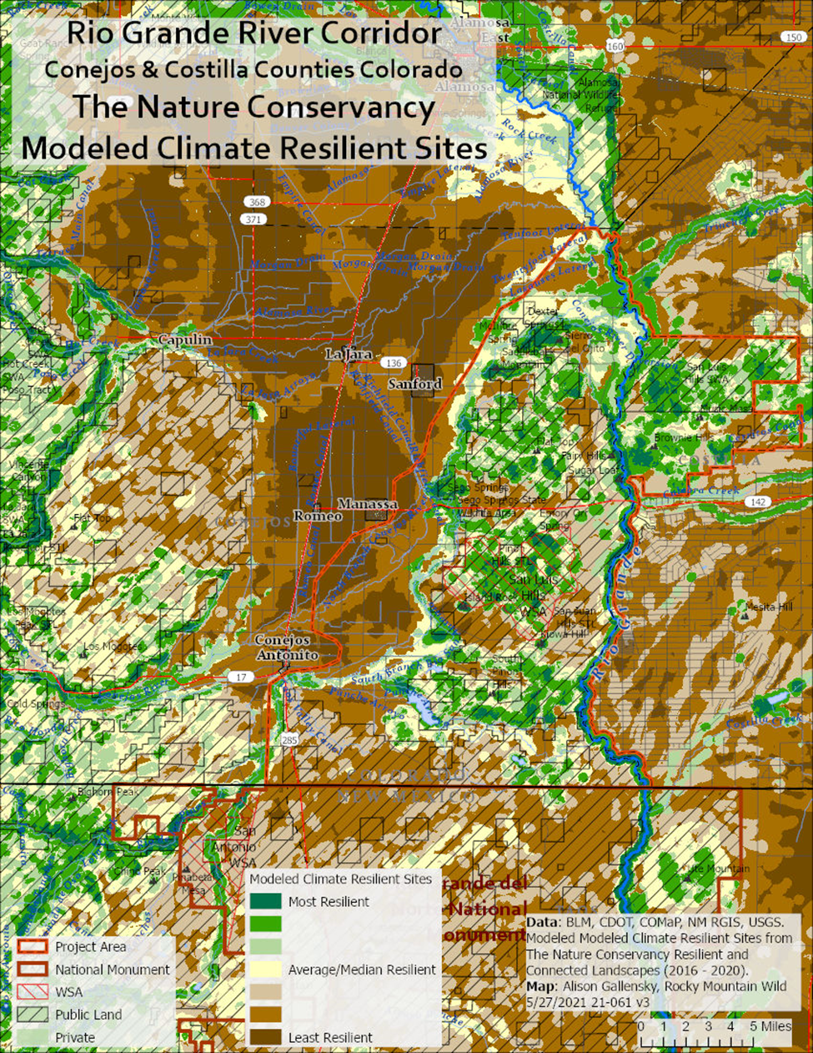
Baseline Information SLVEC Mapped Areas
Wildlife 13 Maps, Cultural Resources, Riparian Areas and Wetlands, Climate resiliency, SEZ’s and Grazing Allotments

Slide 6
BLM Grazing
Feral Horses
Management of cattle trespassing from other areas
Illegal Grazing
Recreation
Water Infrastructure
Riparian Areas

Slide 7
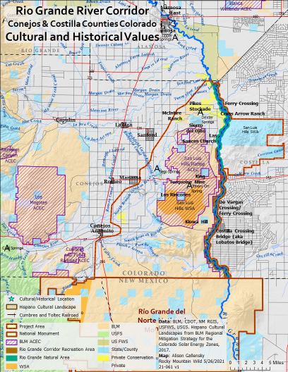
Cultural and Historical Values
13,000 Years of Human Habitation
  Proto-historic, Pre-historic, and Paleo-Indian Time Periods
The Lobatos Bridge
  One of the most significant historic bridges in CO
  One of the rarest truss designs in the country, a Thacher Truss
Kiowa Hill
  The last battle between the Kiowa and the Ute
DeVargas Crossing/Ferry Crossing
  Conquistador Don Diego de Vargas crossed in 1694
Flat Top
  Vantage point for Paleo-Indian hunters
The King Turquoise Mine/The Cordova Mine
  Artisanal mine
  Mined by Indigenous People for Centuries
Pikes Stockade
  National Historic Landmark
  Log fortress built by US Soldiers on the Zebulon Pike Expedition in 1807

Slide 8
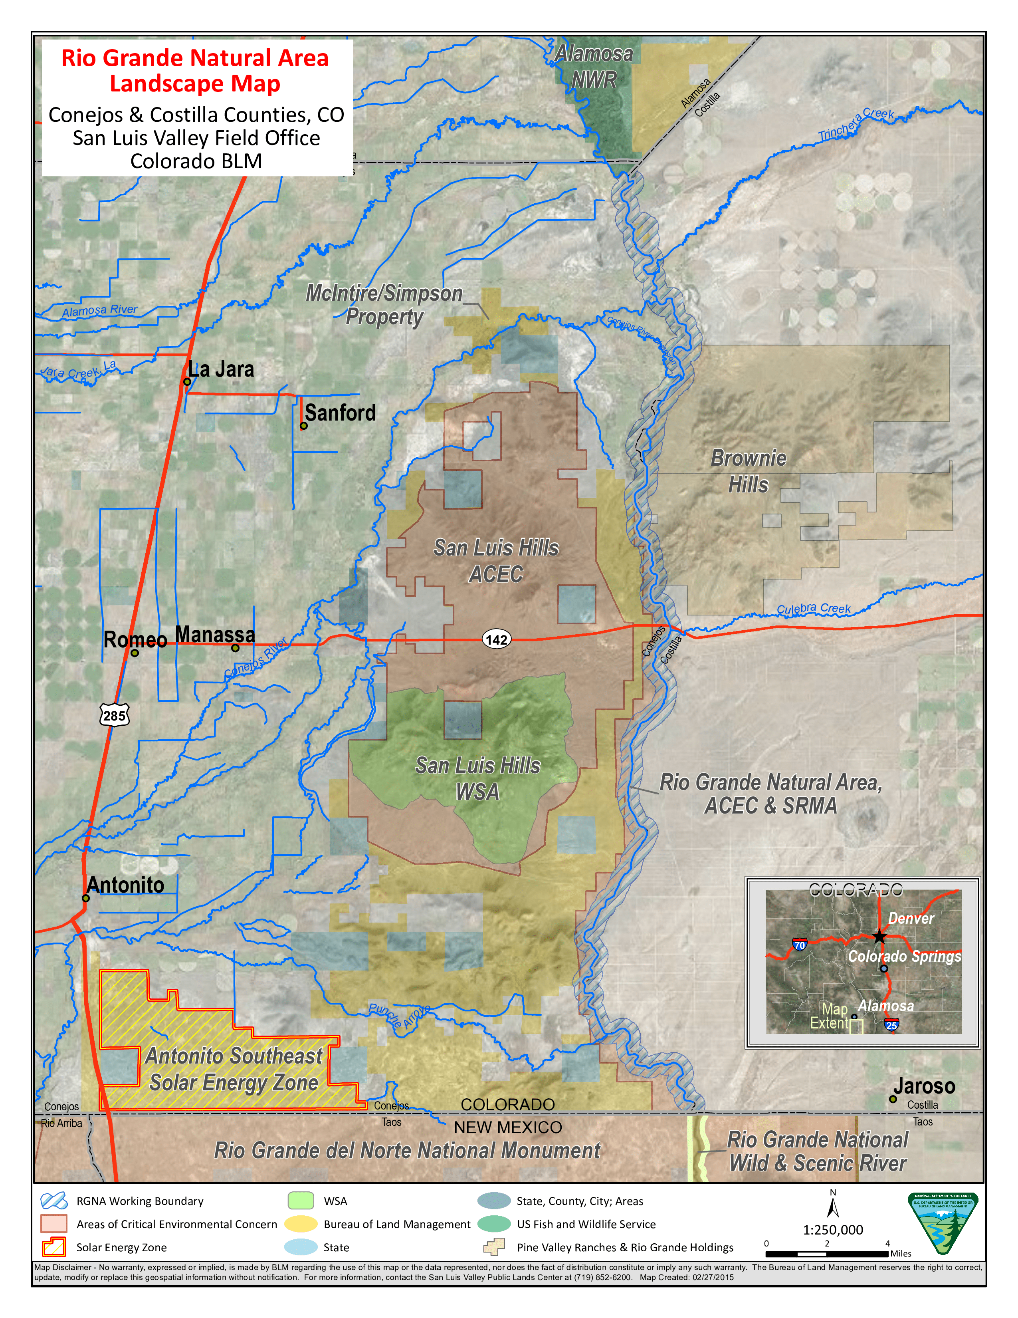
Rio Grande Natural Area
¼ mile on each side of the Rio Grande
33 mile stretch along the Rio Grande
  Staring at the NM State Line to the Alamosa Wildlife Refuge
Established in 2006 through an act of Congress to conserve, restore, and protect the natural, historical, cultural, scientific, scenic, wildlife, and recreational resources of the lower Rio Grande
Includes the riparian area of the Rio Grande
Provides critical habitat for endangered species
Primary corridor for wildlife
Would not be included in any designation

Slide 9
Permanent Protection Discussions
Discussions in 2019 with the Salazar Rio Grande del Norte Center (ASU)
Discussions in 2021 with Senator Bennet’s Office
  Erin Minks
Meeting regularly about interest in permanent protection until COVID
Why permanent protection?
  It’s About Stewardship
  To preserve the nationally significant biological, cultural, historic, scenic, riparian, geological, educational, and scientific values.
  To preserve and protect traditional uses in the area including hunting, fishing, livestock grazing, piñon picking, herb extraction, and wood extraction.
  Water is our most precious natural resource and essential for the continuation of our way of life. Protection of riparian areas are extremely important for healthy watersheds, which when functioning well, provide food and fiber, clean water, and habitat for plants and animals.
  Continues to offer public access to safe, affordable, and healthy ways to experience and appreciate nature.
  Protects public lands for present and future generations
  Safeguards Biodiversity
  Provides carbon-reducing sustainable landscapes that cleanse air and water, replenish aquifers, and protects wildlife habitat
  Builds resilience against climate change
  Boosts tourism
  Provides Local Economic Success

Slide 10
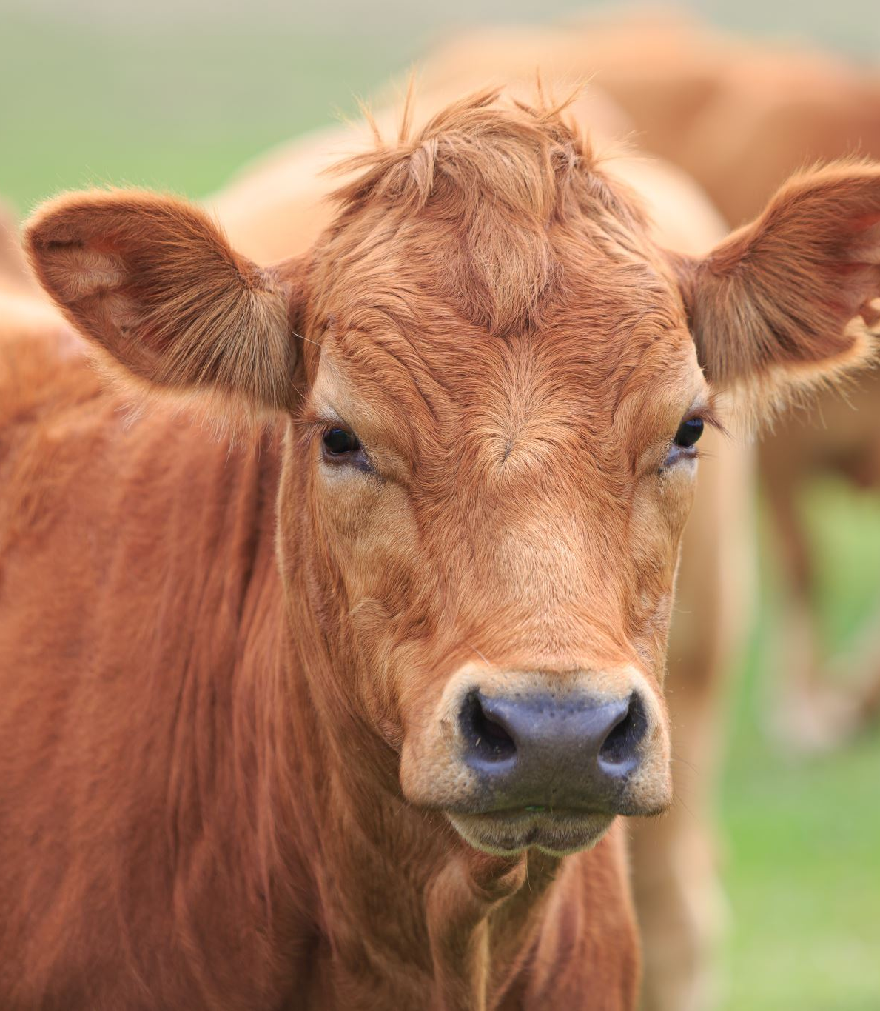
Permanent Protection Discussions
Concerns
  Government overreach
  Added restrictions
  Things will change
  Confusion between a National Monument and National Conservation Area
  Bundy mentality
  Land grab
  Selling off lands to China
  Take away grazing permits
  We hate cattle

Slide 11
What is the difference between a National Monument and National Conservation Area Designation?
National Monument
National Conservation Area
National Monuments are designated by the President through the Antiquities Act, signed into law by Theodore Roosevelt in 1906.
The Act was passed by Congress but gives the president authority to establish National Monuments by presidential proclamation.
National Conservation Areas, which are fairly new, can currently only be designated by Congress as part of the BLM’s National Landscape Conservation System (NLCS), created in 2000.
National Conservation Areas were created to provide the BLM their own designation and are presently can only be managed by the BLM.

Slide 12
What is the difference between a National Monument and National Conservation Area Designation?
National Monument
National Conservation Area
National Monuments generally have a smaller range of resource values than National Conservation Areas in that they are set aside specifically for “historic or scientific interests,” according to the Antiquities Act.
National Conservation Areas are managed for multiple-use and fit into a broader spectrum of values: scientific, cultural, ecological, historical, or recreational.

Slide 13
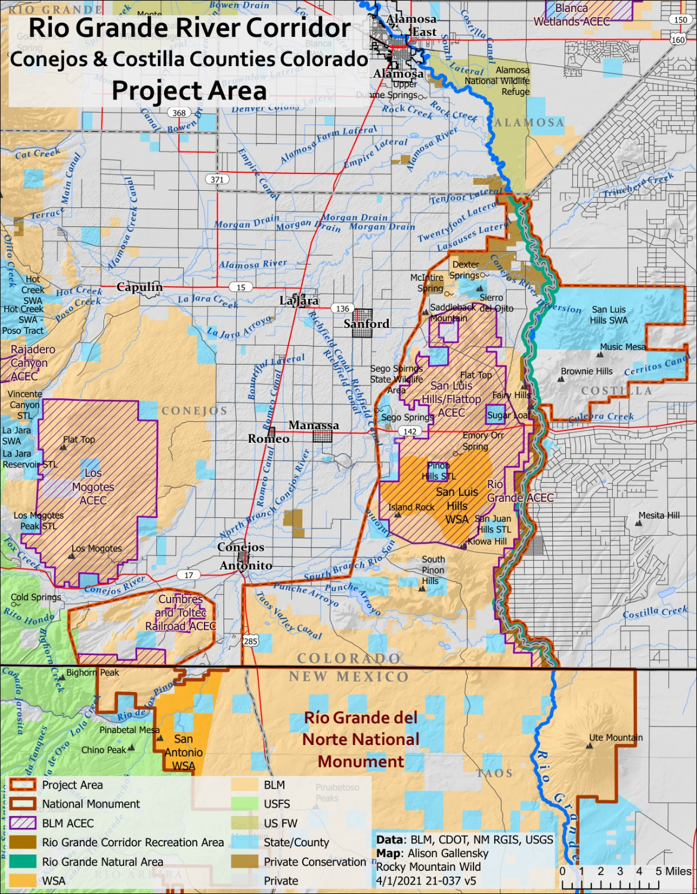
Why Conejos County?
Conejos County represents a multicultural tapestry within the United States. Residents within the region are also proud to host the most extensive wetlands system in the Southern Rocky Mountains. The area within the San Luis Valley has been the home of Hispanics, Mormons, Indigenous People, and other rancher-settlers and is testimony to a long history of sustainable agriculture and nomadic communities dating back 13,000 years.
Protecting the cultural and geographical landscape ensures our heritage will remain preserved for future generations and for all Americans to experience.
As people with a rich history in self-sufficiency, we are presented with an opportunity to honor our heritage, continue stewarding these lands, and ensure our quality of life improves for future generations.
Most striking about the landscape of Conejos County in south-central Colorado is its visible overlap of cultures. Basalt foundations of prehistoric houses, fords where Spanish troops crossed the Rio Grande, and pastures grazed by modern herds of livestock sit side-by-side. The landscape tells the stories of people and cultures with complex inter‑relationships that reach from the past to the present.
Long-term preservation of the County’s cultural resources would help to tell our stories and make future generations proud of their regional heritage, in addition to providing tangible economic benefits. In addition to immediate tourism dollars, this can help strengthen communities and economies over the long term.

Slide 14
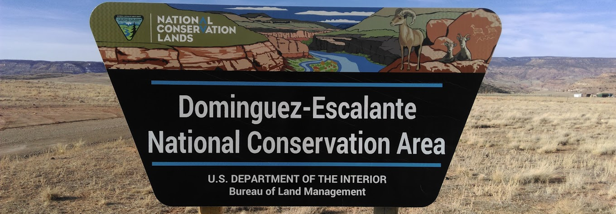
About 150,000 visitors annually, general approximation of $7.2 million in added value revenue.

Slide 15
McGinnis National Conservation Area
Economic Impact to Mesa County
The total impact of outdoor recreation in Mesa County is 7.2% of GDP and 11 % of jobs. Given the abundance of natural amenities such as public land and open space, it is not surprising that the 4.8% direct outdoor recreation economic impact as measured reported by the BEA, (Bureau of Economic analysis).
Accounting for more than 1 out of every 10 jobs in Mesa County (direct, indirect and induced effects), outdoor recreation is a significant part of the economic profile of Mesa County contributing not only revenue and jobs, but quality of life for those workers who also recreate outdoors
  Prepared by Colorado Mesa University

Slide 16
Where Are We Now?
Gauging the feelings of the community regarding a National Conservation Area (NCA)
Had four public meetings since June 2023
Panels of community members and experts of:
  Ranchers/Permittees
  Recreation Experts
  Our BLM
  SdCNHA
  Division of Water Resources
  Conejos County Water Conservancy District
  Attorney Davis Robbins
Formed a working group (names on White Paper)
Working group drafted the White Paper
Nothing has been proposed, only considered

Slide 17
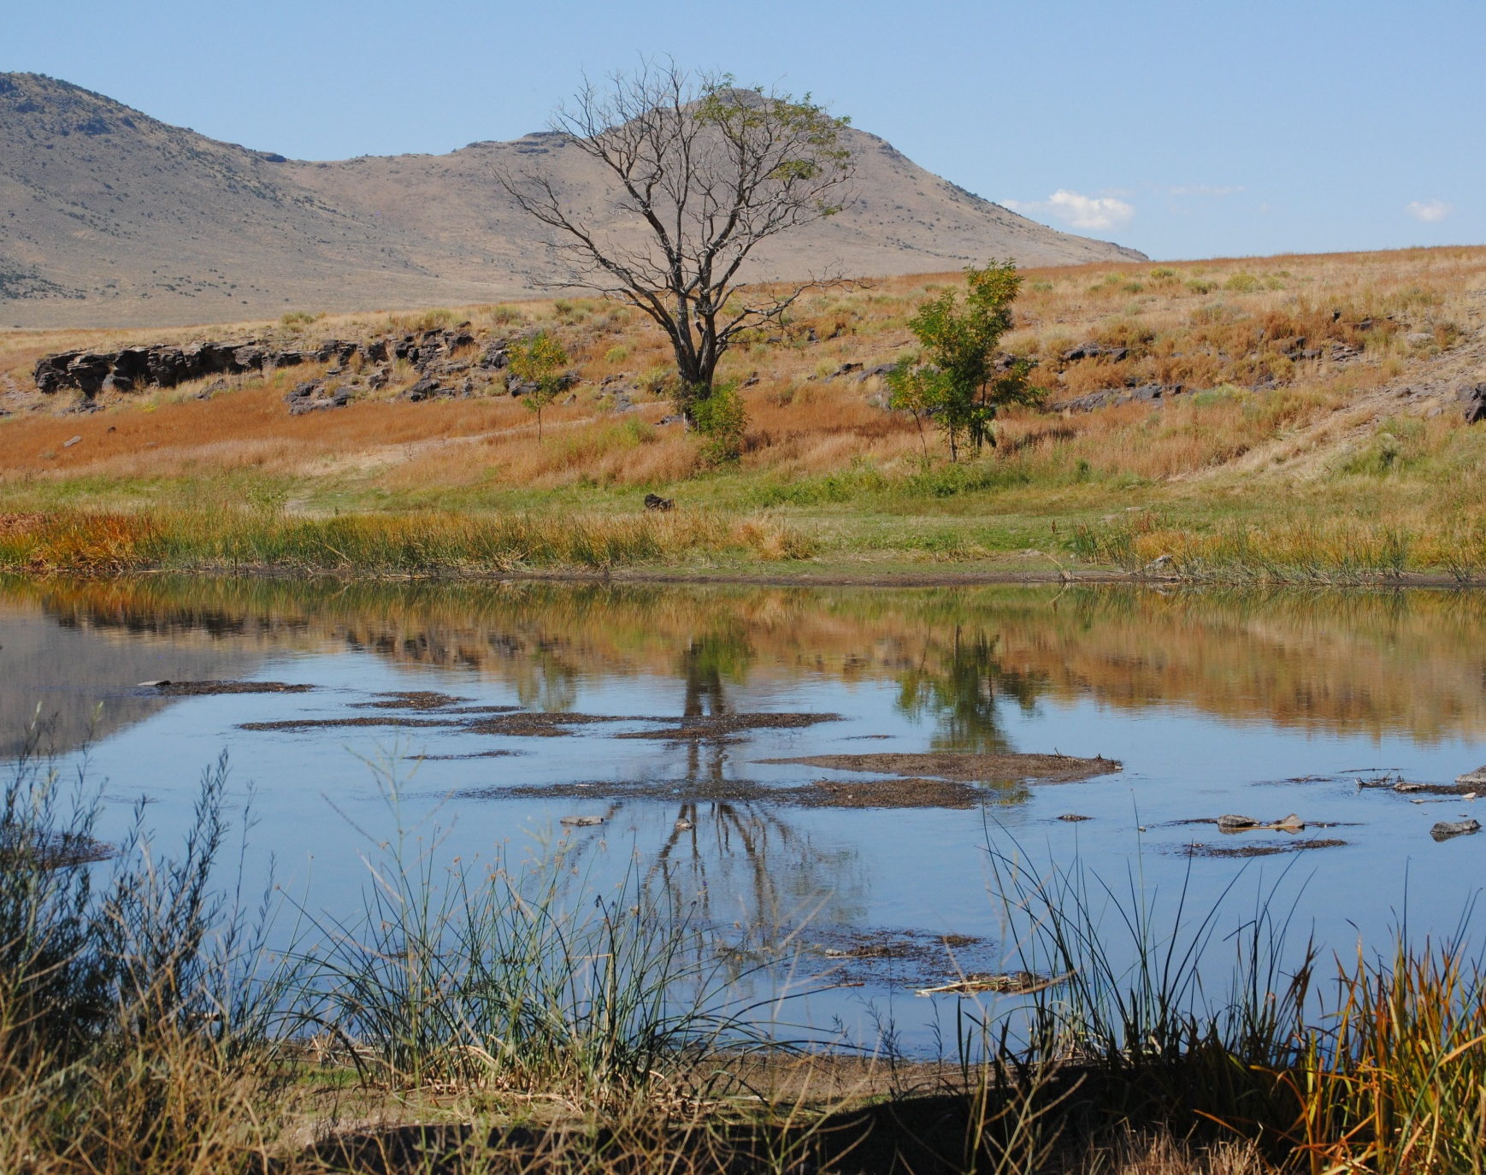
Question and
Answer

