Slide 1
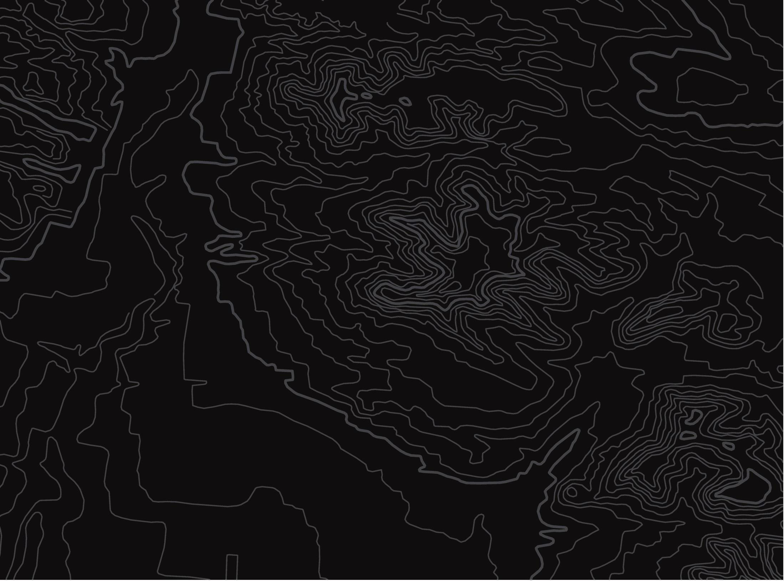


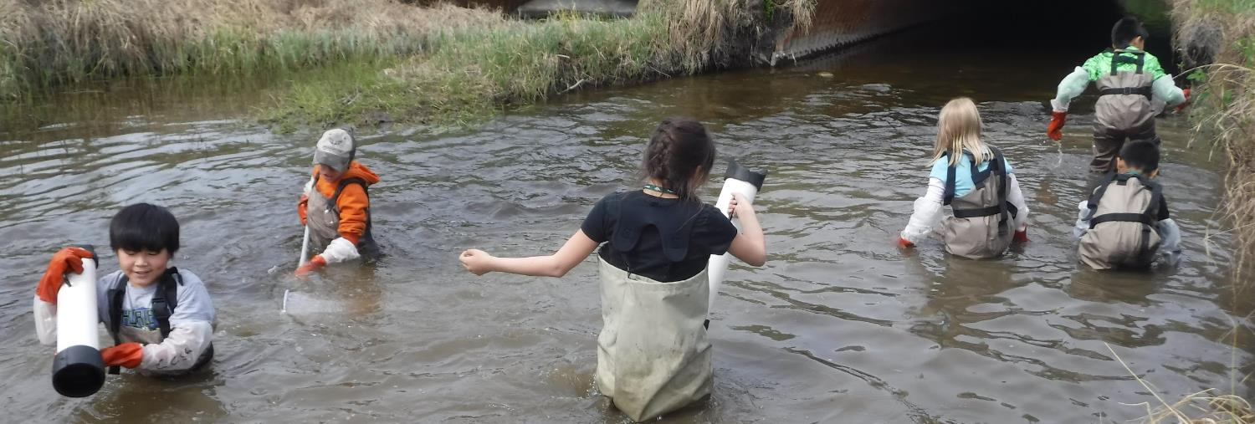
Watershed Steward
U.S. Department of the Interior
Bureau of Land Management
Discover how choices in your daily life can benefit the health of your watershed.
Module 5 Reflection
CCSC Staff, BLM

Slide 2
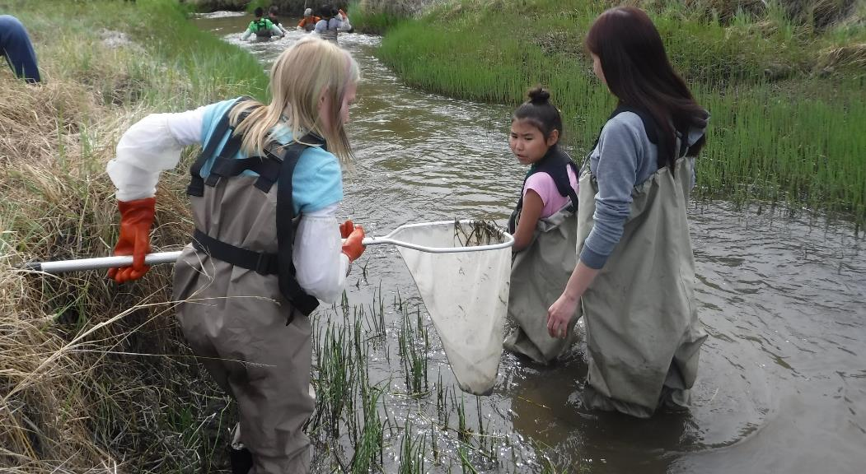
Since everyone lives in a watershed, the decisions you make influence the health of the ecosystem. Your actions impact your local watershed.
U.S. Department of the Interior
Bureau of Land Management
CCSC Staff, BLM

Slide 3
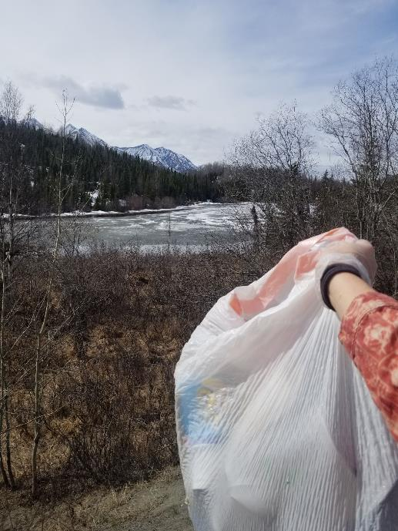
A steward is a person who takes care of the land and the natural environment.
Watershed stewards make choices every day to protect the health of their watersheds.
U.S. Department of the Interior
Bureau of Land Management
CCSC Staff, BLM

Slide 4
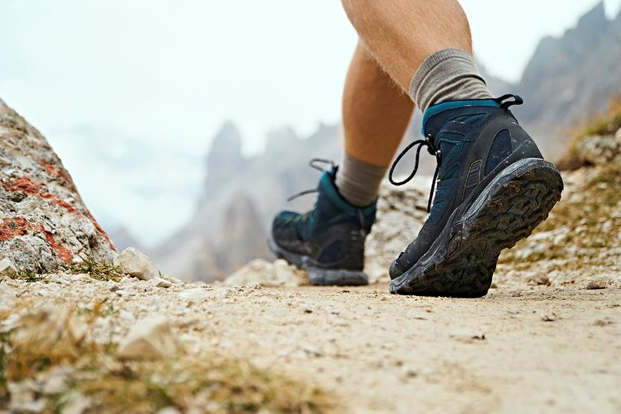
In this activity, you will step into the shoes of a watershed steward. Navigate through various situations and practice making decisions based on what you think will be best for your community and the health of the watershed.
U.S. Department of the Interior
Bureau of Land Management
© Microsoft 365
Notes:
Image MS 365

Slide 5
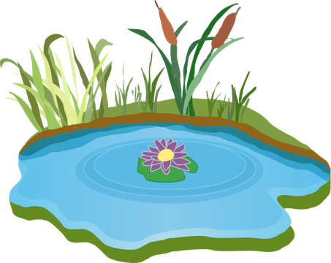

Each slide will have one or two choices. To make your decision, click on the image above your choice and discover what effect that decision might have on the watershed.
U.S. Department of the Interior
Bureau of Land Management
© Microsoft 365
© Pixabay
Not every choice will have a “right” or “wrong” answer. Sometimes there are no perfect answers.
Notes:
Left Image from MS365
Right image from Pixabay

Slide 6
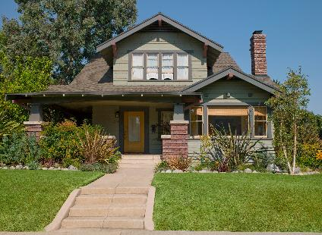
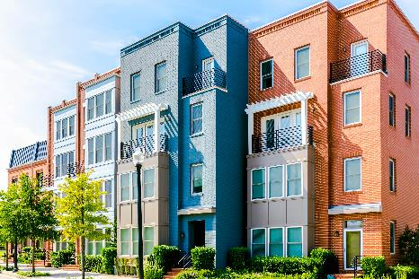
You are moving to a new town and are trying to decide where to live. Living in an apartment will save you money, but you also have the option of building a house by the river. You decide to:
U.S. Department of the Interior
Bureau of Land Management
Start building a house along the river.
Move into an apartment downtown.
© Microsoft 365
© Microsoft 365
Notes:
Images from Microsoft 365

Slide 7
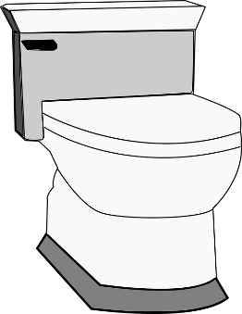
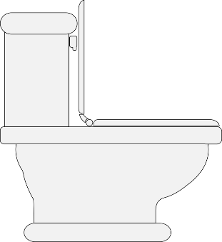
The construction of your house has begun! As the bathrooms are built, you have a toilet decision to make:
U.S. Department of the Interior
Bureau of Land Management
© Pixabay
© Pixabay
Install a more expensive, low-flow toilet that uses less water to flush.
Choose a less expensive toilet that uses more water to flush.
Notes:
Images from Pixabay

Slide 8
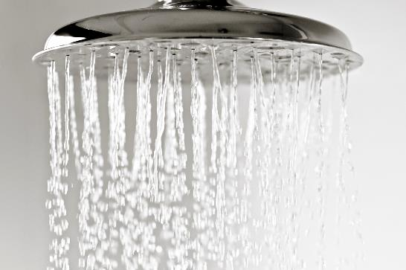
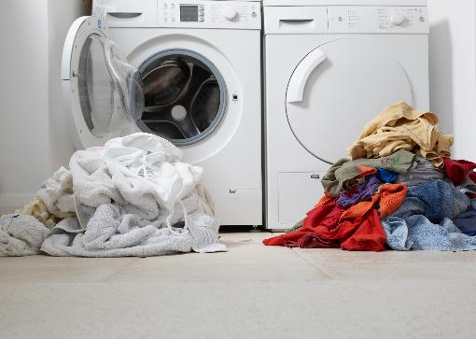
Low-flow toilets save two gallons of water per flush! You want to save even more water another way by:
U.S. Department of the Interior
Bureau of Land Management
Waiting to run your washing machine for full loads of laundry.
Taking shorter showers.
© Microsoft 365
© Microsoft 365
Notes:
Images from MS 365

Slide 9
Regular toilets are cheaper to buy but use about two more gallons of water per flush than low-flow toilets. You figure you will try to save water another way by:
U.S. Department of the Interior
Bureau of Land Management
Waiting to run your washing machine for full loads of laundry.
Taking shorter showers.
© Microsoft 365
© Microsoft 365
Notes:
Images from MS 365

Slide 10
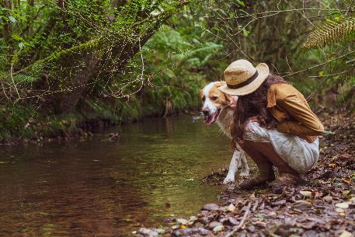
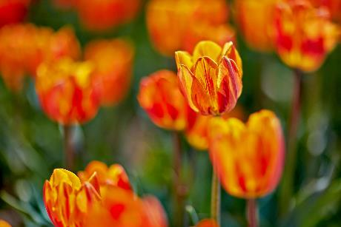
You’re doing your part to use less water! As your home comes together, you meet with a landscaper to design your yard. You both agree to:
U.S. Department of the Interior
Bureau of Land Management
Keep the river bank planted with native plants and leave a greenbelt buffer of 8-10 feet between the yard and the stream.
Plant a variety of ornamental plants to give your yard a more exotic look.
© Microsoft 365
© Microsoft 365
Notes:
Images from MS 365

Slide 11
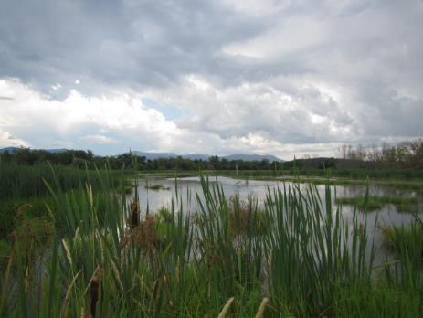
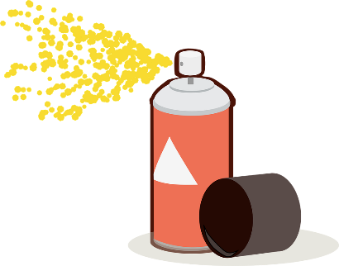
Your yard is vibrant, but the exotic plants require the use of fertilizers and pesticides to keep them alive. Weighing your options, you decide to:
U.S. Department of the Interior
Bureau of Land Management
USFWS
© Pixabay
Remove the exotic plants and plant native plants along the river bank with a greenbelt buffer.
Continue using pesticides to keep insects from eating the exotic plants.
Notes:
Bug Spray from Pixabay

Slide 12


Leaving a greenbelt buffer zone helps prevent the riverbank from eroding. Native plants also support native wildlife. However, the native plants provide habitat for mosquitoes in the summer. You decide to use:
U.S. Department of the Interior
Bureau of Land Management
© Microsoft 365
© Pixabay
A highly effective new pesticide that kills almost all the mosquitoes in your yard.
A natural insect repellent when you play in the yard.
Notes:
Mosquito from MS 365; Bug Spray from Pixabay

Slide 13

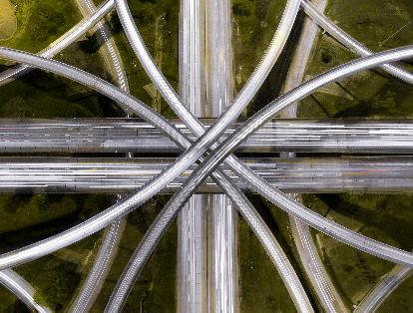
You love your new apartment but the traffic in town is awful. Town managers are considering building a larger highway and are asking residents for their feedback. Considering the best decision for the watershed, you:
U.S. Department of the Interior
Bureau of Land Management
© Microsoft 365
© Microsoft 365
Begin to carpool and bike more often and encourage others to do the same.
Support the construction of the highway.
Notes:
Images from MS365

Slide 14


Highways allow more people to drive at the same time, which means fewer traffic jams. But, you notice there is more polluted urban runoff flowing from the paved roads into the river.
U.S. Department of the Interior
Bureau of Land Management
You decide to carpool and bike more often.
Notes:
MS 365 Image

Slide 15
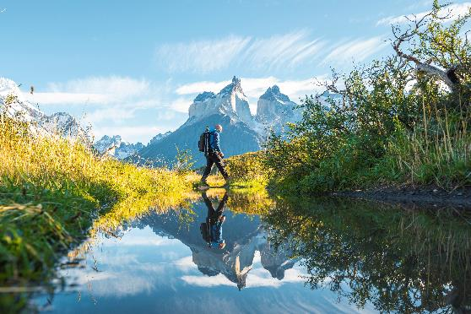
Carpooling and biking means fewer people drive individually, and that leads to less traffic and less pollution. You notice other people are carpooling and biking too! Plus, biking makes you feel fit and energized.
U.S. Department of the Interior
Bureau of Land Management
© Microsoft 365
You go explore the local trails.
Notes:
MS 365 Image

Slide 16
The trails along the river are gorgeous. While hiking, you get bitten by lots of mosquitos. Before your next hike, you stop by the store and choose to buy:
U.S. Department of the Interior
Bureau of Land Management
© Pixabay
© Microsoft 365
A natural insect repellent.
A highly effective new pesticide.
Notes:
Mosquito from MS365; Bug spray from Pixabay

Slide 17
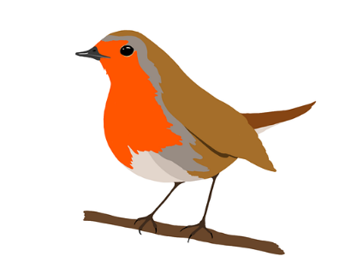
Due to the pesticides, only a few mosquitoes are seen along the stream this year. Unfortunately, there is now less to eat for birds, bats, and fish that feed on mosquitoes. You choose to:
U.S. Department of the Interior
Bureau of Land Management
© Pixabay
Switch to a natural insect repellent so that other animals will have mosquitoes to eat.
Notes:
Image from Pixabay

Slide 18
Due to the pesticides, only a few mosquitoes are seen along the stream this year. Unfortunately, there is now less to eat for birds, bats, and fish that feed on mosquitoes. You choose to:
U.S. Department of the Interior
Bureau of Land Management
© Pixabay
Use fewer pesticides so that other animals will have mosquitoes to eat.
Notes:
Image from Pixabay

Slide 19
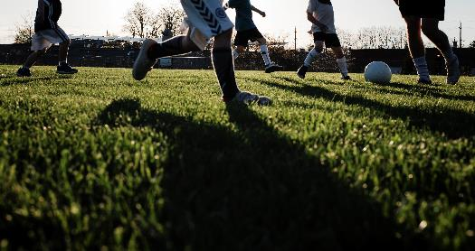
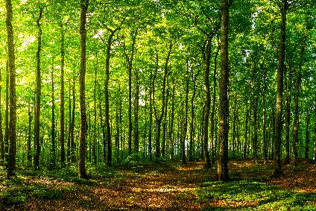
Natural insect repellents keep mosquitoes away without using chemicals that harm other wildlife. To encourage people to spend time outside, town managers are building a park by the river and are asking for public feedback on the park’s design. You vote for the town to:
U.S. Department of the Interior
Bureau of Land Management
© Microsoft 365
© Microsoft 365
Design the park to have a large, grassy field for soccer games, kickball, and other activities.
Design the park to include as much of the natural landscape as possible.
Notes:
Images from MS 365

Slide 20
You learn that grassy areas don’t provide much benefit for erosion control or wildlife habitat along the river, and fields use a lot of water to keep green. You speak out by asking the town to:
U.S. Department of the Interior
Bureau of Land Management
© Microsoft 365
Design the park to include as much of the natural landscape as possible.
Notes:
MS 365

Slide 21
Natural insect repellents keep mosquitoes away without using chemicals that harm other wildlife. To encourage people to spend time outside, town managers are building a park by the river and are asking for public feedback on the park’s design. You vote for the town to:
U.S. Department of the Interior
Bureau of Land Management
© Microsoft 365
© Microsoft 365
Design the park to have a large, grassy field for soccer games, kickball, and other activities.
Design the park to include as much of the natural landscape as possible.
Notes:
Images from MS 365

Slide 22
You learn that grassy areas don’t provide much benefit for erosion control or wildlife habitat along the river, and fields use a lot of water to keep green. You speak out by asking the town to:
U.S. Department of the Interior
Bureau of Land Management
© Microsoft 365
Design the park to include as much of the natural landscape as possible.
Notes:
MS 365

Slide 23
With fewer pesticides in the environment, the riparian ecosystem is booming with wildlife. To encourage people to spend time outside, town managers are building a park by the river and are asking for public feedback on the park’s design. You vote for the town to:
U.S. Department of the Interior
Bureau of Land Management
© Microsoft 365
© Microsoft 365
Design the park to have a large, grassy field for soccer games, kickball, and other activities.
Design the park to include as much of the natural landscape as possible.
Notes:
Images from MS365

Slide 24
You learn that grassy areas don’t provide much benefit for erosion control or wildlife habitat along the river, and fields use a lot of water to keep green. You speak out by asking the town to:
U.S. Department of the Interior
Bureau of Land Management
© Microsoft 365
Design the park to include as much of the natural landscape as possible.
Notes:
MS 365

Slide 25

Building with the natural landscape in mind limited the amount of disturbance to the area. The park is a perfect spot to swim in the river, sit under the trees, and enjoy the wildlife. This calls for a celebration!
U.S. Department of the Interior
Bureau of Land Management
© Microsoft 365
You invite your neighbors to a party at the new park.
Notes:
MS 365

Slide 26
Building with the natural landscape in mind limited the amount of disturbance to the area. The park is a perfect spot to swim in the river, sit under the trees, and enjoy the wildlife. This calls for a celebration!
U.S. Department of the Interior
Bureau of Land Management
© Microsoft 365
You invite your neighbors to a party at the new park.
Notes:
MS 365

Slide 27
Building with the natural landscape in mind limited the amount of disturbance to the area. The park is a perfect spot to swim in the river, sit under the trees, and enjoy the wildlife. This calls for a celebration!
U.S. Department of the Interior
Bureau of Land Management
© Microsoft 365
You invite your neighbors to a party at the new park.
Notes:
Image MS 365

Slide 28
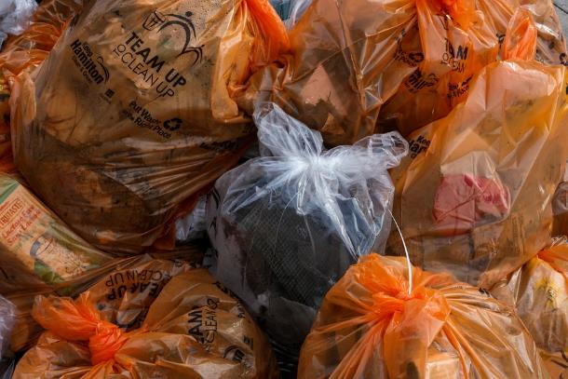
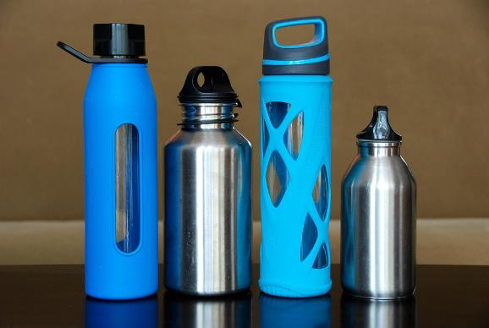
At the neighborhood party, the wind picks up and blows everyone’s paper plates, plastic utensils, balloons, and water bottles into the stream. Oh no!
U.S. Department of the Interior
Bureau of Land Management
© Pixabay
© Pixabay
You decide to start using more reusable items so that you produce less trash.
You help clean up the stream.
Notes:
Images from Pixabay

Slide 29
At the neighborhood party, the wind picks up and blows everyone’s paper plates, plastic utensils, balloons, and water bottles into the stream. Oh no!
U.S. Department of the Interior
Bureau of Land Management
© Pixabay
© Pixabay
You decide to start using more reusable items so that you produce less trash.
You help clean up the stream.
Notes:
Images from Pixabay

Slide 30
Seeing the pollution in the stream made you aware of just how important it is to keep the watershed healthy. You research other ways to help and decide to start saving water by:
U.S. Department of the Interior
Bureau of Land Management
© Microsoft 365
Waiting to run your washing machine for full loads of laundry.
© Microsoft 365
Taking shorter showers.
Notes:
Images from MS365

Slide 31
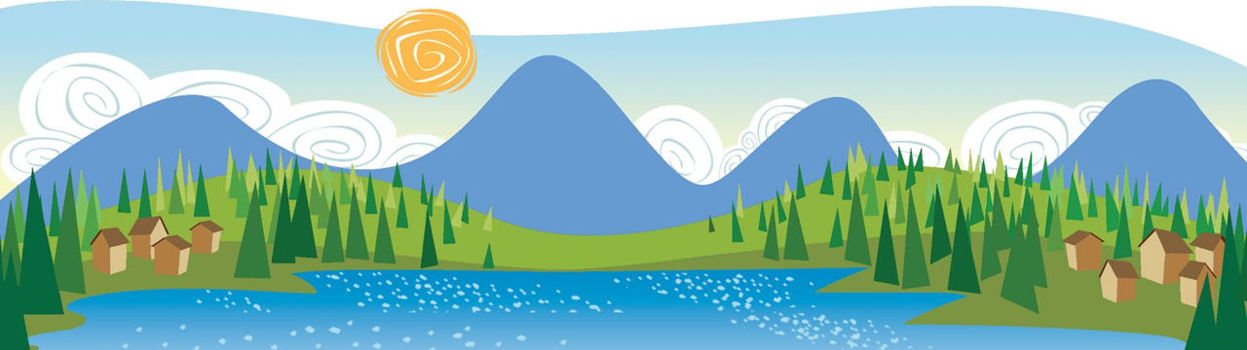
Well done! You have discovered how everyday decisions can protect the health of your watershed. Your decisions may also inspire your neighbors to do their part.
U.S. Department of the Interior
Bureau of Land Management
© Clipart Library
You are committed to being a steward of the land and water by keeping the watershed as healthy as possible for plants, animals, and people.
Notes:
Clipart Library image

Slide 32
Replay the game by clicking the image below to discover how different decisions might impact the watershed.
U.S. Department of the Interior
Bureau of Land Management
© Pixabay
When you are done playing the game, think about the situations you might encounter in your own life. What decisions can you make to positively impact your local watershed?
Notes:
Pixabay Image

Slide 33
To learn which watershed you live in, follow the link below and enter your full address or zip code.
U.S. Department of the Interior
Bureau of Land Management
https://mywaterway.epa.gov/
This website shows you the smallest watershed you live in. For example, it may show you live in the Little Campbell Creek watershed, but you also live in the larger Campbell Creek watershed.
For some watersheds, this website will share monitoring data about the rivers, streams, and lakes in the watershed.

