Slide 1
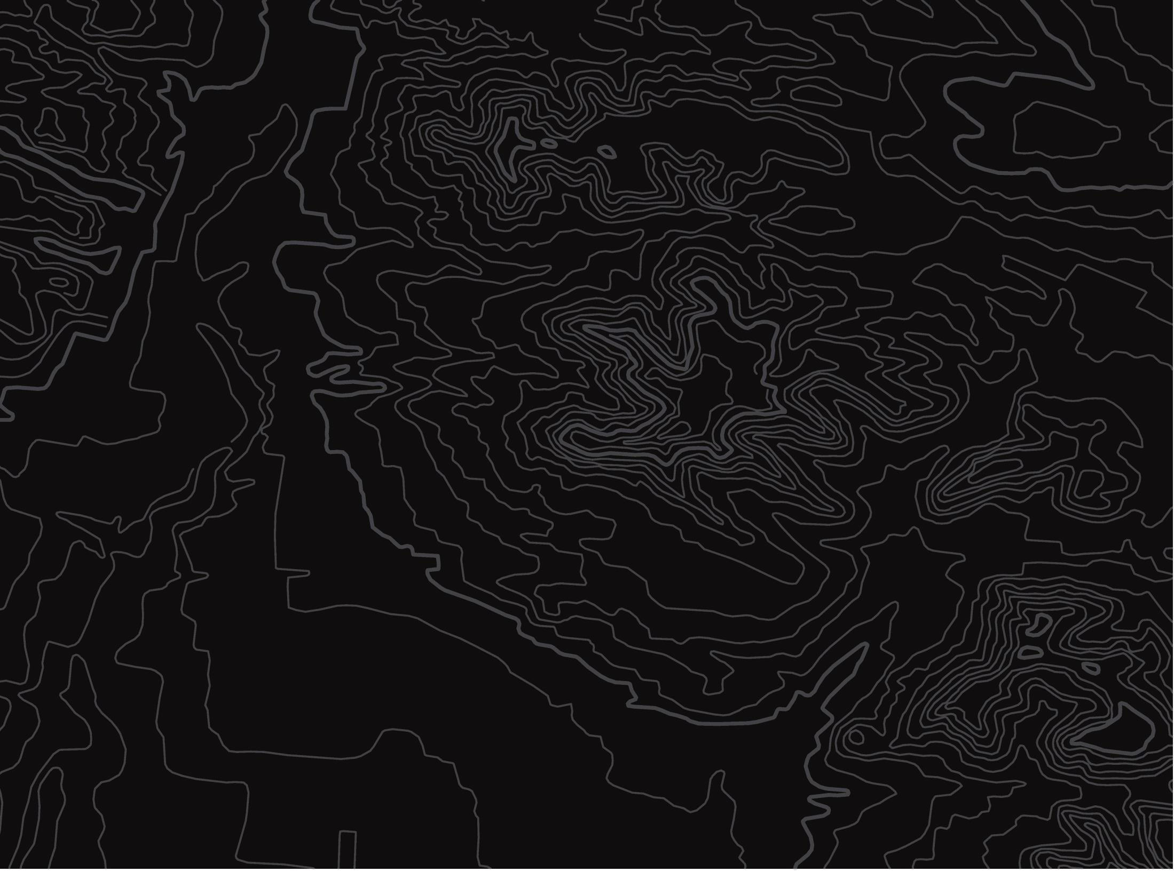
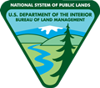

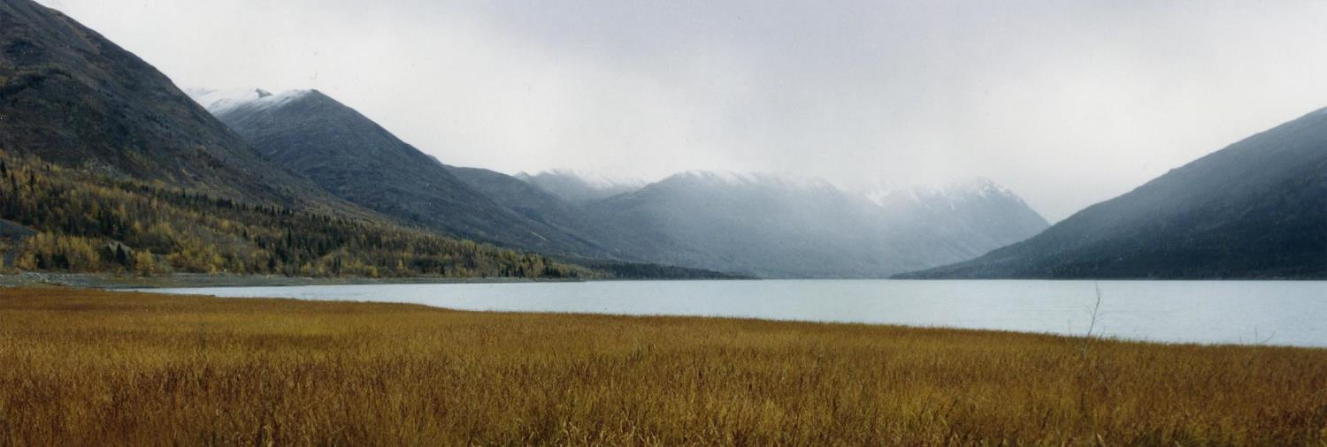
Balancing Act
U.S. Department of the Interior
Bureau of Land Management
Learn how land managers work with groups in the community to understand their different needs.
Module 5, Lesson 4
USDOE

Slide 2
Lesson 4: Balancing Act
Lesson Questions:
U.S. Department of the Interior
Bureau of Land Management
What groups might land managers interact with?
How does a land manager balance the needs of different communities?

Slide 3
Materials:
U.S. Department of the Interior
Bureau of Land Management
science journal or a piece of paper
pencil (or something to write with)

Slide 4
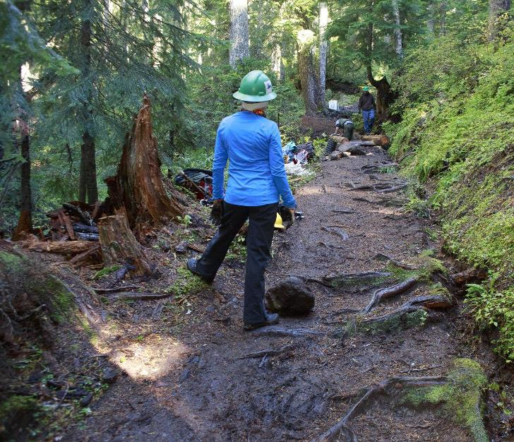
Land managers oversee natural resources. They balance the needs of human communities and the health of ecosystems.
U.S. Department of the Interior
Bureau of Land Management
Kevin Bacher, NPS

Slide 5
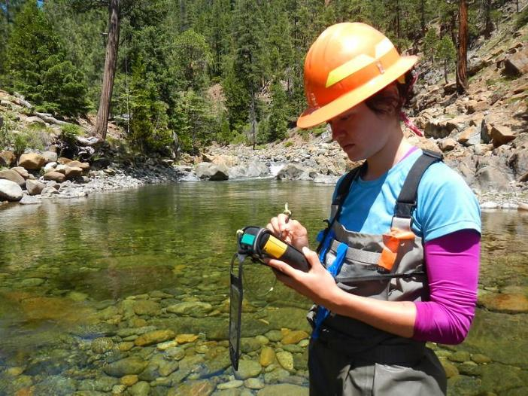
In this lesson, you will play the role of a land manager for an imaginary watershed.
You will listen to community groups that are part of the watershed you help manage.
Take notes in your science journal or on a piece of paper to help you understand the perspectives of all these groups.
U.S. Department of the Interior
Bureau of Land Management
BLM Staff, BLM

Slide 6
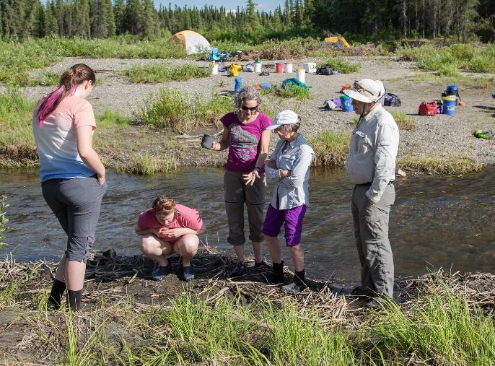
U.S. Department of the Interior
Bureau of Land Management
Land managers listen to different groups in a community before making decisions.
As you read about the community groups in this imaginary watershed, think about the following questions:
What does each group want?
What do they need?
How can they help each other?
Craig McCaa, BLM

Slide 7

Create a separate page for each group. Break your notes into the following sections to help organize your thoughts:
U.S. Department of the Interior
Bureau of Land Management
Group’s name:
How do they use the watershed?
What do they want to change?
How can they help the other groups?

Slide 8

You can listen to each group’s perspective by clicking on the speaker symbol.
U.S. Department of the Interior
Bureau of Land Management
Begin by reading or listening to the first group on the next slide.

Slide 9

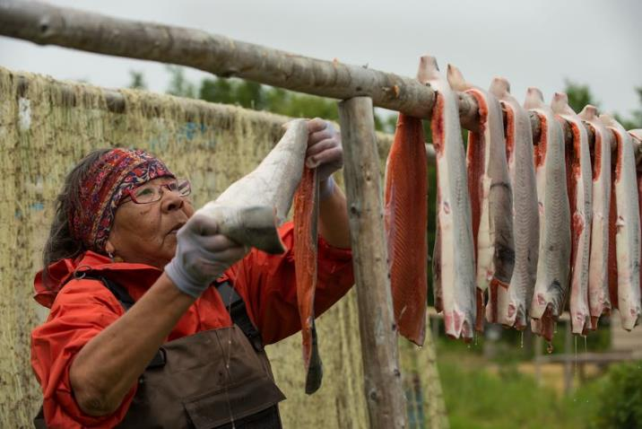
Local Village:
U.S. Department of the Interior
Bureau of Land Management
“Our history with the watershed is long and continues today. We have thousands of years of cultural connection to salmon fishing and sustainable harvesting in this watershed. Creation of the dam has reduced the salmon population around our village. This has affected our families' cultural connections as well as our jobs. Currently, we are looking to regain decision making power for the waterways and our historical area around the lake.”
NPS

Slide 10
Let’s do the first group together:
U.S. Department of the Interior
Bureau of Land Management
How do they use the watershed?
Group’s name:
Fishing to provide cultural connections, food, and money for families
Local Village
What do they want to change?
How can they help the other groups?
Regain decision making power for the waterways and land
Return of salmon populations
Provide knowledge about sustainable harvesting and history in this watershed

Slide 11
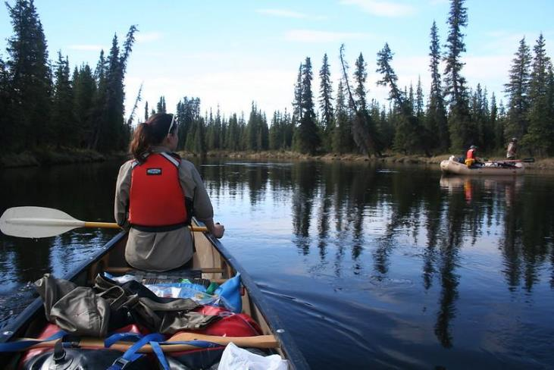
Outdoor Enthusiast:
U.S. Department of the Interior
Bureau of Land Management
“My family and I spend most weekends canoeing and swimming in the reservoir created by the dam. The reservoir is where we do most of our fishing for trout, which is a big part of our summer diet. We are also strong environmental stewards and always spend the end of the day cleaning up around the area so others like us can enjoy the clean land and water.”
Jeremy Matlock, BLM

Slide 12
Make a new page for each group.
U.S. Department of the Interior
Bureau of Land Management
How do they use the watershed?
Group’s name:
Outdoor Enthusiasts
What do they want to change?
How can they help the other groups?

Slide 13
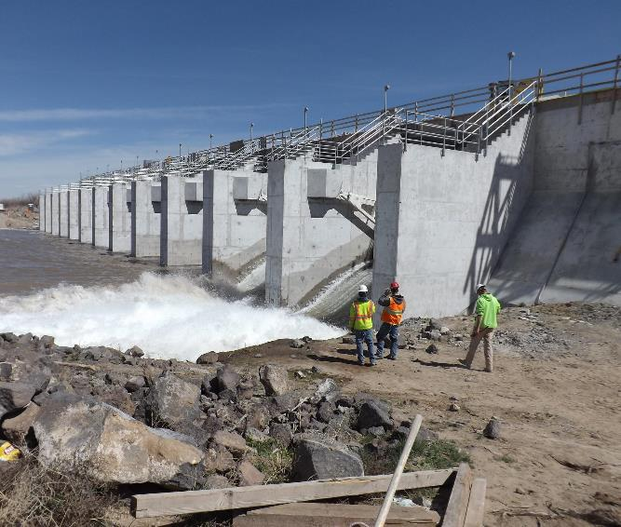
Utility Company:
U.S. Department of the Interior
Bureau of Land Management
“We currently own rights to the dam and control the water flow from the watershed to the hydroelectric power plant. The flow through the dam provides the drinking water and electricity for this area. In addition, our company provides hundreds of jobs to people because of this dam. We would like to continue our use of the watershed.”
US Bureau of Reclamation

Slide 14
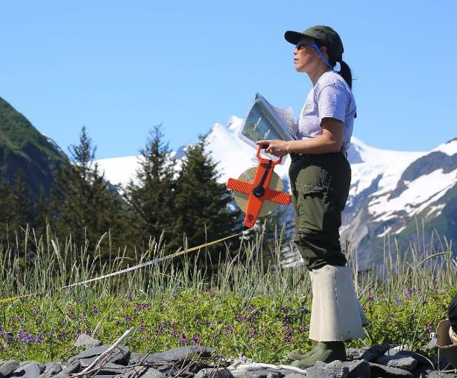
Environmental Organization:
U.S. Department of the Interior
Bureau of Land Management
“The damming of this watershed affects more than just the local area. Salmon cannot migrate in or out of this watershed because of the dam, which then affects the rest of the food web. We want to return the flow of water to its natural state so salmon can complete their life cycle. Our group has many members who are willing to help or contribute money to our mission.”
NPS

Slide 15
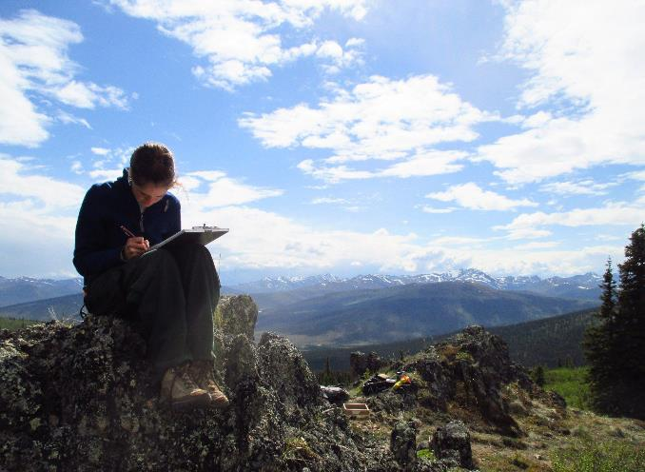
U.S. Department of the Interior
Bureau of Land Management
Each community group has their own unique wants, needs, and strengths to offer.
Using your notes, answer the following questions:
Which wants or needs do groups have in common?
What does one group have offer to another group?
Is there one thing all the groups agree on? If so, what is it?
Greg Kinman, NPS

Slide 16
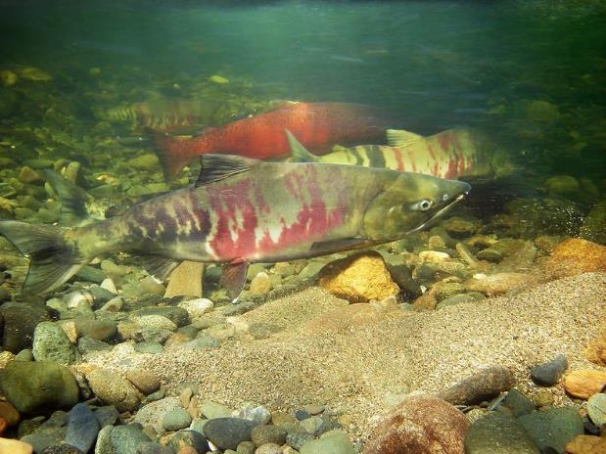
What about the plants and animals?
Human groups are not the only ones in the community. Land managers also have to think about the health of the ecosystem.
The next group you will hear from can provide a perspective on the ecosystem in this land management conversation.
U.S. Department of the Interior
Bureau of Land Management
Jason Post, BLM

Slide 17
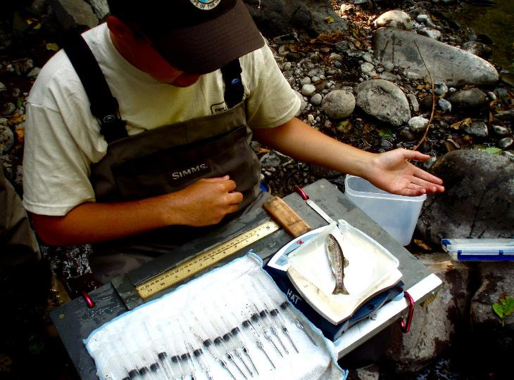
Fish and Wildlife Biologists:
U.S. Department of the Interior
Bureau of Land Management
“We are responsible for monitoring the fish and wildlife around the watershed as well as the quality of the water for those animals. Our job is to be the voice for the ecosystem in management discussions by communicating scientific data to the other groups. Our research shows decreases in macroinvertebrate and salmon populations, which is connected to the decrease in water quality. Currently, the data we collected is assisting the restoration of salmon migration routes.”
Tess McBride, USFWS

Slide 18

What issues in the natural ecosystem have the biologists identified?
U.S. Department of the Interior
Bureau of Land Management
Jason Post, BLM

Slide 19
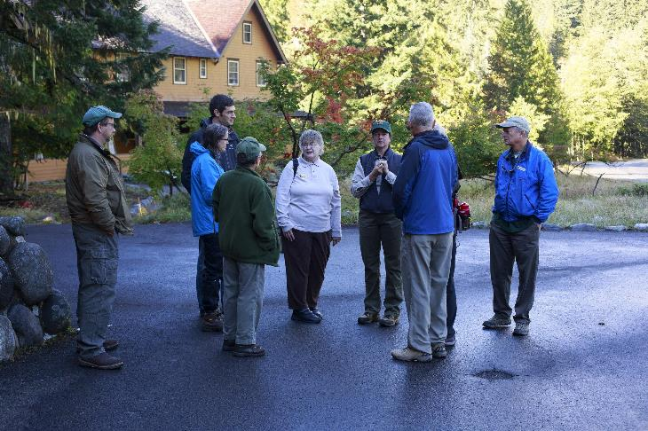
Each land management decision is different.
Every community is made up of unique groups with their own uses and needs from the watershed.
Land managers have to find the balance between each group and figure out a compromise for the whole community.
U.S. Department of the Interior
Bureau of Land Management
Kevin Bacher, NPS

Slide 20
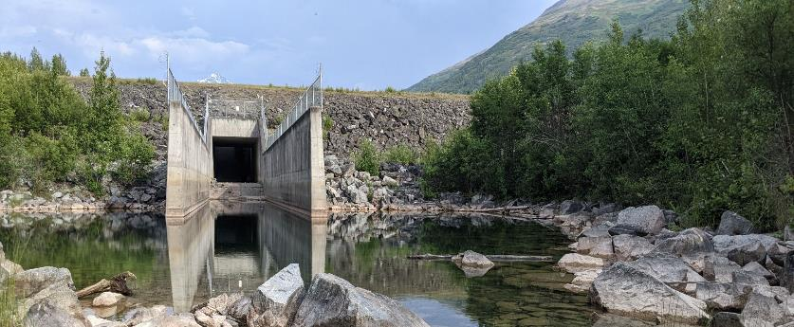
Let’s look again at a real-world example of management in the Eklutna Watershed.
The lower dam was built on the Eklutna River in the 1920s to produce electricity for Anchorage. The upper dam was built in the 1950s to increase the amount of electricity produced.
With two dams blocking water flow, there was a big drop in salmon populations in the watershed, which especially affects the Native Village of Eklutna.
U.S. Department of the Interior
Bureau of Land Management
CCSC Staff, BLM

Slide 21
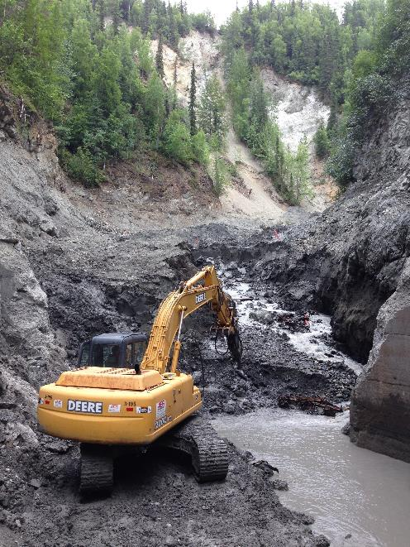
The Native Village of Eklutna, Eklutna Inc., The Conservation Fund, and other partners worked together to remove the lower dam in 2018.
The upper dam is still in place and the utility company is responsible for studying the impacts to the watershed.
In Fall 2021, water was released from Eklutna Lake and allowed to flow naturally into Eklutna River for a few weeks.
U.S. Department of the Interior
Bureau of Land Management
© The Conservation Fund

Slide 22
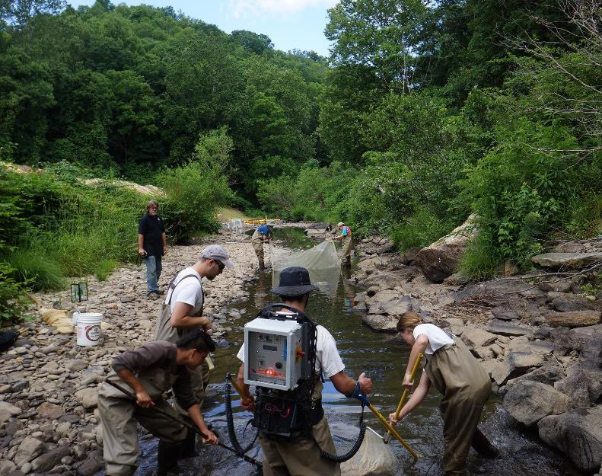
Fish and wildlife biologists and other scientists will continue to study the watershed to determine how the dam affects the local ecosystem.
U.S. Department of the Interior
Bureau of Land Management
G.Peeples, USFWS

Slide 23
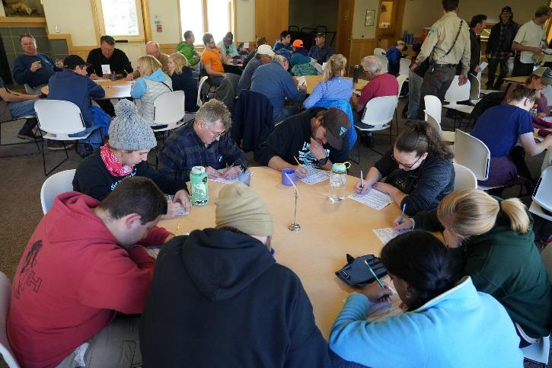
These decisions in the Eklutna Watershed are just one example of land management.
Land managers listen, take notes, and think creatively to balance the needs of each group in the community as well as the health of the ecosystem as best as they can.
U.S. Department of the Interior
Bureau of Land Management
CCSC Staff, BLM

