Slide 1
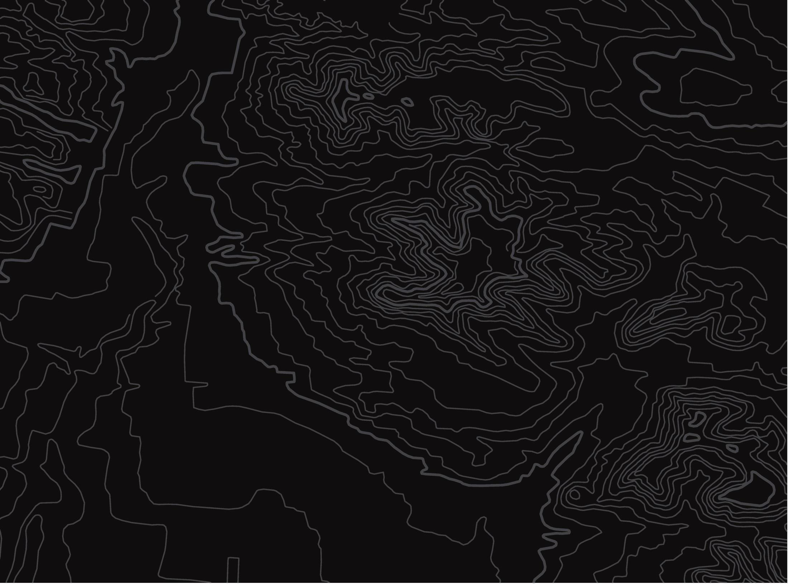
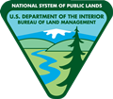

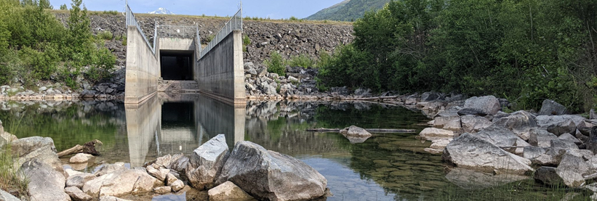
Impacts of a Dam
U.S. Department of the Interior
Bureau of Land Management
Investigate how dams impact ecosystems.
Module 5, Lesson 3
CCSC Staff, BLM

Slide 2
Lesson 3: Impacts of a Dam
U.S. Department of the Interior
Bureau of Land Management
Lesson Questions:
How can dams affect water quality?
How can dams impact living things?

Slide 3
Materials:
U.S. Department of the Interior
Bureau of Land Management
science journal or a piece of paper
pencil (or something to write with)

Slide 4
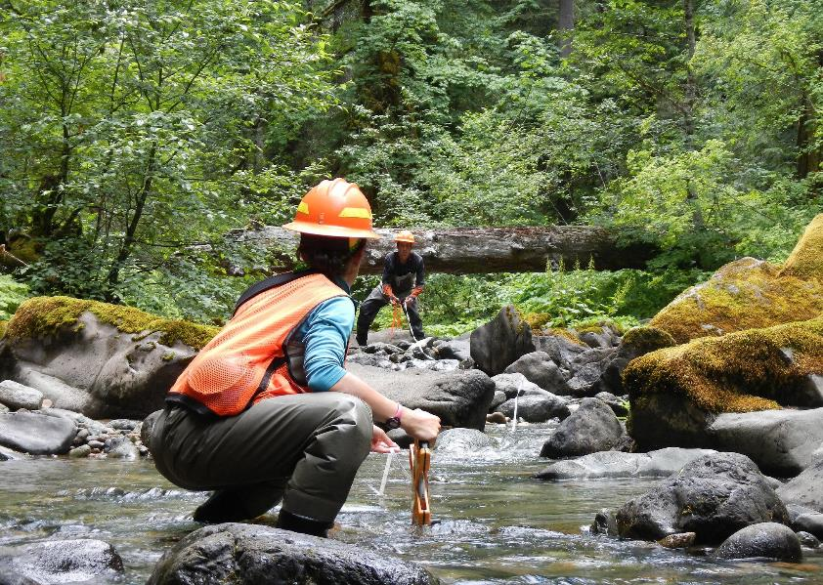
In this lesson, you will investigate how dams impact natural ecosystems, using the Eklutna Watershed as an example.
U.S. Department of the Interior
Bureau of Land Management
BLM

Slide 5
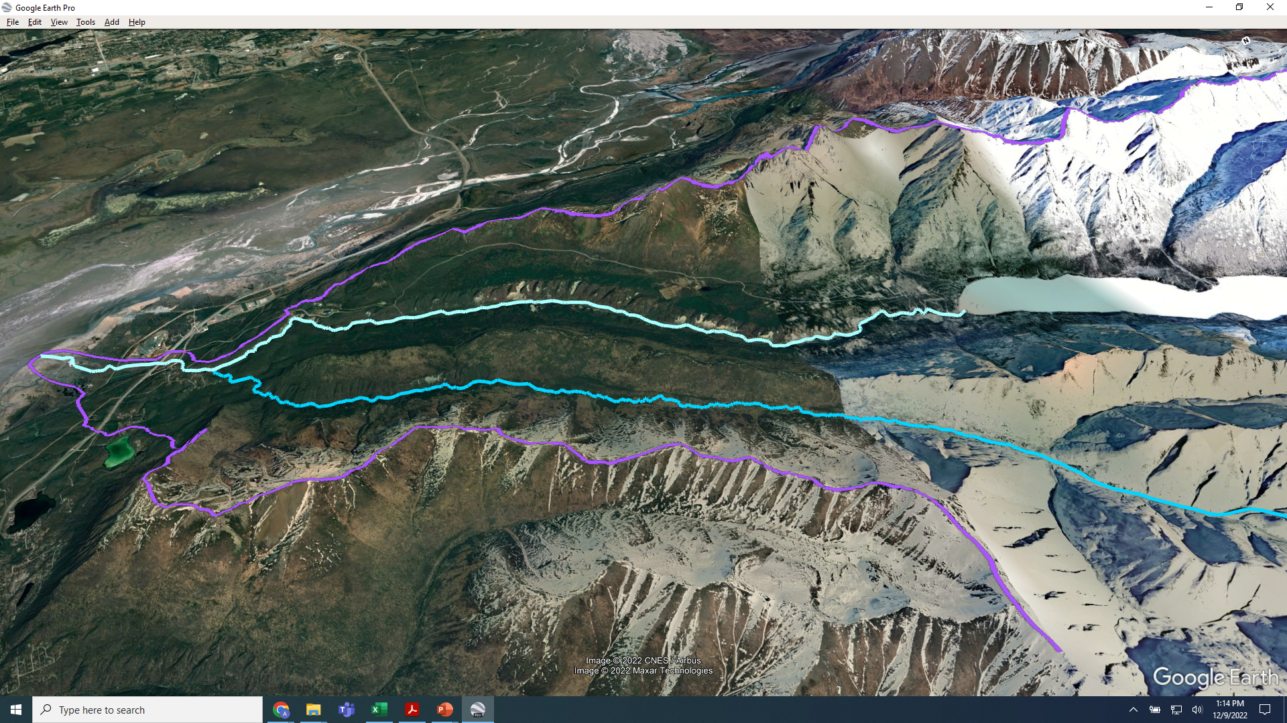


Two dams have been built in the Eklutna Watershed.
U.S. Department of the Interior
Bureau of Land Management
A lower dam (2) was built in the 1920s and provided electricity to Anchorage until the 1950s. It was removed in 2018. The Eklutna River upper dam (1) was built in the 1950s. It is still used today.
Map data: Google, CNES/Airbus, 2022 Maxar Technologies

Slide 6
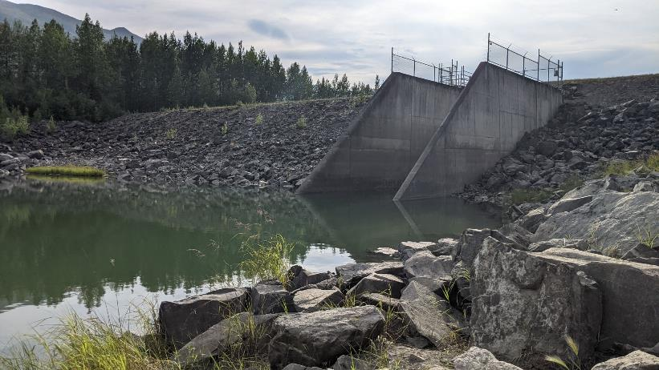

The upper dam blocks water from Eklutna Lake from flowing into the Eklutna River.
U.S. Department of the Interior
Bureau of Land Management
A diversion tunnel sends water from the lake to the Eklutna Hydroelectric Power Plant. The water from Eklutna Lake creates enough electricity to power 24,600 homes for an entire year.
CCSC Staff, BLM

Slide 7
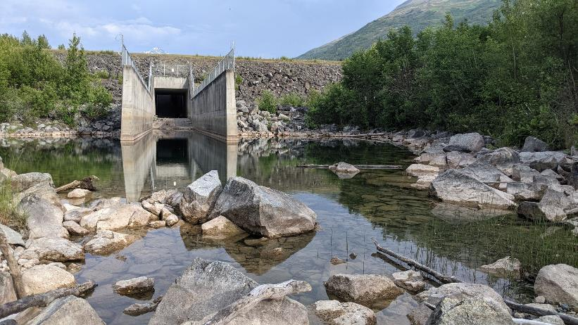
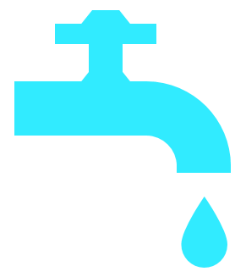
Water from the lake is also sent through another diversion tunnel to the Eklutna Water Treatment Plant. Once treated, this water provides 90% of the drinking water for Anchorage and the surrounding communities. That is 7.6 billion gallons per year!
U.S. Department of the Interior
Bureau of Land Management
CCSC Staff, BLM

Slide 8


The upper dam benefits people by providing electricity and drinking water.
U.S. Department of the Interior
Bureau of Land Management
Let’s travel downstream to find out how the dam affects the Eklutna River and the rest of the watershed. You will visit four sites along the river, starting with Site 1.
Map data: Google, CNES/Airbus, 2022 Maxar Technologies

Slide 9
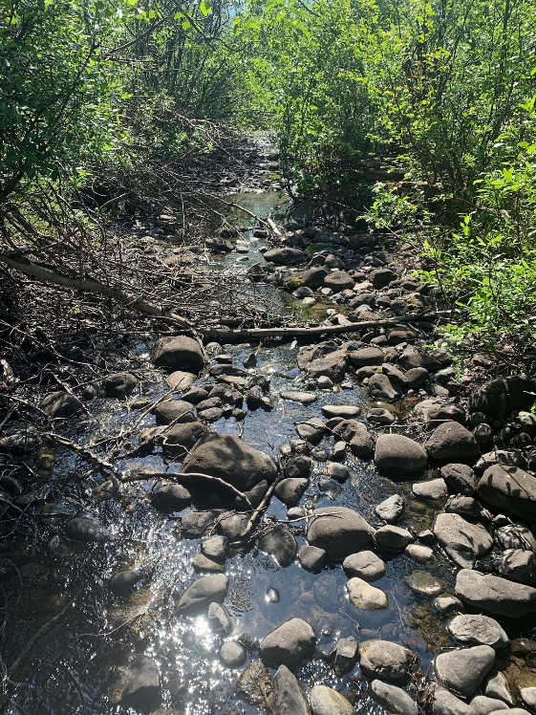

Journaling Activity
U.S. Department of the Interior
Bureau of Land Management
Write “Site 1” in your science journal or on a piece of paper.
Under Site 1, record your observations using the picture to the right. What do you notice?
Next, write down 1-3 questions you have about this area.
Site 1
Observations:
Questions:
©Native Village of Eklutna

Slide 10
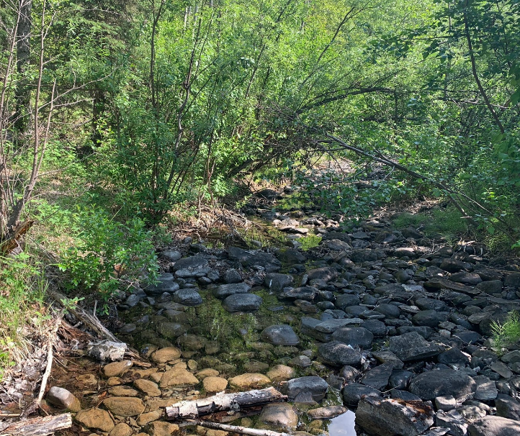
Site 1, first slide
U.S. Department of the Interior
Bureau of Land Management
Site 1, the section of river just downstream from the dam, is mostly dry.
How do you think that impacts living parts of the ecosystem, such as salmon?
Write your prediction under your questions.
Site 1
Observations:
Questions:
Prediction: I think that the river being dry impacts salmon...
© Native Village of Eklutna

Slide 11
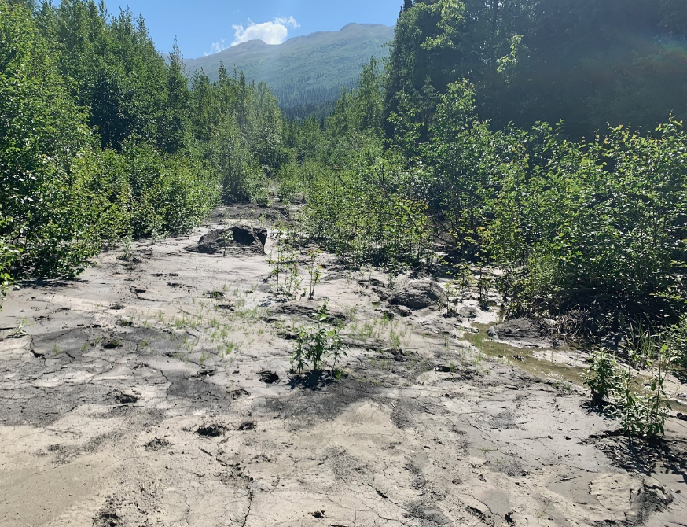
Site 1, second slide
U.S. Department of the Interior
Bureau of Land Management
Because the dam blocks water from flowing out of the lake, the river just below the dam is very dry.
There is not enough water to support habitat for salmon and other fish.
Salmon used to migrate upstream to the lake to spawn, but now there is not enough water for them to travel this far up the river.
©Native Village of Eklutna

Slide 12
Site 2, first slide
U.S. Department of the Interior
Bureau of Land Management
Now travel about 8 miles downstream to Site 2.
Map data: Google, CNES/Airbus, 2022 Maxar Technologies

Slide 13
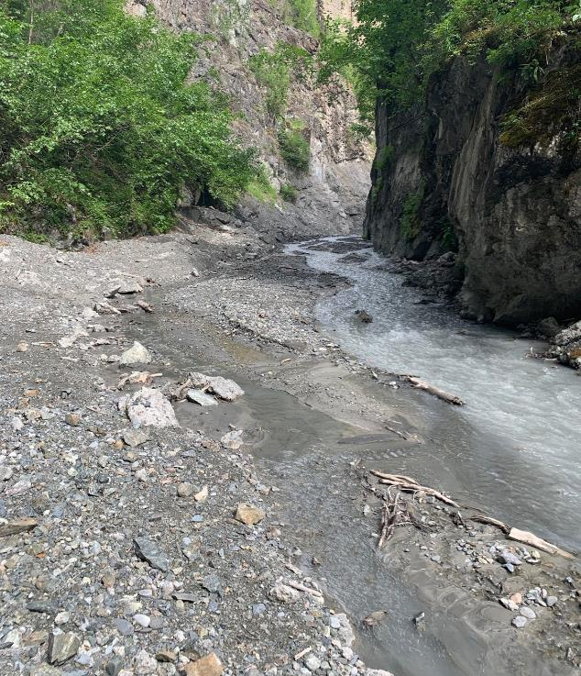
Site 2, second slide
U.S. Department of the Interior
Bureau of Land Management
Write “Site 2” in your science journal or on a piece of paper.
Under Site 2, record your observations. What do you notice?
Next, write down 1-3 questions you have about this area.
Site 2
Observations:
Questions:
© Native Village of Eklutna

Slide 14
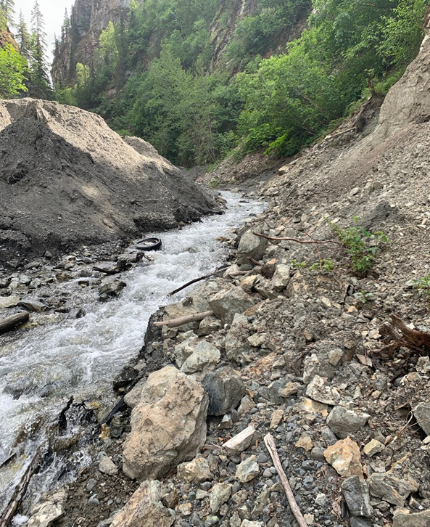
Site 2, third slide
U.S. Department of the Interior
Bureau of Land Management
Site 2 is where the lower dam used to be.
In a natural waterway, erosion carries sediment, such as soil, clay, and small rocks, downstream through the watershed.
The old dam trapped large amounts of sediment behind the barrier.
Even though the dam was removed, there is still a lot of sediment in this area of the river.
© Native Village of Eklutna

Slide 15
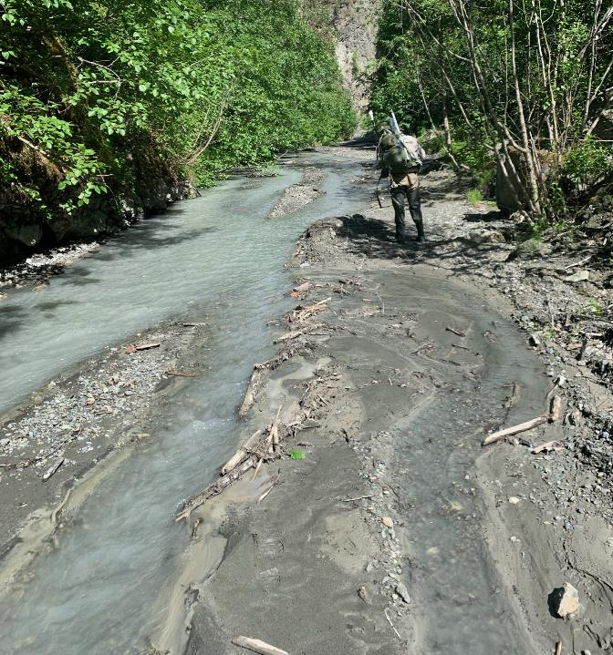
Site 2, fourth slide
U.S. Department of the Interior
Bureau of Land Management
How do you think sediment impacts water quality in this part of the river?
Write your prediction under your questions.
Site 2
Observations:
Questions:
Prediction: I think sediment impacts water quality...
©Native Village of Eklutna

Slide 16
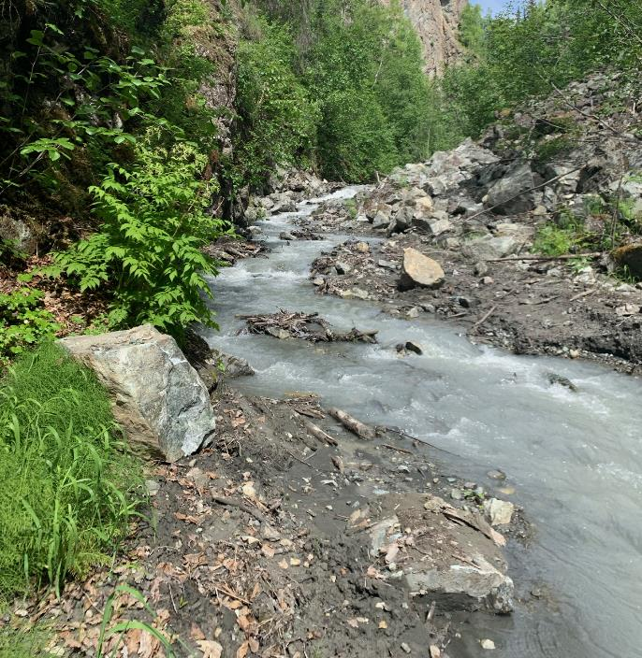
Site 2, fifth slide
U.S. Department of the Interior
Bureau of Land Management
Sediment can cause poor water quality.
Too much sediment can make the water murky and unhealthy for aquatic animals and plants.
Because this part of the river still has low water flow, it does not have enough power to flush the sediment farther downstream.
© Native Village of Eklutna

Slide 17
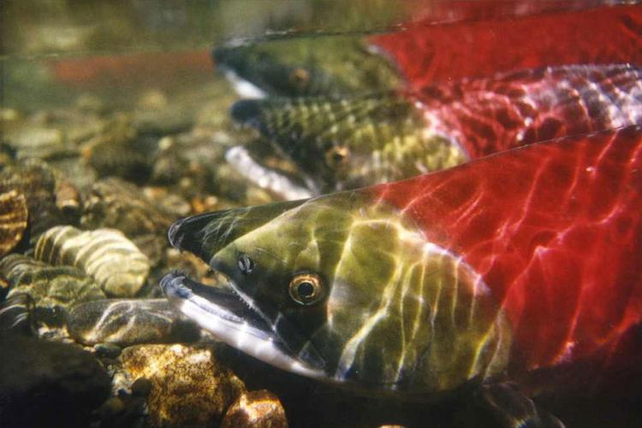
Too much sediment can also damage salmon habitat.
When salmon spawn, they lay their eggs in the gravel.
If sediment fills in the spaces between the gravel, the eggs will not have enough dissolved oxygen to develop.
U.S. Department of the Interior
Bureau of Land Management
NOAA

Slide 18
Head downstream to Site 3 at the confluence of the Eklutna River and Thunderbird Creek.
U.S. Department of the Interior
Bureau of Land Management
Map data: Google, CNES/Airbus, 2022 Maxar Technologies

Slide 19
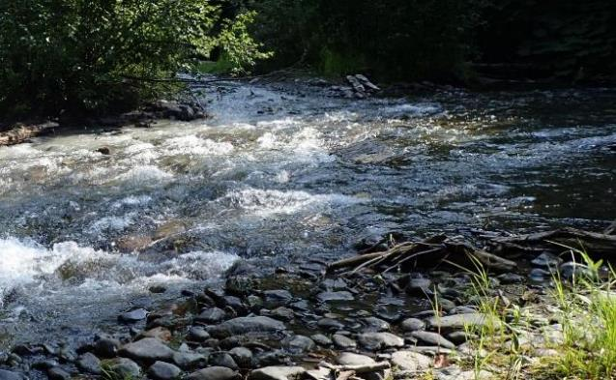
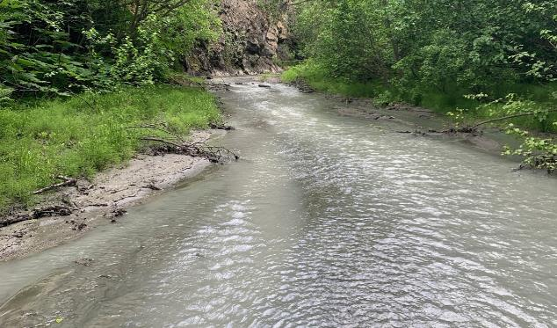
Under Site 3, record your observations of Thunderbird Creek and the Eklutna River.
What differences do you notice between the two waterways?
Next, write down one to three questions you have.
U.S. Department of the Interior
Bureau of Land Management
Thunderbird Creek
© Erin Larson, APU
Eklutna River
Site 3
Observations:
Questions:
© Native Village of Eklutna

Slide 20
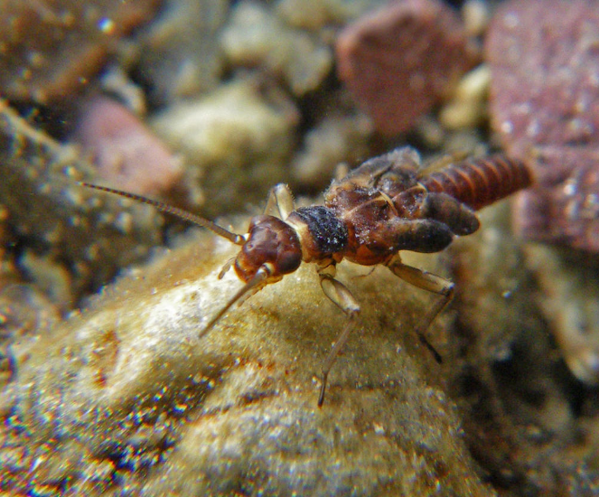
Site 3, third slide
U.S. Department of the Interior
Bureau of Land Management
Which waterway do you think has more types of macroinvertebrates: Thunderbird Creek or Eklutna River?
Write your prediction.
I need cold, clean water with lots of dissolved oxygen!
Site 3
Observations:
Questions:
Prediction:
Joe Giersch, USGS

Slide 21
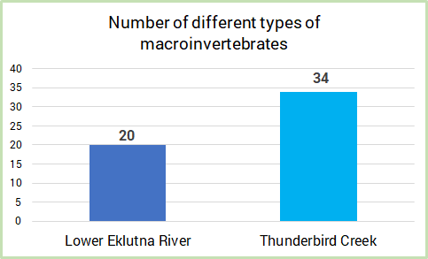
Site 3, fourth slide
U.S. Department of the Interior
Bureau of Land Management
Thunderbird Creek has 34 different types of macroinvertebrates.
The Eklutna River has 20.
Why do you think Thunderbird Creek has more types of macroinvertebrates than the Eklutna River?

Slide 22
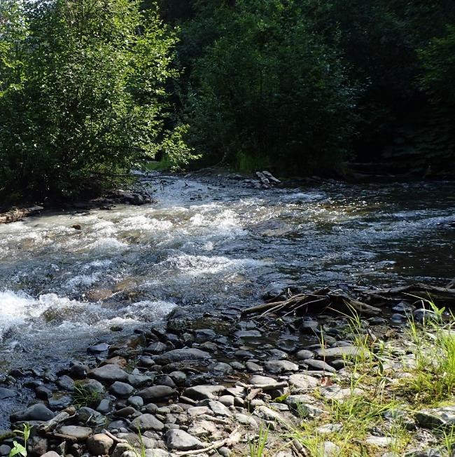
Site 3, fifth slide
U.S. Department of the Interior
Bureau of Land Management
There are no dams on Thunderbird Creek. The water flows naturally through the watershed and is clear instead of cloudy with sediment.
Scientists collect and identify macroinvertebrates to determine the health of waterways.
If the number of different types of macroinvertebrates increases, it may indicate the Eklutna River is getting healthier.
©Erin Larson, APU

Slide 23
The final stop on your downstream journey is Site 4.
U.S. Department of the Interior
Bureau of Land Management
Map data: Google, CNES/Airbus, 2022 Maxar Technologies

Slide 24
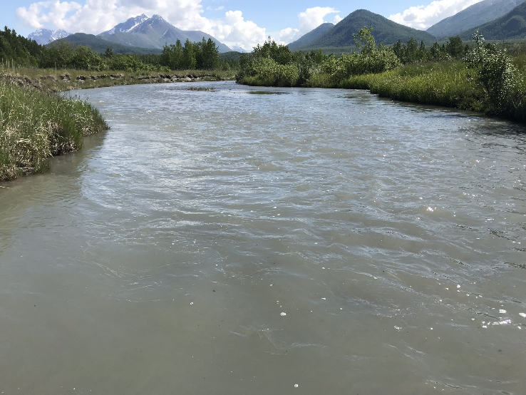
Site 4, second slide
U.S. Department of the Interior
Bureau of Land Management
Site 4 is the near the estuary, where the Eklutna River flows into the ocean.
Under Site 4, record your observations. What do you notice?
Next, write down 1-3 questions you have about this area.
Site 4
Observations:
Questions:
© Native Village of Eklutna

Slide 25
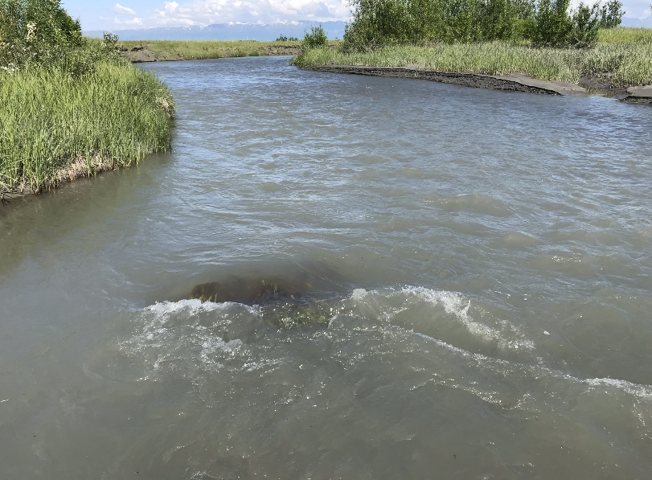
Site 4, third slide
U.S. Department of the Interior
Bureau of Land Management
Do you think the temperature of the river at Site 4 is warm or cold?
Do you think the river has a high or low amount of dissolved oxygen?
Write your prediction.
Site 4
Observations:
Questions:
Prediction:
© Native Village of Eklutna

Slide 26
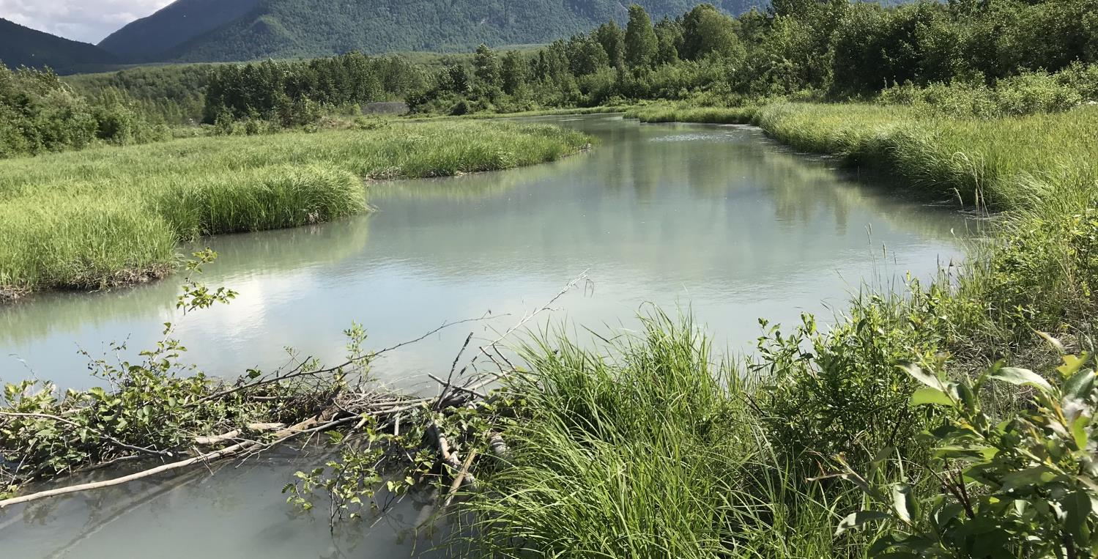
Site 4
U.S. Department of the Interior
Bureau of Land Management
With additional water from Thunderbird Creek, the lower Eklutna River has a high, steady flow compared to the upper part of the river.
Trees shade the water, which keeps the temperature cool.
The temperature of the water is around 42 degrees, cool enough for sensitive macroinvertebrates and salmon to survive.
The cold water has a high amount of dissolved oxygen, which salmon and other animals need to breathe.
Plants hold the riverbank in place, which prevents erosion.
Beaver dams slow the water and create deep pools. Young salmon find food and hide from predators in these pools. Spawning salmon rest in the pools on their way upstream.
© Native Village of Eklutna

