Slide 1
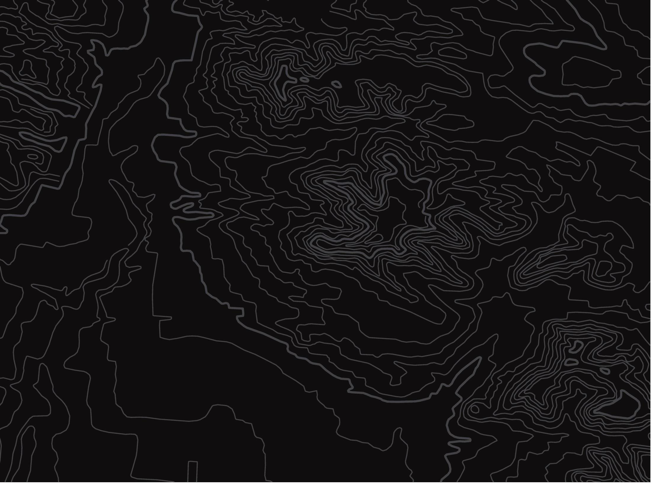
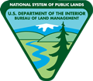
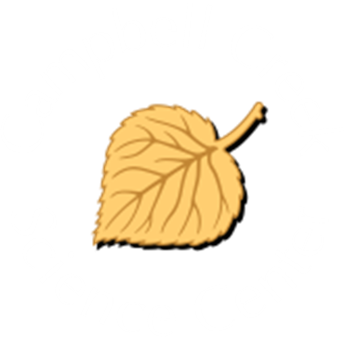
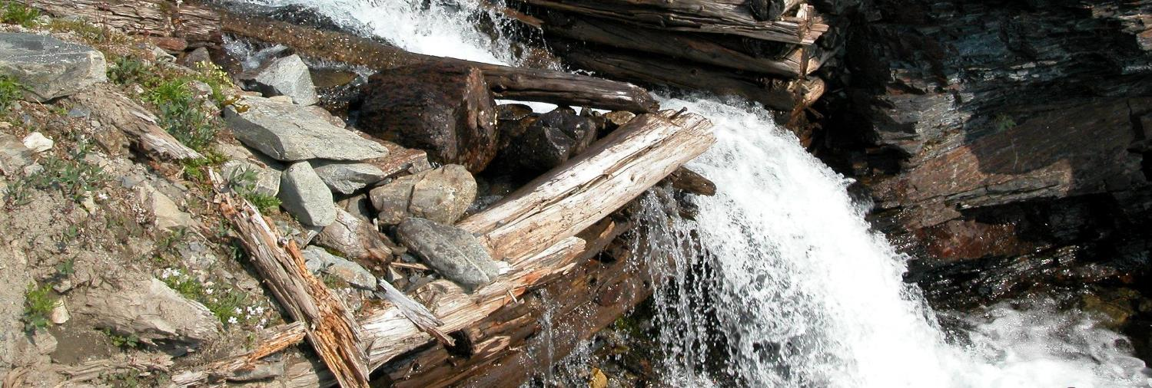
What Is a Dam?
U.S. Department of the Interior
Bureau of Land Management
Explore the different parts of a dam and learn why people build dams.
Module 5, Lesson 2
NPS Staff, NPS

Slide 2
Lesson 2: What is a Dam?
Lesson Questions:
U.S. Department of the Interior
Bureau of Land Management
What are dams and why are they built?
What benefits do dams provide to people?

Slide 3
Materials:
U.S. Department of the Interior
Bureau of Land Management
optional materials:
  cake pan or a similar waterproof container
  flour or fine dirt
  water
  a rock or other waterproof barrier
  measuring cup
  blue food dye (optional)

Slide 4
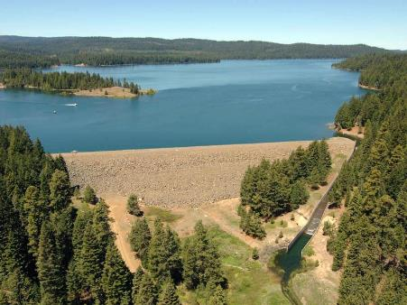
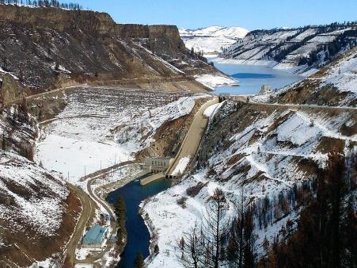
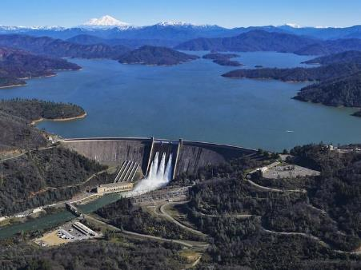
A dam is a barrier that prevents the natural flow of water.
U.S. Department of the Interior
Bureau of Land Management
US Bureau of Reclamation
US Bureau of Reclamation
US Bureau of Reclamation
What are some materials that might stop or slow the flow of water?

Slide 5
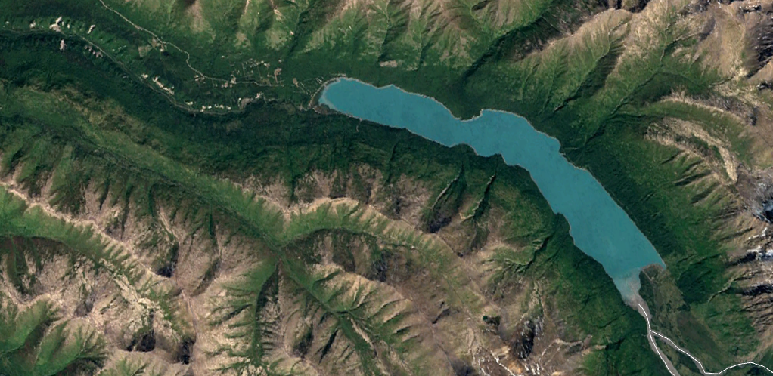
When dams block the flow of water, they often create reservoirs. A reservoir is a large natural or human-made lake used as a water supply source. The water in a reservoir serves many purposes, such as drinking water and hydroelectric power.
U.S. Department of the Interior
Bureau of Land Management
reservoir
dam
Image: Landsat/Copernicus

Slide 6
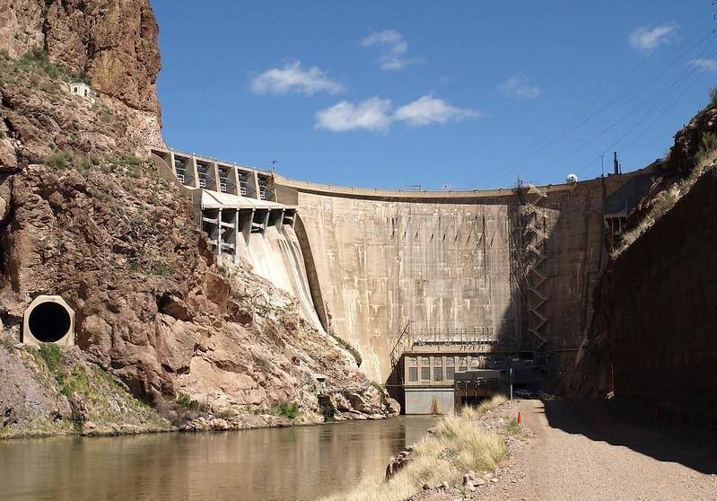
In addition to the main barrier, dams have other important parts. A diversion tunnel is a permanent or temporary tunnel that is built to move water from one location to another. For example, diversion tunnels may be used to move water from reservoirs to hydroelectric power plants and water treatment plants.
U.S. Department of the Interior
Bureau of Land Management
diversion tunnel
U.S. Bureau of Reclamation

Slide 7
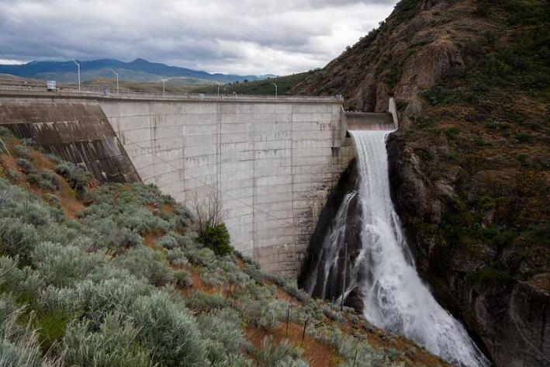
A spillway is a structure used to control the release of water from a reservoir. Sometimes more water is needed downstream for agriculture and wildlife. Sometimes less water is desired downstream to control flooding.
U.S. Department of the Interior
Bureau of Land Management
spillway
US Bureau of Reclamation

Slide 8
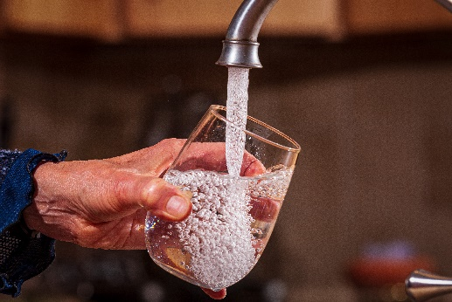
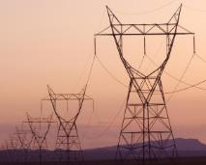
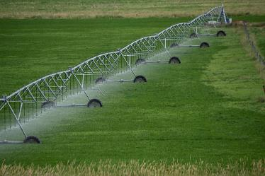
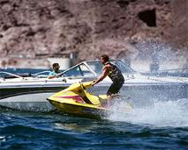
U.S. Department of the Interior
Bureau of Land Management
What are some benefits dams provide?
Water for drinking
Hydroelectricity
Water for irrigation (farming)
Flood control
River navigation
Recreation (swimming, fishing, boating)
Eric Vance, EPA
USBR
USDA
USBR

Slide 9
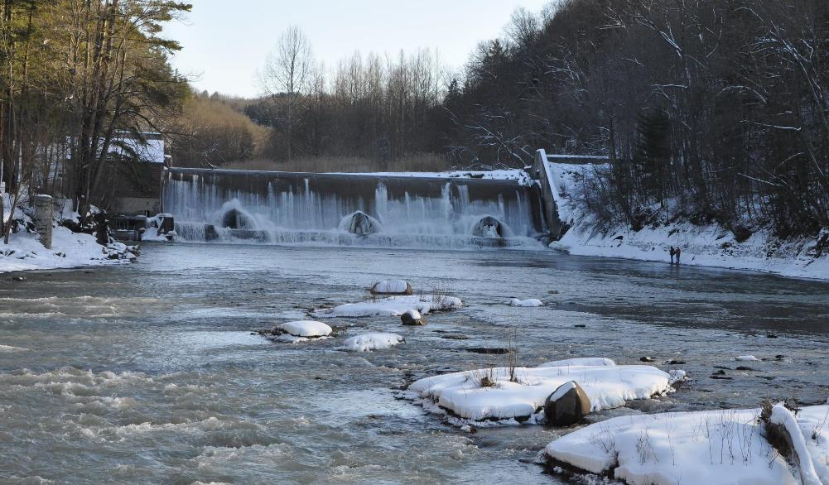
Dams provide resources for humans, but they can also affect the living and nonliving things in and around waterways.
U.S. Department of the Interior
Bureau of Land Management
Andrew Kornacki, USACE

Slide 10
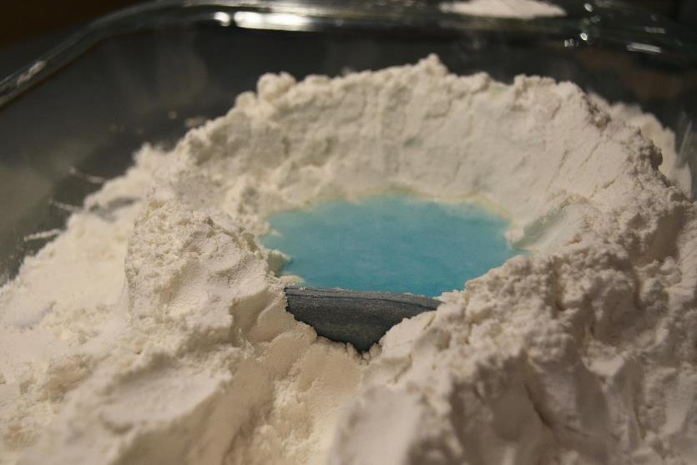
Let’s use a model to learn more about how dams work. Follow along using your own materials or watch what happens in the pictures.
U.S. Department of the Interior
Bureau of Land Management
© Kaitlan McLallen, APU

Slide 11
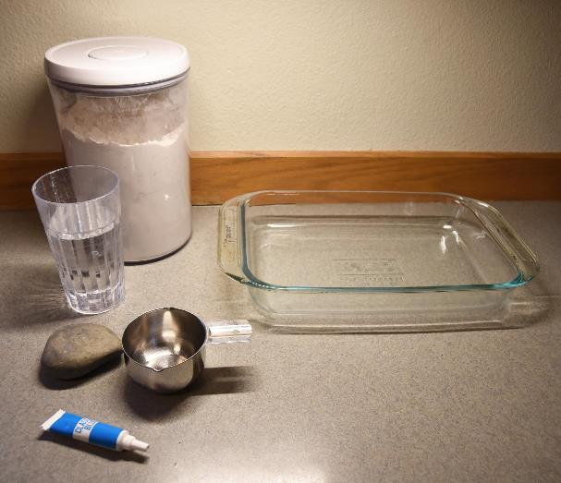
Gather your materials:
U.S. Department of the Interior
Bureau of Land Management
1 cake pan or similar waterproof container
1 rock or other solid waterproof barrier
flour or fine dirt
water
measuring cup
blue food coloring (optional)
© Kaitlan McLallen, APU

Slide 12
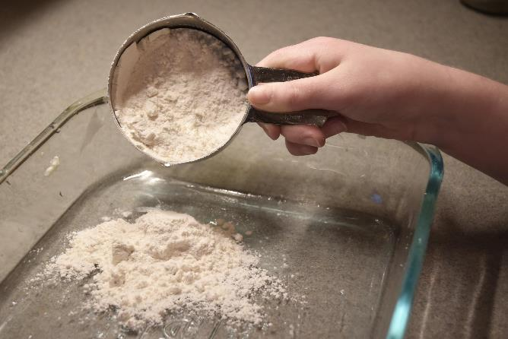
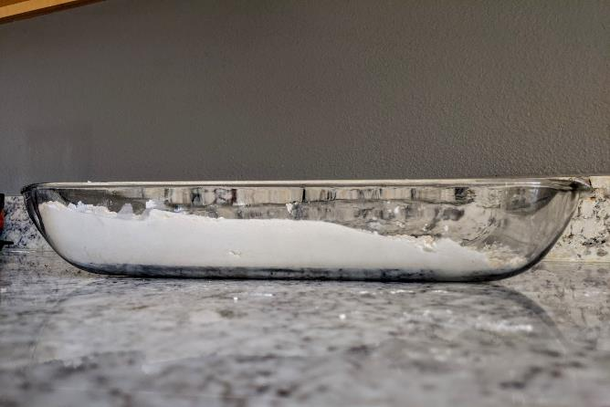
Step 1: Scoop some flour or dirt into your cake pan. Arrange it so there is a high elevation side and a low elevation side.
U.S. Department of the Interior
Bureau of Land Management
high elevation
low elevation
© Kaitlan McLallen, APU
CCSC Staff, BLM

Slide 13
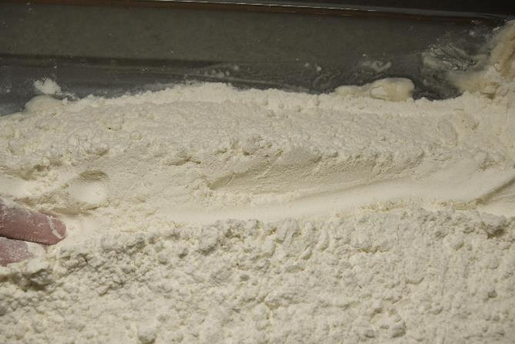
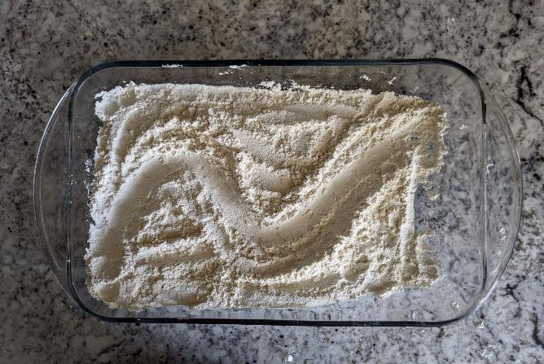
Step 2: Use your fingers to create a riverbed from the high elevation side of the pan to the low elevation side. Feel free to add some curves to your riverbed. Which direction does your river flow?
U.S. Department of the Interior
Bureau of Land Management
CCSC Staff, BLM
CCSC Staff, BLM
  Water flows downhill, so your river flows from the high elevation to the low elevation.

Slide 14
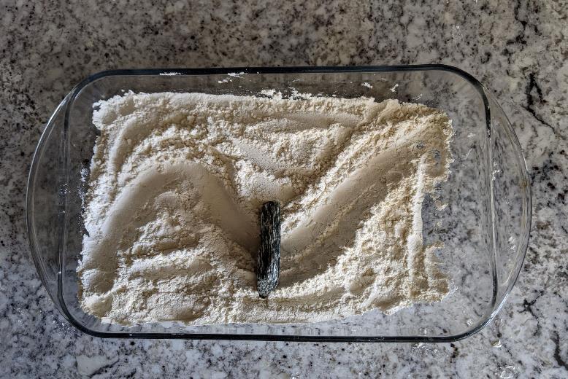
Step 3: Choose a spot to build your dam by placing the rock, or other waterproof barrier, so that it completely blocks the riverbed.
U.S. Department of the Interior
Bureau of Land Management
CCSC Staff, BLM

Slide 15
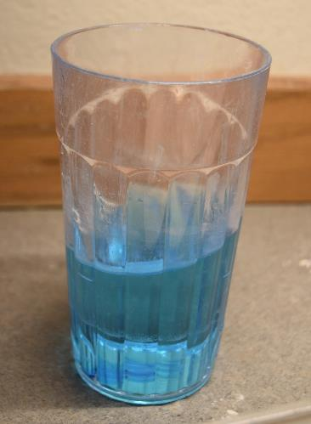
Step 4: Fill a cup or container with water. Add a drop of blue food coloring if you would like the water to be more visible.
U.S. Department of the Interior
Bureau of Land Management
Make a prediction:
What do you think will happen when you start to add water to the high elevation part of the watershed?
© Kaitlan McLallen, APU

Slide 16
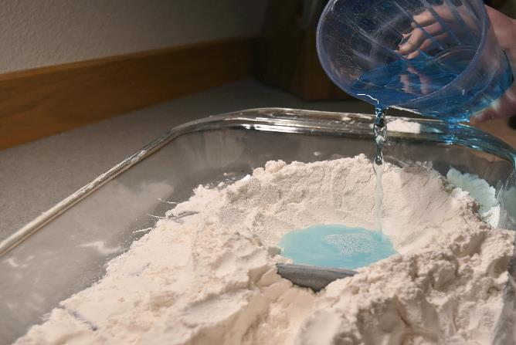
Step 5: Slowly pour a small amount of water upstream from the dam. Do not pour all the water yet.
U.S. Department of the Interior
Bureau of Land Management
What do you notice?
What do you call a lake that is created by a dam?
What do you think will happen when more water is added than what the dam is capable of holding back?
© Kaitlan McLallen, APU

Slide 17
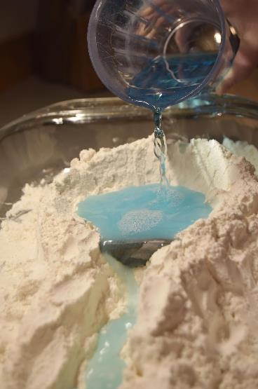
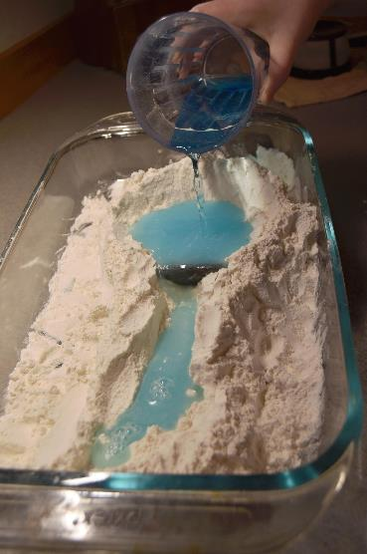
Step 6: Gradually add more water until it starts to spill over the top of the dam.
U.S. Department of the Interior
Bureau of Land Management
Think about the parts of a dam you learned about earlier in the lesson.
What could you add or change to help control the flow of water?
What could you add or change to help move water from the reservoir to a different location?
© Kaitlan McLallen, APU

Slide 18

Step 7: Experiment with your model. Feel free to create new rivers, mountains, dams, spillways, and diversion tunnels.
U.S. Department of the Interior
Bureau of Land Management
© Kaitlan McLallen, APU

Slide 19
Step 8: Clean up your model materials.
U.S. Department of the Interior
Bureau of Land Management
Optional: If you used flour for this activity, you can use the flour to create play dough instead of throwing it away!
Play dough recipe:
1 cup flour
½ cup salt
1 cup water
1 tablespoon vegetable oil
2 teaspoons cream of tartar
food coloring (optional)
Play dough directions:
Mix all ingredients in a saucepan.
Cook ingredients on medium heat until thickened.
Wait until the mixture has cooled before handling.
Store in an airtight container.

