Slide 1
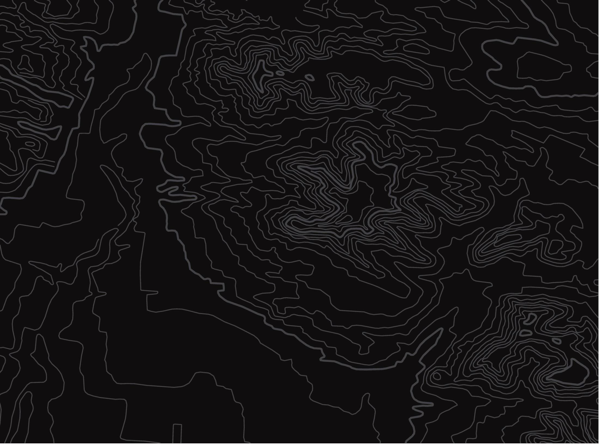
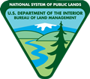

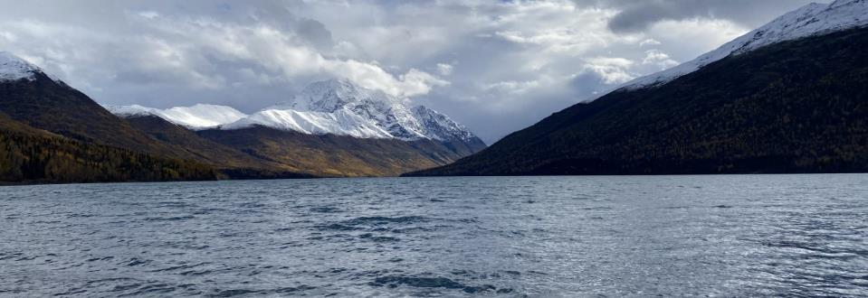
The Eklutna Watershed
U.S. Department of the Interior
Bureau of Land Management
Take a virtual tour to see how people have modified the watershed to get natural resources
Module 5, Lesson 1
Photo by A. Runde, BLM.

Slide 2
Lesson 1: The Eklutna Watershed
Lesson Questions:
U.S. Department of the Interior
Bureau of Land Management
What are the features of the Eklutna Watershed?
How does the Eklutna Watershed benefit people?

Slide 3
Materials:
U.S. Department of the Interior
Bureau of Land Management
science journal or a piece of paper
something to write with

Slide 4
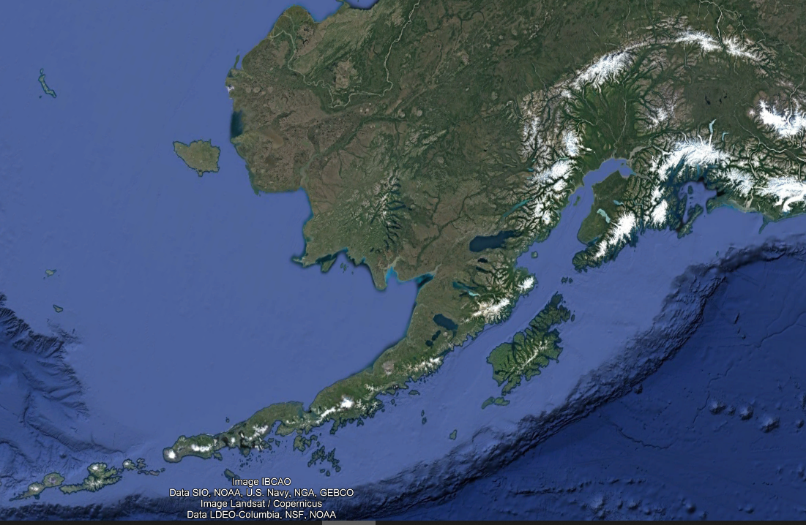

The lessons in this module include examples from the Eklutna Watershed. The marker shows where the Eklutna Watershed is located in Alaska.
U.S. Department of the Interior
Bureau of Land Management

Slide 5
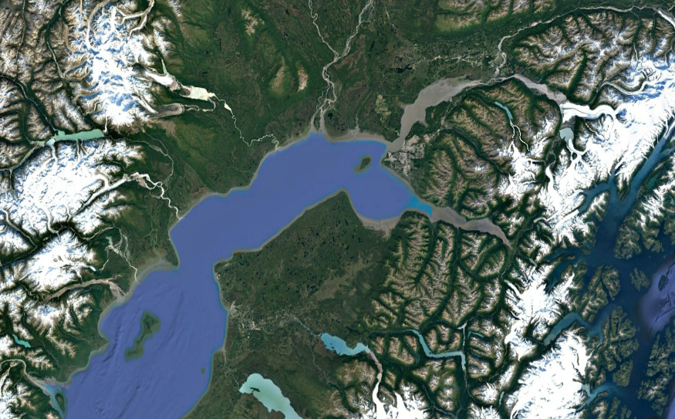
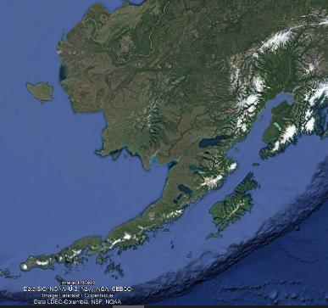
The Eklutna Watershed is in Southcentral Alaska, northeast of Anchorage.
U.S. Department of the Interior
Bureau of Land Management
Image: IBCAO, Data: SIO, NOAA, U.S. Navy, NGA, GEBCO, Image Landsat/Cpernicus, Data: LDEO-Columbia, NSF, NOAA.
Image: IBCAO; Data: SIO, NOAA, U.S. Navy, NGA, GEBCO; Image: Landsat/Copernicus

Slide 6
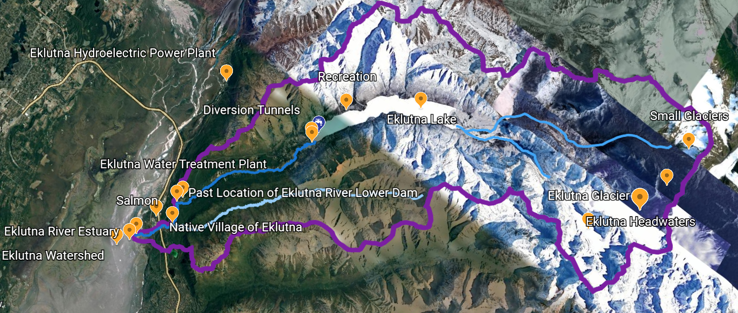
You are going to explore the Eklutna Watershed on an interactive virtual tour. As you move through the watershed, look carefully at the features and discover how people have modified the watershed to get natural resources.
U.S. Department of the Interior
Bureau of Land Management
Google Maxar Technologies, Landsate/Copernicus, CNES/Airbus

Slide 7
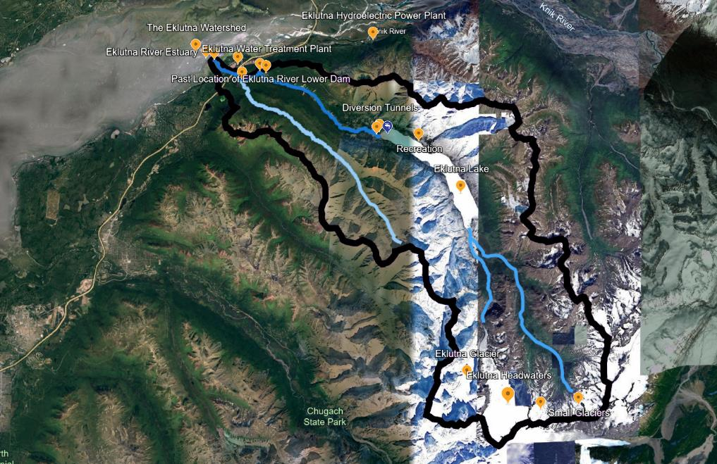
U.S. Department of the Interior
Bureau of Land Management
The Eklutna Watershed
The Eklutna Watershed (outlined with the thick black line) is located northeast of Anchorage, Alaska.
The Eklutna Watershed is the area of land that drains rainwater and snow and ice melt into the Eklutna River, the main waterway.
Watershed border
Map Data: Google, Landsat/Copernicus IBCAO

Slide 8
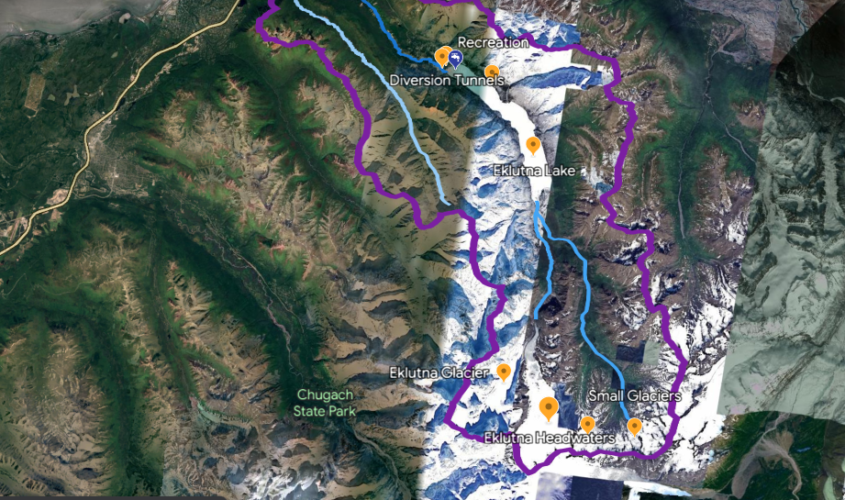
U.S. Department of the Interior
Bureau of Land Management
Eklutna Headwaters
Take a look at the headwaters, or the area at the highest end of the watershed.
Observe this area. Write down 3 things you notice about this part of the watershed in your science journal or on a piece of paper.
Headwaters
Map Data: Google Maxar Technologies Airbus Landsat/Copernicus IBCAO CNES/Airbus

Slide 9
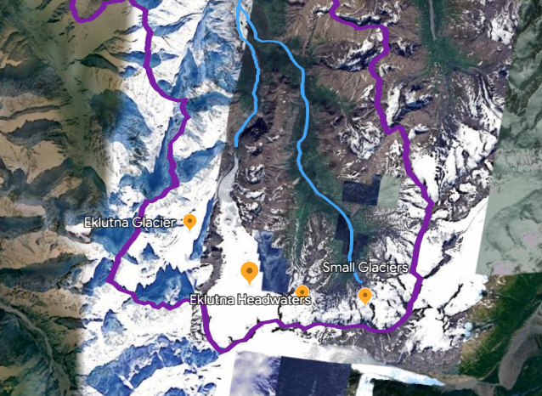
U.S. Department of the Interior
Bureau of Land Management
Where does water come from in the Eklutna Watershed?
The Eklutna Watershed begins in the Chugach Mountains. The waterways form from rain, snow melt, and glacier ice melt.
Glaciers form high in the mountains where snow stays all year round and compresses to form dense glacier ice.
Map Data: Maxar Technologies Airbus Landsat

Slide 10
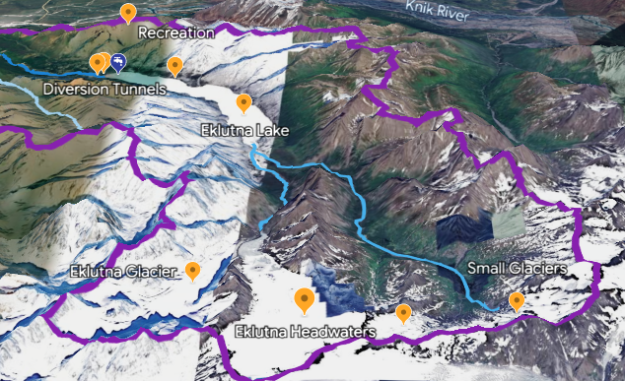
U.S. Department of the Interior
Bureau of Land Management
Eklutna Glacier
Eklutna Glacier (Dena'ina: Idlu Bena Li'a) is the largest glacier in the watershed.
After glacier ice forms from snow over many years, it flows downhill like a slow-motion river. Glacier ice has a distinct light blue color you can see when it is not covered by snow.
Warm temperatures in the summer cause ice to melt from the glacier and flow into the river.
Map Data: Google Maxar Technologies Landsat

Slide 11
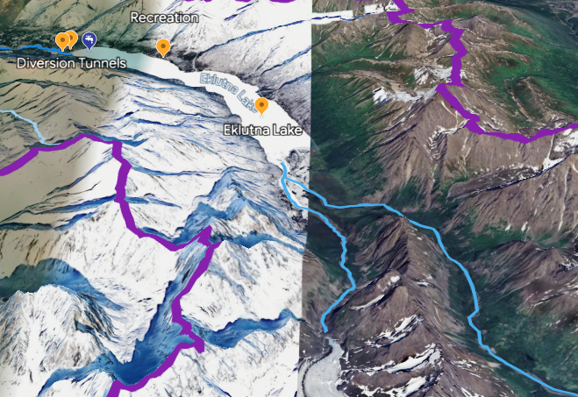
U.S. Department of the Interior
Bureau of Land Management
West Fork Eklutna River
The melt water from Eklutna Glacier flows into the West Fork Eklutna River and then into Eklutna Lake.
West Fork Eklutna River
Map Data: Google Maxar Technology Airbus

Slide 12
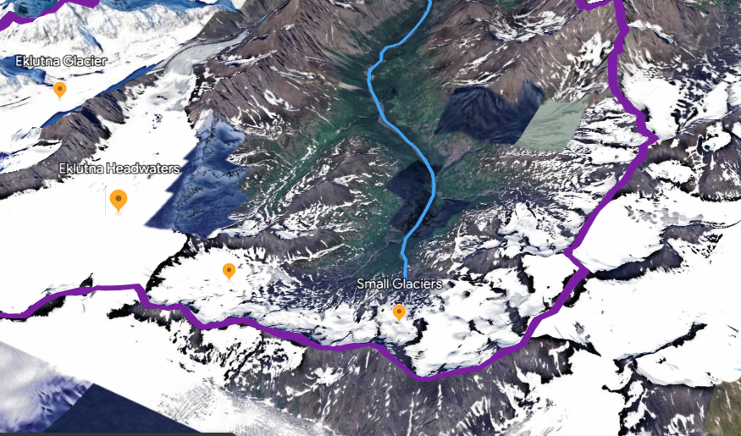
U.S. Department of the Interior
Bureau of Land Management
Small Glaciers
Ice also melts from smaller glaciers east of Eklutna Glacier.
Map Data: Airbus Maxar Technologies Landsat/Copernicus

Slide 13
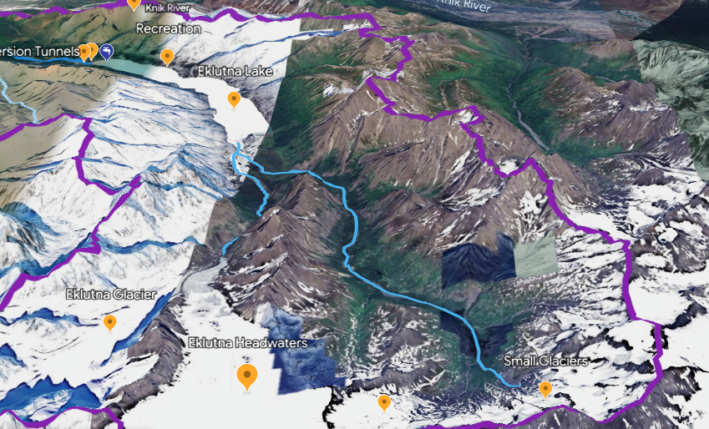
U.S. Department of the Interior
Bureau of Land Management
East Fork Eklutna River
Ice melt from these smaller glaciers and snow and rain that falls in the mountains flows into the East Fork Eklutna River, which also carries water to Eklutna Lake.
Notice how the land slopes down toward the lake. Remember, water moves downhill in a watershed.
East Fork Eklutna River
Map Data: Google Airbus Maxar Technologies Landsat/Copernicus IBCAO Data SIO NOAA

Slide 14
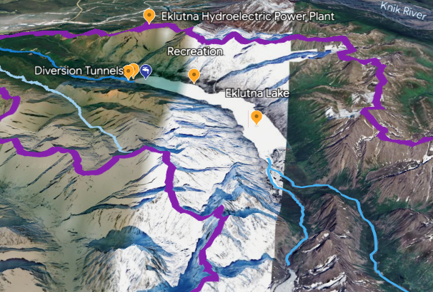
U.S. Department of the Interior
Bureau of Land Management
Eklutna Lake
Water from glacier ice melt, snow melt, and rain that falls in the mountains flows into Eklutna Lake (Idlu Bena).
Map Data: Google Maxar Technologies Airbus Landsat

Slide 15
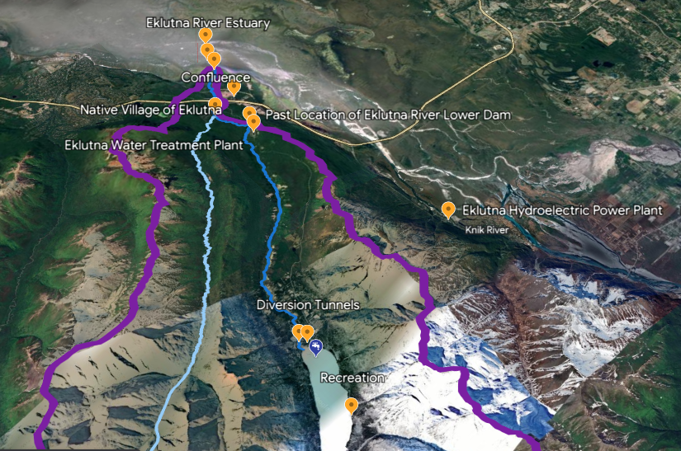
U.S. Department of the Interior
Bureau of Land Management
Eklutna River
Water from Eklutna Lake and the surrounding land drains into the Eklutna River (Idluytnu).
The Eklutna River is shown in dark blue.
Eklutna River
Map Data: Google Airbus Maxar Technologies CNES/Airbus

Slide 16
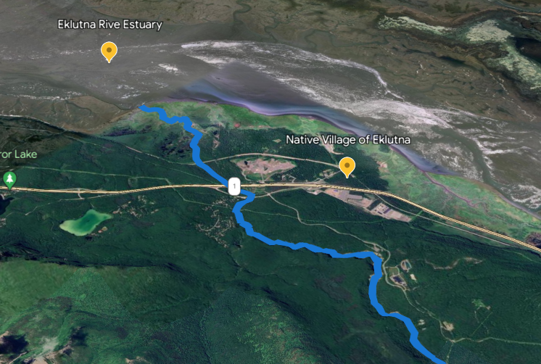
U.S. Department of the Interior
Bureau of Land Management
Eklutna River Estuary
The Eklutna River flows into Cook Inlet (part of the Pacific Ocean) at the Eklutna River Estuary. An estuary is where freshwater from a river meets saltwater from the ocean.
Map Data: Airbus

Slide 17
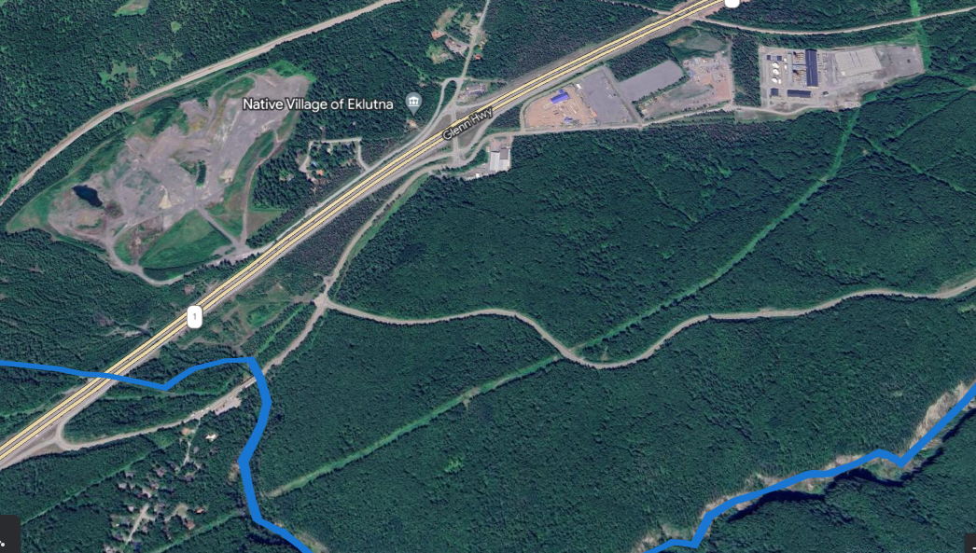
U.S. Department of the Interior
Bureau of Land Management
Native Village of Eklutna
The Dena'ina people of the Native Village of Eklutna (Idlughet) have lived off the land in the Eklutna Watershed for more than 800 years.
Map Data: Airbus

Slide 18
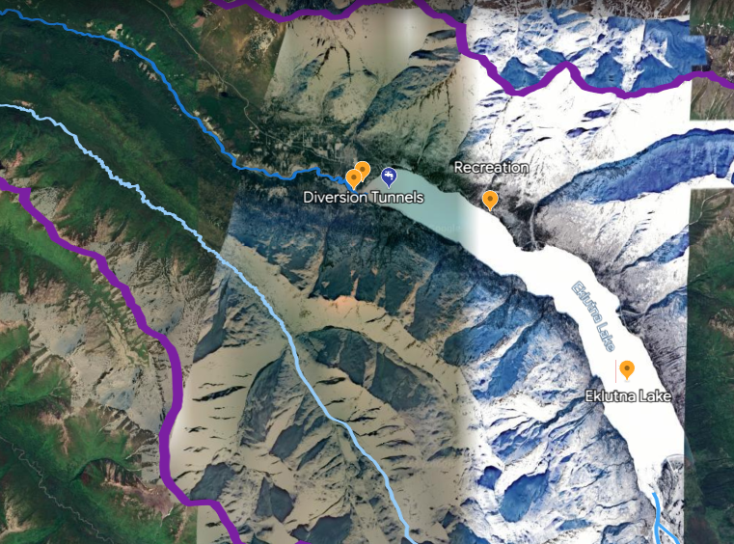
U.S. Department of the Interior
Bureau of Land Management
Reservoir
Eklutna Lake is a water reservoir, which means it is a large natural or human-made lake used as a source of water supply.
The people of the Native Village of Eklutna and Anchorage get almost all of their drinking water from Eklutna Lake.
Map Data: Airbus Maxar Technologies

Slide 19
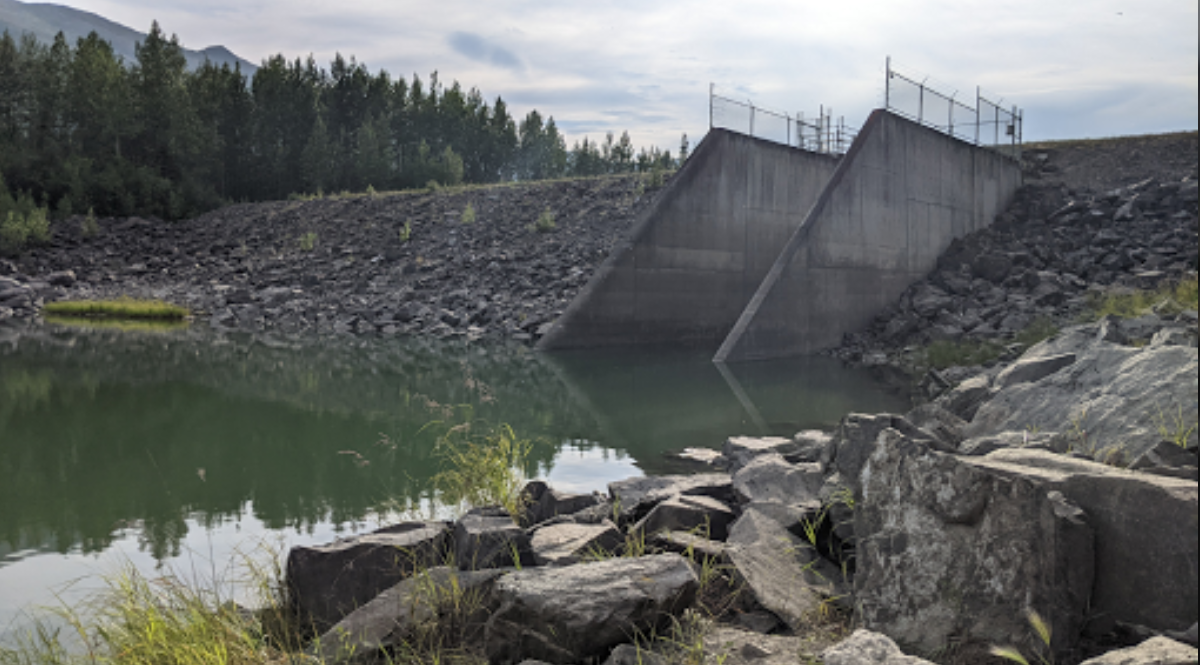
U.S. Department of the Interior
Bureau of Land Management
A Eklutna River Upper Dam
A dam built at the outlet of Eklutna Lake blocks water from flowing downstream to the Eklutna River.
What do you notice about the area around the dam? Write down your observations.
The Eklutna River Upper Dam.
Photo by CCSC staff, BLM.

Slide 20
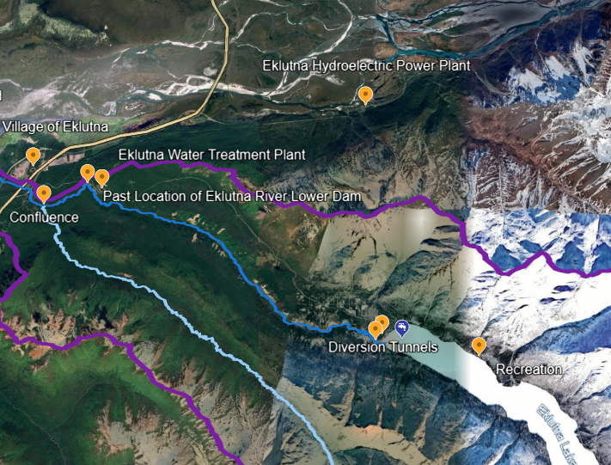
U.S. Department of the Interior
Bureau of Land Management
Eklutna Hydroelectric Power Plant
Water from Eklutna Lake is used to make electricity for the people of Anchorage.
Water is carried in a tunnel under the mountains to the Eklutna Hydroelectric Plant, which is outside the Eklutna Watershed boundary.
Map Data: Google Landsat Copernicus Airbus Maxar Technologies CNES/Airbus

Slide 21
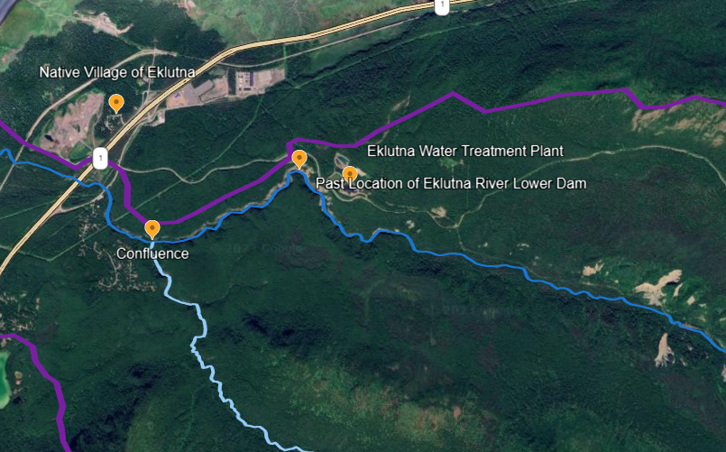
U.S. Department of the Interior
Bureau of Land Management
Eklutna Water Treatment Plant
Water from Eklutna Lake is also carried in a tunnel to the Eklutna Water Treatment Plant where the water is made safe for drinking.
The water then travels in pipes to the native Village of Eklutna and Anchorage.
Map Data: Google Airbus Maxar Technologies

Slide 22
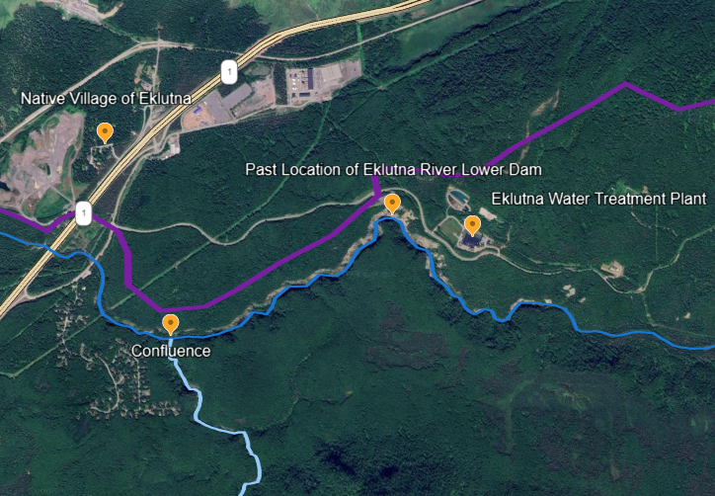
U.S. Department of the Interior
Bureau of Land Management
Past Location of Eklutna River Lower Dam
There used to be a second dam on the Eklutna River. The Eklutna River lower dam was built in the 1920s to generate electricity at a power plant that was used until the 1950s.
The lower dam was removed in 2018 to restore the river’s natural plow, riparian ecosystem, and salmon habitat. Without the dam in the way, salmon will be able to swim upstream to lay eggs.
Map Data: Google Airbus Maxar Technologies

Slide 23
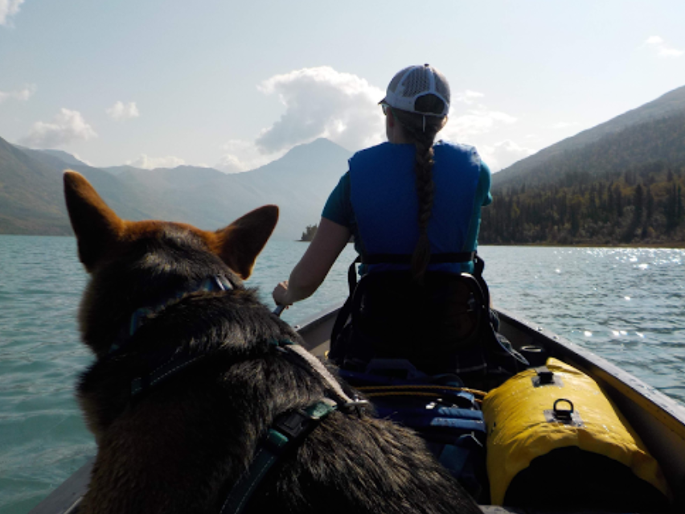
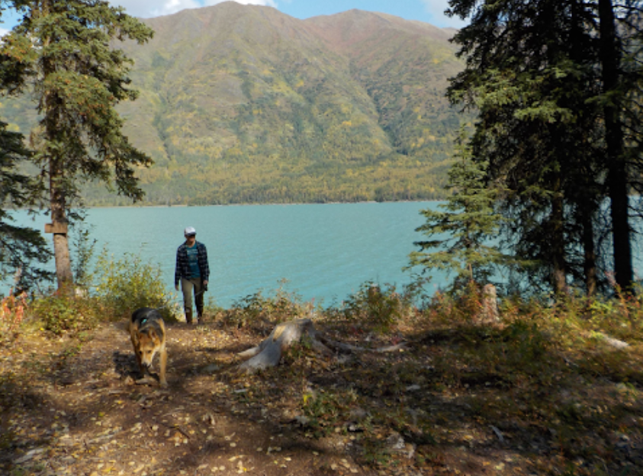
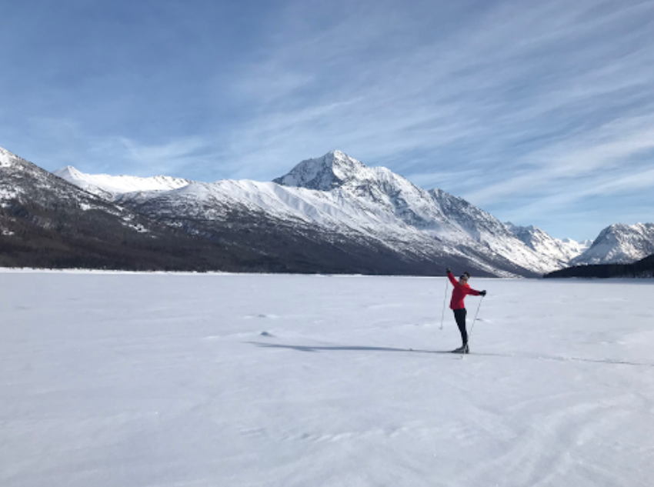
U.S. Department of the Interior
Bureau of Land Management
Recreation
The Eklutna Watershed, including the reservoir, is used for recreation.
Look at the photos to see some of the ways people recreate in the Eklutna Watershed.
Write down observations. What recreation activities do you notice people doing in these photos? How else might people recreate in the watershed?
A person with her dog paddles a small boat on a body of water.
Photo by CCSC staff, BLM.
A person walks on a partially shaded trail near a lake.
Photo by CCSC staff, BLM.
A person spreads their arms to highlight the expansive view.
Photo by CCSC staff, BLM.

Slide 24
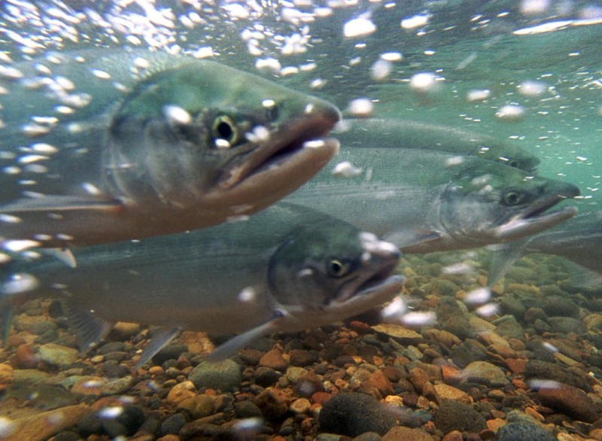
U.S. Department of the Interior
Bureau of Land Management
Salmon
Salmon once thrived in the Eklutna River. The Dena’ina people of the Native Village of Eklutna historically fished salmon that returned to the river to spawn.
When the Eklutna River was dammed, salmon habitat was affected. Salmon now only swim as far up the Eklutna River as the Confluence with Thunderbird Creek.
How do you think this change might affect the Native Village of Eklutna? Write down your answer.
USFWS

Slide 25
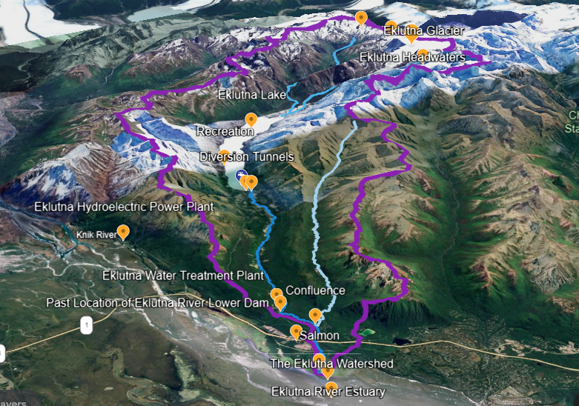
U.S. Department of the Interior
Bureau of Land Management
The Eklutna Watershed
Now that you have explored some of the major stops along the Eklutna Watershed, what other questions do you have about this area?
Write down 3 questions that you have about the Eklutna Watershed.
Map Data: Google Airbus Landsat / Copernicus Maxar Technologies IBCAO CNES / Airbus Data SIO, NOAA, U.S. Navy, NGA, GEBCO

