Slide 1
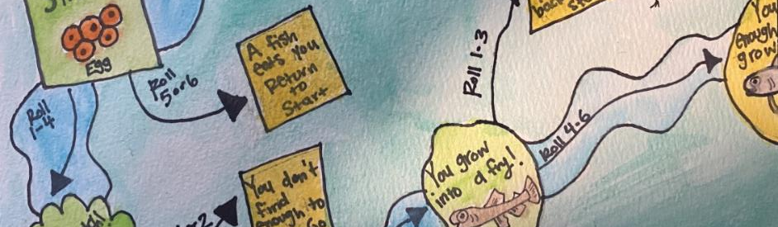
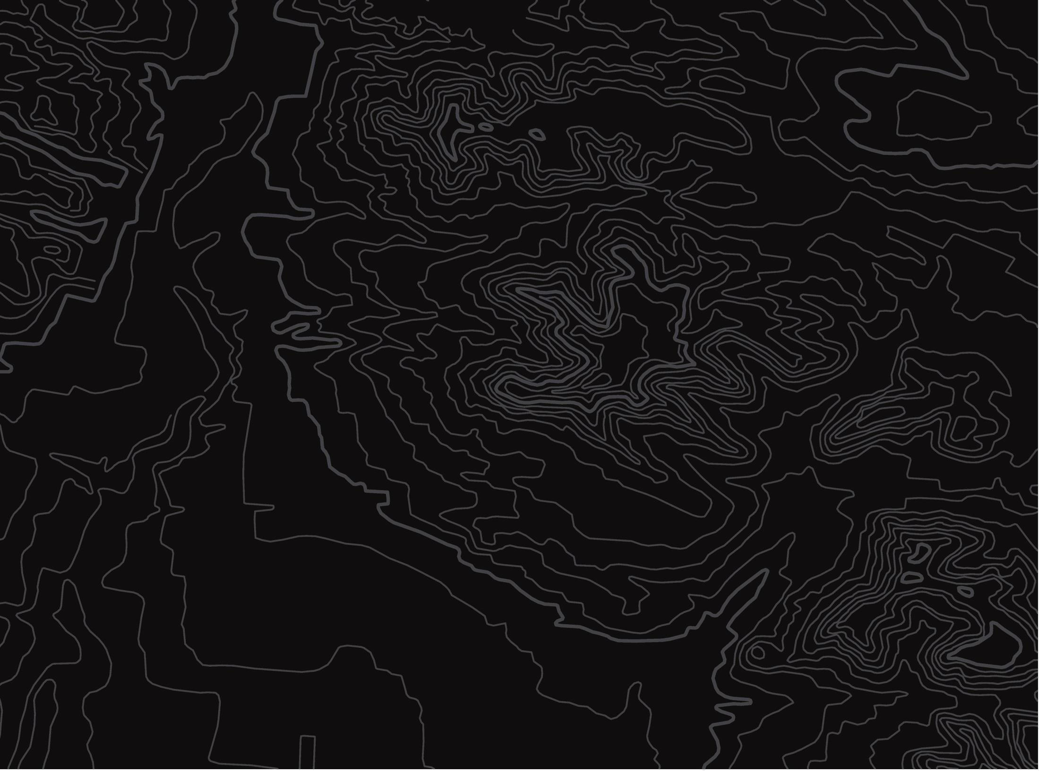


Salmon Game
U.S. Department of the Interior
Bureau of Land Management
Design a game about salmon
Module 4 Reflection
Graphic by CCSC staff, BLM.

Slide 2
Materials:
U.S. Department of the Interior
Bureau of Land Management
paper (or something to write on)
something to write with
coloring supplies (optional)
art supplies (optional)

Slide 3
U.S. Department of the Interior
Bureau of Land Management
Design a game about salmon!
Your game should include:
Each part of the salmon life cycle: egg, alevin, fry, smolt, ocean adult, spawning adult
All three salmon habitats: freshwater streams and lakes, estuary, ocean
At least two challenges salmon might face
Be creative. You can design a board game, card game, video game, trivia game, obstacle course, or something totally unique.
If possible, play the game.

