Slide 1



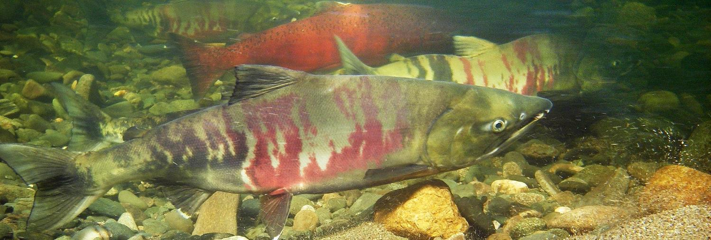
Salmon Life Cycle
U.S. Department of the Interior
Bureau of Land Management
Discover the challenges salmon face to survive long enough to grow up and spawn
Module 4, Lesson 4
Salmon swimming in a river. Photo by J. Post, BLM

Slide 2


Lesson 4: Salmon Life Cycle
Lesson Questions:
U.S. Department of the Interior
Bureau of Land Management
What are the parts of the salmon life cycle?
What are some challenges salmon face during their life cycle?

Slide 3
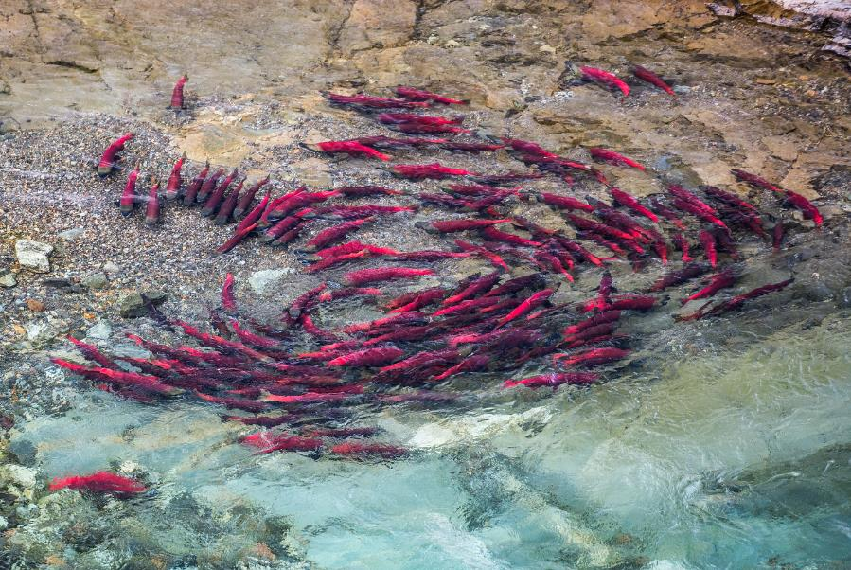
Salmon are always on the move.
They spend part of their lives in fresh water and part of their lives in salt water.
U.S. Department of the Interior
Bureau of Land Management
Salmon swimming in fresh water.
Photo by R. Taylor, NPS.

Slide 4
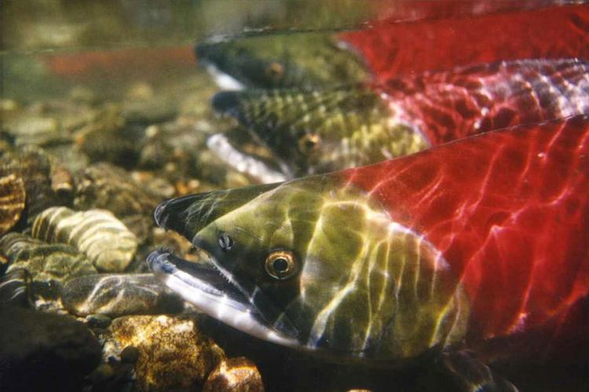
Because salmon migrate between the ocean and freshwater streams, they travel through almost every part of a waterway during their life cycle.
U.S. Department of the Interior
Bureau of Land Management
A close up of salmon swimming fresh water.
Photo by NOAA Fisheries.

Slide 5
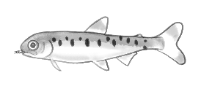
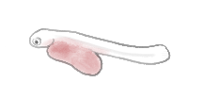
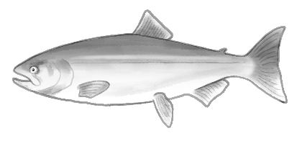
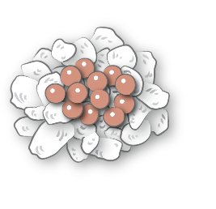
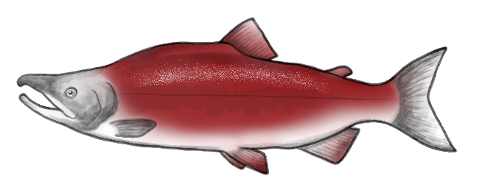

Salmon Life Cycle | Egg
U.S. Department of the Interior
Bureau of Land Management
Salmon start their lives as small eggs hidden among the gravel in freshwater streams and lakes.
Salmon life cycle diagram. Graphic by K. Mincer, BLM.

Slide 6
Salmon Life Cycle | Alevin
U.S. Department of the Interior
Bureau of Land Management
The eggs hatch into tiny alevin that stay in the gravel, feeding on their yolk sac and hiding from predators.
Salmon life cycle diagram. Graphic by K. Mincer, BLM.

Slide 7
Salmon Life Cycle | Fry
U.S. Department of the Interior
Bureau of Land Management
Once they use up their yolk sac, the salmon become fry, swimming around and eating insects.
Salmon life cycle diagram. Graphic by K. Mincer, BLM.

Slide 8
Salmon Life Cycle | Ocean Adult
U.S. Department of the Interior
Bureau of Land Management
Next, salmon travel out to the ocean, where they get much larger feeding on the ocean’s rich food supply.
Salmon life cycle diagram. Graphic by K. Mincer, BLM.

Slide 9
Salmon Life Cycle | Smolt
U.S. Department of the Interior
Bureau of Land Management
As they get older and bigger,
the fish become smolts. They prepare to leave fresh water
and go to the ocean.
Salmon life cycle diagram. Graphic by K. Mincer, BLM.

Slide 10
Salmon Life Cycle | Spawning Adult
U.S. Department of the Interior
Bureau of Land Management
After a few years in the ocean, salmon use their sense of smell to return to their home stream to spawn (lay and fertilize eggs).
Salmon life cycle diagram. Graphic by K. Mincer, BLM.

Slide 11
Salmon Life Cycle | After Spawning
U.S. Department of the Interior
Bureau of Land Management
After spawning, salmon die. Their bodies provide food and nutrients for many other creatures.
Salmon life cycle diagram. Graphic by K. Mincer, BLM.

Slide 12
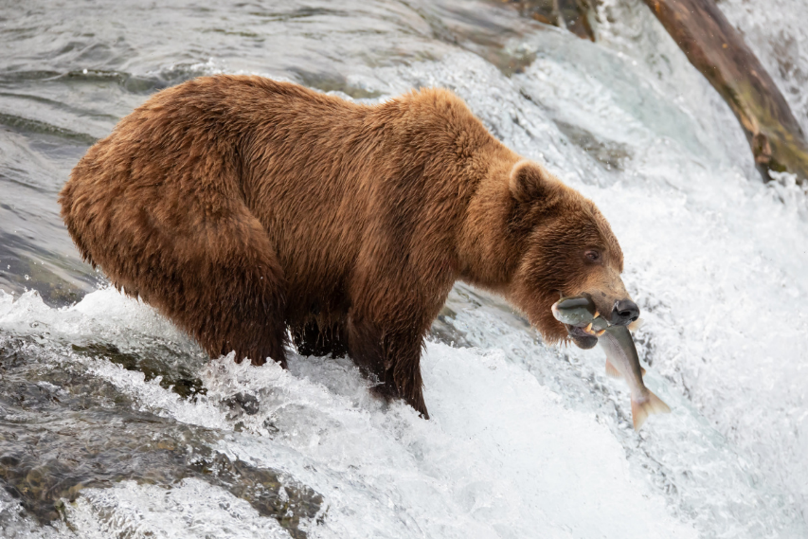
The salmon life cycle is complex and dangerous.
Out of thousands of eggs laid by each female salmon, less than 10 will survive long enough to spawn.
Pretend you are a salmon. Do you have what it takes to survive long enough to spawn? Find out by going to the next slide to play a game.
U.S. Department of the Interior
Bureau of Land Management
A brown bear stands on the edge of a waterfall to catch a tasty salmon.
Photo by M. Freels, NPS.

Slide 13
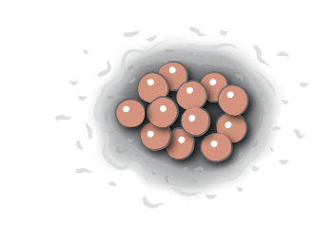


In the beginning…
You hatch from an egg in a freshwater stream in Alaska.
You emerge from the gravel as a salmon fry.
yolk sac
As an alevin, you hide in the stream bed gravel and survive on nutrients from your yolk sac.
Graphics by K. Mincer, BLM.

Slide 14
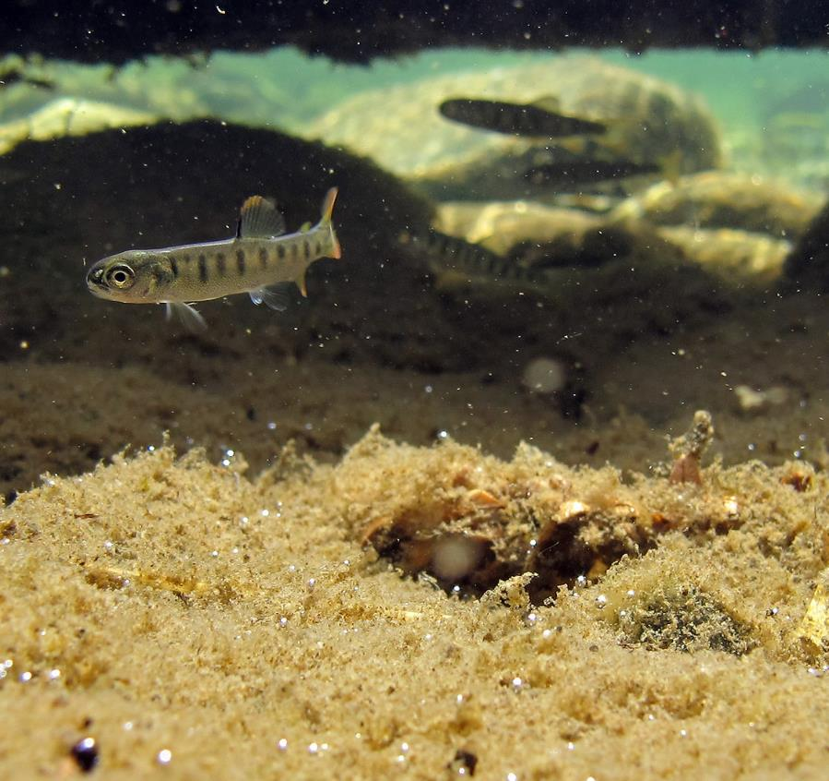
Choose your adventure
You must now survive to be an adult and return to this stream and spawn the next generation of salmon.
Choose where you want to go next.
Swim with
Dolly Varden Trout
Swim with Macroinvertebrates
Small salmon fry swim in fresh water.
Photo by K. Mueller, USFWS.

Slide 15
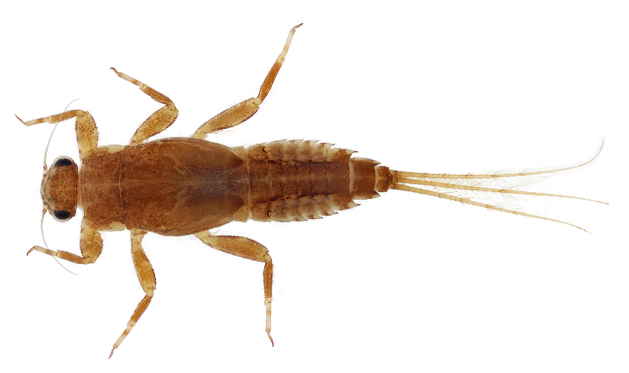
Fresh Water
In the stream where you live, there are lots of aquatic macroinvertebrates. You eat a steady diet of mayflies, stoneflies, and caddisflies and grow strong.
Flex your muscles and swim onwards.
A closeup of a macroinvertebrate.
Photo used with permission © NSF & Macroinvertebrates.org

Slide 16
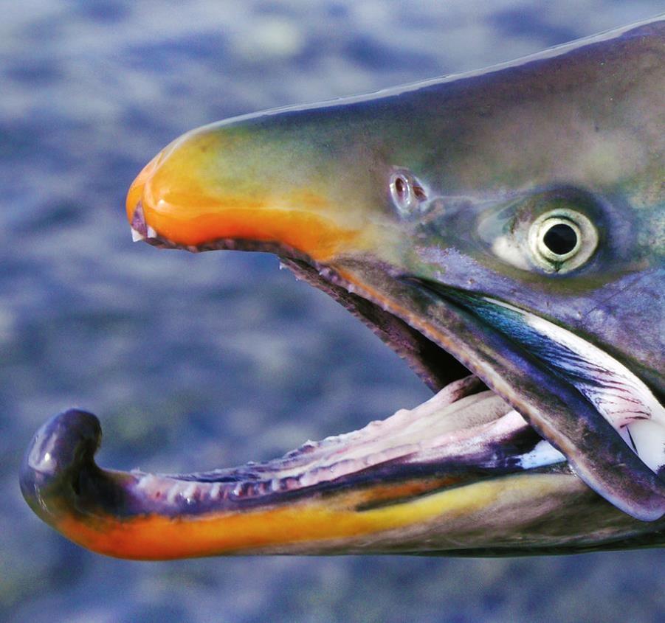
Fresh Water
Look out! A hungry Dolly Varden approaches. Before you can escape, the other fish gobbles you up. You have died.
Go back to the beginning to start the game again as a new salmon.
A close up of a salmon out of water.
Photo by R. Brown, USFWS.

Slide 17
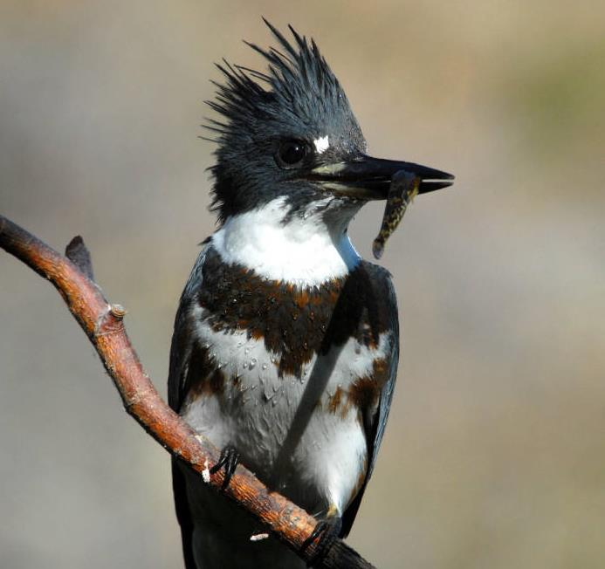
Fresh Water
WHOOSH! Water explodes around you as the long beak of a belted kingfisher snatches up the salmon fry next to you. You flee for cover under a fallen log. Whew, that was close!
Take five deep breaths.
Swim to the next spot.
A kingfisher holds a tiny fish in its beak.
Photo by D. Menke, USFWS.

Slide 18
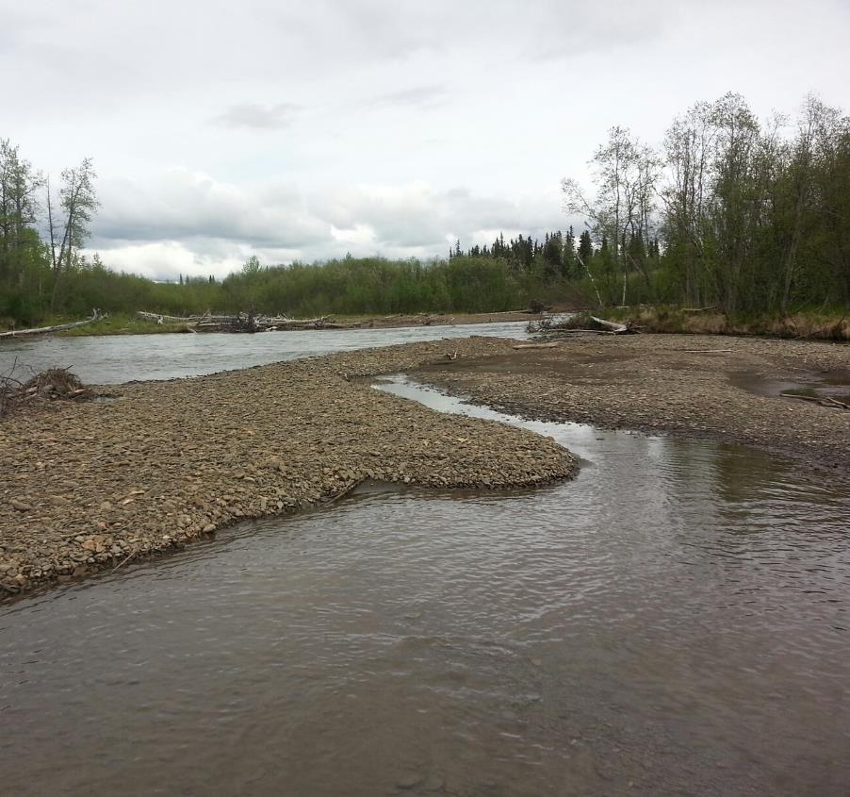
Fresh Water
As you continue to grow, you need to find shelter to hide from predators.
Choose a place to rest.
Swim towards
the edge
Rest under the big shady trees
A gravel bar surrounded by water.
Photo by J. Kowalczyk, BLM.

Slide 19
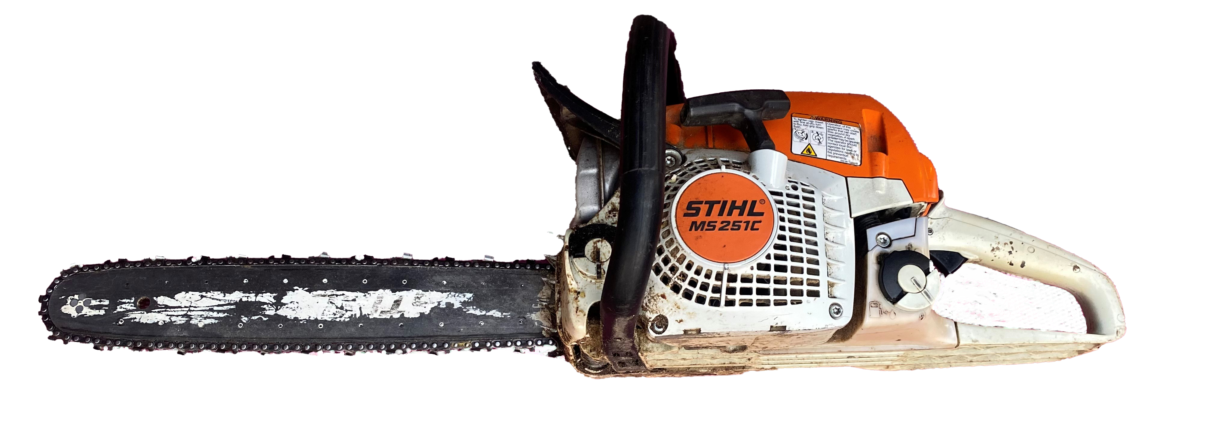
Fresh Water
RRRRRRR! Someone who lives next to the stream uses a chainsaw to cut down trees along the water’s edge. The water gets hot without the shade from the trees.
You need to move to another part of the stream.
Find a new place to rest.
A gravel bar surrounded by water.
Photo by J. Kowalczyk, BLM.
A chainsaw.
Photo by A. Runde, BLM.
Notes:
Microsoft Clipart

Slide 20
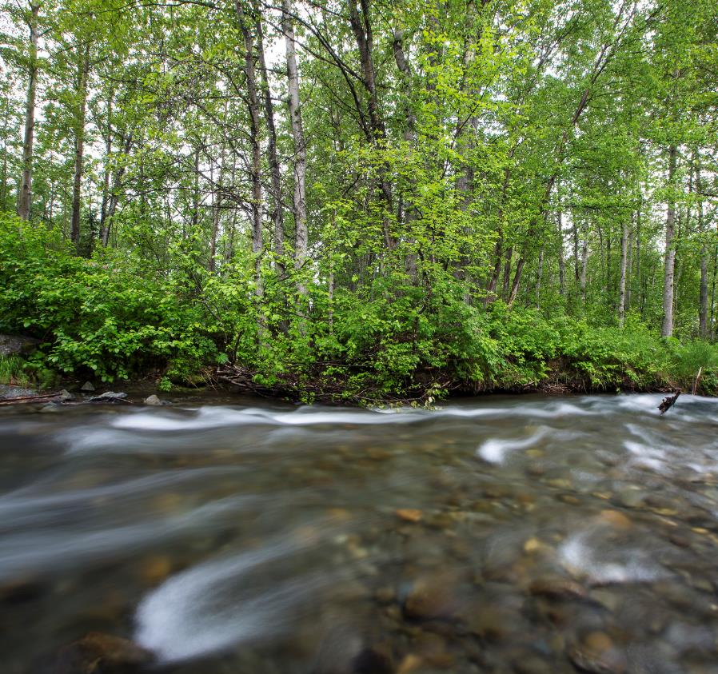
Fresh Water
Large trees shade the stream and keep the water cold. You need cold, clean water with lots of dissolved oxygen to survive.
Rest for five seconds, then continue downstream.
Campbell Creek.
Photo by B. Wick, BLM.

Slide 21
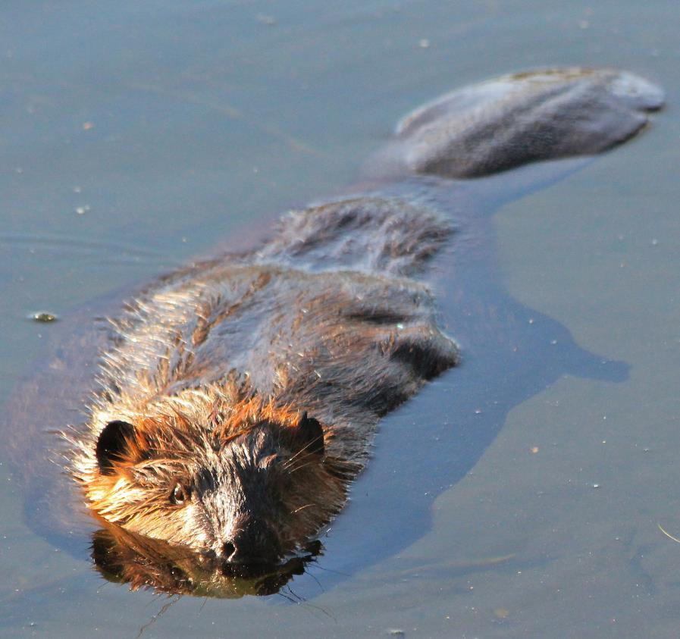
Fresh Water
Beavers cut down a few trees near your stream to build a dam and lodge. The fallen logs create slower moving pools where you like to rest, hide from predators, and hunt for prey.
Continue your journey to the ocean.
A beaver swims casually through the water.
Photo by J. Matlock, BLM.

Slide 22
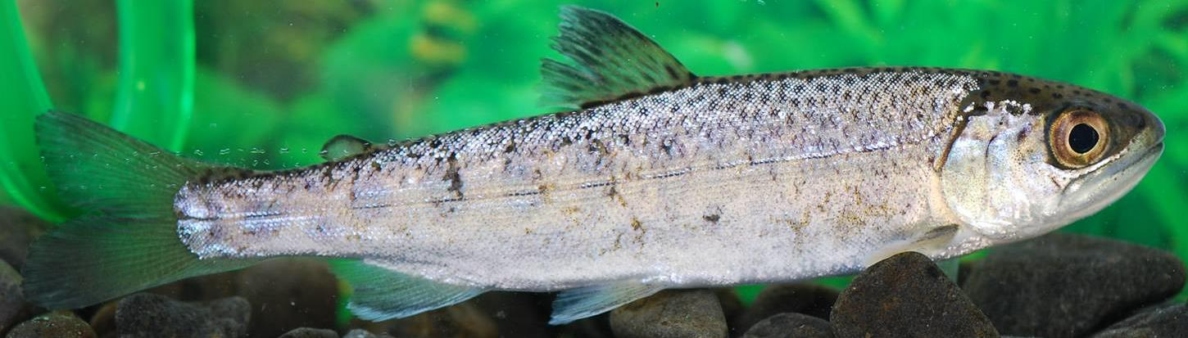
Ocean
Swim with zooplankton
After spending time in fresh water as a fry, you enter the smolt phase of your life cycle.
You travel to the estuary where the freshwater river meets the saltwater in the ocean.
You give your body time to adapt to salt water before moving into the ocean.
Slowly count to 10, then choose a path.
Swim with orcas
The back section of a fish swimming in water.
Photo by USFWS.

Slide 23
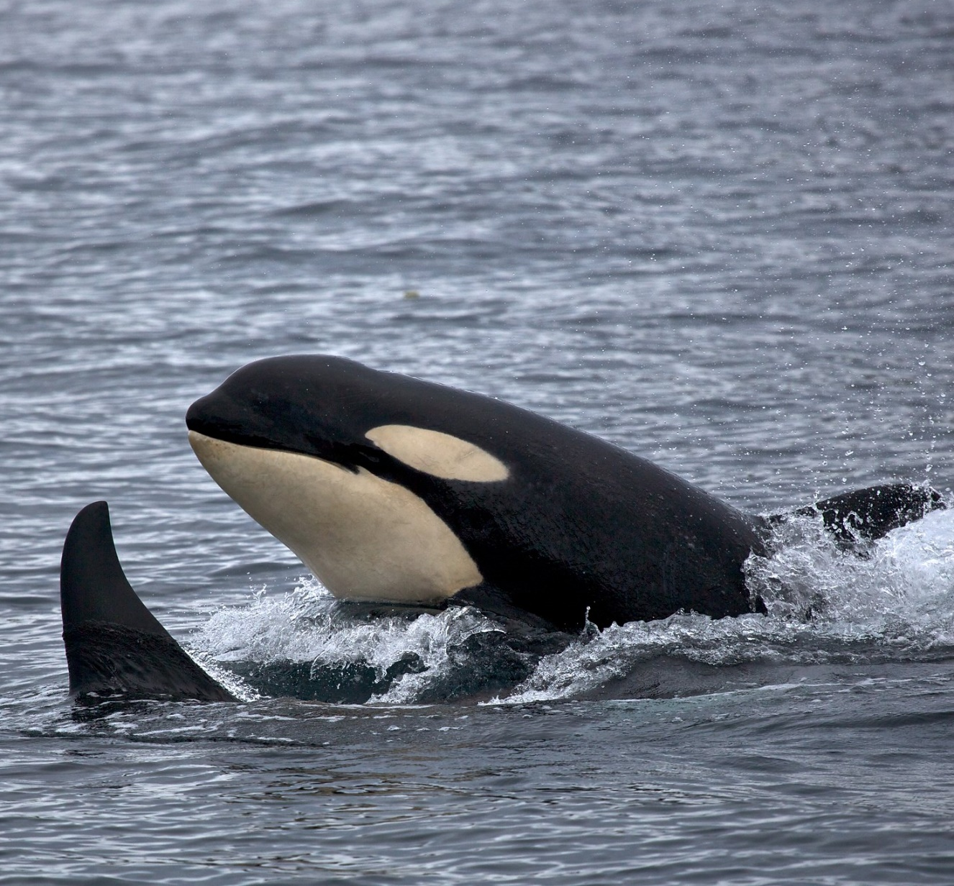
Ocean
Watch out! Orcas are heading your way! You swim as fast as you can, but you are no match for one of the ocean’s top predators. You have died.
Go back to the beginning and start again as a new salmon.
Two orcas (killer whales) momentarily break the water's surface.
Photo by K. Thoresen, NPS.

Slide 24
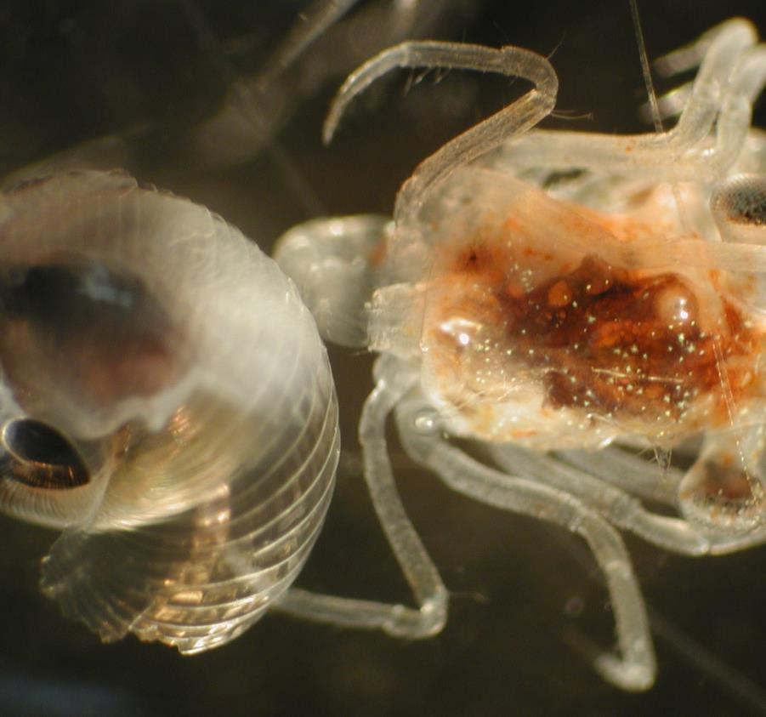
Ocean
The ocean where you spend time maturing is full of floating creatures called zooplankton. You eat plenty of them and grow big.
Choose where to go next…
Explore new territory
Discover new types of fish
Check out that shadow
A close up image of zooplankton.
Photo by M. Wilson & J. Clark, NOAA.

Slide 25
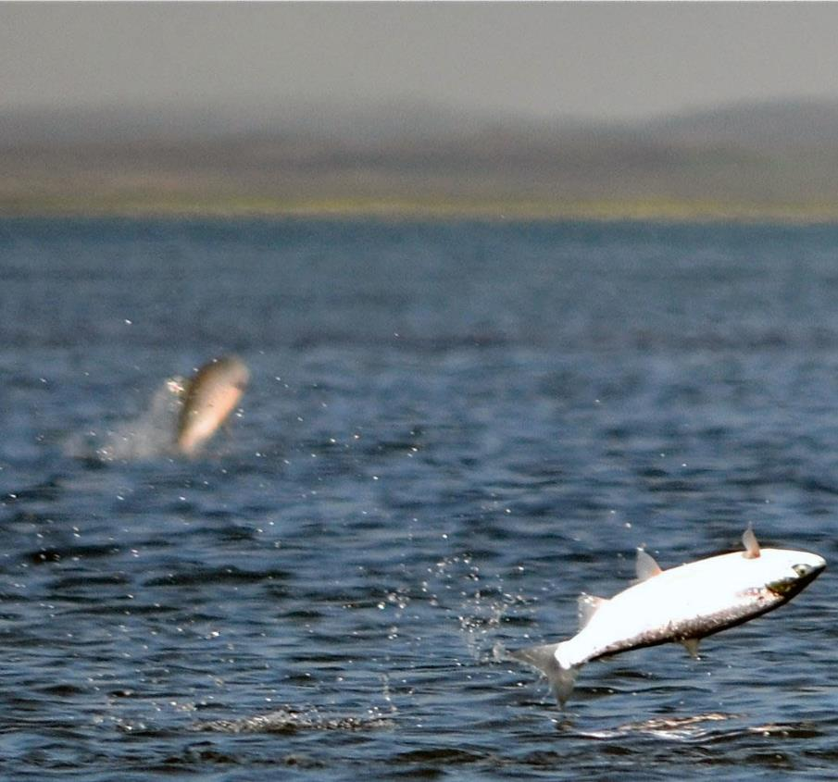
Ocean
Two shadows appear near the surface, one small and one big. You have never seen a fishing net or boat before, so you swim closer to investigate. Suddenly, you are yanked sidewise by a net! As the opening gets smaller, you squeeze closer to other fish. At the last second, you use your powerful tail to swim down and out of the net.
Slowly count to 10, then continue swimming.
Salmon leaping out of the water's surface.
Photo by K. Mueller, USFWS.

Slide 26
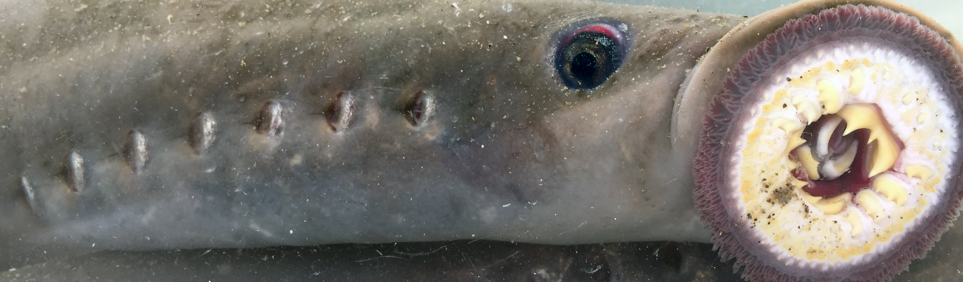
Ocean
OUCH! The sharp teeth of a Pacific lamprey latch onto the side of your body. The lamprey, a parasite, uses its tongue to drill a hole in your body. It drinks your blood and you become weak.
Once the lamprey is full, it lets go. You take a long time to recover.
Go back to Ocean feed on more zooplankton.
A close up image of a Pacific lamprey.
Photo by USFWS.

Slide 27
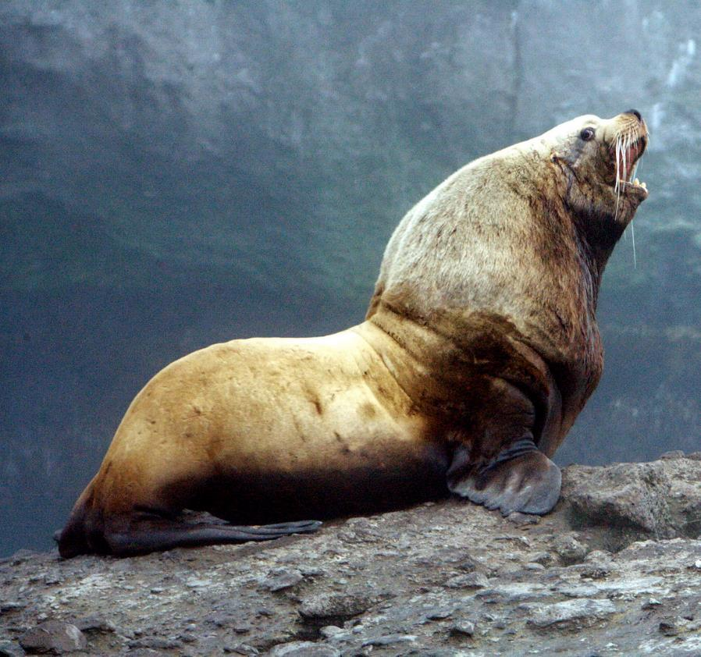
Ocean
Uh oh! The lateral line along the sides of your body senses movement in the water nearby. A sea lion’s large, whiskered face appears. Its teeth graze your side, but the slime covering your scales allows you to slip out of harm’s way.
Continue swimming in the ocean.
A large sea lion hauled out on a rock.
Photo by USFWS.

Slide 28
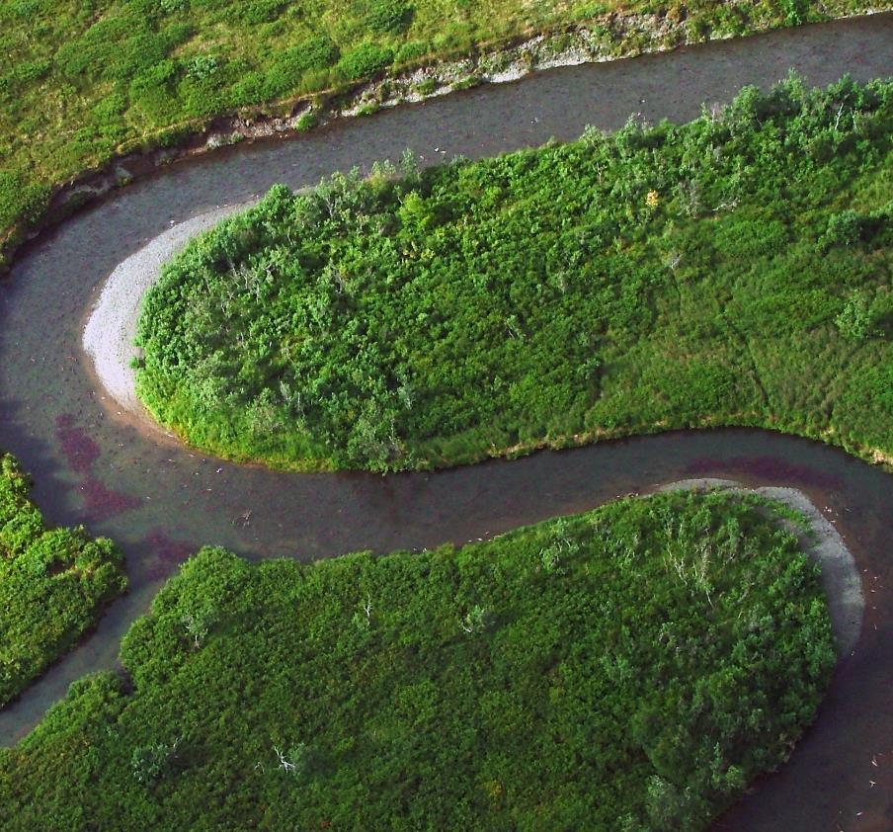
Spawning
After spending time at sea, you reach maturity. You want to produce the next generation of salmon by spawning—laying and fertilizing eggs.
You use your incredible sense of smell to find the exact stream where you hatched from an egg.
Sniff five times to locate your home stream, then choose your next step.
Swim Upstream
Check out the shiny object.
Explore the stream bank.
Migrating salmon swimming upriver to spawn.
Photo by USFWS.

Slide 29
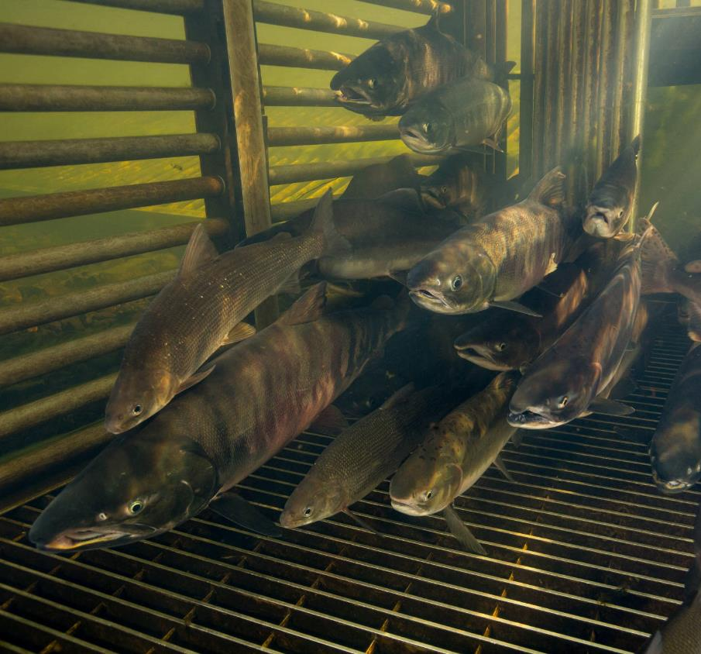
Spawning
As you swim upstream, you run into a weir, a kind of fence placed across a river or stream that funnels you into one opening. Scientists use weirs to trap and count migrating fish.
Swim in a circle five times while you wait to be counted and released.
Once released, continue upstream.
Salmon in a fish weir.
Photo by R. Hagerty, USFWS.

Slide 30
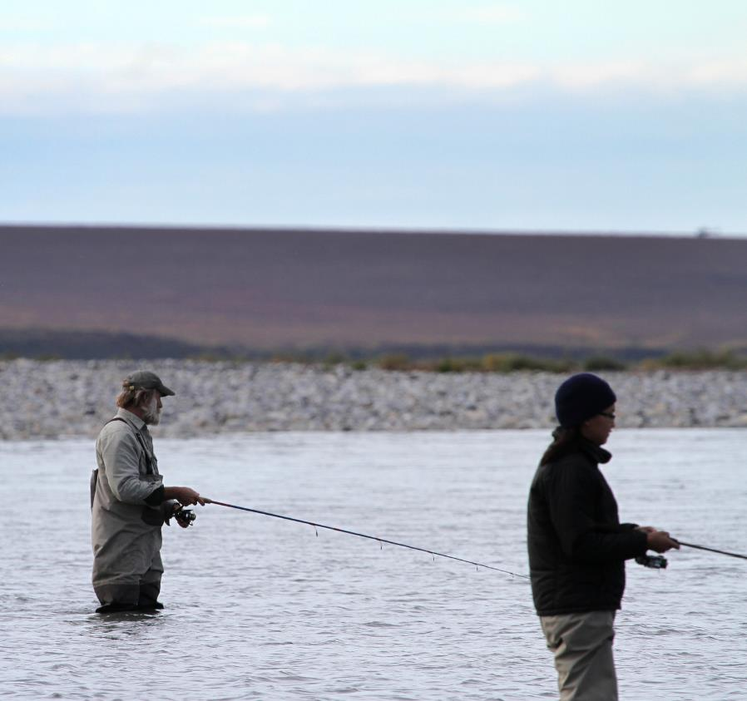
Spawning
Something colorful flashes right in front of you! You bite it and feel a sharp pain in your mouth. Oh no! A fisherman reels you in to shore and puts you into a cooler for dinner.
Go back to the beginning and start again as a new salmon.
Two people standing in water fishing.
Photo by K. Liebich, USFWS.

Slide 31
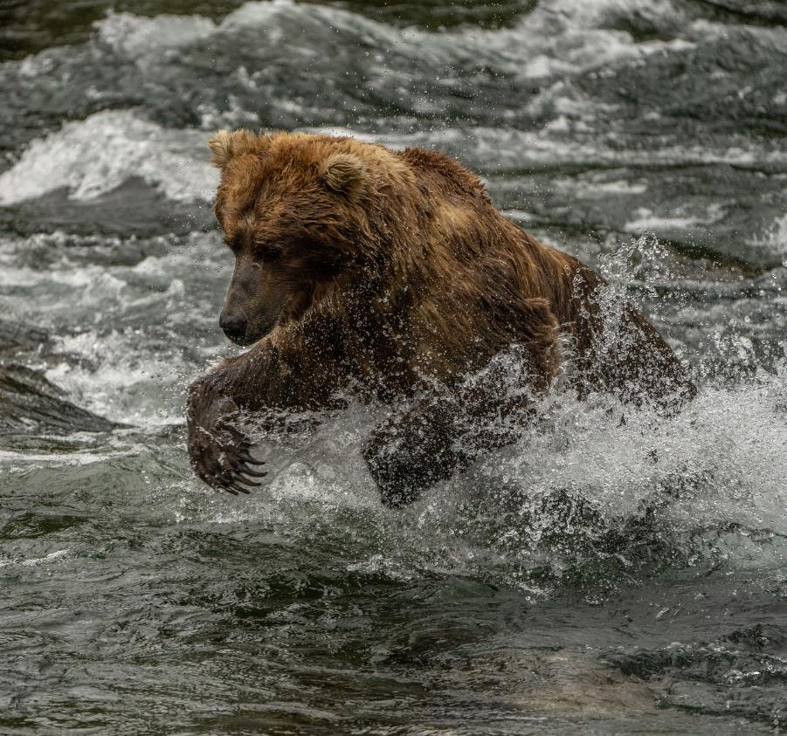
Spawning
You notice a shadow over the water. A bear! The giant face moves toward you, but you dart out of the way.
Take 10 deep breaths as you recover from your close call.
Continue to the spawning grounds.
A hungry brown bear leaps to catch a fish.
Photo by L. Law, NPS.

Slide 32
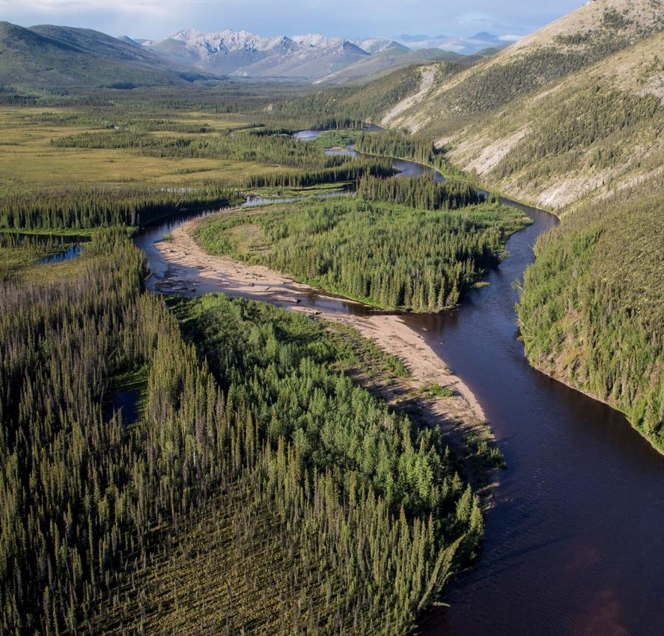
Spawning
You have finally arrived at the spawning grounds! Now you must choose a spot to produce a new generation of salmon.
Spin three times and choose where to go next.
Explore the deep pools.
Explore the waterfall.
Explore the shallow water.
An aerial view of a river winding through a mountainous valley.
Photo by B. Wick, BLM.

Slide 33
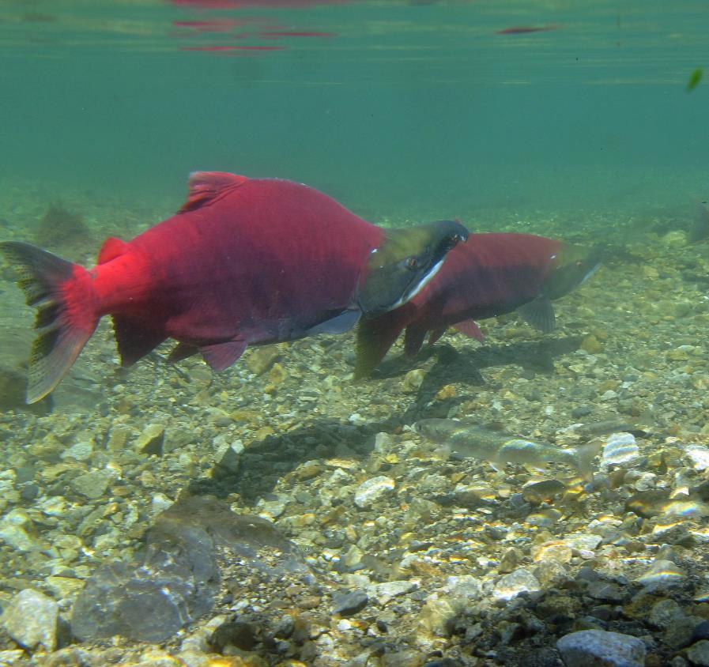
Spawning
Once you reach your upstream spawning grounds, you search for a good place to spawn. You choose a perfect spot, but a bigger salmon with a large hump, hooked jaw, and sharp teeth fights you for it.
You lose the fight and must find a new spot.
Salmon swimming in fresh water.
Photo by K. Mueller, USFWS.

Slide 34
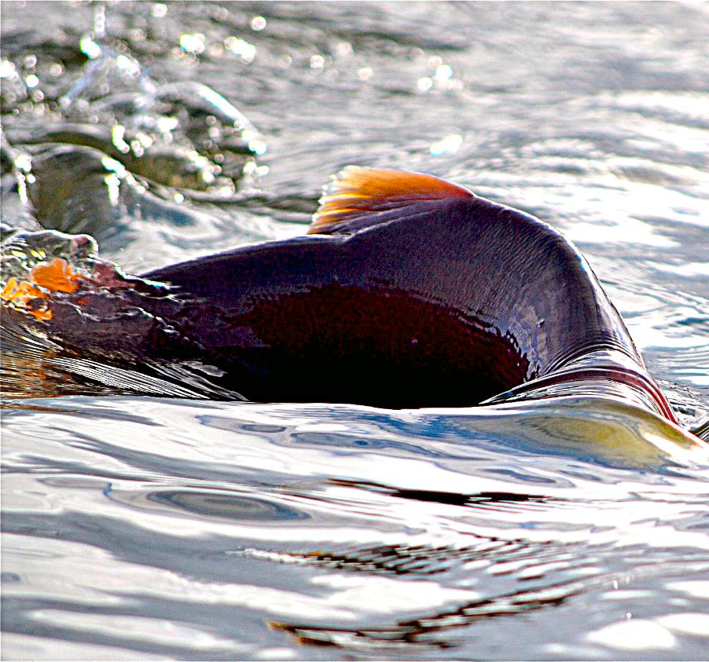
Spawning
As you swim, you notice the top of your body is above the water. Suddenly, you are stuck! There is not enough water in the stream to keep swimming forward.
Wiggle five times to free yourself.
Swim back and choose a path with more water.
A salmon struggles to keep moving in shallow water.
Photo by K. Mueller, USFWS.

Slide 35
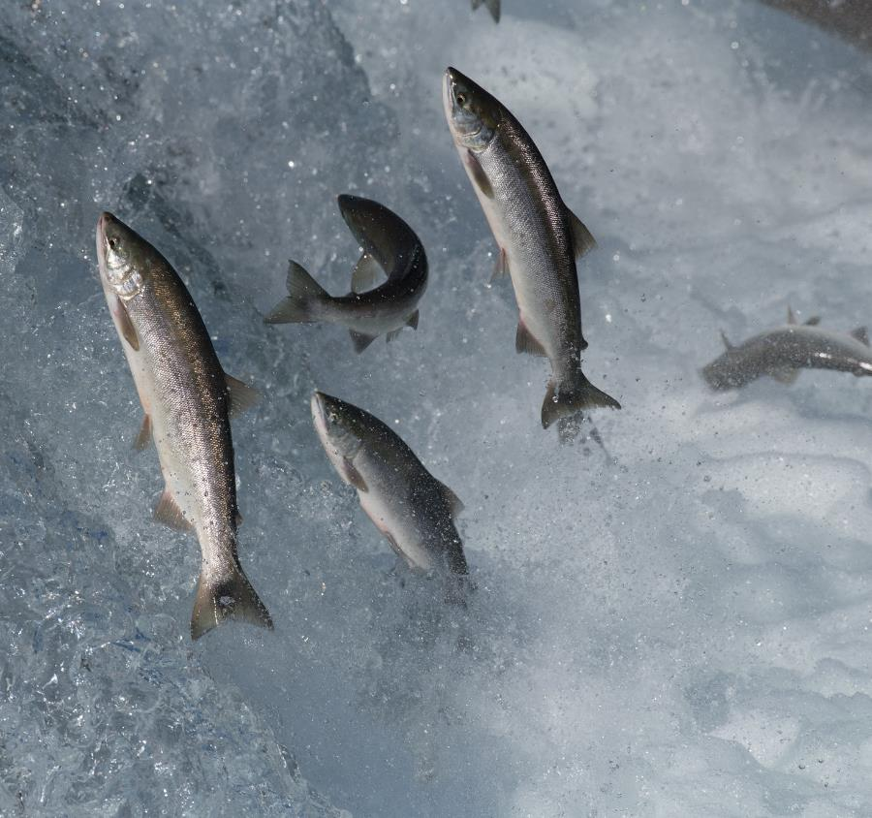
Spawning
After more than a week of swimming upstream, you come to a huge waterfall. You must make it up and over to continue your journey.
Give 10 of your best salmon leaps.
Proceed to the pool above the waterfall.
Salmon jumping out of the water to overcome an obstacle while swimming upstream to spawn.
Photo by R. Taylor, NPS.

Slide 36
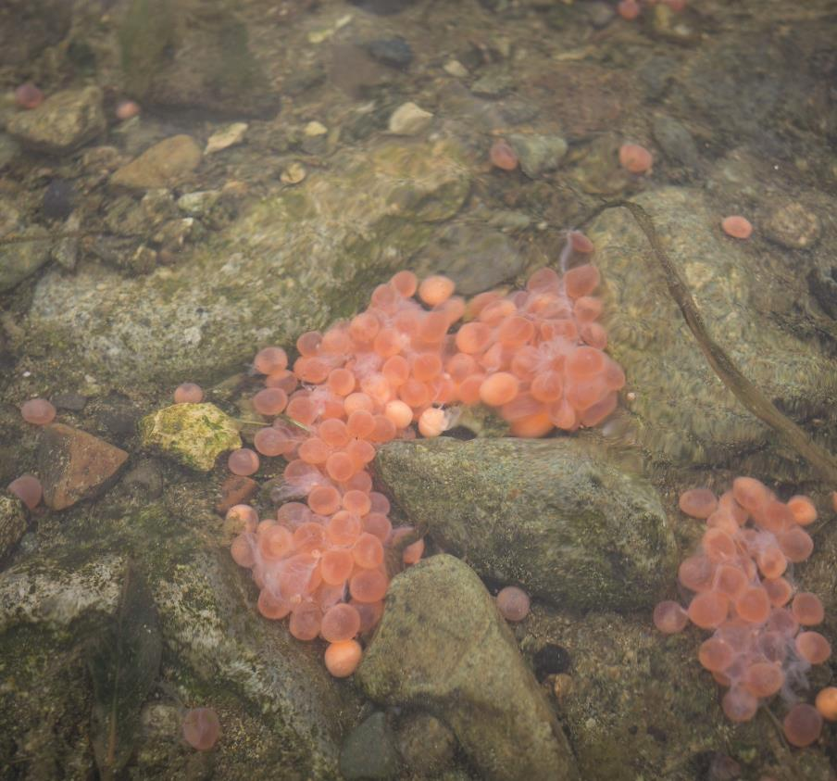
Spawning
Congratulations! You have made it all the way to the end of your journey. You migrated from fresh water to the ocean and back again to produce the next generation of salmon.
You find a mate and create several redds, nests in the gravel, where you lay and fertilize eggs.
A few pink and red salmon eggs scattered among the creek bed rocks.
Photo by A. Ramos, NPS.

Slide 37


Perish
Once animals have eaten their fill, the remaining nutrients from your body go into the soil. Trees absorb the nutrients and grow strong and tall. They provide shade for the developing eggs you spawned.
After spawning, you die. Your body becomes food for the plants and animals that live in and around the stream. Bears, ravens, foxes, eagles, and other animals eat parts of you to gain weight for the winter.
Baby salmon hatch in the spring, and the salmon journey begins again.
Graphics by © Microsoft 365.

