Slide 1
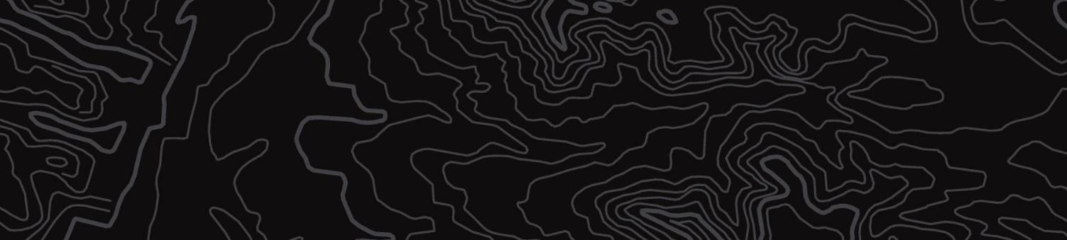
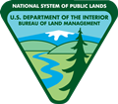

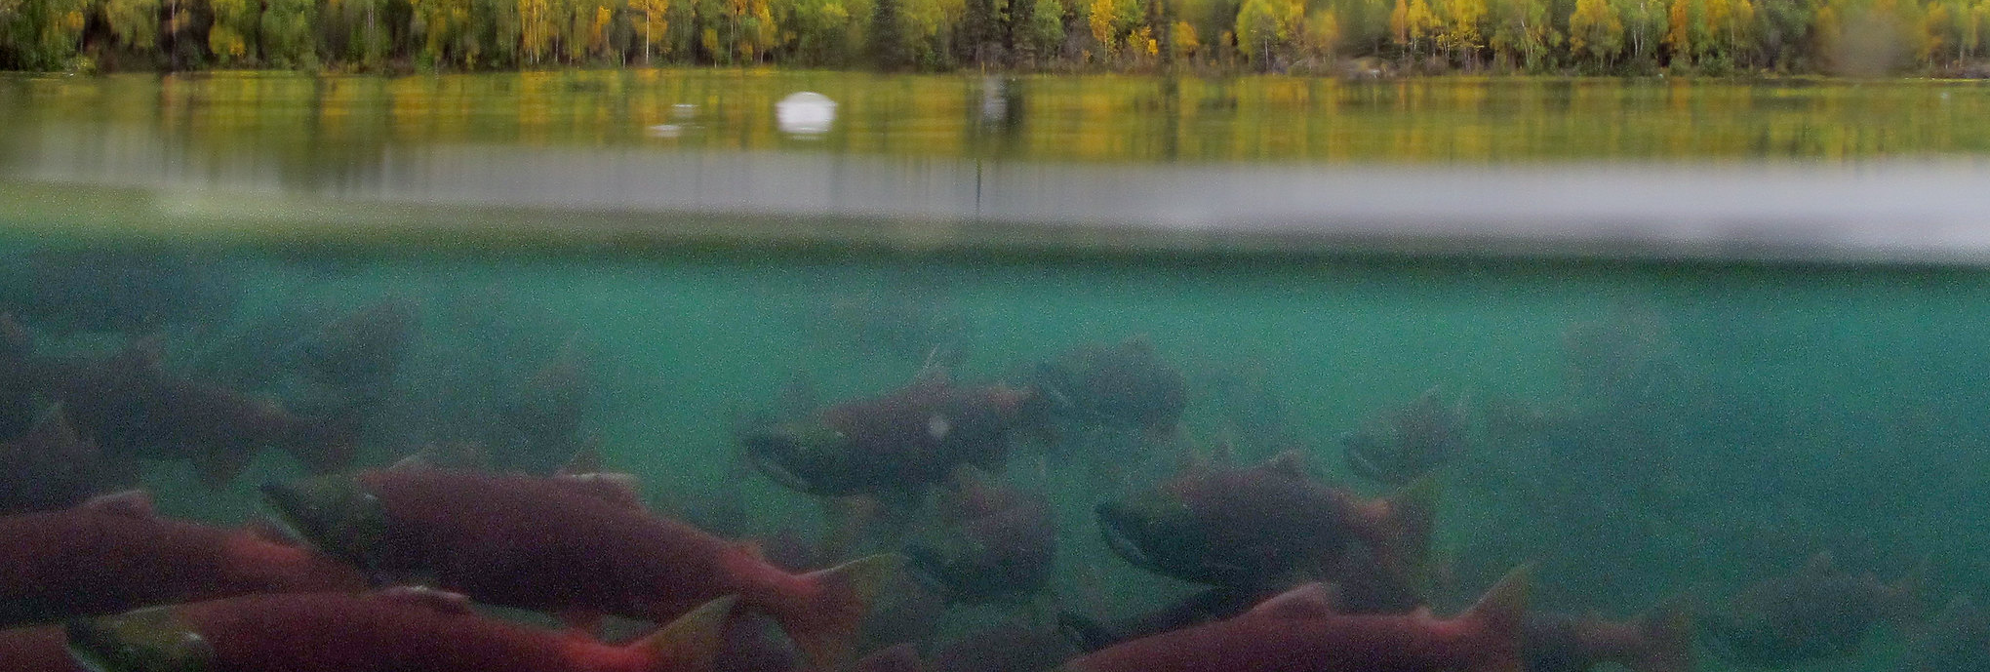
The Salmon Forest
U.S. Department of the Interior
Bureau of Land Management
Create a model of the relationship between salmon and riparian ecosystems
Module 4, Lesson 3
Photo by K. Mueller, USFWS.

Slide 2


Lesson 3: The Salmon Forest
U.S. Department of the Interior
Bureau of Land Management
Lesson Questions:
Why are riparian ecosystems important for salmon?
Why are salmon important for riparian ecosystems?

Slide 3
Materials:
U.S. Department of the Interior
Bureau of Land Management
something to write with
art supplies (optional) - some ideas:
  cardboard
  paper towel rolls or toilet paper rolls
  recycled paper
  clean food containers
  aluminum and tin cans
  sticks, rocks, leaves, or other natural objects
scissors (optional)

Slide 4
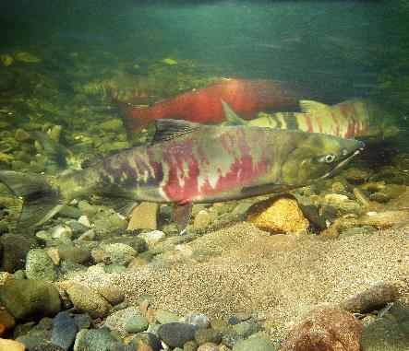
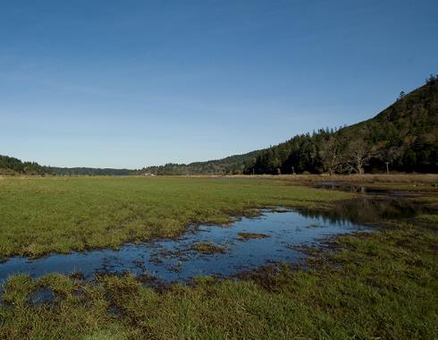
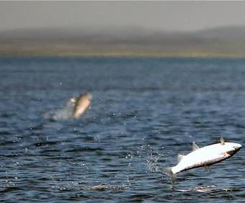
Salmon need different habitats during their life cycle.
U.S. Department of the Interior
Bureau of Land Management
Salmon swimming in water.
Photo by D. Parker, BLM
A landscape view of a water estuary nestled between foothills.
Photo by NOAA.
Salmon leaping out of the water's surface.
Photo by K. Mueller, USFWS.
Freshwater streams & lakes
Estuaries
Ocean

Slide 5
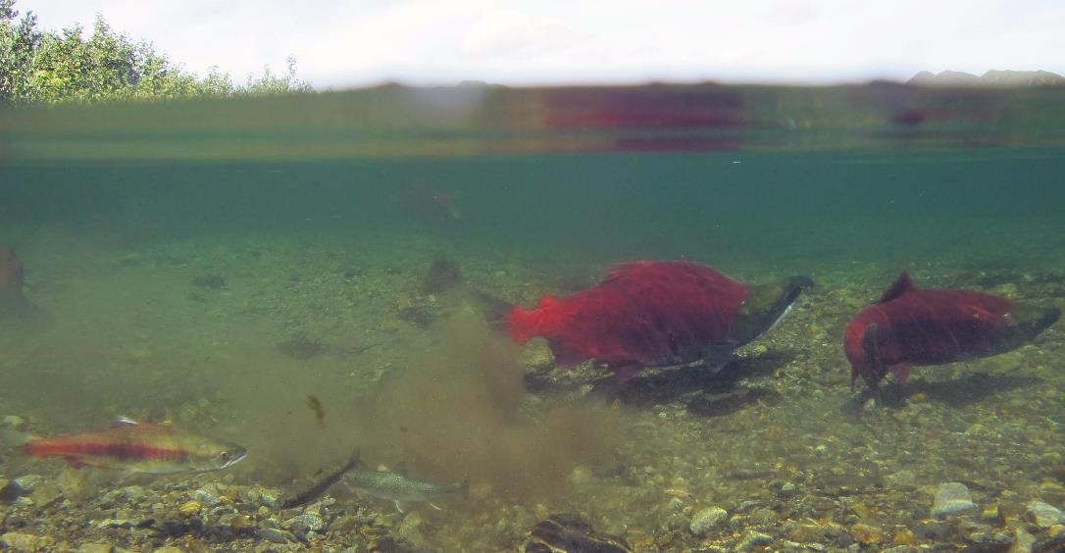
This lesson focuses on one of those habitats: freshwater streams and lakes.
U.S. Department of the Interior
Bureau of Land Management
Salmon swimming in water.
Photo by K. Mueller, USFWS.
Salmon in freshwater streams and lakes are deeply connected to the surrounding riparian ecosystem.

Slide 6
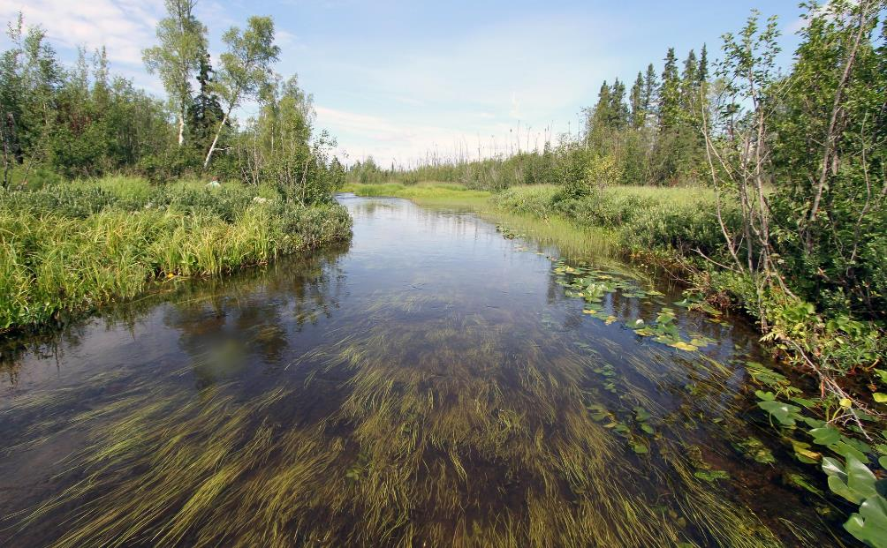
Remember, riparian ecosystems include all the living and nonliving things found along a waterway.
U.S. Department of the Interior
Bureau of Land Management
riparian ecosystem
waterway
Everything pictured here is part of this riparian ecosystem.
Photo by K. Mueller, USFWS.

Slide 7
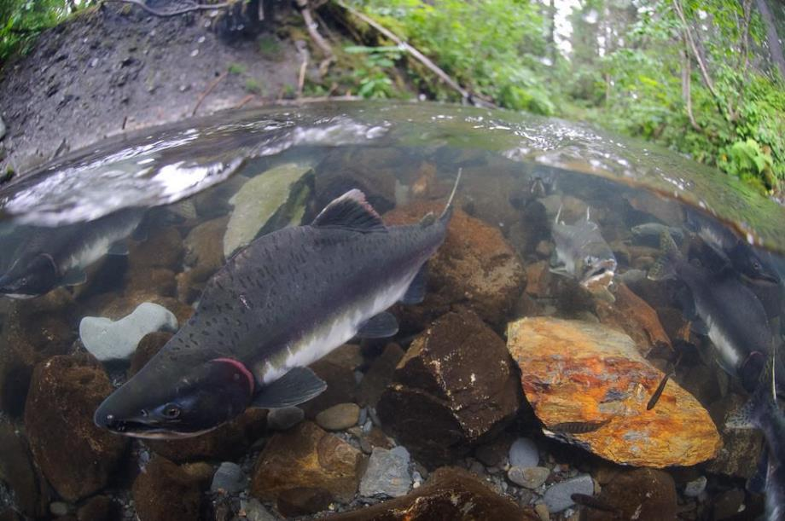
Salmon begin and end their life cycle in freshwater streams and lakes.
U.S. Department of the Interior
Bureau of Land Management
spawning adult salmon near the end of their life cycle
salmon fry in an early stage of their life cycle
Salmon swimming in fresh water.
Photo by K. Yasui, USFWS.

Slide 8
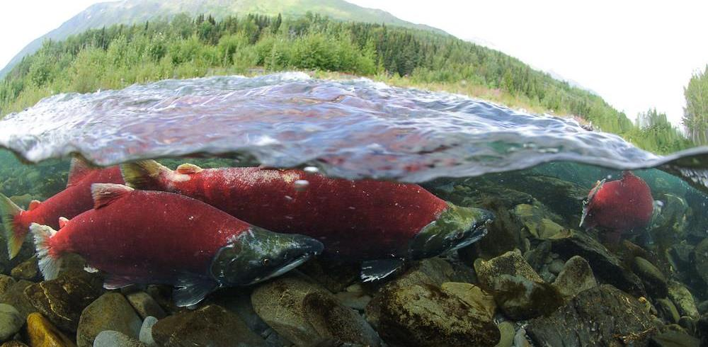
Riparian ecosystems along waterways that have salmon are called salmon forests.
U.S. Department of the Interior
Bureau of Land Management
Salmon swimming in fresh water.
Photo by K. Yasui, USFWS.

Slide 9

U.S. Department of the Interior
Bureau of Land Management
In these salmon forests, people say there are salmon in the trees.
Is that possible?
Why do you think people say that?

Slide 10
To find out, create a model riparian ecosystem.
U.S. Department of the Interior
Bureau of Land Management
Your model will focus on freshwater streams and lakes and will include biotic and abiotic parts of the riparian ecosystem.
To build a 3-D model, gather recycled art supplies or natural objects.
If you prefer, you can draw all parts of your model in your science journal or on a piece of paper.
Be creative! Your model should not look exactly like the example.

Slide 11

Start with abiotic things. Abiotic things have never been and never will be alive.
U.S. Department of the Interior
Bureau of Land Management
Add the sun to your model. The sun provides warmth and energy.
A flattened cardboard box with a yellow circle representing the sun.
Photo by CCSC staff, BLM.

Slide 12
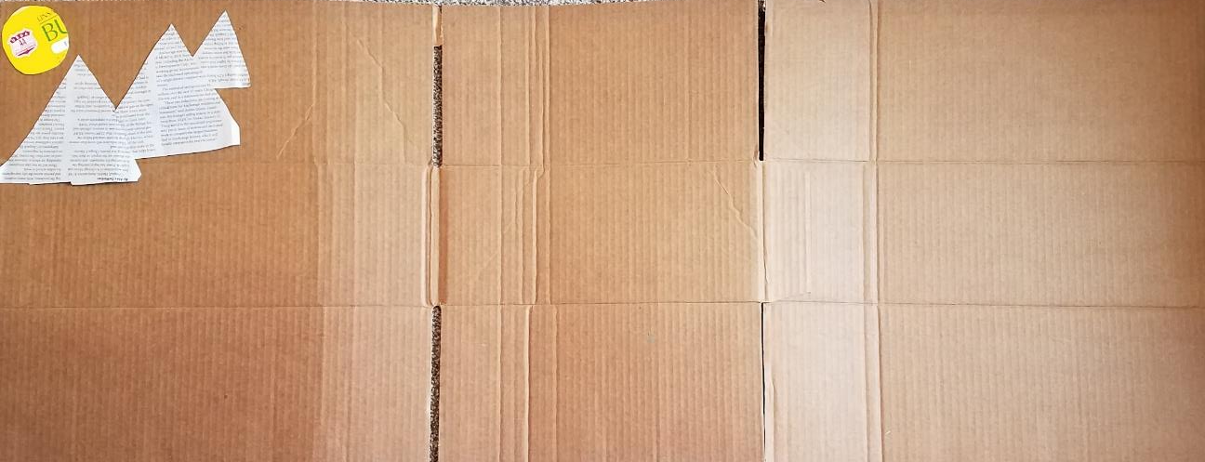
Mountains, hills, and other high ground form the start of a watershed.
U.S. Department of the Interior
Bureau of Land Management
Add mountains or hills to your model.
A flattened cardboard box with a yellow circle representing the sun. White paper triangles represent mountains or hills.
Photo by CCSC staff, BLM.

Slide 13
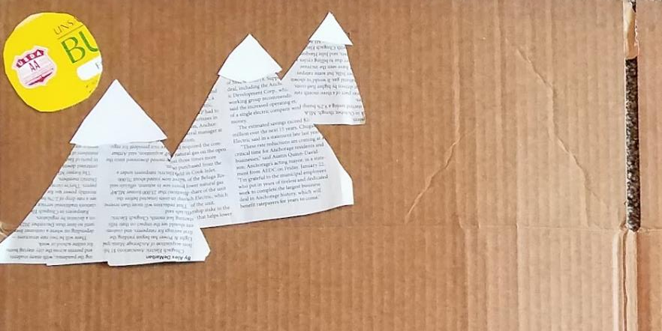
Lots of snow and rain usually fall in this part of a watershed. Add rain or snow to your model.
U.S. Department of the Interior
Bureau of Land Management
A flattened cardboard box with a yellow circle representing the sun. White paper triangles represent mountains or hills. Additional white paper is added for snow.
Photo by CCSC staff, BLM.

Slide 14
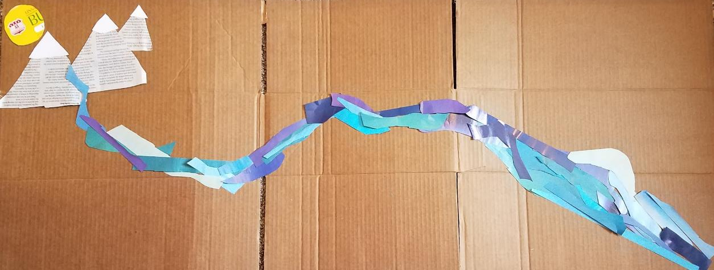
Rainwater and snowmelt flows downhill and collects in waterways, like creeks and rivers.
U.S. Department of the Interior
Bureau of Land Management
Add a waterway to your model.
A flattened cardboard box with a yellow circle representing the sun. White paper triangles represent mountains or hills. Additional white paper is added for snow. Next, blue colored paper is added for a waterway.
Photo by CCSC staff, BLM.

Slide 15
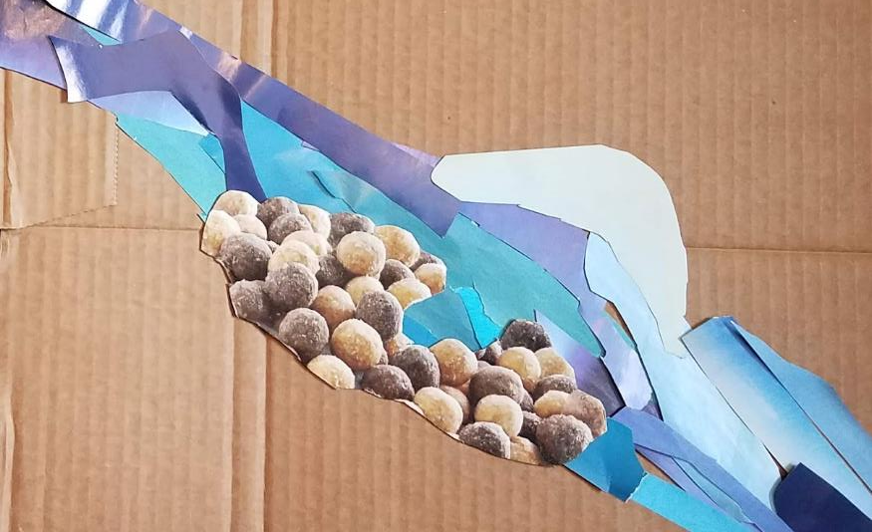
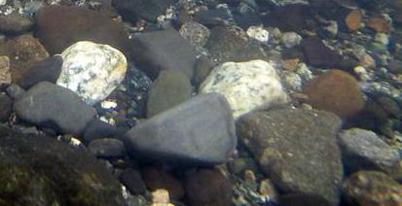
Waterways in Alaska have small rocks, called gravel, on the bottom.
U.S. Department of the Interior
Bureau of Land Management
Add some gravel to your model.
Gravel rock on a creek bed.
Photo by K. Mueller, USFWS.
A picture of "gravel" has been added to the image.
Photo by CCSC staff, BLM.

Slide 16
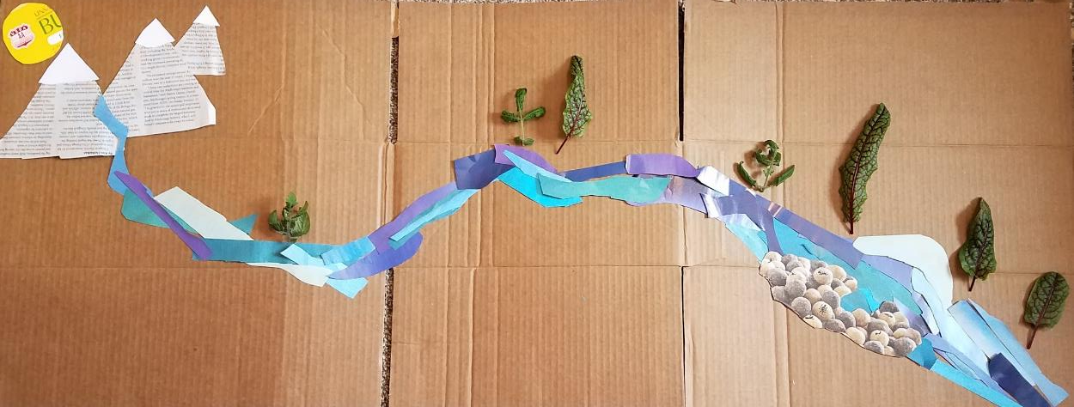
Next, add biotic things. Biotic things are living or used to be alive.
U.S. Department of the Interior
Bureau of Land Management
Add plants to your model. Plants hold the banks of the waterway stable and provide shade, which keeps the water cold.
A flattened cardboard box with a yellow circle representing the sun. White paper triangles represent mountains or hills. Additional white paper is added for snow. Gravel and plants are added to the waterway.
Photo by CCSC staff, BLM.

Slide 17
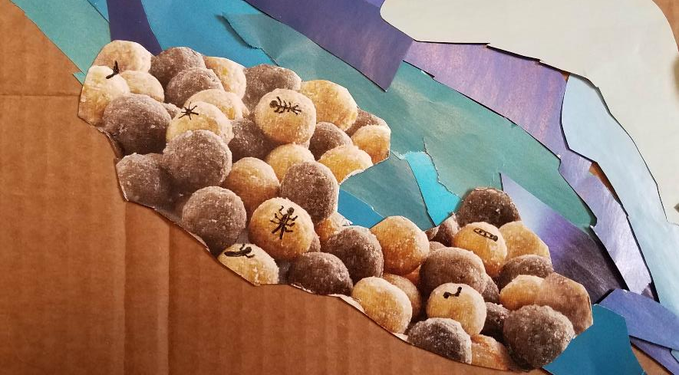
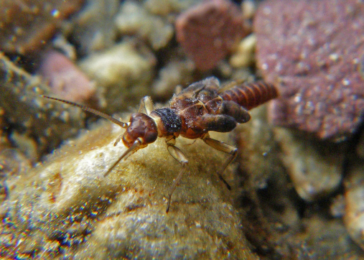
Aquatic macroinvertebrates live in the gravel. Add macroinvertebrates to your model.
U.S. Department of the Interior
Bureau of Land Management
An aquatic macroinvertebrate rests on a rock in a stream bed.
Photo by J. Giersch, USGS.
Macroinvertebrates are drawn on the gravel in the waterway.
Photo by CCSC staff, BLM.

Slide 18
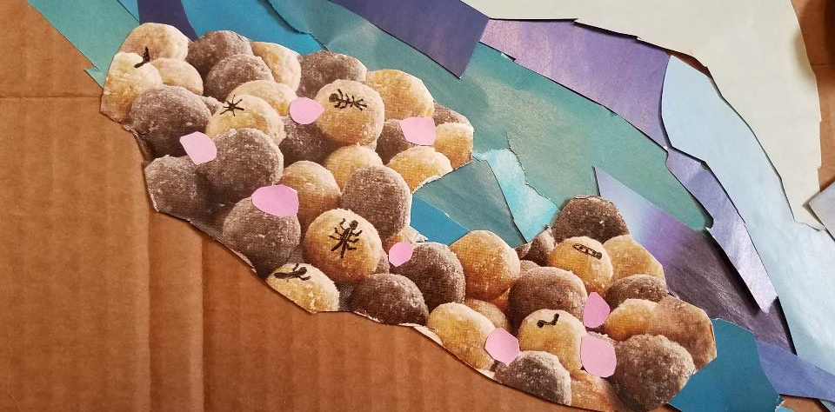
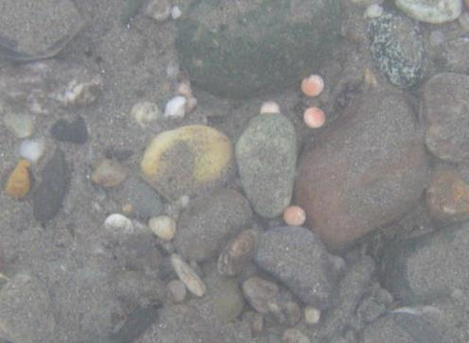
The gravel also provides a safe place for salmon eggs.
U.S. Department of the Interior
Bureau of Land Management
Add salmon eggs to your model.
A few pink and red salmon eggs rest on the bottom of a stream bed.
Photo by C. Zimmerman, USGS.
Salmon eggs are added to the waterway.
Photo by CCSC staff, BLM.

Slide 19
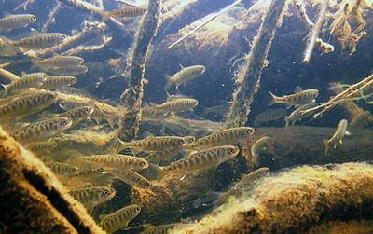
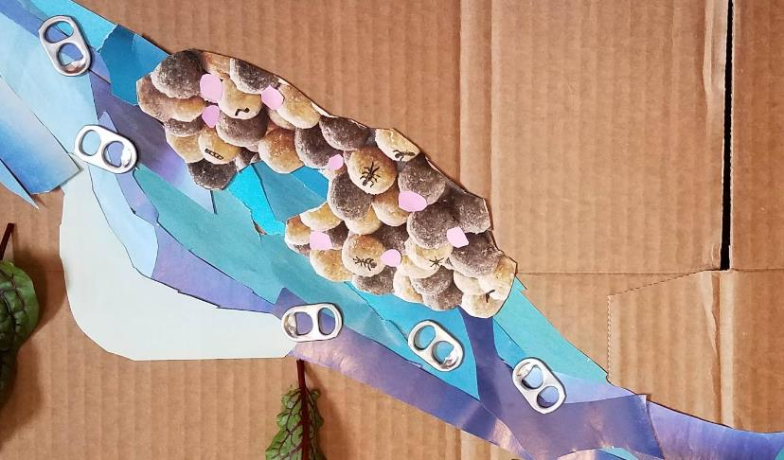
Salmon fry leave the gravel and swim around in the waterway. They eat aquatic macroinvertebrates and hide under fallen trees.
Add salmon fry to your model.
U.S. Department of the Interior
Bureau of Land Management
Salmon fry swimming in fresh water.
Photo by USFWS.
Pop-tops are added as salmon fry.
Photo by CCSC staff, BLM.

Slide 20
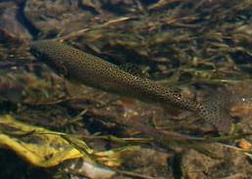
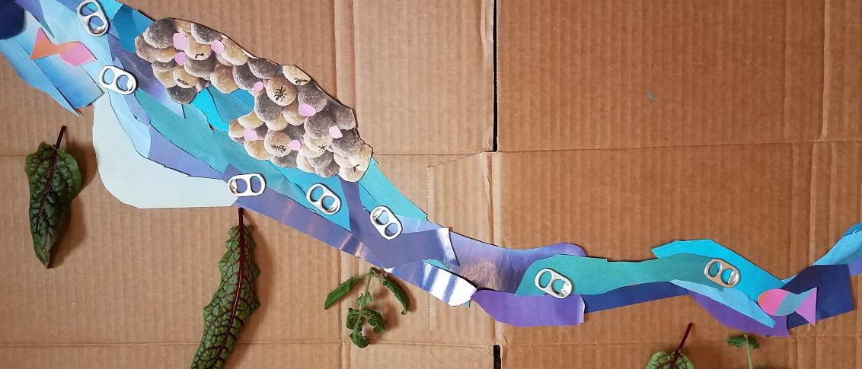
Other fish, such as rainbow trout, eat salmon eggs and fry.
Add other fish to your model.
U.S. Department of the Interior
Bureau of Land Management
A rainbow trout swims in fresh water.
Photo by K. Mueller, USFWS.
Additional fish are added to the waterway.
Photo by CCSC staff, BLM.

Slide 21
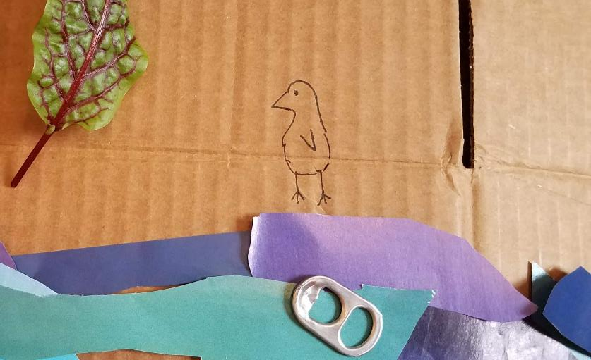
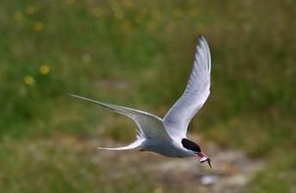
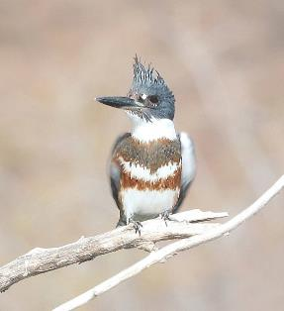
Birds also eat young salmon.
Add a bird that eats young salmon to your model.
U.S. Department of the Interior
Bureau of Land Management
Arctic Tern
An Arctic tern flies with a fish in its beak.
Photo by USFWS.
Belted Kingfisher
A bird is drawn near the waterway.
Photo by CCSC staff, BLM.
A belted kingfisher rests on a tree branch.
Photo by A. Schmierer, USFWS.

Slide 22
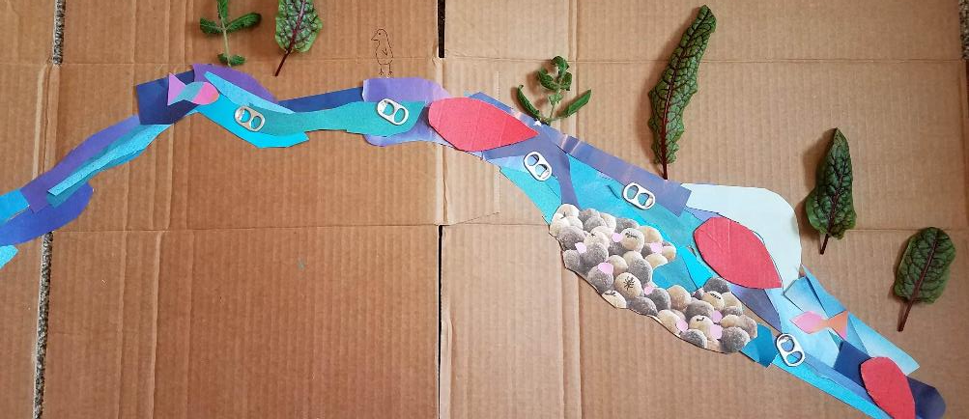
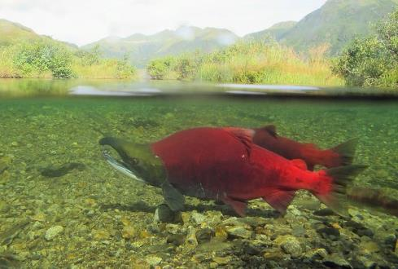
Adult salmon return from the ocean to spawn in freshwater lakes and streams. They have grown large and strong during their time at sea.
Add spawning salmon to your model.
U.S. Department of the Interior
Bureau of Land Management
Salmon swim in fresh water.
Photo by K. Mueller, USFWS.
Spawning salmon are added to the waterway.
Photo by CCSC staff, BLM.

Slide 23
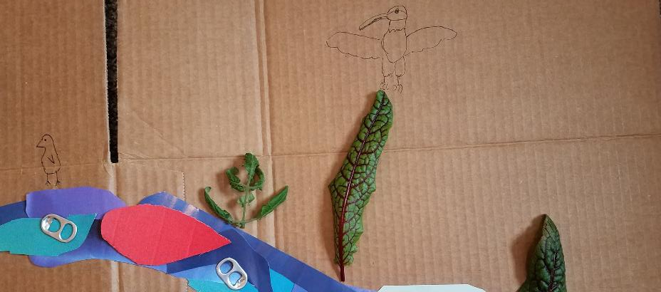
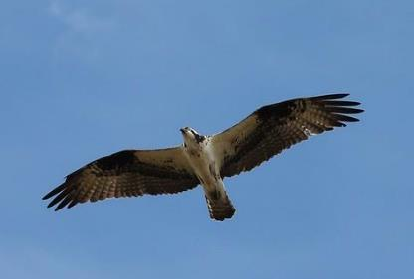
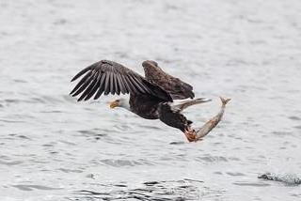
As they move upstream, some adult salmon are eaten by eagles, ospreys, and other large birds.
Add a bird that eats adult salmon to your model.
U.S. Department of the Interior
Bureau of Land Management
Osprey
Bald Eagle
An osprey flies through the blue sky.
Photo by K. Sowl, USFWS.
A large bird is added to the waterway.
Photo by CCSC staff, BLM.
A bald eagle flies away with its fresh catch in its talons.
Photo by J. W. Frank, NPS.

Slide 24
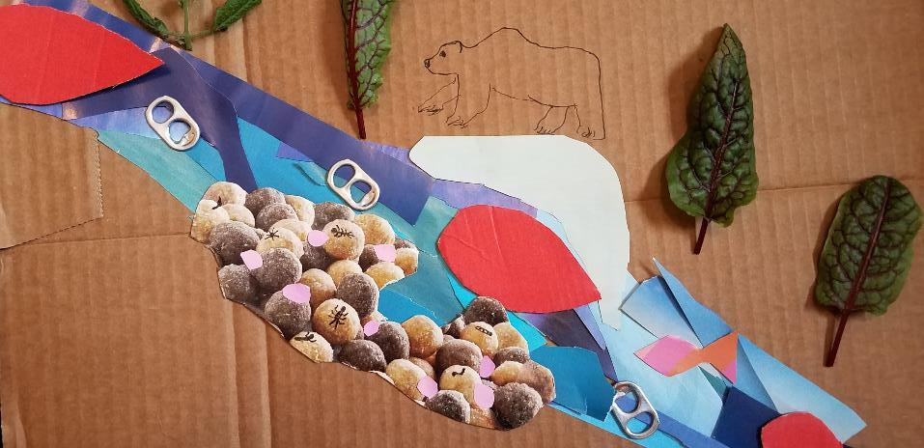
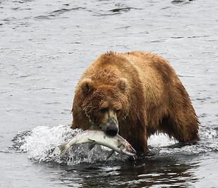
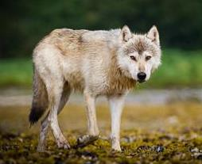
Bears, wolves, river otters, humans, and other mammals also eat returning salmon.
Add a mammal that eats adult salmon to your model.
U.S. Department of the Interior
Bureau of Land Management
A brown bear catches a fish.
Photo by L. Hupp, USFWS.
Hungry mammals are added to the waterway.
Photo by CCSC staff, BLM.
A wolf walks across a clearing.
Photo by USFWS.

Slide 25
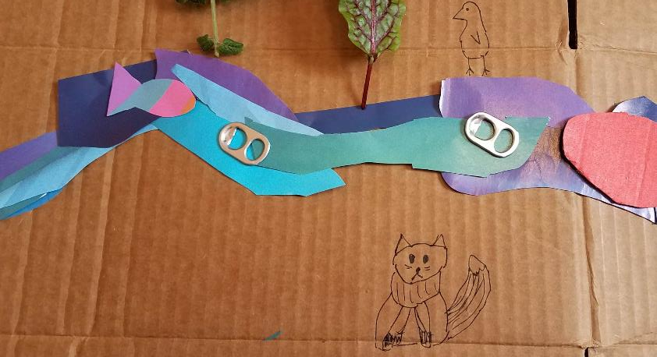
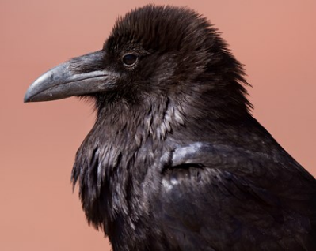
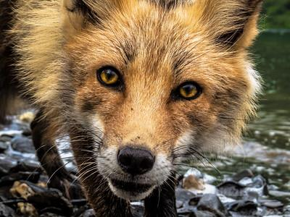
All salmon in Alaska die after spawning. Some animals, such as foxes, coyotes, and ravens, eat adult salmon after they have died.
Add an animal that eats dead salmon to your model.
U.S. Department of the Interior
Bureau of Land Management
A raven eats dead salmon. Photo by A. Kuhn, NPS.
A red fox, such as this one, will also eat dead salmon.
Photo by J. Blouin, USFWS.
Hungry mammals are added to the waterway.
Photo by CCSC staff, BLM.

Slide 26
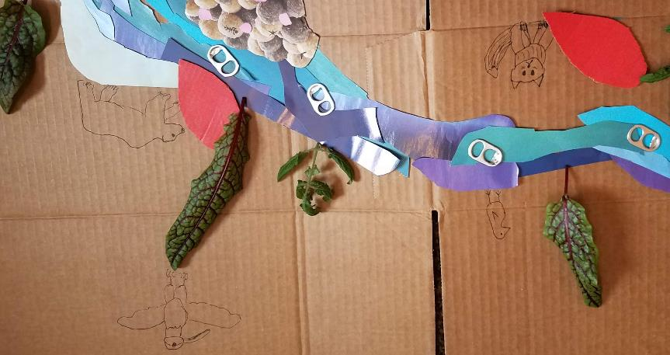
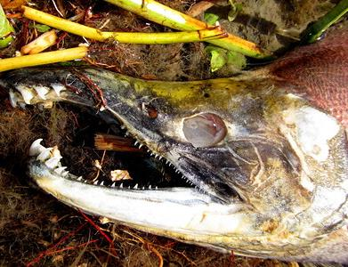
Animals like bears, foxes, and ravens drag salmon into the forest and eat the fattiest parts, leaving the rest behind to decompose.
U.S. Department of the Interior
Bureau of Land Management
A salmon decomposes on the forest floor.
Photo by T. Koerner, USFWS.
A salmon is drug from the water and left on the shore of the waterway.
Photo by CCSC staff, BLM.

Slide 27

As the salmon bodies break down, they release important nutrients into the soil.
U.S. Department of the Interior
Bureau of Land Management
The salmon gained nutrients in the ocean by eating a rich diet of small animals. They carried those nutrients in their bodies when they returned to fresh water to spawn.

Slide 28
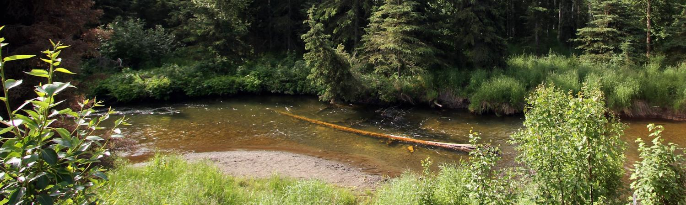
Plants in the riparian ecosystem absorb the ocean nutrients from decomposing salmon bodies and use them to grow.
U.S. Department of the Interior
Bureau of Land Management
A lush, green riparian ecosystem on a sunny day.
Photo by K. Liebich, USFWS.
Trees near waterways with salmon grow three times faster than trees in places without salmon! That is why people say there are salmon in the trees.

Slide 29
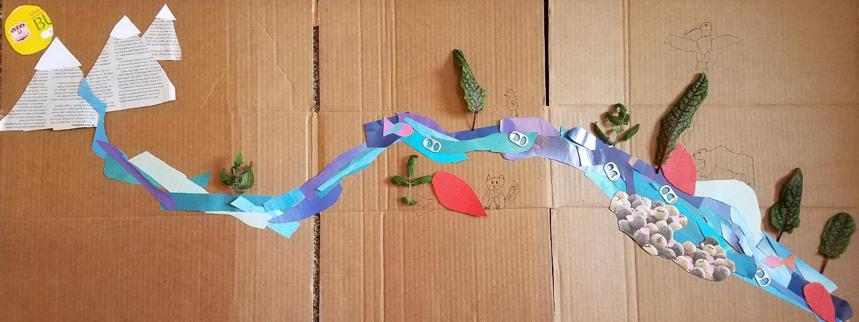
You have made a model salmon forest!
U.S. Department of the Interior
Bureau of Land Management
The model salmon forest is complete.
Photo by CCSC staff, BLM.

Slide 30
Study your model.
U.S. Department of the Interior
Bureau of Land Management
How are salmon connected to abiotic parts of the riparian ecosystem?
The model salmon forest is complete.
Photo by CCSC staff, BLM.

Slide 31
How are salmon connected to abiotic parts of the riparian ecosystem? Slide 1
U.S. Department of the Interior
Bureau of Land Management
Rain and snow that fall in high points of the watershed drain into a waterway.
The model salmon forest is complete.
Photo by CCSC staff, BLM.

Slide 32
How are salmon connected to abiotic parts of the riparian ecosystem? slide 2
U.S. Department of the Interior
Bureau of Land Management
The waterway provides cold, clean water, which salmon need to survive.
The model salmon forest is complete.
Photo by CCSC staff, BLM.

Slide 33
How are salmon connected to abiotic parts of the riparian ecosystem? Slide 3
U.S. Department of the Interior
Bureau of Land Management
Salmon lay their eggs in gravel, which keeps the eggs from getting washed away and protects them from other animals.
The model salmon forest is complete.
Photo by CCSC staff, BLM.

Slide 34
How are salmon connected to abiotic parts of the riparian ecosystem? Slide 4
U.S. Department of the Interior
Bureau of Land Management
Gravel also provides a home for aquatic macroinvertebrates, which are the favorite food of salmon fry!
The model salmon forest is complete.
Photo by CCSC staff, BLM.

Slide 35
Take a close look. How are salmon connected to other biotic parts of the riparian ecosystem?
U.S. Department of the Interior
Bureau of Land Management
The model salmon forest is complete.
Photo by CCSC staff, BLM.

Slide 36
How are salmon connected to other biotic parts of the riparian ecosystem? Slide 1
U.S. Department of the Interior
Bureau of Land Management
Plants along the waterway shade the creek, which keeps the water cold. Salmon need cold water to survive.
The model salmon forest is complete.
Photo by CCSC staff, BLM.

Slide 37
How are salmon connected to other biotic parts of the riparian ecosystem? Slide 2
U.S. Department of the Interior
Bureau of Land Management
Fallen trees create places for salmon fry to hide from other fish or birds.
The model salmon forest is complete.
Photo by CCSC staff, BLM.

Slide 38
How are salmon connected to other biotic parts of the riparian ecosystem? Slide 3
U.S. Department of the Interior
Bureau of Land Management
Plants along the waterway hold the bank in place. This keeps soil from filling in the gravel and burying salmon eggs.
The model salmon forest is complete.
Photo by CCSC staff, BLM.

Slide 39
How are salmon connected to other biotic parts of the riparian ecosystem? Slide 4
U.S. Department of the Interior
Bureau of Land Management
Other fish eat young salmon.
Salmon fry eat macroinvertebrates.
The model salmon forest is complete.
Photo by CCSC staff, BLM.

Slide 40
How are salmon connected to other biotic parts of the riparian ecosystem? Slide 5
U.S. Department of the Interior
Bureau of Land Management
Eagles and bears eat adult salmon returning to spawn.
Foxes and other animals move dead salmon into the forest and eat them.
Macroinvertebrates eat dead salmon in the waterway.
The model salmon forest is complete.
Photo by CCSC staff, BLM.

Slide 41
How are salmon connected to other biotic parts of the riparian ecosystem? Slide 6
U.S. Department of the Interior
Bureau of Land Management
Trees near waterways with salmon grow fast and strong.
Dead salmon fertilize the forest.
The model salmon forest is complete.
Photo by CCSC staff, BLM.

Slide 42
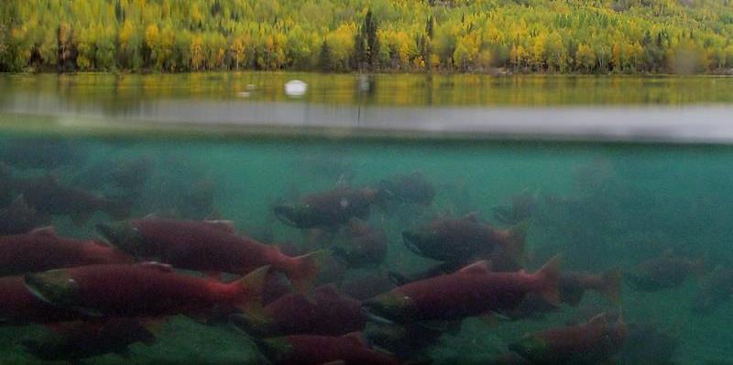
The many connections between salmon and riparian ecosystems are why these special places are called salmon forests.
U.S. Department of the Interior
Bureau of Land Management
A group of salmon swimming in fresh water. Photo by K. Mueller, USFWS.

