Slide 1
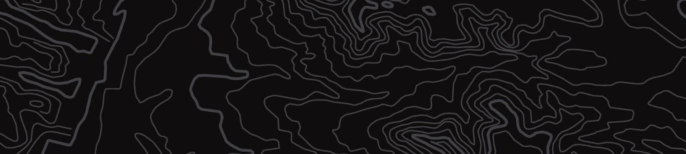


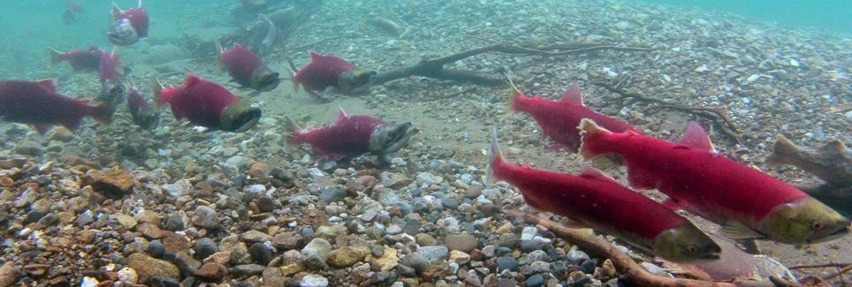
Salmon Habitats
U.S. Department of the Interior
Bureau of Land Management
Discover the different habitats salmon need during their life
Module 4, Lesson 2
Photo by D. Young, NPS.

Slide 2


Lesson 2: Salmon Habitats
Lesson Questions:
U.S. Department of the Interior
Bureau of Land Management
What types of habitat do salmon need throughout their life cycle?
Why do salmon need different habitats during different parts of their life?

Slide 3
Materials:
U.S. Department of the Interior
Bureau of Land Management
science journal or a piece of paper
something to write with

Slide 4

A habitat is a home that provides living things with everything they need to survive.
What are your needs?
What do you really need in order to survive?
U.S. Department of the Interior
Bureau of Land Management

Slide 5
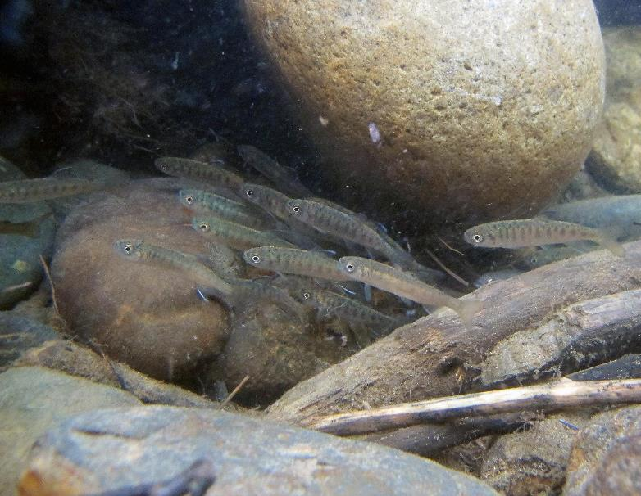
Salmon habitats provide all the things salmon need in order to survive.
Where do you think salmon live?
What do you think salmon need to survive?
U.S. Department of the Interior
Bureau of Land Management
Salmon fry swimming in a stream.
Photo by K. Mueller, USFWS.

Slide 6
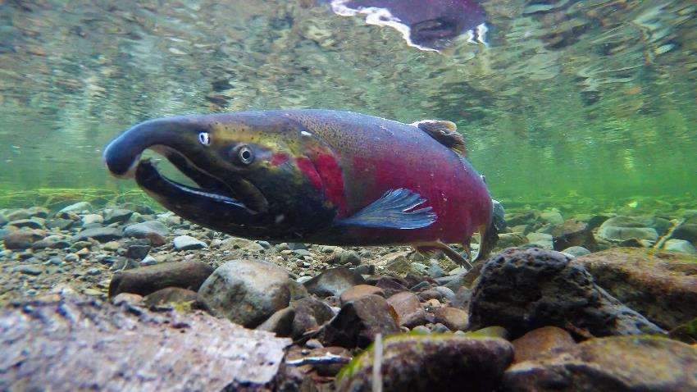
U.S. Department of the Interior
Bureau of Land Management
Salmon need habitats with:
cold, clean water
dissolved oxygen
food
protection
Salmon swimming in a shallow stream.
Photo by BLM.

Slide 7
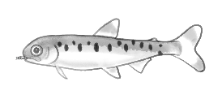
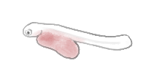
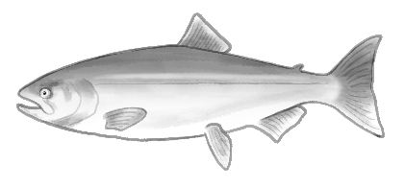
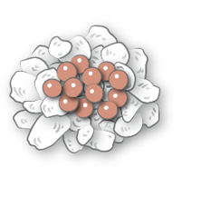
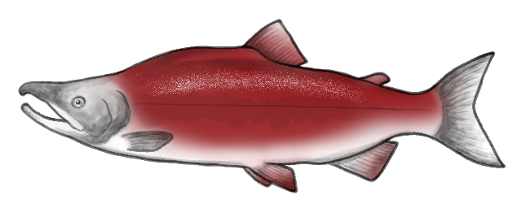

Salmon don’t live in just one habitat!
As salmon go through their life cycle, their bodies and needs change.
Salmon must move to different habitats to meet their changing needs.
U.S. Department of the Interior
Bureau of Land Management
Graphic by K. Mincer,BLM.

Slide 8
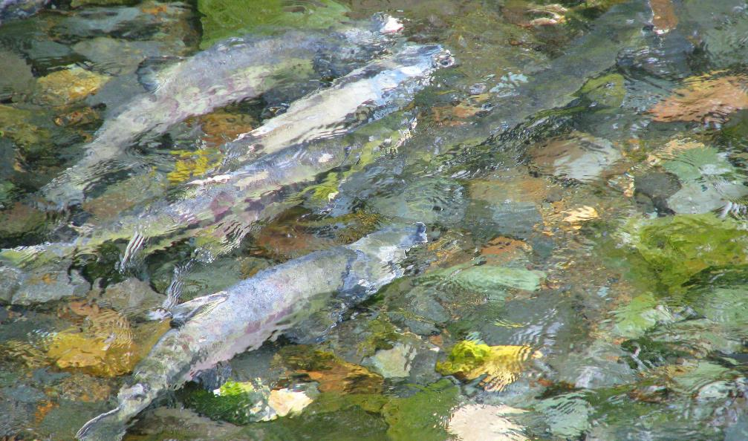
Salmon migrate long distances to find the right aquatic habitat for each stage of their life cycle.
U.S. Department of the Interior
Bureau of Land Management
Salmon in a stream.
Photo by C. Nealson, USFWS.

Slide 9
U.S. Department of the Interior
Bureau of Land Management
In the following activity you will explore the three different salmon habitats:
Freshwater streams and lakes
Estuaries
Ocean
You will make observations about the living and nonliving things in each habitat.

Slide 10
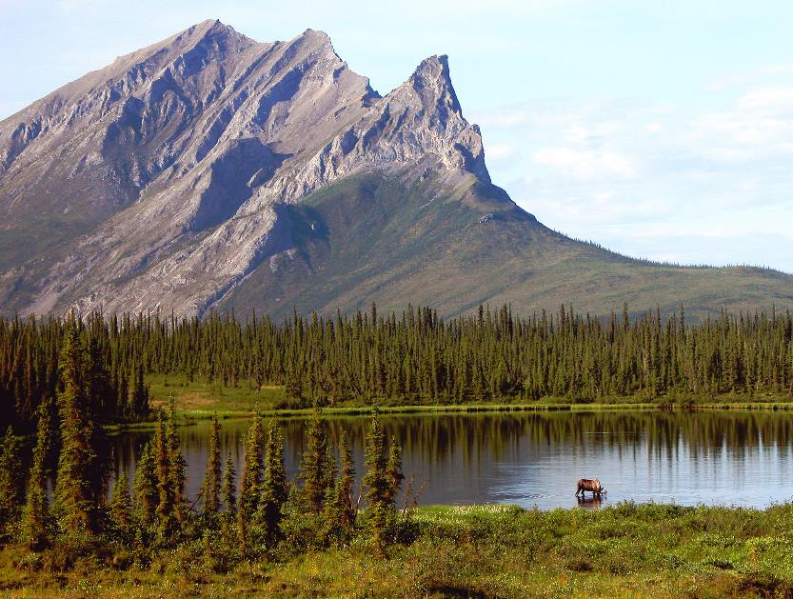
Things that are living or used to be alive are biotic.
Things that are nonliving and have never been alive are abiotic.
What biotic things do you see in this picture?
What abiotic things do you see?
U.S. Department of the Interior
Bureau of Land Management
Landscape image of a watershed.
Photo by T. Craig, BLM.

Slide 11

Biotic and Abiotic
U.S. Department of the Interior
Bureau of Land Management
Snow, water, rocks, and air are examples of abiotic things.
Plants, mammals, birds, insects, fish, and bacteria are examples of biotic things.
Landscape image of a watershed.
Photo by T. Craig, BLM.

Slide 12
Scientists use tables like this to record information.
Copy this table in your science journal or on a piece of paper.
You will use the table to write down observations about each salmon habitat.
U.S. Department of the Interior
Bureau of Land Management
Habitat
Salmon life cycle stage
Abiotic things
Biotic
things

Slide 13
Salmon begin their life cycle in freshwater streams and lakes.
They need this habitat as eggs, alevin, and fry.
Write the information in your table.
U.S. Department of the Interior
Bureau of Land Management
Habitat
Salmon life cycle stage
Abiotic things
Biotic
things
freshwater streams and lakes
eggs, alevin, fry
Freshwater Streams & Lakes

Slide 14
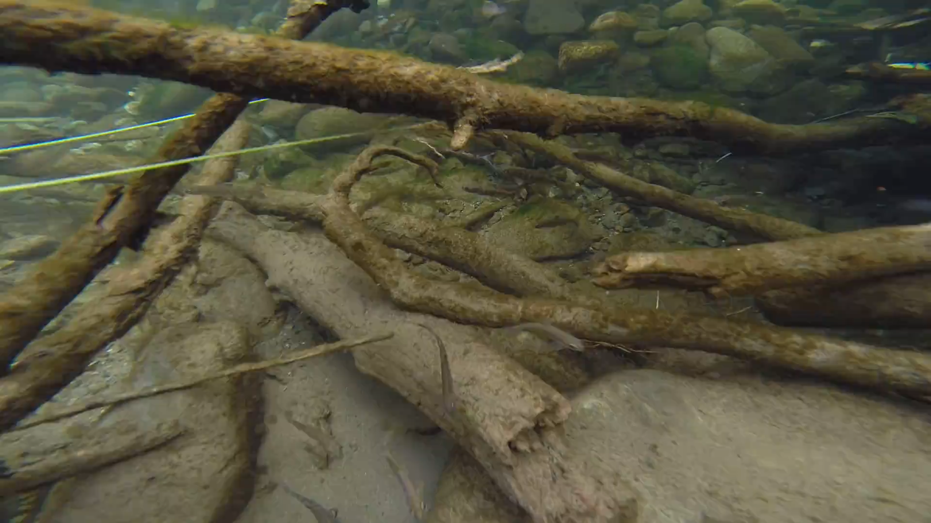
Next, write down all the abiotic things you observe in this freshwater habitat in the third column of your table.
U.S. Department of the Interior
Bureau of Land Management
Video by K. Mueller, USFWS.
Freshwater Streams & Lakes

Slide 15
Now write down all the biotic things you observe in the habitat in the fourth column of your table.
U.S. Department of the Interior
Bureau of Land Management
Video by K. Mueller, USFWS.
Freshwater Streams & Lakes

Slide 16
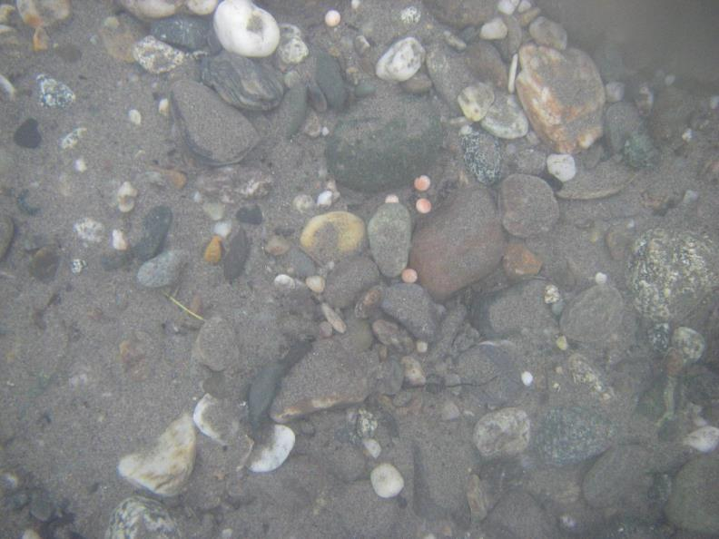
Freshwater streams and lakes are the perfect habitat for salmon eggs, alevin, and fry.
Salmon eggs are hidden in the gravel on the bottom of the streams or lakes. These gravel egg nests are called redds.
Redds protect the eggs from predators and keep them from washing away in the current.
U.S. Department of the Interior
Bureau of Land Management
Can you spot the salmon eggs?
A few pink and red salmon eggs scattered among the creek bed rocks.
Photo by C. Zimmerman, USGS.
Freshwater Streams & Lakes

Slide 17
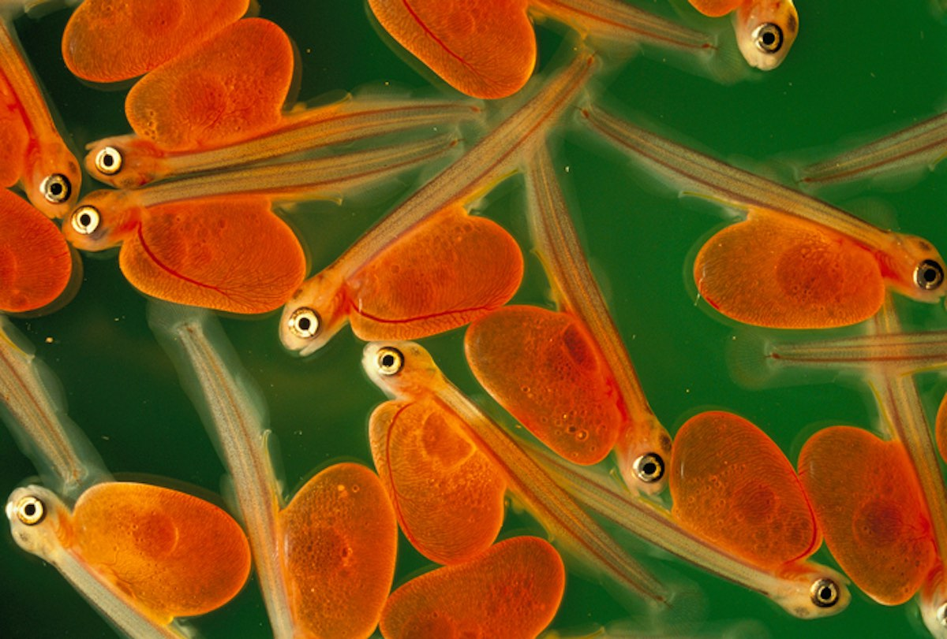
Next, the salmon develop into alevin.
Alevin continue hiding in gravel redds until they have used up all the nutrients in their yolk sac.
U.S. Department of the Interior
Bureau of Land Management
Can you spot the yolk sacs?
Salmon alevin.
Photo by NPS.
Freshwater Streams & Lakes

Slide 18
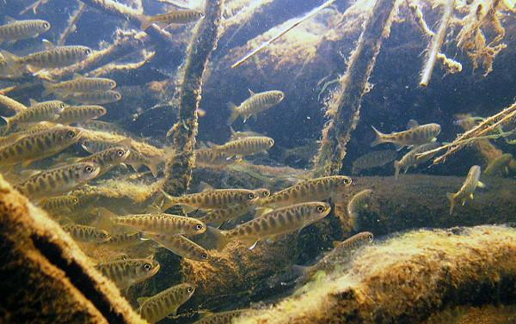
Once they have used up their yolk sacs, salmon leave the protection of the gravel and begin to swim around the freshwater streams or lakes looking for insects to eat.
U.S. Department of the Interior
Bureau of Land Management
At this point in their life cycle, they are called fry.
How many salmon fry do you see?
Salmon fry swimming in a stream.
Photo by USFWS.
Freshwater Streams & Lakes

Slide 19
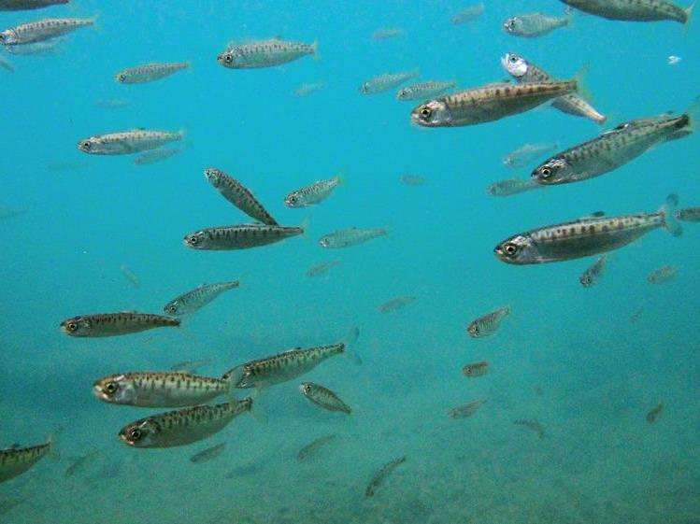
U.S. Department of the Interior
Bureau of Land Management
Streams and lakes are the safest places for young salmon, but they don’t have enough food for all the growing fish.
Eventually, salmon must leave the freshwater habitat and migrate (move) downstream to estuaries.
Salmon fry swimming in water.
Photo by K. Martin, NPS.
Estuaries

Slide 20
Estuaries are the places where freshwater rivers meet the saltwater ocean.
In this stage of their life cycle, salmon are called smolts.
Add the information to your table.
U.S. Department of the Interior
Bureau of Land Management
Habitat
Salmon life cycle stage
Abiotic things
Biotic
things
freshwater streams and lakes
estuaries
eggs, alevin, fry
smolts
Estuaries

Slide 21
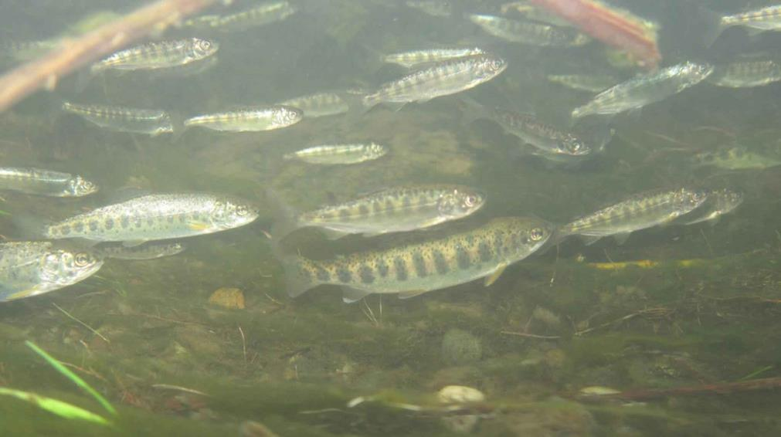
Next, write down the abiotic things you observe in this estuary habitat in the third column of your table.
U.S. Department of the Interior
Bureau of Land Management
Salmon fry swimming in water.
Photo by D. Cox, USFWS.
Estuaries

Slide 22
Now write down the biotic things you observe in the habitat in the fourth column of your table.
U.S. Department of the Interior
Bureau of Land Management
Salmon fry swimming in water.
Photo by D. Cox, USFWS.
Estuaries

Slide 23
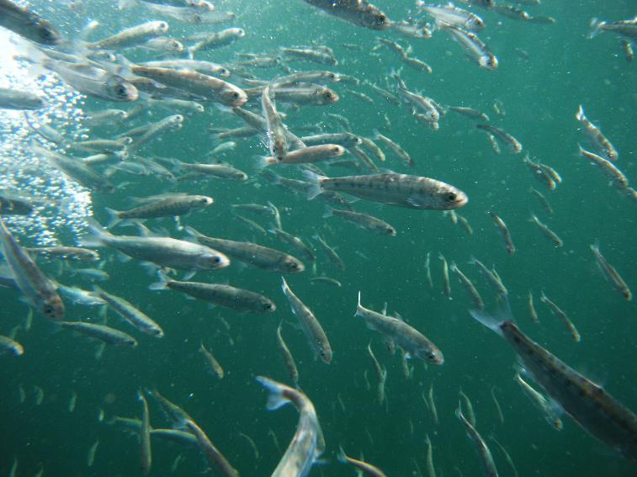
The mixing of fresh and salt water in estuaries helps smolts adjust to salt water before they enter the ocean.
Their bodies change color from dark and spotted, which allowed them to blend in among the rocks and wood in the streams, to bright silver to camouflage in larger bodies of water.
U.S. Department of the Interior
Bureau of Land Management
Salmon smolts swimming in the water.
Photo by M. Peterson, NOAA.
Estuaries

Slide 24
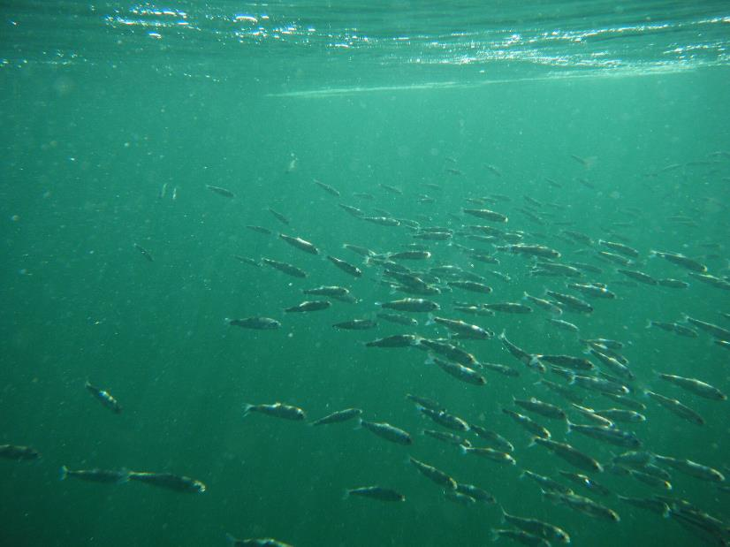
Once again, estuary habitats can’t provide all the food growing salmon need.
After letting their bodies get used to salt water in the estuaries, salmon swim out into the open ocean in search of more food.
U.S. Department of the Interior
Bureau of Land Management
Salmon heading out into the ocean to feed.
Photo by M. Peterson, NOAA.
Ocean

Slide 25
In the ocean, salmon rely on their many adaptations to protect them from danger.
In this stage in their life cycle, salmon are ocean adults.
Add the information to your table.
U.S. Department of the Interior
Bureau of Land Management
Habitat
Salmon life cycle stage
Abiotic things
Biotic
things
freshwater streams and lakes
estuaries
ocean
eggs, alevin, fry
smolts
ocean adults
Ocean

Slide 26
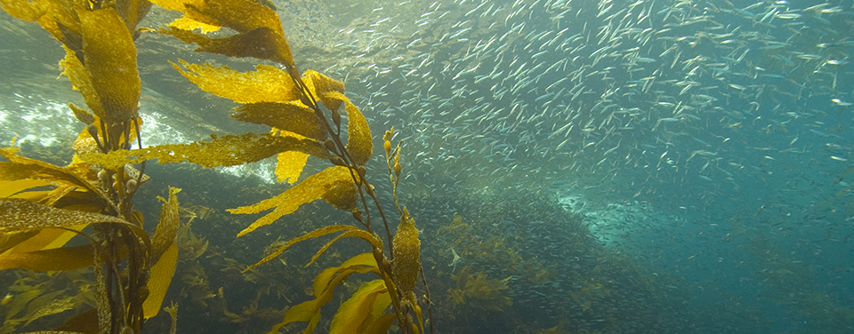
Next, write down the abiotic things you observe in the ocean habitat in the third column of your table
U.S. Department of the Interior
Bureau of Land Management
What abiotic things in this picture would benefit salmon?
Photo by NOAA.
Ocean

Slide 27
Now write down the biotic things you observe in the habitat in the fourth column of your table.
U.S. Department of the Interior
Bureau of Land Management
What biotic things in this picture would benefit salmon?
Photo by NOAA.
Ocean

Slide 28
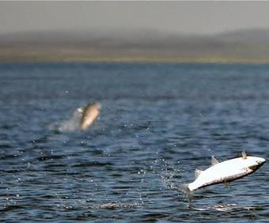
Most types of salmon spend two or three years in the ocean, although some salmon spend seven years at sea and others spend just one.
The ocean has lots of food for salmon that allows them to grow big.
U.S. Department of the Interior
Bureau of Land Management
Salmon leaping out of the water's surface.
Photo by K. Mueller, USFWS.
Ocean

Slide 29
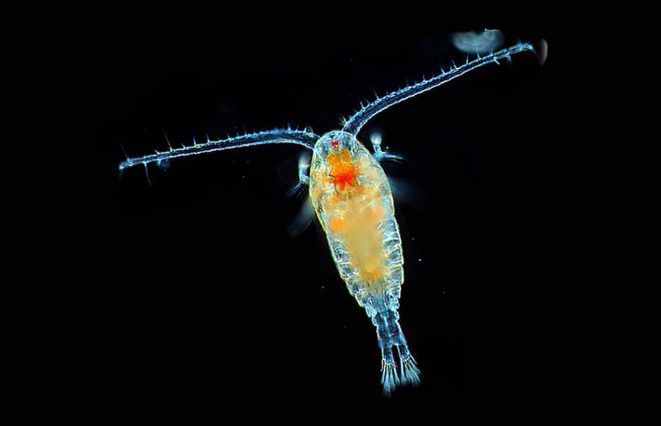
In the ocean salmon eat fish, squid, plankton, and crustaceans.
On this steady diet salmon grow bigger and mature into adults.
U.S. Department of the Interior
Bureau of Land Management
This is one type of plankton
Plankton in the ocean.
Photo by NASA.
Ocean

Slide 30
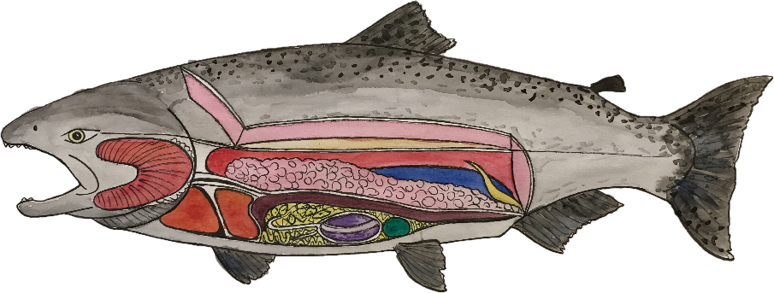
Once they are mature adults, they are ready to spawn (reproduce). It is not safe to lay their eggs in the ocean.
U.S. Department of the Interior
Bureau of Land Management
Female salmon develop thousands of eggs.
Graphic by M. Harris, BLM.
Ocean

Slide 31
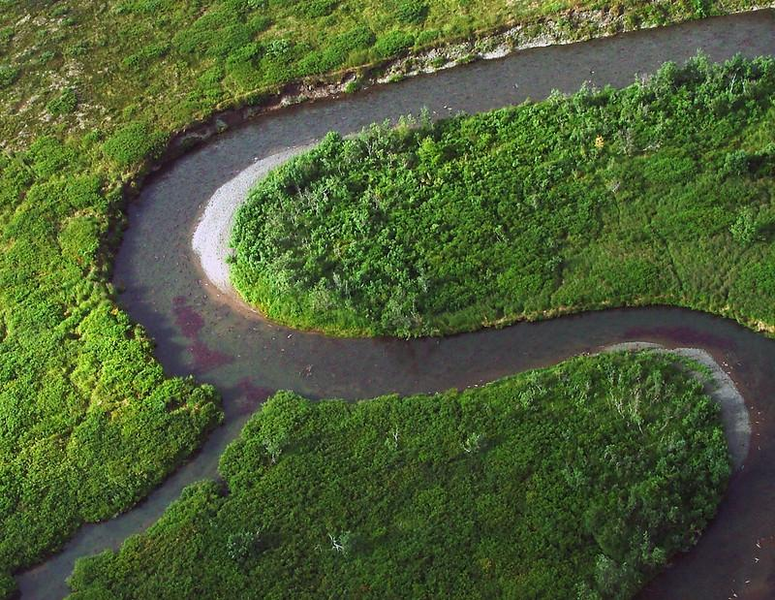
Salmon must migrate back to the same river where they began their life cycle.
Their eggs need fresh water and the protection of gravel redds.
U.S. Department of the Interior
Bureau of Land Management
Migrating salmon swimming upriver to spawn.
Photo by USFWS.
Can you spot the migrating salmon?
Freshwater Streams & Lakes

Slide 32
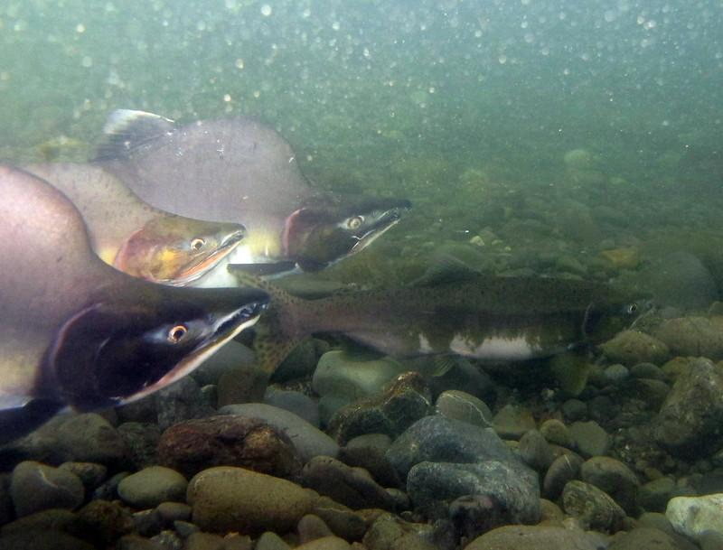
When they migrate upstream, salmon develop new spawning adaptations.
Their bodies change color from bright silver to darker red, green, or striped patterns.
Some males develop big humps on their backs.
U.S. Department of the Interior
Bureau of Land Management
Which salmon are males? Which is female?
Katrina Mueller, USFWS
Freshwater Streams & Lakes

Slide 33
In this final stage of their life cycle, salmon once again need freshwater streams and lakes.
Mature adults that return from ocean to fresh water to reproduce are called spawning adults.
Add the information to your table.
U.S. Department of the Interior
Bureau of Land Management
Habitat
Salmon life cycle stage
Abiotic things
Biotic
things
freshwater streams and lakes
estuaries
ocean
freshwater streams and lakes
eggs, alevin, fry
smolts
ocean adults
spawning adults
Freshwater Streams & Lakes

Slide 34
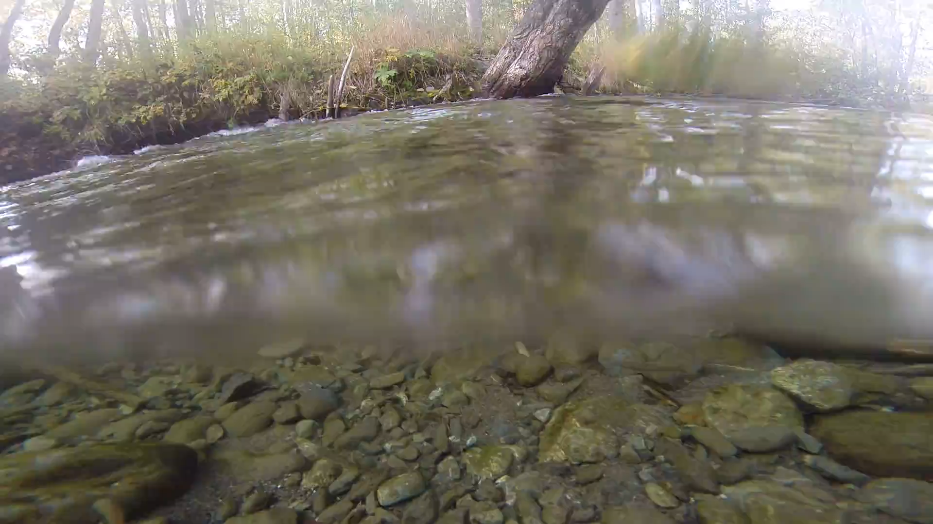
As they struggle upstream against the current, salmon stop to rest in slower pools.
What other biotic things do you notice in this habitat?
What abiotic things do you notice?
Record your observations in your table.
U.S. Department of the Interior
Bureau of Land Management
Video by K. Mueller, USFWS.
Freshwater Streams & Lakes

Slide 35
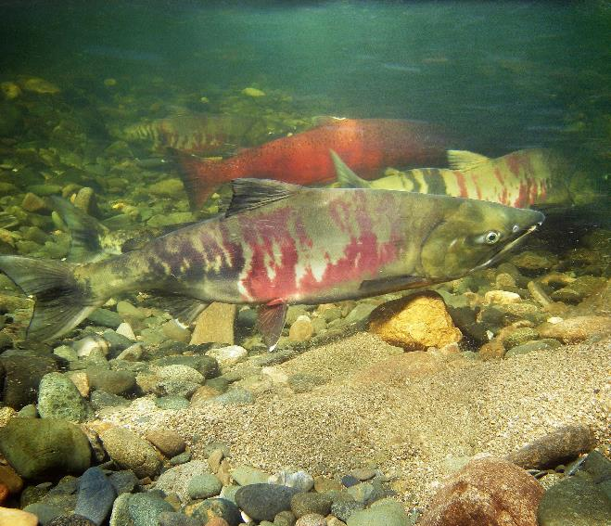
The salmon that make it back to their spawning grounds create and defend redds in the gravel.
Females lay eggs and males fertilize them. Soon after, the spawning salmon die.
The next generation of salmon will also depend on healthy aquatic habitats to complete their life cycle.
U.S. Department of the Interior
Bureau of Land Management
Can you spot the redd?
Salmon swimming in water.
Photo by D. Parker, BLM.
Freshwater Streams & Lakes

Slide 36
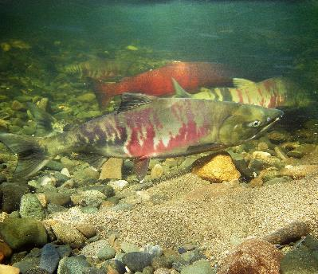
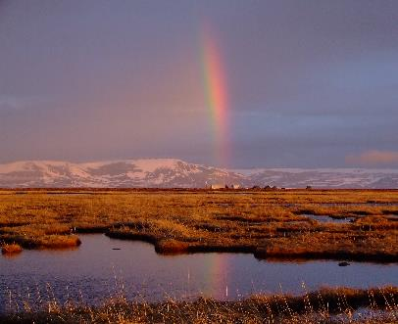
Look at your observations of the three salmon habitats.
How are the habitats different?
What do all three habitats have in common?
U.S. Department of the Interior
Bureau of Land Management
freshwater streams and lakes
Salmon swimming in water.
Photo by D. Parker, BLM.
estuaries
ocean
A rainbow reflects in the water estuaries.
Photo by USFWS.
Salmon leaping out of the water's surface.
Photo by K. Mueller, USFWS.

