Slide 1



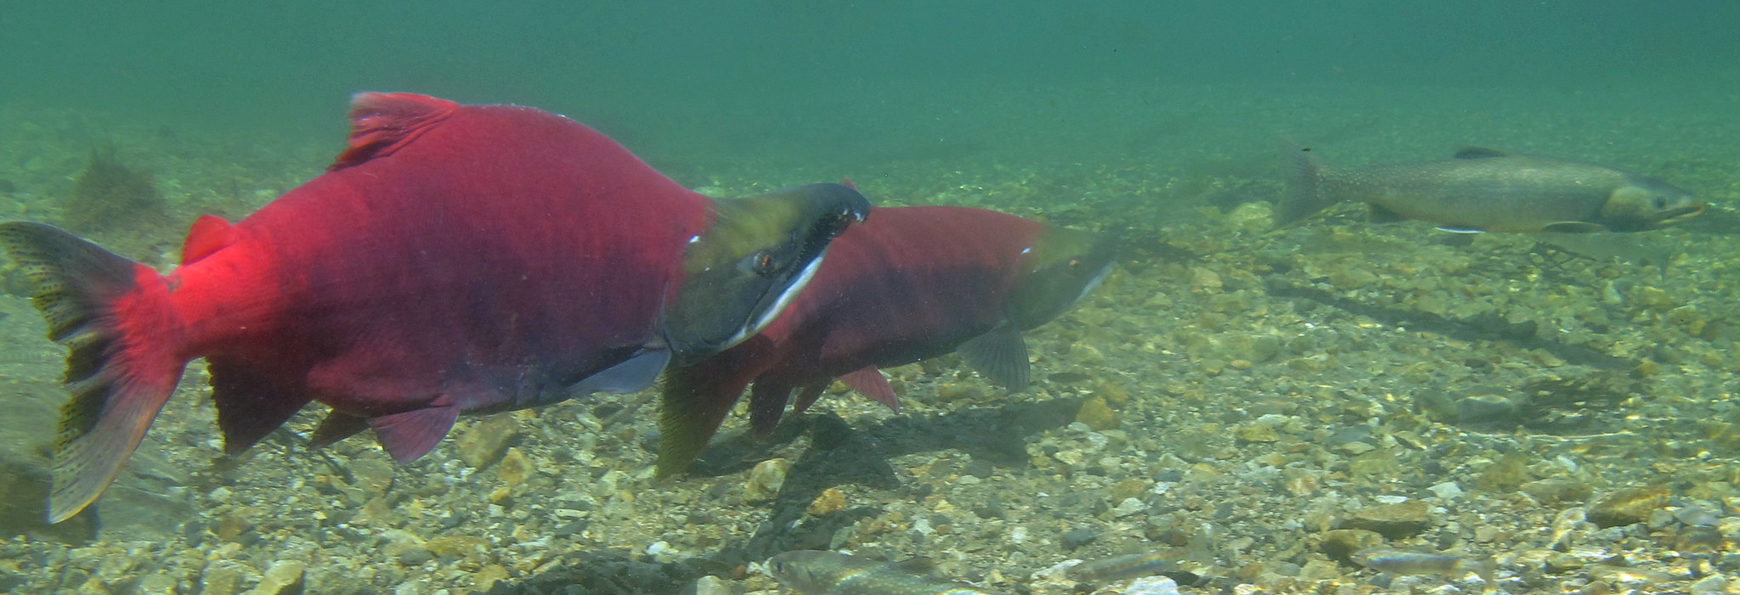
Salmon Adaptations
U.S. Department of the Interior
Bureau of Land Management
Explore salmon body parts through writing
Module 4, Lesson 1
Photo by K. Mueller, USFWS.

Slide 2


Lesson 1: Salmon Adaptations
U.S. Department of the Interior
Bureau of Land Management
Lesson Question:
How are salmon adaptations important for their survival?

Slide 3
Materials:
U.S. Department of the Interior
Bureau of Land Management
science journal or a piece of paper
something to write with

Slide 4

Scientists use writing and creativity in their work.
U.S. Department of the Interior
Bureau of Land Management
They record observations, steps for experiments, and discoveries to share what they learn with other scientists and the public.
They also use art and music to share ideas.

Slide 5
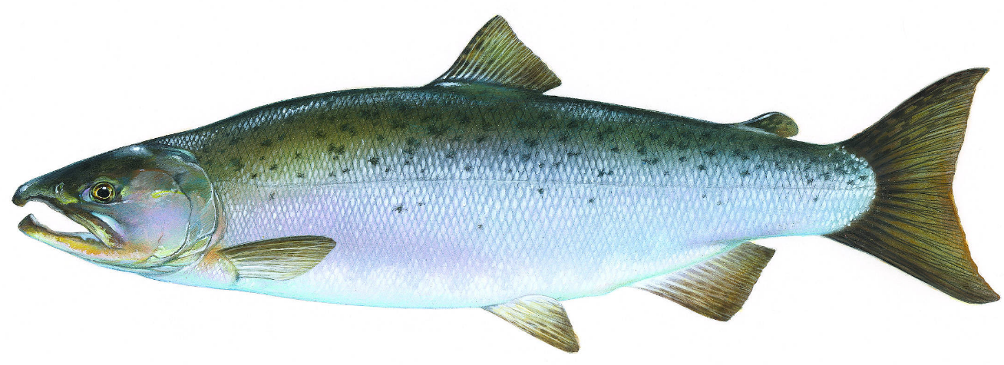
In this lesson, you will explore and write about salmon adaptations.
U.S. Department of the Interior
Bureau of Land Management
Adaptations are body parts or behaviors that help living things survive.
dorsal fin
eye
nostril
lateral line
mouth
gill cover
caudal fin
Graphic by T. Knepp, NPS.

Slide 6


Take a big sniff through your nostrils. What do you smell?
U.S. Department of the Interior
Bureau of Land Management
nostril
Graphic by T. Knepp, NPS.
Salmon have nostrils, too, which help them smell food and avoid predators.
Adult salmon also use their incredible sense of smell to navigate from the ocean back to their home streams to reproduce the next generation of salmon.

Slide 7


Salmon have eyes that help them see food, avoid predators, and navigate around in the water.
U.S. Department of the Interior
Bureau of Land Management
eye
Graphic by T. Knepp, NPS.
Try to keep your eyes open without blinking for 20 seconds. What happens?
Unlike humans, salmon do not need eyelids or tears because they live in water. Their eyes are naturally wet.

Slide 8
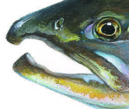
Open and close your mouth a few times. How do you use your mouth?
U.S. Department of the Interior
Bureau of Land Management
Graphic by T. Knepp, NPS.
mouth
Salmon use their mouths to eat. Salmon eat macroinvertebrates, fish, squid, plankton, and other small animals. Macroinvertebrates are animals without a backbone that are visible to the naked eye, such as insects, worms, and snails.
Salmon have sharp teeth in their mouths, but they do not chew their food. Salmon use their teeth to catch and hold food, which they swallow whole.

Slide 9
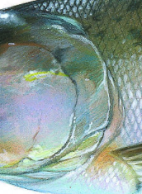
Put your hands on your sides and take a deep breath. Do you feel your rib cage expand and contract?
U.S. Department of the Interior
Bureau of Land Management
Graphic by T. Knepp, NPS.
gill cover
Humans have rib cages to project their lungs; salmon have gill covers to protect their gills.
Salmon “breathe” by filtering water through their mouths and over their gills, which absorb dissolved oxygen from the water.

Slide 10

Close your eyes and listen carefully for 10 seconds. What do you hear?
U.S. Department of the Interior
Bureau of Land Management
lateral line
Graphic by T. Knepp, NPS.
Salmon do not have ears to hear, so they use lateral lines instead.
Lateral lines are small, fluid-filled sacs that run along each side of the fish.
The sacs detect movement and vibrations in the water, which helps salmon escape predators and find food.

Slide 11

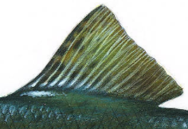
What do you notice on the salmon’s back?
It’s a dorsal fin.
Salmon use dorsal fins (and their other fins) to balance and move through the water.
U.S. Department of the Interior
Bureau of Land Management
Graphic by T. Knepp, NPS.
dorsal fin

Slide 12
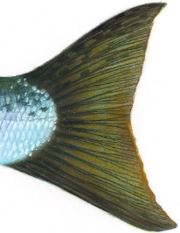

The caudal fin, or tail, provides swimming power for the salmon. This is similar to humans kicking their feet to move through the water.
Caudal fins help salmon steer, change direction, and move in quick bursts of speed.
Adult salmon rely on their caudal fins to swim against the current as they travel up their home streams to reproduce.
U.S. Department of the Interior
Bureau of Land Management
Graphic by T. Knepp, NPS.
caudal fin

Slide 13
What other adaptations do you notice?
What adaptations might salmon have inside their bodies?
U.S. Department of the Interior
Bureau of Land Management
Graphic by T. Knepp, NPS.

Slide 14

Now it’s time to share scientific information about salmon adaptations in a creative way!
U.S. Department of the Interior
Bureau of Land Management
In the following activity, you will write a haiku poem and a song or rap about two of the salmon adaptations you learned about in this lesson.

Slide 15

A haiku is a short poem with a specific structure.
U.S. Department of the Interior
Bureau of Land Management
It has five syllables in the first line, seven syllables in the second line, and five syllables in the third line.
This type of poem does not need to rhyme.
Example:
Black bear looks around
Her keen eyes spot food nearby
Blueberry feast, yum!
1 2 3 4 5
1 2 3 4 5 6 7
1 2 3 4 5

Slide 16

Choose one of the salmon adaptations you learned about.
U.S. Department of the Interior
Bureau of Land Management
Write a haiku poem about the adaptation.
To help count syllables, say each line of your poem out loud. Put a finger up to count each syllable as you say it.

Slide 17
Songs and raps include describing words. Sometimes, the words (lyrics) rhyme.
U.S. Department of the Interior
Bureau of Land Management
Songs and raps are often written to argue a point in an entertaining way.
Example song to the tune of “Hot Cross Buns”:
Black bear claws, black bear claws,
Long and dark on all four feet, black bear claws.
Black bear claws, black bear claws,
Help climb trees to escape, black bear claws.
Black bear claws, black bear claws,
Break open logs to find insects, black bear claws.
Black bear claws, black bear claws,
Dig a den to sleep all winter, black bear claws.

Slide 18

Choose a salmon adaptation different from the one you highlighted in your haiku poem.
U.S. Department of the Interior
Bureau of Land Management
Write a song or rap about the adaptation. You can write lyrics only, or you may also write a beat or music to go with your lyrics.
You may think of a tune you already know and write new lyrics to go with that tune.

