Slide 1

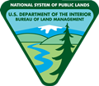
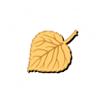
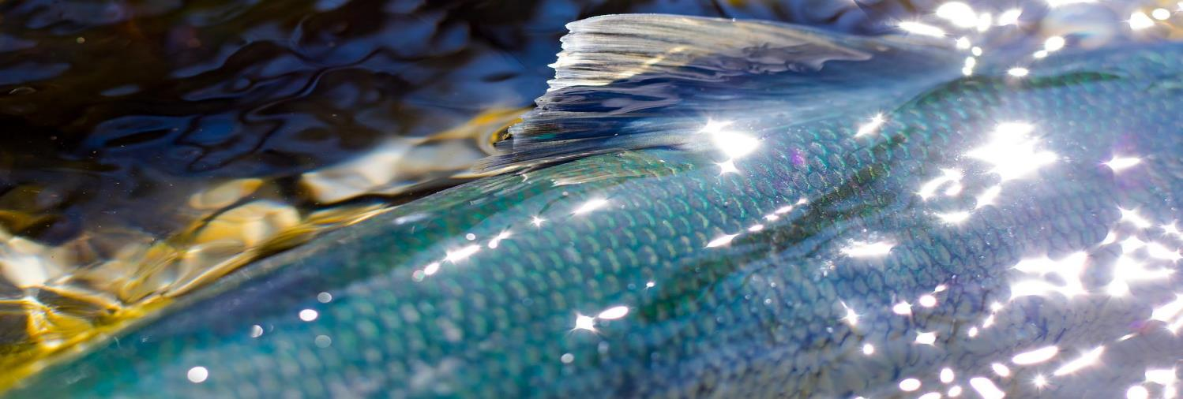
Salmon in Alaska
U.S. Department of the Interior
Bureau of Land Management
Module 4 Introduction
Photo by L. Hupp, USFWS.

Slide 2


Module 4: Salmon in Alaska
Module Questions:
U.S. Department of the Interior
Bureau of Land Management
How are salmon adaptations important for their survival?
What are some challenges salmon face during their life cycle?
Why do salmon need different habitats during different parts of their life?
Why are riparian ecosystems important for salmon?
Why are salmon important for riparian ecosystems?

Slide 3
Materials:
U.S. Department of the Interior
Bureau of Land Management
blank piece of paper
something to write with
coloring supplies (optional)

Slide 4
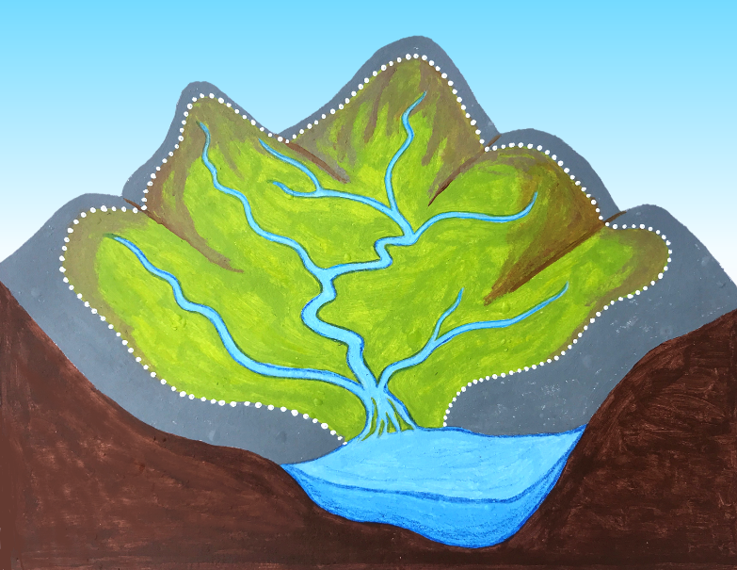
A watershed is an area of land that drains rainwater or snow melt into a river or other waterway.
The dotted line shows the boundary of this watershed.
U.S. Department of the Interior
Bureau of Land Management
Graphic by M. Harris, BLM.

Slide 5
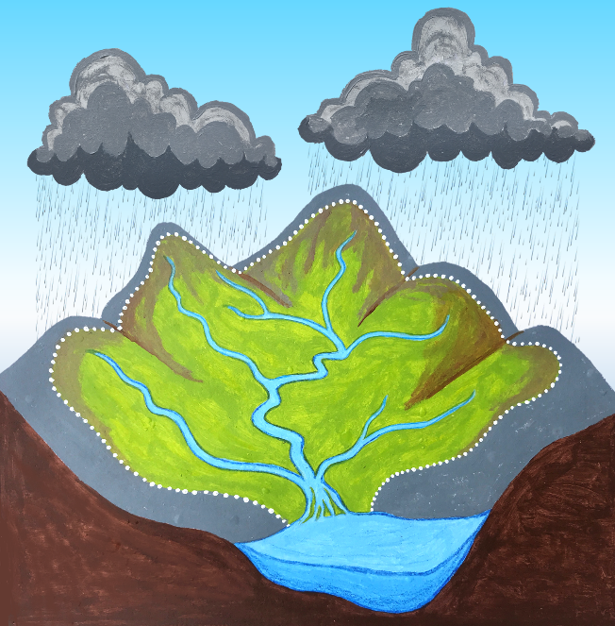
When snow melts or rain falls in a watershed, it flows downhill and collects in a waterway, such as a creek or river.
The waterway drains into the ocean or a large lake.
U.S. Department of the Interior
Bureau of Land Management
Graphic by M. Harris, BLM.

Slide 6
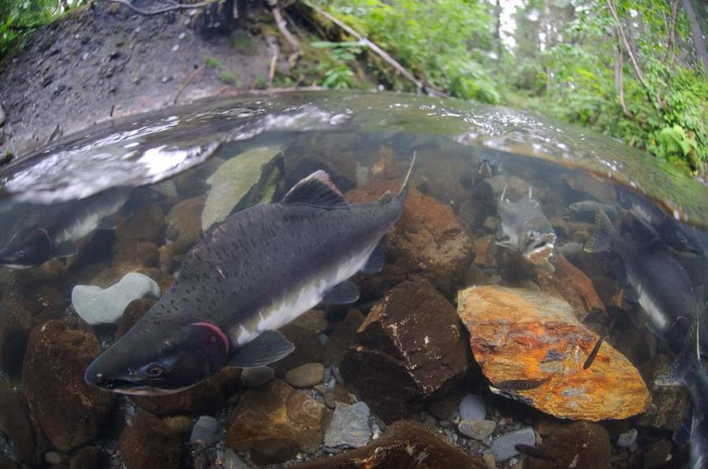
Salmon live in many waterways in Alaska.
Have you seen salmon in the waterways in your watershed?
Does your family fish for salmon?
Does your family eat salmon?
U.S. Department of the Interior
Bureau of Land Management
Fish swimming over a rocky creek bed.
Photo by K. Yasui, USFWS

Slide 7
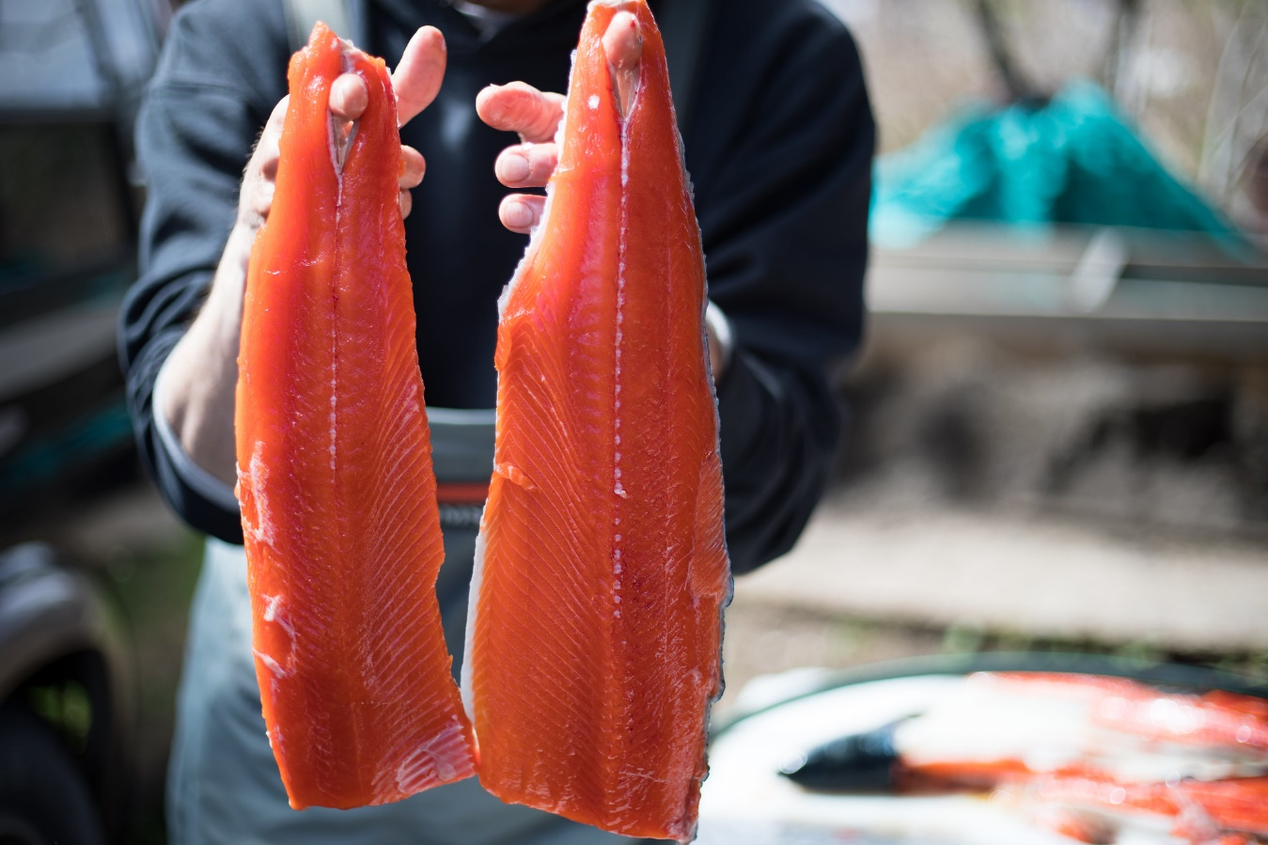
Many people in Alaska depend on salmon for food.
U.S. Department of the Interior
Bureau of Land Management
Prepared salmon fillets.
Photo by L. Hupp, USFWS.

Slide 8
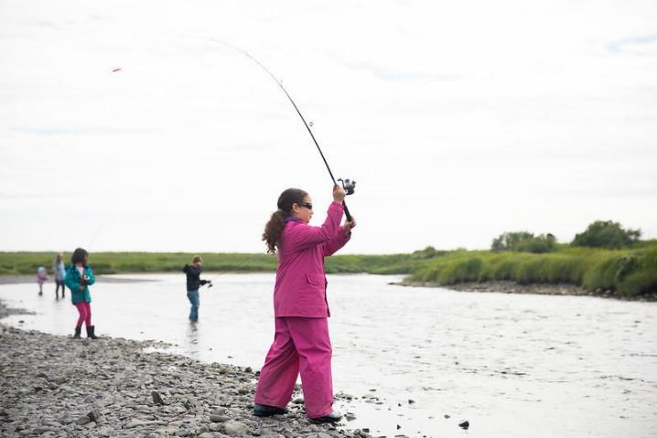
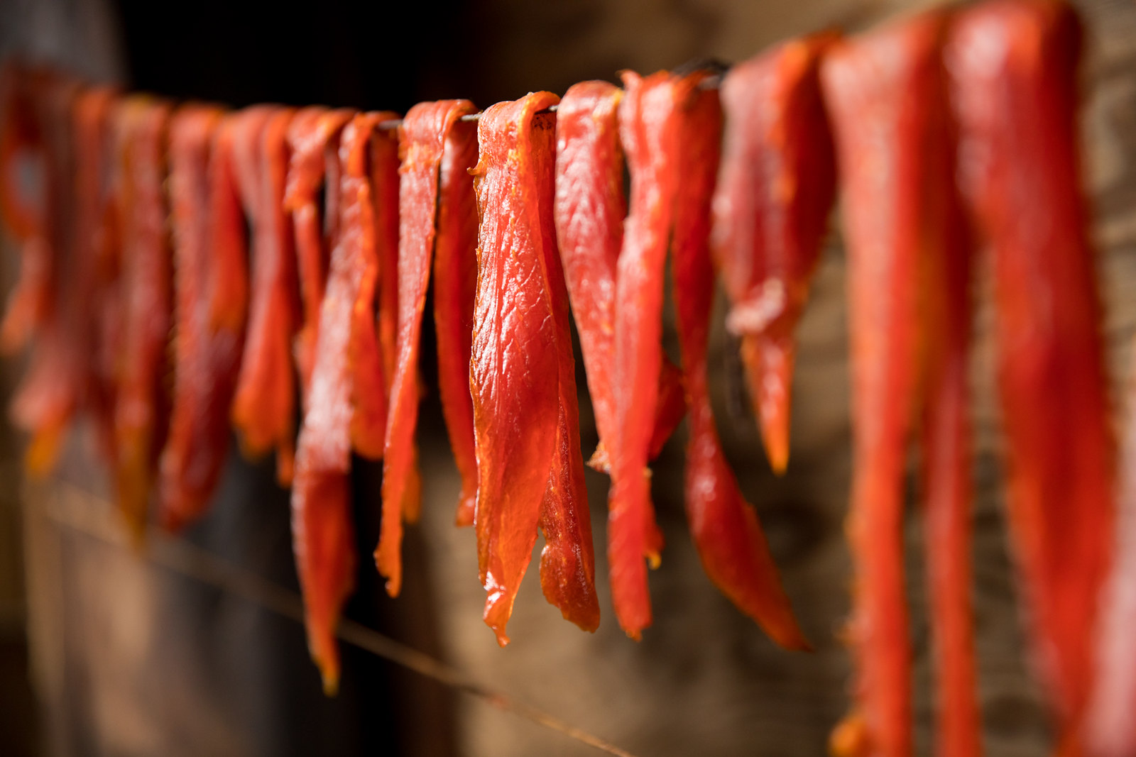
People around the state use nets and fishing poles to catch salmon. They fill freezers, drying racks, and smokehouses with salmon that will feed them all year.
U.S. Department of the Interior
Bureau of Land Management
People fishing on a riverbank.
Photo by L. Hupp, USFWS.
Salmon strips.
Photo by USFWS.

Slide 9
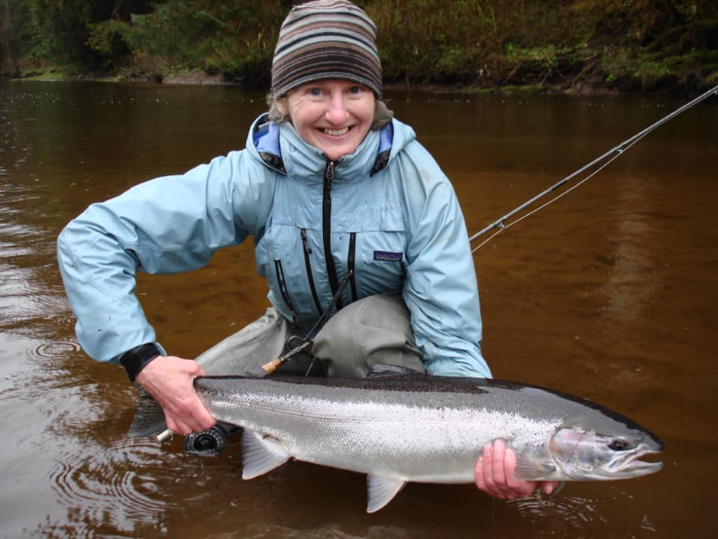
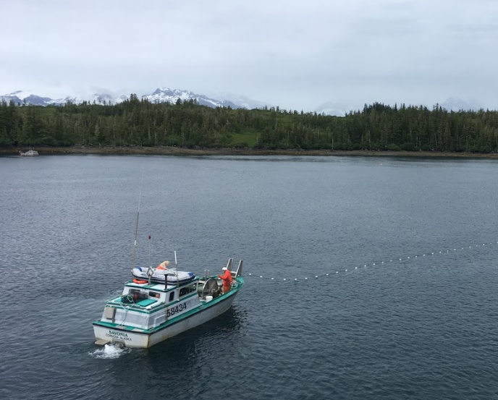
Sport fishing and commercial fishing for salmon provide food, jobs, and money for people in Alaska.
U.S. Department of the Interior
Bureau of Land Management
A person holds a salmon just above the water's surface.
Photo by USFWS.
A fishing crew checks their fishing net in the water.
Photo by CCSC staff, BLM.

Slide 10
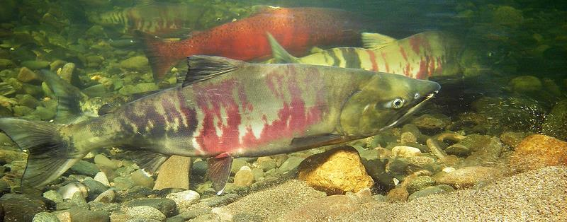
There are five types of salmon in Alaska.
U.S. Department of the Interior
Bureau of Land Management
Salmon swim over a rocky creek bed.
Photo by J. Post, BLM.

Slide 11
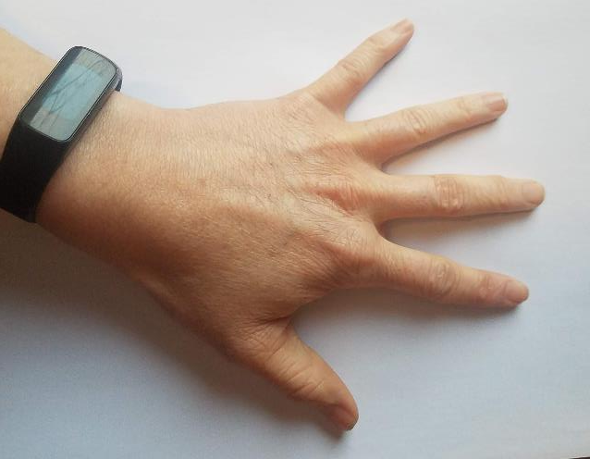
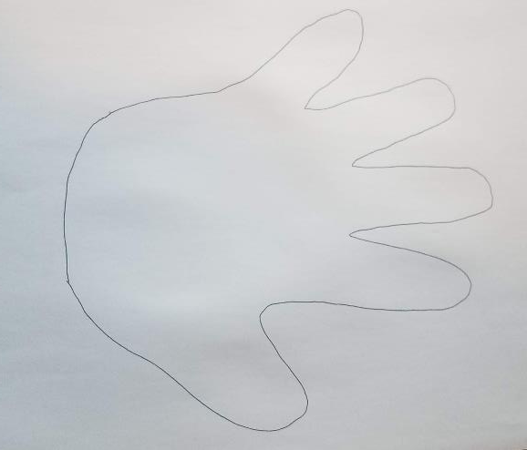
You can use your hand to remember all five types of salmon in Alaska. Each finger will represent one type of salmon.
First, trace your hand on a piece of paper.
U.S. Department of the Interior
Bureau of Land Management
Hand tracing on paper.
Photos by CCSC staff, BLM.

Slide 12
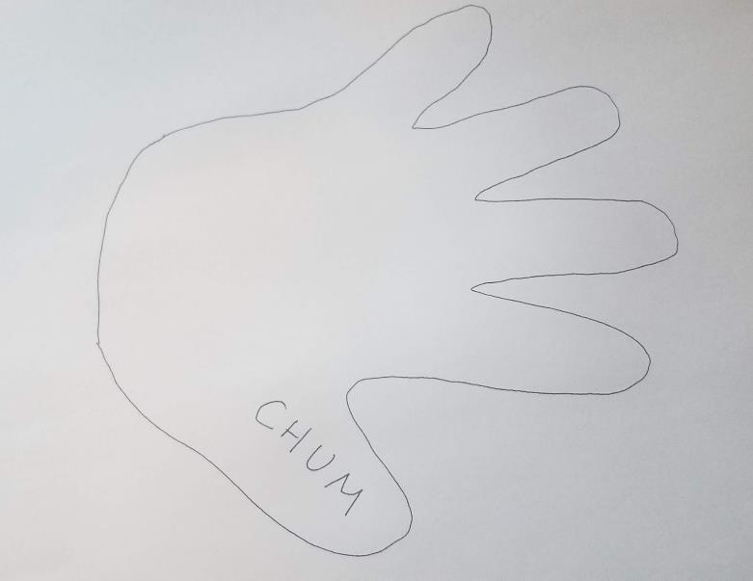
On the outline of your thumb, write Chum. “Thumb” rhymes with “chum” for chum salmon.
U.S. Department of the Interior
Bureau of Land Management
Hand tracing on paper.
Photo by CCSC staff, BLM.

Slide 13
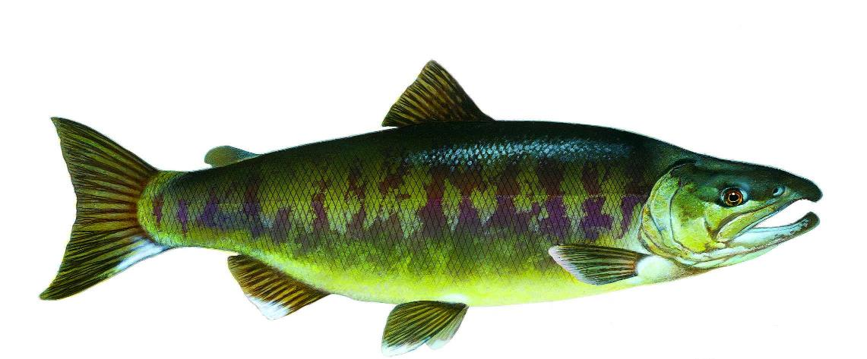
Chum salmon are also called dog salmon.
U.S. Department of the Interior
Bureau of Land Management
Graphic by T.Knepp, USFWS.

Slide 14
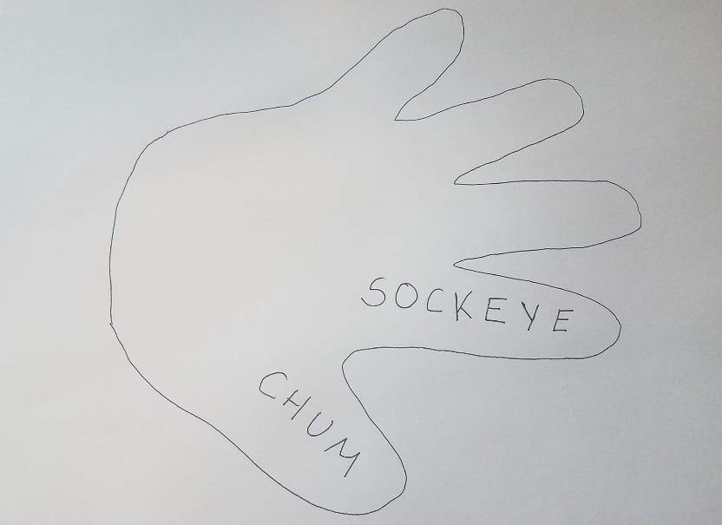
On the outline of your pointer finger, write Sockeye. Use your pointer finger to point to your eye and say “sockeye” for sockeye salmon.
U.S. Department of the Interior
Bureau of Land Management
Hand tracing on paper.
Photo by CCSC staff, BLM.

Slide 15
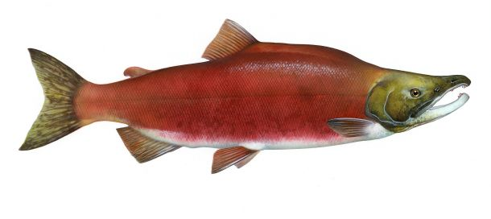
Sockeye salmon are also called red salmon.
U.S. Department of the Interior
Bureau of Land Management
Graphic by T. Knepp, USFWS.

Slide 16
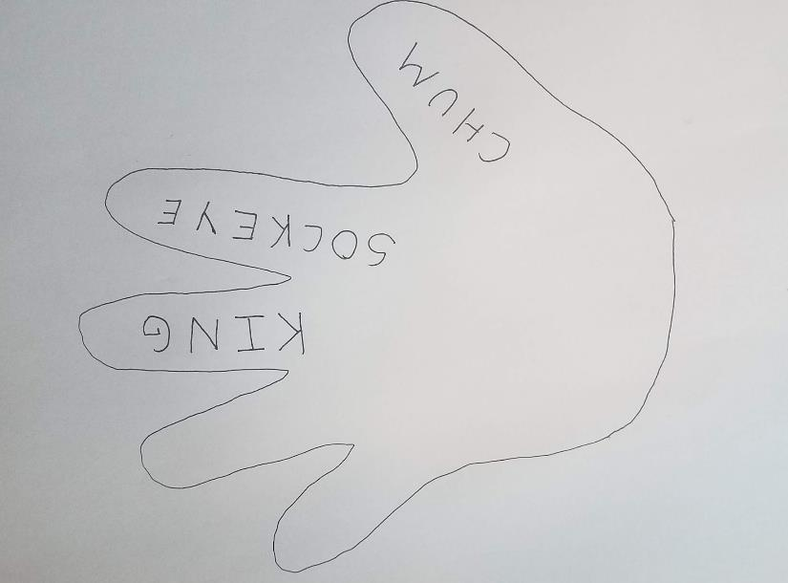
On the outline of your middle finger, write King. Your longest finger stands for the biggest salmon: king salmon.
U.S. Department of the Interior
Bureau of Land Management
Hand tracing on paper.
Photo by CCSC staff, BLM.

Slide 17
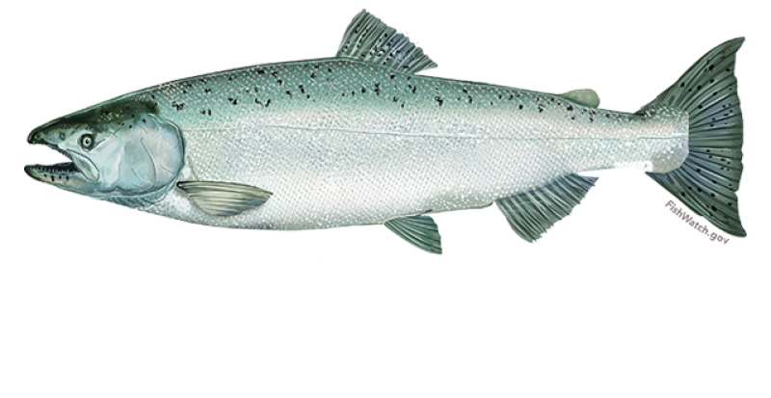
King salmon are also called chinook salmon.
U.S. Department of the Interior
Bureau of Land Management
Graphic by NOAA Fisheries, NOAA.

Slide 18
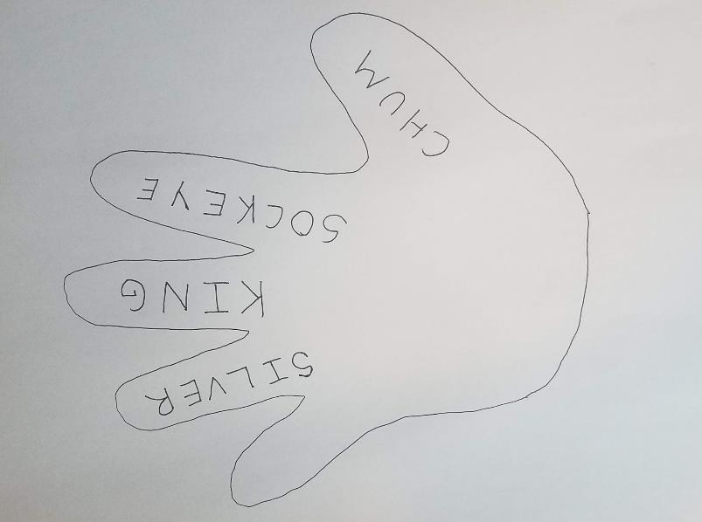
On your fourth finger, write Silver. You might wear a silver ring on your fourth finger, which can help you remember silver salmon.
U.S. Department of the Interior
Bureau of Land Management
Hand tracing on paper.
Photo by CCSC staff, BLM.

Slide 19
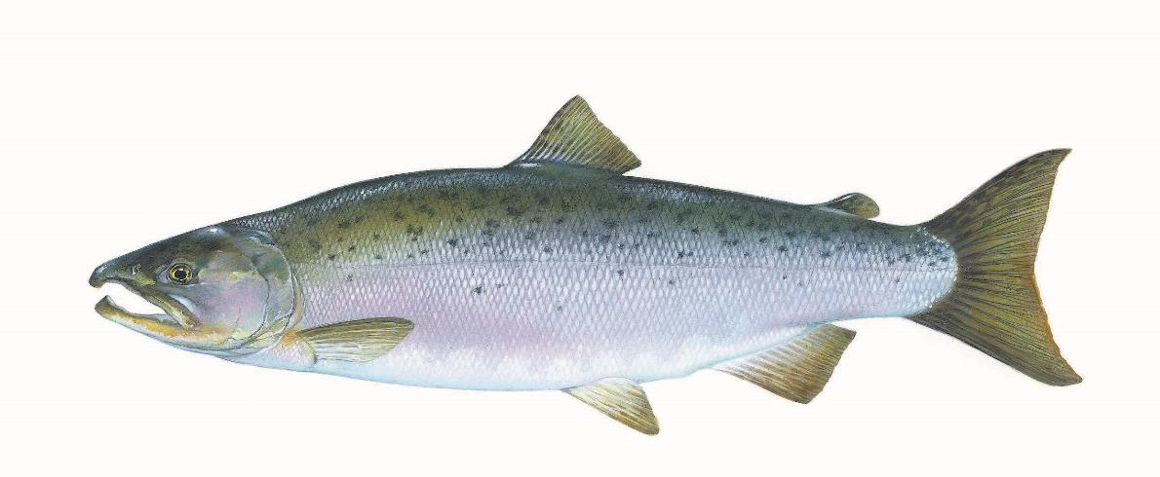
Silver salmon are also called coho salmon.
U.S. Department of the Interior
Bureau of Land Management
Timothy Knepp, USFWS

Slide 20
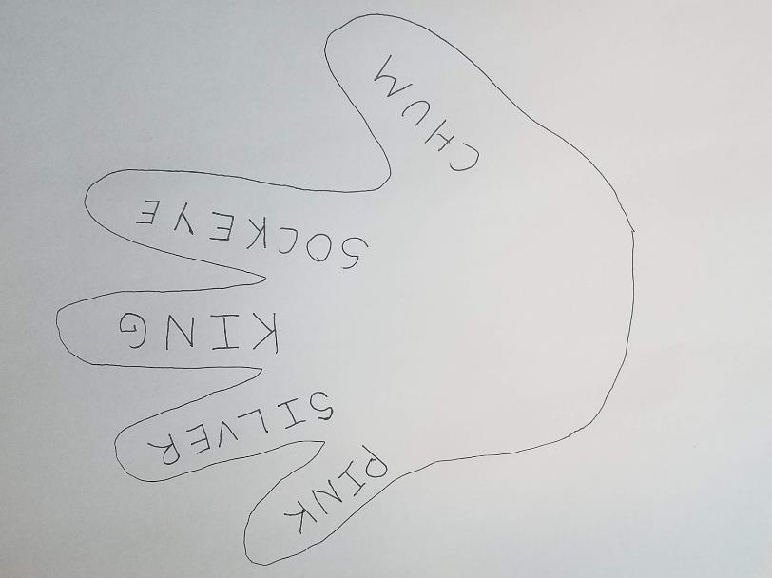
On your pinky finger, write Pink. Your smallest finger, the pinky, represents pink salmon.
U.S. Department of the Interior
Bureau of Land Management
CCSC Staff, BLM

Slide 21
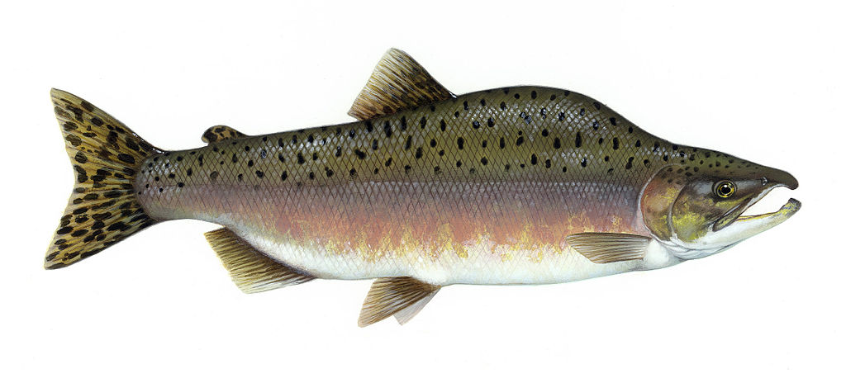
Pink salmon are also called humpy salmon.
U.S. Department of the Interior
Bureau of Land Management
Graphic by T. Knepp, USFWS.

Slide 22
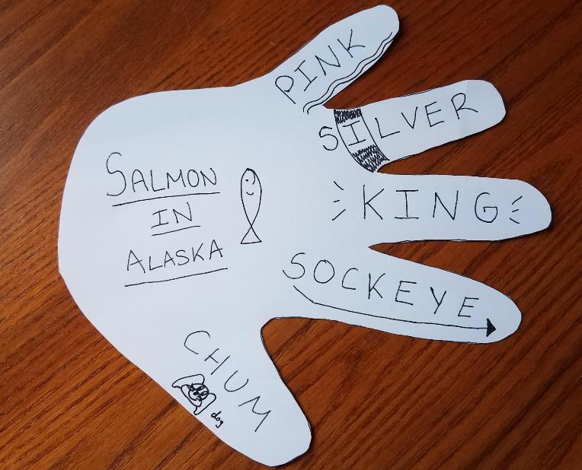
Cut out your hand outline, if you like. Feel free to add drawings or decorations to each finger to help you remember the different types of salmon in Alaska.
U.S. Department of the Interior
Bureau of Land Management
Hand tracing on paper.
Photo by CCSC staff, BLM.

Slide 23
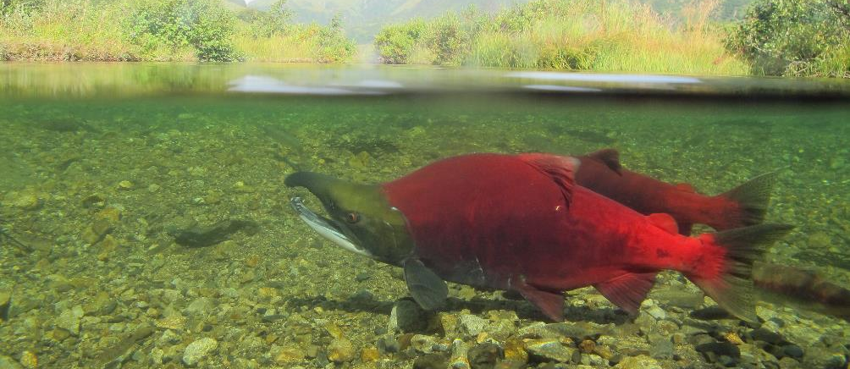
Alaska provides everything these five types of Pacific salmon need to survive and complete their life cycle. A life cycle is a series of stages a living thing goes through as it develops. Salmon play an important role in Alaska’s waterways and riparian ecosystems.
U.S. Department of the Interior
Bureau of Land Management
Salmon swim in a shallow stream.
Photo by K. Mueller, USFWS.

