Slide 1
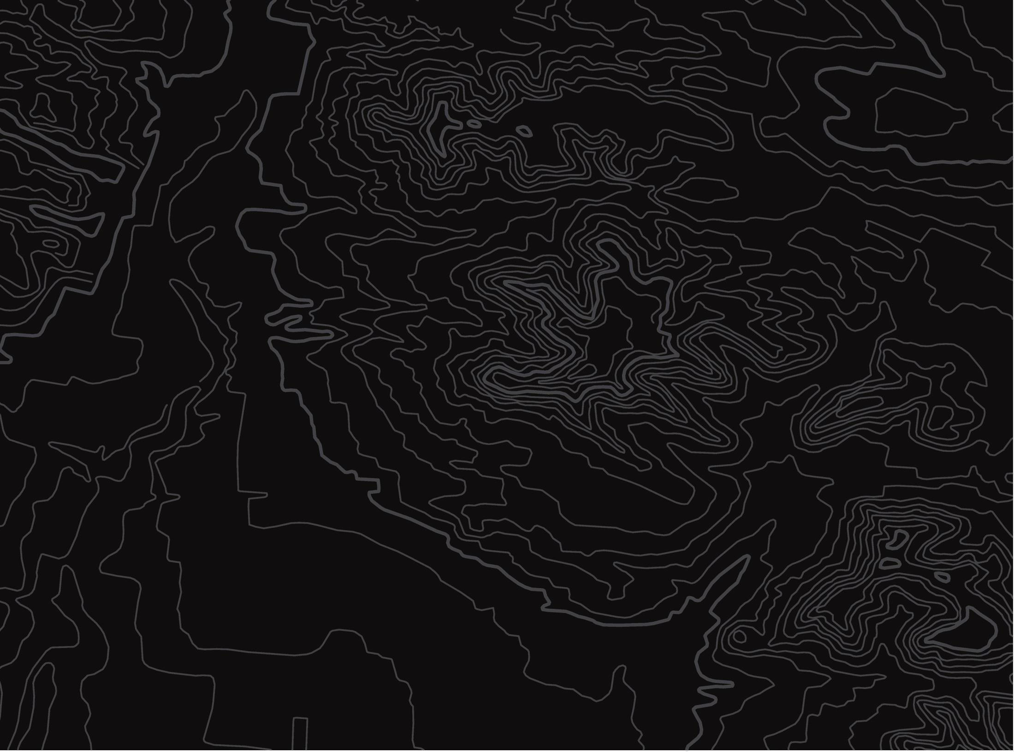


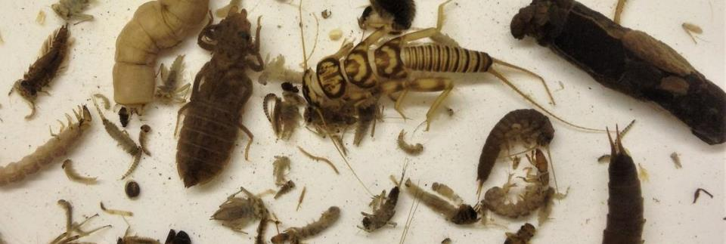
Indicator Species
U.S. Department of the Interior
Bureau of Land Management
A story about looking for critters in a creek
Module 3, Lesson 3
Photo by K. Maloney, USGS.

Slide 2
Lesson 3: Indicator Species
Lesson Questions:
U.S. Department of the Interior
Bureau of Land Management
Why are mayflies, stoneflies, and caddisflies called indicator species?
Why do scientists look for indicator species?

Slide 3
Materials:
U.S. Department of the Interior
Bureau of Land Management
paper
something to write with
coloring supplies (optional)

Slide 4




In this activity you will read a story and draw your own cartoon!
To begin, fold your paper in half three times so it ends up looking like this:
U.S. Department of the Interior
Bureau of Land Management
1
2
3

Slide 5

Unfold your paper. Now you have 8 equal boxes. Number the boxes 1- 8 as shown in the example below.
U.S. Department of the Interior
Bureau of Land Management

Slide 6

U.S. Department of the Interior
Bureau of Land Management
You will draw a cartoon in the boxes. Your drawing in each box will come from a different part of the story.
Instructions in the slides will tell you when to draw a part of your cartoon.
Each part of the story can be played out loud. Look for the speaker symbol to play the recording.
The story begins on the next slide.

Slide 7

Collecting Critters in the Creek
Chapter 1
U.S. Department of the Interior
Bureau of Land Management
One day, a 10-year-old named Micah took a walk along the creek behind his house. He was bored because he didn’t have anyone to play with. As he walked, he looked for fish swimming in the water. He was so distracted by the water that he ran into his classmate Malia.
“Ahh!” Micah exclaimed. “Sorry, Malia, I didn’t see you there.”
Malia jumped up from the ground.
“Careful where you walk!” she yelled. “And don’t step in my cookie tray.”
Micah looked at the ground and realized he was about to step in a metal tray. It looked like the type of tray his grandma used to bake cookies. But, instead of cookies, this tray was full of water, small rocks, and dirt.

Slide 8

Stop reading or listening to the story and draw your first cartoon. Draw a picture of the scene you just read here:
U.S. Department of the Interior
Bureau of Land Management

Slide 9
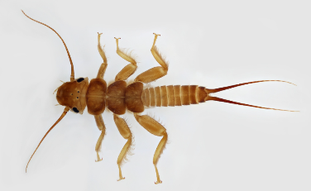
Chapter 1 Continued
U.S. Department of the Interior
Bureau of Land Management
“What’s in there?” Micah asked, pointing at the cookie tray.
“Oh, those are my macroinvertebrates,” Malia said. “I’m sorting them.”
“Your ma-ma-ma what?” Micah said, confused.
“My macroinvertebrates,” Malia repeated.
“What are those?” Micah asked.
“Macroinvertebrates are little bugs that live in the water. They don’t have backbones, and they like to live on and under rocks in creeks. My mom taught me how to catch them. She’s a scientist. She says it is important to know what lives in the creek. Every year she sends me out here to count how many different kinds of bugs I can find.”
“Wow, I never knew anything but fish lived in the creek,” Micah said.
“Yeah, there are lots of critters that live in the water besides fish,” Malia said.
© Macroinvertebrates.org, NSF

Slide 10
Chapter 1 Continued
U.S. Department of the Interior
Bureau of Land Management
“Can you teach me how to sort them?” Micah asked.
Malia agreed and gave Micah her extra forceps, a tool that looks like tweezers.
He looked closely at the tray full of dirt, rocks, and water. After a while, he saw things crawling and swimming around.
Malia taught Micah how to carefully grab the bugs in the tray with the forceps and move them to an ice cube tray full of water. She sorted the critters into different sections in the tray based on what they looked like.
In one part of the ice cube tray, there were macroinvertebrates with three tails. In another, there were macroinvertebrates with two tails. In one part there was one in a rock case with its head sticking out. And one section held a lot of slimy black creatures that looked like slugs.

Slide 11
Stop reading or listening to the story and draw your second cartoon. Draw a picture of the scene you just read here:
U.S. Department of the Interior
Bureau of Land Management

Slide 12
Chapter 1 Continued
U.S. Department of the Interior
Bureau of Land Management
“Okay, I can do this,” Micah said, as he gently picked up a critter from the cookie tray with his forceps.
“Look, this one has three tails!” Micah exclaimed. He held up the tiny bug to show Malia.
“Ooh, that’s a macroinvertebrate called a mayfly. It starts its life in the water and then changes into a flying insect. Fish like to eat them. Put it into this section of the ice cube tray with the other mayflies,” Malia said.
Micah dropped the bug into the mayfly section. There were only two other mayflies in that section. Along with the mayflies, Malia found two stoneflies, which have two tails, one caddisfly, which was hiding in a casing made of small rocks, and at least 20 black slug-like things. Each type was sorted into its own section of the ice cube tray.

Slide 13

Stop reading or listening to the story and draw your second cartoon. Draw a picture of the scene you just read here:
U.S. Department of the Interior
Bureau of Land Management

Slide 14
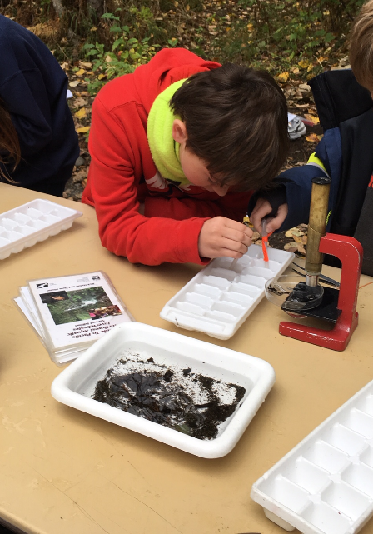
You have completed the first chapter of the story.
Make a prediction:
U.S. Department of the Interior
Bureau of Land Management
Why do you think Malia and Micah are finding many black slug-like things but only a few mayflies, stoneflies, and caddisflies?
Once you have made your prediction, start Chapter 2 on the next slide.
A student scientists observes aquatic macroinvertebrates.
Photo by M. Clark, BLM.

Slide 15
Chapter 2
U.S. Department of the Interior
Bureau of Land Management
“What are those?” Micah asked, pointing to the many black sluggy things in the ice cube tray.
“Those are leeches. I have never found so many of them in this creek before. Usually, I find more mayflies, stoneflies, and caddisflies. But this year is different. I am worried it is a bad sign,” Malia said.
“What do you mean a bad sign?” Micah asked.
“A bad sign about the creek. My mom said that when you find a lot of stoneflies, mayflies, and caddisflies in a creek that indicates the water is clean and healthy. If you can’t find mayflies, stoneflies, or caddisflies, the water is unhealthy. Stoneflies, mayflies, and caddisflies can only survive in clean water. If the water gets too polluted, they die,” Malia explained.

Slide 16
Chapter 2 continued
U.S. Department of the Interior
Bureau of Land Management
“What do you think is happening to the mayflies, stoneflies, and caddisflies?” Micah asked.
“I don’t know,” Malia said. “Do you want to go on an adventure and try to find out?”
An adventure! Micah wasn’t bored anymore. He loved to explore. They started walking upstream along the creek. As they walked, they looked for things that might pollute the water.
It was difficult to walk along the creek. The rocks were slippery. Micah nearly fell into the water, but Malia reached out a hand and grabbed him. Together they slowly made their way up the watershed.

Slide 17
Stop reading or listening to the story and draw your fourth cartoon. Draw a picture of the scene you just read here:
U.S. Department of the Interior
Bureau of Land Management

Slide 18
Chapter 2 Continued
U.S. Department of the Interior
Bureau of Land Management
Micah and Malia followed the creek for a long time. After what felt like hours, Malia suddenly stopped. She sniffed the air.
“Do you smell that?” Malia asked Micah.
“Eww, yes, it smells gross!” Micah said, plugging his nose.
They walked a little further until they discovered the source of the smell: a pipe dumping dirty brown water right into the creek.
They had found the source of pollution.
“Maybe this is what is killing all the mayflies, stoneflies, and caddisflies,” Malia exclaimed, pointing to the dirty water entering the creek.

Slide 19
Stop reading or listening to the story and draw your fifth cartoon. Draw a picture of the scene you just read here:
U.S. Department of the Interior
Bureau of Land Management

Slide 20
U.S. Department of the Interior
Bureau of Land Management
You have completed the second chapter of the story.
In the story, Malia says that her mom taught her that finding lots of stoneflies, mayflies, and caddisflies in a creek indicates the water is clean and healthy.
What do you think the word indicate means?

Slide 21
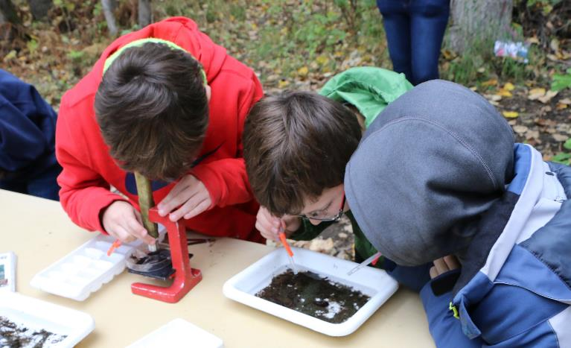
To indicate means to signal something that is happening.
If scientists find lots of different kinds of mayflies, stoneflies, and caddisflies, it indicates that the water is healthy and clean.
Mayflies, stoneflies, and caddisflies are called indicator species.
U.S. Department of the Interior
Bureau of Land Management
A student scientists observes aquatic macroinvertebrates under a microscope..
Photo by M. Clark, BLM.

Slide 22
Chapter 3
U.S. Department of the Interior
Bureau of Land Management
Micah and Malia felt helpless as they watched the polluted water flow from the pipe into the creek.
“Let's go back and tell my mom,” Malia said. “She’ll know what to do.”
Micah and Malia ran as fast as they could to Malia’s house. They found Malia’s mom, Dr. Kahele, in the kitchen.
“What is going on?” Dr. Kahele asked as Malia and Micah burst in.

Slide 23
Stop reading or listening to the story and draw your sixth cartoon. Draw a picture of the scene you just read here:
U.S. Department of the Interior
Bureau of Land Management

Slide 24
Chapter 3 Continued
U.S. Department of the Interior
Bureau of Land Management
“Mom, we have a problem. You have to come quick!” Malia exclaimed.
“What’s wrong?” Dr. Kahele asked.
“We found a pipe that’s spilling pollution into the creek,” Micah blurted out. “And we found only leeches when we sorted the macroinvertebrates Malia collected.”
“Really? Only leeches?” Dr. Kahele asked.
“Well, we did find a few mayflies, stoneflies, and caddisflies,” Malia said, “but that was it.”
“What do you think that could mean?” Dr. Kahele asked.
“You told me I should find lots of different kinds of bugs,” Malia said. “You said the creek is healthy when there is a lot of biodiversity, but we mostly found leeches.”

Slide 25
Chapter 3 Continued
U.S. Department of the Interior
Bureau of Land Management
“So, we had to find out what was wrong,” Micah interrupted, eager to tell about their adventure.
“We walked a long way upstream. Then we started smelling something really terrible,” Micah said. “We saw a pipe pouring dirty polluted water into the creek.”
“Come with us back to the creek so we can show you,” Malia said, pulling on Dr. Kahele’s arm.
“Ok, let me put my boots on,” Dr. Kahele said.
As the three of them walked together back down to the creek, Dr. Kahele thought quietly to herself. She had taught Malia about indicator species years ago, but she did not think Malia had been paying attention. Now, Malia was climbing over slippery rocks with a classmate to discover what could be making the mayflies, stoneflies, and caddisflies disappear.

Slide 26
Stop reading or listening to the story and draw your seventh cartoon. Draw a picture of the scene you just read here:
U.S. Department of the Interior
Bureau of Land Management

Slide 27
Chapter 3 Continued
U.S. Department of the Interior
Bureau of Land Management
When they reached the creek, they crouched around the ice cube tray. Sure enough, Dr. Kahele could see solid evidence that Malia and Micah had found many leeches but only a few mayflies, stoneflies, and caddisflies.
“Leeches have a high tolerance for pollution and warm water temperatures,” Dr. Kahele said. “Mayflies, stoneflies, and caddisflies have a low tolerance. This means that if the water temperature increases or if the water is polluted, mayflies, stoneflies, and caddisflies will die off quickly, but leeches will be OK.”
“So that's why mayflies, stoneflies, and caddisflies are called indicator species?” Micah asked. He thought has was finally beginning to understand what Malia meant. If they could not find mayflies, stoneflies, or caddisflies, it was a signal that the water was unhealthy.

Slide 28
Chapter 3 continued
U.S. Department of the Interior
Bureau of Land Management
“Yes, exactly,” Dr. Kahele said.
“Well, what are we going to do about it?” Malia asked impatiently.
“That's a good question,” Dr. Kahele said. “We better go find out where the dirty water is coming from. Let’s start by calling our neighborhood council to see if they know who owns the pipe.”
They gently released the macroinvertebrates they had collected back into the creek and walked back to the house to make some important phone calls.
The End

Slide 29
In box number eight, draw a picture of the final part of the story:
U.S. Department of the Interior
Bureau of Land Management

