Slide 1


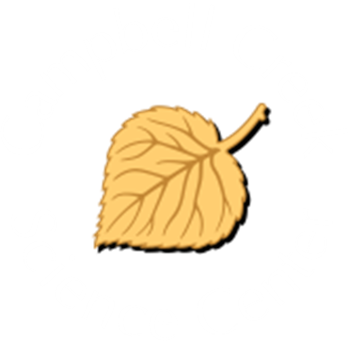
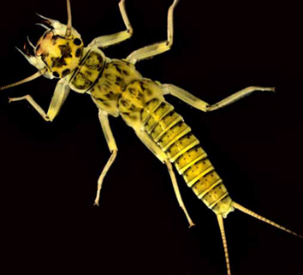
Aquatic Macroinvertebrates
U.S. Department of the Interior
Bureau of Land Management
Learn how tiny animals survive in a big, wet world
Module 3, Lesson 2
Photo by NPS.

Slide 2
Lesson 2: Aquatic Macroinvertebrates
Lesson Questions:
U.S. Department of the Interior
Bureau of Land Management
What are aquatic macroinvertebrates?
How do adaptations help macroinvertebrates survive in aquatic habitats?

Slide 3
Materials:
U.S. Department of the Interior
Bureau of Land Management
science journal or a piece of paper
something to write with
craft supplies that you have available

Slide 4
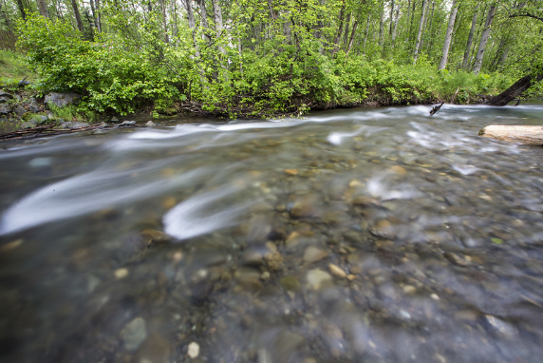
Imagine you are reaching into the water in a creek.
Pick up a rock.
Turn it over.
What do you find?
U.S. Department of the Interior
Bureau of Land Management
Campbell Creek.
Photo by B. Wick, BLM.

Slide 5
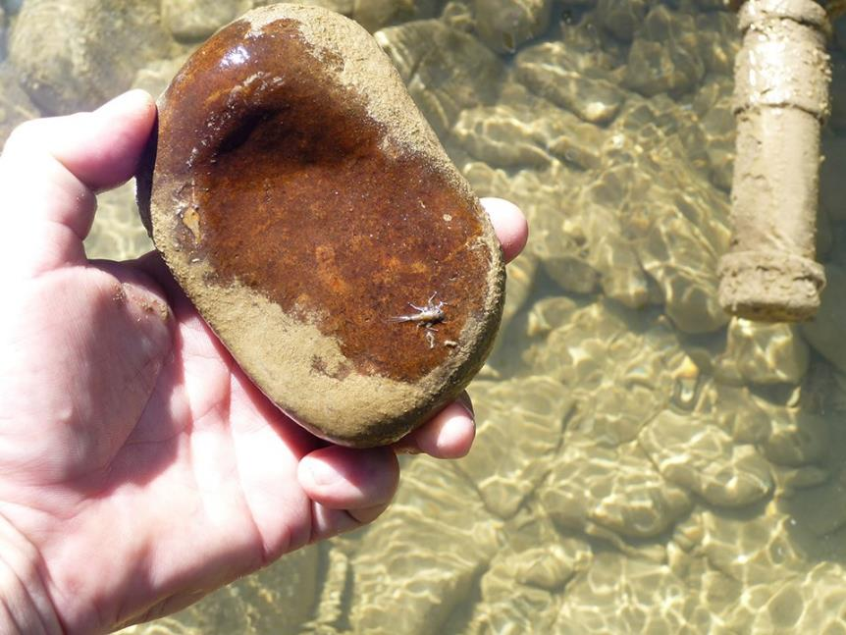
What is that?
U.S. Department of the Interior
Bureau of Land Management
A macroinvertebrate takes shelter underneath a creek bed rock.
Photo by NPS.

Slide 6
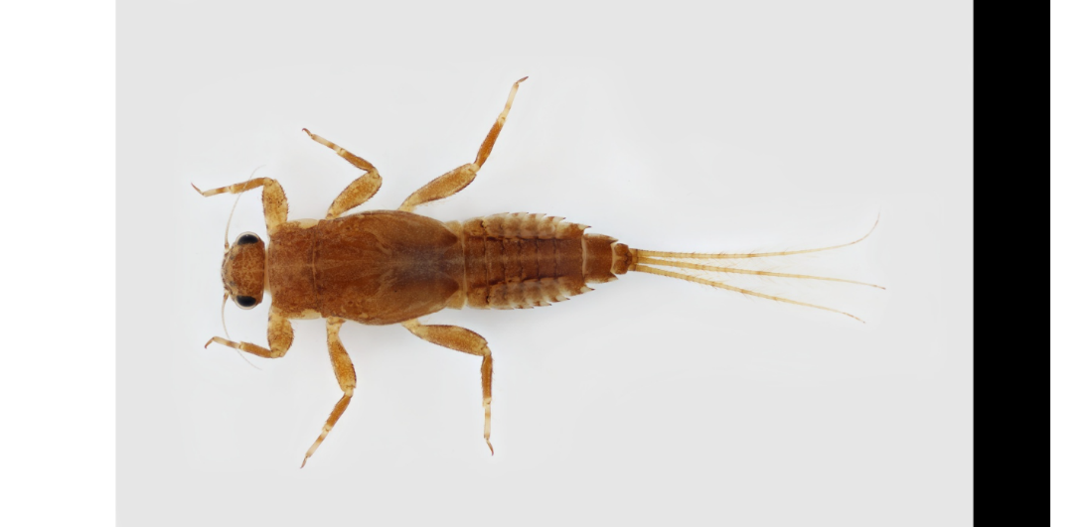
It’s an aquatic macroinvertebrate!
U.S. Department of the Interior
Bureau of Land Management
© Macroinvertebrates.org, NSF
Notes:
Stacey: Blurry image

Slide 7
What are macroinvertebrates? Break up the word into its parts to figure it out!
U.S. Department of the Interior
Bureau of Land Management
macroinvertebrate
macro: big enough to see with just our eyes (opposite of micro)
in: prefix meaning “no”
vertebrate: a living thing with a backbone
Put it together: A macroinvertebrate is a living thing with no backbone that is big enough to see. An aquatic macroinvertebrate lives at least part of its life cycle in water.

Slide 8
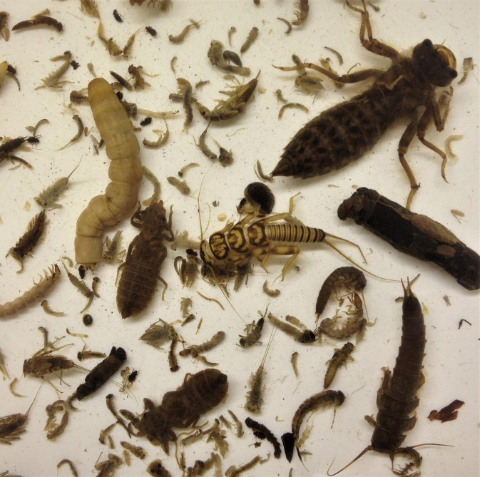
There are lots of different types of aquatic macroinvertebrates.
Most macroinvertebrates are insects, but some are worms, mites, snails, or other animals.
U.S. Department of the Interior
Bureau of Land Management
A collection of macroinvertebrates.
Photo by K. Maloney, USGS.

Slide 9
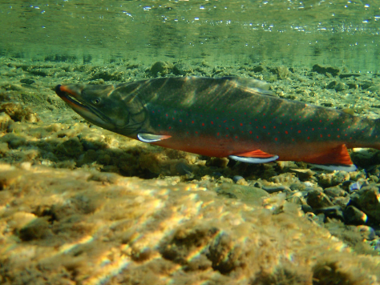
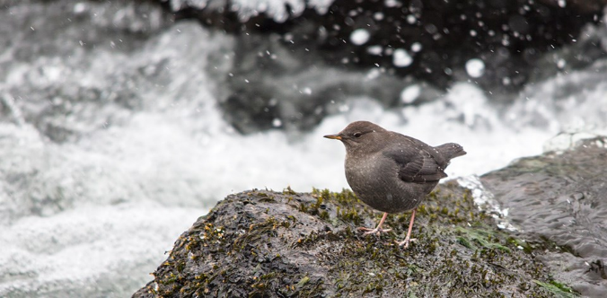
Even though aquatic macroinvertebrates are small, they play a big role in riparian ecosystems.
Aquatic macroinvertebrates are food for all sorts of animals, including fish like Arctic Char and birds like the American Dipper.
Aquatic macroinvertebrates also help break down dead plants and animals in waterways.
U.S. Department of the Interior
Bureau of Land Management
Arctic Char
An Arctic char swims through a body of water.
Photo by D. Parker, BLM.
American Dipper
An American dipper rests on a rock near the water's edge.
Photo by J. W. Frank, NPS.

Slide 10
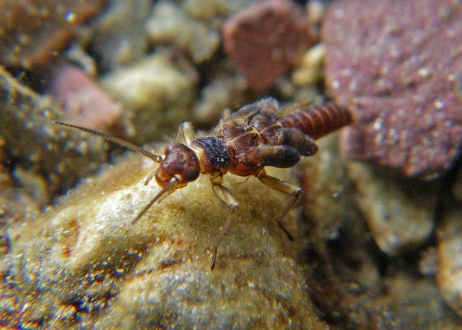
U.S. Department of the Interior
Bureau of Land Management
Aquatic macroinvertebrates have different ways of getting their food.
Some eat large pieces of leaves by shredding them apart.
Some filter particles out of the water using nets or hairs.
Some scrape algae off rocks.
Some pick up small pieces of food on the bottom of the stream.
Some spear their food, such as large plant stems.
Some eat other macroinvertebrates.
Because of these different feeding habits, large numbers of macroinvertebrates can share the same healthy aquatic habitats.
How do you think I get my food?
A macroinvertebrate rests on a rock in a creek bed.
Photo by J. Giersch, USGS.

Slide 11
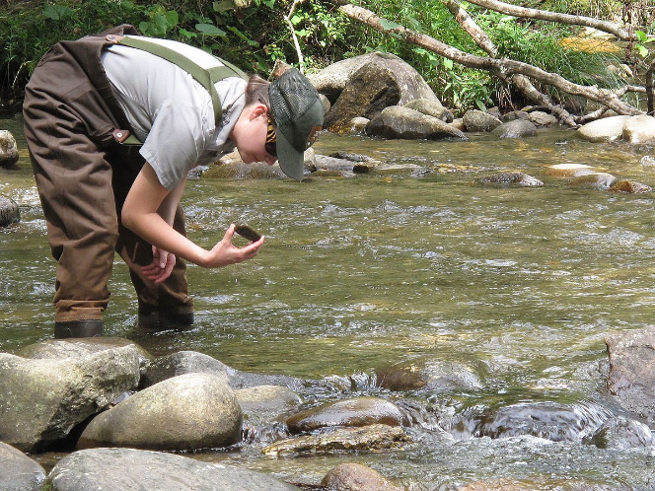
Scientists also use macroinvertebrates to check the health of aquatic habitats.
Some aquatic macroinvertebrates can live only in very clean water. Scientists know that if they find lots of those kinds of aquatic macroinvertebrates in a waterway, the water must be clean.
U.S. Department of the Interior
Bureau of Land Management
A scientists looks for macroinvertebrates in a creek bed. Photo by G. Peeples, USFWS.

Slide 12
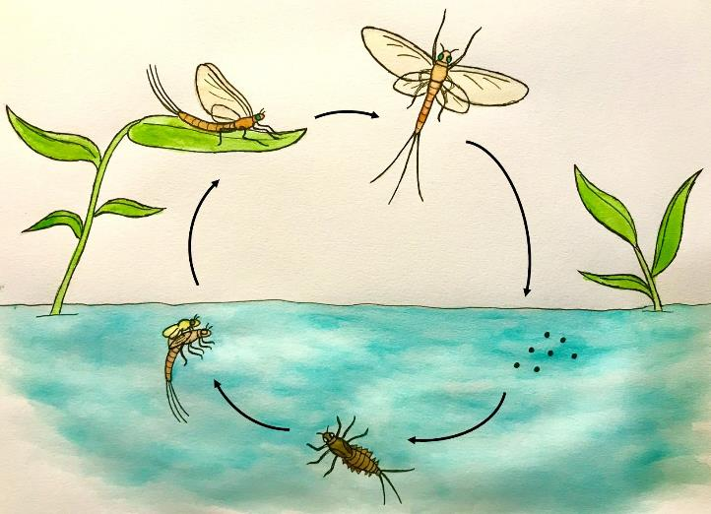
Many aquatic macroinvertebrates have a life cycle with several stages. They go through metamorphosis, a change of shape or form, similar to how caterpillars change their bodies into butterflies.
.
U.S. Department of the Interior
Bureau of Land Management
Graphic by M. Harris, BLM.

Slide 13
Aquatic macroinvertebrates start their lives as tiny eggs, laid in or near the water.
U.S. Department of the Interior
Bureau of Land Management
eggs
Graphic by M. Harris, BLM.

Slide 14
Macroinvertebrates hatch out of the eggs as a larvae, which are insects in an early stage of development.
The larvae will then spend months or even years living underwater.
U.S. Department of the Interior
Bureau of Land Management
Graphic by M. Harris, BLM.
larva

Slide 15
Over time, the larvae turn into adults. Once they mature, some larvae grow wings and climb out of the water.
U.S. Department of the Interior
Bureau of Land Management
larva transforming into an adult
Graphic by M. Harris, BLM.

Slide 16
These adult macroinvertebrates then use their wings to live the rest of their lives in the air.
Eventually, the adult macroinvertebrates will find their way back to a waterway and lay their eggs, starting the life cycle over again.
U.S. Department of the Interior
Bureau of Land Management
Graphic by M. Harris, BLM.
adult insect

Slide 17
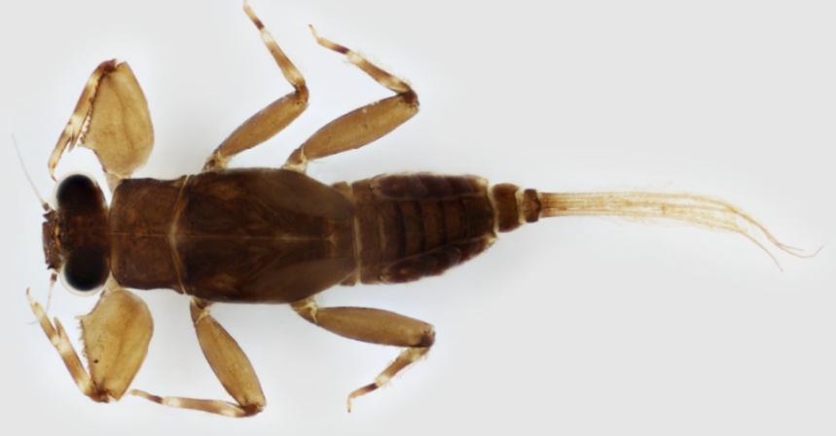
It is not easy to live in a fast-moving waterway. Staying alive requires adaptations. An adaption is a body part or behavior that helps a living thing survive.
Aquatic macroinvertebrates have many useful (and strange) adaptations that keep them alive.
U.S. Department of the Interior
Bureau of Land Management
© Macroinvertebrates.org, NSF

Slide 18
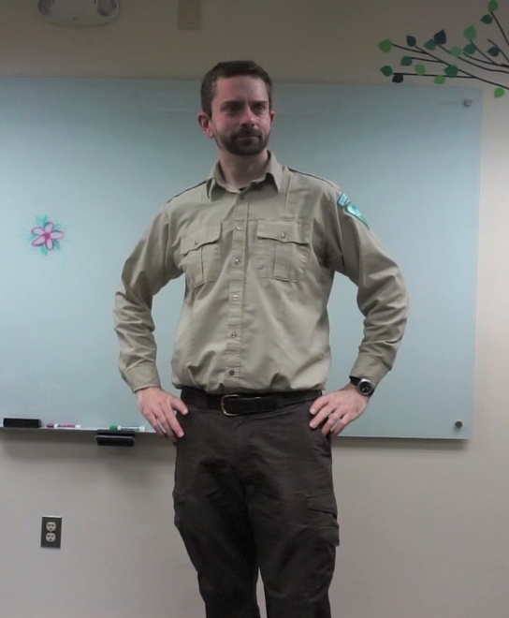
What would it look like if we gave a human some of the same adaptations as aquatic macroinvertebrate larvae?
Let’s find out!
U.S. Department of the Interior
Bureau of Land Management
A CCSC staff member gets ready for an adaptation makeover.
Photo by CCSC staff, BLM

Slide 19
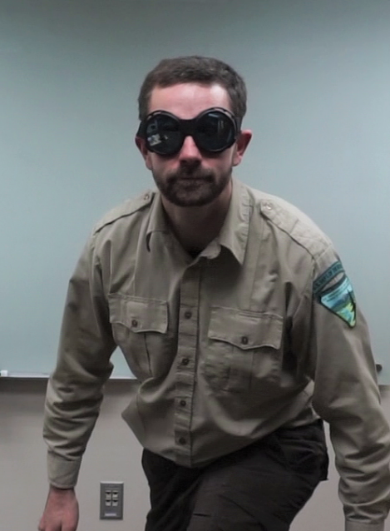
The first adaptation we will give our human are these giant eyes.
Many macroinvertebrates have large eyes that seem to bulge out of their heads.
Why might this be a helpful adaptation to have?
U.S. Department of the Interior
Bureau of Land Management
eyes
The first adaptation for this CCSC staff member is giant eyes.
Photo by CCSC staff, BLM.

Slide 20
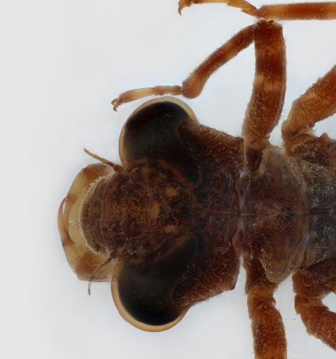
When you are this small and tasty, lots of things want to eat you.
Having large, complex eyes allow macroinvertebrates like this stonefly to see in many directions at once. This lets them know when danger is near.
U.S. Department of the Interior
Bureau of Land Management
eyes
©Macroinvertebrates.org, NSF
Notes:
Stacey: Blurry image

Slide 21
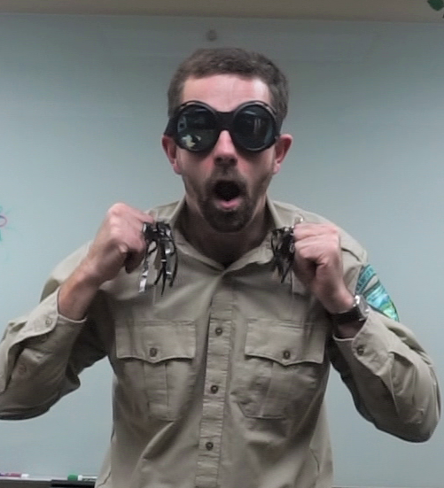
Check out these gills we’ve attached to our human.
To help our human survive underwater, we will need to give him a set of gills to help him breathe.
U.S. Department of the Interior
Bureau of Land Management
gills
The second adaptation, is gills.
Photo by CCSC staff, BLM.

Slide 22
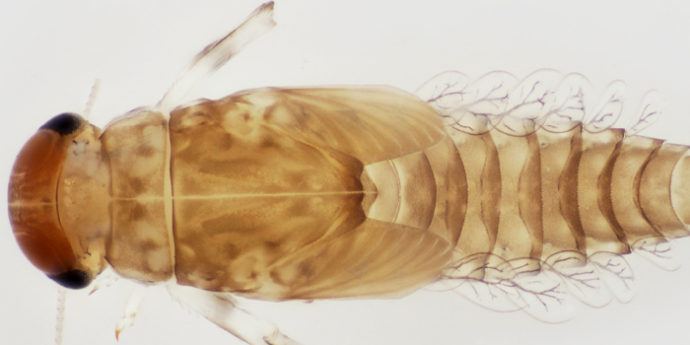
If you look closely, you can see feathery- looking things on the sides of this mayfly larva.
These are gills that wave back and forth and pick up dissolved oxygen the mayfly needs to survive.
U.S. Department of the Interior
Bureau of Land Management
gills
©Macroinvertebrates.org, NSF

Slide 23
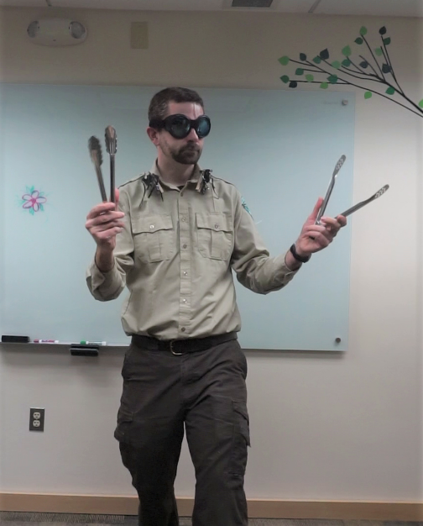
The next adaptation we’ll give our human is a set of big, pinchy claws.
Many macroinvertebrates have claws similar to these.
How do you think macroinvertebrates use their claws?
U.S. Department of the Interior
Bureau of Land Management
claws
The third adaptation is pinchers or claws.
Photo by CCSC staff member, BLM.

Slide 24
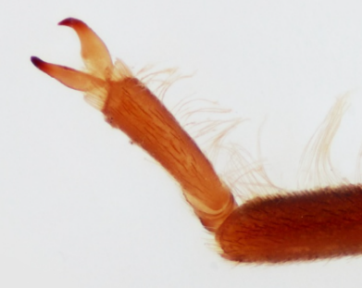
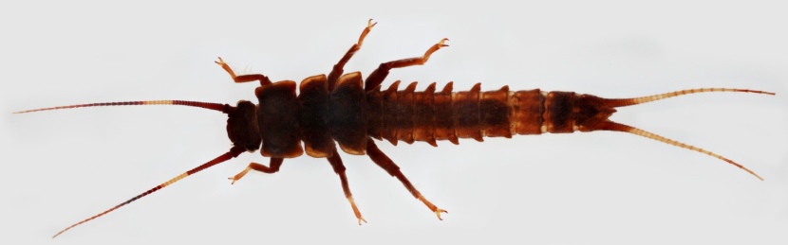
Having claws allows aquatic macroinvertebrates like this stonefly to hold on to rocks and quickly grab food as it floats by in the current.
U.S. Department of the Interior
Bureau of Land Management
claw
© Macroinvertebrates.org, NSF
© Macroinvertebrates.org, NSF

Slide 25
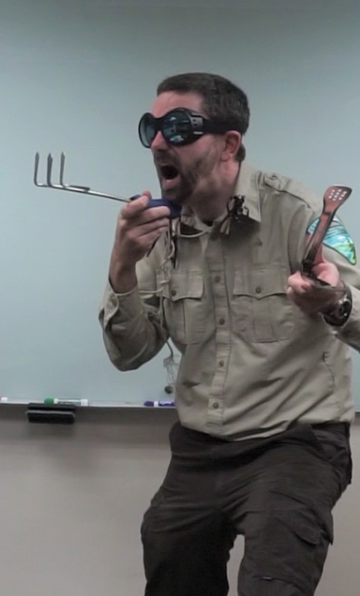
Look at the amazing mouth attachment we’ve given our human.
Some macroinvertebrates have extendable lower jaws.
Why might that be a helpful adaptation to give our human?
U.S. Department of the Interior
Bureau of Land Management
jaw
The fourth adaptation for this lucky CCSC staff member is an extendable lower jaw.
Photo by CCSC staff, BLM.

Slide 26
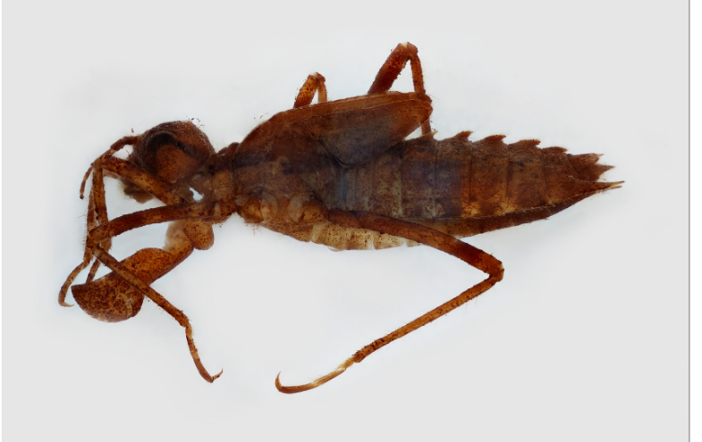
Dragonfly larvae wait patiently on rocks or underwater plants for a potential meal to float by.
When small animals get close, dragonfly larvae extend their jaws outward to snatch and draw in the food.
U.S. Department of the Interior
Bureau of Land Management
jaw
© Macroinvertebrates.org, NSF

Slide 27
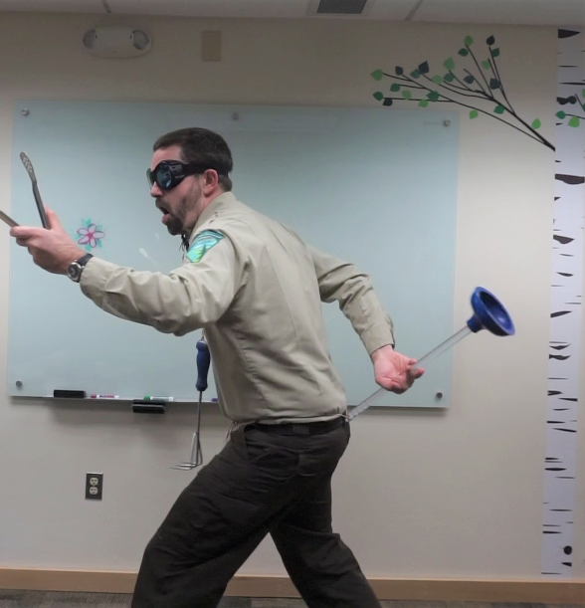
Check out this amazing adaptation!
Some aquatic macroinvertebrates have special hairs and suction cups on their bodies.
Why would this be a useful adaptation for macroinvertebrates living in a stream?
U.S. Department of the Interior
Bureau of Land Management
suction cup
The fifth adaptation is a suction cup.
Photo by CCSC staff, BLM.

Slide 28
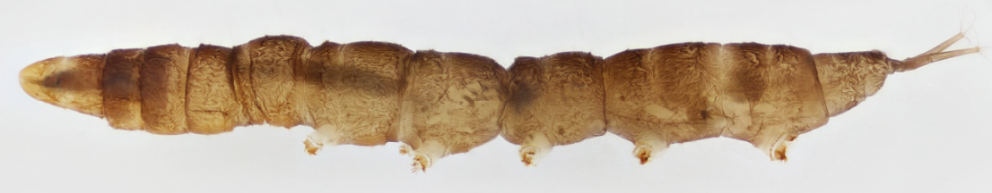
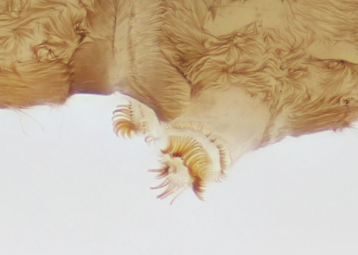
Cranefly larvae have tiny hairs and suction cups along their body that help them hold on to rocks in fast-flowing water.
U.S. Department of the Interior
Bureau of Land Management
© Macroinvertebrates.org, NSF
© Macroinvertebrates.org, NSF
suction cup

Slide 29
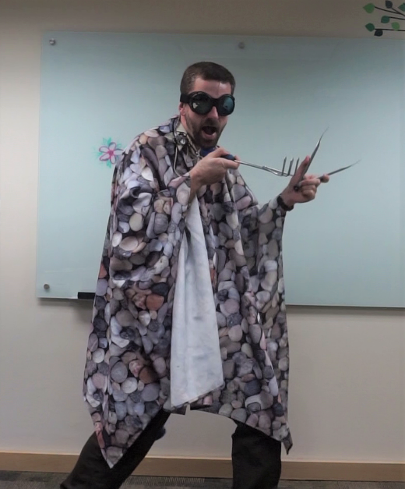
Now we’ve covered our human with a case of small stones.
Why might this be a helpful adaptation?
U.S. Department of the Interior
Bureau of Land Management
The sixth adaptation is a protective casing of small stones.
Photo by CCSC staff, BLM.

Slide 30
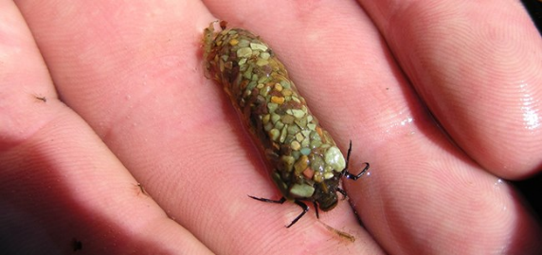
U.S. Department of the Interior
Bureau of Land Management
Some caddisfly larvae make their own camouflage to help blend in with their surroundings.
They collect small rocks or pieces of plants and use silk to hold them together as a case around their bodies. This case helps them hide from animals that want to eat them.
A macroinvertebrate encased in protective stones.
Photo by NPS.
case

Slide 31
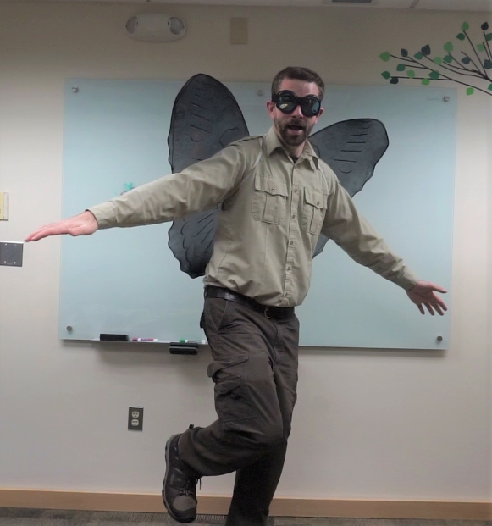
After using his many adaptations to survive underwater for several years, our human is ready for metamorphosis.
It is time for him to grow wings, leave the water, and fly around in the air as an adult.
U.S. Department of the Interior
Bureau of Land Management
The seventh, and final adaptation for our friendly CCSC staff member is a set of wings.
Photo by CCSC staff, BLM.

Slide 32
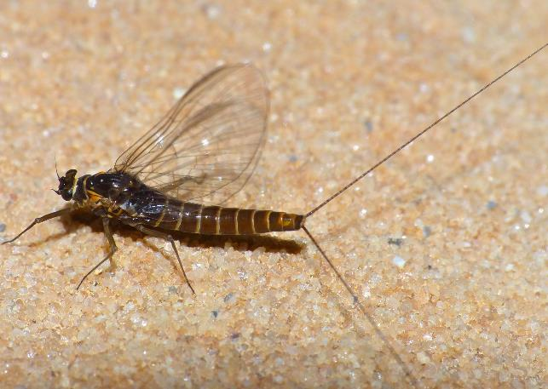
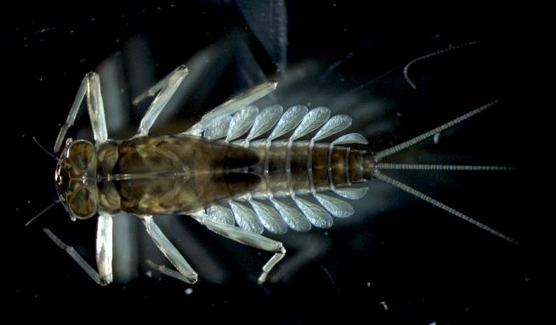
Many aquatic macroinvertebrates, like this mayfly, will spend most of their lives underwater...
U.S. Department of the Interior
Bureau of Land Management
...until they undergo metamorphosis and become adults that fly away into the air.
A mayfly macroinvertebrate.
Photo by M. Croteau, USGS.
A mayfly that is now outside of the water and ready to fly away.
Photo by E. Dinger, NPS.

Slide 33
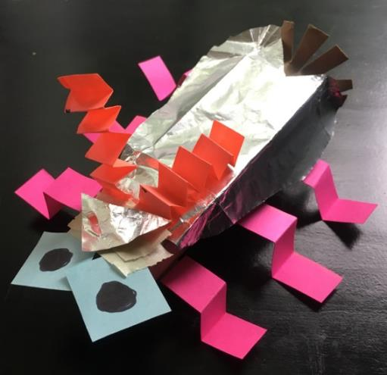
Now, you will create your own aquatic macroinvertebrate.
First, gather craft materials, such as cardboard, glue, tape, ribbon, or whatever else you have around.
You can even grab materials from the trash or recycling bin, such as toilet paper rolls or plastic bottles.
U.S. Department of the Interior
Bureau of Land Management
An artistic representation of an aquatic macroinvertebrate.
Photo by CCSC staff, BLM.
Example: Pink-legged paper towel roll fly.

Slide 34
Using the materials you gathered, design an aquatic macroinvertebrate.
Remember, aquatic macroinvertebrates come in many different shapes and sizes.
What adaptations does your imaginary critter need to survive in a stream habitat? Be creative!
U.S. Department of the Interior
Bureau of Land Management
An artistic representation of an aquatic macroinvertebrate.
Photo by CCSC staff, BLM.
Example: Pink-legged paper towel roll fly

