Slide 1
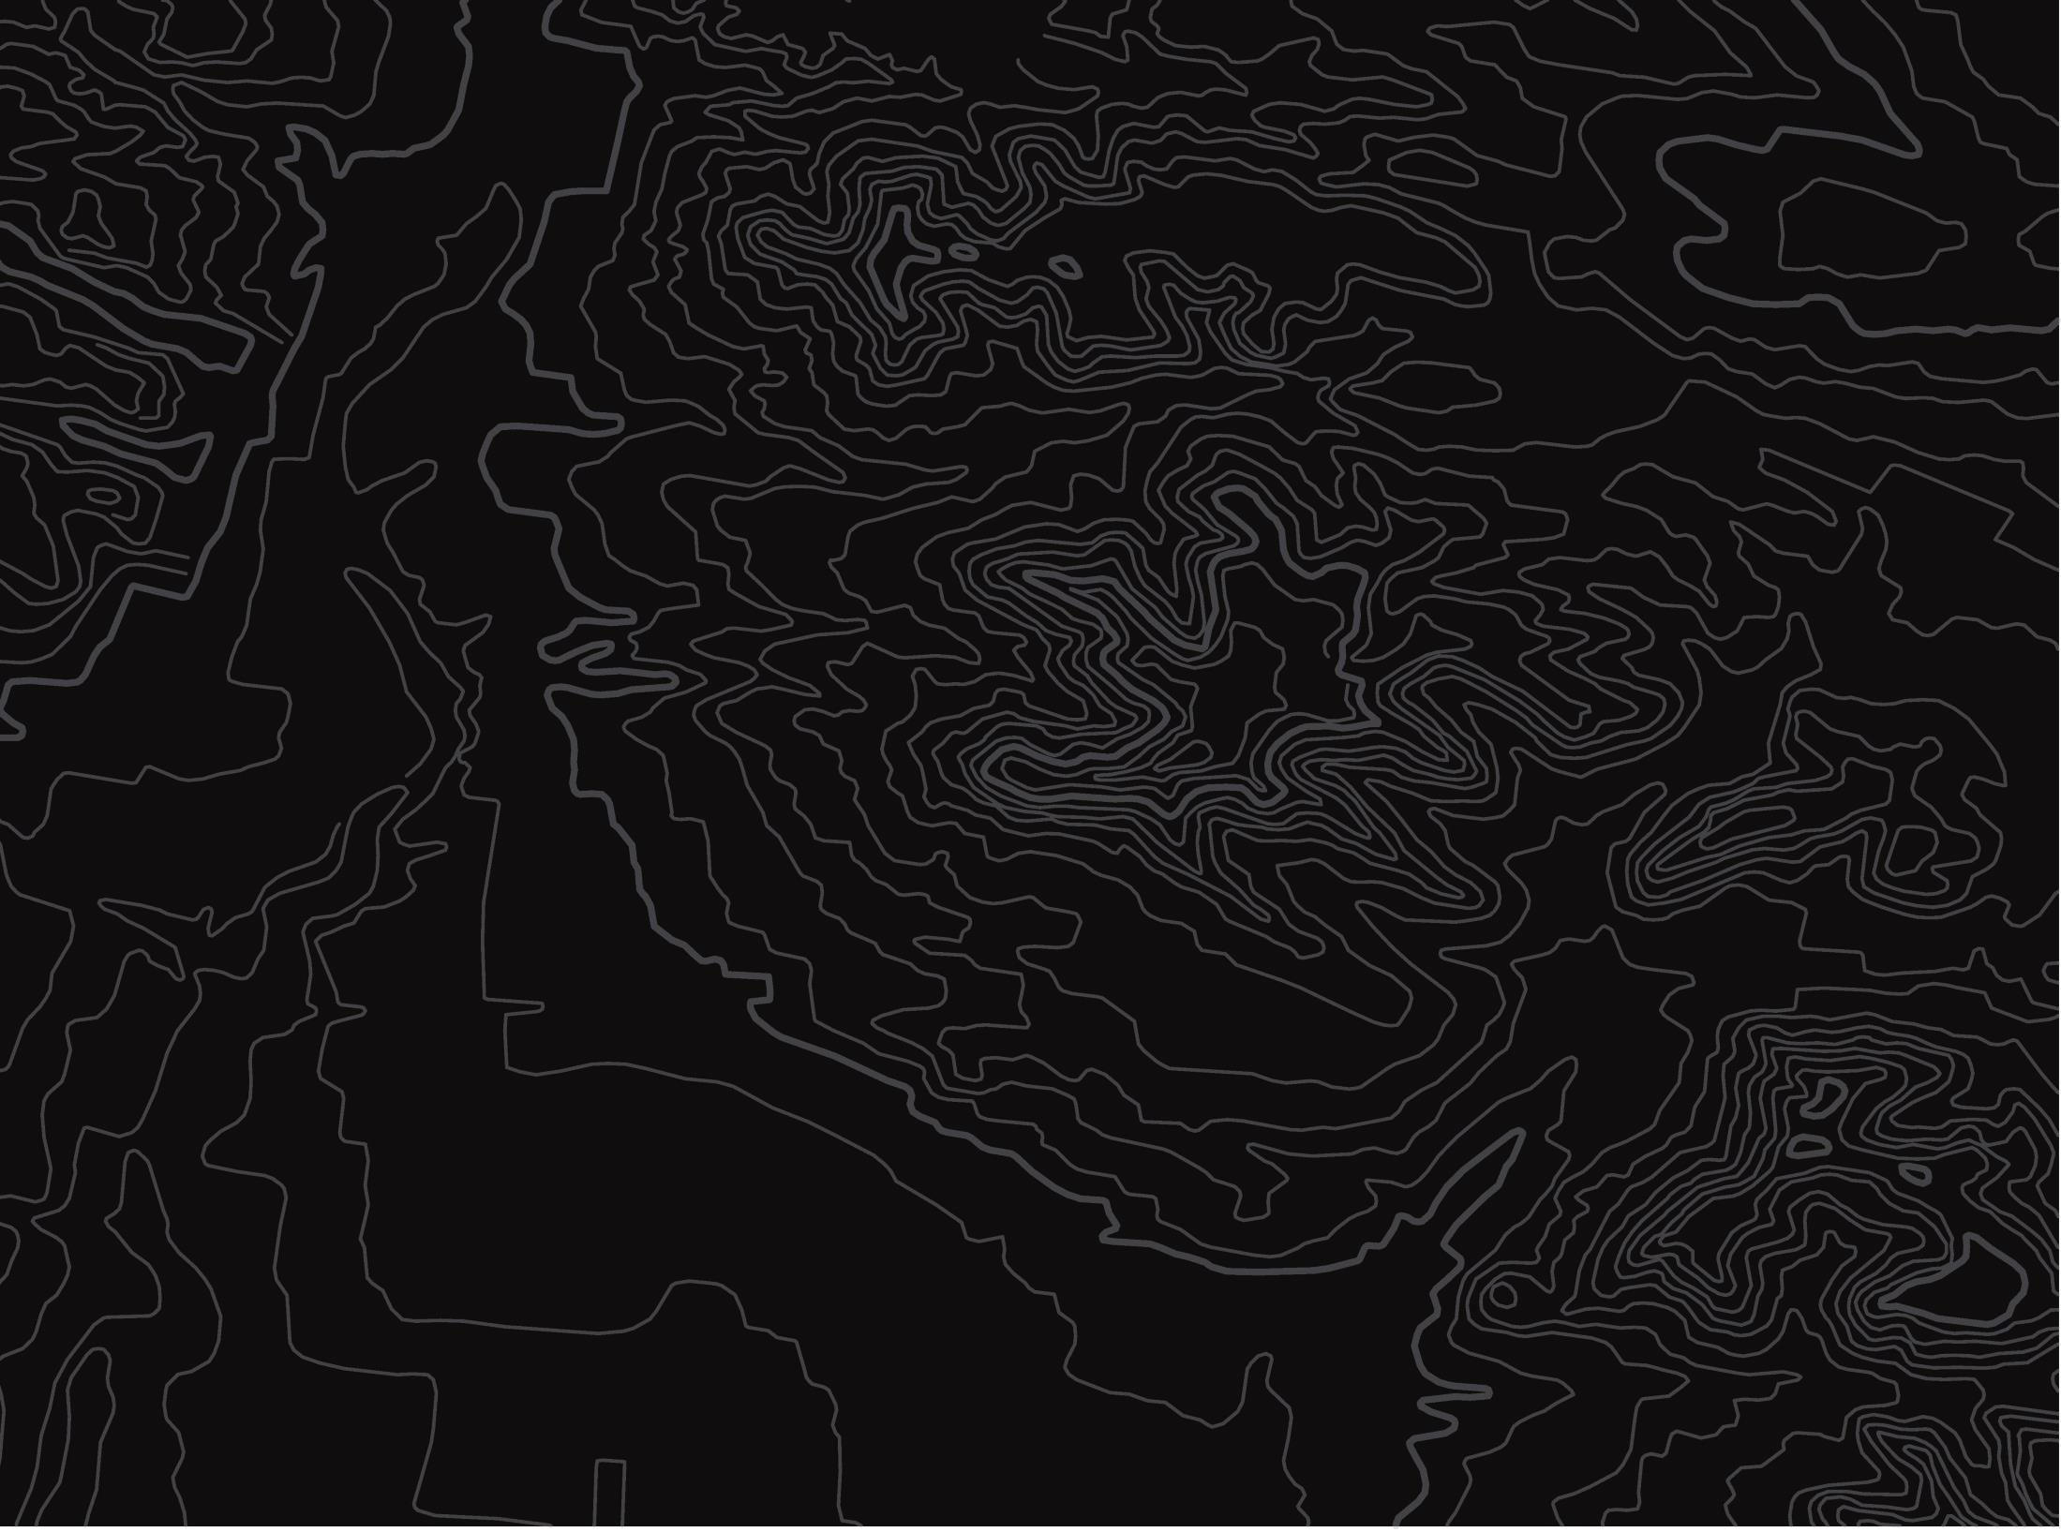
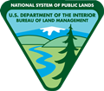

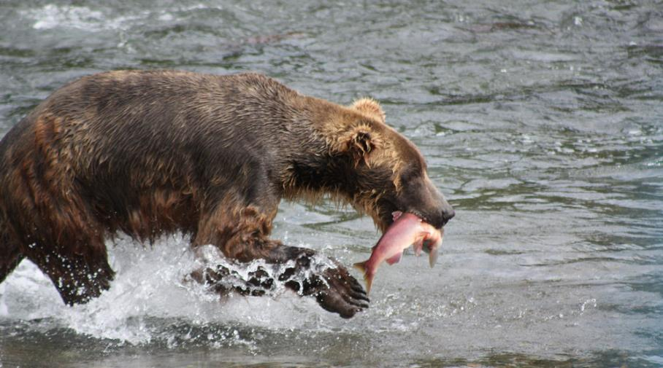
Food Webs
U.S. Department of the Interior
Bureau of Land Management
Explore how energy moves through riparian ecosystems
Module 3, Lesson 1
Photo by NPS.

Slide 2
Lesson 1: Food Webs
U.S. Department of the Interior
Bureau of Land Management
Lesson Question:
How does energy flow through ecosystems?

Slide 3
Materials:
U.S. Department of the Interior
Bureau of Land Management
science journal or a piece of paper
something to write with
coloring supplies (optional)

Slide 4
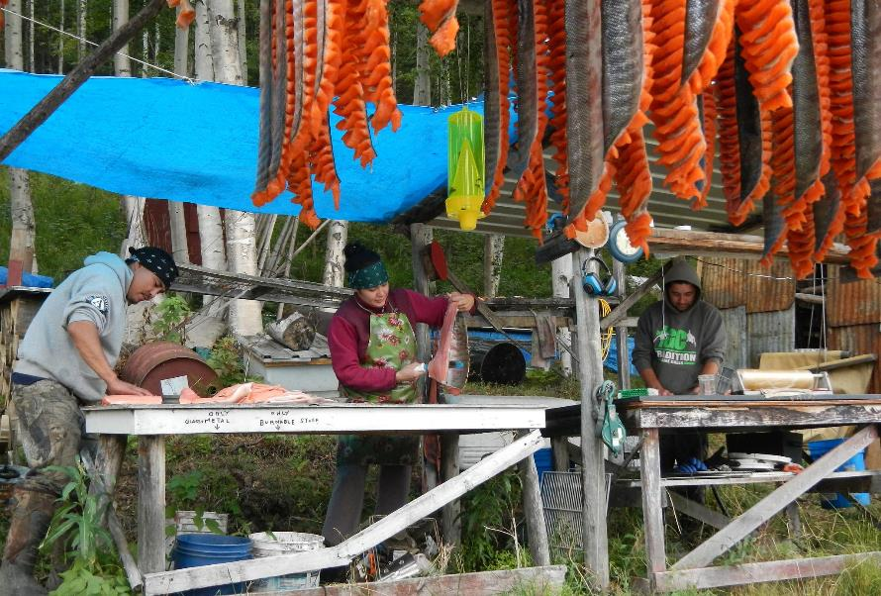
Where does your body get the energy it needs?
U.S. Department of the Interior
Bureau of Land Management
Write down at least five examples of foods you like to eat in your science journal or on a piece of paper.
People process salmon at a fish camp.
Photo by USFWS.

Slide 5
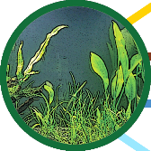
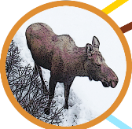
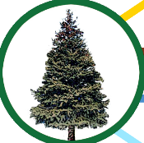
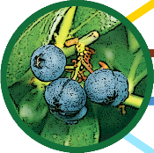
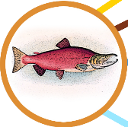

Journal Activity
U.S. Department of the Interior
Bureau of Land Management
Write responses to each of these questions in your science journal or on a piece of paper:
Where do plants like these get their energy? Where do animals like these get their energy?
aquatic plant
moose
spruce tree
blueberry plant
salmon
bald eagle
All graphics by CCSC staff, BLM.

Slide 6
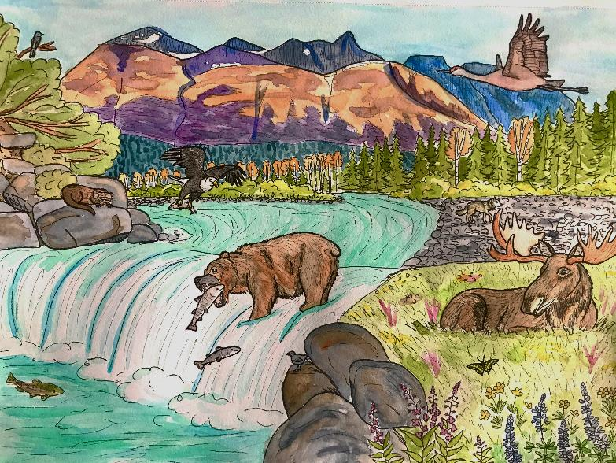
Riparian ecosystems have high biodiversity, which means different kinds of plants and animals live in them. Living things in riparian ecosystems get their energy in different ways.
U.S. Department of the Interior
Bureau of Land Management
Riparian Ecosystems
Wolves and bears eat salmon. Bears also eat plants along the creek.
Trees use leaves to get energy from the sun.
Trout eat insects in and around the creek.
Moose eat plants.
Graphic by M. Harris, BLM.

Slide 7


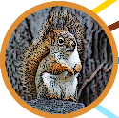

A food chain illustrates where living things get their energy.
Scientists draw food chains with arrows that show the direction energy flows.
Plants capture energy from the sun. Animals get energy from eating plants or other animals.
U.S. Department of the Interior
Bureau of Land Management
Example food chain:
Sun
Spruce trees use energy from the sun to make their own food.
E
N
E
R
G
Y
Squirrels eat spruce tree seeds.
Bald eagles eat squirrels.
Graphics by CCSC staff, BLM.

Slide 8
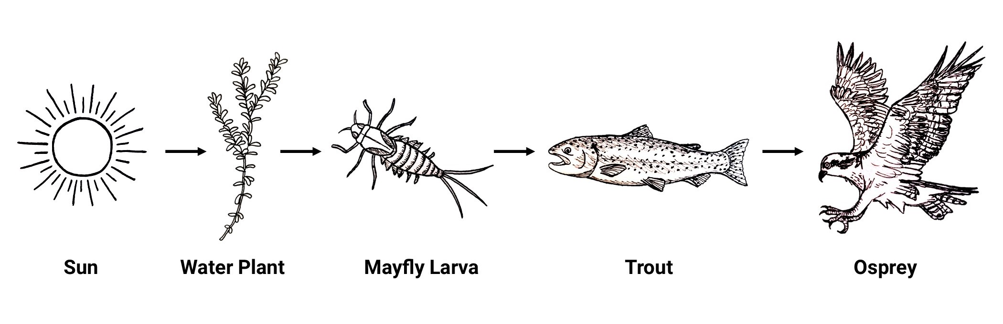
Here is an example of a food chain from a riparian ecosystem:
Water plants get energy from the sun.
Some aquatic insects, like mayfly larvae, get energy from plants.
Some fish, such as trout, get energy from eating aquatic insects.
Some birds, like the osprey, get energy from eating fish.
U.S. Department of the Interior
Bureau of Land Management
Graphic by M. Harris, BLM.

Slide 9
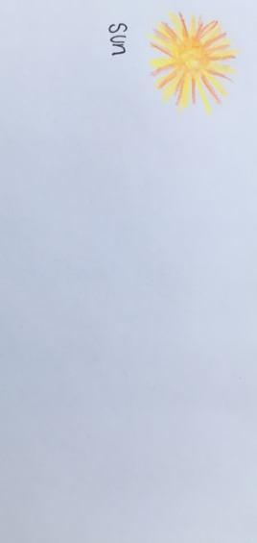
Now, it’s your turn to create a food chain!
Get ready to draw in your science journal or on a piece of paper. It is okay if your drawing looks different from the example.
On the left side of your paper, draw the sun.
U.S. Department of the Interior
Bureau of Land Management
Graphic by CCSC staff, BLM.

Slide 10
U.S. Department of the Interior
Bureau of Land Management
Plants use energy from sunlight to make food. Draw a plant next to the sun.
Your plant can be real or imagined.
Color it in, if you like.
Write the plant’s name by your drawing.

Slide 11
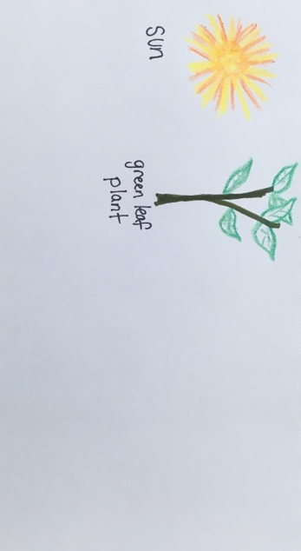
Here is an example of a plant:
U.S. Department of the Interior
Bureau of Land Management
Graphic by CCSC staff, BLM.

Slide 12
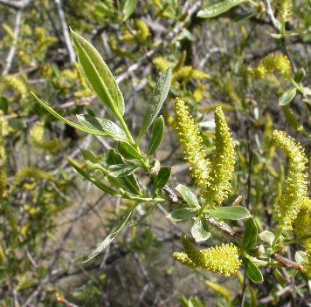
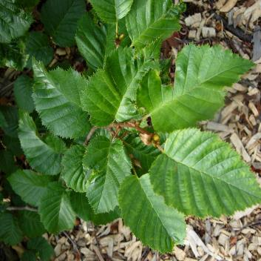
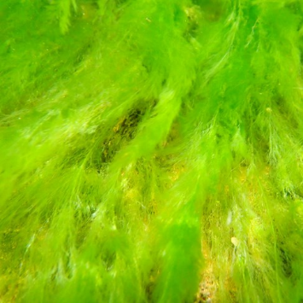
Producers
U.S. Department of the Interior
Bureau of Land Management
Plants, such as willows, alders, and algae are examples of producers in a riparian ecosystem.
Producers are living things that are able to make their own food using energy from the sun.
Willow Alder Green Algae
Photo by NPS.
Photo by BLM.
Photo by NPS.

Slide 13
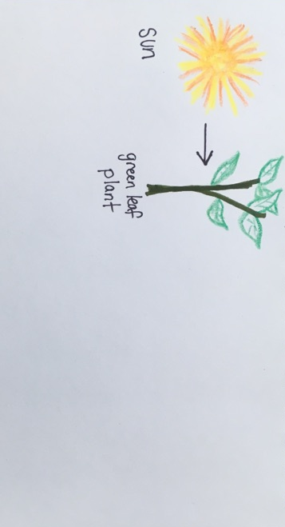
Draw an arrow from the sun to your plant to show how energy moves from the sun to the plant.
U.S. Department of the Interior
Bureau of Land Management
Graphic by CCSC staff, BLM.

Slide 14
Next to your plant, draw an animal that eats that type of plant.
U.S. Department of the Interior
Bureau of Land Management
Your animal can be real or imagined.
Color it in, if you like.
Write the animal’s name by your drawing.

Slide 15
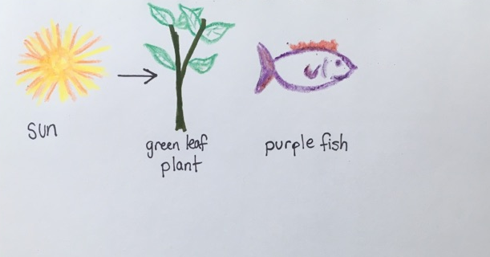
Here is an example of an imagined animal that would eat the plant:
U.S. Department of the Interior
Bureau of Land Management
Graphic by CCSC staff, BLM.

Slide 16
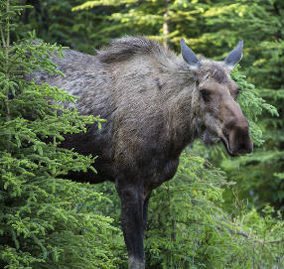
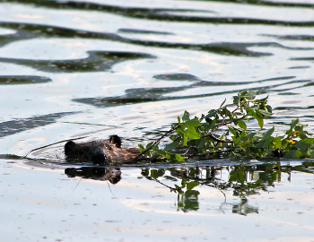
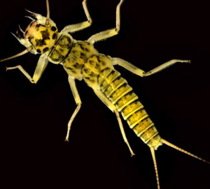
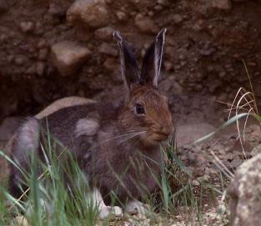
U.S. Department of the Interior
Bureau of Land Management
Animals, including insects, are consumers. Consumers eat plants or other animals for food.
Here are some examples of animals that eat plants in a riparian ecosystem:
Moose Beaver Mayfly Larva Snowshoe Hare
Photo by B. Wick, BLM.
Photo by J. Matlock, BLM.
Photo by NPS.
Photo by J. Peaco, NPS.

Slide 17
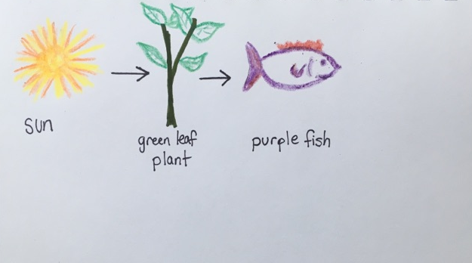
Draw an arrow from the plant to your animal to show how the energy moves from the plant to the animal when the plant gets eaten.
U.S. Department of the Interior
Bureau of Land Management
Graphic by CCSC staff, BLM.

Slide 18
Some animals eat other animals.
U.S. Department of the Interior
Bureau of Land Management
Next to your first animal, draw an animal that eats the type of animal you already drew.
Your animal can be real or imagined.
Color it in, if you like.
Write the animal’s name by your drawing.

Slide 19
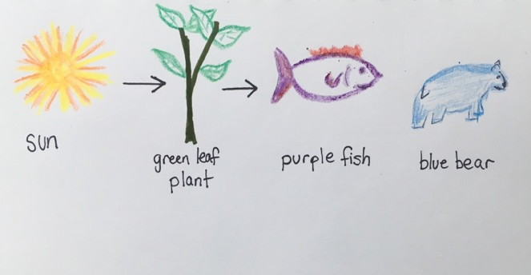
Here is an example of an imagined animal that would eat the first animal:
U.S. Department of the Interior
Bureau of Land Management
Graphic by CCSC staff, BLM.

Slide 20
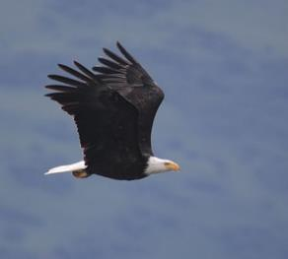
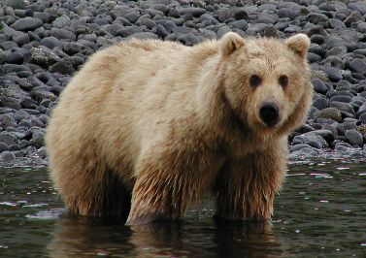
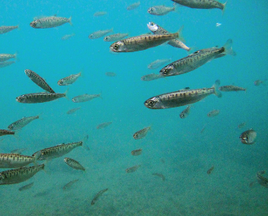
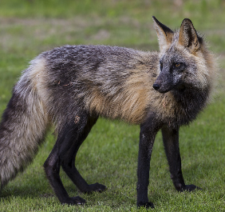
Animals that eat other animals are also consumers.
Here are some examples of animals that eat other animals in a riparian ecosystem:
Bald Eagle Brown Bear Salmon Fox
U.S. Department of the Interior
Bureau of Land Management
Photo by R. Corcoran, USFWS.
Photo by M. Wilson, BLM.
Photo by K. Martin, NPS.
Photo by B. Wick, BLM.

Slide 21
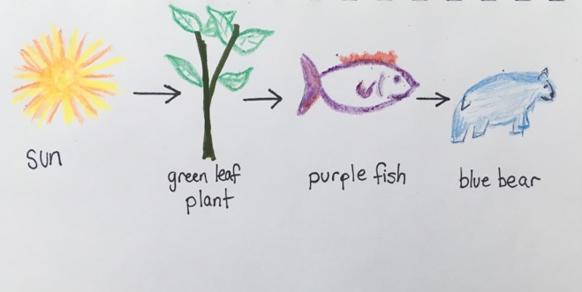
Draw an arrow from your first animal to your second animal to show how energy moves from one animal to another.
U.S. Department of the Interior
Bureau of Land Management
Graphic by CCSC staff, BLM.

Slide 22
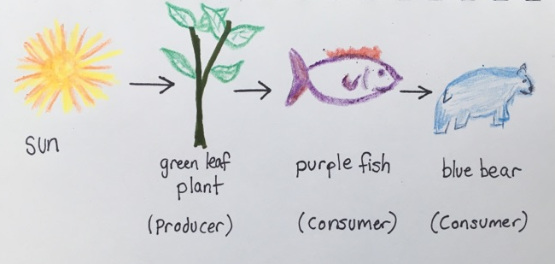
You have drawn a food chain!
U.S. Department of the Interior
Bureau of Land Management
Your food chain shows how energy moves from the sun through the living things.
Here is the completed example food chain drawing:
How does your food chain look similar to the example? How is it different?
Graphic by CCSC staff, BLM.

Slide 23
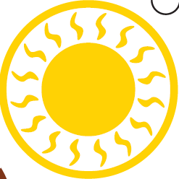
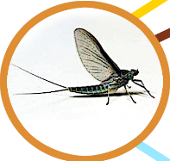
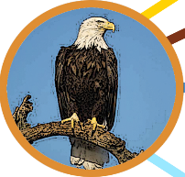

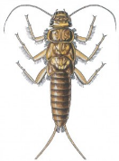

Here is an example of a real food chain from a riparian ecosystem:
U.S. Department of the Interior
Bureau of Land Management
sun plant (producer) animal (consumer) animal (consumer) animal (consumer)
aquatic plant stonefly larva salmon bald eagle
All graphics by CCSC staff, BLM.

Slide 24

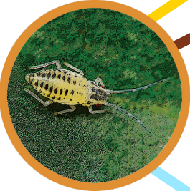
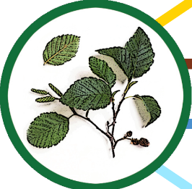
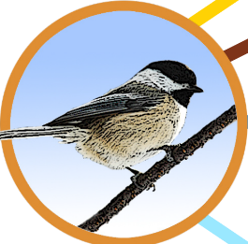
Your turn!
U.S. Department of the Interior
Bureau of Land Management
Arrange the sun, the plant, and the animals into a food chain in order of energy flow. Draw the complete food chain in your science journal or on a piece of paper.
Add arrows to show the direction energy moves between the sun and the living things.
sun
consumer (eats plants)
producer (plant)
consumer (eats animals)
Graphics: CCSC, BLM

Slide 25
Answer:
U.S. Department of the Interior
Bureau of Land Management
sun
producer (plant)
consumer (eats plants)
consumer (eats animals)
All graphics by CCSC staff, BLM.

Slide 26
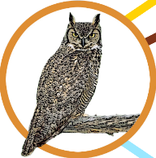

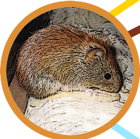
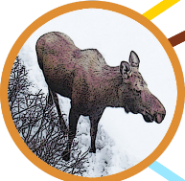
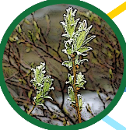


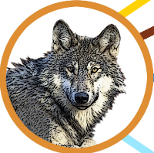
U.S. Department of the Interior
Bureau of Land Management
Time for a challenge! Complete the following food chains by drawing the plants and animals in order in your science journal or on a piece of paper.
Each food chain will have one producer (plant) and two consumers (animals). There is more than one correct answer!
All graphics by CCSC staff, BLM.

Slide 27

Animals often get their energy by eating different kinds of plants or animals or both. One single food chain doesn’t show all the connections.
A way to show all the different ways energy flows through an ecosystem is with a food web. A food web shows all the food chains in one ecosystem.
U.S. Department of the Interior
Bureau of Land Management
Notes:
Image from Microsoft 365

Slide 28


Here is an example food web. Can you trace the food chains you created within this food web?
U.S. Department of the Interior
Bureau of Land Management
All graphics by CCSC staff, BLM.

Slide 29
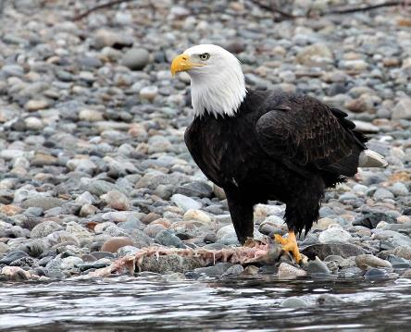
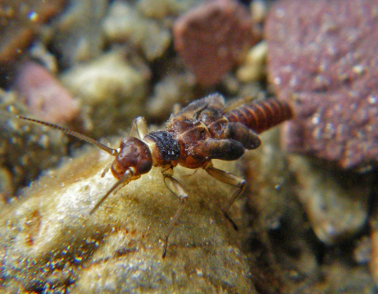
Some animals get their energy by eating plants or animals that have died. These consumers help break down dead things into smaller pieces, which helps the whole ecosystem.
For example, bald eagles feed on salmon that have died. Aquatic insects, including some mayflies, feed on dead plants in waterways.
U.S. Department of the Interior
Bureau of Land Management
Bald eagle feeds on a rocky river bank.
Photo by J. Ransom, NPS.
A macroinvertebrate rests on a rocky creek bed.
Photo by J. Giersch, USGS.

Slide 30
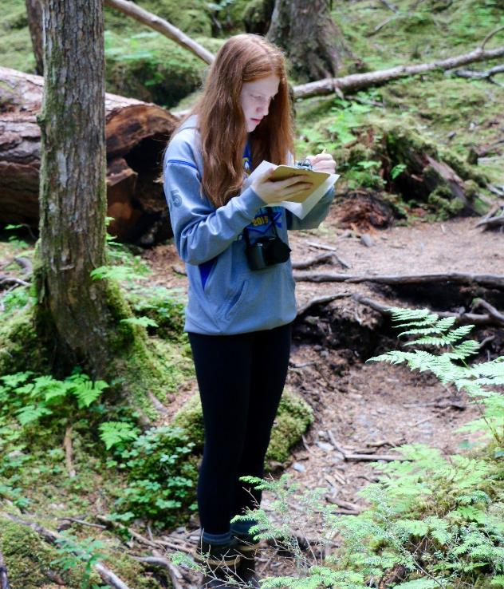
Food webs help scientists understand how living things are connected.
U.S. Department of the Interior
Bureau of Land Management
If there is a change in the ecosystem, understanding the food web can help scientists predict what might happen to the plants and animals in that area.
Scientists make continuous observations while in the field.
Photo by R. Taylor, BLM

Slide 31
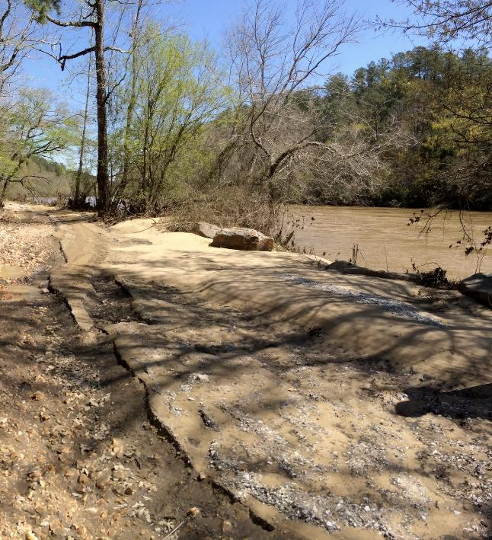
Let’s investigate an example!
High water levels wash away a big section of a riverbank.
The erosion removes plants along the bank, including most of the willows in the area.
U.S. Department of the Interior
Bureau of Land Management
Erosion washes away vegetation.
Photo by S. Clardy, USFWS.

Slide 32
What do you think might happen to the other plants and animals in this part of the riparian ecosystem?
Use the food web on the next slide to make your prediction.
U.S. Department of the Interior
Bureau of Land Management
Erosion washes away vegetation.
Photo by S. Clardy, USFWS.

Slide 33
Food Web:
U.S. Department of the Interior
Bureau of Land Management
great horned owls
spruce trees
squirrels
sun
bald eagles
blueberry plants
voles
willows
moose
wolves
All graphics by CCSC staff, BLM.

Slide 34





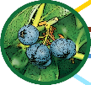




Scenario
U.S. Department of the Interior
Bureau of Land Management
If most of the willows are washed away, the moose in that area will have less food.
The moose may move to a different area, or they might eat more blueberry plants farther from the river.
If the moose leave, the wolves in the area will have less food and may also move somewhere else.
Or, the wolves may need to eat more of their other foods, such as voles or squirrels.
How else might the food web be affected?
All graphics by CCSC staff, BLM.

Slide 35
Extension Activity:
U.S. Department of the Interior
Bureau of Land Management
Complete a fun outdoor activity about connections between living and nonliving things in an ecosystem.
Ecosystem Connections

