Slide 1
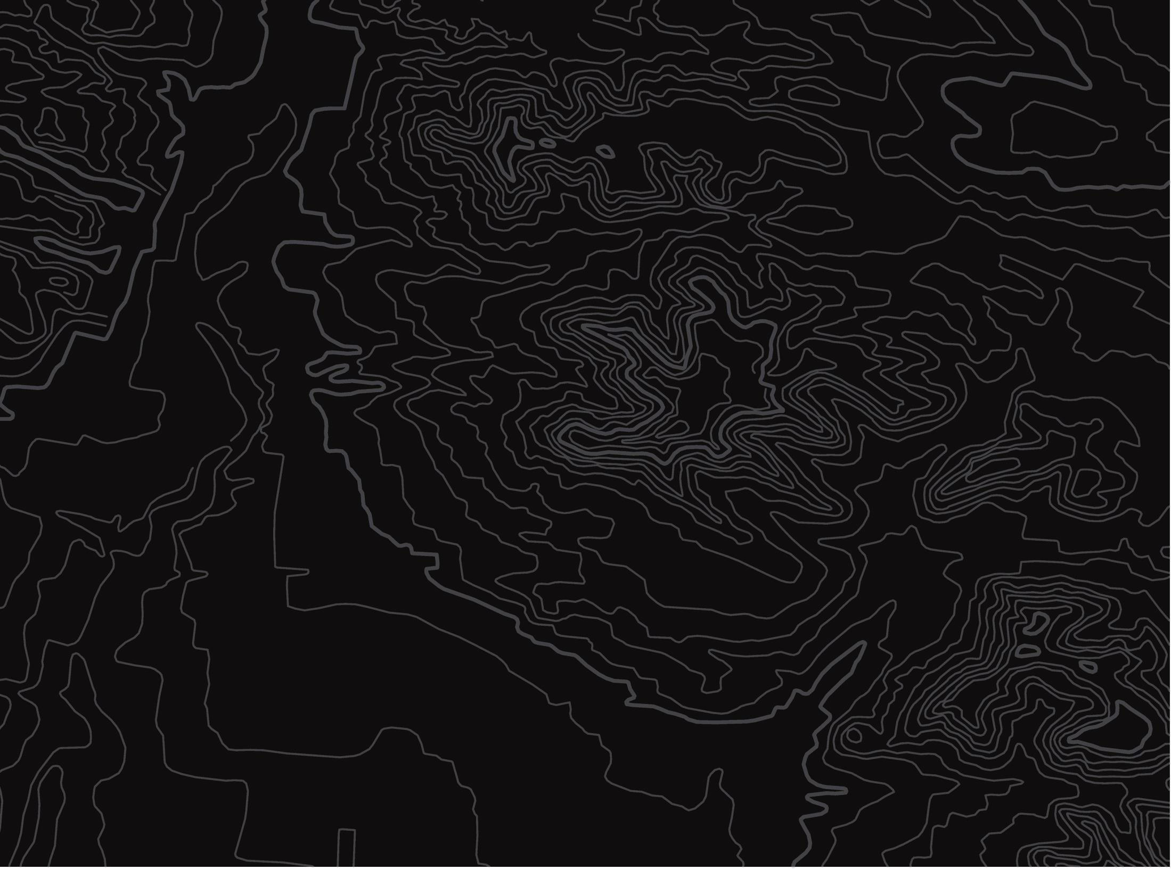
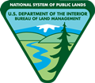

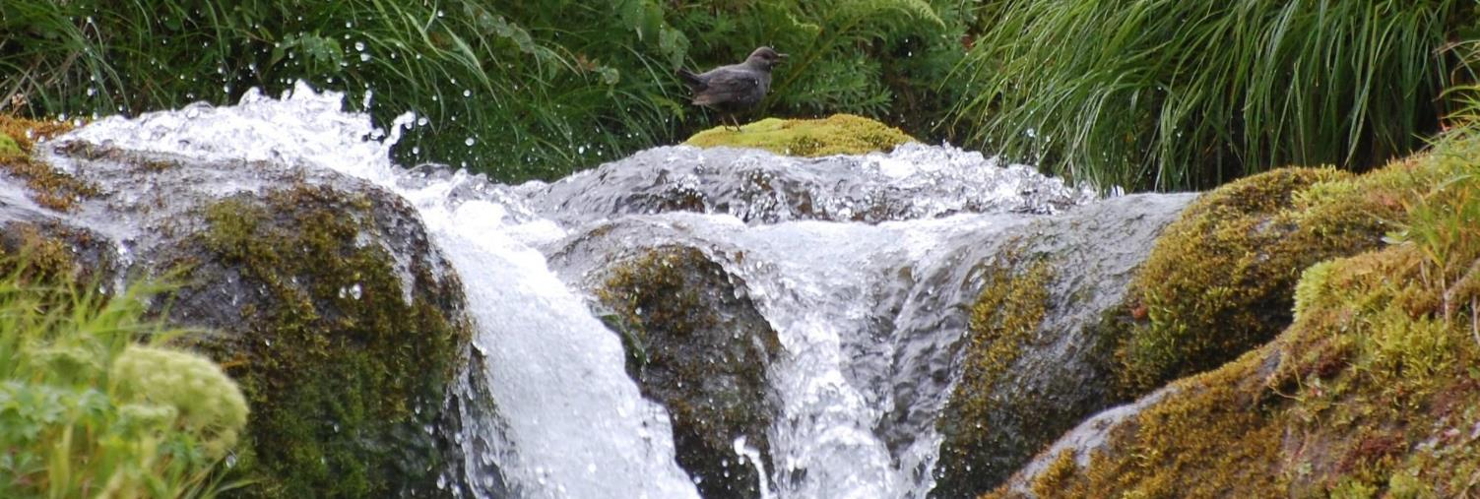
Creek Critters
U.S. Department of the Interior
Bureau of Land Management
Module 3 Introduction
Photo by K. Sowl, USFWS.

Slide 2
Module 3: Creek Critters
Module Questions:
U.S. Department of the Interior
Bureau of Land Management
How does energy flow through an ecosystem?
How do adaptations help aquatic macroinvertebrates survive?
Why do scientists look for indicator species?
How do scientists determine if a waterway is healthy?

Slide 3
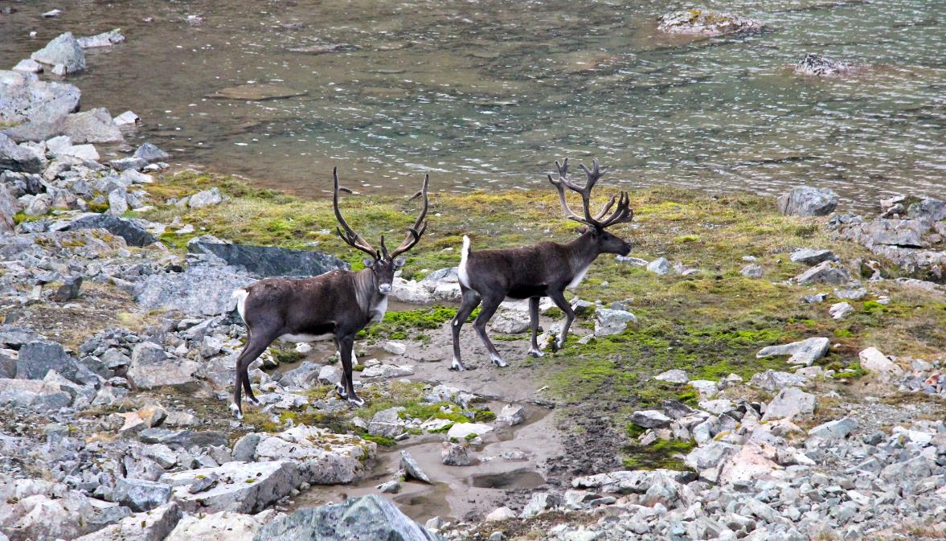
Watersheds connect living and nonliving things.
U.S. Department of the Interior
Bureau of Land Management
A pair of caribou cross rocky land.
Photo by J. Matlock, BLM.

Slide 4

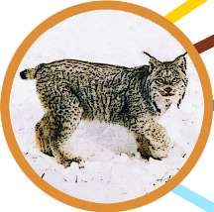


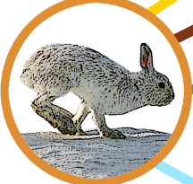
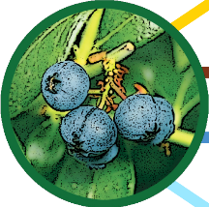

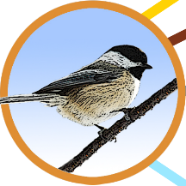
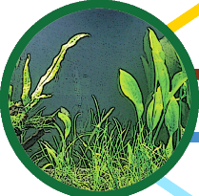

Which of these things are living? Which are nonliving?
U.S. Department of the Interior
Bureau of Land Management
Photos and graphics by CCSC staff, BLM.

Slide 5
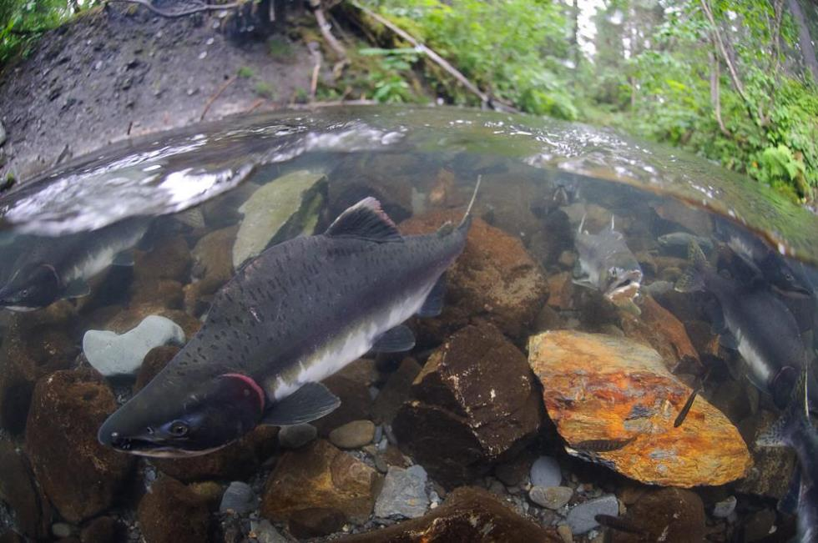
Living things, such as plants, wildlife, and people, depend on nonliving things, such as air, sunlight, water, and rocks to survive.
U.S. Department of the Interior
Bureau of Land Management
plants
water
water
nonliving
living
nonliving
rocks
rocks
adult salmon
young salmon
Fish swimming in over a rocky creek bed.
Photo by K. Yasui, USFW.

Slide 6
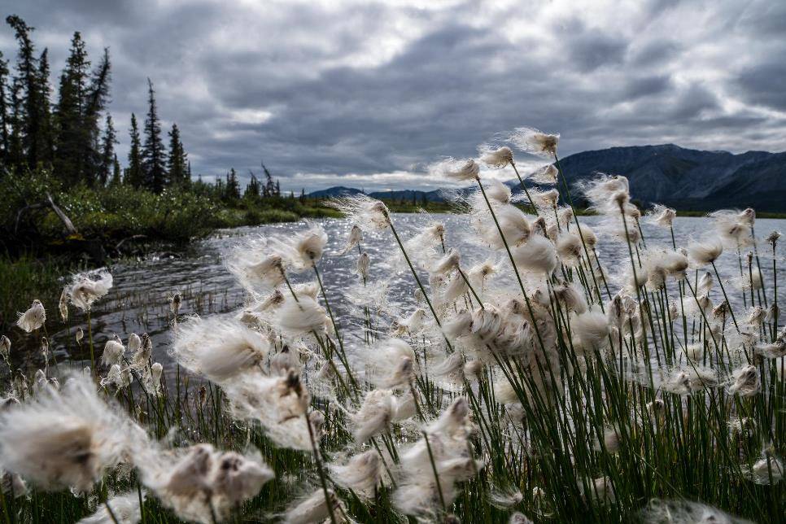
Waterways have nonliving and living parts. Many plants, animals, and bacteria live in or around waterways. Do you live near a waterway?
U.S. Department of the Interior
Bureau of Land Management
Wild flowers blow in the wind with a flowing river in the background.
Photo by A. Bonogofsky, USFWS.

Slide 7
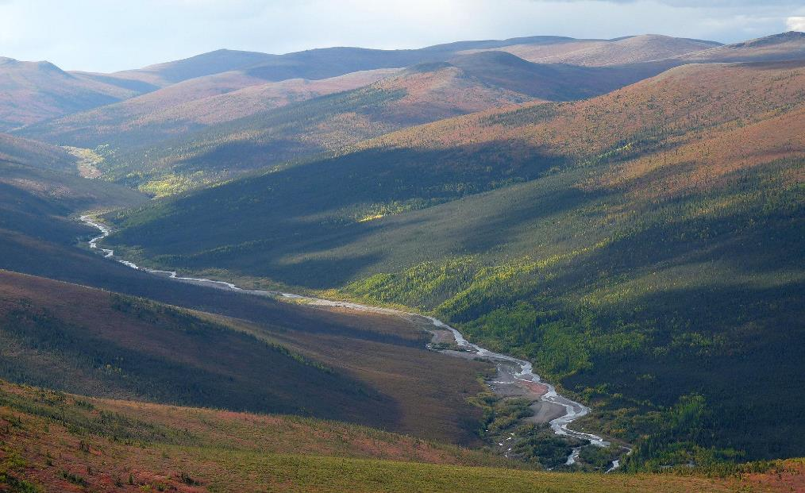
Riparian (“ry-PAIR-ee-an”) ecosystems include all the living and nonliving things found along waterways.
U.S. Department of the Interior
Bureau of Land Management
waterway
riparian ecosystem
A landscape view of a watershed.
Photo by J. Herriges, BLM.

Slide 8
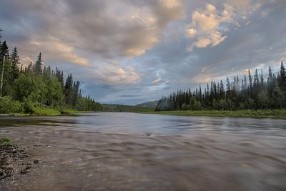
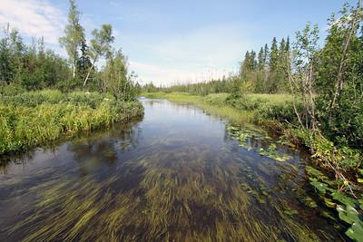
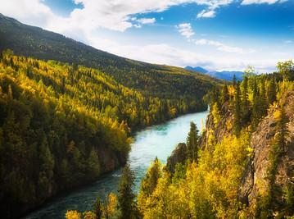
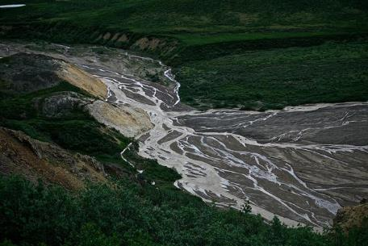
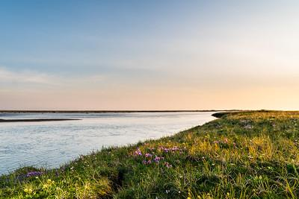
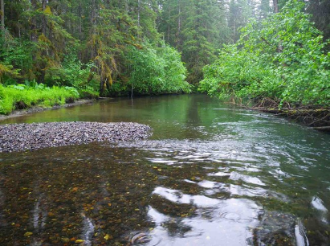
Riparian ecosystems look different across Alaska.
U.S. Department of the Interior
Bureau of Land Management
Riparian ecosystem in Alaska.
Photo by B. Wick, BLM.
Riparian ecosystem in Alaska.
Photo by L. Hupp, USFWS.
Riparian ecosystem in Alaska.
Photo by K. Mueller, USFWS.
Riparian ecosystem in Alaska.
D. Kirkendall, NPS.
Riparian ecosystem in Alaska.
Photo by A. Bonogofsky, USFWS.
Riparian ecosystem in Alaska.
Photo by NPS.
Which image looks most like the riparian ecosystem where you live?

Slide 9
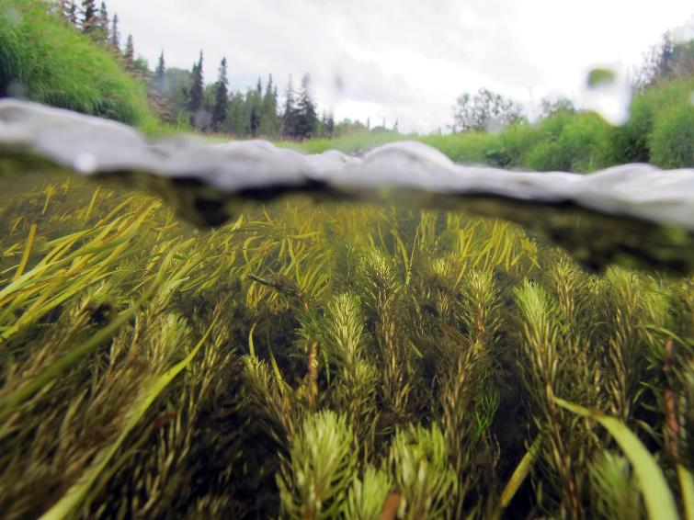
Waterways provide aquatic habitats. Aquatic habitats are water environments where plants and animals live. This module focuses on freshwater aquatic habitats, such as rivers, creeks, and lakes.
U.S. Department of the Interior
Bureau of Land Management
Subsurface imagery of an aquatic habitat. Photo by K. Mueller, USFWS.

Slide 10
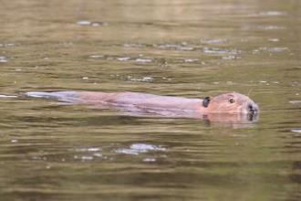
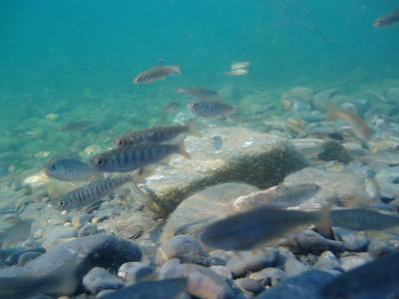
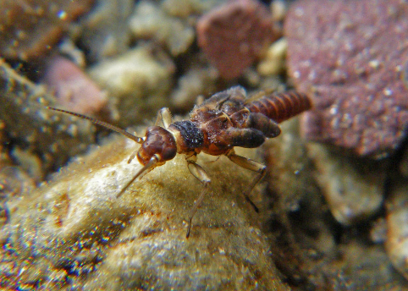
Many animals live in freshwater aquatic habitats.
U.S. Department of the Interior
Bureau of Land Management
A beaver swims across a body of water.
Photo by J. Matlock, BLM.
Salmon fry swim through a body of water.
Photo by USFWS.
A macroinvertebrate rests on a rock in a creek bed.
Photo by J. Giersch, USGS.
Have you seen any of these animals in waterways near your home?

Slide 11
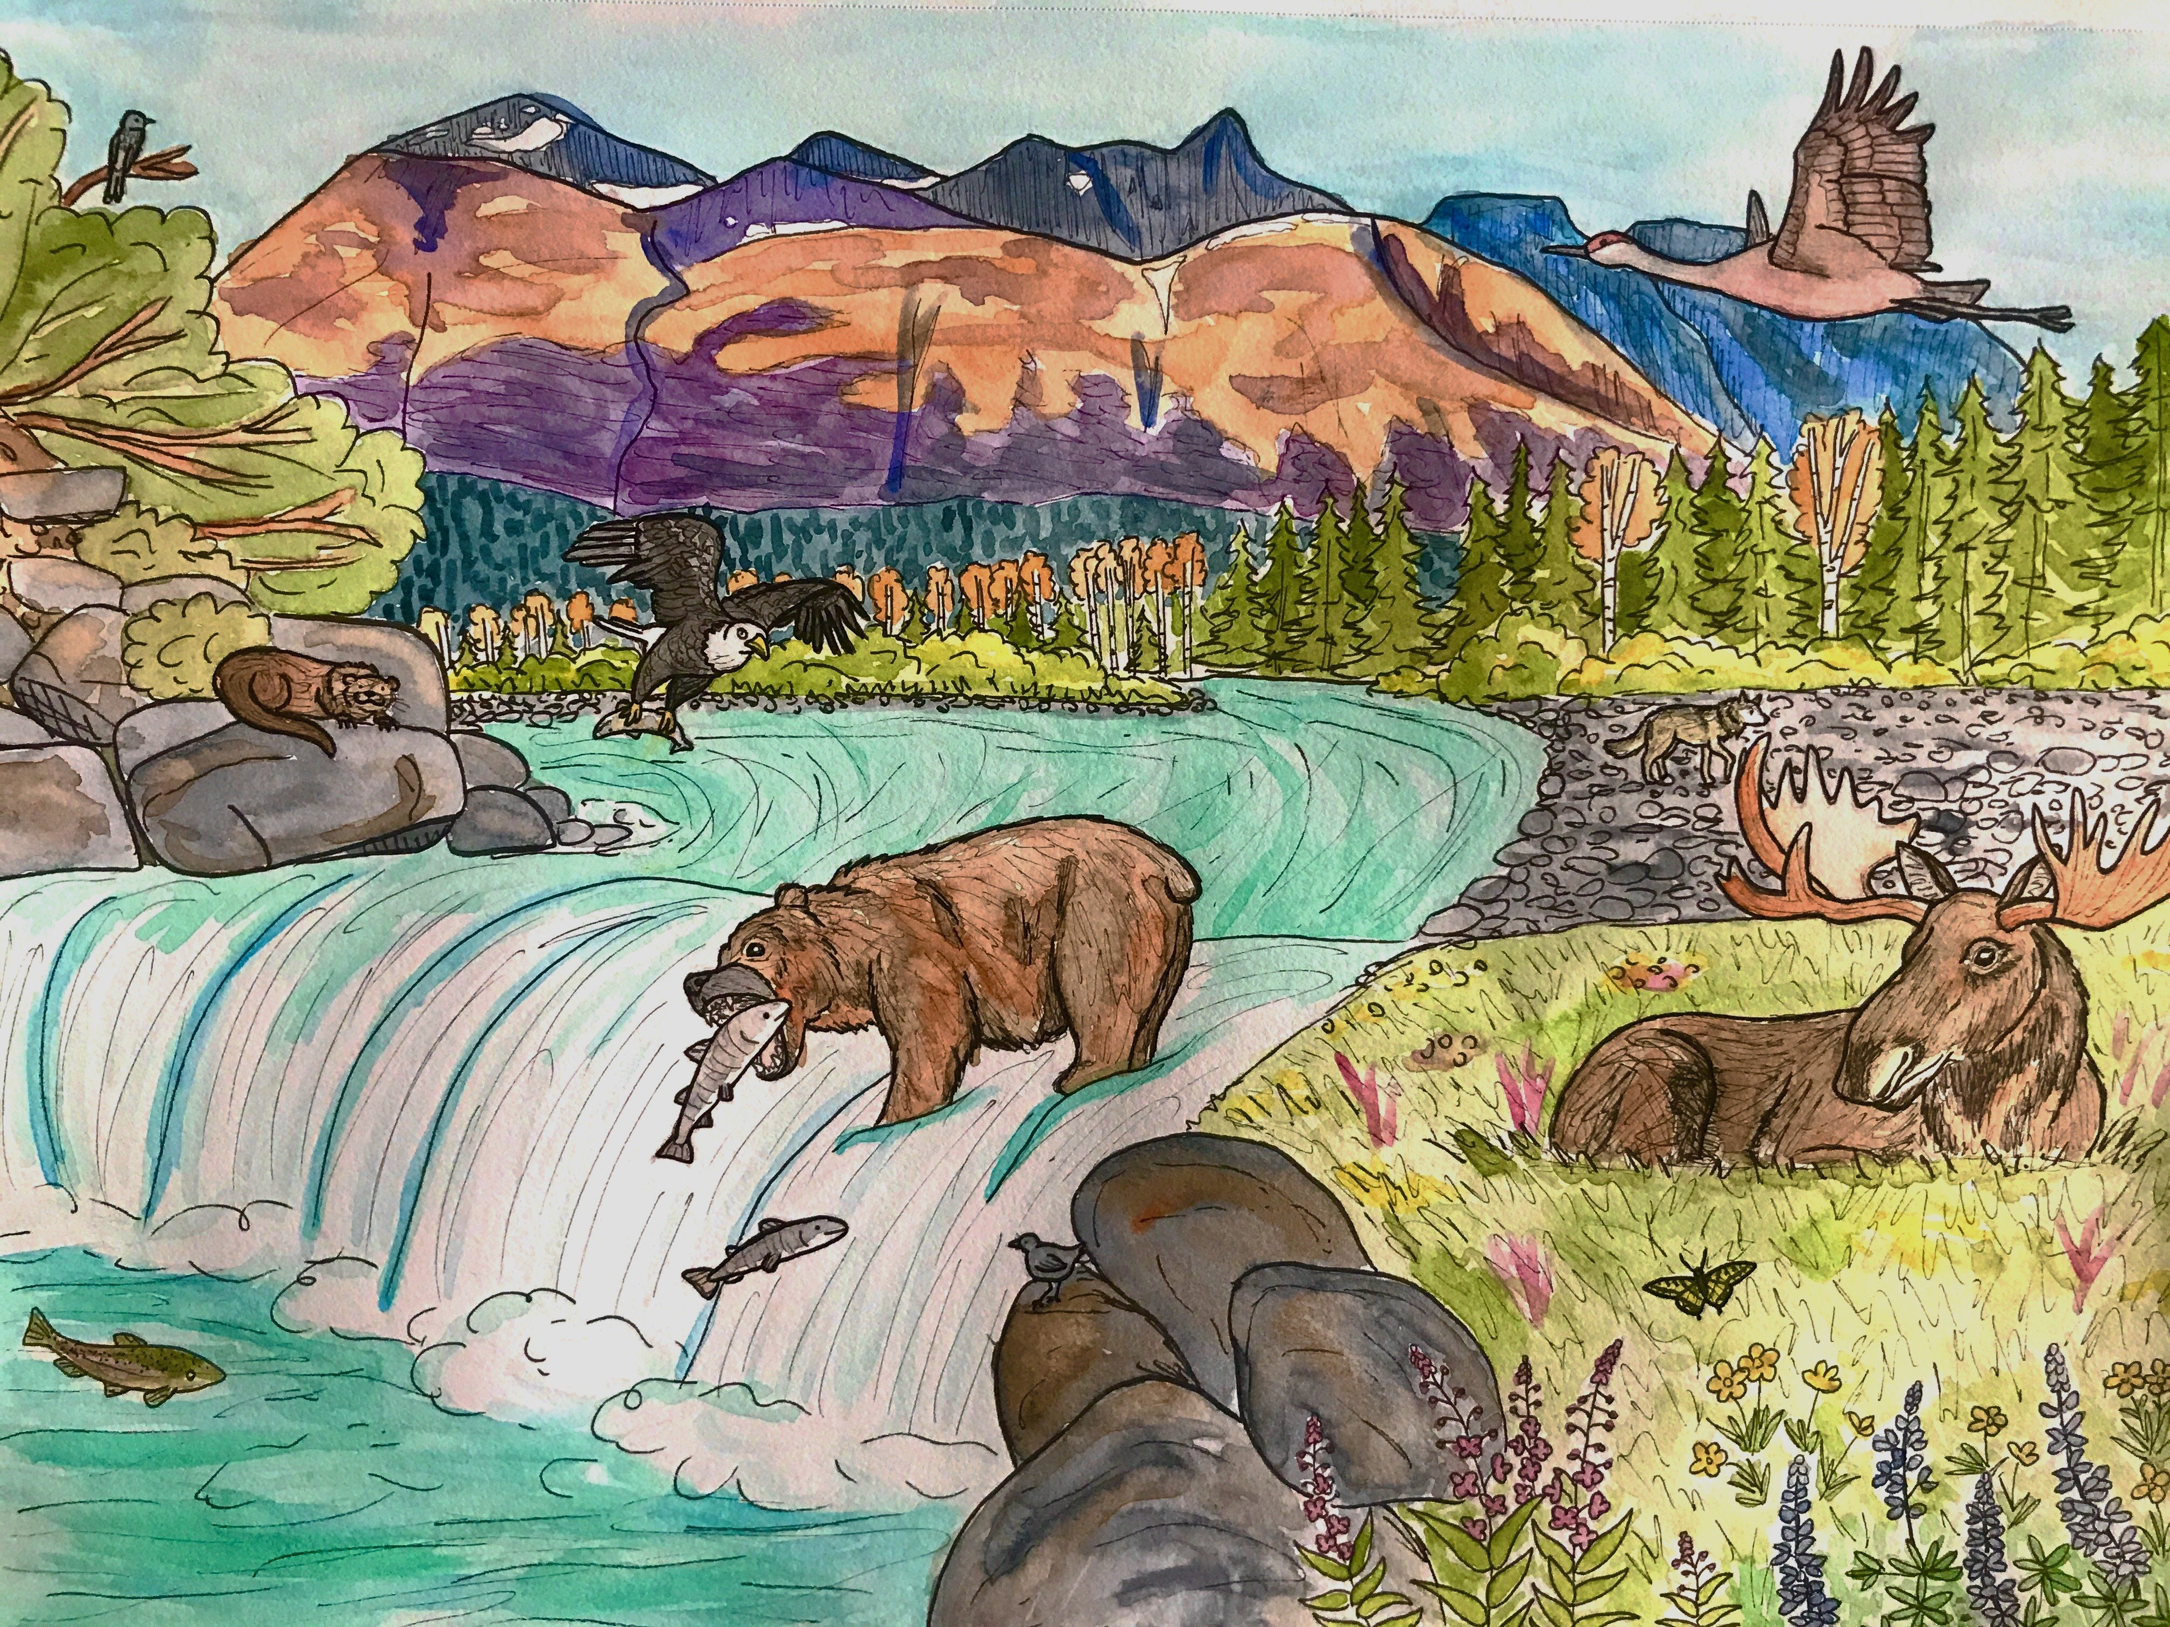
Healthy aquatic habitats and riparian ecosystems support different kinds of living things. The variety of living things in an area is called biodiversity.
U.S. Department of the Interior
Bureau of Land Management
How many different kinds of living things do you see in this picture?
Graphic by M. Harris, BLM.

Slide 12
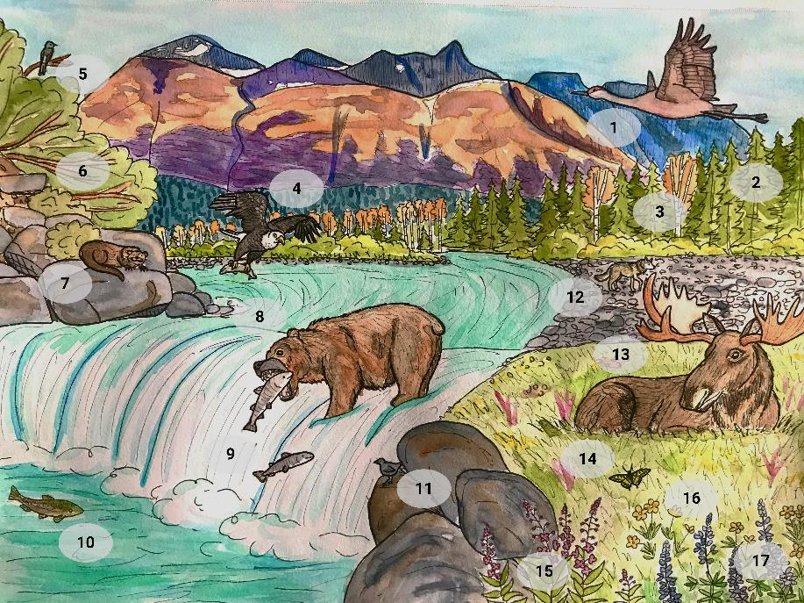
This ecosystem has at least 17 different kinds of living things. It has high biodiversity!
U.S. Department of the Interior
Bureau of Land Management
Graphic by M. Harris, BLM.

Slide 13
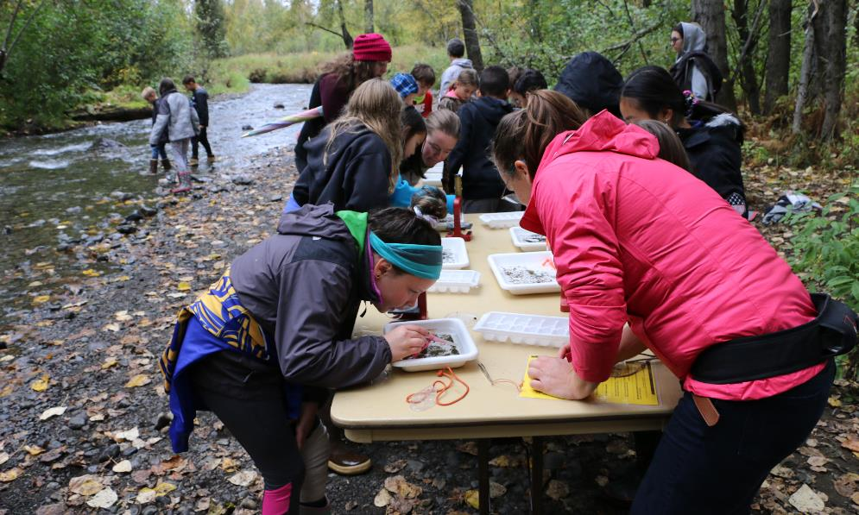
Biodiversity is an indicator, or sign, of a healthy ecosystem.
U.S. Department of the Interior
Bureau of Land Management
A group of student scientists check for macroinvertebrates in their water samples.
Photo by M. Clark, BLM.
If scientists find many different kinds of living things in an area, that is a positive sign!

