Slide 1



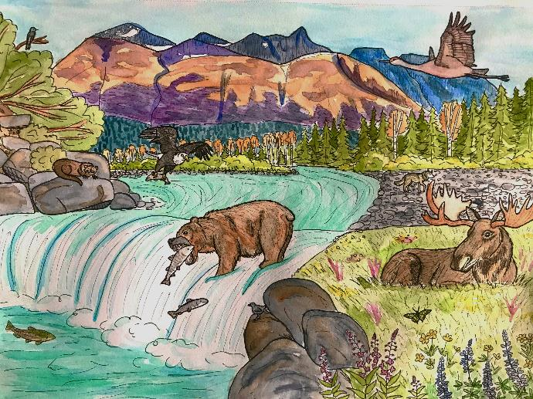
Design a Watershed
U.S. Department of the Interior
Bureau of Land Management
Module 2 Reflection
Graphic by M. Harris, BLM.

Slide 2


Materials:
U.S. Department of the Interior
Bureau of Land Management
Available items needed to build a model watershed. Some suggestions:
  a large container or baking sheet
  material that you can mold into a watershed (snow, sand, playdough, flour, etc.)
  cardboard
  figurines or small toys
  paper, pens, markers, or crayons (if you want to draw your model watershed)

Slide 3
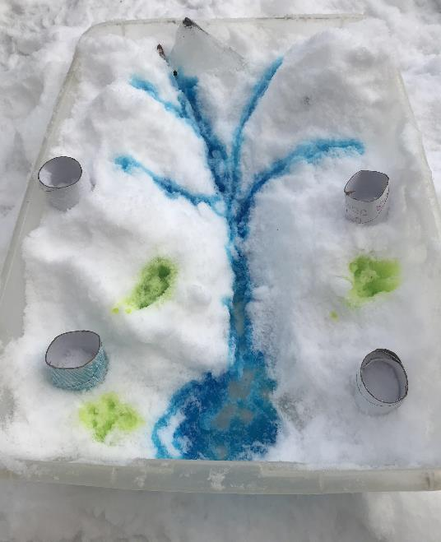
Create a healthy watershed!
Use materials you have available to design a model watershed with healthy water quality.
As you design, think about how to include human developments, such as roads and houses, while minimizing pollution, urban runoff, erosion, and other impacts to the land and water.
U.S. Department of the Interior
Bureau of Land Management
Food coloring is used with snow to display a model watershed.
Photo by CCSC staff, BLM>

Slide 4
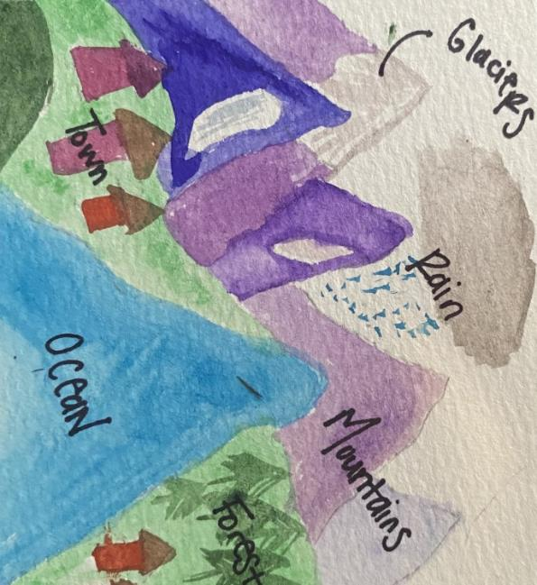
Feel free to include some or all the following features in your watershed:
U.S. Department of the Interior
Bureau of Land Management
your home
your school
roads
animals
plants
wetlands
a dog park or dog yard
a water treatment system
Graphic by CCSC staff, BLM.

