Slide 1
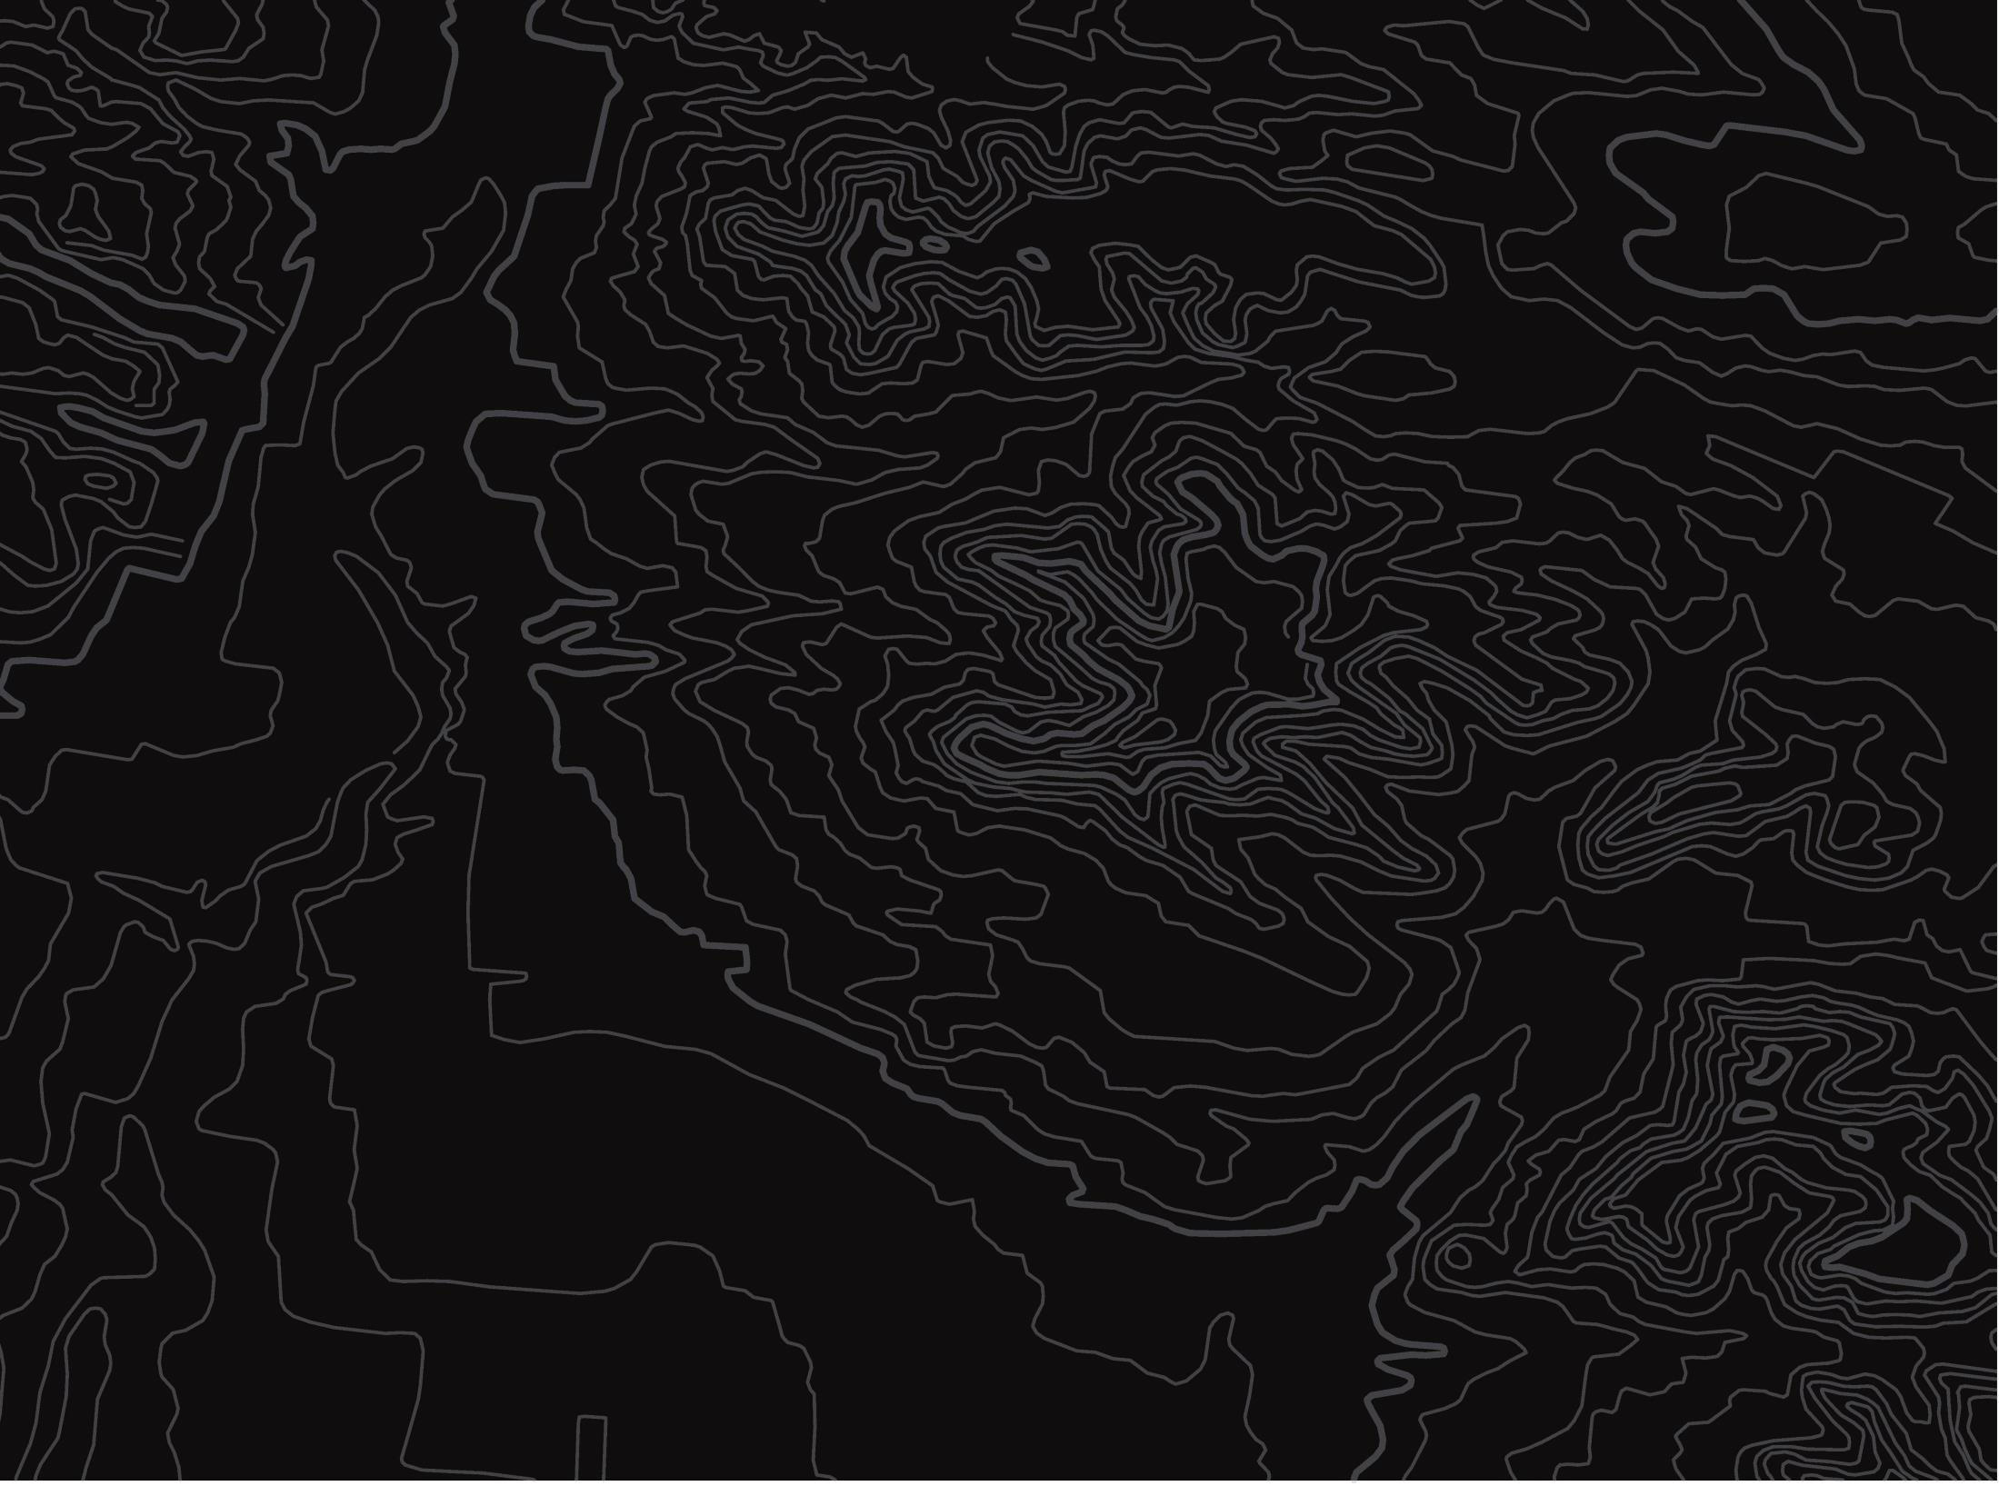


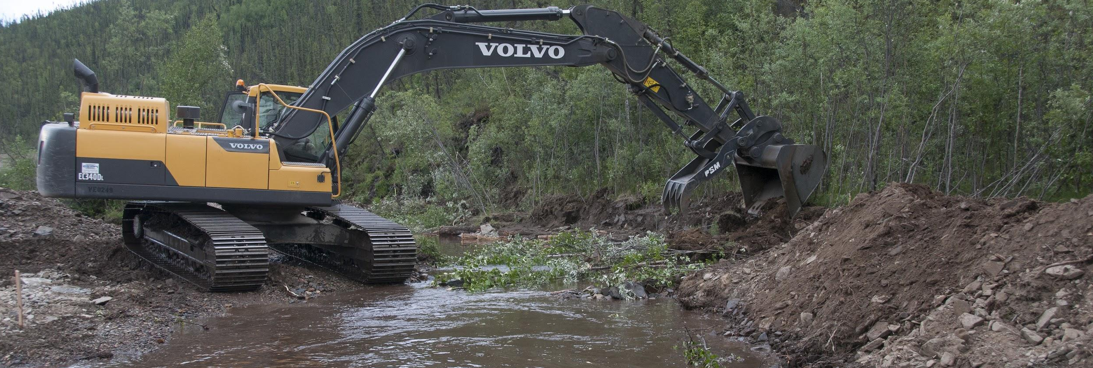
Human Impacts
U.S. Department of the Interior
Bureau of Land Management
Explore how people’s actions affect water quality
Module 2, Lesson 3
Photo by BLM

Slide 2
Lesson 3: Human Impacts
Lesson Question:
U.S. Department of the Interior
Bureau of Land Management
How can people’s actions impact water quality?

Slide 3
Materials:
U.S. Department of the Interior
Bureau of Land Management
science journal or a piece of paper
pencil (or something to write with)

Slide 4
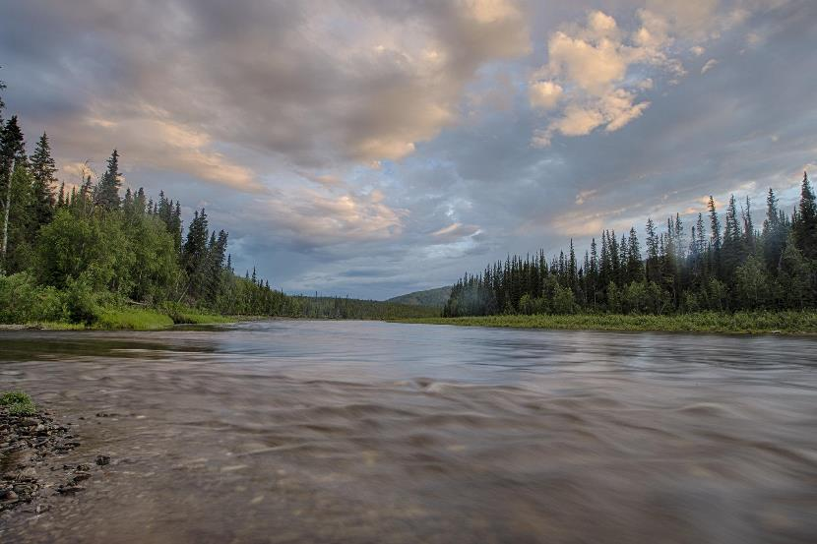
Since watersheds are connected systems, many natural things can affect water quality. Some examples are floods, droughts, erosion, and animal behaviors.
U.S. Department of the Interior
Bureau of Land Management
A river flows between two banks of trees.
Photo by B. Wick, BLM.

Slide 5
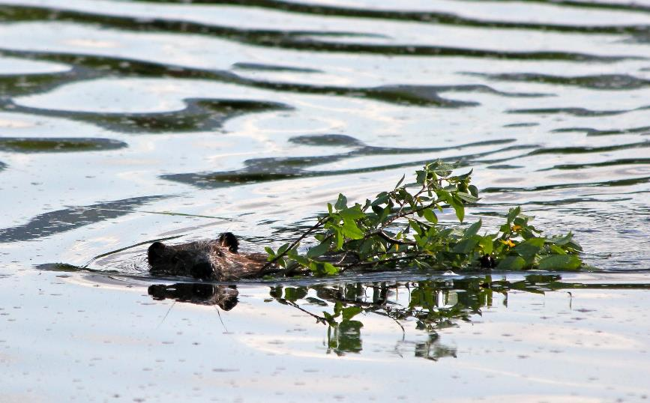
One animal that impacts water quality is the beaver. Beavers affect water quality by building dams and lodges that slow the flow of waterways enough to create wetlands and ponds.
U.S. Department of the Interior
Bureau of Land Management
A beaver swims with a leafy branch through the water.
Photo by J. Matlock, BLM.

Slide 6
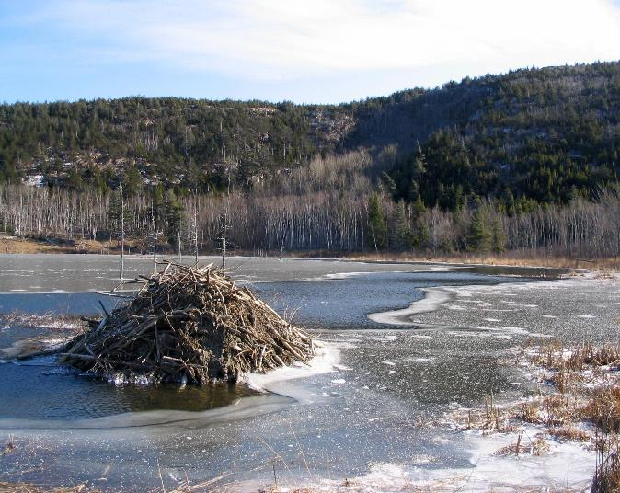
Beaver ponds trap and store sediment, which improves water quality downstream.
They also create deep, cool pools that young salmon use to find food and hide from predators.
Have you ever seen a beaver? A beaver dam?
U.S. Department of the Interior
Bureau of Land Management
A beaver dam in water. Photo by NPS.

Slide 7
Since everyone lives in a watershed, people are also part of the system. Human actions impact water quality.
U.S. Department of the Interior
Bureau of Land Management
How do you think people impact water quality?
Write down at least three ideas in your science journal or on a piece of paper.

Slide 8
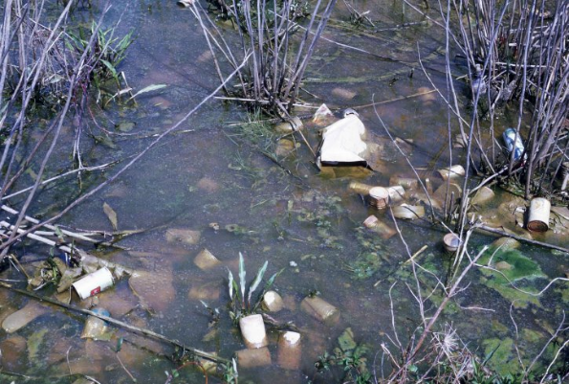
One human impact is pollution. Some pollution is easy to see, such as trash.
U.S. Department of the Interior
Bureau of Land Management
Polluted water.
Photo by USFWS.
Have you observed trash in the waterways in your community?

Slide 9
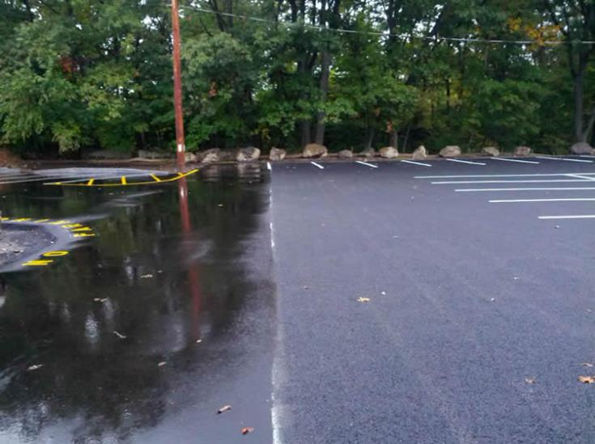
Other pollution is harder to see.
Many waterways get polluted through a process called urban runoff.
Urban runoff usually happens when rain falls or snow melts on polluted surfaces and flows into waterways.
U.S. Department of the Interior
Bureau of Land Management
Parking log with standing water.
Photo by EPA.

Slide 10
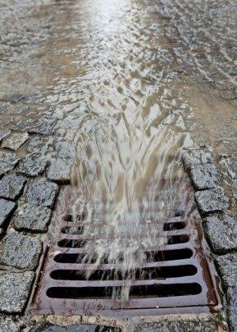
One example of urban runoff happens when water flows across parking lots and picks up oil and other chemicals left behind by cars.
In cities, urban runoff usually flows into storm drains. Have you observed storm drains in your community?
U.S. Department of the Interior
Bureau of Land Management
Water flows from a street into a sewer grate.
Photo by EPA.

Slide 11
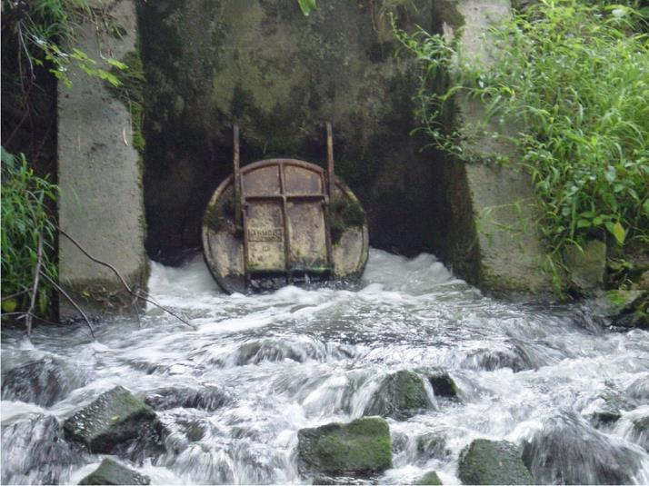
Storm drains send urban runoff into underground pipes. The pipes eventually release the polluted water into waterways, which then affects downstream parts of watersheds.
U.S. Department of the Interior
Bureau of Land Management
A storm drain channels polluted water into a body of water.
Photo by USGS.

Slide 12
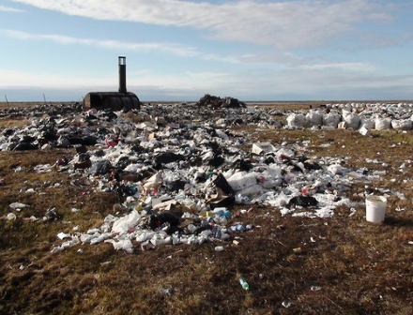
Runoff pollution happens in rural communities, too. If trash dump sites are located close to a waterway, oils and other pollution can flow from the dump site into the water.
U.S. Department of the Interior
Bureau of Land Management
A rural area dump site. Photo by USDA.
How does your community deal with trash?

Slide 13
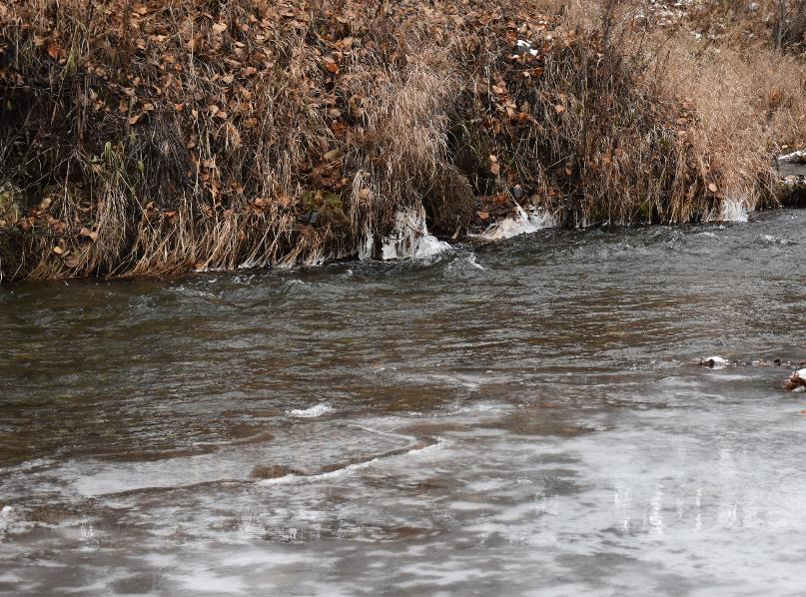
Another human impact is erosion. Although erosion is a natural process, humans can increase erosion by damaging or removing the plants that line the area.
U.S. Department of the Interior
Bureau of Land Management
Campbell Creek.
Photo by CCSC staff, BLM.

Slide 14
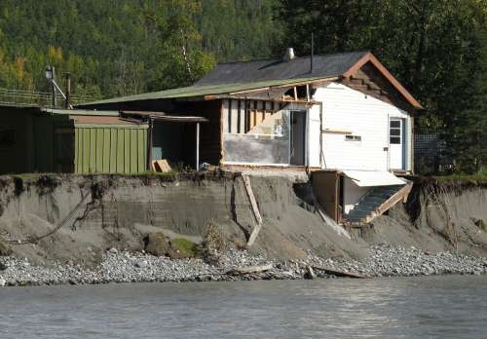
The roots of trees and other plants keep the banks of waterways stable. Without vegetation, banks are more likely to erode.
U.S. Department of the Interior
Bureau of Land Management
A building structure is at risk of falling into the water due to erosion.
Photo by USGS.
Have you observed erosion in your community?

Slide 15
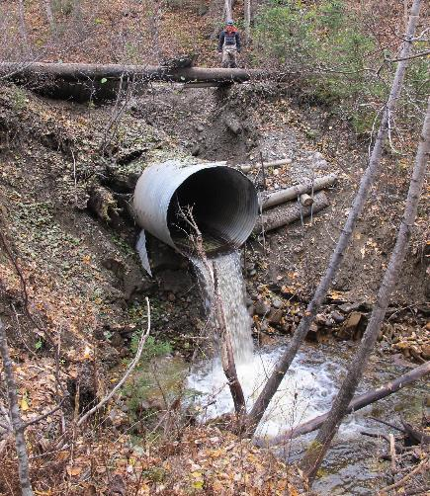
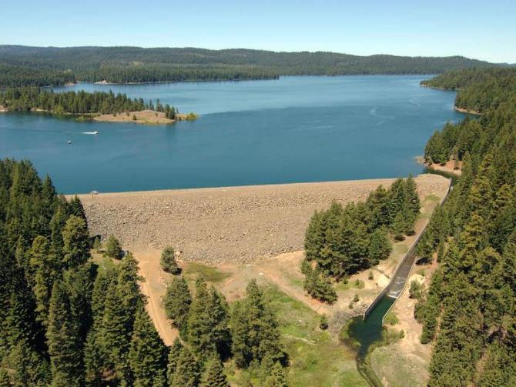
Humans also impact water quality through development. For example, communities build culverts underneath roads so waterways can pass through without flooding the roadway. Communities build dams to store water and create electricity to power homes and businesses.
U.S. Department of the Interior
Bureau of Land Management
culvert
dam
A dam holds back water.
Photo by U.S. Bureau of Reclamation.
A culvert channels water into a stream.
Photo by USFWS.

Slide 16
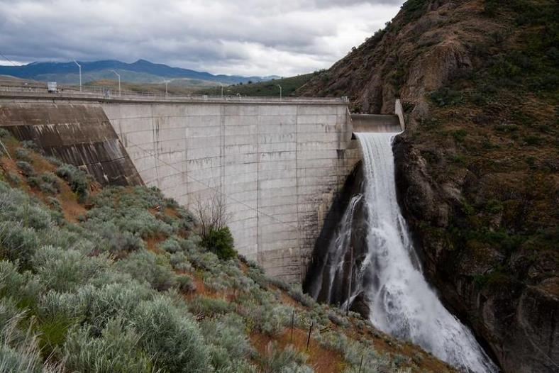
Culverts and dams can negatively affect water quality and make it difficult (and sometimes impossible) for salmon and other fish to swim upstream.
U.S. Department of the Interior
Bureau of Land Management
A dam restricts water flow into a body of water.
Photo by U.S. Bureau of Reclamation.
Have you observed culverts in your community? Is there a dam in your community?

Slide 17
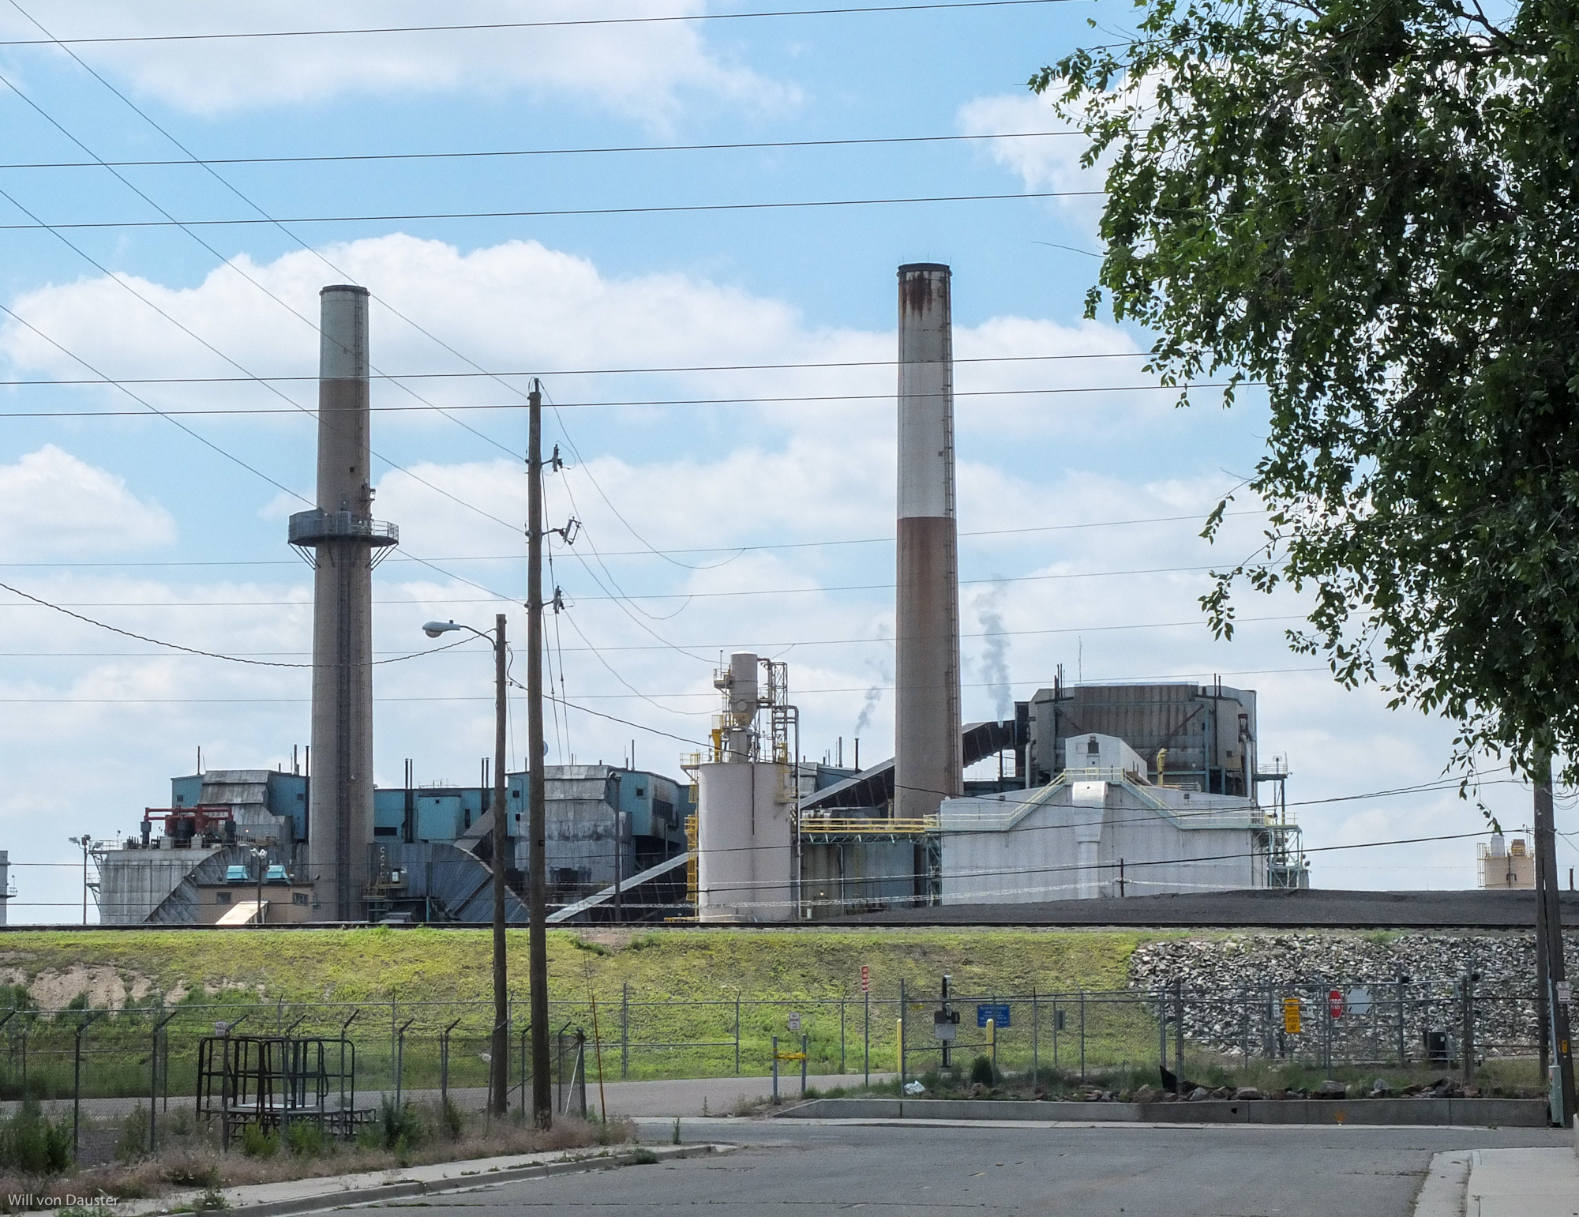
Have you heard of climate change? Human actions that burn fossil fuels are causing Earth’s climate to warm up. As the climate warms, the water temperatures in our waterways rise as well.
U.S. Department of the Interior
Bureau of Land Management
Factories can contribute to climate change.
Photo by W. von Dauster, NOAA.

Slide 18
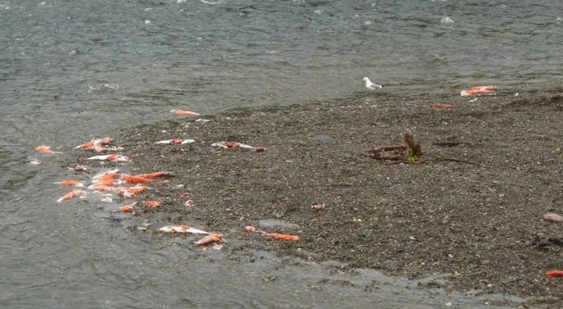
In 2019 and 2020, hot summer weather made water temperatures around Alaska very warm. Communities observed large numbers of dead salmon in the rivers. This affected people’s ability to live a traditional lifestyle harvesting wild salmon to feed their families and, in some cases, their sled dogs.
U.S. Department of the Interior
Bureau of Land Management
Several dead fish line the banks of this body of water.
Photo by M. Fitz, NPS.
Have you observed salmon die-offs in your community? How else is climate change affecting your community?

Slide 19
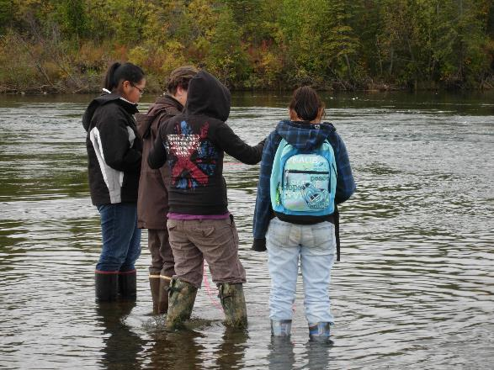
To learn about human impacts on water quality, scientists ask questions, record observations, and make predictions.
U.S. Department of the Interior
Bureau of Land Management
A group of student scientists stand in water to make their observations.
Photo by CCSC staff, BLM.
In the following activity, you will visit the Campbell Creek Watershed to make observations and predictions about how people affect water quality.

Slide 20
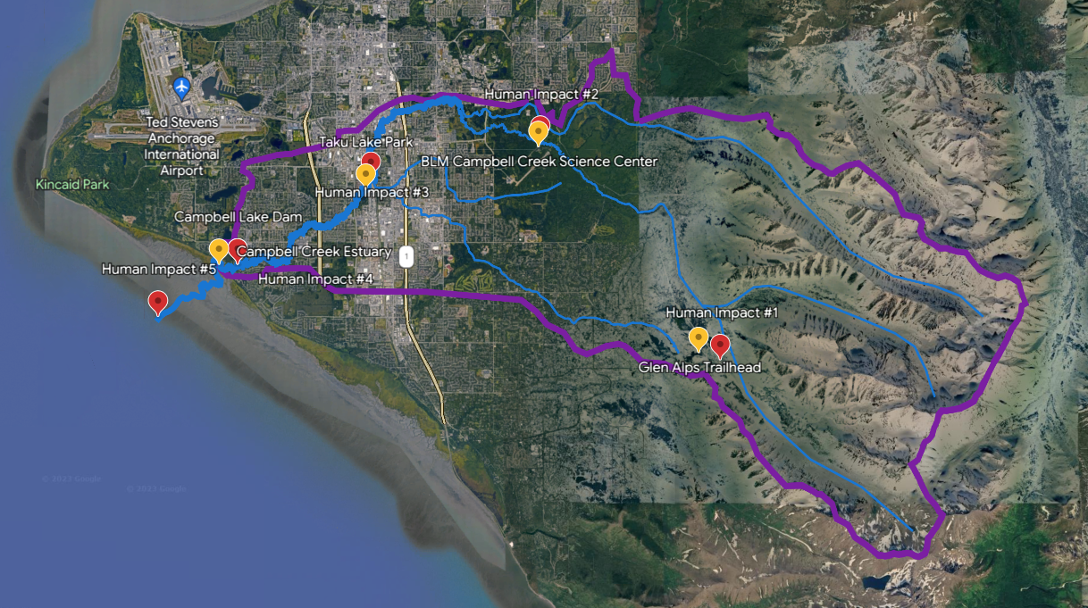
U.S. Department of the Interior
Bureau of Land Management
Campbell Creek Watershed
The Campbell Creek Watershed is one of five major watersheds in Anchorage.
On this tour, you will make predictions about human impacts in the Campbell Creek Watershed that affect water quality. These impacts could be found in other watersheds, too.
Get ready to write in your science journal or on a piece of paper.
Watershed Border
Map Data: IBCAO Airbus Maxar Technologies CNES/Airbus

Slide 21
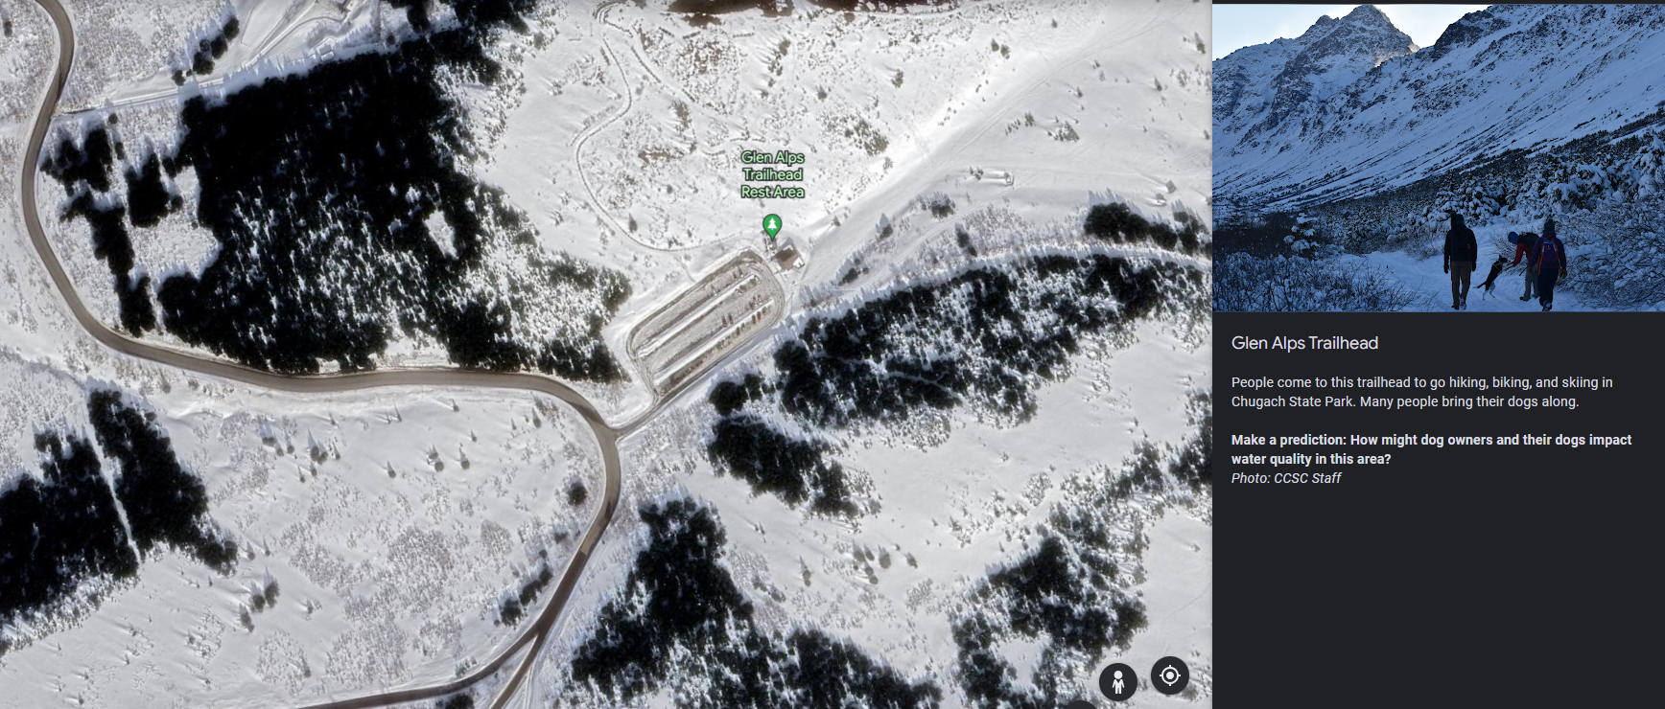
Glen Alps Trailhead
People come to this trailhead to go hiking, biking, and skiing in Chugach State Park. Many people bring their dogs along.
Make a prediction: How might dog owners and their dogs impact water quality in this area?
U.S. Department of the Interior
Bureau of Land Management
Map Data: Airbus © 2023

Slide 22
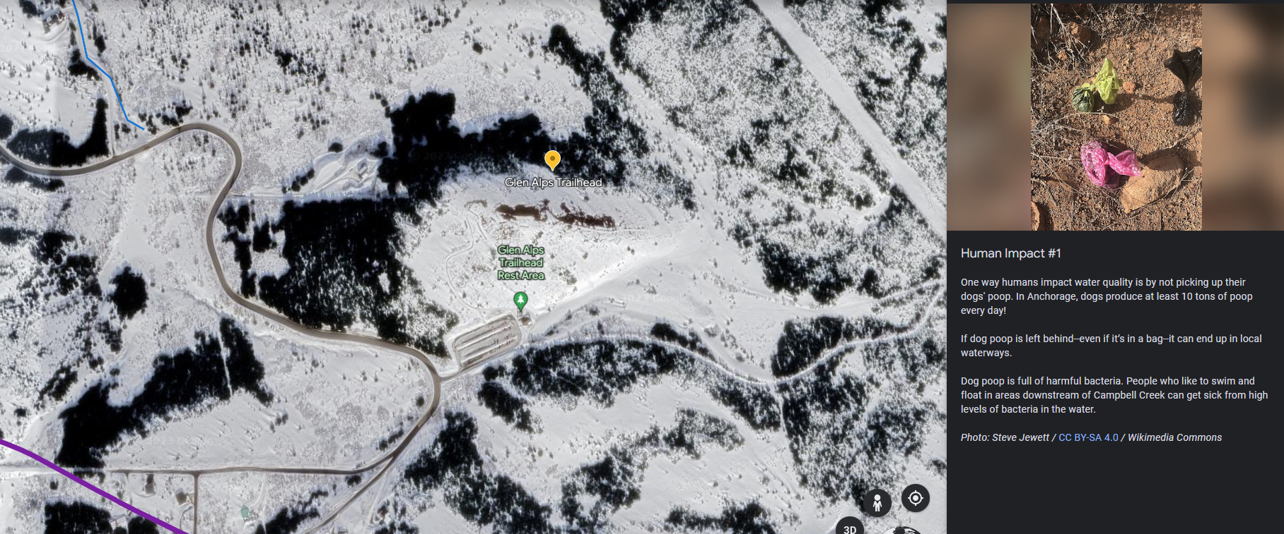
U.S. Department of the Interior
Bureau of Land Management
Human Impact #1
One way humans impact water quality is by not picking up their dogs' poop. In Anchorage, dogs produce at least 10 tons of poop every day!
If dog poop is left behind--even if it’s in a bag--it can end up in local waterways.
Dog poop is full of harmful bacteria. People who like to swim and float in areas downstream of Campbell Creek can get sick from high levels of bacteria in the water.
Map Data: Airbus © 2023

Slide 23
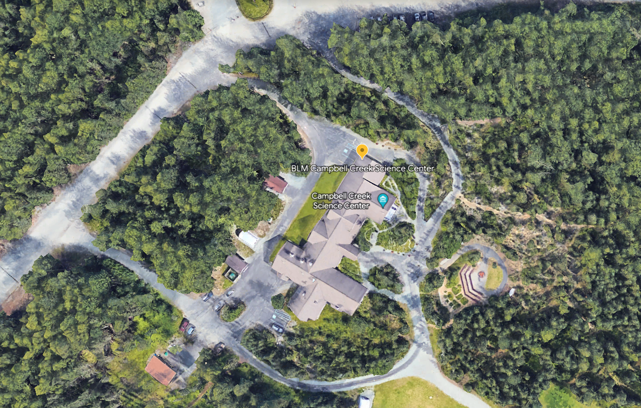
U.S. Department of the Interior
Bureau of Land Management
The Campbell Tract, home of the Campbell Creek Science Center, sits alongside Campbell Creek. It is a popular spot for outdoor activities all times of the year.
Map Data: Google © 2014

Slide 24
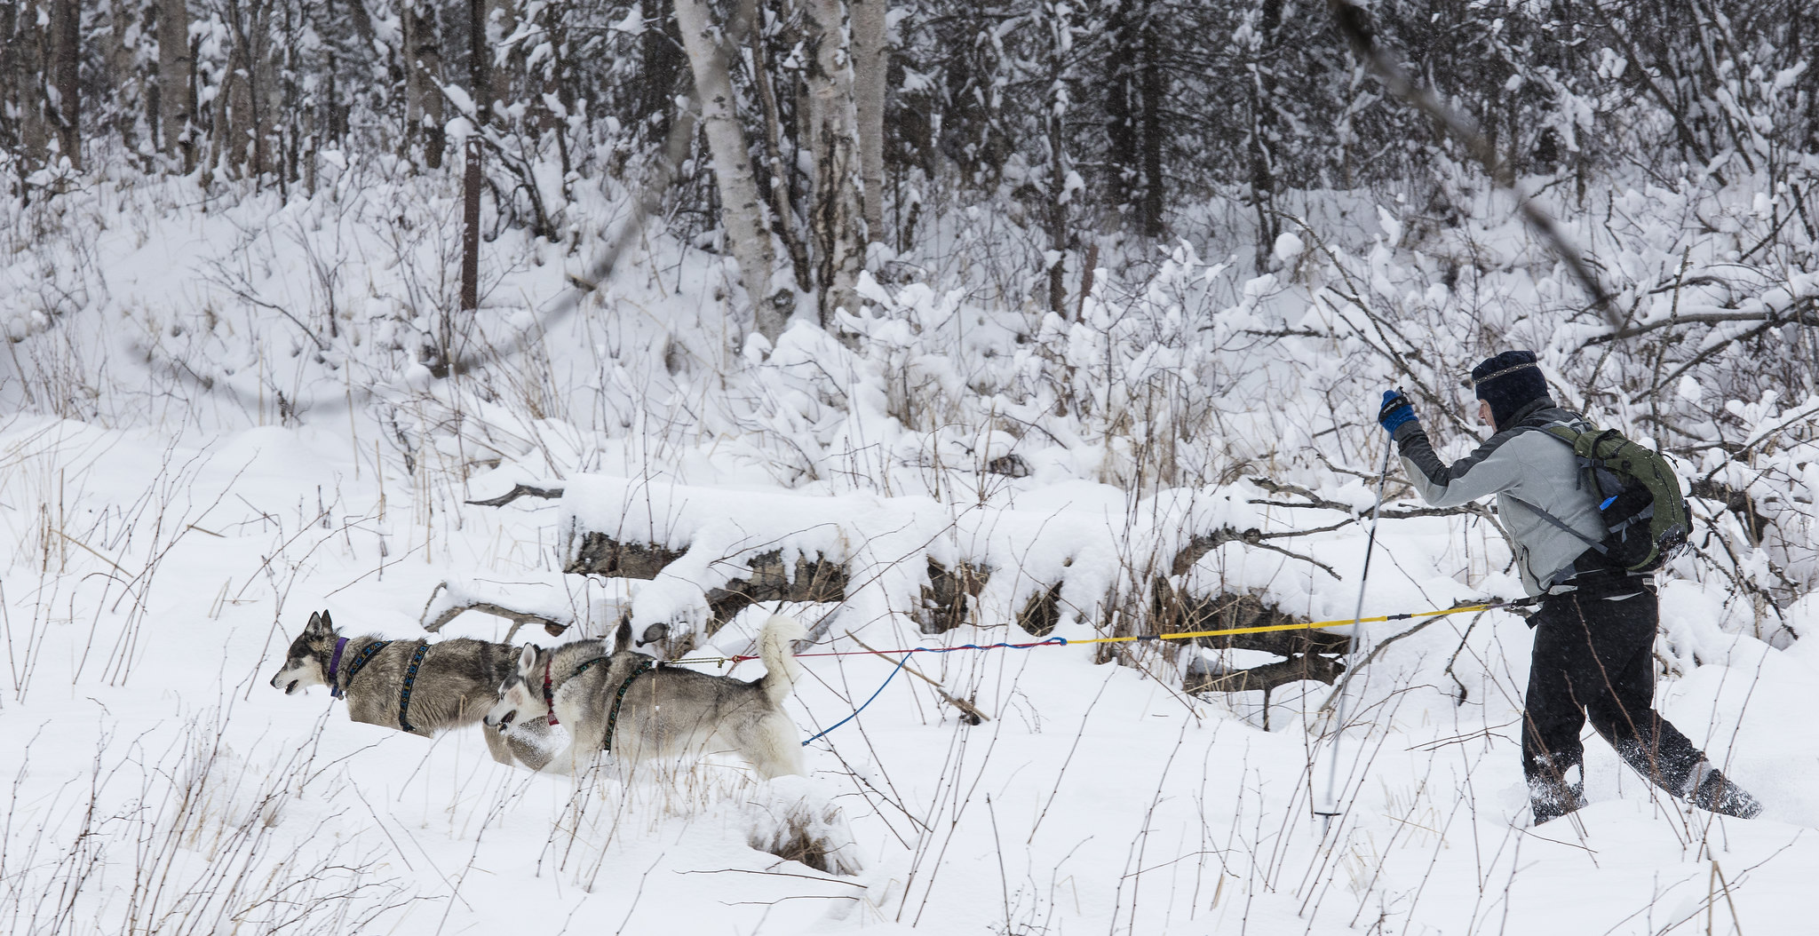
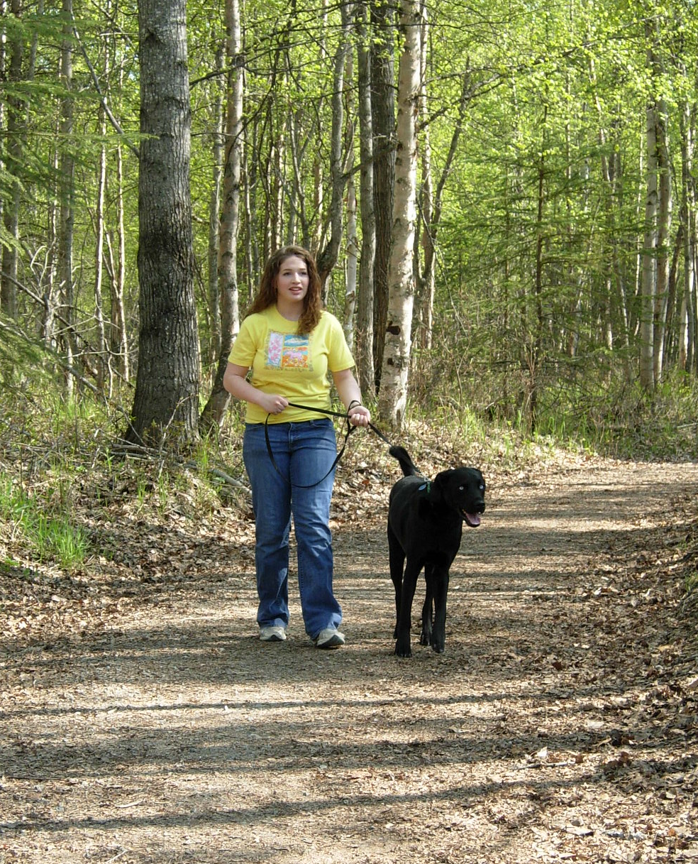
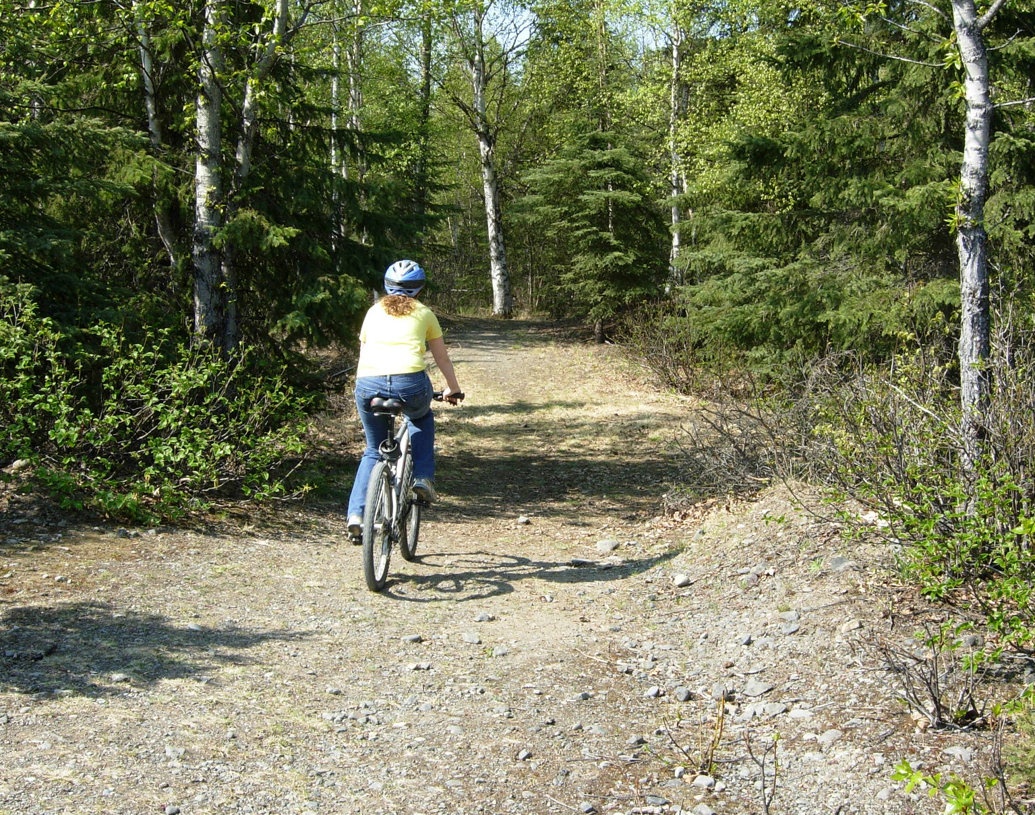
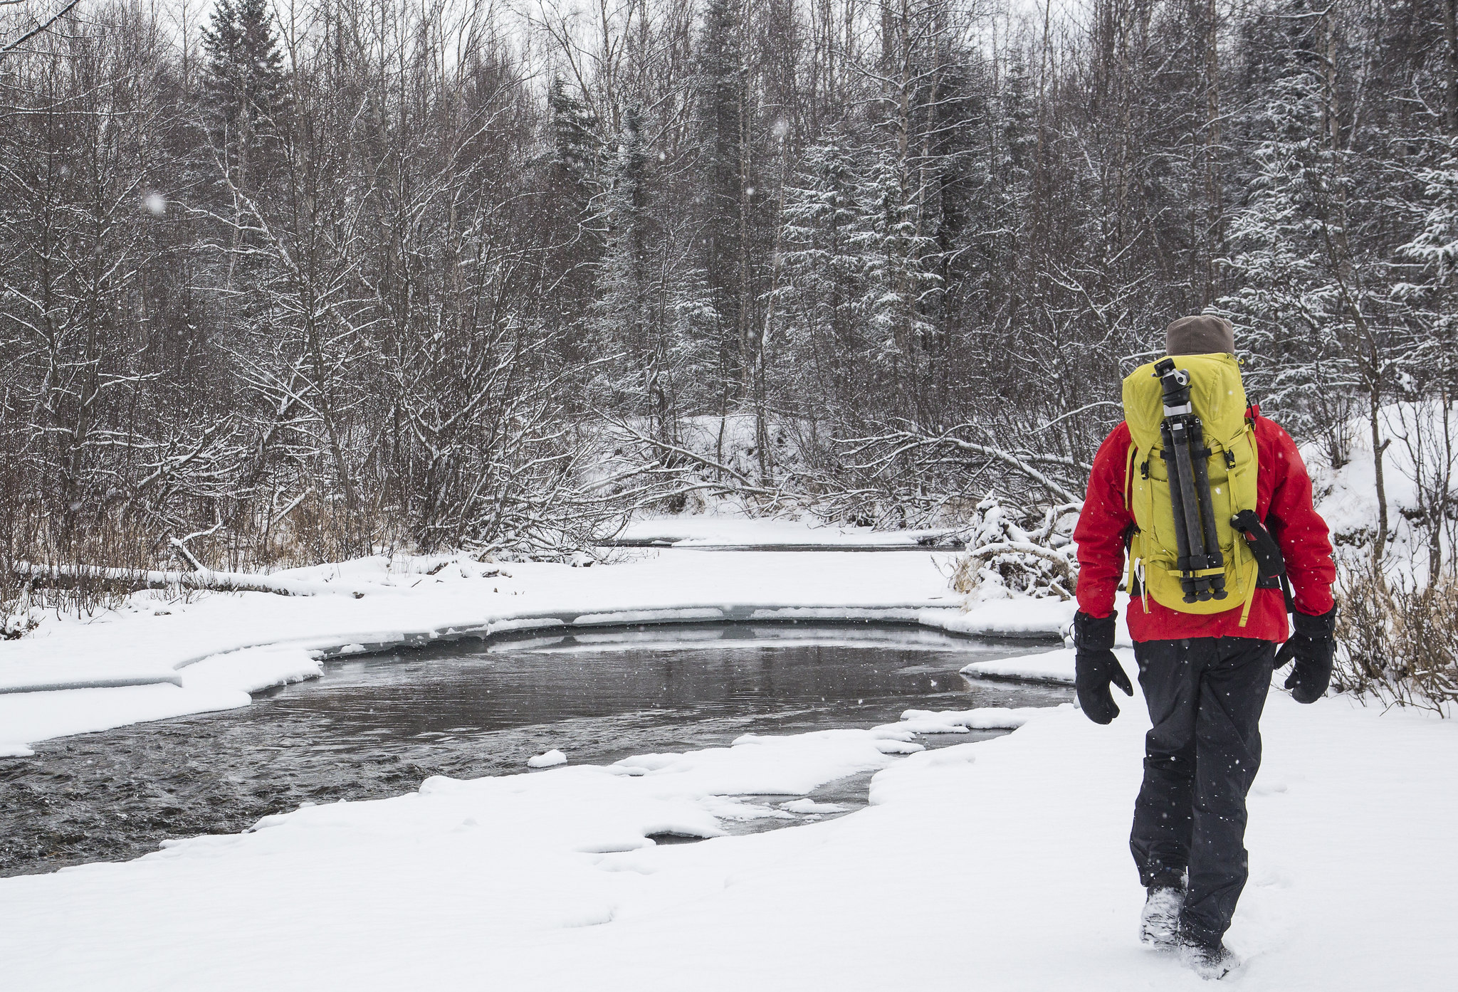
U.S. Department of the Interior
Bureau of Land Management
What types of activities do you observe in these photos?
Make a prediction: How might these activities impact water quality in this area?
A person cross-country skiing on a winter trail.
Photo by B. Wick, BLM.
A person walks their dog on a shady, dirt trail.
Photo by V. Rathbun, BLM.
A person rides their bike on a dirt trail on a bright, sunny day.
Photo by V. Rathbun, BLM.
A person enjoys a winter walk on a snowy path. Photo by B. Wick, BLM.

Slide 25
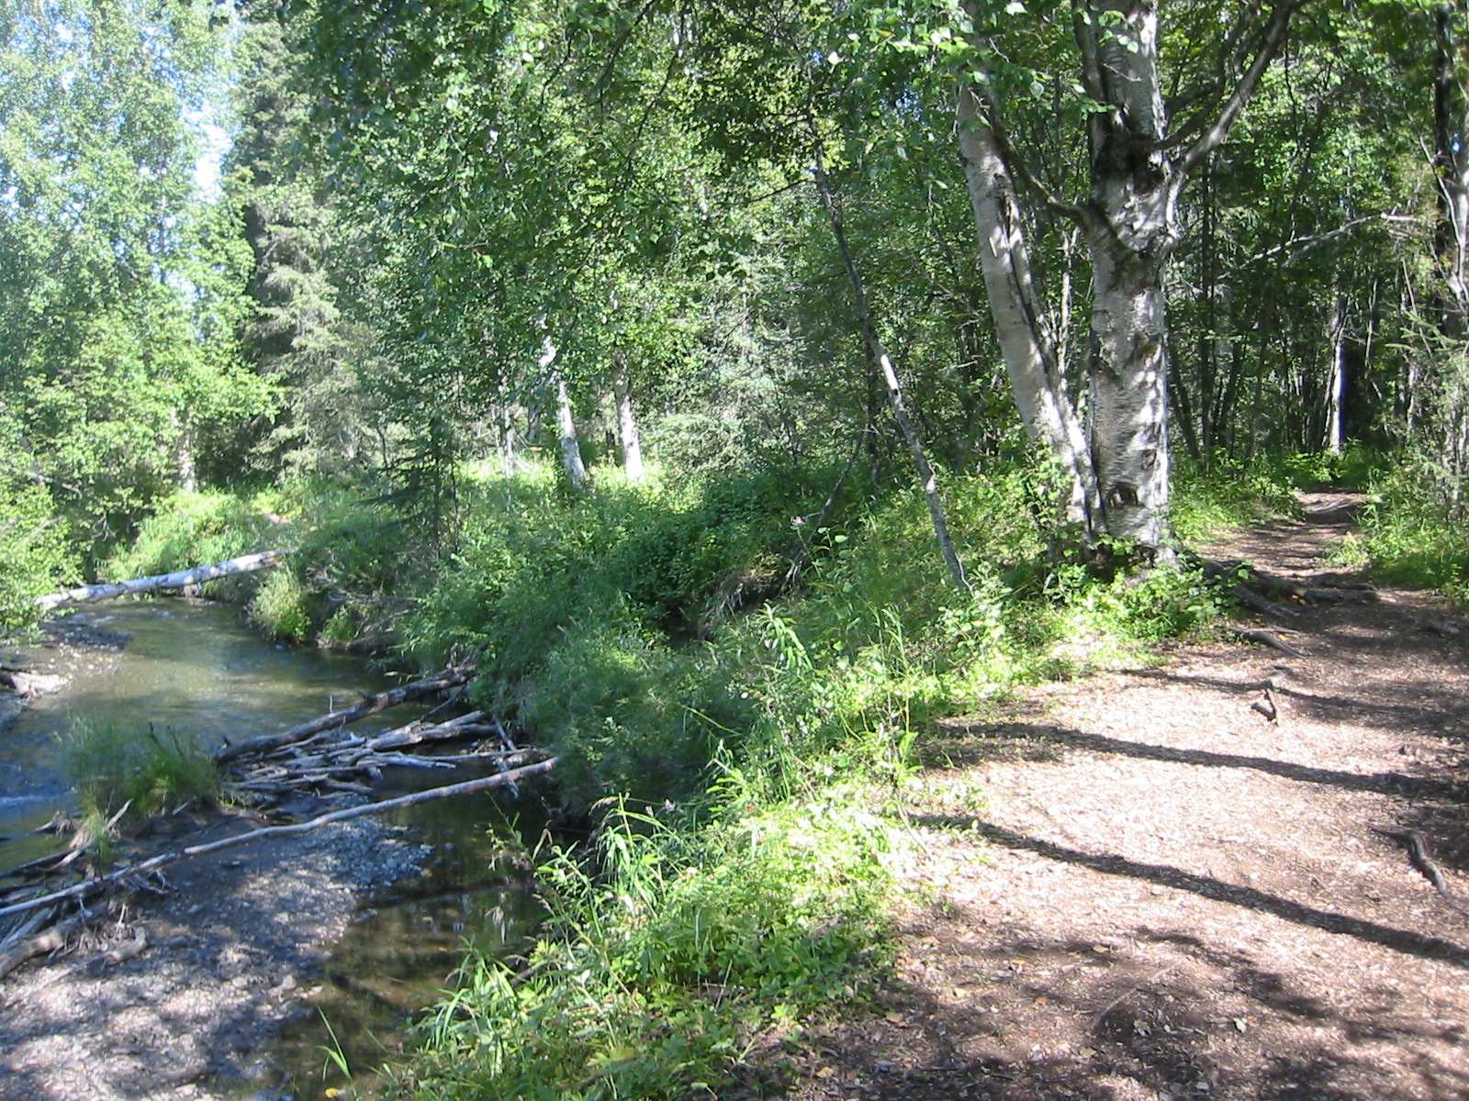
U.S. Department of the Interior
Bureau of Land Management
Human Impact #2
Many people walking, biking, and skiing in one area can trample vegetation along the edge of the creek.
Without vegetation to hold the bank in place, sediment erodes into the creek.
Although erosion is a natural process, too much sediment in the water can clog gravel beds, which are important habitats for fish, insects, and other river life.
A shaded dirt trail runs along a creek.
Photo by K. Mincer, BLM.

Slide 26
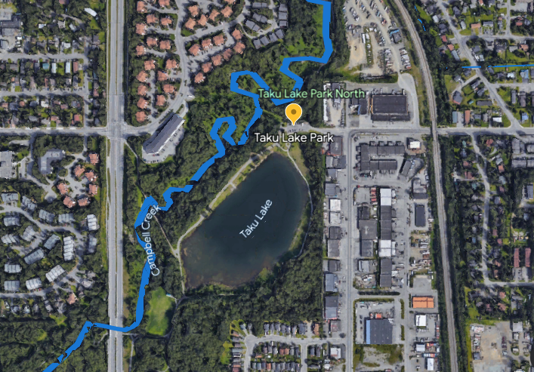
U.S. Department of the Interior
Bureau of Land Management
Taku Lake Park
The area where Campbell Creek flows past Taku Lake Park is surrounded by developed areas, such as neighborhoods, businesses, parking lots, and busy roads.
Make a prediction: How might these human developments affect water quality in this area?
Map Data: Google © 2014

Slide 27
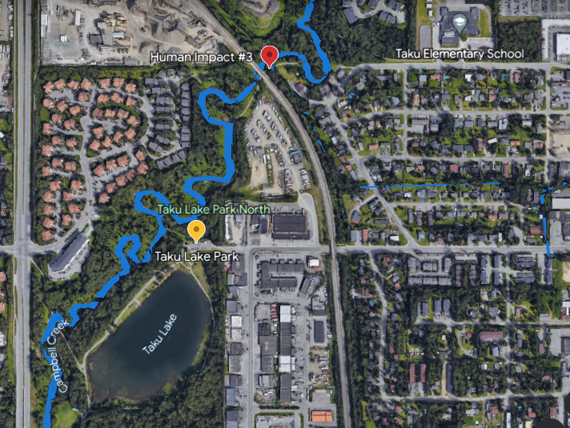
U.S. Department of the Interior
Bureau of Land Management
Taku Lake Park
The area where Campbell Creek flows past Taku Lake Park is surrounded by developed areas, such as neighborhoods, businesses, parking lots, and busy roads.
Make a prediction: How might these human developments affect water quality in this area?
Map Data: Google © 2014

Slide 28
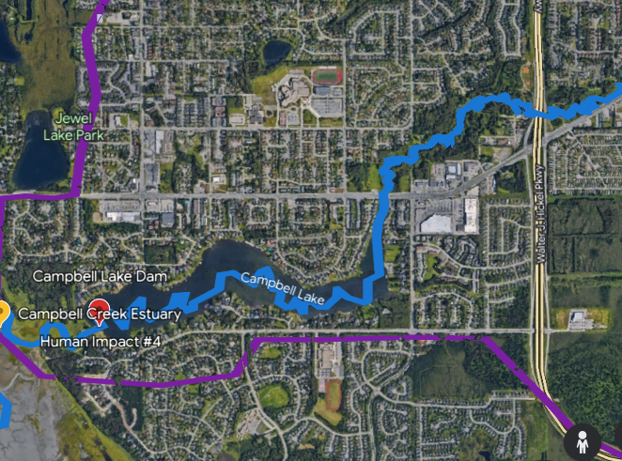
U.S. Department of the Interior
Bureau of Land Management
Campbell Lake Dam
Just before it reaches the estuary, Campbell Creek is slowed by a man-made dam. This dam creates Campbell Lake.
Make a prediction: How might the dam impact water quality in this area?
Map Data: IBCAO © 2014

Slide 29
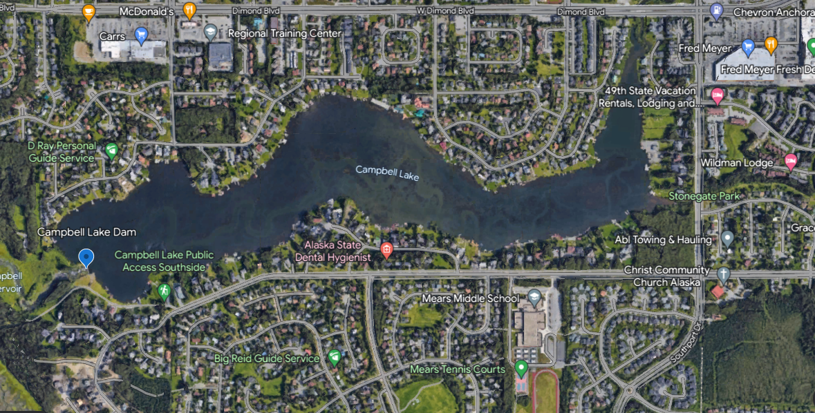
U.S. Department of the Interior
Bureau of Land Management
Human Impact #4
The dam caused Campbell Creek to flood a large area of land, which created Campbell Lake. In the photo, you can see under the lake the outline of where the creek used to flow.
The dam slows the water down. Slow water has warmer temperatures and less oxygen. This may affect fish and other underwater animals that need cold water and high amounts of dissolved oxygen to survive.
The dam also creates a challenge for salmon to return to Campbell Creek from the ocean to spawn.
Map Data: Google © 2014

Slide 30
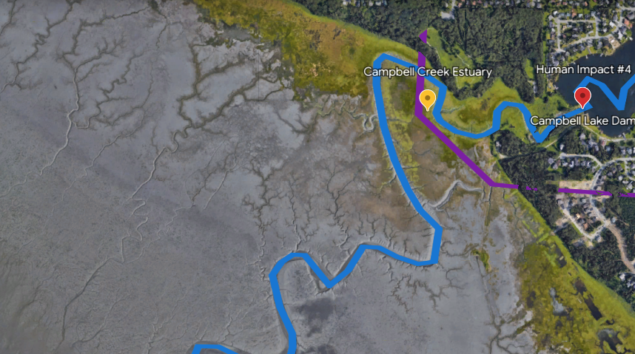
U.S. Department of the Interior
Bureau of Land Management
Campbell Creek Estuary
Campbell Creek flows downhill through the city until it reaches the estuary, where it drains into the ocean.
Make a prediction: How might human impacts in the Campbell Creek Watershed affect water quality in the ocean?
Map Data: Google © 2014

Slide 31
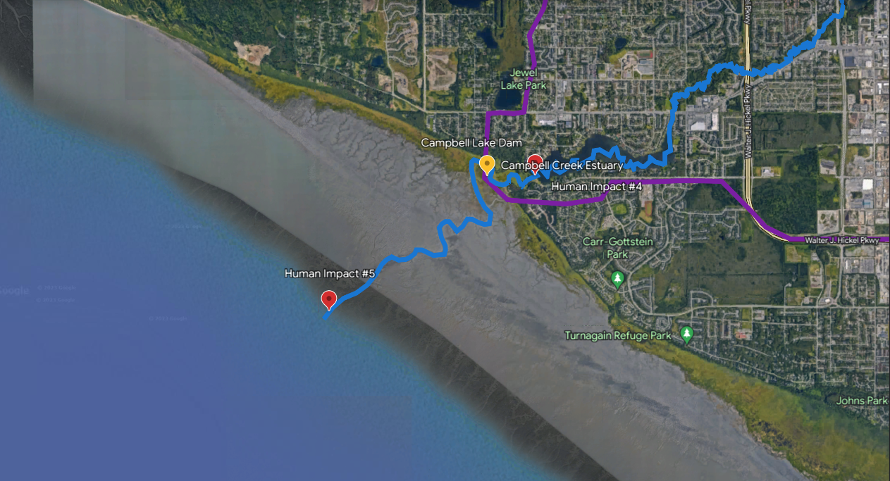
U.S. Department of the Interior
Bureau of Land Management
Human Impact #5
Pollution and other human impacts in one watershed can affect other waterways, too.
Since the estuary is the place where Campbell Creek meets the Pacific Ocean, pollution from this watershed can move into the larger body of water and affect the living and non-living things in that ecosystem.
Map Data: Google © 2023

