Slide 1
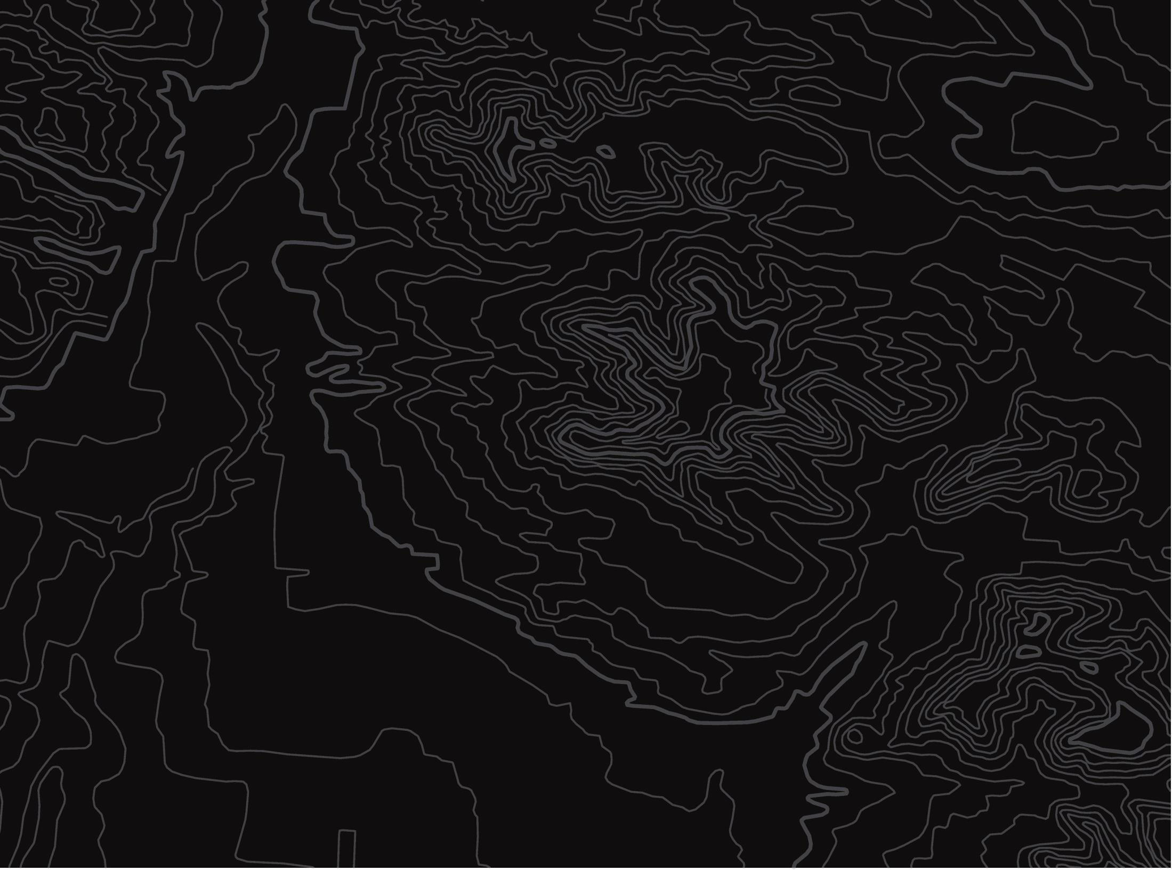

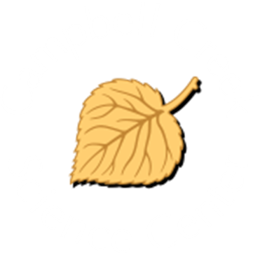
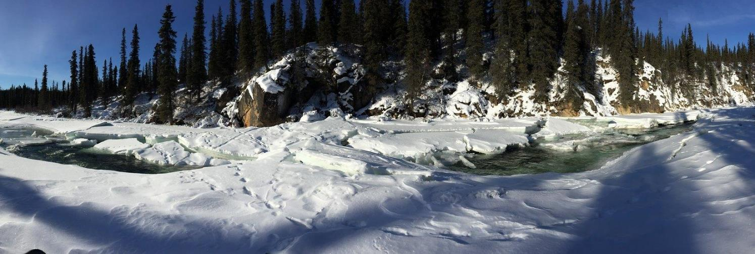
Water Temperature
U.S. Department of the Interior
Bureau of Land Management
Discover how to measure and graph water temperatures
Module 2, Lesson 1
Photo by L. Sorlie, BLM.

Slide 2
Lesson 2: Water Temperature
Lesson Questions:
U.S. Department of the Interior
Bureau of Land Management
What can change the temperature of the water?
How do you read a bar graph about water temperature?
Why is water temperature important for plants and animals that live in the water?

Slide 3
Materials:
U.S. Department of the Interior
Bureau of Land Management
graphing paper and/or science journal or a piece of paper
ruler (or a straight edge)
something to write with

Slide 4
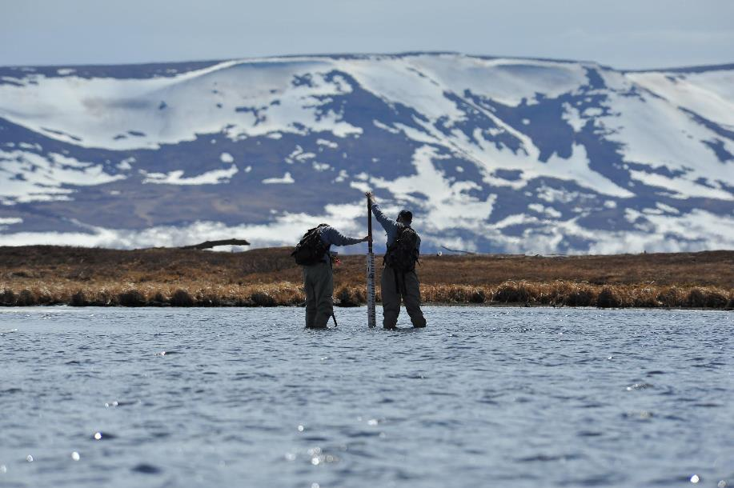
Scientists make observations and conduct tests to determine water quality. One important part of water quality that scientists measure is water temperature.
U.S. Department of the Interior
Bureau of Land Management
Scientists observe water characteristics.
Photo by M. Gabrielson, USFWS.

Slide 5
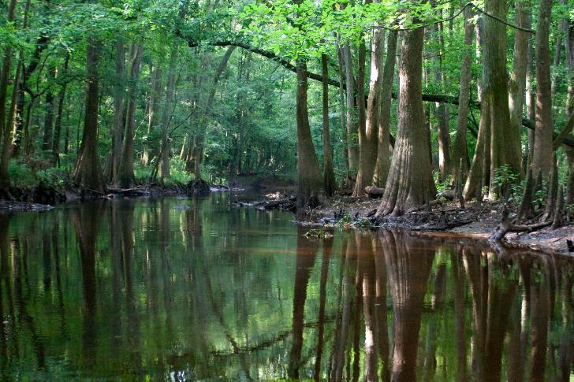
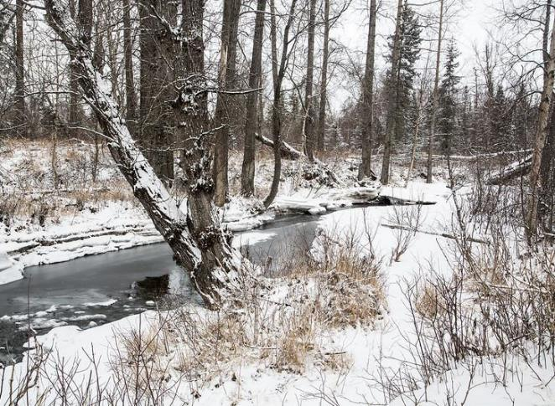
Make an observation:
What do these two pictures have in common? How are they different?
U.S. Department of the Interior
Bureau of Land Management
Large trees shroud the banks of a slow moving body of water.
Photo by S. McNamara, NPS.
Swift moving water keeps it from freezing during the winter months.
Photo by B. Wick, BLM.

Slide 6

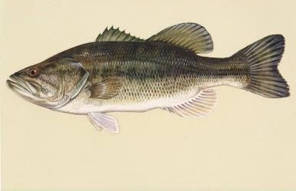
U.S. Department of the Interior
Bureau of Land Management
This is a warm water stream.
Plants and animals that need warm water survive here.
Water in these watersheds are healthy when the water temperature is warm.
For example:
Largemouth bass
live only in
warm water.
Large trees shroud the banks of a slow moving body of water.
Photo by S. McNamara, NPS.
Largemouth bass.
Graphic by USFWS.
Notes:
H. Zell / CC BY-SA 3.0 / Wikimedia Commons

Slide 7
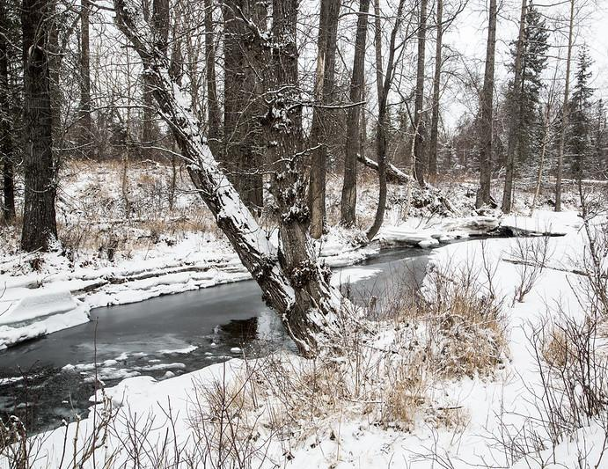
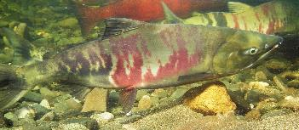
U.S. Department of the Interior
Bureau of Land Management
This is a cold-water stream.
Waterways in Alaska have cold water.
Cold water creeks, rivers, and lakes are healthy when the water temperature is below 70°F.
Plants and animals that need cold environments survive there.
For example:
Salmon live only
in cold water.
Swift moving water keeps it from freezing during the winter months.
Photo by B. Wick, BLM.
Salmon swimming in clear, cool water.
Photo by J. Post, BLM.

Slide 8
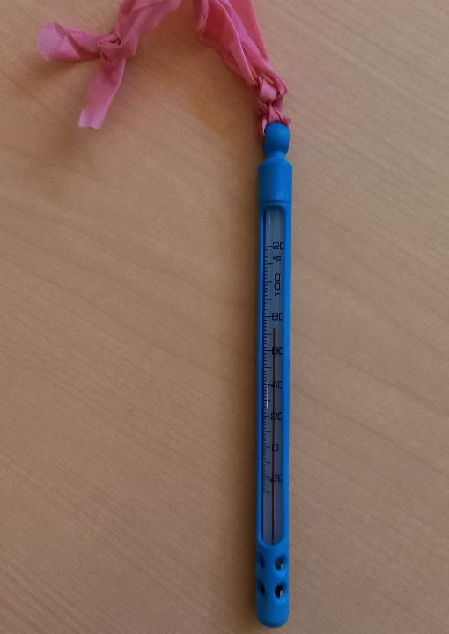
Scientists measure temperature using a thermometer.
Temperature is the measure of how hot or cold something is.
U.S. Department of the Interior
Bureau of Land Management
A thermometer is used to measure temperature.
Photo by CCSC staff, BLM.

Slide 9
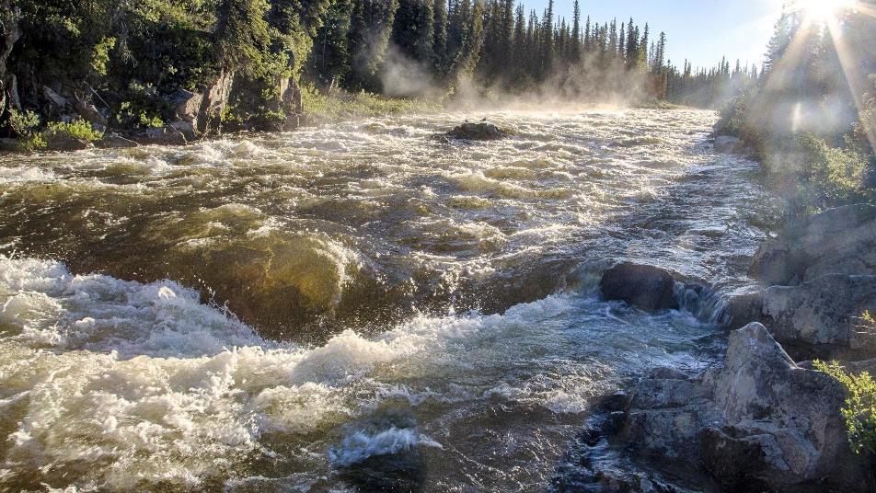
Air temperature can change water temperature. When it is cold outside, the water temperature will become colder. When it is hot outside, the water temperature will become warmer.
U.S. Department of the Interior
Bureau of Land Management
Sunlight shimmers on rapidly moving water.
Photo by B. wick, BLM.

Slide 10
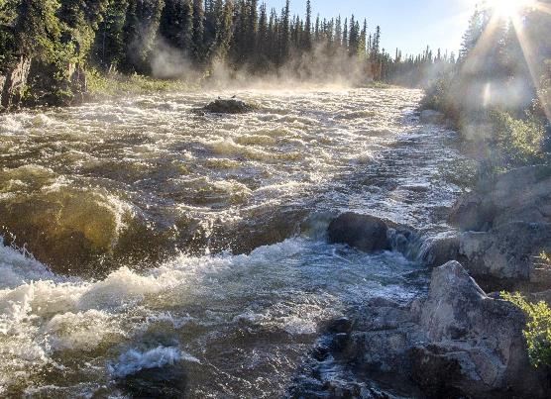
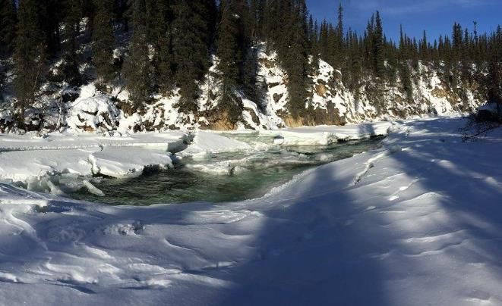
The Gulkana River in Southcentral Alaska
U.S. Department of the Interior
Bureau of Land Management
Sunlight shimmers on rapidly moving water.
Photo by B. wick, BLM.
A pocket of water remains unfrozen during winter months.
Photo by L. Sorlie, BLM.
This picture is from the summer. The water temperature of the Gulkana at this time was 57°F.
This picture is from the winter. The water temperature of the Gulkana at this time was 32°F.

Slide 11
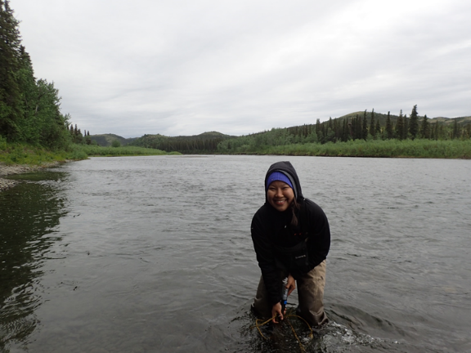
Scientists measure water temperature to understand how it might affect plants and animals that live in Alaska’s waterways.
During hot summers, the water temperature will be warmer.
Hot summers can be stressful for underwater animals like salmon.
U.S. Department of the Interior
Bureau of Land Management
A person stands in knee-deep water to take a temperature reading.
Photo by B. Stratton, BLM.

Slide 12
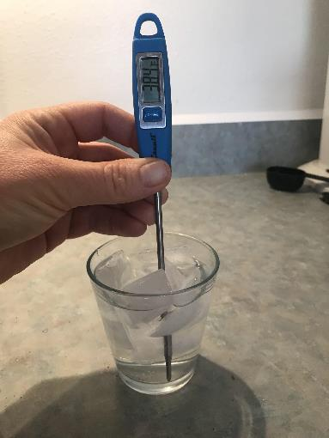
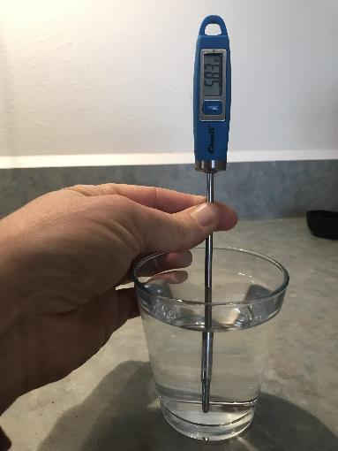
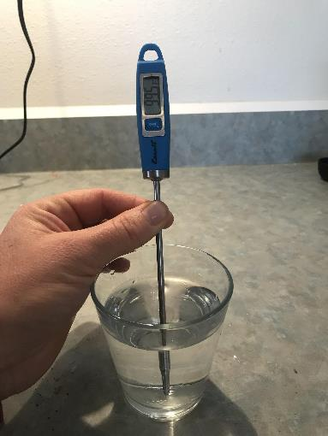
Make a prediction: In which of these water temperatures could salmon not survive?
U.S. Department of the Interior
Bureau of Land Management
Ice water
Cool Water
Hot water
38.4°F
58.3°F
99.5°F
Various thermometer readings show a range of water temperatures.
Photos by CCSC staff, BLM.

Slide 13
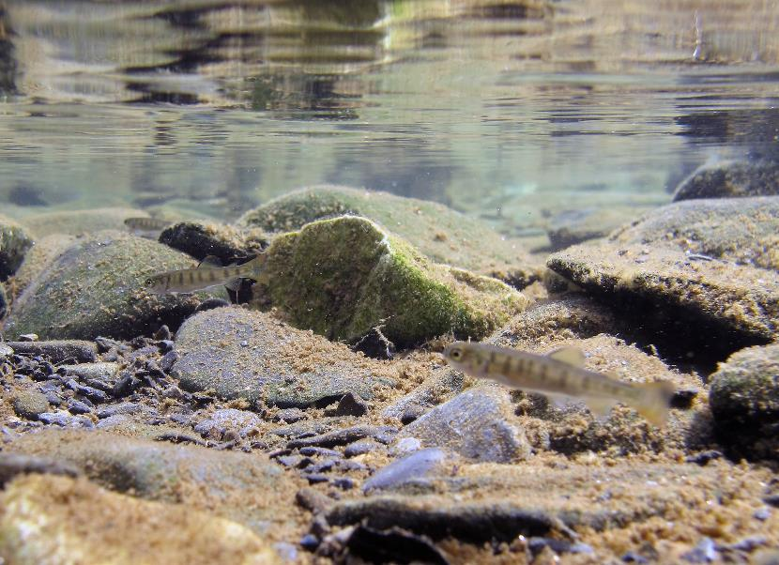
Salmon cannot survive if the water temperature is above 70°F. They prefer if the water is colder, around 40-50°F.
When it is hot outside, salmon have to search for the coldest places in waterways in order to survive.
U.S. Department of the Interior
Bureau of Land Management
Salmon fry swimming in clear, cool water.
Photo by K. Mueller, USFWS.

Slide 14
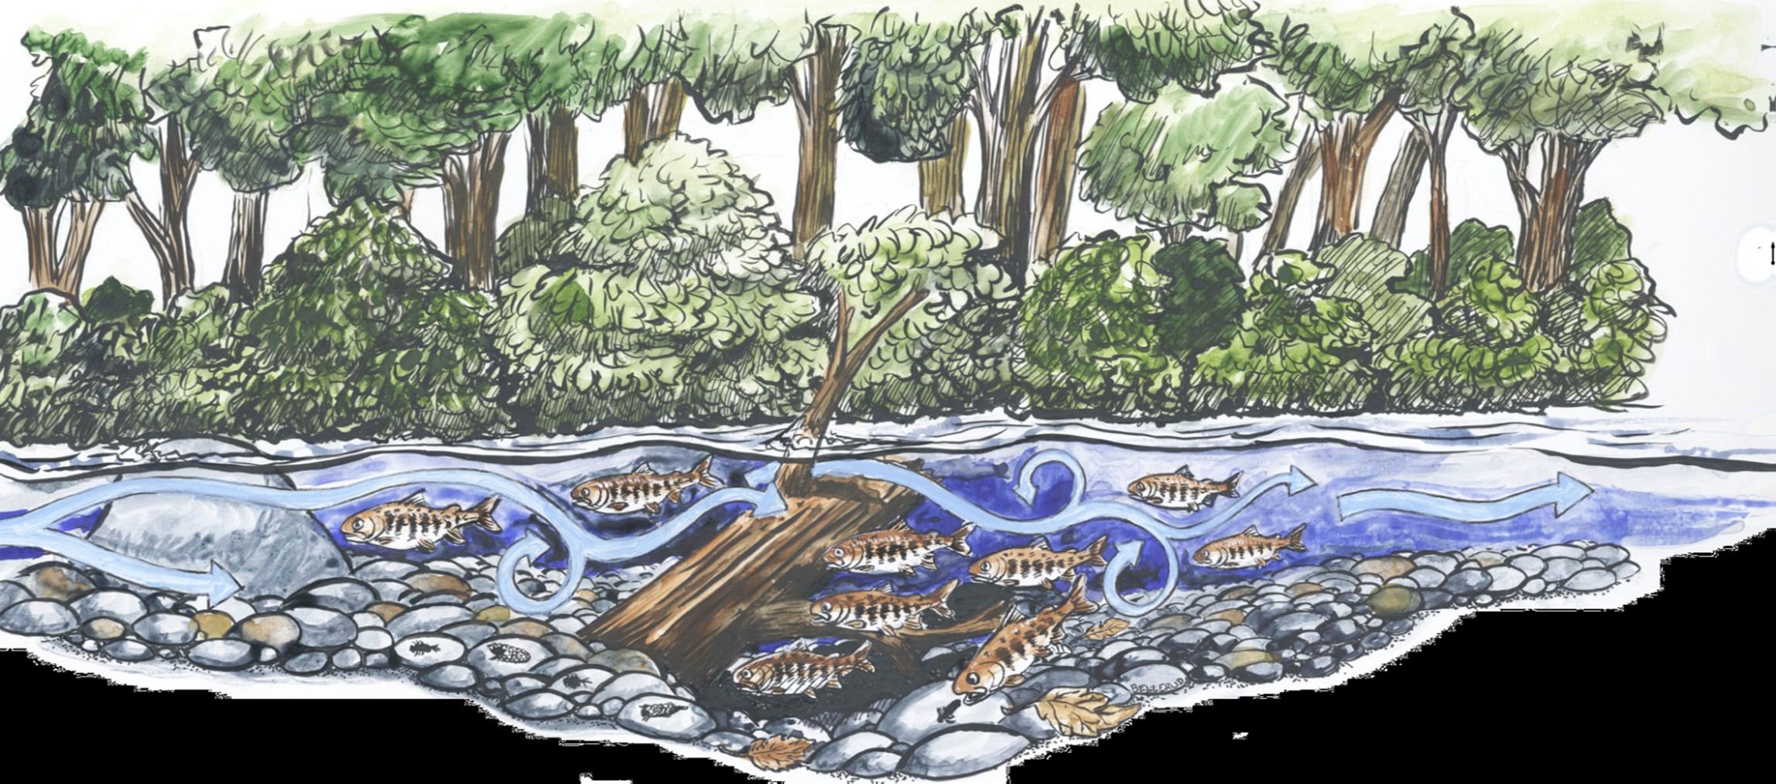
In this river with healthy water quality, trees provide shade from the sun, which keeps the water cooler.
U.S. Department of the Interior
Bureau of Land Management
Graphic by NOAA Fisheries.
The light blue arrows show the location of warmer water. Water near the surface is warmed by the sun.
Fallen logs in the water provide protection for fish and create deep, dark pools where water is colder.

Slide 15
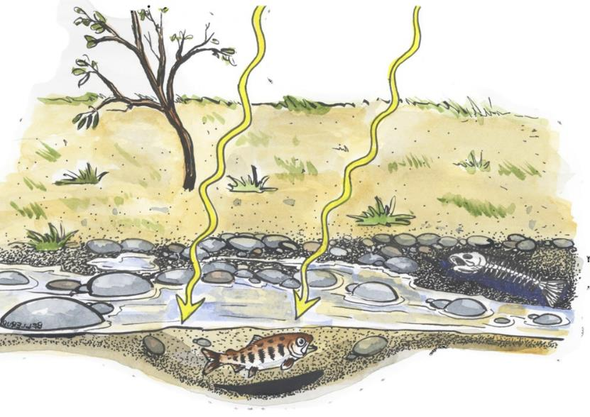
In shallow creeks with no shade, the sun warms up the water quickly.
U.S. Department of the Interior
Bureau of Land Management
Graphic by NOAA Fisheries.

Slide 16
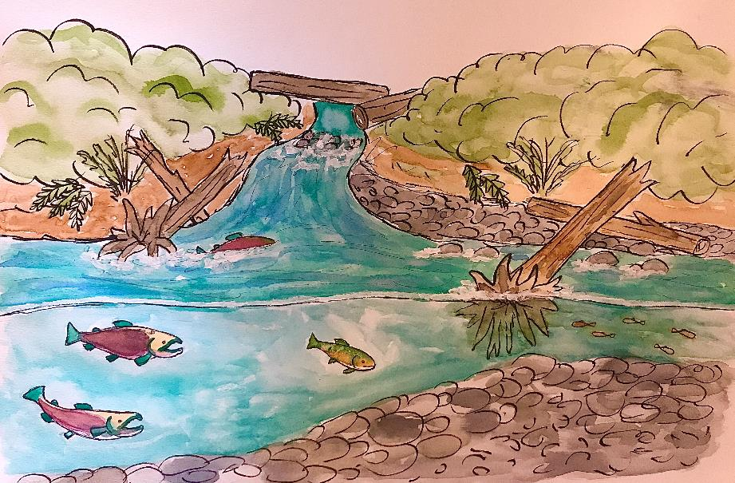
Here is a picture of a creek. Where do you think the water is warmest? Where do you think it is coldest?
U.S. Department of the Interior
Bureau of Land Management
Graphic by M. Harris, BLM.

Slide 17
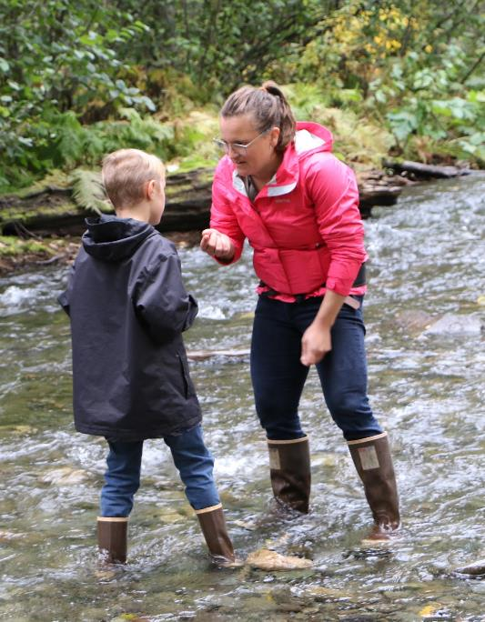
Maddy is a hydrologist who measures the average water temperature in the imaginary Nerka River in Alaska every July.
She measures the water temperature to determine if it is healthy for the animals and plants that live there.
Help Maddy record and analyze her data. Write down information in your science journal or on a piece of paper.
U.S. Department of the Interior
Bureau of Land Management
Two scientists make observations about the water they are standing in.
Photo by M. Clark, BLM.

Slide 18

Maddy recorded these results from 2019-2022:
In July 2019, the average water temperature was 55°F.
In July 2020, the average water temperature was 52°F.
In July 2021, the average water temperature was 55°F.
In July 2022, the average water temperature was 60°F.
U.S. Department of the Interior
Bureau of Land Management
A thermometer is used to measure temperature.
Photo by CCSC staff, BLM.

Slide 19
Here is a table that shows the data.
U.S. Department of the Interior
Bureau of Land Management
Year
Average Temperature (°F)
July 2019
55
July 2020
52
July 2021
55
July 2022
60

Slide 20
These are all the years that Maddy took water temperature measurements in the Nerka River. Her first time was in July 2019.
U.S. Department of the Interior
Bureau of Land Management
Average Temperature (°F)
Year
July 2019
55
July 2020
52
What was the last year that Maddy went to visit the river?
How many total years did she visit the river?
July 2021
55
July 2022
60

Slide 21
These are the average temperatures Maddy measured in the Nerka River.
U.S. Department of the Interior
Bureau of Land Management
Average Temperature (°F)
Year
July 2019
55
60°F is the warmest average temperature she measured.
What is the coldest average temperature she measured?
July 2020
52
July 2021
55
July 2022
60

Slide 22
The numbers in the red circle show that in July 2019, the average water temperature was 55°F.
U.S. Department of the Interior
Bureau of Land Management
Average Temperature (°F)
Year
July 2019
55
July 2020
52
July 2021
55
What was the average water temperature in July 2021?
July 2022
60

Slide 23
Now it’s time to represent the data using a bar graph.
U.S. Department of the Interior
Bureau of Land Management
First, copy this table at the top of your journal page or a piece of paper. Leave space under the table or on the next page for your graph.
Year
Average Temperature (°F)
July 2019
55
July 2020
52
July 2021
55
July 2022
60

Slide 24

U.S. Department of the Interior
Bureau of Land Management
Draw your table here.
Below the table, draw two lines.
Draw one line down to the bottom of the page on the left side. Draw the other line along the bottom.
Draw these two black lines.

Slide 25

Add tick marks and numbers to your lines.
The example graph will count up by tens. You can use a different scale, if you prefer.
U.S. Department of the Interior
Bureau of Land Management
Table
Table
70
70
60
60
50
50
40
40
The little black line is a tick mark.
30
30
20
20
10
10
2019
2020
2021
2022

Slide 26

The numbers on the left that go up and down represent different temperatures.
U.S. Department of the Interior
Bureau of Land Management
Table
70
60
50
Can you guess what the numbers on the bottom represent?
40
30
20
10
2019
2020
2021
2022

Slide 27
Did you guess years? That is correct!
The numbers on the bottom are the different years Maddy visited the Nerka River.
Write the labels for “Temperature” and “Year” next to the numbers on your graph.
U.S. Department of the Interior
Bureau of Land Management
Table
Table
70
70
60
60
50
50
40
40
Temperature (°F)
30
30
20
20
10
10
2019
2020
2021
2022
Year

Slide 28
U.S. Department of the Interior
Bureau of Land Management
Average July Water Temperature in the Nerka River
Table
Table
70
70
Every graph must have a title.
The title of this graph is:
Average July Water Temperature in the Nerka River
Write the title at the top of your graph.
60
60
50
50
40
40
Temperature (°F)
30
30
20
20
10
10
2019
2020
2021
2022
Year

Slide 29
Now it is time to add in the bars.
U.S. Department of the Interior
Bureau of Land Management
Average July Water Temperature in the Nerka River
Table
Table
70
70
60
60
Look at your table.
What was the average water temperature in 2019?
50
50
40
40
Temperature (°F)
30
30
20
20
10
10
2019
2020
2021
2022
Year

Slide 30
The average water temperature in 2019 was 55°F.
Draw the bar on your paper.
Start down at year 2019 and draw the bar up to 55°F. 55°F is halfway between 50°F and 60°F.
U.S. Department of the Interior
Bureau of Land Management
Average July Water Temperature in the Nerka River
Table
Table
70
70
60
60
50
50
40
40
Temperature (°F)
30
30
20
20
10
10
2019
2020
2021
2022
Year

Slide 31
Now draw a bar for the year 2020.
The water temperature in 2020 was 52°F.
U.S. Department of the Interior
Bureau of Land Management
Average July Water Temperature in the Nerka River
Table
Table
70
70
60
60
50
50
40
40
Temperature (°F)
30
30
20
20
10
10
2019
2020
2021
2022
Year

Slide 32
Next, draw bars to represent average water temperature for 2021 and 2022.
U.S. Department of the Interior
Bureau of Land Management
Average July Water Temperature in the Nerka River
Table
Table
70
70
60
60
50
50
40
40
Temperature (°F)
30
30
20
20
10
10
2019
2020
2021
2022
Year

Slide 33
Does your graph look like this?
Your bar graph is complete!
U.S. Department of the Interior
Bureau of Land Management
Average July Water Temperature in the Nerka River
Table
Table
70
70
60
60
50
50
40
40
Temperature (°F)
30
30
20
20
10
10
2019
2020
2021
2022
Year

Slide 34
U.S. Department of the Interior
Bureau of Land Management
Average July Water Temperature in the Nerka River
Use the bar graph you created to answer the following questions.
What year did Maddy record the warmest average temperature?
What year did Maddy record the coldest average temperature?
Table
Table
70
70
60
60
50
50
40
40
Temperature (°F)
30
30
20
20
10
10
2019
2020
2021
2022
Year

Slide 35
U.S. Department of the Interior
Bureau of Land Management
Average July Water Temperature in the Nerka River
Table
Table
The warmest year was 2022.
The average temperature in July that year was 60°F. Follow the red line to help you read the graph.
You can tell it was the warmest year because it is the tallest bar.
70
70
60
60
50
50
40
Temperature (°F)
30
30
20
20
10
10
2019
2020
2021
2022
Year

Slide 36
The coldest year was 2020. You can tell because it is the shortest bar.
The average temperature in July 2020 was 52°F.
U.S. Department of the Interior
Bureau of Land Management
Average July Water Temperature at the Salmon River
Table
Table
70
70
60
60
50
50
40
Temperature (°F)
30
30
20
20
10
10
2019
2020
2021
2022
Year

Slide 37
What two years did Maddy record the same average temperature?
U.S. Department of the Interior
Bureau of Land Management
Average July Water Temperature at the Salmon River
Table
Table
70
70
60
60
50
50
40
40
Temperature (°F)
30
30
20
20
10
10
2019
2020
2021
2022
Year

Slide 38
U.S. Department of the Interior
Bureau of Land Management
Average July Water Temperature in the Nerka River
2019 and 2021 had the same average water temperature.
You can tell by following the red line across. It meets the top of both bars for 2019 and 2021. It intersects at 55°F.
Both of the bars are the same height, which shows those years had the same average water temperature in July.
Table
Table
70
70
60
60
50
50
40
Temperature (°F)
30
30
20
20
10
10
2019
2020
2021
2022
Year

Slide 39
Based on the average water temperatures, do you think Maddy might have seen salmon in the Nerka River when she visited each July? Why or why not?
U.S. Department of the Interior
Bureau of Land Management
Average July Water Temperature in the Nerka River
Table
Table
70
70
60
60
50
50
40
40
Temperature (°F)
30
30
20
20
10
10
2019
2020
2021
2022
Year

Slide 40
U.S. Department of the Interior
Bureau of Land Management
Salmon thrive in cold water.
Because the river stayed below 70°F during the hottest part of the year, the water temperature was healthy for salmon.
Maddy saw hundreds of salmon in the Nerka River each July.
In fact, the word “nerka” is part of the scientific name for sockeye salmon: Oncorhynchus nerka!
Average July Water Temperature in the Nerka River
Table
Table
70
70
60
60
50
50
40
Temperature (°F)
30
30
20
20
10
10
2019
2020
2021
2022
Year

Slide 41
Graphs are important tools for scientists.
They help scientists understand changes across multiple years.
Why do you think graphs like this are helpful?
U.S. Department of the Interior
Bureau of Land Management
Average July Water Temperature in the Nerka River
Table
Table
70
70
60
60
50
50
40
Temperature (°F)
30
30
20
20
10
10
Year
2019
2020
2021
2022

