Slide 1
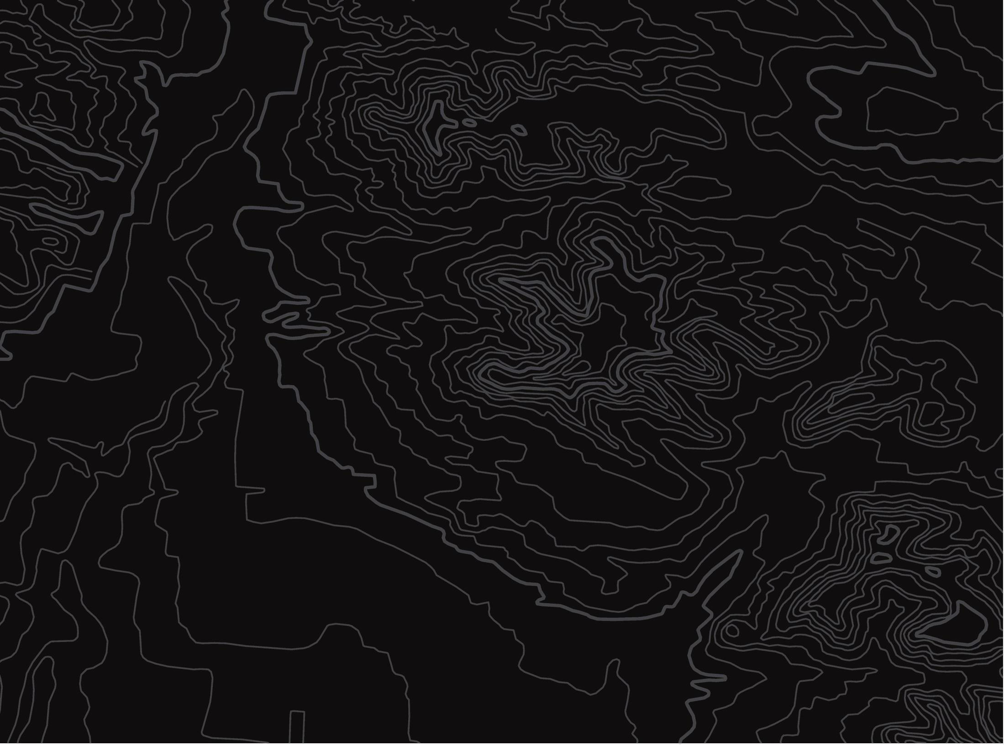
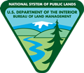
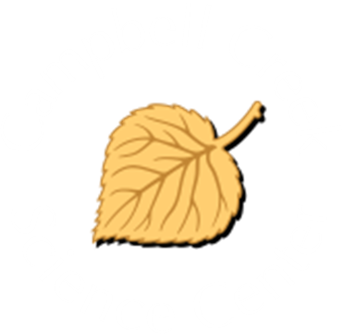
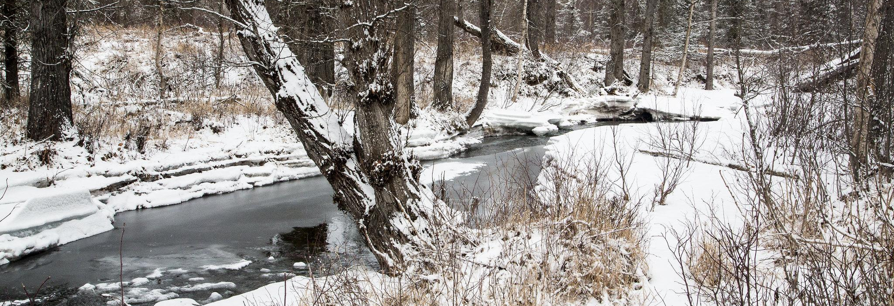
The Campbell Creek Watershed
U.S. Department of the Interior
Bureau of Land Management
Take a virtual watershed tour
Module 1, Lesson 4
Bob Wick, BLM

Slide 2
Lesson 4: The Campbell Creek Watershed
Lesson Questions:
U.S. Department of the Interior
Bureau of Land Management
What are the parts of a watershed?
How are the parts of a watershed connected?

Slide 3
Materials:
U.S. Department of the Interior
Bureau of Land Management
science journal or a piece of paper
something to write with

Slide 4
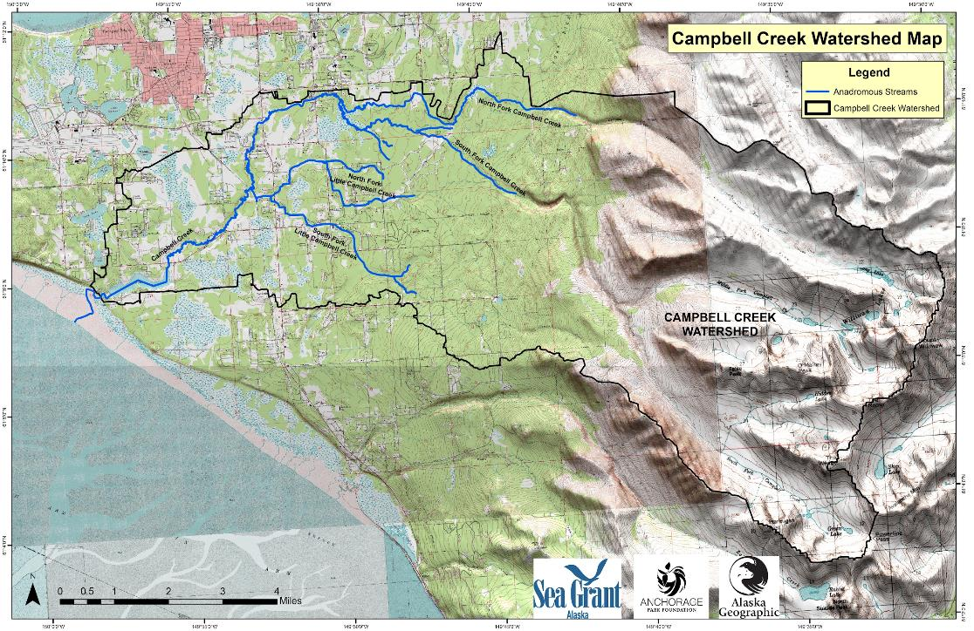
The Campbell Creek Watershed is outlined in black on this map.
The watershed drains 70 square miles of land in Anchorage. Let's take a tour of this watershed!
U.S. Department of the Interior
Bureau of Land Management
© Anchorage Park Foundation

Slide 5
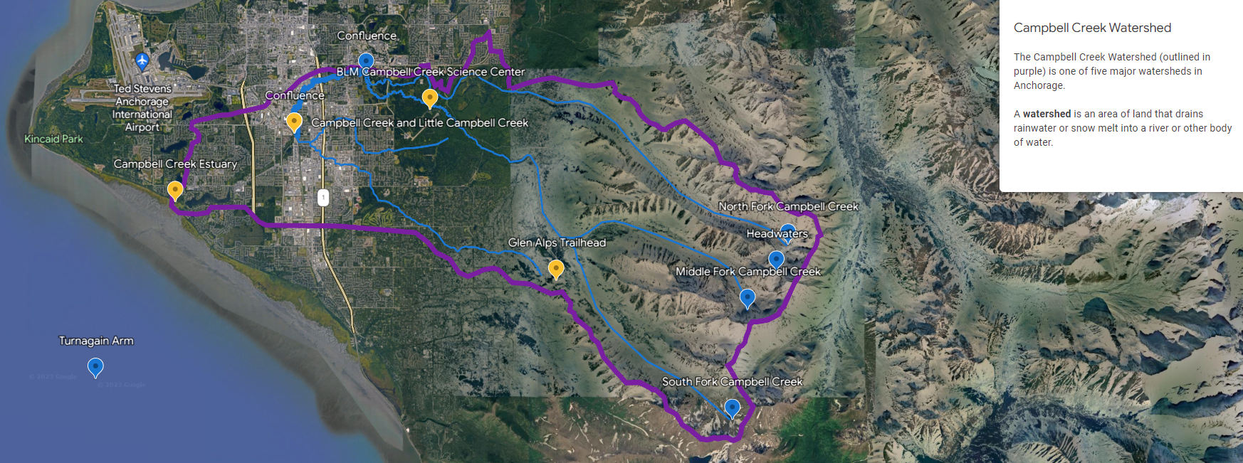
U.S. Department of the Interior
Bureau of Land Management
Campbell Creek Watershed
The Campbell Creek Watershed (outlined in purple) is one of five major watersheds in Anchorage.
A watershed is an area of land that drains rainwater or snow melt into a river or other body of water.
Map data: Airbus IBCAO Maxar Technologies CNES/Airbus © 2023

Slide 6
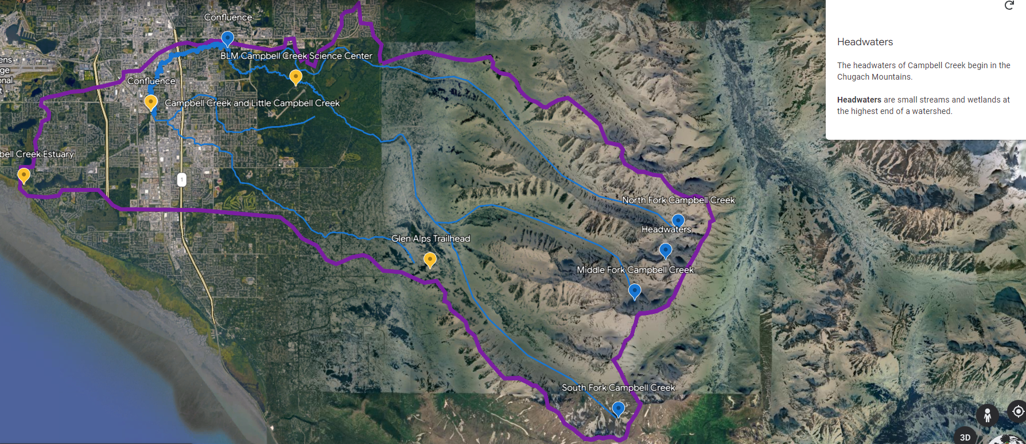
U.S. Department of the Interior
Bureau of Land Management
Headwaters
The headwaters of Campbell Creek begin in the Chugach Mountains.
Headwaters are small streams and wetlands at the highest end of a watershed.
Map Data: Airbus IBCAO Maxar Technologies CNES/Airbus Landsat/Copernicus © 2023

Slide 7
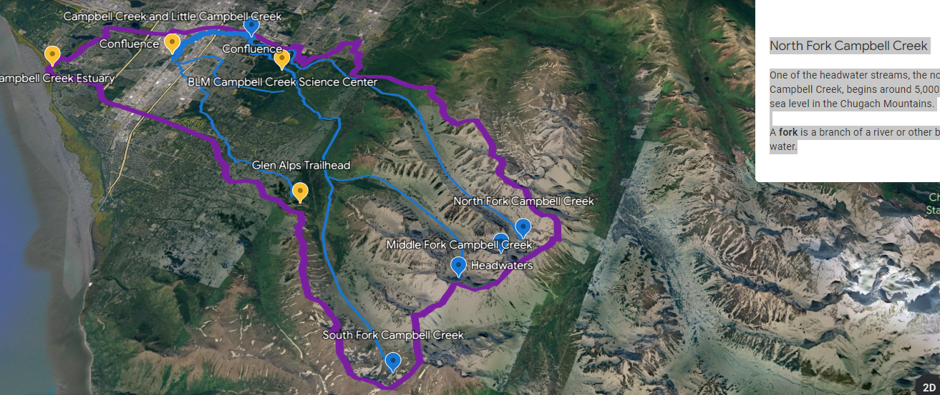
U.S. Department of the Interior
Bureau of Land Management
North Fork Campbell Creek
One of the headwater streams, the north fork of Campbell Creek, begins around 5,000 feet above sea level in the Chugach Mountains.
A fork is a branch of a river or other body of water.
Map Data: Google Maxar Technologies Airbus IBCAO CNES/Airbus Terrametrics

Slide 8
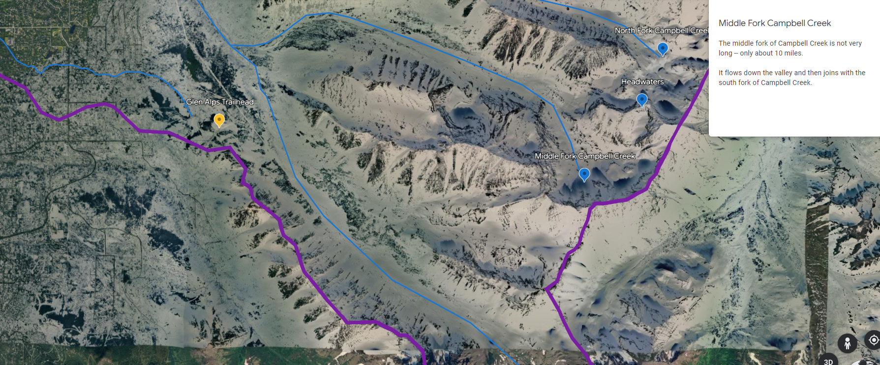
U.S. Department of the Interior
Bureau of Land Management
Middle Fork Campbell Creek
The middle fork of Campbell Creek is not very long -- only about 10 miles.
It flows down the valley and then joins with the south fork of Campbell Creek.
Map Data: Airbus Maxar Technologies © 2023

Slide 9
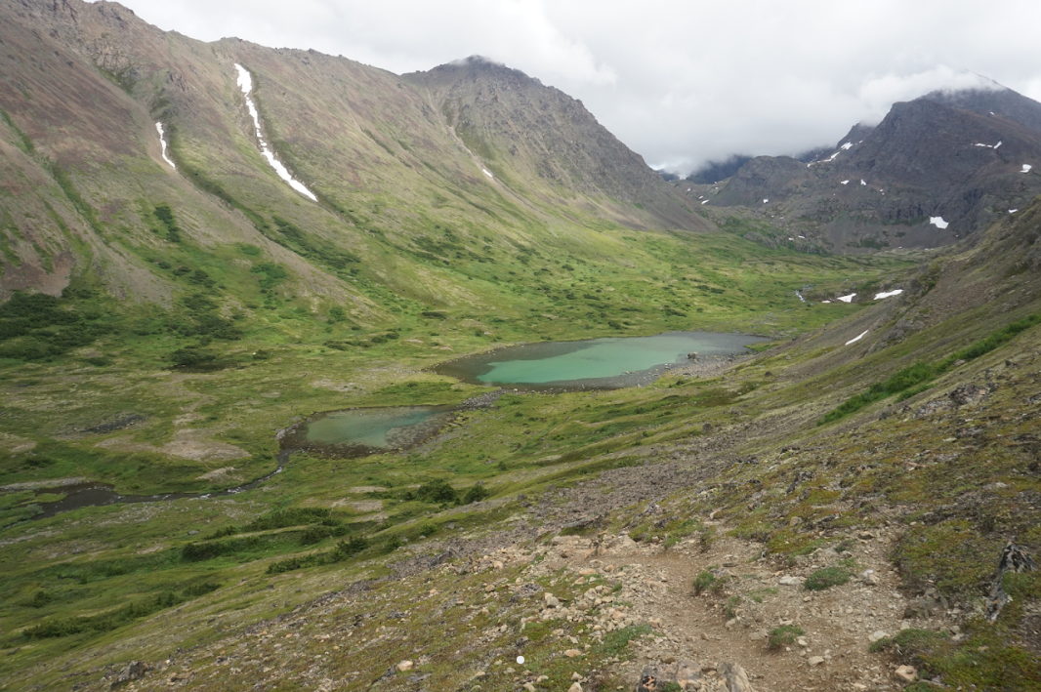
U.S. Department of the Interior
Bureau of Land Management
Middle Fork Campbell Creek
There are several lakes at the headwaters of the middle fork of Campbell Creek.
Water flowing down from the mountains collects in lower parts of the landscape, forming lakes.
Water in the lakes eventually flows downhill toward the city.
Water often collects in lower parts of the landscape forming lakes.
Photo by B. Janson, BLM.

Slide 10
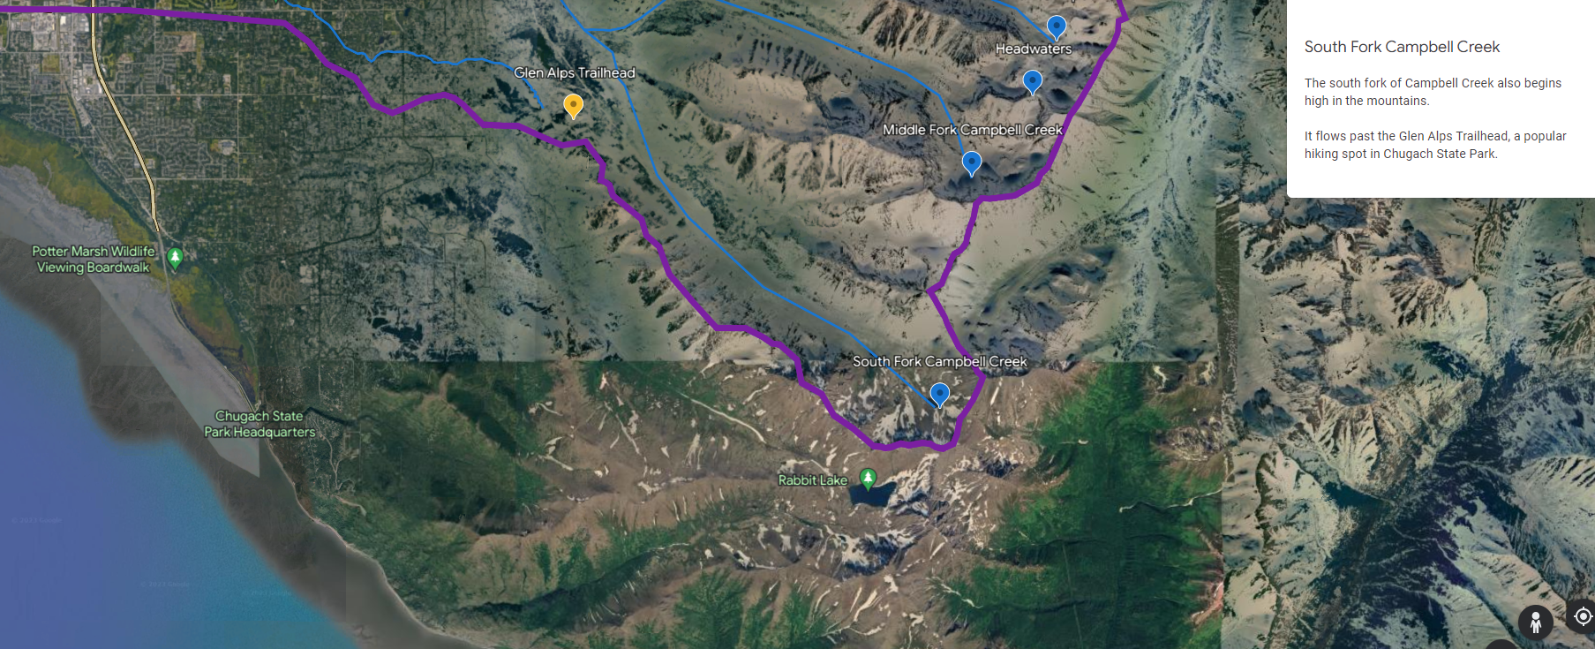
U.S. Department of the Interior
Bureau of Land Management
South Fork Campbell Creek
The south fork of Campbell Creek also begins high in the mountains.
It flows past the Glen Alps Trailhead, a popular hiking spot in Chugach State Park...
Map Data: Maxar Technologies Airbus IBCAO CNES/Airbus TerraMetrics © 2023

Slide 11
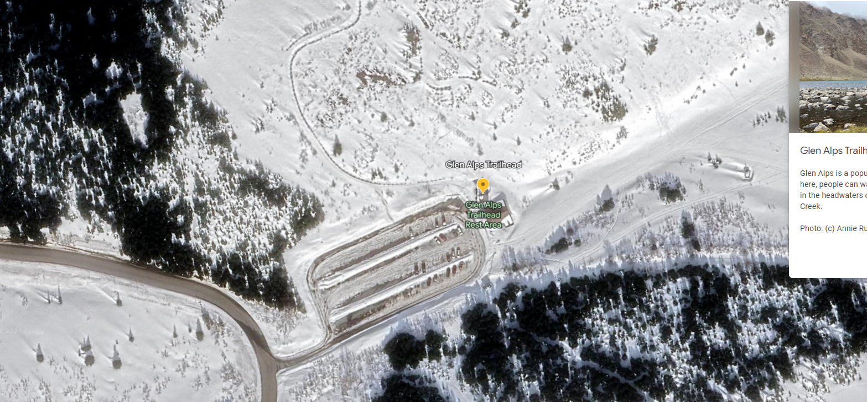
U.S. Department of the Interior
Bureau of Land Management
Glen Alps Trailhead
Glen Alps is a popular hiking trailhead. From here, people can walk up to the lakes and creeks in the headwaters of the South Fork of Campbell Creek.
Map Data: Airbus © 2023

Slide 12
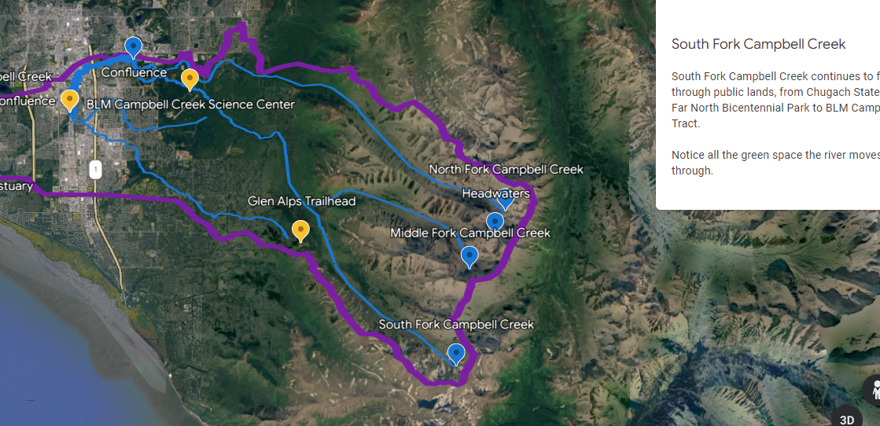
U.S. Department of the Interior
Bureau of Land Management
South Fork Campbell Creek
South Fork Campbell Creek continues to flow through public lands, from Chugach State Park to Far North Bicentennial Park to BLM Campbell Tract.
Notice all the green space the river moves through.
Map Data: IBCAO Airbus Maxar Technologies CNES/Airbus © 2023

Slide 13
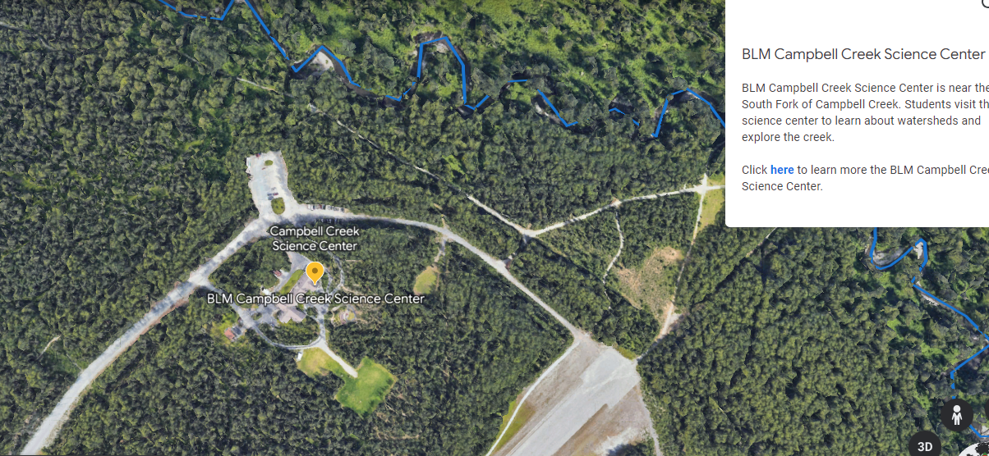
U.S. Department of the Interior
Bureau of Land Management
BLM Campbell Creek Science Center
BLM Campbell Creek Science Center is near the South Fork of Campbell Creek. Students visit the science center to learn about watersheds and explore the creek.
Learn more about the BLM Campbell Creek Science Center.
Map Data: Google © 2014

Slide 14
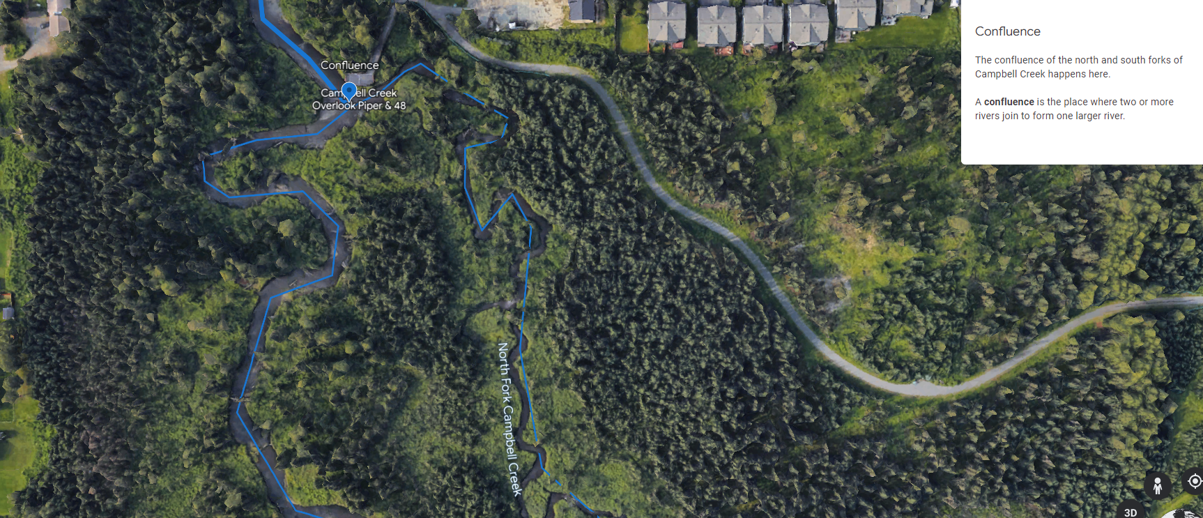
U.S. Department of the Interior
Bureau of Land Management
Confluence
The confluence of the north and south forks of Campbell Creek happens here.
A confluence is the place where two or more rivers join to form one larger river.
Map Data: Google © 2014

Slide 15
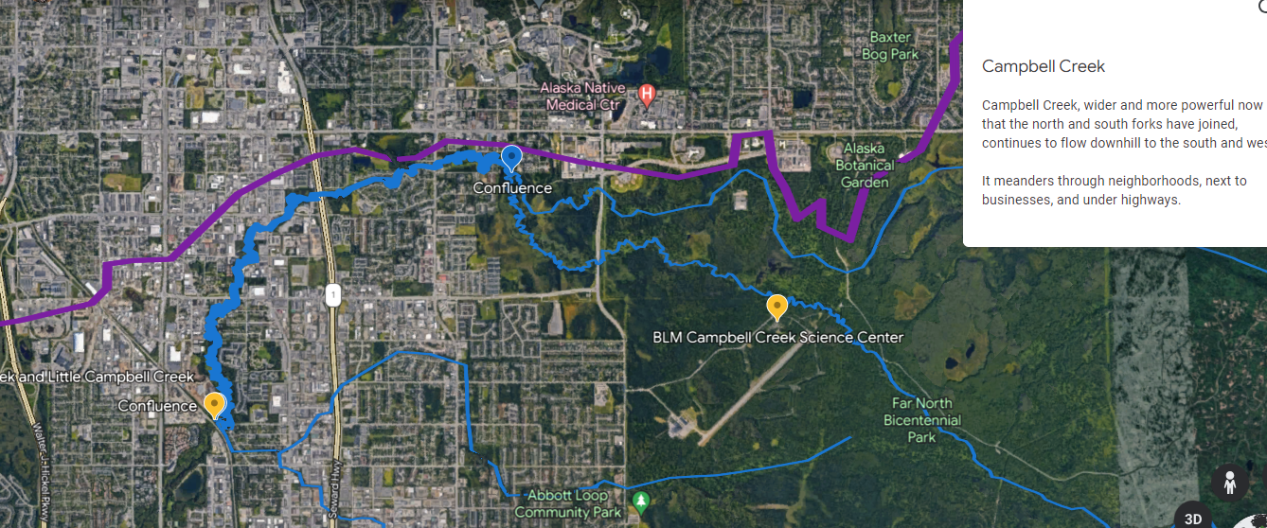
U.S. Department of the Interior
Bureau of Land Management
Campbell Creek, wider and more powerful now that the north and south forks have joined, continues to flow downhill to the south and west.
It meanders through neighborhoods, next to businesses, and under highways.
Map Data: Airbus © 2014

Slide 16
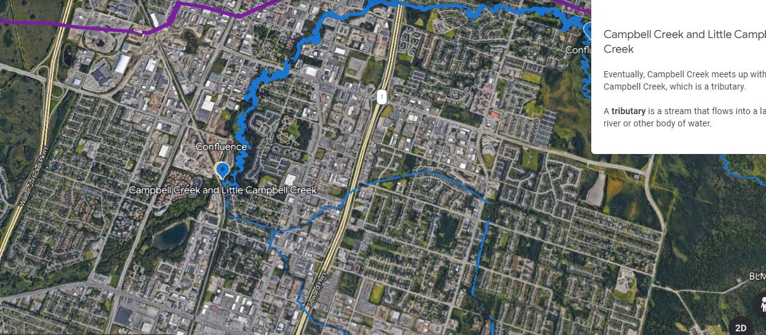
U.S. Department of the Interior
Bureau of Land Management
Campbell Creek and Little Campbell Creek
Eventually, Campbell Creek meets up with Little Campbell Creek, which is a tributary.
A tributary is a stream that flows into a larger river or other body of water.
Map Data: Google © 2014

Slide 17
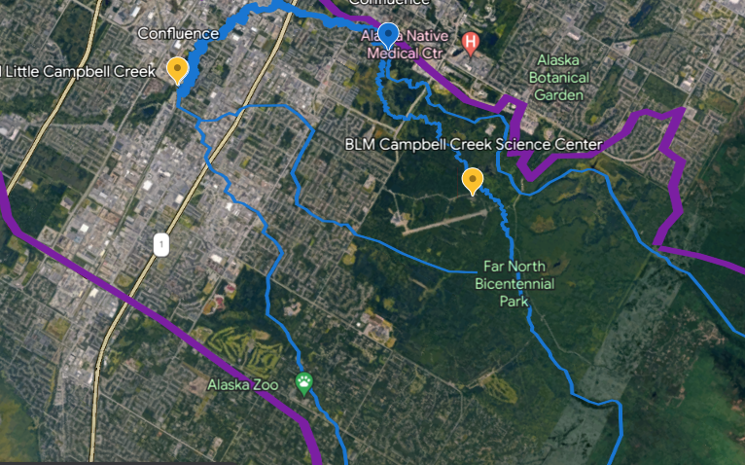
U.S. Department of the Interior
Bureau of Land Management
Little Campbell Creek
The north and south forks of Little Campbell Creek also begin in the Chugach Mountains.
Little Campbell Creek flows downhill until it joins with the larger Campbell Creek near Taku Lake Park.
Map Data: Airbus IBCAO Maxar Technologies © 2023

Slide 18
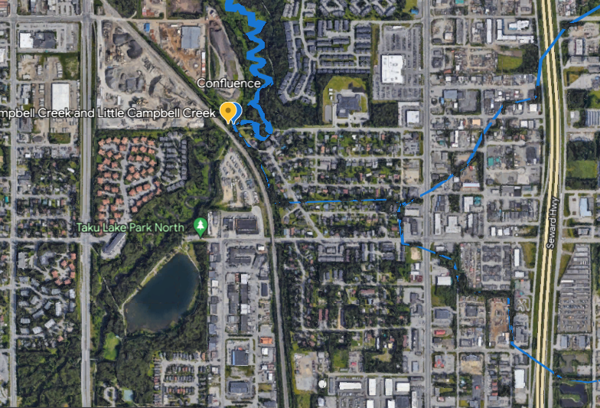
U.S. Department of the Interior
Bureau of Land Management
Confluence
Campbell Creek and Little Campbell Creek join at this confluence and continue flowing out away from the mountains.
Map Data: Google © 2014

Slide 19
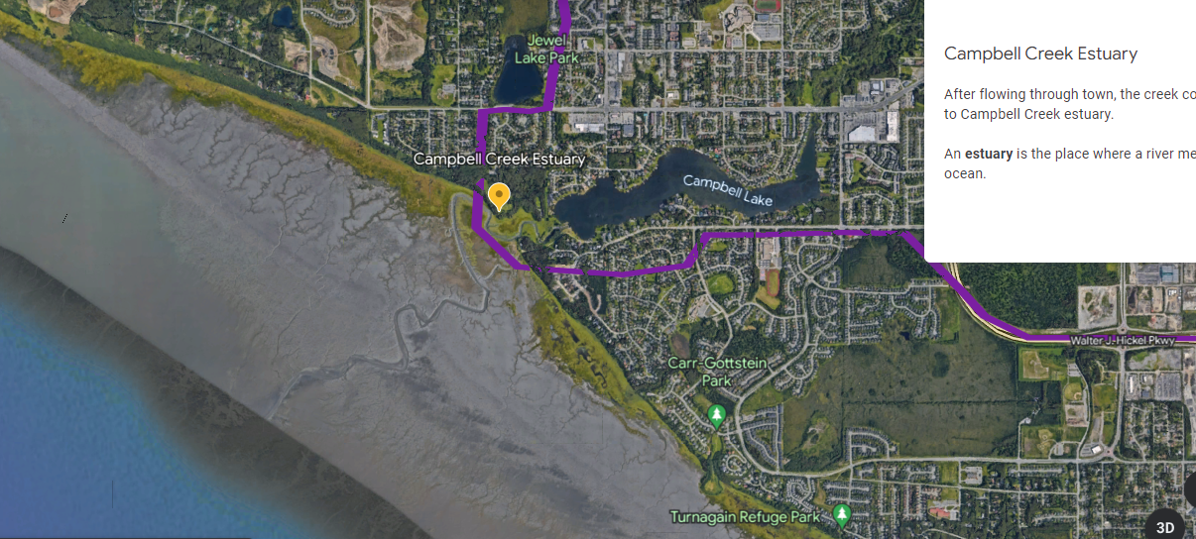
U.S. Department of the Interior
Bureau of Land Management
Campbell Creek Estuary
After flowing through town, the creek continues to Campbell Creek estuary.
An estuary is the place where a river meets the ocean.
Map Data: IBCAO TerraMetrics © 2023

Slide 20
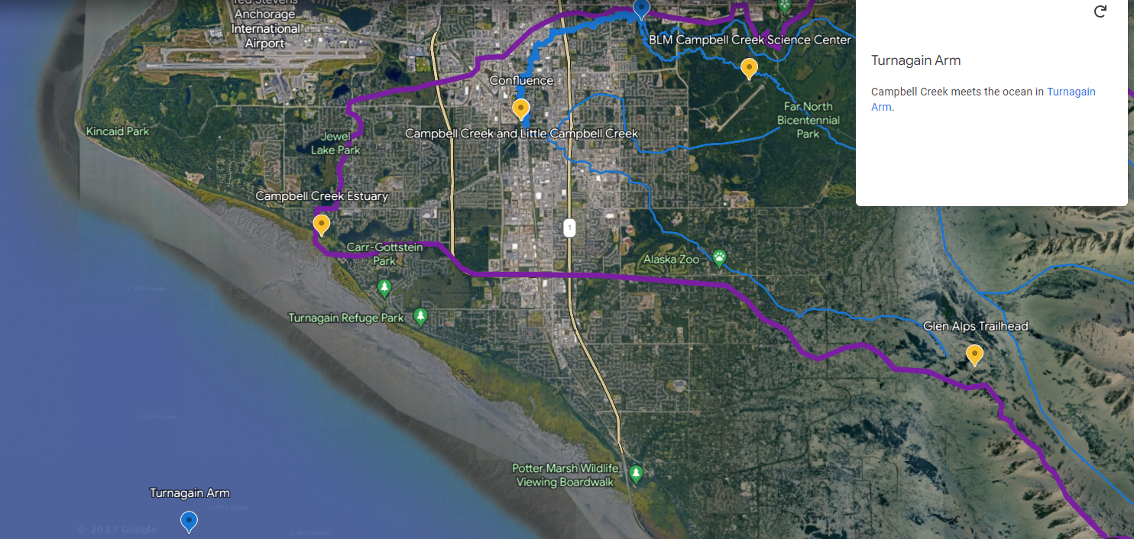
U.S. Department of the Interior
Bureau of Land Management
Turnagain Arm
Campbell Creek meets the ocean in Turnagain Arm.
Map Data: IBCAO Airbus Maxar Technologies © 2023

Slide 21
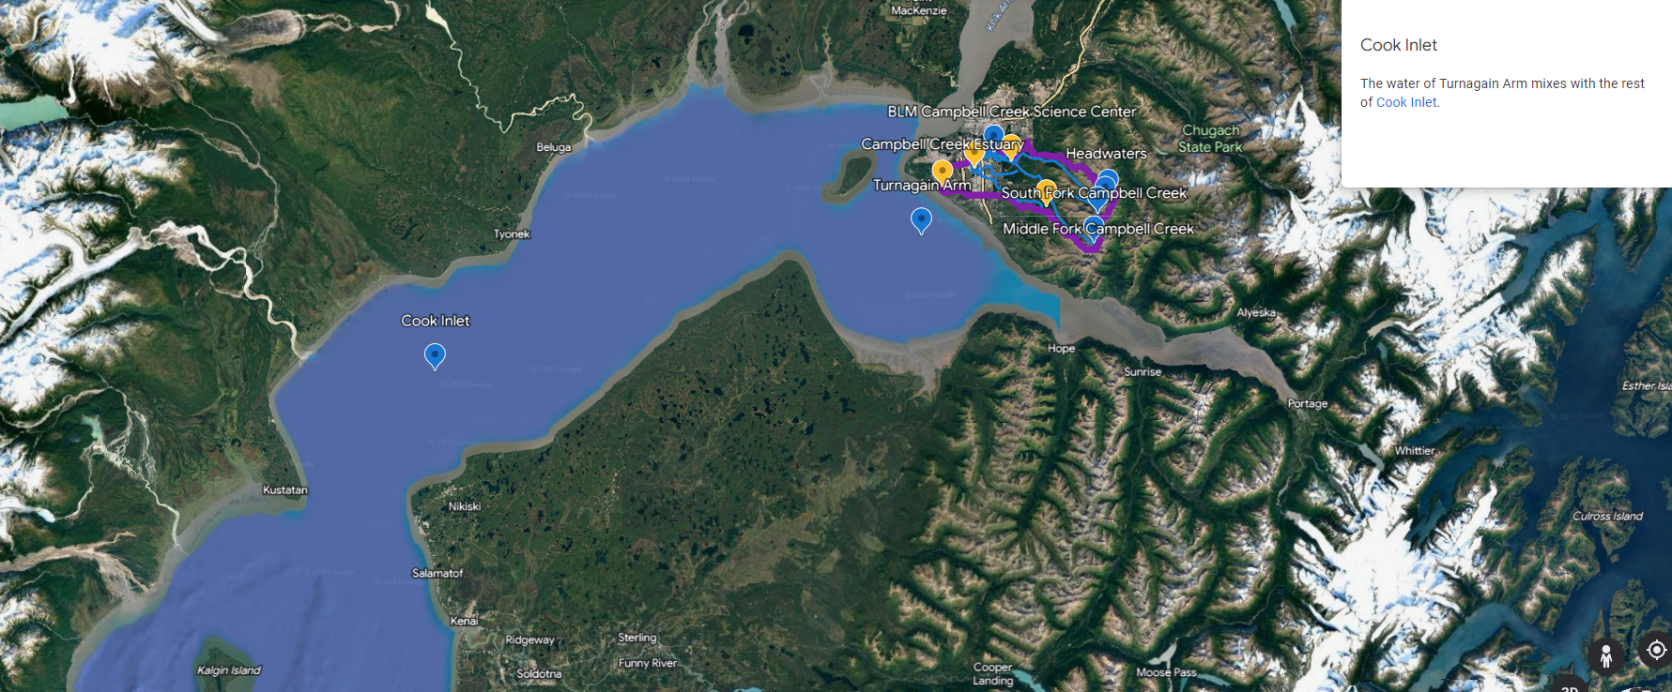
U.S. Department of the Interior
Bureau of Land Management
Cook Inlet
The water of Turnagain Arm mixes with the rest of Cook Inlet.
Map data: Google Landsat/Copernicus data SIO, NOAA, US Navy, NGA, GEBCO IBCAO

Slide 22
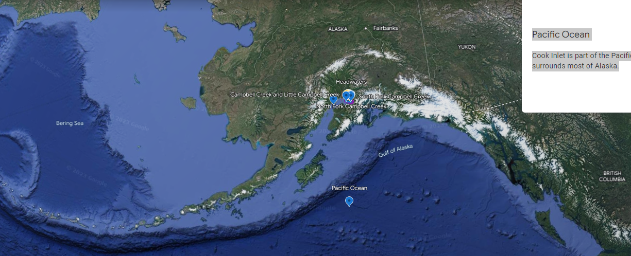
U.S. Department of the Interior
Bureau of Land Management
Pacific Ocean
Cook Inlet is part of the Pacific Ocean, which surrounds most of Alaska.
Map Data: Google Landsat/ Copernicus Data SIO, NOAA US Navy, NGA, GEBCO IBCOA INEGI Data LDEO-Columbia NSF, NOAA

Slide 23
Extension Activity:
U.S. Department of the Interior
Bureau of Land Management
People are connected to watersheds and give them meaningful place names.
The Dena’ina Athabascan name for Campbell Creek is Qin Cheghitnu (Kin-shag-hit-new), which means “Crying Ridge Creek.”
Explore more Dena’ina history and other interesting facts about the watershed on the Municipality of Anchorage Virtual Campbell Creek Interpretive Trail.

