Slide 1
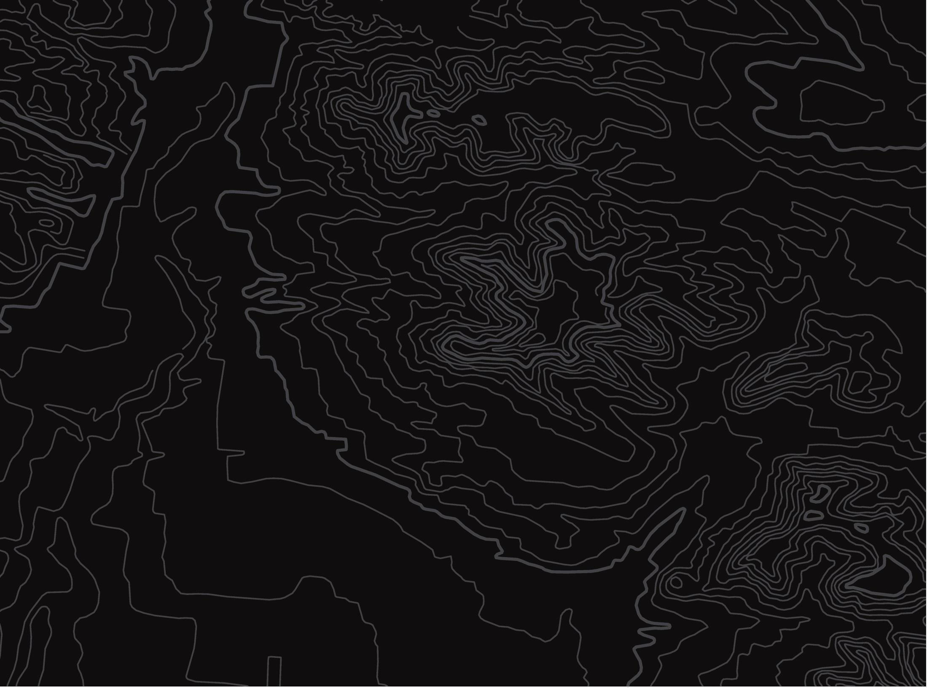


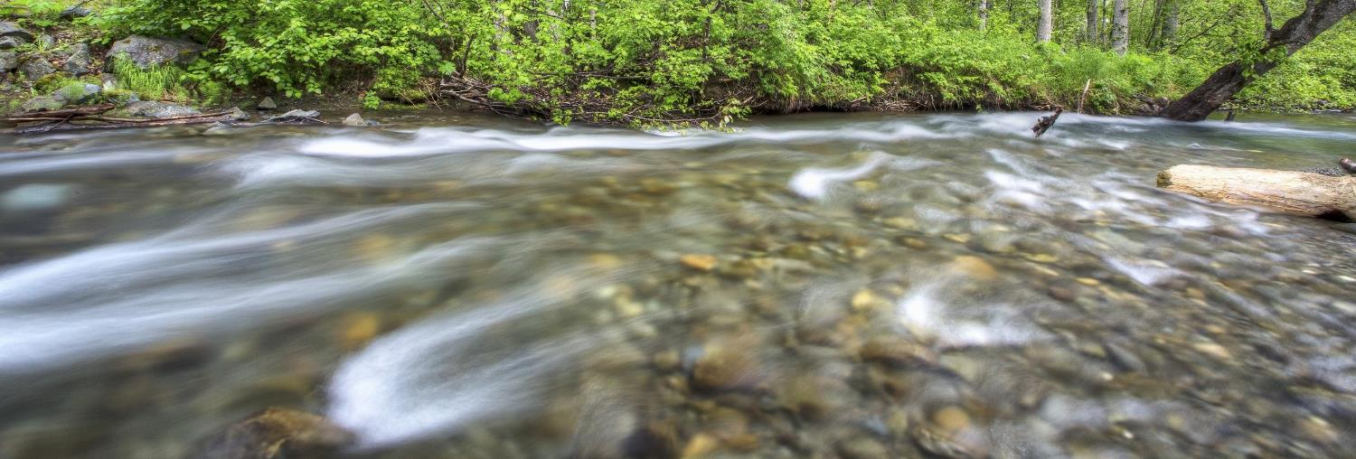
Erosion
U.S. Department of the Interior
Bureau of Land Management
Discover how water shapes the landscape
Module 1, Lesson 3
Bob Wick, BLM

Slide 2
Lesson 3: Erosion
Lesson Questions:
U.S. Department of the Interior
Bureau of Land Management
How do water and sediment move through a watershed?
How does erosion shape the landscape?

Slide 3
Materials:
U.S. Department of the Interior
Bureau of Land Management
science journal or a piece of paper
something to write with

Slide 4
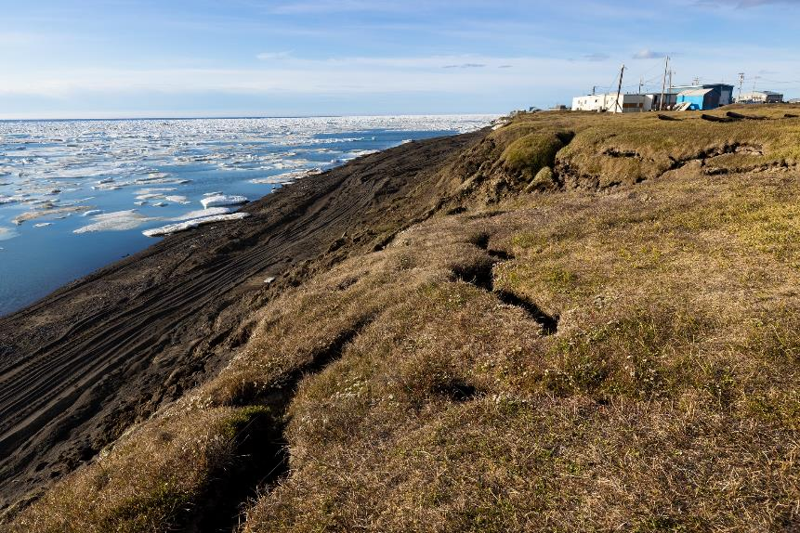
Erosion is the process of rocks and soil being worn away by wind, water, or ice. This lesson focuses on erosion caused by water.
U.S. Department of the Interior
Bureau of Land Management
Wind, water and ice erode the land near a body of water.
Photo by L. Hupp, USFWS.

Slide 5
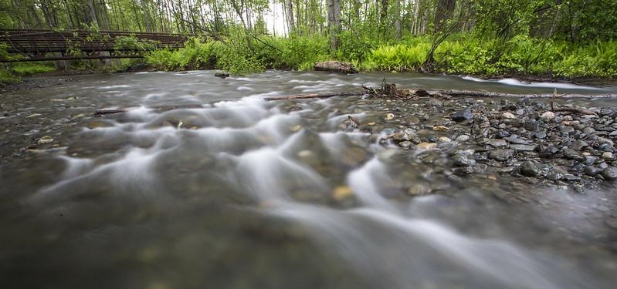
Water erosion carries sediment, pieces of solid material such as rocks and soil, down through the watershed. Creeks, streams, and rivers move water and sediment from the mountains to the ocean.
U.S. Department of the Interior
Bureau of Land Management
Fast moving water rushes over pebbles in Campbell Creek.
Photo by B. Wick, BLM.

Slide 6
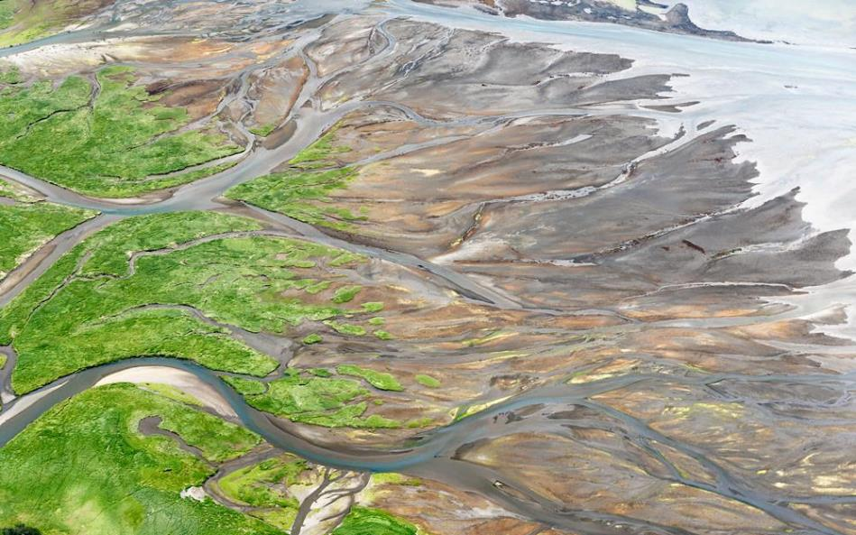
Some mudflats, like those surrounding Anchorage, are created by erosion. Rivers carry sediment down from glaciers and deposit it where they meet the ocean.
U.S. Department of the Interior
Bureau of Land Management
An aerial view of mudflats. Photo by J. Jones, USFWS.

Slide 7
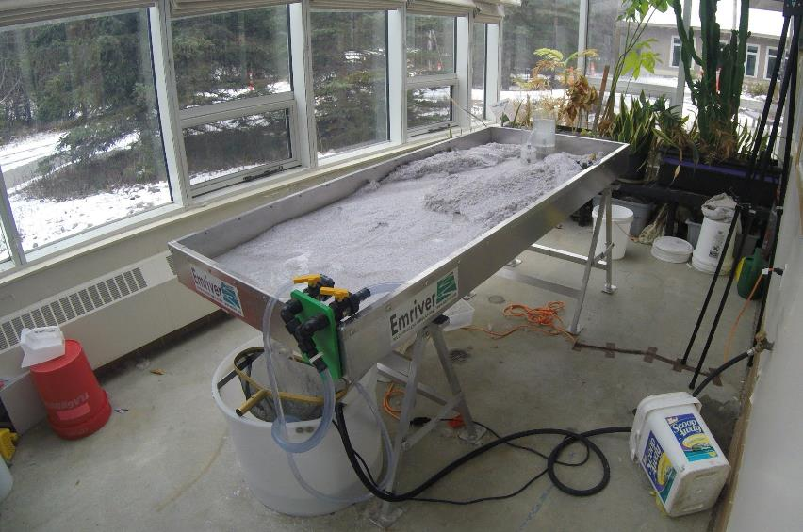
This is a stream table. Scientists use stream tables to model how water shapes the land.
U.S. Department of the Interior
Bureau of Land Management
Water pours out of here and flows across the table.
This tank is filled with water. A pump in the bucket cycles the water back up to the far end of the table.
The water flows downhill across this fake sediment, which is made from recycled plastic.
A stream table shows how water shapes the land.
Photo by CCCSC staff, BLM.

Slide 8
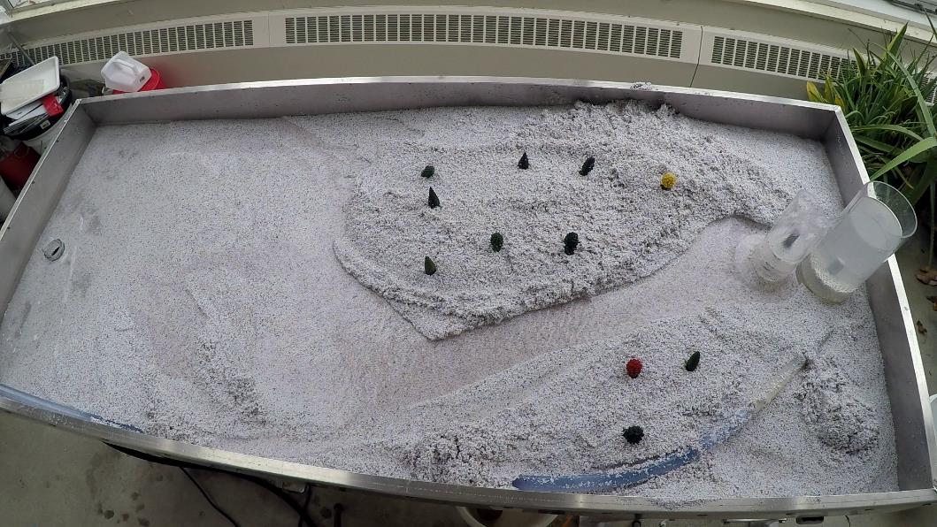
The water that comes out here acts like the headwaters at the highest part of a watershed.
U.S. Department of the Interior
Bureau of Land Management
Eventually, the water collects at the lower end of the table, which represents the ocean.
The water then carves a channel through the sediment, forming a river.
Photo by CCSC staff, BLM.

Slide 9
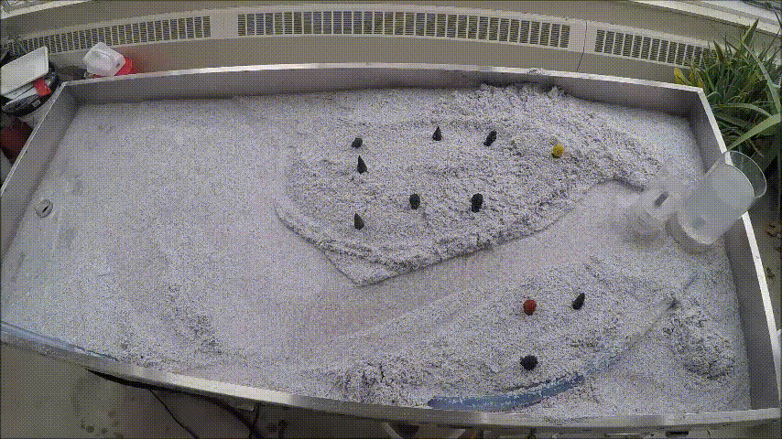
Watch the stream table in action!
What do you notice?
Write down some observations in your science journal or on a piece of paper.
U.S. Department of the Interior
Bureau of Land Management
A video of a stream table shows how water shapes the land.
Video by CCSC staff, BLM.
(For an audio described version of this video, please visit this link)

Slide 10
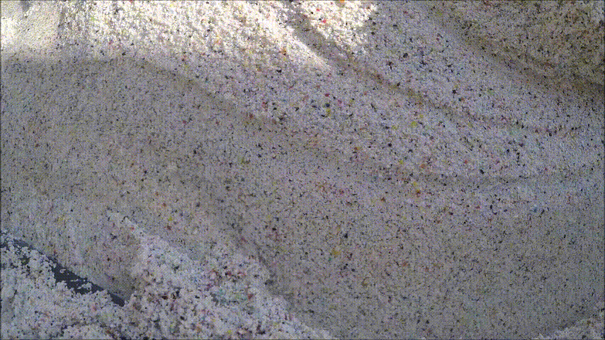
Take a close look at the water moving across the sediment.
As the water flows, it picks up and carries sediment with it. This is erosion.
U.S. Department of the Interior
Bureau of Land Management
A video of a miniature stream shows how water shapes the land.
Video by CCSC staff, BLM.
(For an audio described version of this video, please visit this link)

Slide 11
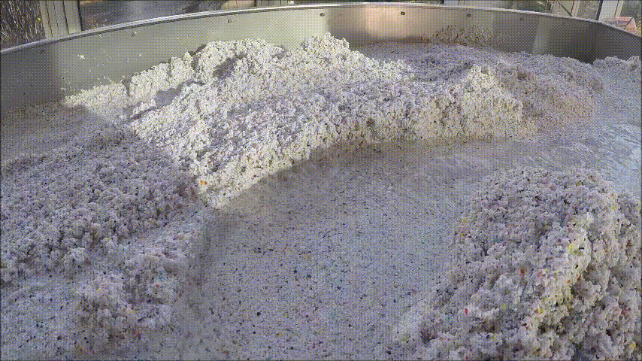
What do you notice happening to the sides of the river in this video?
Do you see parts of the riverbank fall into the water?
The sand that eroded away will be carried downstream by the water.
U.S. Department of the Interior
Bureau of Land Management
A video of a miniature stream shows how water shapes the land.
Video by CCSC staff, BLM.
(For an audio described version of this video, please visit this link)

Slide 12
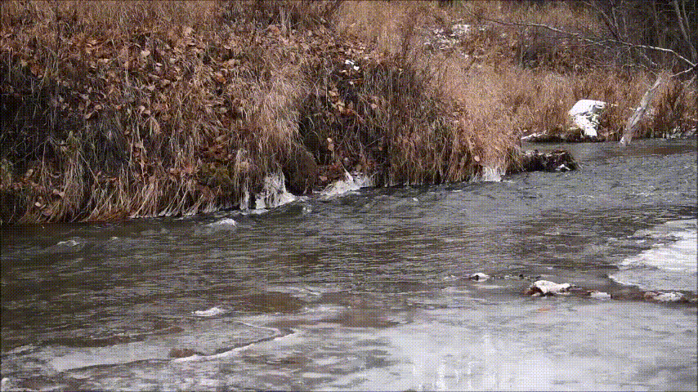
Let’s return to the real-world example of Campbell Creek.
Where is the water moving fastest?
Where is the water moving slowly?
Write down some observations in your science journal or on a piece of paper.
U.S. Department of the Interior
Bureau of Land Management
Campbell Creek
Video by CCSC staff, BLM.
(For an audio described version of this video, please visit this link)

Slide 13
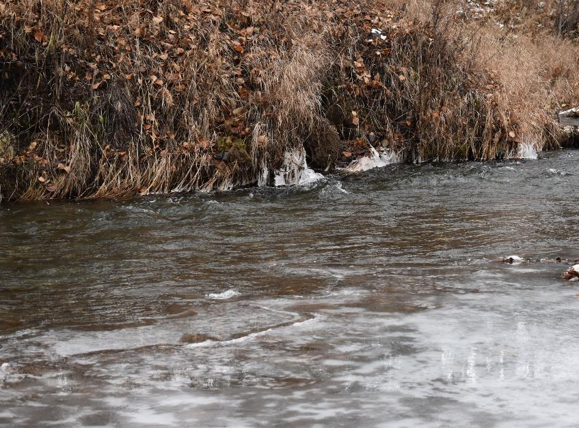
Water moves faster on the outer part of a river.
This fast-moving water erodes riverbanks more quickly and carries the sediment downstream.
U.S. Department of the Interior
Bureau of Land Management
Campbell Creek.
Photo by CCSC staff, BLM.

Slide 14
Water slows on the inner part of the river. Slow-moving water cannot carry as much sediment, so sediment is deposited on the inner bank.
U.S. Department of the Interior
Bureau of Land Management
Campbell Creek.
Photo by CCSC staff, BLM.

Slide 15
Because of this difference in erosion and deposition of sediment caused by different water speeds, the river is constantly changing shape.
U.S. Department of the Interior
Bureau of Land Management
Campbell Creek.
Photo by CCSC staff, BLM.

Slide 16
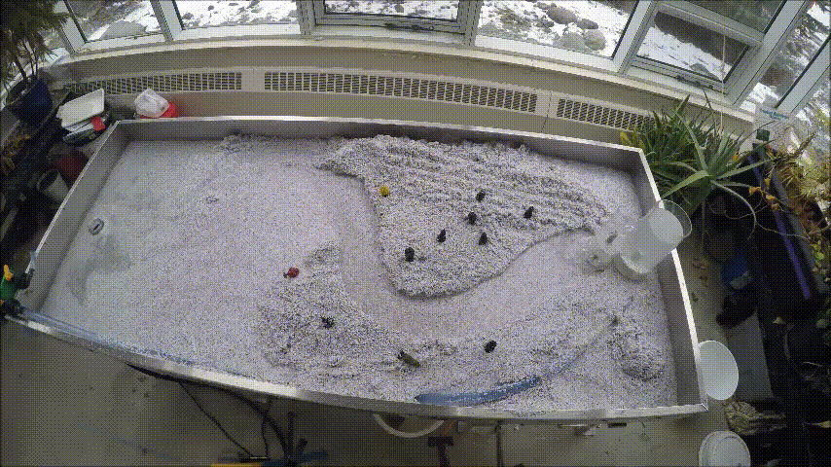
Use this time-lapse video to answer the following questions in your science journal or on a piece of paper.
How does the shape of the river change?
What happens to the trees?
U.S. Department of the Interior
Bureau of Land Management
A video of a stream table shows how water shapes the land.
Video by CCSC staff, BLM.
(For an audio described version of this video, please visit this link)

Slide 17
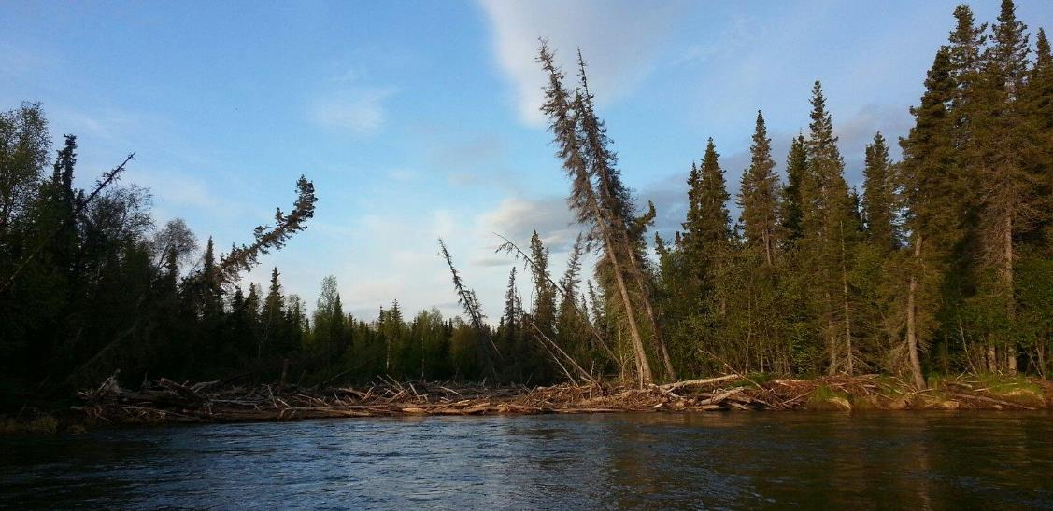
Extension Activity:
U.S. Department of the Interior
Bureau of Land Management
Can you find examples of erosion in rivers or creeks near your home?
Erosion from moving water can impact trees on the water's banks.
Photo by, J. Kowalczyk, BLM.

