Slide 1
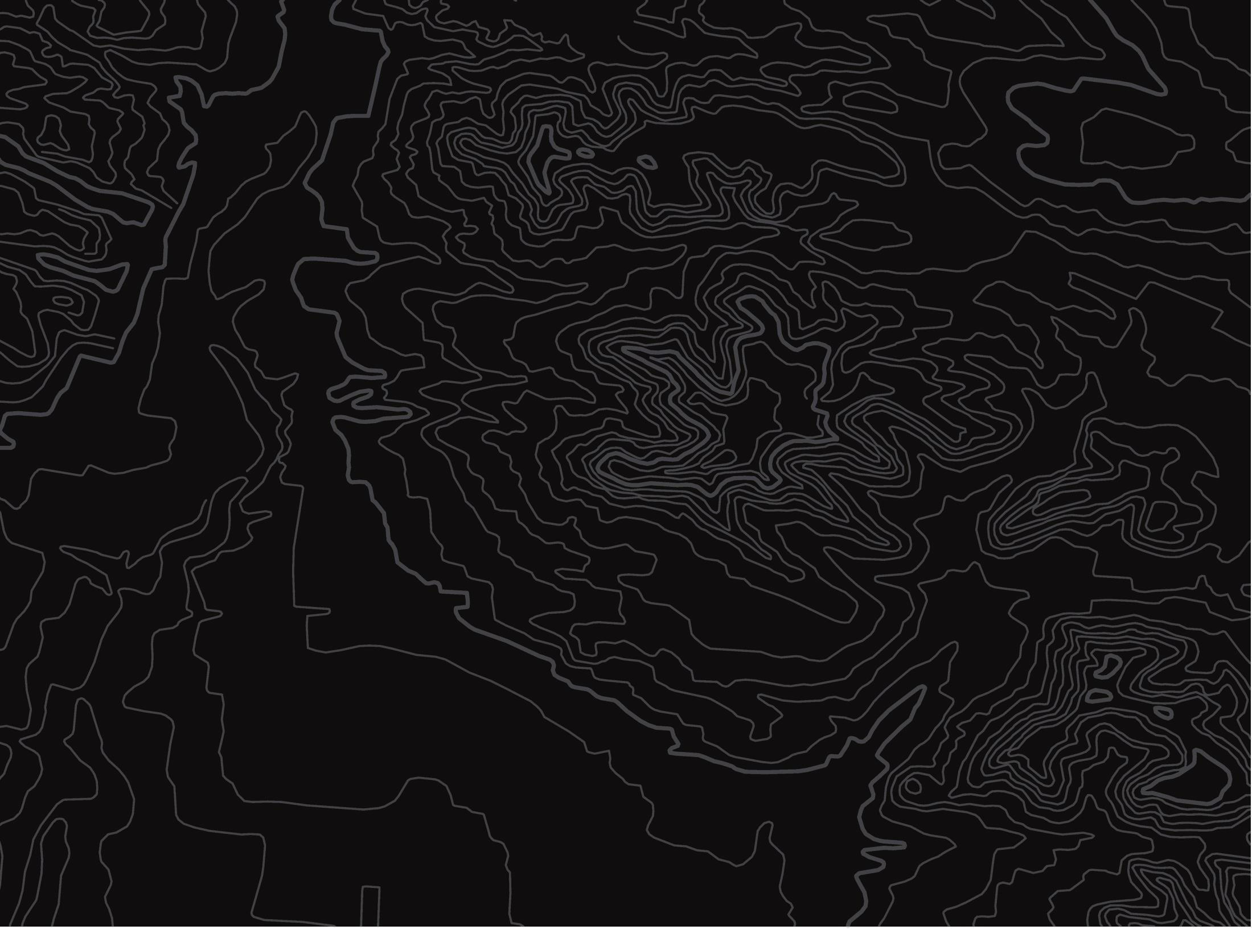
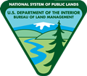
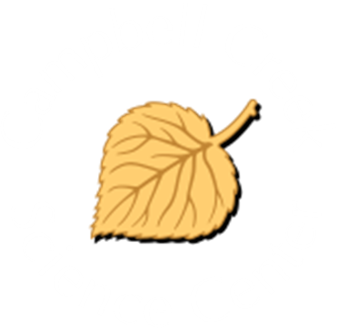
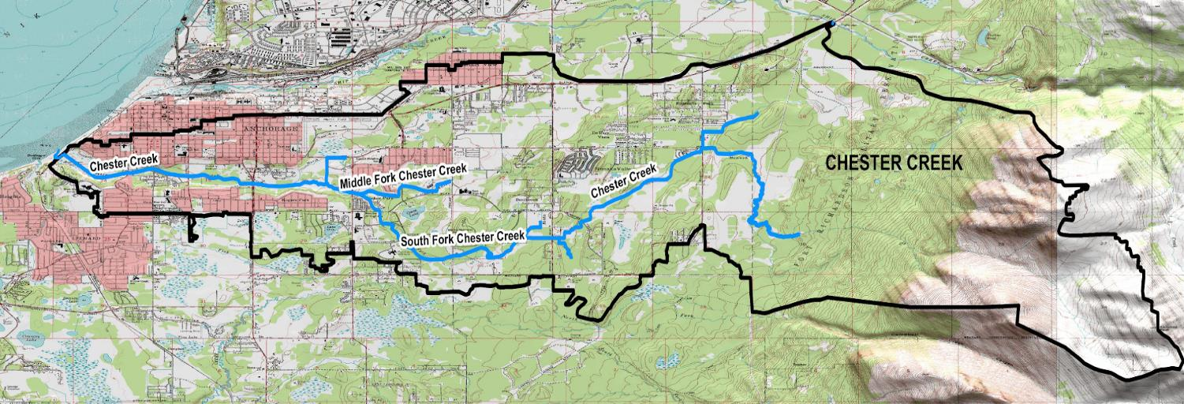
Mapping Watersheds
U.S. Department of the Interior
Bureau of Land Management
Use maps to identify watershed features
Module 1, Lesson 2
© Anchorage Park Foundation

Slide 2
Lesson 2: Mapping Watersheds
Lesson Questions:
U.S. Department of the Interior
Bureau of Land Management
Where do watersheds start, and where do they end?
How can you use maps to identify watershed features?

Slide 3
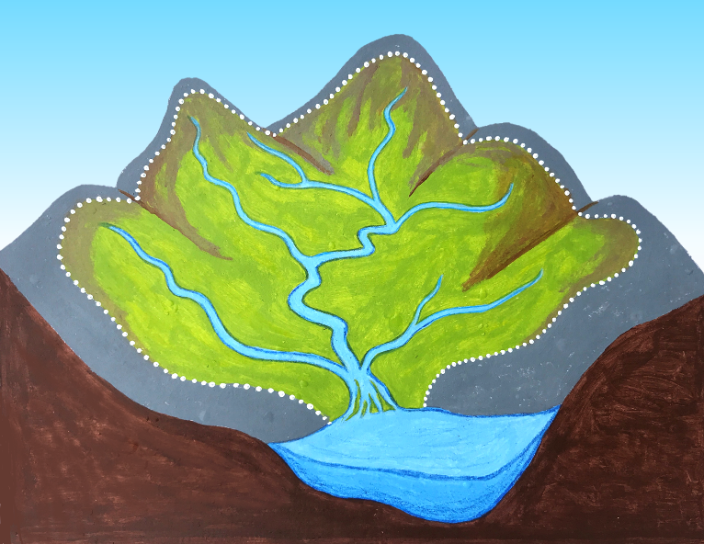
Watersheds start at elevation, such as hills or mountains. Watersheds end where they meet the ocean or a large lake.
U.S. Department of the Interior
Bureau of Land Management
start
end
Graphic by M. Harris, BLM

Slide 4
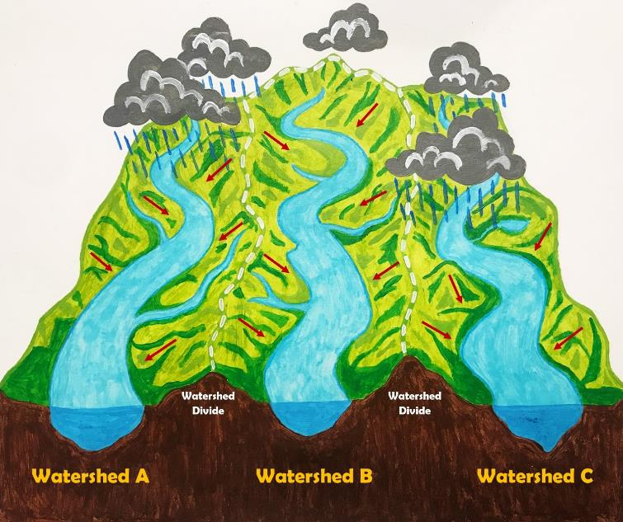
Mountain peaks and ridges often form the boundaries of watersheds.
U.S. Department of the Interior
Bureau of Land Management
Graphic by M. Harris, BLM

Slide 5

Watersheds drain into rivers, streams, and creeks, which are all names for water flowing on the Earth's surface. Rivers are the largest waterways, and creeks are typically the smallest.
U.S. Department of the Interior
Bureau of Land Management
creeks
river
Graphic by M. Harris, BLM

Slide 6
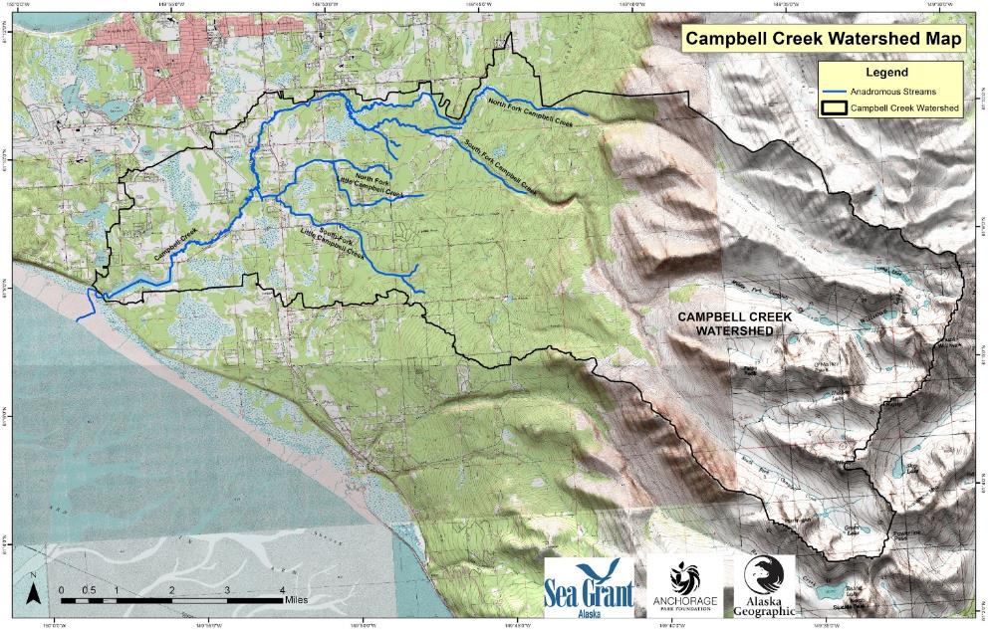
Watersheds are different shapes and sizes.
Here is a map of the Campbell Creek Watershed in Anchorage, Alaska.
It is a relatively small watershed of 70 square miles.
U.S. Department of the Interior
Bureau of Land Management
© Anchorage Park Foundation

Slide 7
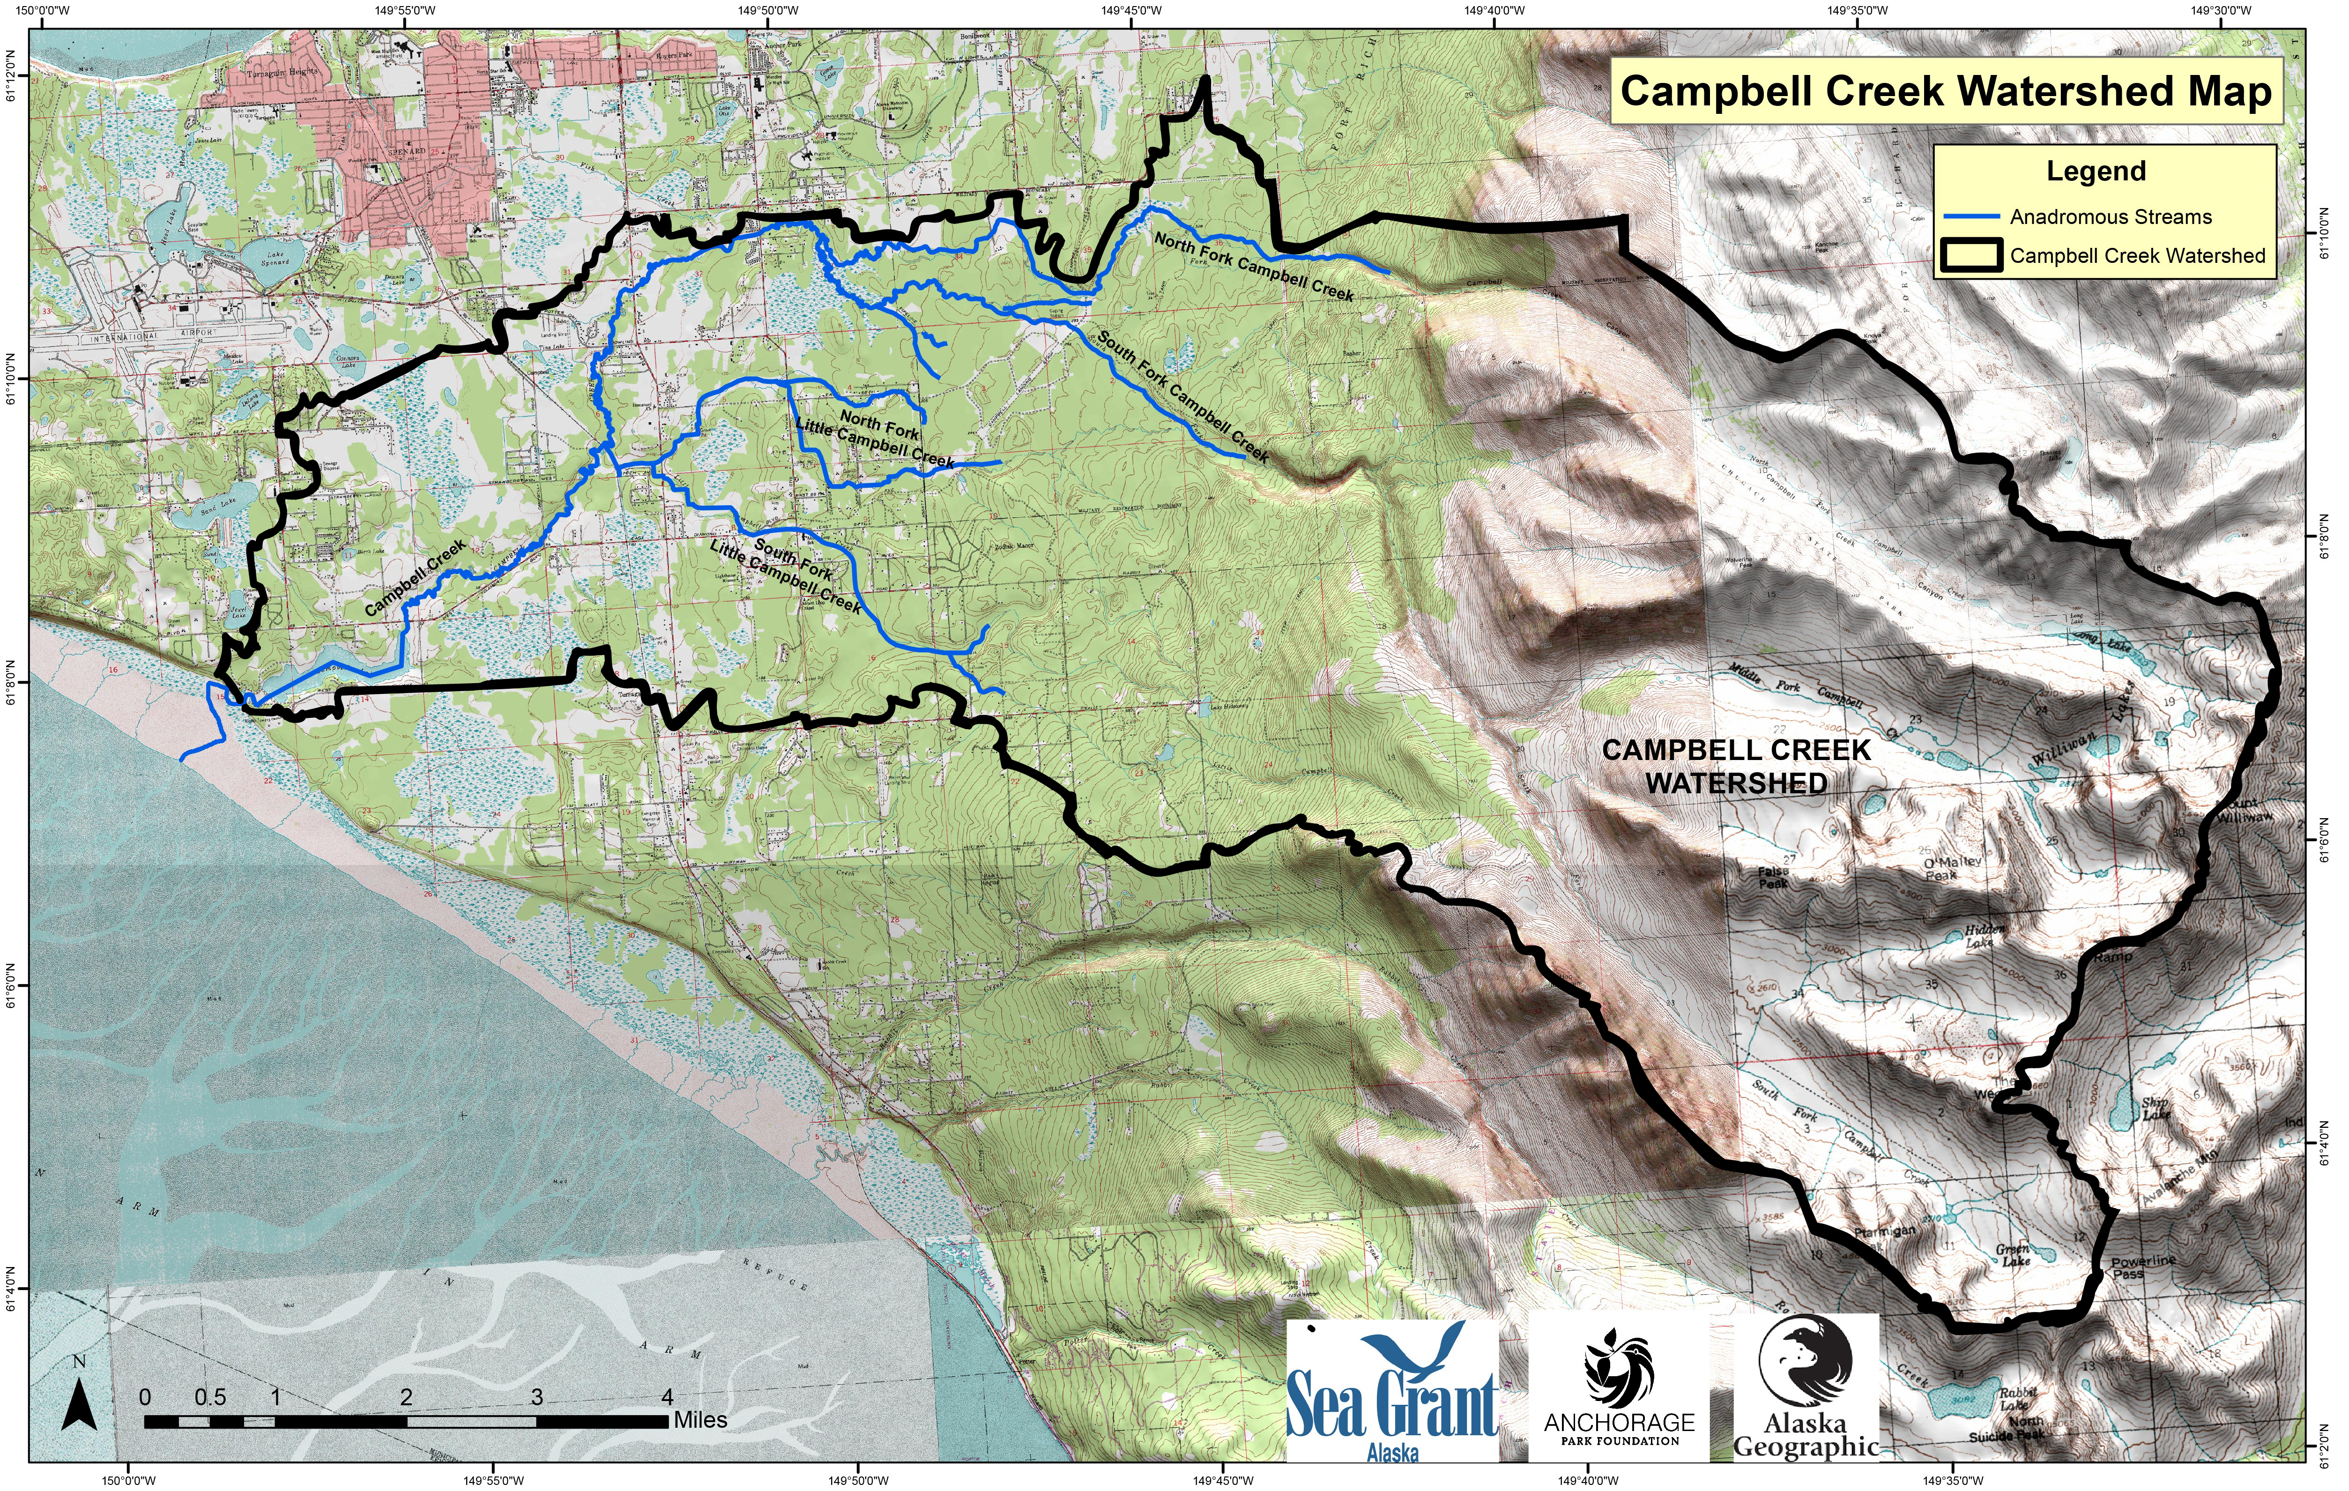
Can you find the black outline on the map?
All the land inside the thick black line is part of the Campbell Creek Watershed. The land drains into Campbell Creek.
U.S. Department of the Interior
Bureau of Land Management
Watershed border
© Anchorage Park Foundation

Slide 8
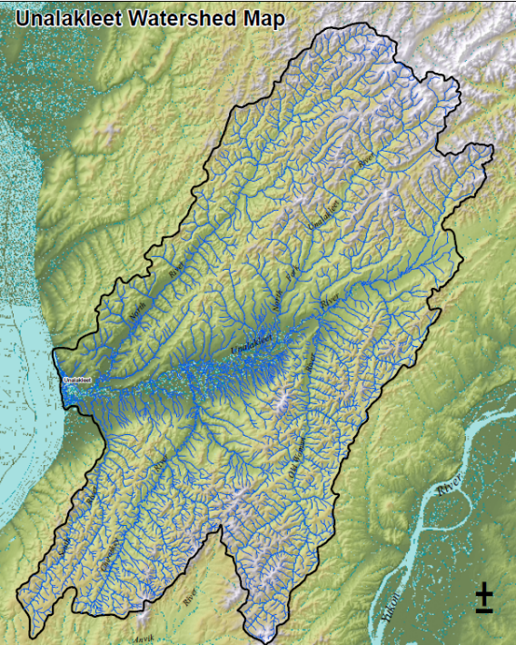
This is a map of the Unalakleet Watershed in Western Alaska.
The land inside the boundary line—more than 1,700 square miles—drains into the Unalakleet River.
The Unalakleet Watershed starts in the Nulato Hills and ends where it meets the Pacific Ocean in Norton Sound.
U.S. Department of the Interior
Bureau of Land Management
BLM

Slide 9
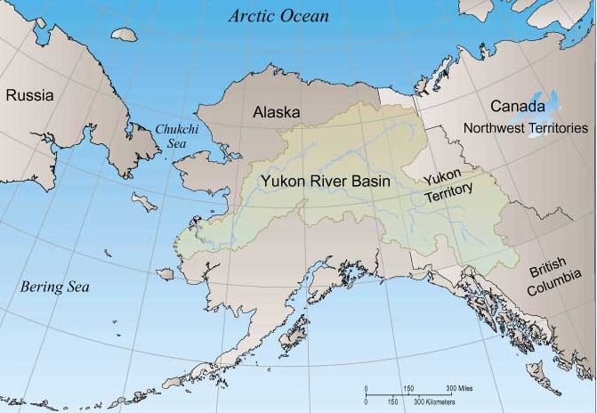
This map shows the huge Yukon River Watershed. It is made up of many smaller watersheds.
It starts in Canada and goes through Alaska.
All 330,000 square miles of the watershed drain into the Yukon River.
U.S. Department of the Interior
Bureau of Land Management
Yukon River Watershed
Graphic by USGS

Slide 10
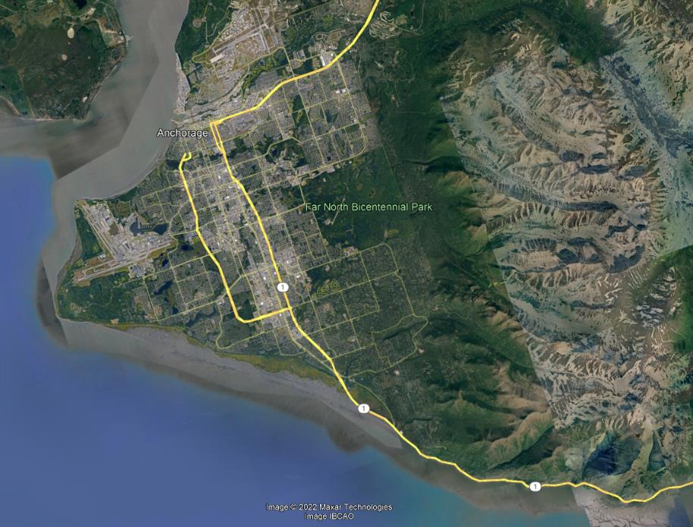
Maps can help you identify watershed features.
Let’s practice finding features on a map of Anchorage. Can you locate each of these features?
• mountains
• ocean
• lakes
U.S. Department of the Interior
Bureau of Land Management

Slide 11
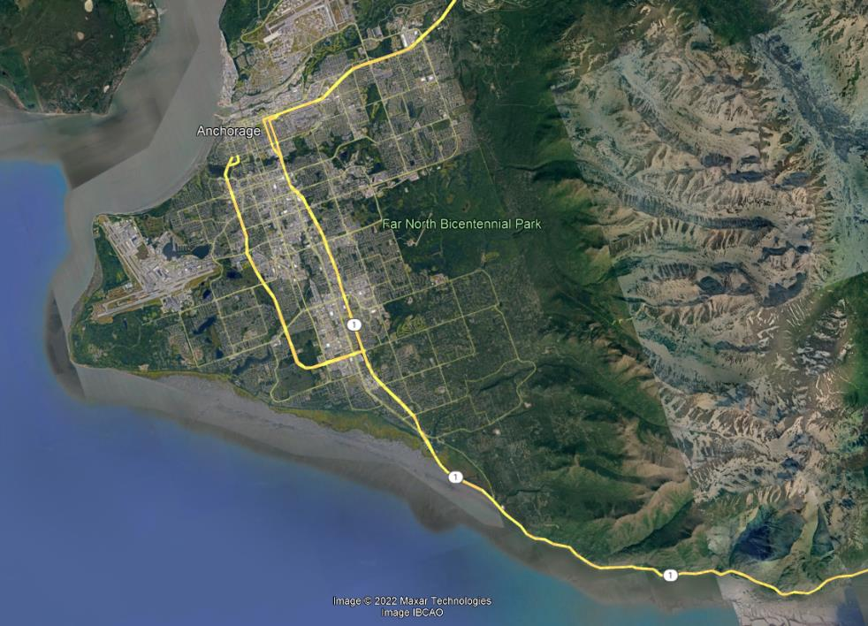
mountains
U.S. Department of the Interior
Bureau of Land Management

Slide 12
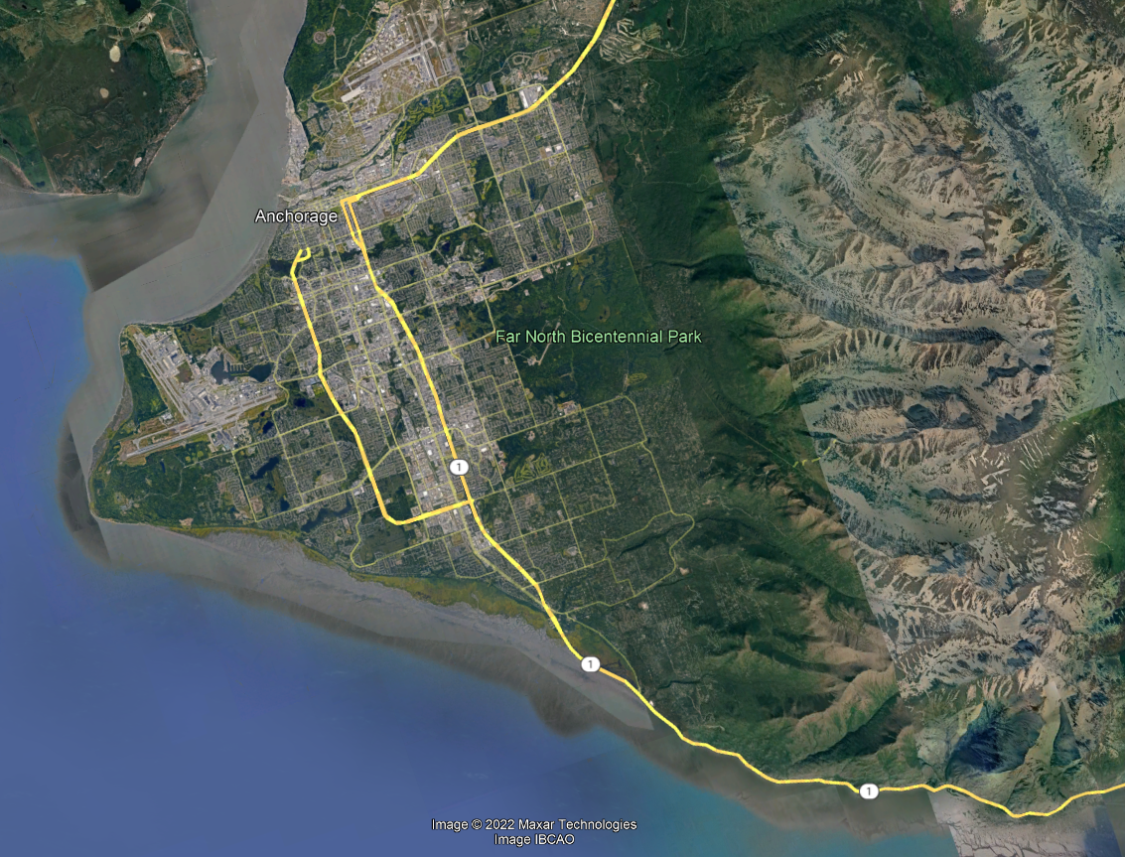
ocean
U.S. Department of the Interior
Bureau of Land Management
Notes:
Needs blue squiggle - see next slide for reference

Slide 13
lakes
U.S. Department of the Interior
Bureau of Land Management

Slide 14
Now that you know what features look like on this map, you can locate watersheds.
The next slide takes you on a trip to the start of a watershed.
U.S. Department of the Interior
Bureau of Land Management

Slide 15
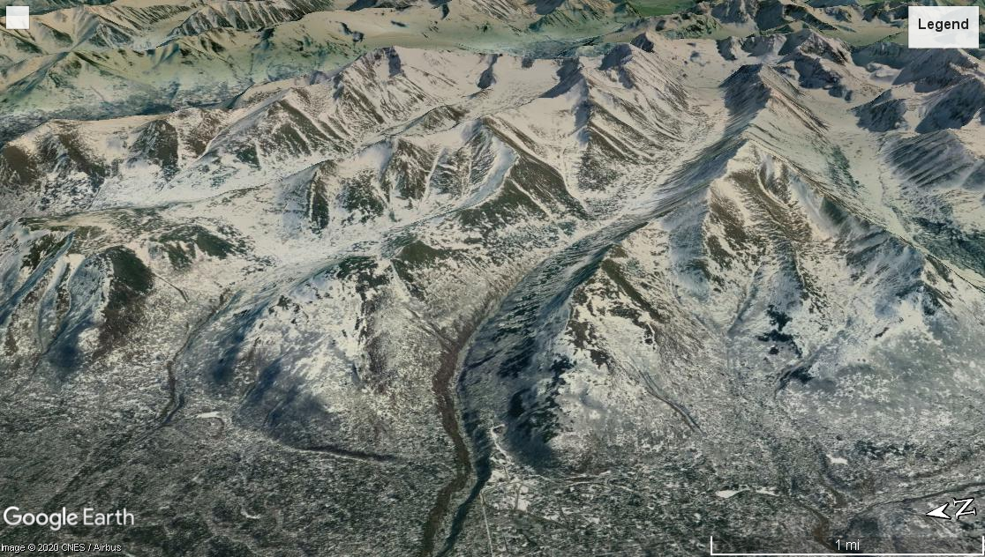
This area of a watershed is called the headwaters because it is the start, or “head,” of the creek the land drains into.
Make a prediction: Where do you think the creek is on this map?
U.S. Department of the Interior
Bureau of Land Management
Map Data: Google, CNES, Airbus © 2020

Slide 16
The creek runs through the valley, the low part of land between the mountains.
What other valleys do you notice on this map?
U.S. Department of the Interior
Bureau of Land Management
Map Data: Google, CNES, Airbus © 2020

Slide 17
Ridges run along the high points of mountains.
Ridges form the boundaries of watersheds.
What other ridges do you notice on this map?
U.S. Department of the Interior
Bureau of Land Management
Map Data: Google, CNES, Airbus © 2020

Slide 18
Make a prediction:
If it started to rain in the mountains, where would the water go?
U.S. Department of the Interior
Bureau of Land Management
Map Data: Google, CNES, Airbus © 2020

Slide 19
When it rains, water flows down the mountains and drains into the creek.
The creek flows downhill through the valley toward the city of Anchorage.
U.S. Department of the Interior
Bureau of Land Management
Map Data: Google, CNES, Airbus © 2020
Notes:
Make 2 slides

Slide 20
Rain that falls on the other side of the ridges drains into different watersheds.
Creeks that form in different watersheds may eventually join together, creating a large watershed out of several smaller ones.
U.S. Department of the Interior
Bureau of Land Management
Map Data: Google, CNES, Airbus © 2020

Slide 21
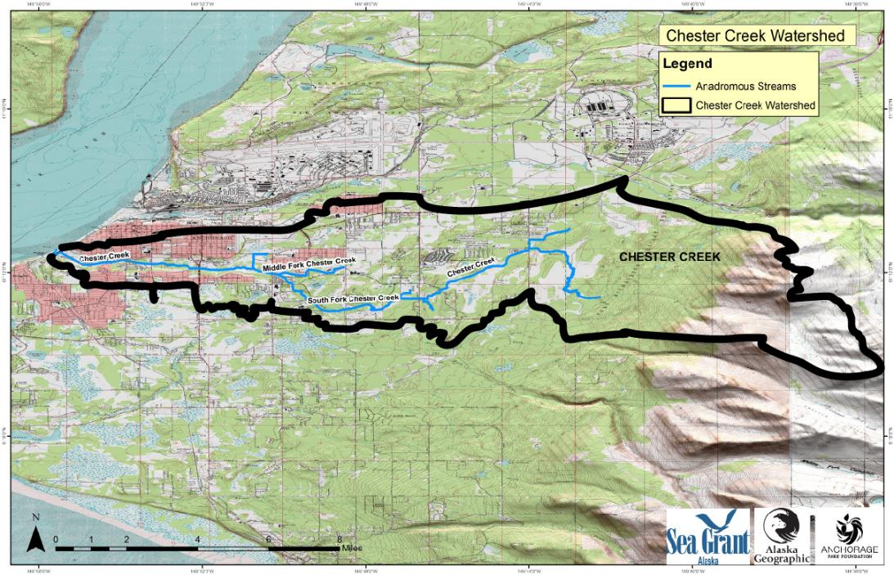
Here is a map of Anchorage. The Chester Creek Watershed is outlined by the thick black line.
The thin blue line shows Chester Creek.
Anadromous streams like Chester Creek are home to fish that spend part of their lives in fresh water and part of their lives in the ocean.
U.S. Department of the Interior
Bureau of Land Management
Watershed border
© Anchorage Park Foundation

Slide 22
The thick black line shows the boundary of the Chester Creek Watershed.
All the land inside the border drains into Chester Creek.
Chester Creek eventually flows into the Pacific Ocean.
U.S. Department of the Interior
Bureau of Land Management
© Anchorage Park Foundation

Slide 23
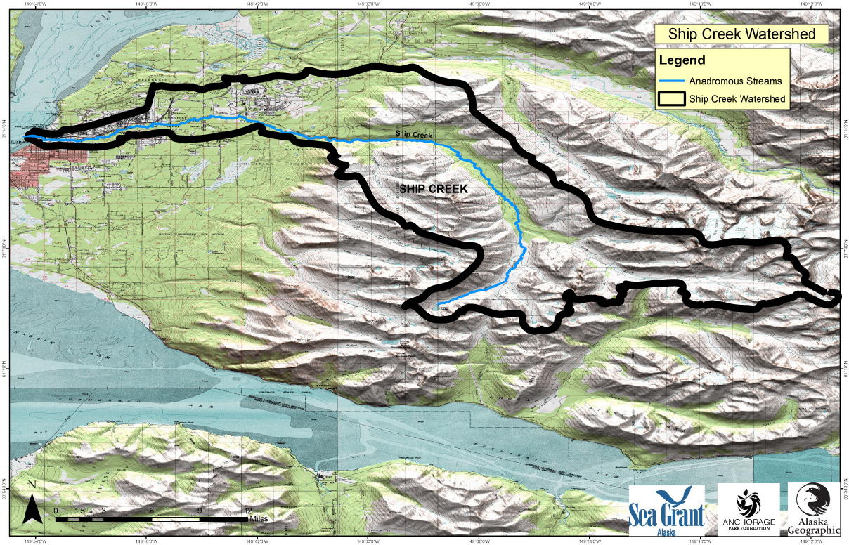
This is a map of the Ship Creek Watershed, which is also in Anchorage.
Notice that much of the thick black line follows mountain ridges, which form the watershed boundary.
Rain that falls and snow that melts inside the watershed boundary will end up in Ship Creek.
U.S. Department of the Interior
Bureau of Land Management
© Anchorage Park Foundation

Slide 24
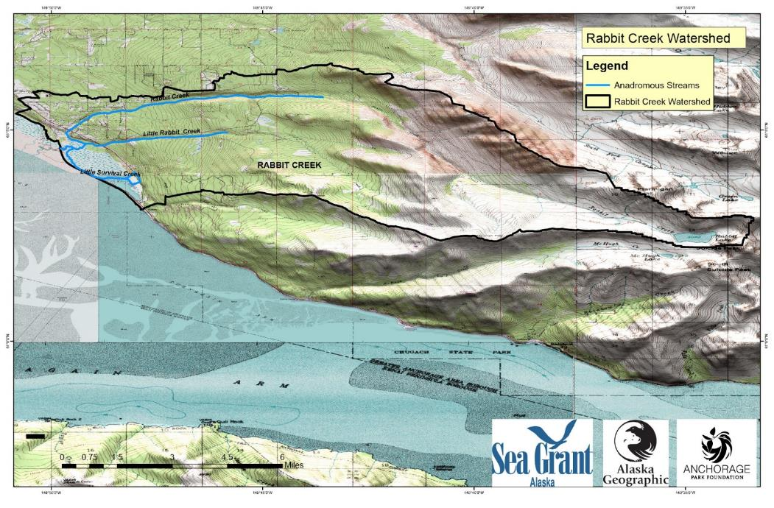
Here is a map of the Rabbit Creek Watershed, another watershed in Anchorage.
Can you point to the ridges and valleys in the Rabbit Creek Watershed?
U.S. Department of the Interior
Bureau of Land Management
© Anchorage Park Foundation

Slide 25
Where does the Rabbit Creek Watershed start?
Where does the Rabbit Creek Watershed end?
U.S. Department of the Interior
Bureau of Land Management
© Anchorage Park Foundation

Slide 26
The Rabbit Creek Watershed starts in the mountains. You can see a lake at the headwaters.
The Rabbit Creek Watershed ends where it meets the ocean.
U.S. Department of the Interior
Bureau of Land Management
end
start
© Anchorage Park Foundation

Slide 27


Extension Activity:
U.S. Department of the Interior
Bureau of Land Management
Draw or paint a map of a watershed. Include mountains, ridges, valleys, lakes, creeks, and other features.

