Slide 1
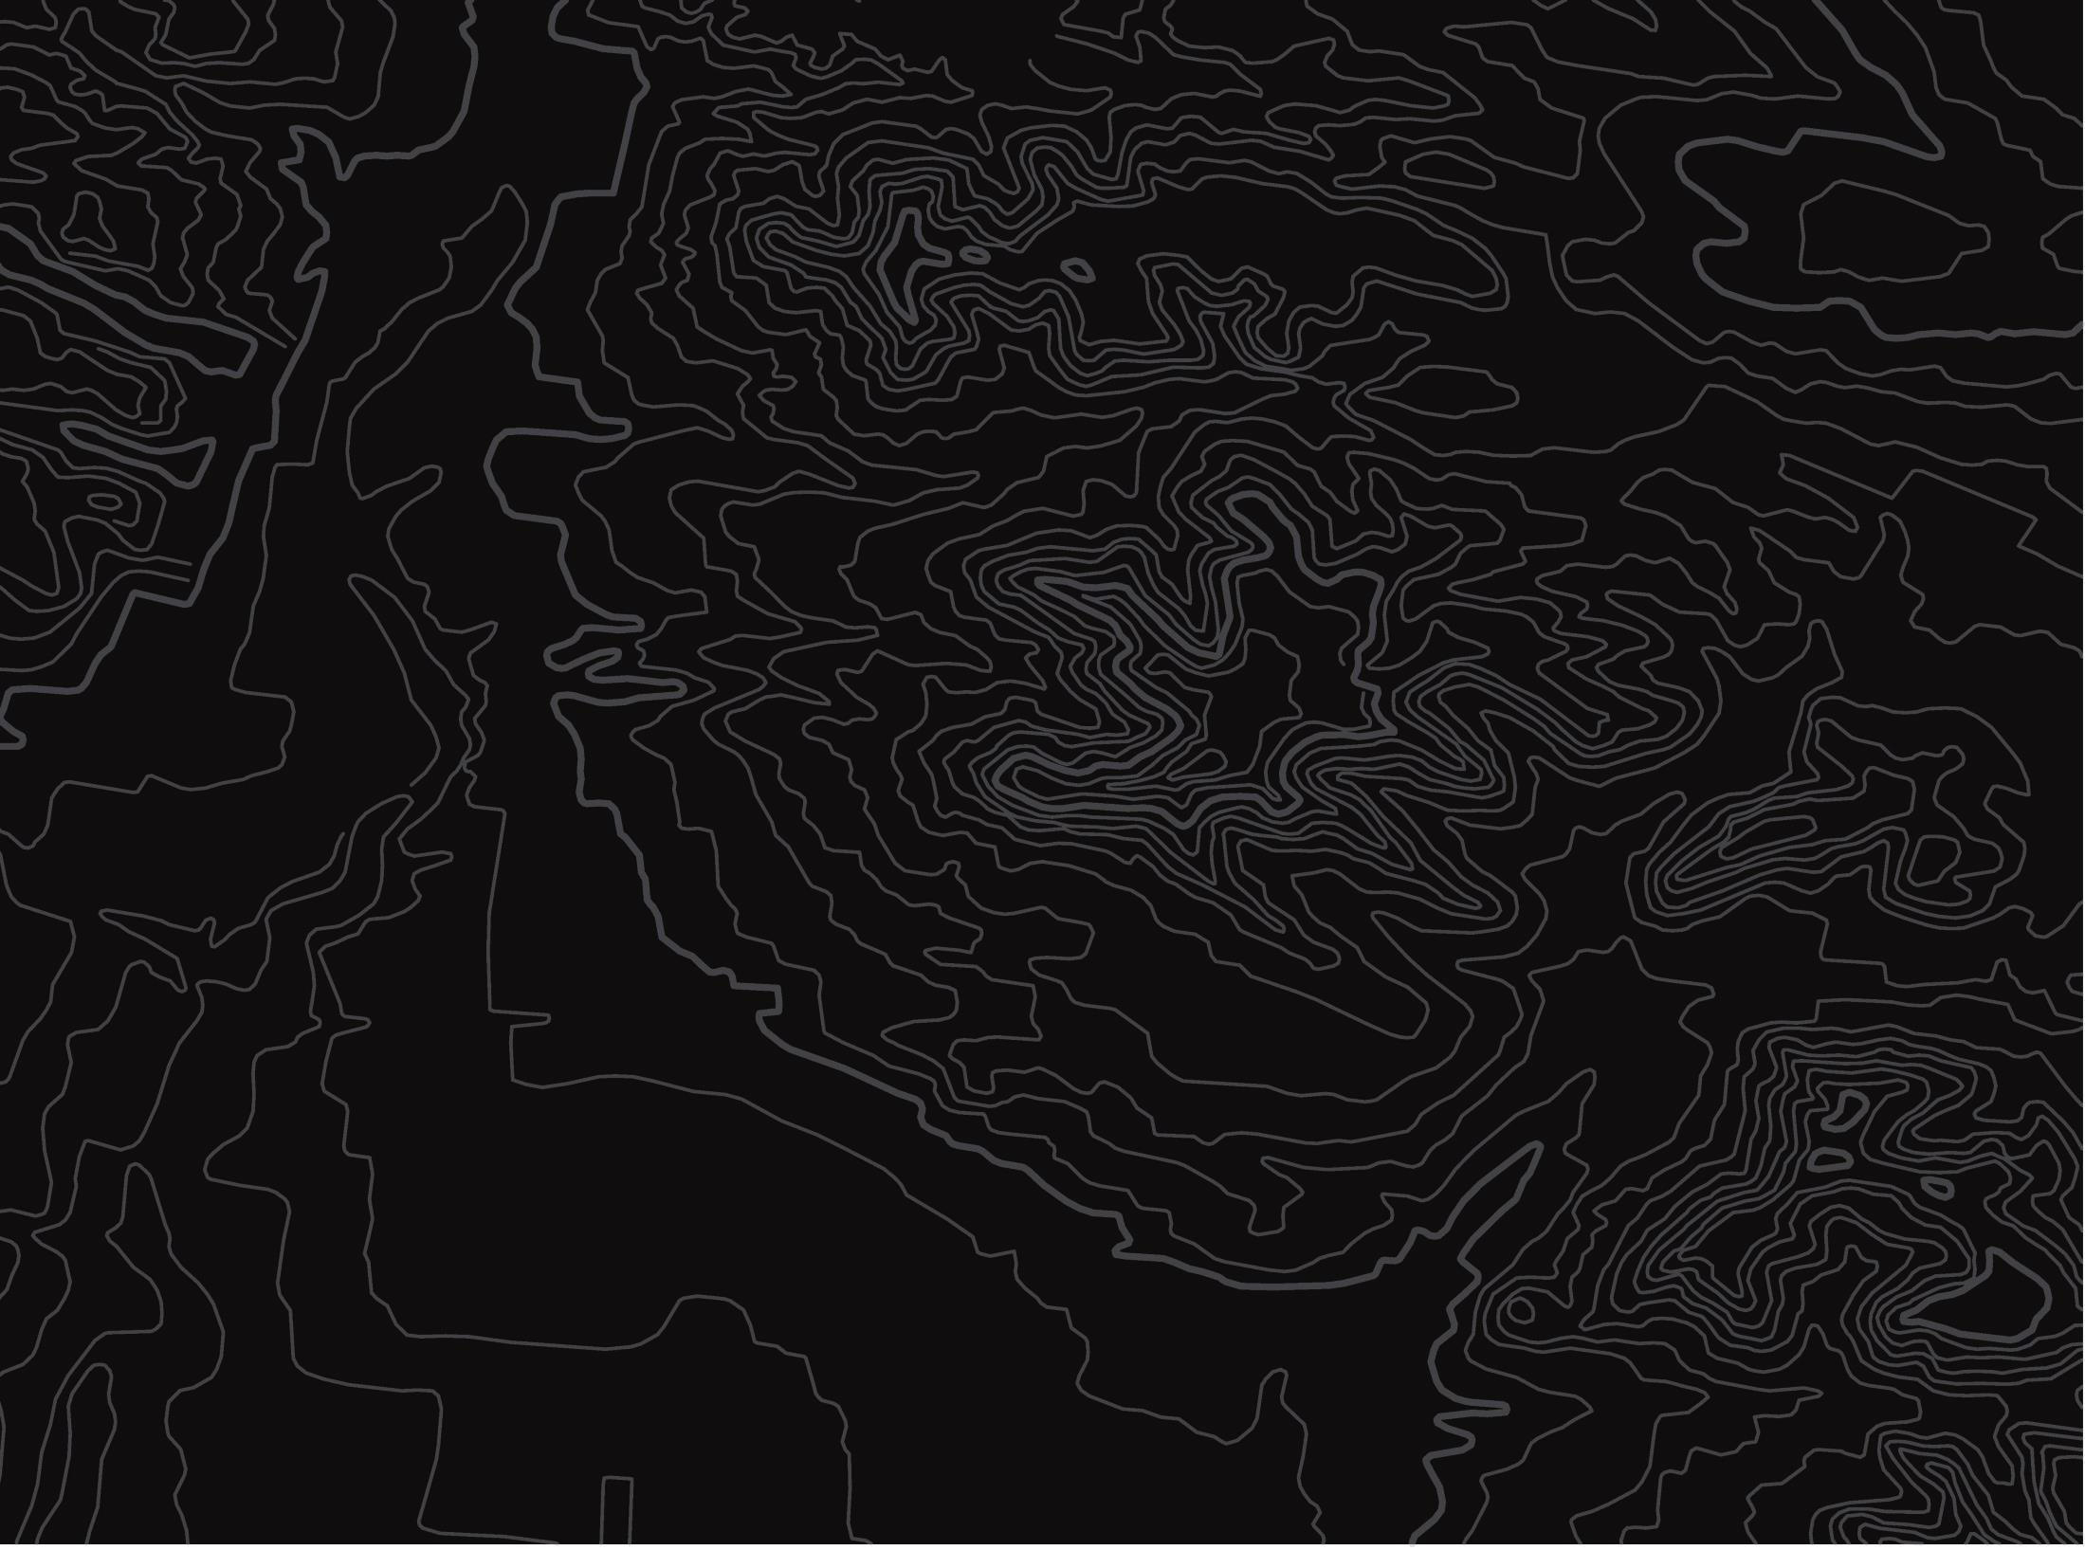
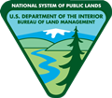

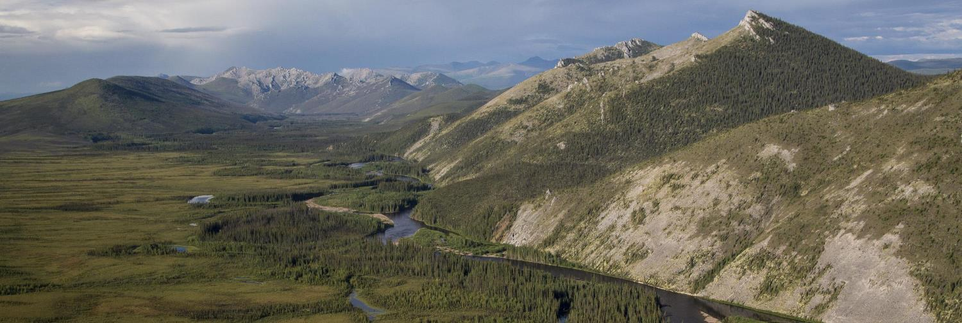
What Is a Watershed?
U.S. Department of the Interior
Bureau of Land Management
Module 1 Introduction
Photo by B. Wick, BLM

Slide 2
Module 1: Watersheds
Module Questions:
U.S. Department of the Interior
Bureau of Land Management
What is a watershed?
How does water shape the landscape?
How are the parts of a watershed connected?
Which watershed do you live in?

Slide 3
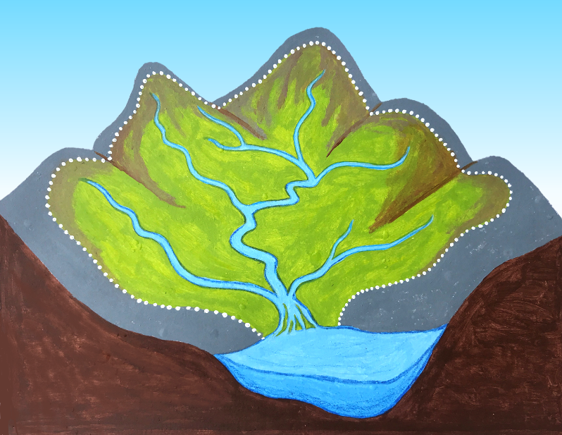
A watershed is an area of land that drains rainwater or snow melt into a river or other waterway.
U.S. Department of the Interior
Bureau of Land Management
The dotted line shows the boundaries of this watershed.
Rain and snow that falls within the watershed boundary drains into this river.
The river flows to the ocean.
Photo by M. Harris, BLM

Slide 4
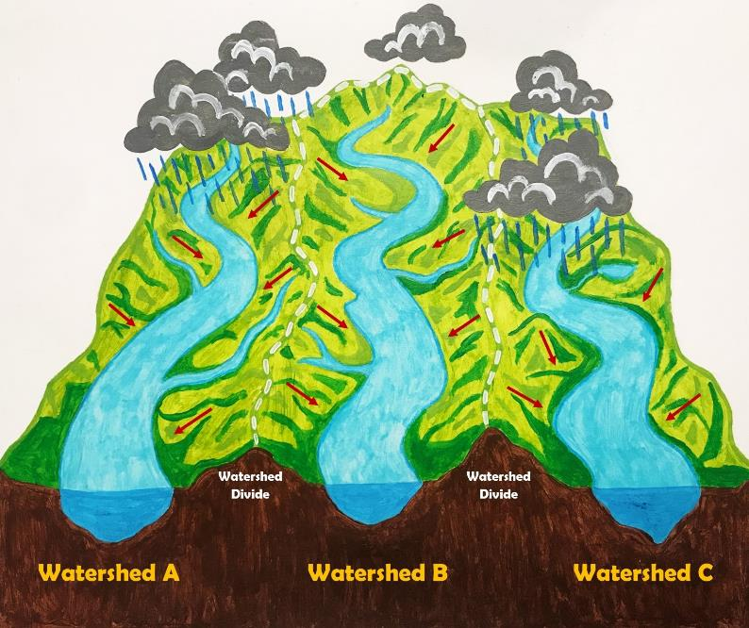
Mountains, hills, and other elevation form the boundaries of watersheds.
U.S. Department of the Interior
Bureau of Land Management
Photo by M. Harris, BLM

Slide 5
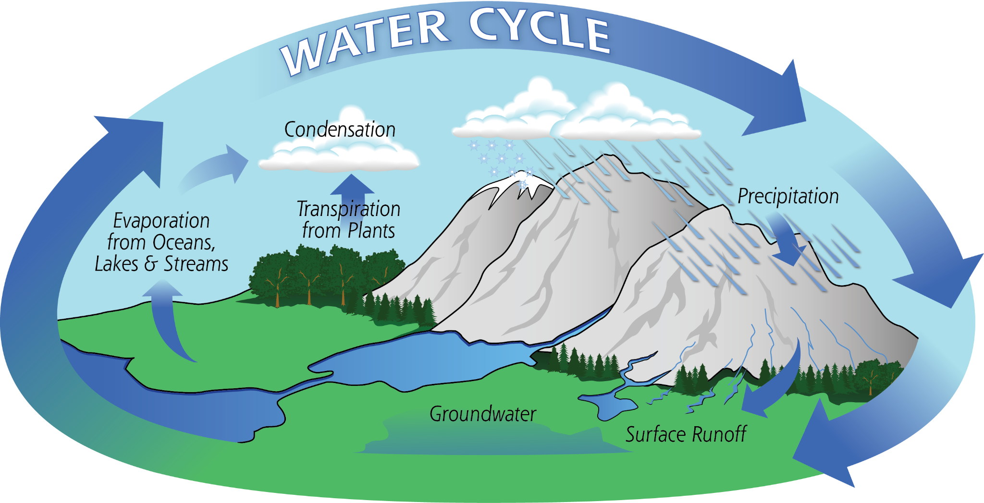
Watersheds connect water, air, land, and living things through the water cycle.
The water cycle is the movement of water between lakes, rivers, oceans, the atmosphere, and the land.
U.S. Department of the Interior
Bureau of Land Management
Graphic provided by NASA

Slide 6
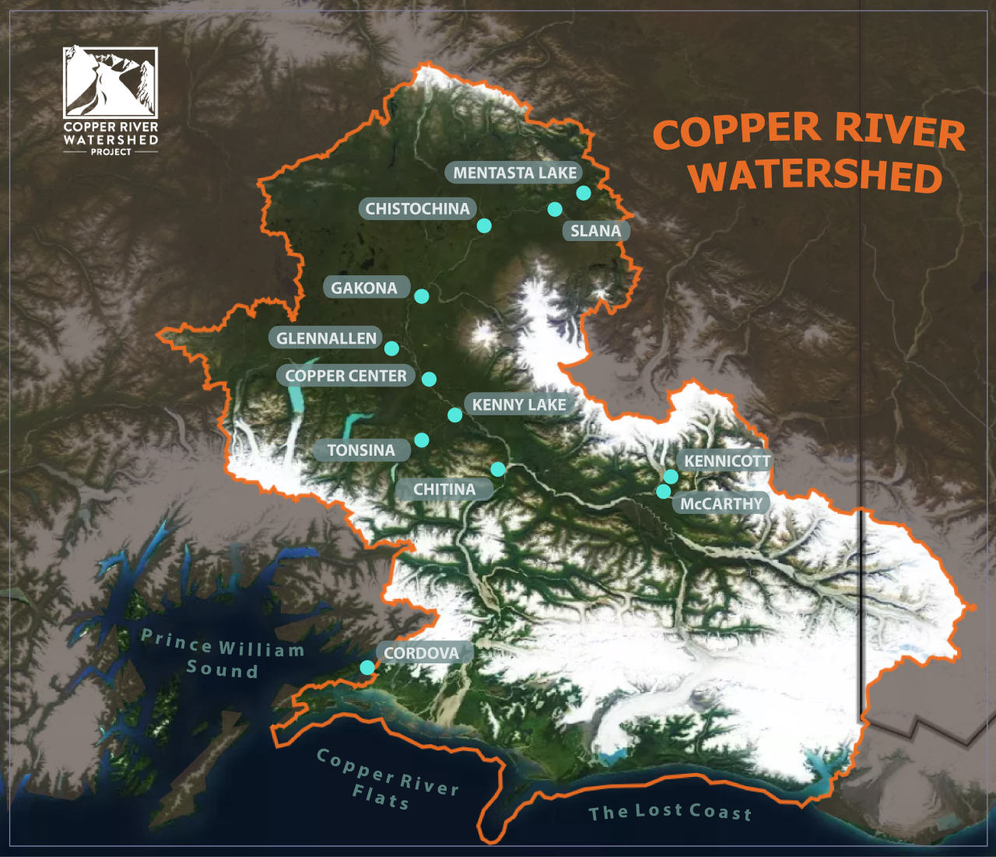
U.S. Department of the Interior
Bureau of Land Management
Watersheds are usually named for the largest creek or river they drain into.
For example, the Copper River Watershed is named for the Copper River.
© Copper River Watershed Project

Slide 7
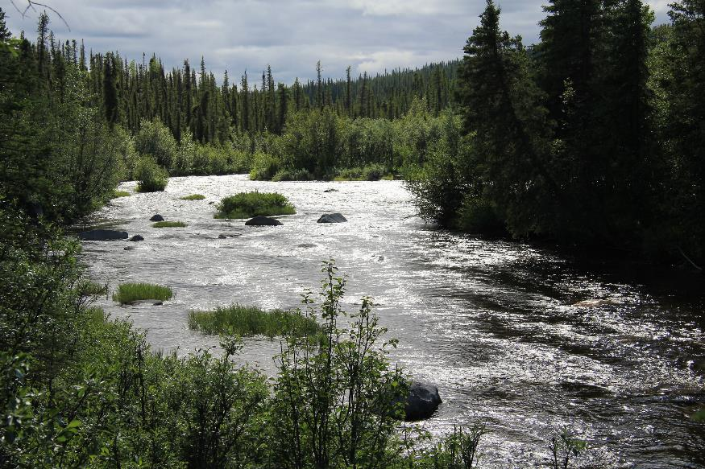
Many smaller watersheds make up the Copper River Watershed.
Water that drains into the Klutina, Chitina, Tazlina, Gakona, Tonsina, and Gulkana (pictured here) Rivers, and hundreds of other smaller rivers and lakes, eventually flows into the Copper River.
U.S. Department of the Interior
Bureau of Land Management
Water flows through lush green vegetation. Photo by J. Matlock, BLM.

Slide 8
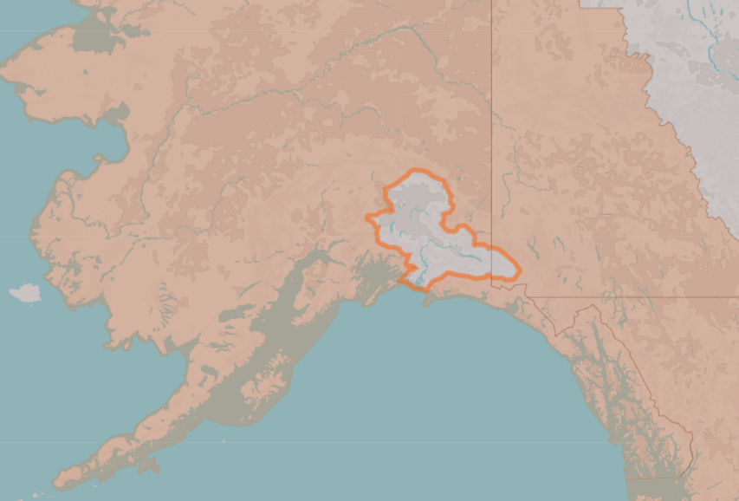
Remember, watersheds are areas of land.
U.S. Department of the Interior
Bureau of Land Management
© Copper River Watershed Project
The Copper River Watershed drains water from 26,500 square miles of land
into the Copper River.

Slide 9
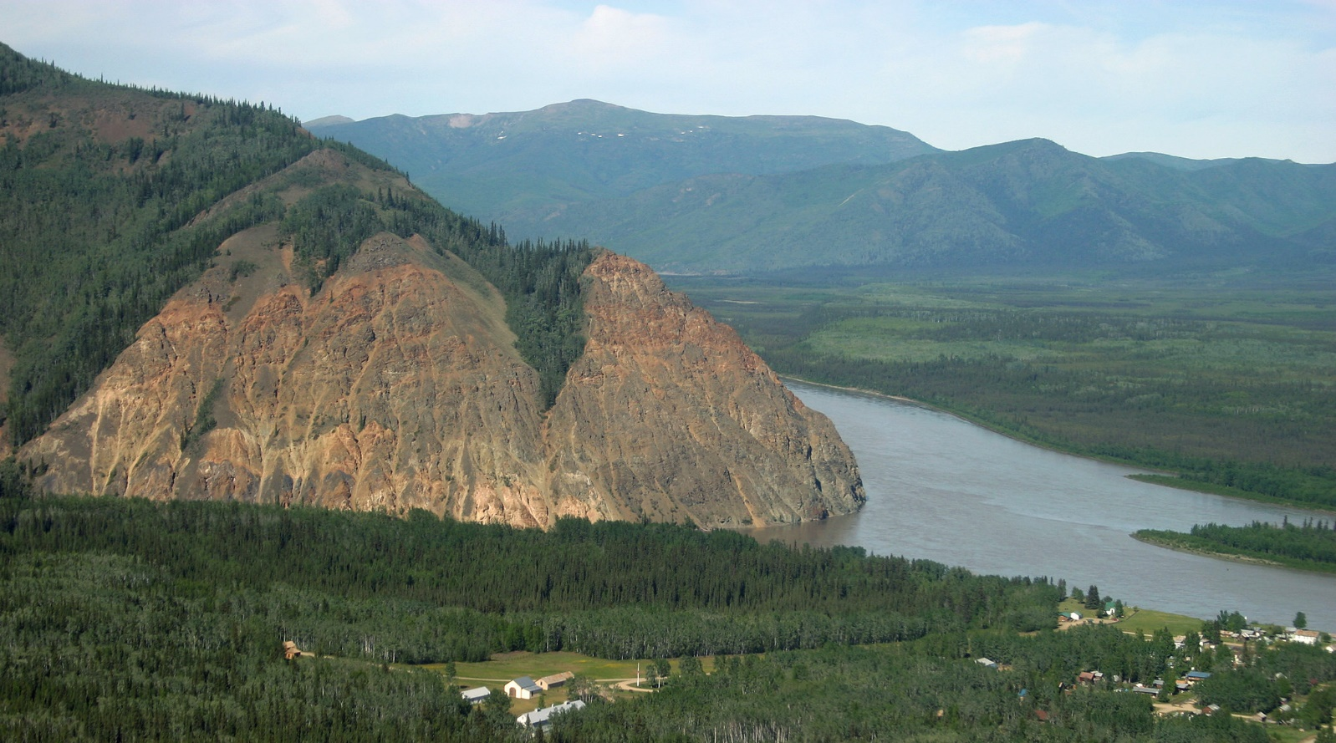
All land on Earth is part of a watershed. Everyone lives in a watershed!
U.S. Department of the Interior
Bureau of Land Management
Scenic view of a watershed.
Photo by C. McCaa, BLM.

