Slide 1


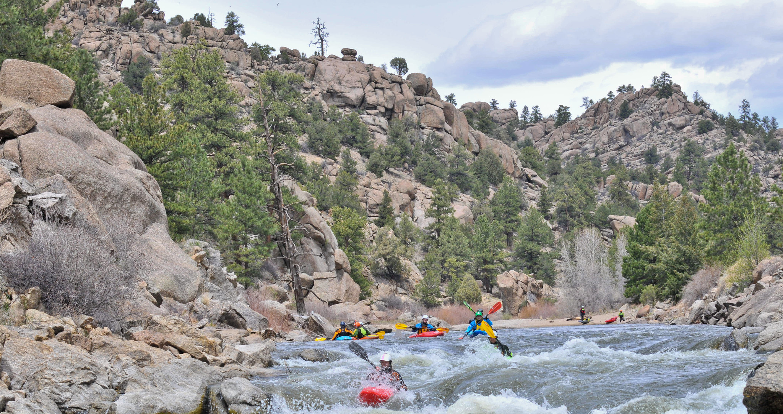
Notes:
Photo: Boaters on the Arkansas River in the Arkansas Headwaters Recreation Area
I am Cathy Cook, The Rocky Mountain District Manager. We are pleased to provide this zoom meeting today with our Resource Advisory Council. Joining me in hosting this event is Stephanie Carter, who is the Rocky Mountain District NEPA Coordinator. As you may be aware our PAO left the BLM to work at the NPS Regional Office and we have not yet filled his Brant Porter’s position. Thanks, Stephanie for pitching in. I will be your facilitator today. Steph will run the slide show and watch for questions. We also have Mianna Maestas who will be our notetaker for the day.
As you know Our district is located on Colorado’s Front Range and within the San Luis Valley. Today’s meeting is being held in Canon City at the Royal Gorge Field Office. Our district has two field offices the Royal Gorge (RGFO) and San Luis Field Offices. They both work with partners and local communities to develop recreation opportunities and manage a whole host of outdoor programs.

Slide 2

Rocky Mountain Resource Advisory Council Meeting
Nov. 9, 2023
Zoom Link:
Thursday, Nov. 9
9:30 a.m. Meeting begins (Zoom meeting SOP, brief review of agenda)
9:35 a.m. Introductions
9:45 a.m. Opening remarks, RMD Manager
9:55 a.m. RAC Chair Nominations
9:05 a.m. RAC Chair Election
10:30 a.m. RGFO Fee Proposal
11:00 a.m. RAC Vote on RGFO Fee Proposal
11:05 a.m. Public comments
11:35 a.m. Closing remarks
11:45 p.m. Adjourn
Notes:
GO OVER AGENDA FOR DAY 1 Let's take A quick look at the agenda. tells me that we have just a half day meeting today with the election of a chair and then revisit the camping business plan, followed by a vote.

Slide 3


Rocky Mountain District RAC Overview
Representative | Interest | Term Expiration
Curtis Howell | Outdoor Recreation | April 6, 2025
Preston Larimer | Commercial Recreation Activities | June 1, 2026
Chris Cooper | Energy and Minerals | June 1, 2026
Pete Stagner | Grazing | June 1, 2026
VACANT
CATEGORY 1
Representative | Interest | Term Expiration
John Sztukowski | Environmental Organizations | April 6, 2025
Irene Shonle | Dispersed Recreation | April 6, 2025
Loretta Mitson | Dispersed Recreation | April 6, 2025
Michael Daniel | Dispersed Recreation | April 6, 2025
Kelly Collins | Dispersed Recreation | June 1, 2026
CATEGORY 2
Representative | Interest | Term Expiration
Ray Douglas | Elected Official | Jan. 14, 2024
Kent Wood | Public-at-Large | April 6, 2025
Lawrence Pacheco | Public-at-large | April 6, 2025
Travis Black | State Agency Representative | April 6, 2025
Arthur Koepsell | State Agency Representative | June 1, 2026
CATEGORY 3
Notes:
Just some details on the composition of our board.
I will call out your name and please introduce yourself to the team, so we can take note of attendance. Levi is taking notes today and running our zoom session.

Slide 4

RAC Training and Elections Prep

Slide 5
OBJECTIVES AND SCOPE OF ACTIVITIES: The Council will serve in an advisory capacity concerning the planning and management of the public land resources located within BLM's Rocky Mountain District (encompassing the Royal Gorge and San Luis Valley field offices).
DESCRIPTION OF DUTIES: Council duties and responsibilities, where applicable, are as follows:
Develop recommendations for BLM with respect to the land use planning, classification, retention, management, and disposal of the public lands
Make recommendations regarding a standard amenity recreation fee or an expanded amenity recreation fee,
  The implementation of a standard amenity recreation fee or an expanded amenity recreation fee or the establishment of a specific recreation fee site;
  The elimination of a standard amenity recreation fee or an expanded amenity recreation fee; or
  The expansion or limitation of the recreation fee program.
  At the conclusion of each meeting or shortly thereafter, provide a detailed recommendation report, including meeting minutes, to the DFO.
ESTIMATED NUMBER AND FREQUENCY OF MEETINGS: Meet approximately two to four times annually. The Council will be comprised of 15 members distributed in a balanced fashion among the three interest groups. Members will be appointed to the Council to serve 3-year terms.
RECORDKEEPING: These records shall be available for public inspection and copying, subject to the Freedom of Information Act (5 U.S.C. 552).
Notes:
An overview of the FACA.
The Federal Advisory Committee Act (FACA) is a Federal law that governs the establishment and operation of advisory committees. It is implemented Government-wide by the General Services Administration (GSA), which has issued regulations and guidance.
The purpose of the FACA is to ensure that the public has knowledge of and an opportunity to participate in meetings between Federal agencies and groups that the agency either has established, or manages and controls for the purpose of obtaining group advice and recommendations regarding the agency’s operations or activities.
The FACA requires that such groups be chartered, that their meetings be announced in advance and open to the public, and that their work product be made available to the public. We can spend a few minutes going over the activities of the committee and roles of the members and chairperson.
Please review the RAC Charter
We can expect since we will have our quorum now for the next meeting that we will get nominations for board chair and be able to start our work in earnest onplanning the meeting for FY23, resource concerns, support for supplemental rules and other board tasks.
Let’s take just a minute to review the highlights of the new Charter signed Sept 2021.
RAC Charter Highlights
OBJECTIVES AND SCOPE OF ACTIVITIES: The Council will serve in an advisory capacity concerning the planning and management of the public land resources located within BLM's Rocky Mountain District (encompassing the Royal Gorge and San Luis Valley field offices).
DESCRIPTION OF DUTIES: Council duties and responsibilities, where applicable, are as follows:
develop recommendations for BLM with respect to the land use planning, classification, retention, management, and disposal of the public lands
make recommendations regarding a standard amenity recreation fee or an expanded amenity recreation fee,
the implementation of a standard amenity recreation fee or an expanded amenity recreation fee or the establishment of a specific recreation fee site;
the elimination of a standard amenity recreation fee or an expanded amenity recreation fee; or
the expansion or limitation of the recreation fee program.
At the conclusion of each meeting or shortly thereafter, provide a detailed recommendation report, including meeting minutes, to the DFO.
ESTIMATED NUMBER AND FREQUENCY OF MEETINGS: Meet approximately two to four times annually
The Council will be comprised of 15 members distributed in a balanced fashion among the three interest groups. Members will be appointed to the Council to serve 3-year terms.
RECORDKEEPING: These records shall be available for public inspection and copying, subject to the Freedom of Information Act (5 U.S.C. 552).

Slide 6
Roles and Responsibility of the Chairperson
The board chair is responsible for leading the board. This position demands exceptional commitment to the organization, first-rate leadership qualities, and personal integrity.
No board can function without a competent board chair. Holding this position requires specific skills that help to accomplish the above duties. For instance, keeping meetings on track requires a high level of productivity and the ability to be assertive. To ensure harmony on the board, you need to be able to communicate efficiently and compromise when necessary. Further, the board chair needs to value fellow board members and promote collaboration in all situations.
Above all, the board chair needs to remember that his or her primary role is to help the board lead in ensuring a sound future for the organization. Please consider self - nomination for the role or who among your peers would do well and we will work on an election at our next meeting.
Notes:
Role of Federal Advisory Committees
With the expertise from advisory committee members, federal officials and the public have access to information and advice on a broad range of issues affecting federal policies and programs. The public is afforded an opportunity to provide input into a process that forms the basis for government decisions.
Meetings –
Generally • Any member of the public is permitted to file a written statement with the committee. • Any member of the public is permitted to speak before the committee subject to reasonable guidelines set by the committee
Record Keeping
• Detailed minutes of each meeting must be kept. The District typically provides the staffing. The meeting minutes are kept and a summary provided to the national office. The notes must contain the following.
- Who is in attendance; description of matters discussed and conclusions reached; and copies of all reports received, issued or approved by the committee
Public Access to Committee Records
Transparency of how business is conducted is the goal here.
Committee records are made available to the public.
Committee records defined broadly as -”reports, transcripts, minutes, appendixes, working papers, drafts, studies, agenda, or other documents which were made
available to or prepared for or by the committee”
• Exceptions – withholding under 5 U.S.C. 552 (FOIA Exemptions)
General Services Administration administers the FACA committees and hosts the database where the work of the committee is stored. They also
• review the charter and activities of federal advisory committees and issues regulatory guidelines consistent with
Questions/disputes over committee operation and meeting procedures
a. DFO sets the rules
b. In addition, DFO approves or calls the meeting of the committee and subcommittee(s)
Questions/disputes over scope of authority and duties of the committee
a. Recall that the Statute/Charter sets for the authority for the committee
b. The agency, via DFO, interprets the scope of authority and duty of the
committee.

Slide 7
Leader of the board
To function effectively, groups need a leader. A board leader is approachable and available. He or she is objective and listens actively. He or she needs to be a strategist, knowledgeable about the organization and board practices, a coach, and a conciliator. Finally, he or she must be respected in the community. The chair most commonly performs the following functions:
Serves as the contact point for every board member on board issues.
Sets goals and objectives for the board and ensures that they are met.
Ensures that all board members are involved in committee activities; assigns committee chairs.
Motivates board members to attend meetings. Assisting in recruiting, welcoming and onboarding new members
Notes:
A few notes on what the function of the board lead is

Slide 8
Facilitator of board meetings
One of the trickiest responsibilities of a chair is to run effective and productive board meetings. Effective meeting facilitators must be able to
create a purposeful agenda in collaboration with the Designated Federal Official and follow it
know how to run a less formal and productive meeting
engage each board member in deliberation
control dominating or out-of-line behavior during meetings
Should the chair vote?
The chair has the same right to vote as other board members.

Slide 9
Recreation in BLM
Kalem Lenard
Assistant Field Manager/
Browns Canyon National Monument Manager
Royal Gorge Field Office
jlenard@blm.gov
719-433-8486

Slide 10
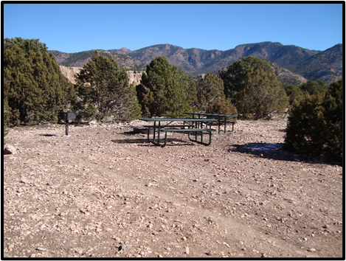
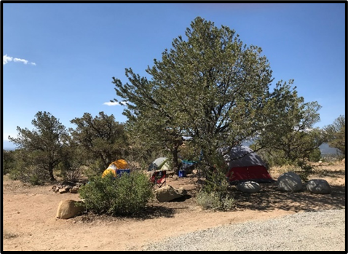
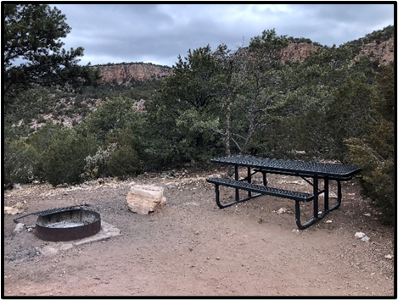
Royal Gorge Field Office
Campground Business Plan
Develop a business plan for all campgrounds (current and potential) within the Royal Gorge Field Office
Establish a set fee for level of campground development (primitive/developed)
Includes a new fee at Turtle Rock, increased fee at The Bank and Sand Gulch Campground, and new fees for campgrounds proposed in the Chaffee County Camping Plan.
Will be presented to the RAC in the future

Slide 11
Questions?

Slide 12
Time for us to take Public Comments

Slide 13
Wrap Up
Public comments
Bin items, and open discussion
Adjourn

