Slide 1

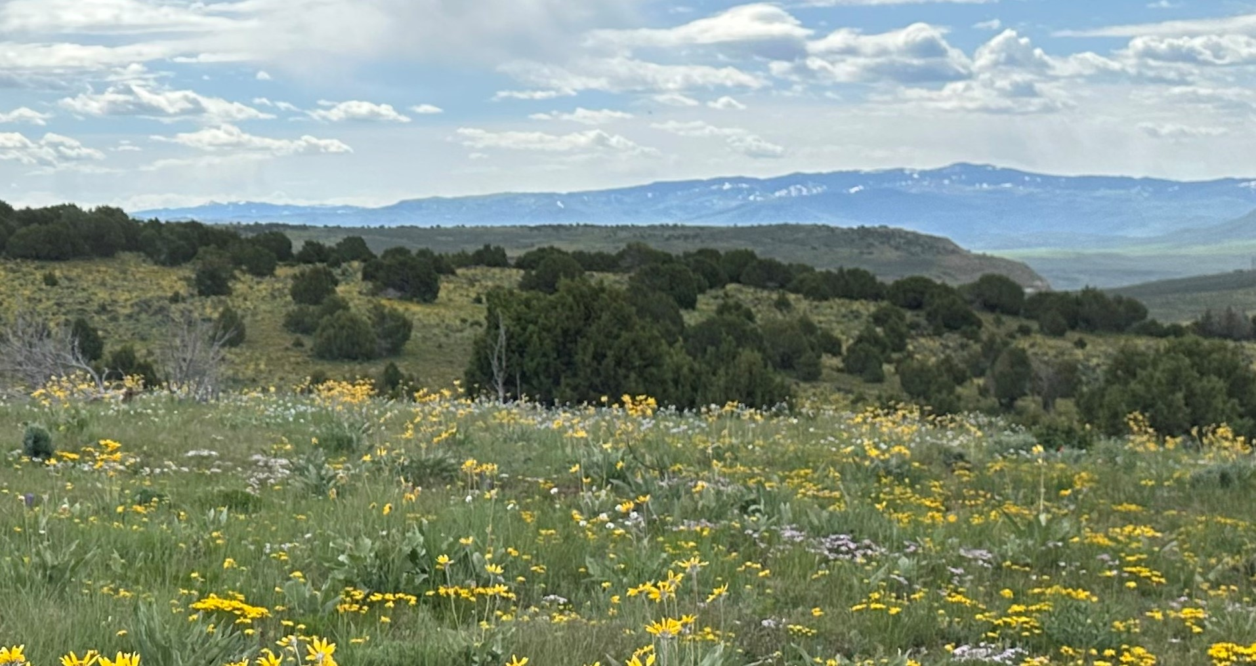
BLM Colorado – Northwest RAC

Slide 2

Agenda
October 5, 2023
8:00 a.m. Housekeeping and Introductions
8:20 a.m. Opening Remarks
8:30 a.m. Review and Discuss the Field Trip and Fire Management
9:00 a.m. Fire Management Presentation and Discussion - “Fuels treatments, opportunities and challenges”
10:30 a.m. Upper Colorado River Special Recreation Management Area - Business Plan
11:30 p.m. Lunch
12:55 p.m. Reconvene
1:00 p.m. Field Manager Updates
2:00 p.m. Public Comment Period
2:30 p.m. Closing Remarks and Open Discussion
3:00 p.m. Adjourn

Slide 3

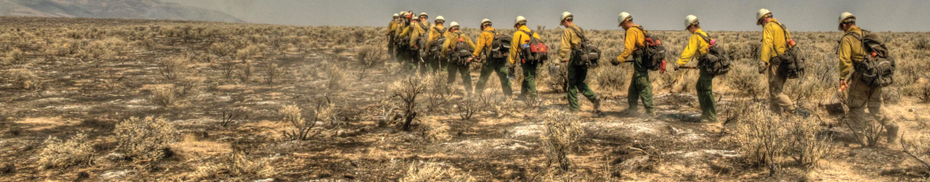
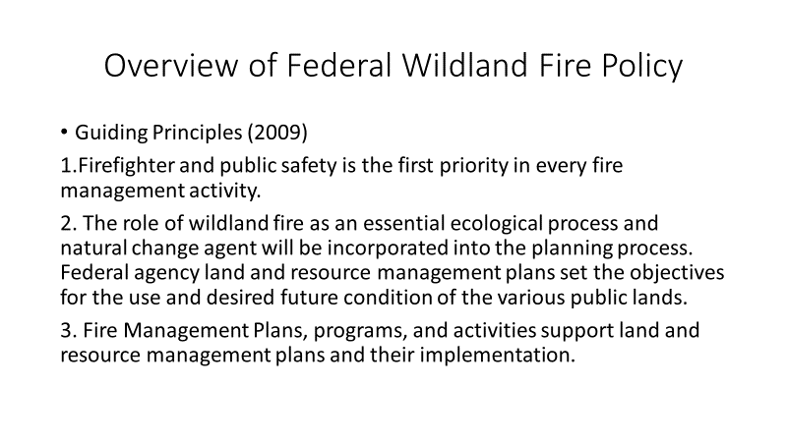

Slide 4
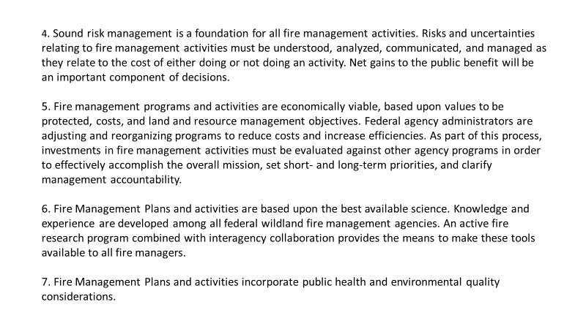

Slide 5
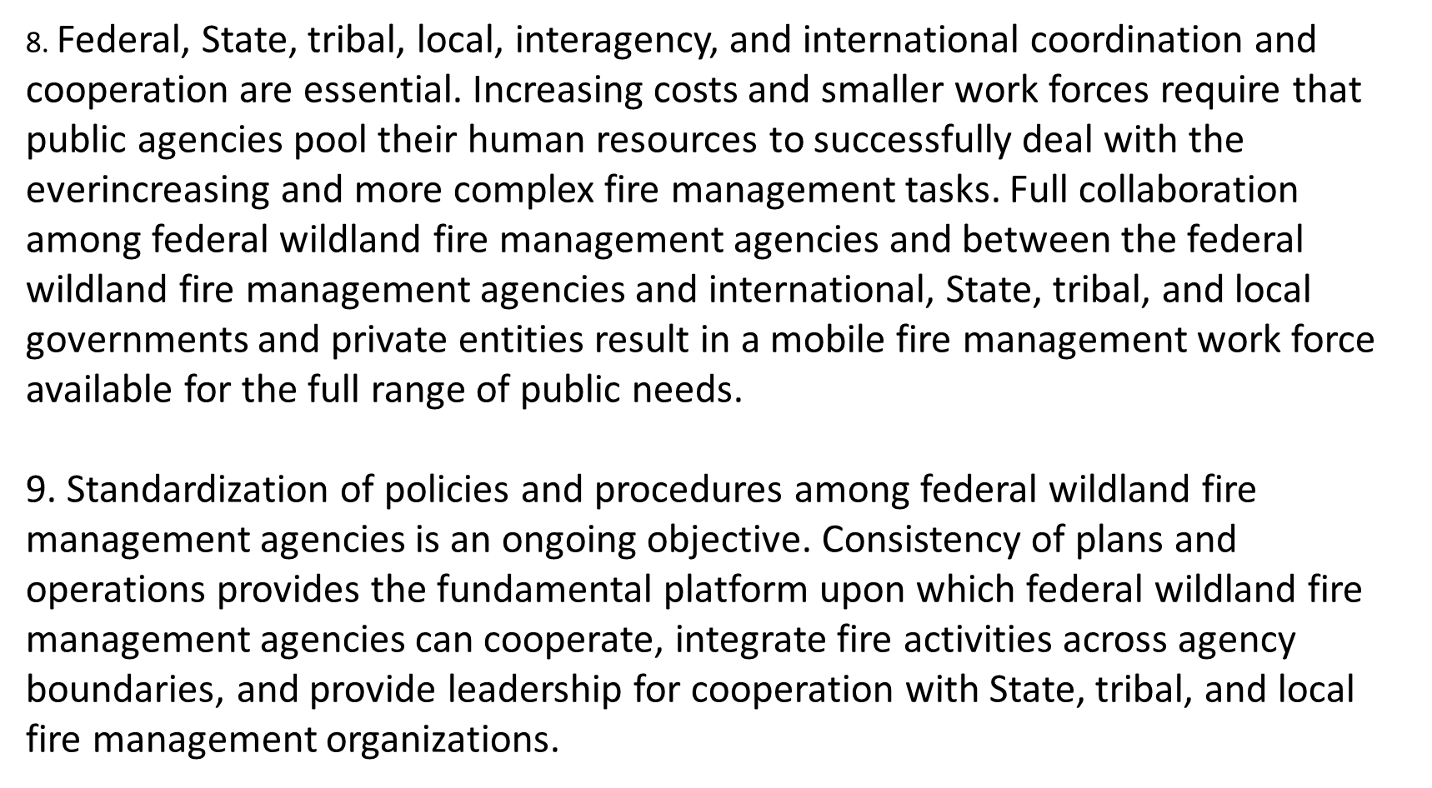

Slide 6
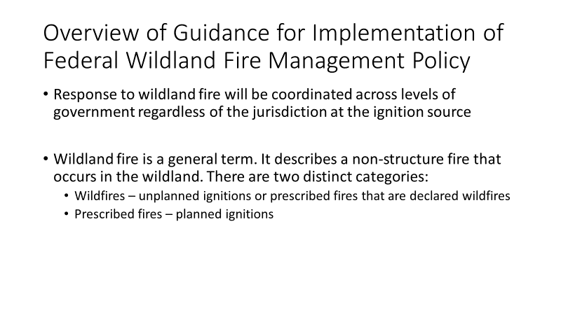
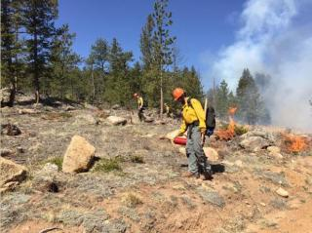

Slide 7
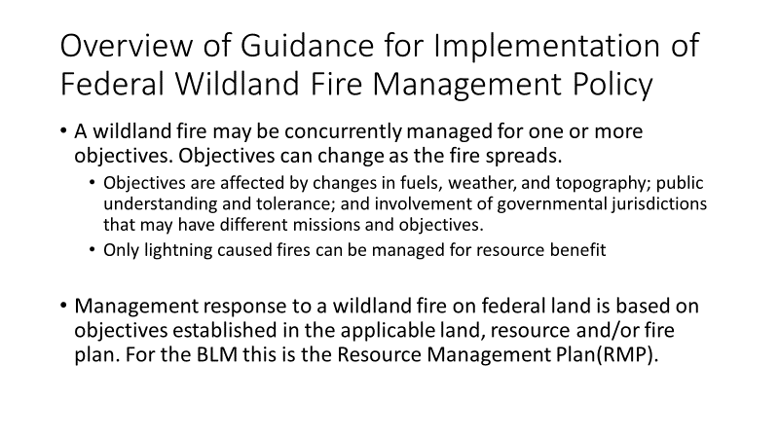
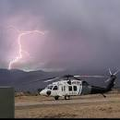

Slide 8
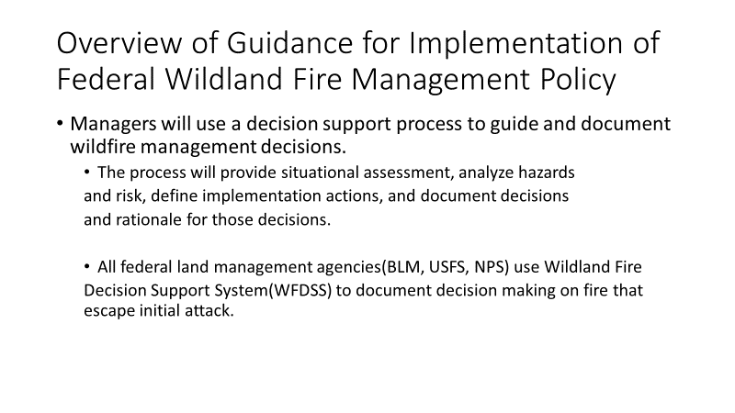
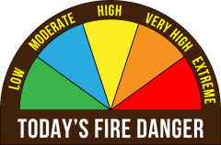

Slide 9
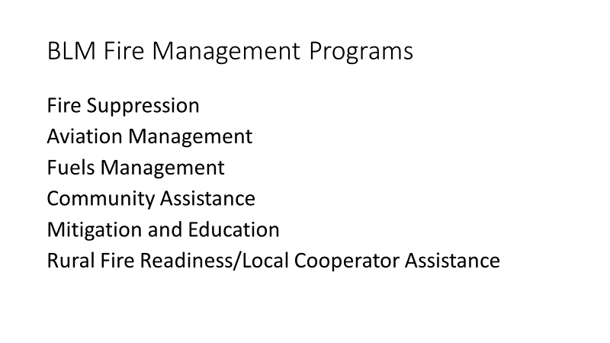


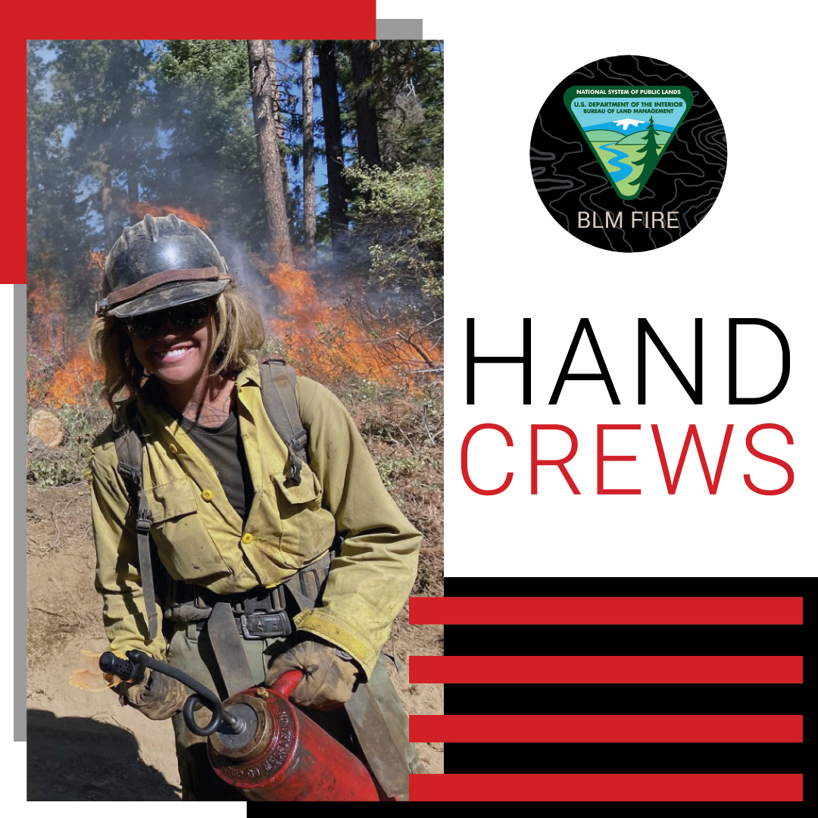
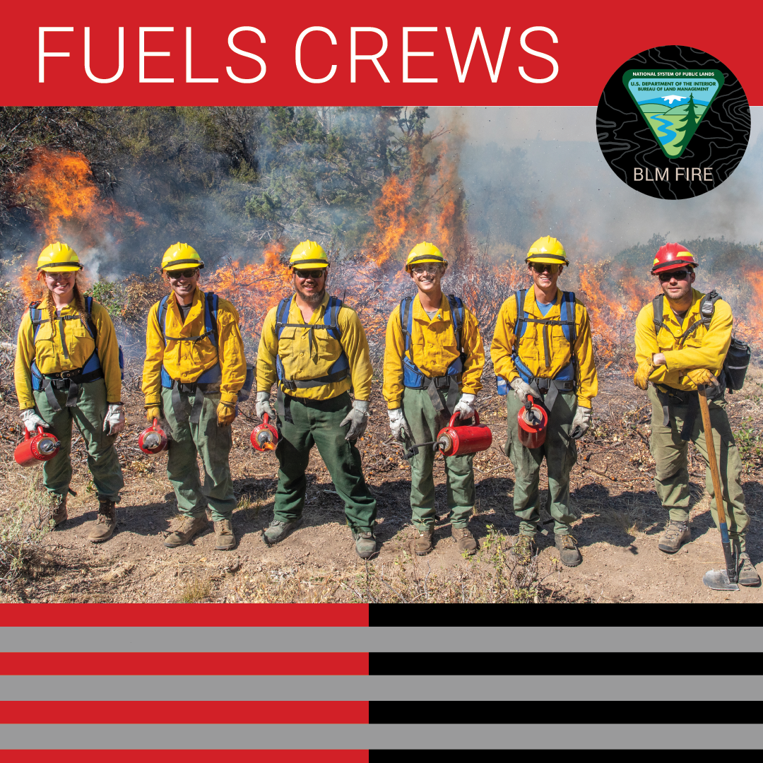

Slide 10
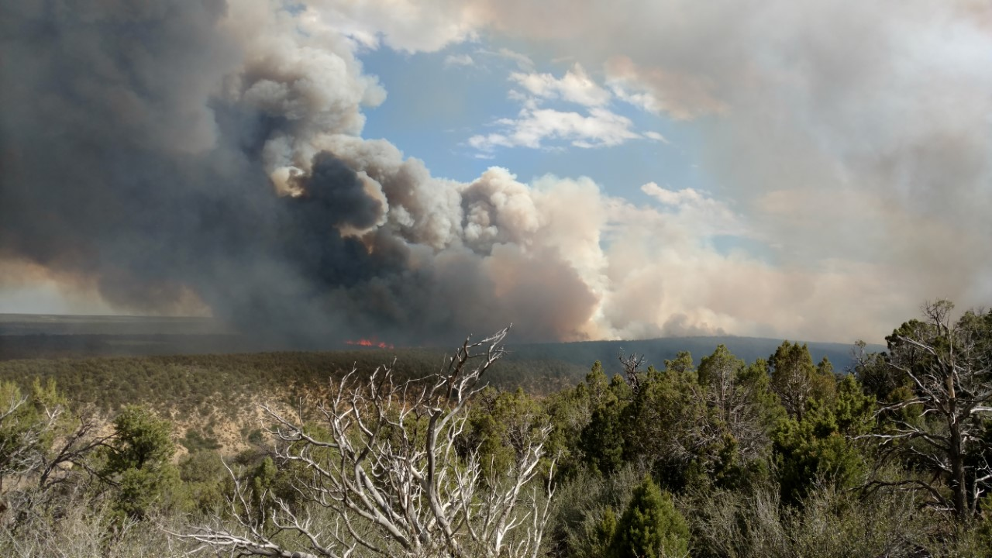
Fuels Treatments; Current Opportunities and Challenges in NWDFA/UCRD
RAC Meeting, 10/5/2023
Northwest & Upper Colorado River District
Fire & Fuels Programs

Slide 11
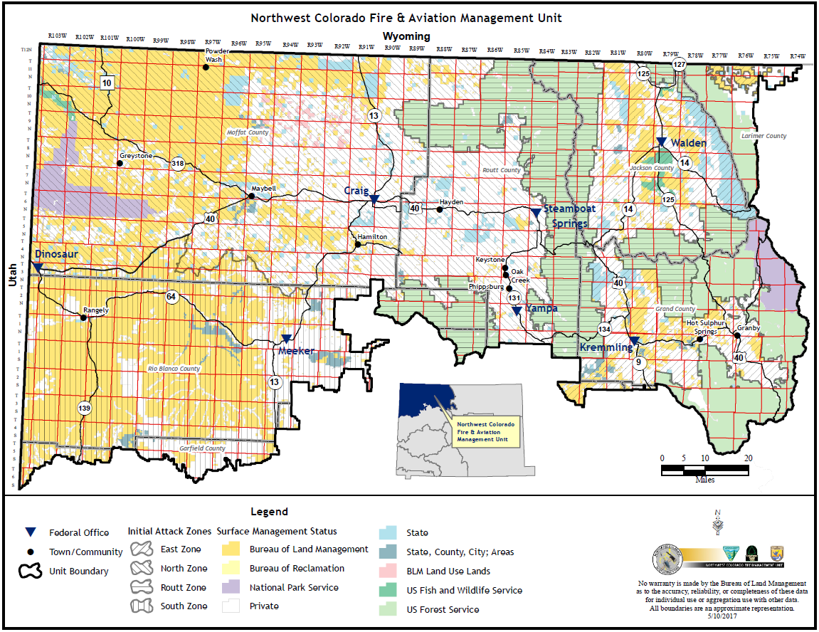

Slide 12
About the District
The Northwest Colorado FMP provides direction and guidance for the Bureau of Land Management (BLM) and U.S. Fish and Wildlife Service lands in Northwest Colorado, which include The Little Snake, White River, and Kremmling Field Offices and Browns Park and Arapahoe Fish and Wildlife Refuges. This area covers just over 8.5 million acres of state, private and federal lands. The total acres of BLM and FWS lands are just over 3.1million acres and this plan applies to these acres.
Agency | Acres | Counties Represented
BLM Kremmling Field Office | 377,900 | Grand, Jackson, Routt, Eagle, Summit, Larimer
BLM Little Snake Field Office | 1,300,000 | Routt, Rio Blanco, Moffat
BLM White River Field Office | 1,455,900 | Garfield, Rio Blanco, Moffat
Browns Park National Wildlife Refuge | 12,150 | Moffat
Arapaho National Wildlife Refuge | 23,464 | Jackson
Colorado side of the Medicine Bow-Routt NF | 1,125,438 | Grand, Jackson, Routt, Eagle, Summit, Larimer
Dinosaur National Monument | 210,844 | Moffat, Uintah in Utah
State and Private Lands (estimated) | 4,000,000 | All the above
Total Acres | 8,505,696

Slide 13
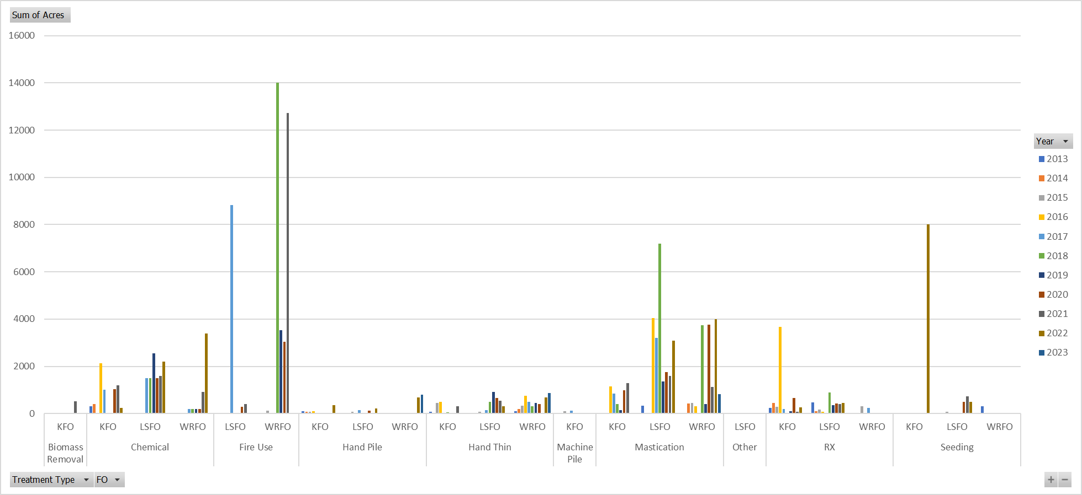
About the District
Overview of Fuels related treatments since 2013 (via NFPORS)

Slide 14
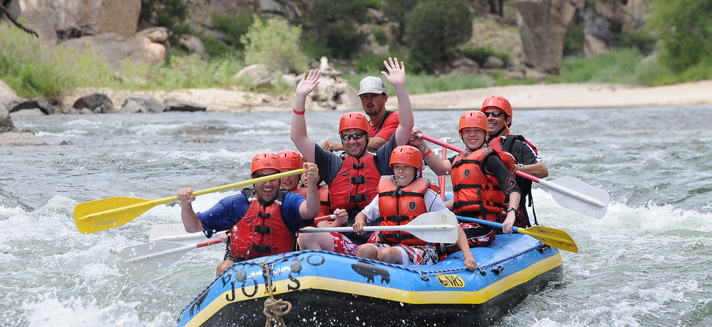
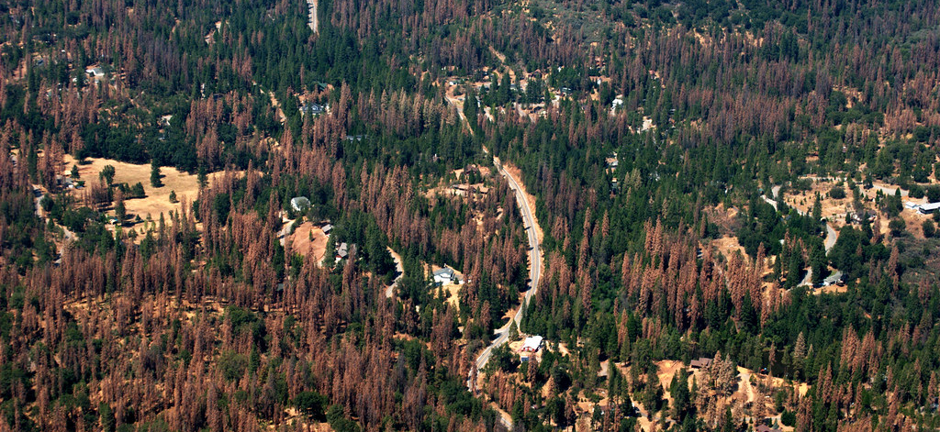
About the District:
Kremmling
Field Office
The area includes approximately 3.1 million acres of mixed ownership in north central Colorado. It includes lands within Jackson, Grand counties in their entirety, and portions of Summit, Eagle, Larimer, and Routt counties. KFO, includes approximately 377,900 acres of public surface estate and approximately 653,500 acres of Federal subsurface minerals managed by the BLM.

Slide 15
About the District:
Kremmling Field Office
Diverse set of resources and values present throughout the field office.
Outdoor recreation is main economic driver in southern part of the field office (mainly Grand County).
Agriculture is more of an economic driver in northern part of the field office (Jackson and Larimer Counties).
Subsequently, SRPs, grazing permits, timber related activities make up majority of NEPA workload in field office

Slide 16
About the District:
Kremmling Field Office
Vegetation varies greatly as climate changes with elevation; the field office is comprised of North Park and Middle Park, which largely consist of sagebrush and native grass cover. The high elevation portions consist largely of Lodgepole pine, sub alpine fire, and some pockets of spruce.
Actively manage for Greater Sage Grouse (GRSG) habitat with some fire and fuels decisions.
Acres of GRSG Habitat by BLM District/Field Office in the Decision Area (BLM-Administered Surface Lands Only)
BLM Field Office | ARMPA
 | PHMA | GHMA | Total
Colorado River Valley Field Office | 24,700 | 40,200 | 64,900
Grand Junction Field Office | 5,600 | 8,900 | 14,500
Kremmling Field Office | 198,900 | 18,900 | 217,800
Little Snake Field Office | 570,400 | 479,700 | 1,050,100
White River Field Office | 122,000 | 180,200 | 302,200

Slide 17
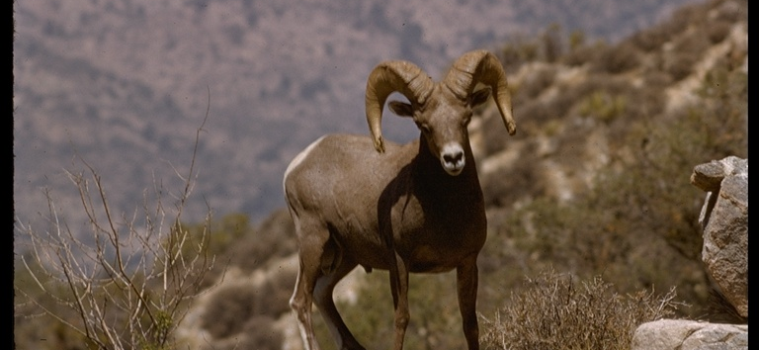
About the District:
Kremmling Field Office
Suppression program: On BLM, KFO averages 3 starts and 1,728 acres burned since 2003. *Does not include private, state or USFS fire stats.
Remove historic 2016 and 2020 fire seasons, the average acres burned per year drops to 37.
Active fuels program. Focus on hazardous fuels reduction near WUI and after timber sales, along with PJ encroachment that effects big game, lynx, RM Big Horn Sheep and sage grouse habitat.
10 Year average: 8 treatments per year, for an average of 2,809 treated per year.
Previous 5 years: Average 6 treatments per year, for an average of 3,046 acres treated.
Chronic fuels program and field office vacancies and turnover have contributed to reduction in numbers of projects that are able to be implemented per year.

Slide 18
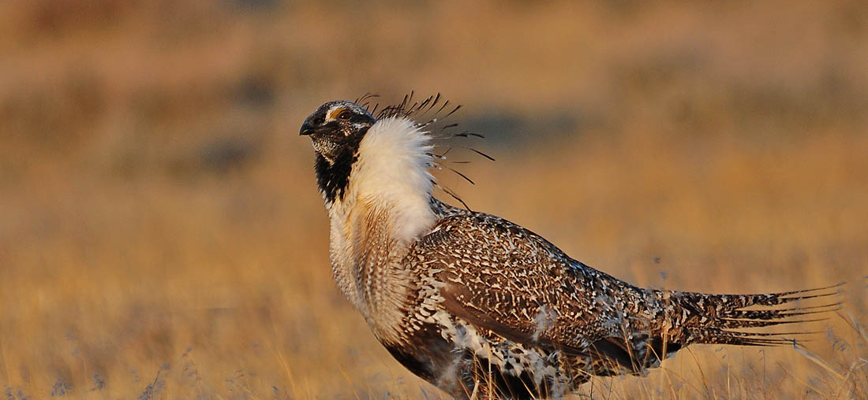
About the District:
Little Snake Field Office
The Little Snake Field Office includes within its administrative boundary approximately 4.2 million acres of federal, State, county, and private lands.
The area is bordered on the north by the State of Wyoming, on the west by the State of Utah, on the south by the BLM White River Field Office and Routt and White River National Forests, and on the east by Routt National Forest.
This Photo by Unknown Author is licensed under CC BY-SA-NC

Slide 19
About the District:
Little Snake Field Office
Of the 4.2 million surface acres within the LSFO, approximately 1.3 million acres (32 percent) are administered by BLM, 41 percent is privately owned, 6 percent is owned by the State of Colorado, and 21 percent is administered by other federal agencies.
This Photo by Unknown Author is licensed under CC BY-SA-NC

Slide 20
About the District:
Little Snake Field Office
Vegetation varies greatly as climate changes with elevation; the western portion of the field office consists of mostly high mountain desert where temperatures can rise to the high 90’s and relative humidity drops to single digits. Fuels consist of mostly sagebrush and invasive cheat grass in the lower valleys with pinyon juniper hills and mesa tops. Moving further to the east, the vegetation changes to include mountain brush and conifer trees as the elevation increases.
Actively manage for Greater Sage Grouse (GRSG) habitat with all fire and fuels decisions.
Acres of GRSG Habitat by BLM District/Field Office in the Decision Area (BLM-Administered Surface Lands Only)
BLM Field Office | ARMPA
 | PHMA | GHMA | Total
Colorado River Valley Field Office | 24,700 | 40,200 | 64,900
Grand Junction Field Office | 5,600 | 8,900 | 14,500
Kremmling Field Office | 198,900 | 18,900 | 217,800
Little Snake Field Office | 570,400 | 479,700 | 1,050,100
White River Field Office | 122,000 | 180,200 | 302,200

Slide 21
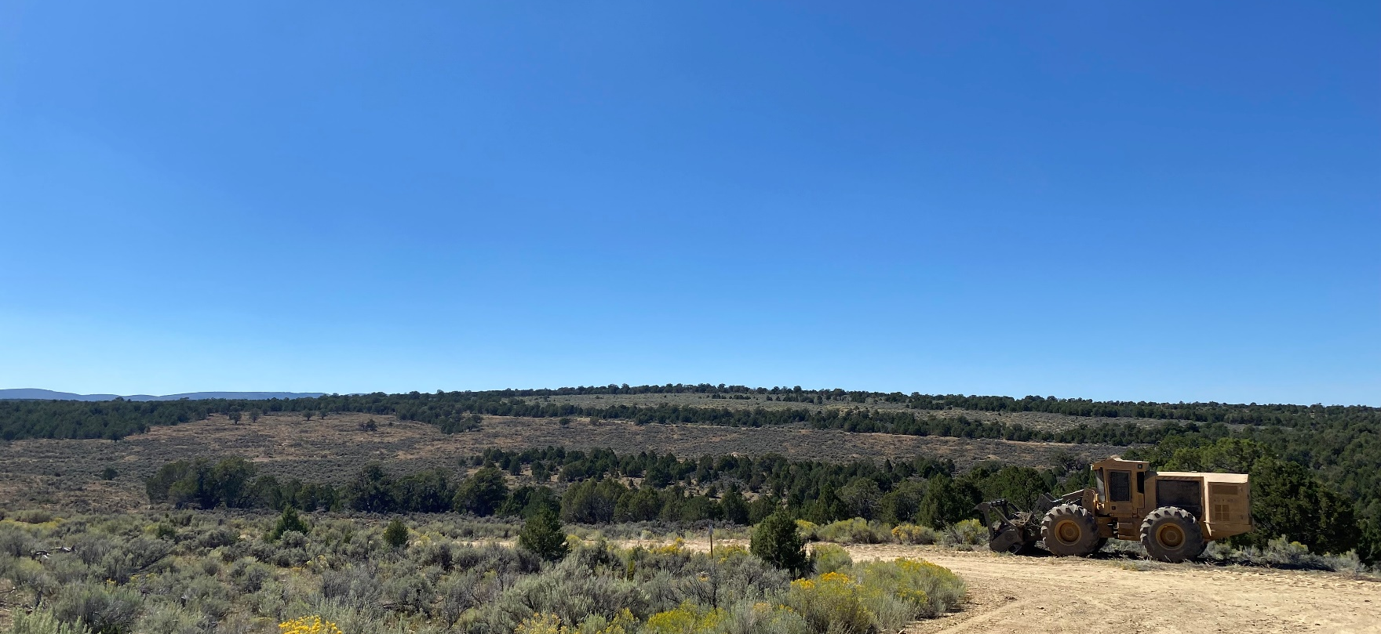
About the District:
Little Snake Field Office
Active suppression program. On BLM, LSFO averages 51 starts and 4,603 acres burned since 2003. *Does not include Moffat County fire stats.
Active fuels program. Focus on PJ encroachment that effects sage grouse habitat as well as big game habitat.
10 Year average: 10 treatments per year, for an average of 5,175 treated per year.
Previous 5 years: Average 14 treatments per year, for an average of 6,494 acres treated.
Somewhat unique in productive relationship between fuels and wildlife bio… many coordinated projects to benefit SG.
This Photo by Unknown Author is licensed under CC BY-SA-NC

Slide 22
About the District:
Little Snake Field Office
6 ‘Fires for Resource Benefit’ since 2017. Challenging to manage natural starts under anything but full suppression due to amount of SG habitat and private / state land.
Douglas Mountain RX. Challenging area to burn with VERY short windows, distance from contingency resources, isolated population of Ponderosa Pine.
Limited broadcast opportunities elsewhere in the field office. Invasives, SG habitat, and impacts to private property main concerns.
GNA and cooperative agreements in place to treat BLM and adjacent state / private lands.
This Photo by Unknown Author is licensed under CC BY-SA-NC

Slide 23
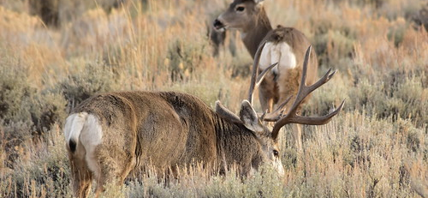
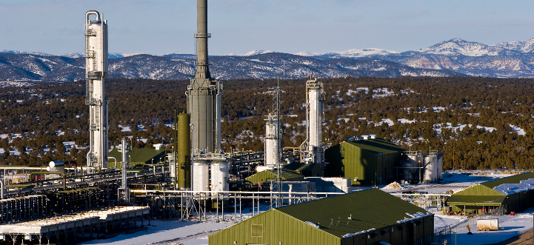
About the District:
White River Field Office
The White River Field Office includes within its administrative boundary approximately 2.7 million acres of federal, State, county, and private lands.
The area incorporates parts of Rio Blanco, Moffat, and Garfield Counties and includes the towns of Meeker, Rangely, and Dinosaur. The BLM administers approximately 1,455,900 surface acres, including minerals, and 365,000 acres of mineral estate underlying state and privately owned surface estate.

Slide 24
About the District:
White River Field Office
Vegetation varies greatly as climate changes with elevation; the western portion of the field office consists of mostly high mountain desert where temperatures can rise to the high 90’s and relative humidity drops to single digits. Fuels consist of mostly sagebrush and invasive cheat grass in the lower valleys with pinyon juniper hills and mesa tops. Moving further east and south, the vegetation changes to include mountain brush and conifer trees as the elevation increases.
Actively manage for Greater Sage Grouse (GRSG) habitat with some fire and fuels decisions.
Acres of GRSG Habitat by BLM District/Field Office in the Decision Area (BLM-Administered Surface Lands Only)
BLM Field Office | ARMPA
 | PHMA | GHMA | Total
Colorado River Valley Field Office | 24,700 | 40,200 | 64,900
Grand Junction Field Office | 5,600 | 8,900 | 14,500
Kremmling Field Office | 198,900 | 18,900 | 217,800
Little Snake Field Office | 570,400 | 479,700 | 1,050,100
White River Field Office | 122,000 | 180,200 | 302,200

Slide 25
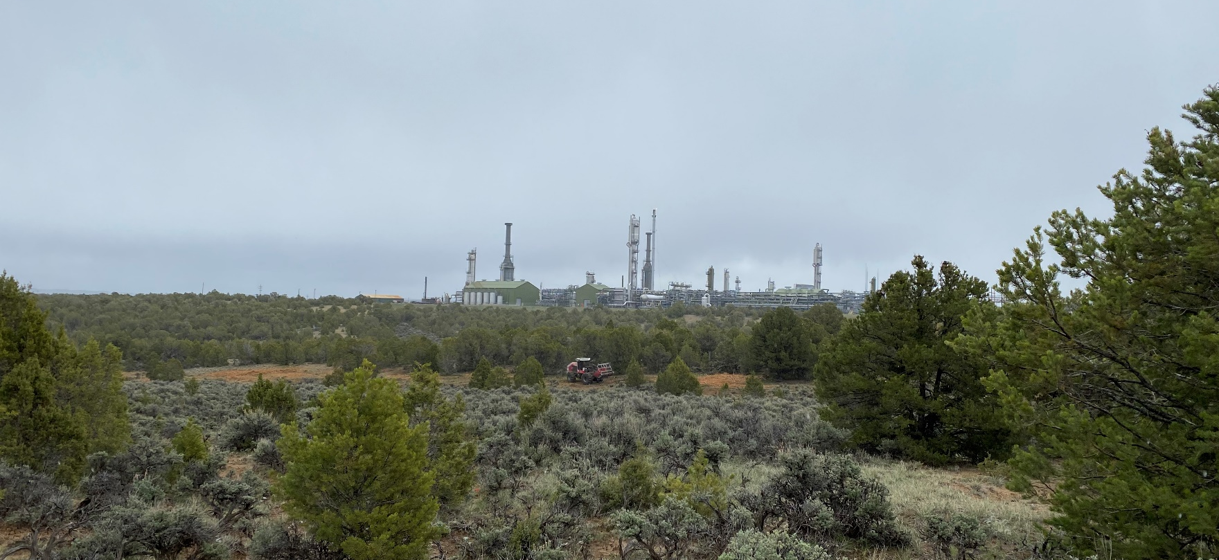
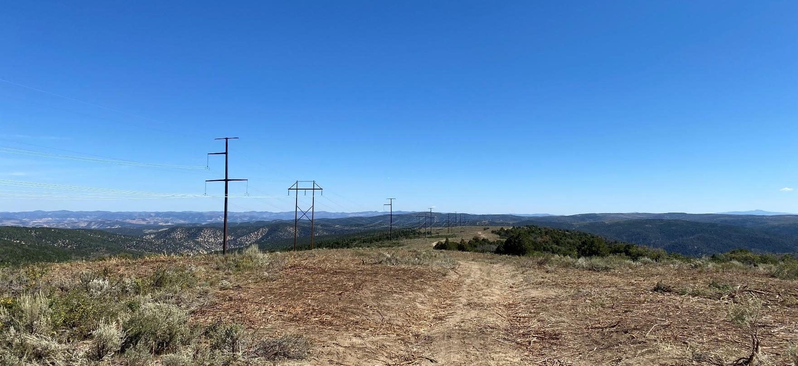
About the District:
White River Field Office
Active suppression program. On BLM, WRFO averages 94 starts and 5,398 acres burned since 2003. *Does not include Rio Blanco County fire stats.
Active fuels program. Focus on treatments that will help avoid significant wildfire impacts to electrical and oil and gas infrastructure, as well as PJ encroachment that effects sage grouse and big game habitat.
10 Year average: 8 treatments per year, for an average of 6,050 treated per year.
Previous 5 years: Average 13 treatments per year, for an average of 7,600 acres treated.

Slide 26
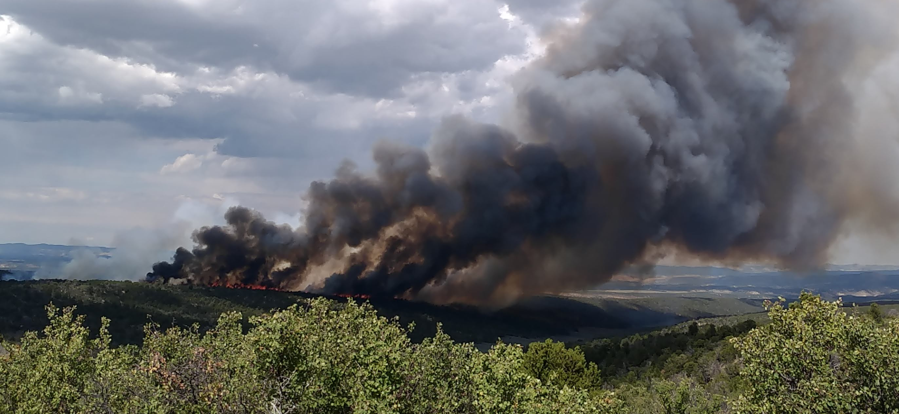
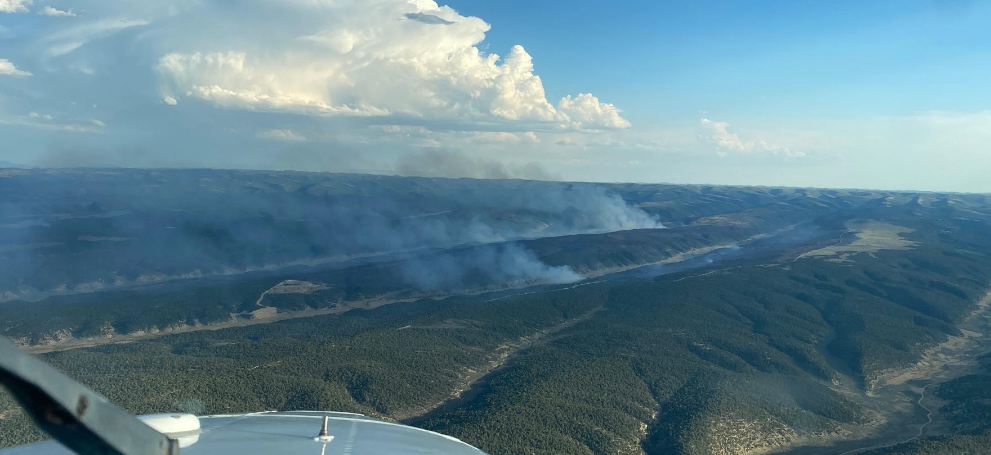
About the District:
White River Field Office
20 ‘Fires for Resource Benefit’ since 2018. Significant departure from FRCC in portions of the field office. O&G and electrical infrastructure mostly in concentrated areas.
FO Leadership have ‘progressive’ mindset towards utilizing wildfire when / where it makes sense to accomplish multiple resource objectives.
33,650 acres burned for multiple resource and fire/fuels objectives since 2018 at significant cost savings compared to full suppression or fuels treatment costs.
Limited RX opportunities due to tight burn windows, invasives and impacts to SG and big game habitat.

Slide 27
About Fuels
Overview of Fuels related treatments since 2013 (via NFPORS)

Slide 28
About the District:
White River Field Office
Number of partnerships that have been utilized to treat thousands of acres within WRFO. Include: CPW, CLB, FWS, MDF, NRCS, WRCD, Trout Unlimited, others.
Coordinated Resource Management Plans (CRMP). Are a focus in the WRFO, able to leverage outside funds with federal and state funds to meet multiple resource and fuels objectives.

Slide 29
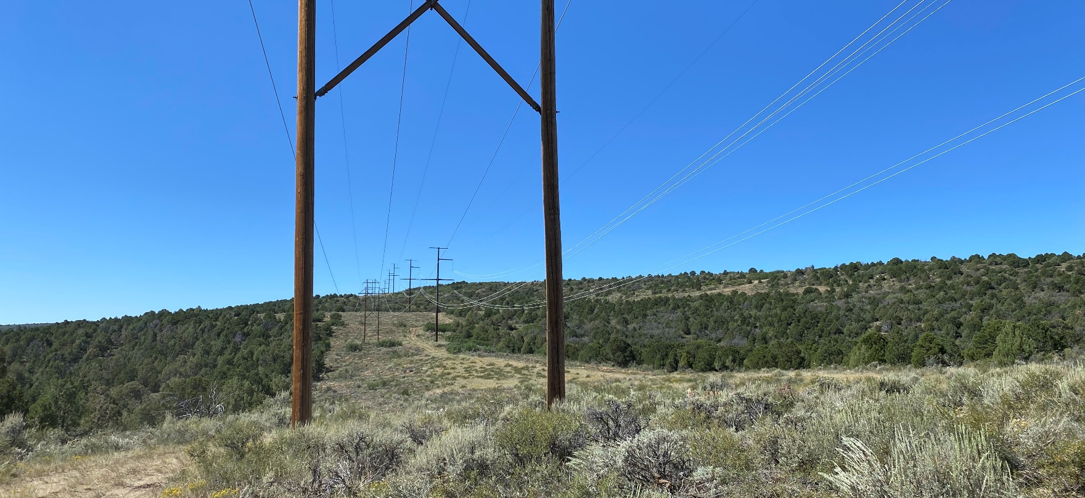
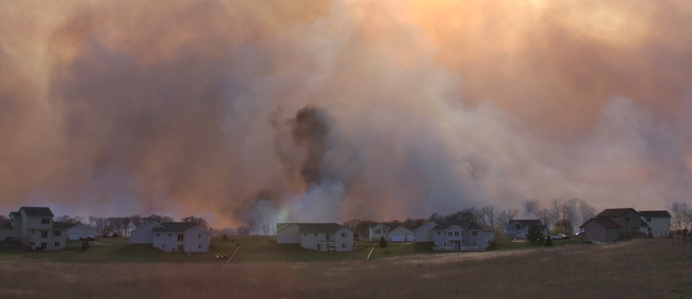
About the District:
CA / Mit Ed / Trespass
We currently have 6 community assistance agreements.
These agreements cover Moffat, Rio Blanco, Routt, and Grand counties.
The Community Assistance Program treated 915 acres in the Wildland Urban Interface in 2022
Currently our community assistance agreement with the Grand County Wildfire Council is planning to create defensible space near Sheep Mountain in Grand County. Work in these communities will increase the effectiveness of BLM and Colorado State Forest Service fuels treatments.
This Photo by Unknown Author is licensed under CC BY

Slide 30
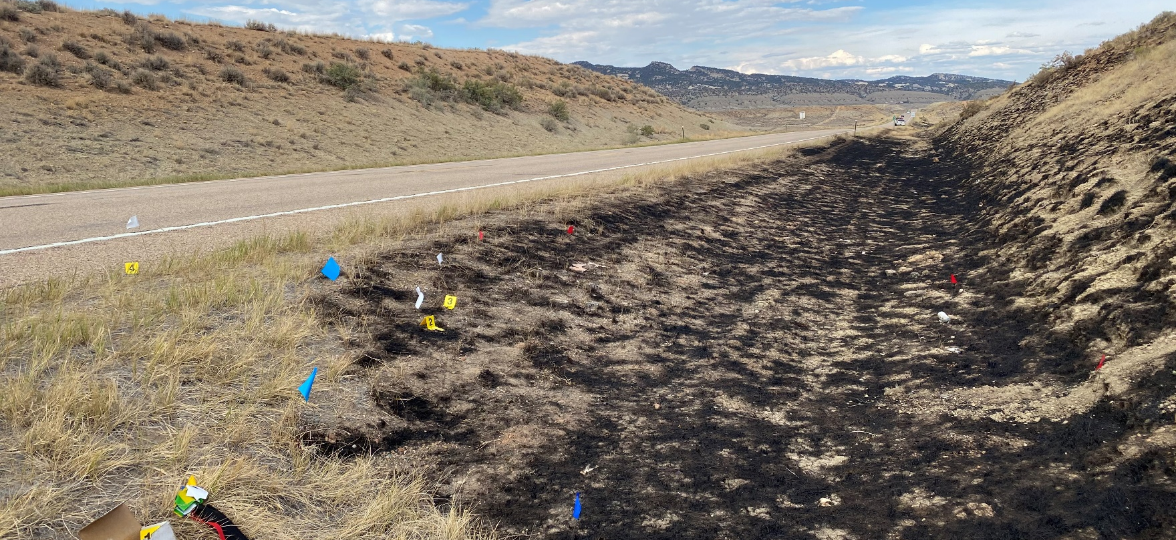
About the District:
CA / Mit Ed / Trespass
We investigate between 5-10 fires per year.
On average we send 6 cases to the Solicitor's office.
Since 2020 we have collected $939,407.00 in suppression reimbursement funds.
Funds used locally for training.
This Photo by Unknown Author is licensed under CC BY

Slide 31
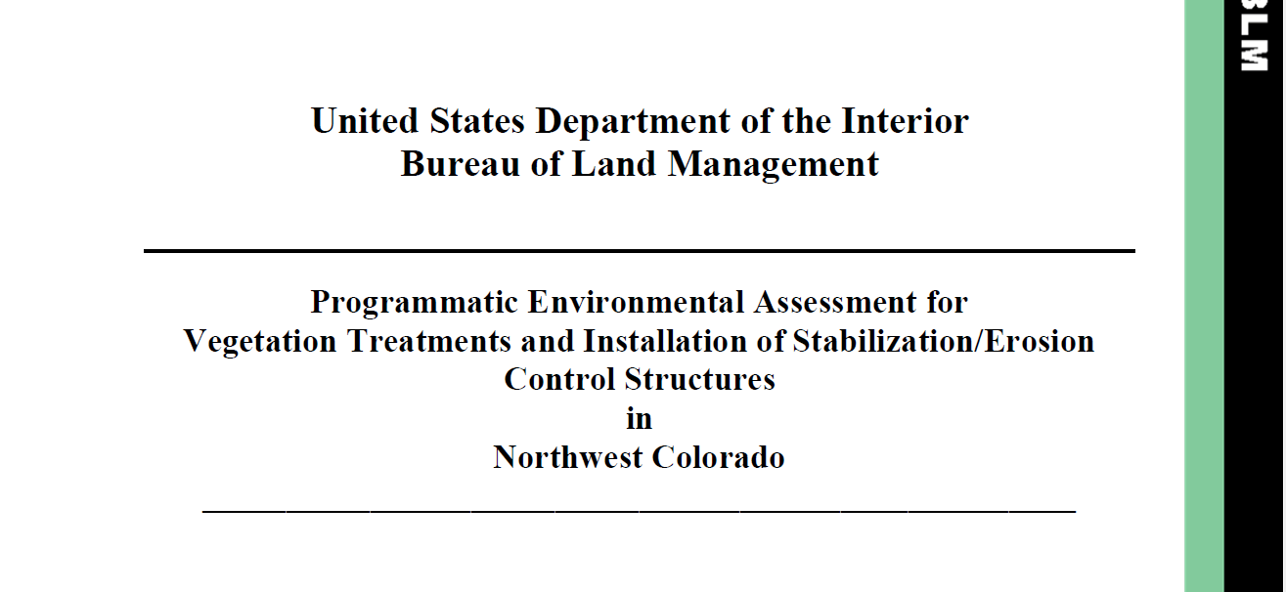
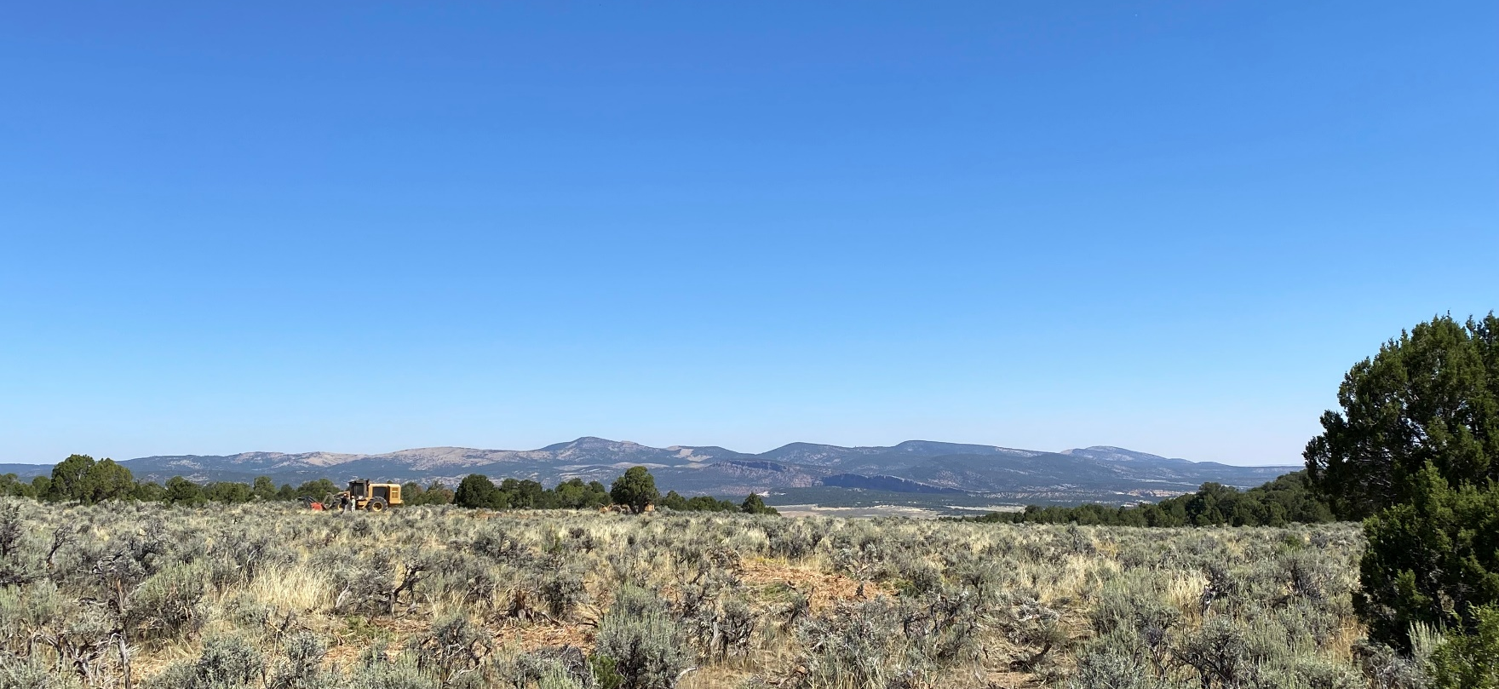
Northwest District Programmatic Veg EA.
Programmatic analysis has been critical in ramping up the number of acres available to be treated.
While the focus is somewhat narrow, it includes enough space to treat for fuels and habitat objectives.
Just under 30,000 acres analyzed for NEPA adequacy (DNA) under the EA in WRFO since 2017. *No data available in LSFO or KFO.

Slide 32
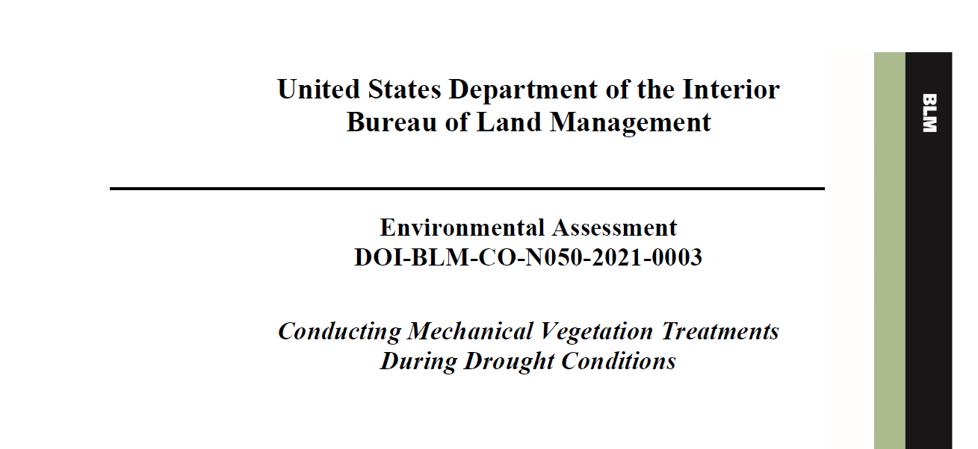
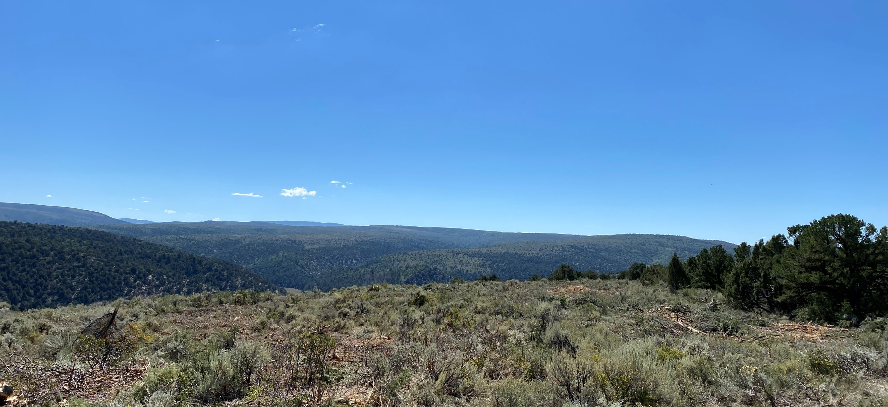
Northwest District Programmatic Veg EA.
Design feature ‘discovered’ in 2019 eliminating treatments during severe, extreme or exceptional drought.
Original intent was to avoid damage to drought stressed plants.
WRFO analyzed the effects of treatments during drought conditions under 2021 Treatment in Drought EA.
Rather than eliminating treatments all together, included an updated design feature to eliminate treatments in drought conditions during growing seasons.

Slide 33
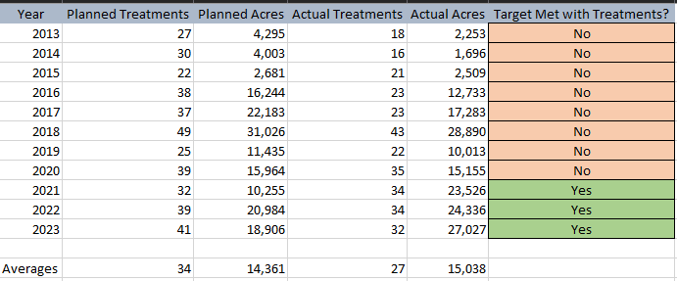
Program Overview Since 2013

Slide 34
Planning
NWD 2024
Planning Documents:
-3 EAs
-15 DNAs
-6 Smoke Permits
-Monitoring previous treatments for effectiveness and invasive species (3, 5 and 10 year cycle):
-2017 POW: 2 treatments
-2019 POW: 6 treatments
-2020 POW: 3 treatments
-Monitoring current (2022) and future treatments, AIM, Photoplots:
-2022 POW: 3 treatments
-2023 POW: Between 6 and 10 treatments planned, depending on funding
-Burn Plans: 6

Slide 35
Potential “Bumps in the Road”
NWD 2024
NEPA backlog.
Cultural clearances.
Cadastral. Not as big of an issue in LSFO and WRFO due to large blocks of federal land.
Vacancies (Fuels staff).
Vacancies (Resource staff).
DNAs tiered to the District Veg Treatment EA & recent Drought EA.
No PJ CX authority.
Contracting.

Slide 36

Workforce

Slide 37
NWD Workforce
2024 and Beyond
Working Well:
  1. Fuels Specialists are all full performance level 11’s.
  2. Starting to see ‘ladder’ positions available (i.e. Fuels Techs).
  ‘Fire Series’ (0456) could be a game changer.
Challenges:
  1. Qualified applicants (RXB2 qualification is difficult to obtain locally)
  2. 0401 series qualified applicants. Maybe this will change with Fire series?
  3.

Slide 38
Fuels Management Planning

Slide 39
NWD Fuels Management Planning
2024 and Beyond
Working Well:
  1. District Veg EA.
  2. Starting to utilize Fuels Break CX authority (BIL) to treat along linear features.
  Working on filling District Fuels planning staff.
Challenges:
  1. Funded Planning efforts
  2. Lost Mule Deer / Sage Grouse CX Authority.
  3. Vacancies in Fuels program and in Field Offices are mounting, increasing time it takes to get a project through NEPA.

Slide 40
Contracting

Slide 41
NWD Contracting
2024 and Beyond
Working Well:
  1. Current CO’s are ‘punching above their weight’ to get out large number of contracts in short amount of time
  IDIQ’s work well if used early in the FY.
  BIL Funds can be obligated via PR at any point in the year
Challenges:
  1. Capacity.
  Deadlines.
  Number of available vendors.
  IDIQ vs. Open market.
  5. Simplified Acquisition threshold.

Slide 42
Partnerships

Slide 43
NWD Partnerships
2024 and Beyond
Working Well:
  1. Partnering on projects that emphasize habitat improvement.
  2. GO-CO grant funding.
  Increasing “treatment power” of federal dollars.
  CRMP.
Challenges:
  1. Building capacity on private land.
  2. O&G mitigation acres.
  3. Extended NEPA clearance timelines.

Slide 44
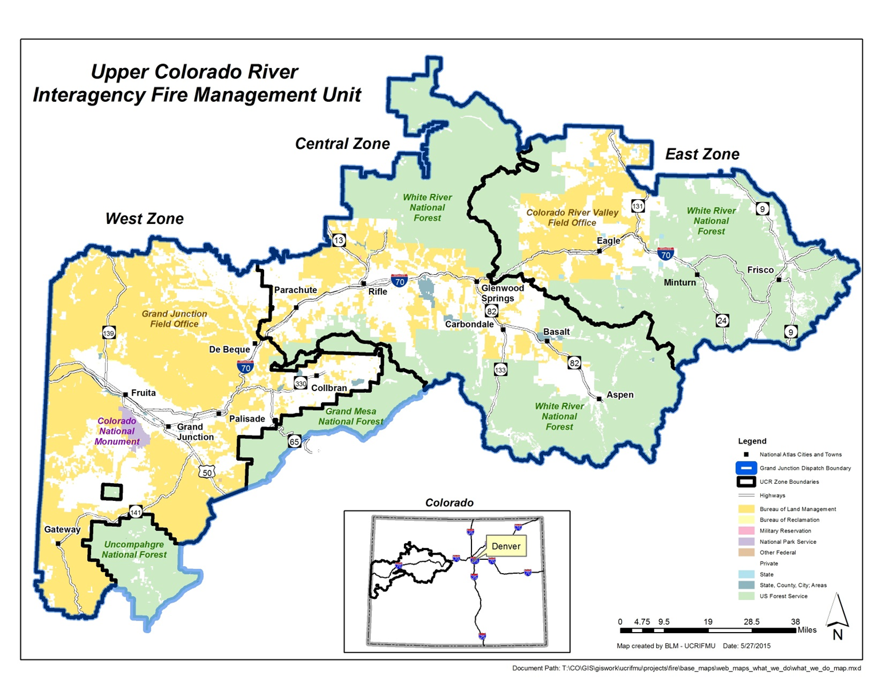

Slide 45
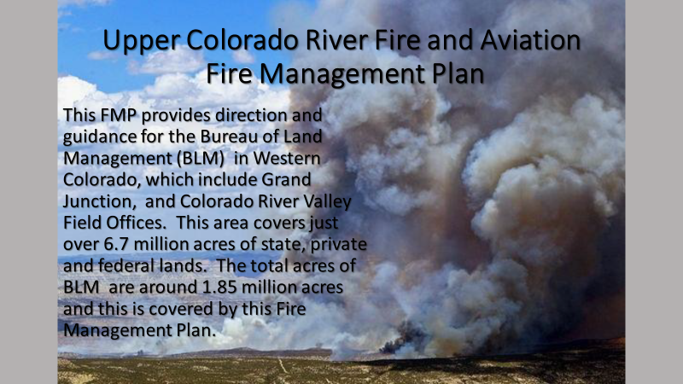

Slide 46
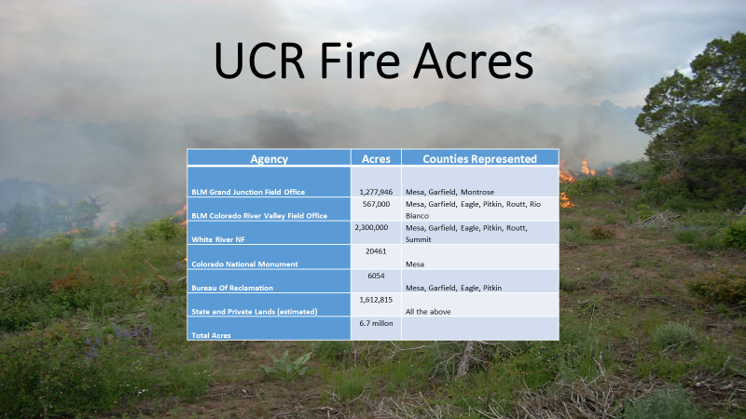

Slide 47
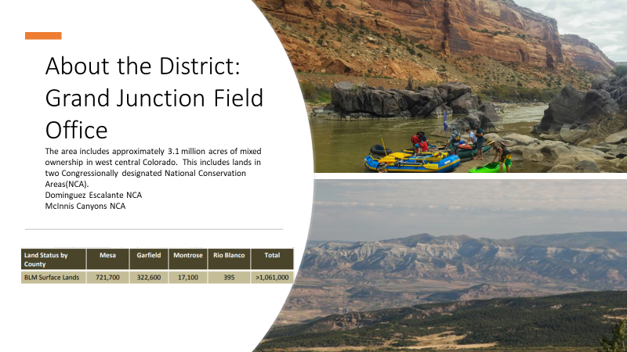

Slide 48
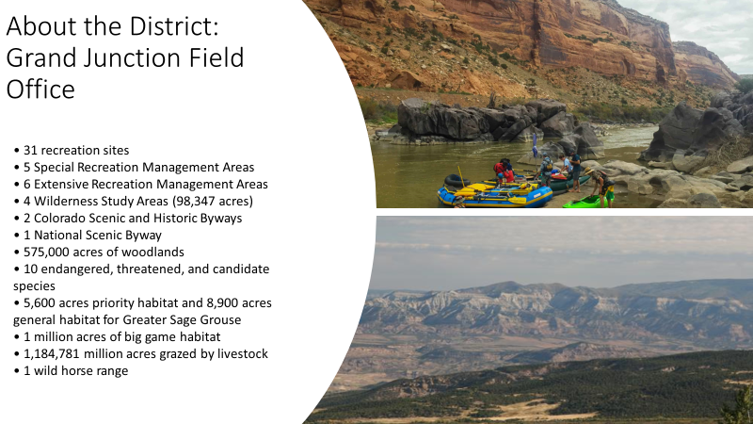

Slide 49
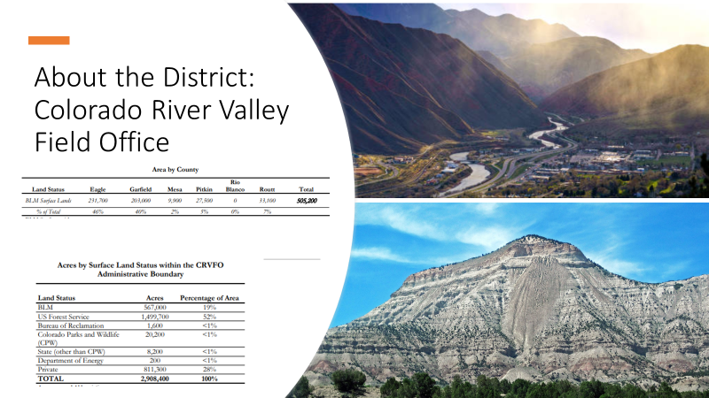

Slide 50
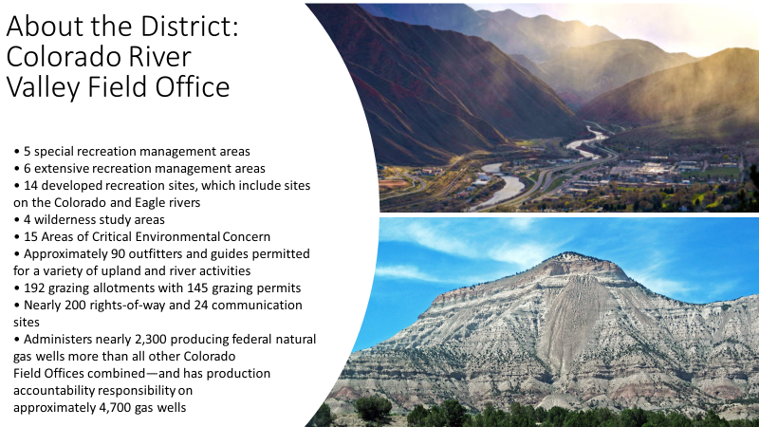

Slide 51
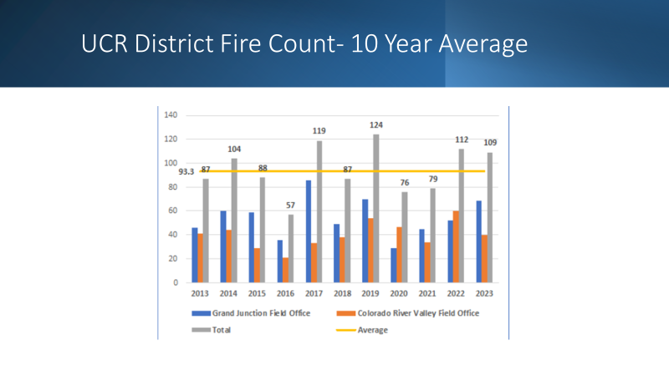

Slide 52
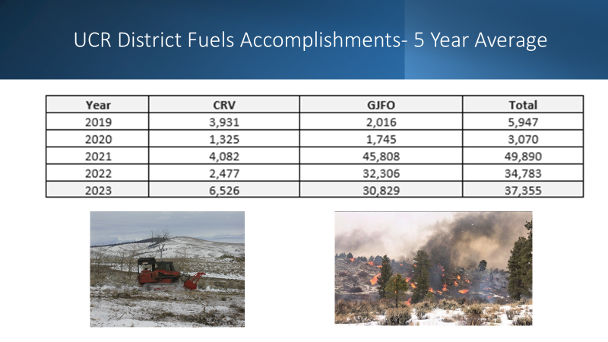

Slide 53
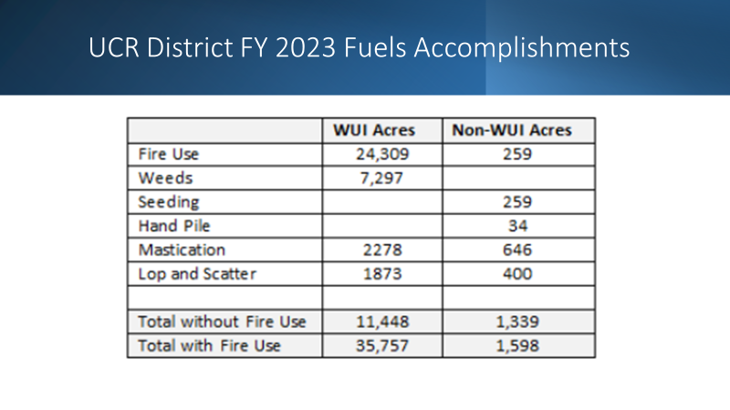

Slide 54
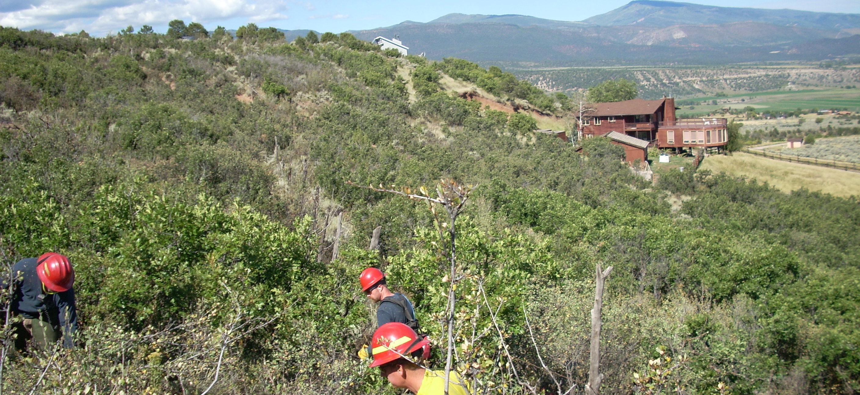
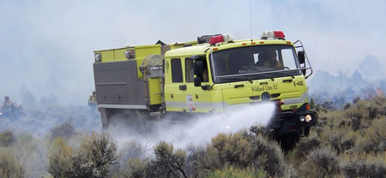
About the UCR District:
Community Assistance
UCR has 10 community assistance agreements.
These agreements cover Mesa, Garfield, Eagle and Pitkin counties.
The Community Assistance Agreements help support work being done by multiple Wildfire Collaboratives.
Used for a wide range of activities from creating Fuels Breaks to suppling fire departments with fire prevention materials.

Slide 55
Thank you for your time!
Any questions?

Slide 56
Field Manager Updates

Slide 57
Kremmling Field Office (KFO – Kremmling)
North Park Restoration Area- The Kremmling Field Office will receive 5 million dollars for investment in aquatic, riparian, wetland and terrestrial habitat improvements, fuels reduction and invasive species management will preserve historic and cultural sites and enhance recreational opportunities.
Update: The Kremmling Field Office has initiated the following projects for the North Park Restoration area.
Wheeler Creek Tributaries Stream Restoration- Colorado Open Lands will utilize low-tech process-based restoration methods of beaver dam analogs (BDAs) and post assisted log structures (PALs). The project is divided into the North and South project areas. The North Project Area will have up to 55 structures constructed within a 7-acre area on the BLM, utilizing onsite native vegetation and untreated posts. The structures will be a mix of BDAs and PALs to help connect the stream to its floodplain, create habitat diversity, and increase channel roughness. The structures are intended to be temporary, with structure monitoring to identify their effectiveness and if any initial maintenance is needed. Eventually, beavers could re-inhabit the stream and continue maintenance in the future, which may allow some structures to fail while beavers construct new structures.

Slide 58
Hebron Watchable Wildlife/Waterfowl Management Area ditch reconstruction-
Ducks Unlimited is in the process of reconstructing the Lateral B ditch supplying water to the Hebron Sloughs. The Hebron Waterfowl Management Area encompasses natural sloughs and constructed ponds in about a 9,400-acre area. Since 1975, the BLM and CPW have worked to provide high quality habitat for waterfowl, shorebirds, and a variety of other species, including pronghorn, deer, elk, moose, and sage-grouse. There are more than 160 surface acres of water, with depths ranging from 6 to 24 inches deep.
Hebron Air Quality monitoring- The Hebron area in North Park has active oil and gas exploration and development. The air quality station continually monitors weather, visibility, particulate matter, ozone, and nitrogen dioxide concentrations. From June 2022 to October 2022, samples were collected for Volatile Organic Compound lab analysis, until the funding ran out under the contract modification. The KFO used North Park Restoration Area money to restart the toxic monitoring, sampling six months of the year, especially during the winter months which are yet unsampled. The station is planned to remain at the site for at least two more years and current station conditions are publicly available online.
Bolton Draw Meadow Restoration- Wildland Restoration Volunteers will use Zeedyk rock structures and other process-based methods to stop the gully advancement and help detain runoff across the mesic meadow.

Slide 59
Blue Valley Land Exchange-
The BLM issued a Notice of Decision to exchange nine parcels, totaling 1,489 acres of Federal lands managed by the BLM in Grand County, Colorado for nine parcels totaling 1,830 acres of non-Federal lands in Summit and Grand counties, Colorado, owned by Galloway, Inc., the owners of the Blue Valley Ranch (BVR). The exchange results in a net gain of 341 acres of public land. In July 2021, the Kremmling Field Office published the Final Environmental Impact Statement (EIS) that was publicly available for 30 days. During the public availability period numerous comments were received both in support and against the land exchange. Comments were consistent with what BLM received in response to the Draft EIS. The strongest support in favor of the land exchange was received from Summit County Commissioners, Grand County Commissioners, Trout Unlimited, and Colorado Parks and Wildlife. The decision initiated a 45-day protest period.
The protest period ended March 2, 2023. Twenty-one protests were received with some of them being large in scope. The BLM is preparing responses to the protests and expects to finish later this fall.

Slide 60
Kinney Creek Stream Restoration-
The BLM issued a Notice of Decision authorizing restoration work on Kinney Creek. The work will utilize low-tech process-based restoration methods of beaver dam analogs (BDAs) and post assisted log structures (PALs).
The project will be a mix of BDAs and PALs to help connect the stream to its floodplain, create habitat diversity, and increase channel roughness. The structures are intended to be temporary, with structure monitoring to identify their effectiveness and if any initial maintenance is needed. Eventually, beavers could re-inhabit the stream and continue maintenance in the future, which may allow some structures to fail while beavers construct new structures.
Fuels Project (Update) FY23 Fuels EA (3,500 acres)-Fuels reduction and Hazard Tree Removal in the Blacktail, Cow Creek, Little HO, McQueary, and San Toy project areas has an expected implementation summer of 2024, pending the outcome of archeological surveys.

Slide 61
White River Field Office (WRFO – Meeker)
Wild Horse and Burro Program-
Meeker Mustang Makeover (MMM)-
This year’s MMM took place August 25-26, 2023, at the Rio Blanco Fairgrounds in Meeker. The MMM is an event where horse trainers from across the West come together to compete for prize money and scholarships after only 120 days of training a Wild American Mustang. This year’s event featured horses from the Piceance-East Douglas Herd Management Area, all the horses were adopted following the event. The WRFO continues to partner with MMM for assistance with this and future events, planning and processing adoption applications.
Adoptions-
There will be an adoption event in Florence, CO October 13th, and 14th. This adoption will feature approximately 35 animals some from the Piceance-East Douglas Herd Management Area.
West Douglas Herd Area Gather-
The WRFO completed the removal of 122 wild horses from the West Douglas Herd Area between September 1 and 8th. WRFO will be evaluating to identify if there are remaining horses within the herd area over the next few months.

Slide 62
Minerals and Lands Program-
Oil and Gas Development- The WRFO currently processes the oil and gas for all three field offices in the Northwest District (Kremmling Field Office (KFO), Little Snake Field Office (LSFO), and the WRFO). There are approximately 4,000 active oil and gas wells located within the Northwest District Office (approximately 3,400 in WRFO, 300 in LSFO, and 200 in KFO). The largest oil and gas workload is located within the WRFO. In 2022, the WRFO’s processed a total of 45 Applications for Permits to Drill (APD) (43 in WRFO, 0 in LSFO, and 2 in KFO). Currently, WRFO is processing 60 APDs as part of operators’ multi-year plans of development for two separate companies. WRFO has been monitoring three active drilling rigs located in the Piceance Basin with plans of perhaps increasing that number to 4 by the end of the year. The FO is working with Chevron USA to complete the plugging and closure of the Wilson Creek Field.
The field office also processes approximately 2,000 sundry notices annually. The WRFO completes the oil and gas inspection and enforcement covering all three field offices. The WRFO anticipates completing over 370 total oil and gas inspections (265 within WRFO and 105 within LSFO and KFO planned). The FO is currently working to secure funding for work to be completed on four orphan wells within 2023.
Solid Minerals- The WRFO oversees Natural Soda’s mineral development of sodium bicarbonate. The WRFO recently approved the development of two new solution wells for continued development of their sodium lease.

Slide 63
Land Tenure Adjustments-
Buffalo Horn Land Exchange: In January 2021, the BLM issued a decision to approve a land exchange with Buffalo Horn Properties, LLC that would convey 14 parcels of Federal lands in Rio Blanco and Moffat Counties in the Strawberry Creek area (total of 2,652 acres) to acquire one parcel of non-Federal lands in Rio Blanco County in the Smith Gulch area (total of 1,327.06). (Note: Land exchanges are balanced based on appraised values rather than acreage.) The BLM will also accept Buffalo Horn's offer to donate four parcels of non-Federal land in Rio Blanco County (totaling 508.2 acres) that are isolated "inholdings" between the non-Federal exchange parcel and other BLM-managed public land. The BLM received three protests of the decision to move forward with the land exchange. On September 7, the Colorado State Director issued a decision to dismiss the protests. This initiated a 30-day appeal period.
Realty Infrastructure Projects-
Carbon Sequestration: The WRFO has received an application for a carbon sequestration project located within Rio Blanco County. The site is being proposed for injection of up to 750,000 metric tonnes (MMt) of CO2, within two injection zones. The proposal would inject CO2 below the Mancos Shale at a depth between 12,000 and 15,000 feet. The project would issue a subsurface pore space right-of-way for 150,000 acres. The proposal will also include surface infrastructure including injection facilities as well as pipelines to connect the CO2 sources to the injection facilities.

Slide 64
Recreation Program-
The WRFO recreation program staff is working with partners, the Town of Meeker, Eastern Rio Blanco Parks and Recreation district (ERBM), and local volunteer group Meeker Area Mountain Biking Association (MAMBA) constructing the new Anderson Gulch Trail, part of the Meeker Trails System. The trail is approximately 60 percent complete and is projected to be completed this fall. BLM worked with Rocky Mountain Youth Corps (RMYC), MAMBA, and BLM South zone Fire for initial construction of the trail during summer 2022. A RMYC specialty saw crew came out in July 2023 to continue to work on the trail. The trail will be an approximate 2-mile single track addition to the 22-mile trail system.
The WRFO completed stage one of the travel management implementation in the LO7 and North Rangely Open areas last month. RMYC camp crews will assist with implementing travel management signage, post and pole fencing, and an OHV skills course with obstacles. BLM engineering and contractors completed implementing road and parking lot improvements, installed loading ramps in both open areas, and installed a vault toilet at LO7. These projects were funded by the WRFO, Colorado State Office Colorado Youth Corps Association (CYCA) agreements, deferred maintenance, and a CPW state trails grant. The CPW Northwest Motorized Trails Crew assisted WRFO Recreation staff with the skills course design, heavy equipment, and operators the third week of June. Other partners who have helped with the project are Rio Blanco County Road and Bridge Department, and RMYC. The open areas are unique for the field office, and offer diverse, unique OHV recreation opportunities.

Slide 65
WRFO has been awarded a CPW state motorized trail grant for FY 24 that will help pay for two seasonal GS-7 Park Rangers, a utility OHV and trailer, as well as travel management signage, personal protective equipment, and other supplies. This grant will assist WRFO with much needed route maintenance, travel management signage, monitoring dispersed recreation sites, visitor contacts, and increase BLM presence on the ground.
WRFO administers approximately 65 Special Recreation Permits including Outfitters & Guides, OHV events, educational backpack outdoor ethics tours, paleo digs, and cultural interpretive tours. Staff also held two cultural 4th-grade elementary school field trips for Rangely and Meeker students who were presented with Every Kid Outdoor (EKO) pass.

Slide 66
Little Snake Field Office (LSFO - Craig)
Large Power Transmission Lines- PacifiCorp’s Gateway South and TransWest Express (update): Gateway South (GWS) construction started in June 2022. The CO portions are in full construction with wire stringing operations occurring throughout the alignment. Reclamation efforts are occurring on pad and pulling and tensioning sites. Construction will continue the rest of the year as weather allows or until big game winter range restrictions begin in December. TransWest Express (TWE) received their Notice to Proceed (NTP) on April 10, will begin limited construction in WY this year. Construction within CO will occur in 2024.
Lands with wilderness characteristics (LWC) and GRSG mitigation funding from the TWE project were agreed upon and have been deposited with National Fish and Wildlife Foundation (NFWF) (approximately $4 million dollars for LWC and $7-9 million dollars for GRSG).
Wilderness Lands-
NFWF has awarded the grant money collected for compensatory mitigation funds for authorized impacts of the GWS Transmission Project to LWC lands in Colorado. Two proposals related to LSFO were awarded $3.2 million dollars and $1.9 million dollars respectively. The awards were made for proposals from two consulting firms in conjunction with partners and collaboration with the field office. One of the proposals will conduct work near Cross Mountain and the other will involve work on Wilderness Study Area (WSA) and LWC wilderness lands throughout the field office.

Slide 67
Greater Sage Grouse Funds-
The first round of proposal evaluation is complete, and the applicants have been notified whether they are welcome to resubmit proposals for the Round 2 evaluation. The Round 2 submittal deadline was in mid-August. It is expected that award decisions will be made in November of 2023.
National Public Lands Day Event-
On September 23, LSFO recreation staff held a National Public Lands Day event with Routt County Riders and the Steamboat Adaptive Recreational Sports (STARS). The event was held at the Emerald Mountain Special Recreation Area and involved trail work that would increase access to the Rotary Trail for all users. The goal of the event was to help users who need wider trails to navigate with assisted or adaptive modes of transportation. The completed volunteer work will ensure that everyone can use the trails regardless of their circumstances to include various adaptive sports equipment.
Recreation events in the field office-
Several events covered under Special Recreation Permits (SRPs) were held during late summer and fall, including the Emerald Mountain Epic in early August and the Sand Wash Enduro Race which was delayed from June due to wet area conditions. The Epic is a mountain bike and running race held over two days and the Enduro is a two-day motorized OHV event. Both events were well attended and compliance with the permit stipulations was good.

Slide 68
Hunting season has arrived-
The LSFO administers over 60 SRP permits related to hunting guides and outfitters. LSFO lands are utilized by resident and non-resident hunters alike and our Park Ranger will be traveling around BLM lands this fall, providing information to the public about trails, access, and OHV regulations.
Outcome Based Grazing Pilot Project-
In 2023, LSFO issued Colorado’s only grazing authorization within BLM’s Outcome-Based Grazing Pilot Program (OBGA). In June of this year, LSFO hosted several interested individuals, program participants from other field offices, and BLM staff for the OBGA program annual meeting as an opportunity to meet with the permittee, their consultant, and LSFO staff. LSFO will be presenting this project during a symposium at the 2024 Society for Range Management Annual Meeting in Sparks, NV.

Slide 69
Sand Wash Herd Management Area-
LSFO and NWD staff completed a Determination of NEPA Adequacy to approve the construction of permanent bait traps within the Sand Wash HMA. The bait traps are part of a strategy to remove smaller numbers of horses on a more frequent basis, help facilitate ongoing fertility control efforts, more consistently maintain the herd size within the Appropriate Management Level over time and reduce the need for large scale helicopter gathers.
Wild Horse Refuge-
In 2023, Pat Craig of the Wild Animal Sanctuary purchased approximately 17,000 acres of the former Rio Ro Mo Ranch with the intention of creating The Wild Horse Refuge as a home for titled former wild horses. The 17,000 acres serves as qualifying base property for, and is intermixed with, approximately 5,000 acres of public land across three grazing allotments. Pat has applied for and acquired the grazing preference for these allotments and will be working with LSFO staff for an application to change the class of livestock on the authorizations from sheep and cattle to horses. Pat has retained the services of a range consultant to aid in crafting a management plan suitable for the resources on the allotments and the LSFO will be analyzing his proposed management plan in an EA over the winter of 2023/2024.

Slide 70
Upper Colorado River District (UCRD)
Supplemental EIS/RMP for Colorado River Valley Field Office (CRVFO) and Grand Junction Field Office (GJFO):
CRVFO and GJFO continue to work on the court ordered Supplemental EIS to address issues related to analysis of downstream greenhouse gas emissions and the range of alternatives for acres available for leasing under their 2015 RMPs and Records of Decision. The CRVFO consolidated oil and gas team is writing the EIS, with support from a contractor managed by the Colorado State Office. The comment period for the Draft EIS is open, with comments accepted until November 1. Three public meetings were held in September to help answer questions on the Draft Supplemental EIS. In-person meetings were held in Glenwood Springs and Grand Junction, and one meeting was virtual. The BLM expects to release a final EIS and Proposed Plan summer of 2024.

Slide 71
Grand Junction Field Office (GJFO) including
McInnis Canyons National Conservation Area (MCNCA) and
Dominguez-Escalante National Conservation Area (DENCA)
Low Elevation (Desert) Rangeland Management-
The Grand Junction Field office (GJFO) is looking for the most innovative methods to manage rangelands; specifically, rangelands that have converted to cheatgrass from past management. GJFO has had many low elevation rangelands transition over the years to be cheatgrass dominated and is working on developing a best management practices plan for rangelands that are in this state.
This project would include looking at the most recent research studies done on cheatgrass rangelands and incorporating that information into a best practices management action plan. Mapping and identifying these areas with the best available data would also be part of this project to help management identify which rangelands to focus management on and what would be the best course of action. The project deliverable will be a report that will help prioritize where and how the office can be most effective at managing these areas to return them to perennial rangelands.

Slide 72
Special Status Species Grazing EA-
The GJFO is planning to reissue 24 grazing permits with revised terms and conditions on 29 grazing allotments that have Colorado hookless cactus and Debeque phacelia (two threatened species). A comment period on the proposed EA started June 15 and ended on July 14. The 12 conservation measures approved by the USFWS would be added to the permits.
North Fruita Desert Trails Master Plan-
In April 2022, BLM signed an Environmental Assessment approving the North Fruita Desert Trails Master Development Plan which includes 32 miles of new trails and trail reroutes and authorizes the use of Class 1 e-bikes on current and future trails in the North Fruita Desert (NFD) Special Recreation Management Area. The Mesa County Trail Crew, Western Colorado Conservation Corps, and volunteers began construction of the new trails and have completed approximately 12 miles of new singletrack trails.
Bangs OHV trail planning and development-
Approximately nine miles of new OHV trails (ATV, motorcycle and 4x4 rock crawling) routes were completed and opened to the public in 2022. Most of the construction was completed by OHV crews funded by Colorado Parks and Wildlife OHV grants. Planning is completed for another six miles of proposed OHV trails in the Bangs Special Recreation Management Area that are planned for construction in the summer and fall of 2023.

Slide 73
Lands and Realty-
Monument Trail-
The Grand Junction Field Office is working with the City of Grand Junction to process their requested right-of-way grant for the Monument Connector Trail, which is an extension of the existing Monument Trail bike path. The path extension would connect the Lunch Loops (Tabeguache) Trailhead to South Camp Road. The City of Grand Junction is also partnering with Colorado West Land Trust on this project.

Slide 74
McInnis Canyons National Conservation Area
Rabbit Valley Campgrounds-
The Grand Junction Field Office implemented an online reservation system for overnight camping on February 1, 2023, for the five campgrounds in the Rabbit Valley area of McInnis Canyons National Conservation Area. The Recreation.gov online reservation system will help manage the increased popularity of the area and will ensure campsite availability prior to arrival. Do to extenuating circumstances connected with the long winter, campsite construction is not yet complete. The BLM is working with the contractor on a regular basis and has limited the reservation of incomplete campsites on rec.gov. The delay has resulted in some visitor confusion. The GJFO is actively engaging the public through regular patrols, signage, and social media.
Visitors may make online reservations at www.recreation.gov or call 1-877-444-6777. Reservations can be made up to six months in advance or on-site using a mobile device. The Equestrian campground will be closed to the public from February through April each year to accommodate livestock operations. The camping fee is $20 per night plus an $8 transaction fee for each reservation. Approximately 50 percent of the sites in each campground will be available for online reservations on a six-month rolling window, with the rest of the sites available on a four-day rolling window to accommodate spontaneous trips. Camping in the McInnis Canyons National Conservation Area is limited to 7 nights per month.

Slide 75
Dominguez-Escalante National Conservation Area (D-E NCA)
Gunnison River Campsite Designation and Permit System-
The BLM implemented a decision from the 2017 D-E NCA RMP to require overnight boaters on the Lower Gunnison River, from Delta to Whitewater, to obtain a permit. BLM staff updated signage and conducted outreach regarding the change with places like Mountain Buzz and American Whitewater. For now, the BLM has implemented a free, self-issued, permit that is filled out on-site. Compliance is estimated at 50-70% and compliance is expected to increase with additional education and outreach.
Moving forward, the BLM will refine the permit system, implement a reservation system, designate river campsites, and develop an allocation for permitted outfitters. Staff spent over 50 days in the field conducting outreach to the public and soliciting input to the planning process. Staff also contacted river outfitters and collaborated with partners like Colorado Canyons Association for outreach. BLM drafted a proposed action for campsites along the Gunnison River and conducted public scoping on the proposal during the winter of 2021.
The BLM received over 100 comments – several substantive comments have shaped the proposed action and alternatives in the Environmental Assessment (EA). The BLM released the Preliminary EA on June 7 for a 30-day public comment period that will end on July 6.

Slide 76
Cactus Park Special Recreation Management Area-
The 2017 D-E NCA RMP designated the Cactus Park Area as a Special Recreation Management Area targeting family friendly motorized trail riding and associated camping.
The BLM is currently working with Western Slope ATV Association (WSATVA) on projects to improve recreation opportunities and protect sensitive resources in the area. WSATVA received a motorized trail grant from CPW to conduct archaeological surveys on the proposed new Ponderosa Loop Trail. In addition, the BLM is working on layout and design of the Farmers Canyon Trail reroute. This will reroute users outside the mule deer winter range that is closed to travel during the winter to protect mule deer. The BLM completed biological surveys and finished the archaeological surveys during spring of 2022.

Slide 77
Colorado River Valley Field Office (CRVFO – Silt)
Resources
Horse Creek Stabilization Work-
The CRVFO completed the first phase of a project to stop the upstream migration of headcuts and resulting stream channel incision along Horse Creek, a small perennial stream approximately ten miles north of Dotsero, to help protect the existing riparian corridor and resident fishery. Phase I involved road improvements and using heavy equipment and large boulders to build stabilization and grade control structures in critical areas. Additional structures are planned for next year. Once stabilized, the BLM will investigate the causal factors contributing to the headcutting and work to reduce or eliminate future risk.
Integrated Fuels and Habitat Improvement Projects-
The CRVFO is in various stages of planning and implementing several integrated vegetation management projects including the following:
Stifel Creek –
The Upper Colorado River District Fuels program will be implementing the selective thinning of pinyon and juniper woodlands in the Stifel Creek area. A mix of mechanical and hand thinning is proposed to accomplish restoration of sage and woodland habitats.

Slide 78
Sutey Ranch Targeted Goat Grazing –
This is the fourth year that the CRVFO has contracted Goat Green LLC to use targeted goat grazing to improve soil conditions and increase plant diversity in the former agricultural fields. This treatment also reduces fuel loads around the historic buildings. The goats are expected to arrive in mid-October.
Proposed Fuels Treatments in the King Mountain SRMA –
The CRVFO is in the early stages of collaborating with partners including Colorado State Forest Service, range permittees, water users, conservation groups and elected officials on proposed fuels reduction treatments in the King Mountain SRMA. This area is within Routt County south of the town of Toponas. Approximately 3,000 acres could be mechanically treated over multiple years using Good Neighbor Authority with the Colorado State Forest Service to reduce hazardous fuels and maintain access to infrastructure including range fences and access routes.

Slide 79
Energy, Lands and Minerals
Mid-Continent Quarry Updates-
Noncompliance and Rock Fall - The BLM’s work with RMI to address the noncompliance Order that BLM issued last August for exceeding authorized acres (among other items) has been delayed following the large rockslide that occurred in January. This event resulted in interagency coordination with the U.S. Mine Safety and Health Administration (MSHA) and Colorado Division of Reclamation, Mining and Safety (DRMS).
Ultimately, this event triggered the need for RMI to provide the agencies with a geotechnical engineering report, which includes two parts. The first part is an analysis of the rockfall, the contributing factors, and why it potentially failed like it did. Part two, which the BLM recently received includes an analysis of how likely the highwall areas are to fail again along with some stabilization methods that could be used. It also includes recommendations for mining above the rockfall and how to do that to prevent future failures. After BLM understands how much additional ground disturbance may be needed to stabilize the highwall, it will resume follow-up actions needed to address the noncompliance.

Slide 80
DCV and Proposed Expansion-
The BLM is in the final review stages of the Determination of Common Variety Report (DCV), which was initiated in Spring 2019 by BLM mineral examiners. DCVs are needed to help inform whether the mineral deposit that RMI is currently mining and proposes to expand is an uncommon variety and locatable under the 1872 Mining Law, or common variety. After review of the DCV findings is completed, BLM will identify the appropriate next steps guided by law, regulation, and policy. This could include moving forward with the hydrologic baseline study and Ethnography to help inform a proposed expansion at the original or a reduced scale, or other potential paths.

Slide 81
Oil & Gas
West Mamm Oil & Gas Pipelines Project-
Project Information: TEP Rocky Mountain LLC (TEP) is requesting new Rights-of-Ways (ROWs) from the Bureau of Land Management (BLM) for the installation and operation of a new buried 8-inch produced water pipeline and a new 6-inch produced water pipeline about 7 miles south of Rifle, CO. Installation of the buried 8-inch produced water pipeline would also require Special and Temporary Use permits from the U.S. Forest Service (FS). The proposed 8-inch produced water pipeline would connect TEP’s existing and proposed West Mamm Creek development to their existing water transfer system at the existing RU 42-7 pad. Access to the proposed 8-inch and 6-inch produced water pipelines would be on existing Fee lease roads, county roads, National Forest System Road (NFSR) 818, and existing BLM lease roads and two tracks. The produced water pipelines would cross BLM lands managed by the Colorado River Valley Field Office (CRVFO), National Forest System (NFS) lands managed by the White River National Forest’s (WRNF) Rifle Ranger District, and private lands in Garfield County, Colorado. The 6-inch and 8-inch water pipelines would be installed in the same trench.

Slide 82
Grand River Gathering, LLC (GRG), a wholly owned subsidiary of Summit Midstream Partners, LP (Summit) is requesting Special and Temporary Use permits from the FS to construct and operate two co-located, up to 8-inch diameter low pressure natural gas pipelines. The 8-inch natural gas pipelines would begin at the proposed WMC 24-29 pad. One of the pipelines would terminate at the existing McClung Central Delivery Point (CDP). The other would terminate at Summit’s Rose Valve Yard. The natural gas pipelines would cross NFS lands, managed by the WRNF’s Rifle Ranger District and private lands. In locations where the proposed 8-inch natural gas pipelines parallel the proposed produced water pipelines, they would be installed in the same trench at the same time by the same contractor.
TEP’s 6-inch and 8-inch produced water pipelines would be co-located in the same trench and would require a 30-foot ROW (COC 80870) from the BLM. A separate ROW (COC 80933) would be required from the BLM for pipeline access. A short-term ROW (COC 80941) would be required for temporary use areas including 20-feet along the pipeline length and 25 feet for existing road and pipeline crossings. GRG’s 8-inch natural gas pipelines would also be co-located in the same trench as the TEP produced water pipelines and would require a 30-foot permanent ROW from the FS. On NFS lands, special use and temporary use permits would be required from the FS for TEP’s 6-inch and 8-inch produced water pipelines and GRG’s 8-inch natural gas pipelines.

Slide 83
Current and Forecasted Drilling Activity-
Currently, there are no active drill rigs working in the CRVFO or GJFO. We do have an operator that has submitted APDs for 3 federal wells on one pad and 8 federal wells on another. Another operator has submitted 3 APDs for the area in the Uncompahgre Field Office that is permitted by the CRVFO. In addition to drilling, the CRVFO has worked with a few operators to continue to plug wells through the summer and into the end of Fiscal Year 2023, primarily in the GJFO. Drilling and plugging activity are anticipated to continue at a similar into and through Fiscal Year 2024.
Trespass and Similar Issues/Activities-
Trespass - The CRVFO has a growing list of trespass cases where private landowners have inadvertently, or in some cases, knowingly occupied BLM managed lands with items including debris, fencing, vehicles, structures, and motorized trails. Our realty specialists, law enforcement ranger, and Colorado State Office surveyors are working on both backlogged and new cases as we learn about these trespasses.
Residing on Public Lands and Abandoned Vehicles-
These are both a growing resource and law enforcement issue as the cost of living remains an issue in the Colorado, Roaring Fork and Eagle River Valleys. Both issues have the unfortunate direct effect of occupying law enforcement’s time, creating an increased risk of hazardous materials cleanups, and the cost of towing and disposing of abandoned vehicles to local landfills continues to increase.

Slide 84
Closing Remarks
Your Public Lands – 245 Million Acres of Possibilities
Supporting Text
Notes:
Reimagining Your Public Lands is a year-long campaign to celebrate 75 years of the BLM as well as open the door for how the agency moves forward including how we interact with the public, approach partnerships, and encourage responsible use of America’s public lands.
This is the vision of the anniversary campaign, culminating in Dec. 2021.

