Slide 1
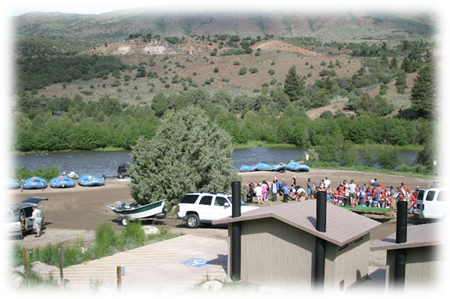
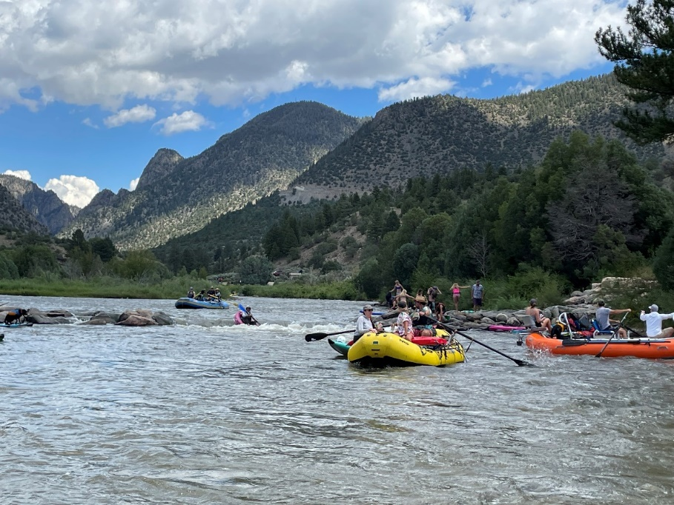
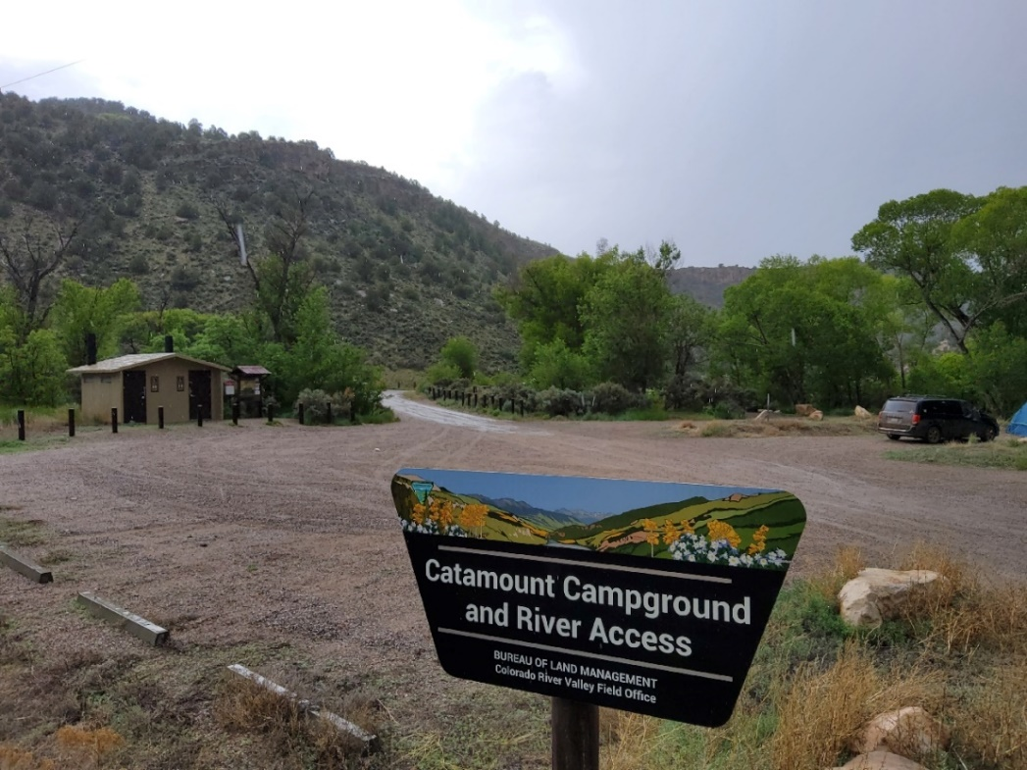
Colorado River Valley Field Office - Kremmling Field Office
Coordinated River Management
Combined Business Plan for the Upper Colorado River SRMAs

Slide 2
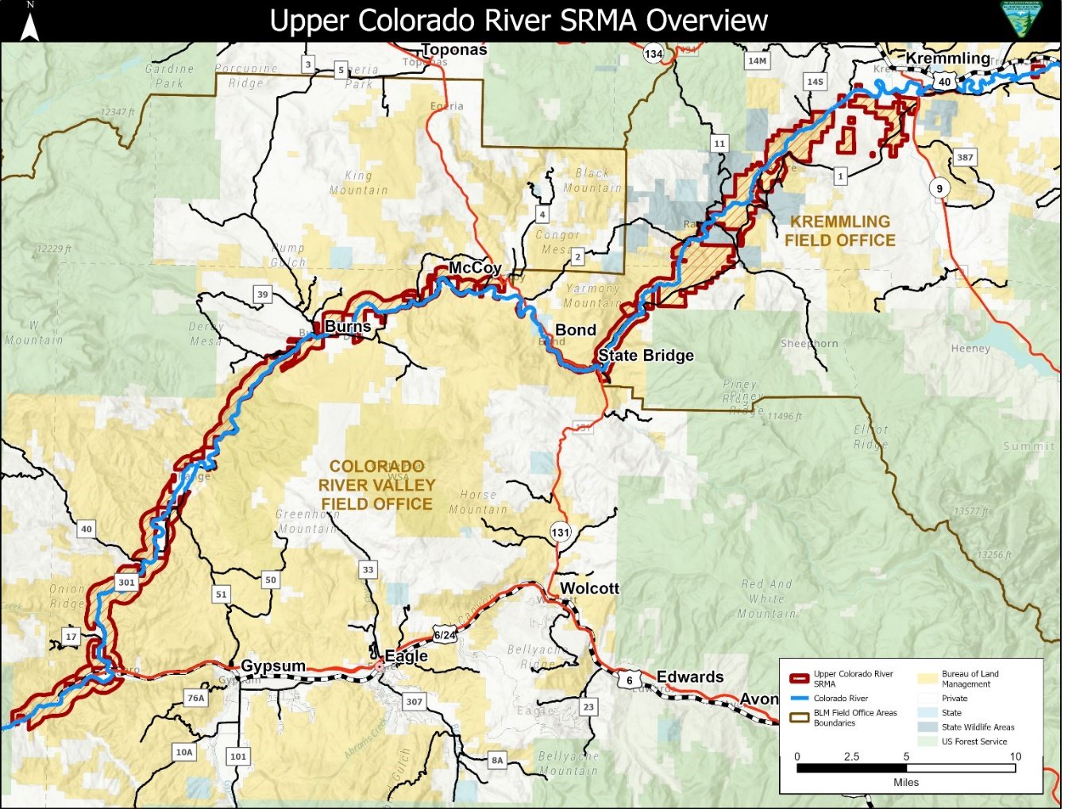
SRMA River Management
Both Field Offices have SRMA Designations through RMP’s
SRMA’s are managed to protect and enhance a targeted set of activities, experiences, beneficial outcomes, and desired recreation setting characteristics. The SRMAs may be subdivided into Recreation Management Zones (RMZ) to further delineate specific recreation opportunities.
KFO SRMA
Parshall to State Bridge
15,026 acres
37 River Miles (20 BLM)
5 Recreation Management Zones (RMZ)
2 Wild and Scenic Eligible Segments
CO Headwaters Scenic & Historic Byway
CRVFO SRMA
State Bridge to Glenwood Canyon
15,695 Acres
51 River Miles (31 BLM)
2 Recreation Management Zones (RMZ)
2 Wild and Scenic Eligible Segments
Same Supplemental Rules for Corridor
*Wild and Scenic Segments Managed under Upper Colorado River Wild and Scenic Stakeholder Group Management Plan

Slide 3
Business Plan Update
River Management Consistency – Including Fees
KFO and CRVFO combined Business Plan
DRAFT KFO Proposed Fees Presented at September 2022 RAC Meeting
KFO Last Business Plan and Fee Schedule Update 2012
Recreation Area Management Plan completed in 2019
Identified On-River Camping Permit System (ISRPs)
CRVFO Campground Business Plan and Fees Approved by RAC in 2019
Not Implemented yet due to pandemic
Federal Register Notice Pending – can implement 6 mos. after
Only Covered Campgrounds and One Day Use Site
Fee Schedule inconsistent with adjacent KFO proposal
RAC input to KFO that proposed fees were too low
With KFO Updating Proposed Fee Schedule, Desire for Consistent River Management, a combined Business Plan was best path forward

Slide 4
Update Schedule to be consistent with fees at other areas
Arapaho National Recreation Area: Single Campsites $25-$34
Rocky Mountain National Park: Single Campsite $35
Arkansas Headwaters Recreation Area: Daily Vehicle Pass $10; Individual Daily Pass $4; Annual Pass $80 (sticker) $120 (Hangtag)
Rio Chama River Launch/Camping: $5 per person/per launch
Increased Use and Facility Needs
Add additional Fee Sites due to improved facilities and use at current non-fee sites
Proposal includes approving future fee sites once improvements are made
Campgrounds may be expanded in future

Slide 5
KFO SRMA Current Fee Sites - 2 Current Fee Sites with Campgrounds Fee Proposal - Updated Fee Schedule - 3 New Day Use Fee Sites - 3 Deferred Fee Sites (2 Day Use, 1 Campground) - Utilize Consumer Price Index (CPI) to adjust fees annually

Slide 6
CRVFO Campground and Wolcott Day Use Site Fees Timeline
CRVFO Campground and Wolcott Day Use Site Fees Timeline
June 2019 - Draft Business Plan completed following public comment period.
June 13, 2019 - Northwest Colorado RAC voted unanimously in favor of fees.
Dec. 2019 - Final Business Plan signed.
2020 Pandemic – National direction to halt new fees.
Currently - Notice of Intent to collect fees is moving through BLM approval process.
New fee structure will go into effect six months after the NOI is published in the Federal Register.
Collected fees will stay on-site to maintain and improve these increasingly popular areas.

Slide 7
CRVFO SRMA
Current Fee Sites
- No Day Use Fee Sites
- Campgrounds Approved (Not Implemented)
Fee Proposal
- 6 New Day Use Fee Sites
- Utilize Consumer Price Index (CPI) to adjust fees annually
Updated Fee Schedule for Campgrounds
(Including Campgrounds
outside of SRMA)

Slide 8
KFO and CRVFO - No current permit or fees associated with on-river campsites Fee Proposal - Designated On-River Campsite Permit System with per participant fee

Slide 9
KFO Current Fee Schedule and Updated Fee Proposal
Current Fee Schedule |  | Provides | DRAFT Proposed Fee Schedule | Provides
Day Use Pass | $5 Per Entry | One single vehicle, motorcycle, bicycle or walk-in | $10 Per Vehicle $5 Per Motorcycle, Bicycle or Walk-in Per Day | One single vehicle, motorcycle, bicycle or walk-in
Pumphouse Single Campsite | $10 Per Night | Up to 10 people, includes 1st vehicle | $25 Per Night (No Vehicle included) | Up to 10 people (No Vehicle included)
Pumphouse Group Campsite | $30 Per Night | Up to 30 people, includes 1st vehicle | $75 Per Night (No Vehicle included) | Up to 30 people (No Vehicle included)
Radium Single Campsite | $6 Per Night | Up to 10 people, includes 1st vehicle | $25 Per Night (No Vehicle included) | Up to 10 people (No Vehicle included)
Radium Group Campsite | $30 Per Night | Up to 30 people, includes 1st vehicle | $75 Per Night (No Vehicle included) | Up to 30 people (No Vehicle included)
Season Pass | $20 Per Pass | For 1 Vehicle, motorcycle or bicycle | $50 Per Pass | For 1 Vehicle, motorcycle, bicycle, or walk-in
Designated On-River Campsites | None | No Current Fee or Limitation on Campsite Group size | $5 Per Participant Per Night | On-River Camping Per Participant
Commercial Client Facility Use Fee | $1.25 Per Client Per Day | Area and Facility Use Per Client | $2.00 Per Client Per Day | Area and Facility Use Per Client

Slide 10
CRVFO Current Approved Fee Schedule and DRAFT Fee Proposal
Current Approved Fee Schedule (pending FRN NOI) |  | Provides | Updated Proposed Fee Schedule | Provides
Day Use Pass | Wolcott Day Use Site Only - $5.00 None at other sites | One single vehicle, motorcycle, bicycle or walk-in | $10 Per Vehicle $5 Per Motorcycle, Bicycle or Walk-in Per Day | One single vehicle, motorcycle, bicycle or walk-in
Catamount Campground | $20.00 Per Single Site | Up to 9 people, 2 vehicles and 2 tents per single site. | Single Site-$25 Per Night | Single - Up to 10 People (No Vehicle included)
Pinball Campground | $20.00 Per Single Site | Up to 9 people, 2 vehicles and 2 tents per single site. | Single Site-$25 Per Night | Single - Up to 10 People (No Vehicle included)
Lyons Gulch Campground | $20.00 Per Night for single site; $4.00 Per Person in Group Sites ($40.00 Minimum) | Up to 9 people, 2 vehicles and 2 tents per single site. No limits for Group Sites. | Single Site-$25 Per Night Group Site-$75 Per Night | Single - Up to 10 People Group – Up to 30 People (No Vehicle included)
Gypsum Campground** | $20.00 Per Night for single site; $4.00 Per Person in Group Sites ($40.00 Minimum) | Up to 9 people, 2 vehicles and 2 tents per single site. No limits for Group Sites. | Single Site-$25 Per Night Group Site-$75 Per Night | Single - Up to 10 People Group – Up to 30 People (No Vehicle included)
Wolcott Campground** | $20.00 Per Single Site | Up to 9 people, 2 vehicles and 2 tents per single site. | Single Site-$25 Per Night | Single - Up to 10 People (No Vehicle included)
Prince Creek Campgrounds** | $20.00 Per Night for single site; $4.00 Per Person in Group Sites ($40.00 Minimum) | Up to 9 people, 2 vehicles and 2 tents per single site. No limits for Group Sites. | Single Site-$25 Per Night Group Site-$75 Per Night | Single - Up to 10 People Group – Up to 30 People (No Vehicle included)
Season Pass | None |  | $50 Per Pass | One Vehicle, motorcycle, bicycle, or walk-in
Commercial Client Facility Use Fee | None |  | None Proposed
** Sites not within the Upper Colorado SRMA

Slide 11
KFO Use of Proposed Fees
Provide funding for critical maintenance and additional improvements
Recreational Onsite Fee Kiosks – allows for credit cards
Additional Parking at Pumphouse Recreation Area
Gore Canyon Ranch Access Parking and Trailhead
Warm Springs Recreation Area additional funding for campground expansion
State Bridge Recreation Area Boat Ramp Improvements
Fund additional Career Seasonal River Ranger Position
Fund 2 additional Seasonal Recreation Staff Positions
For maintenance, implementation and compliance of River Permit System, Supplemental Rules (upcoming) and Campground Reservations through Recreation.gov
Fund 4-6 Campground and Recreation Site Hosts
Notes:
Emphasize that ranger is non-law enforcement positions

Slide 12
CRVFO Use of Proposed Fees
Provide funding for critical maintenance and additional improvements
Annual Facility Maintenance
Recreational Onsite Fee Kiosks – allows for credit cards
Gravel Two-Bridges Parking Area
Two-Bridges Building Improvements
Campsite Expansion at Pinball Recreation Site
Fund 2 additional Seasonal Recreation Staff Positions
For maintenance, implementation and compliance of River Permit System, Supplemental Rules (upcoming) and Campground Reservations through Recreation.gov
Fund Campground and Recreation Site Hosts
Notes:
Emphasize that ranger is non-law enforcement positions

