Slide 1
Programmatic Vegetation Treatment EA Sagebrush Biome
NW Colorado RAC Meeting
December 8, 2016

Slide 2
RAC Involvement
RAC involvement would be helpful.
Good CRVFO field trip opportunity in February
What thoughts/concerns does the RAC have?
Public sometimes do not understand these treatments – resolution opportunity?

Slide 3
Background
FWS identified PJ encroachment as one of the threats to GRSG in NW Colorado.
The BLM has completed a Program of Work (POW) for vegetation projects in GRSG habitat for projects to be completed over the next 5 years.
Greater Sage Grouse projects would be the focus, but other sagebrush species would also benefit (Big game, etc.) from the proposed treatments.
Goal is to streamline the NEPA process for these projects over the next several years.

Slide 4
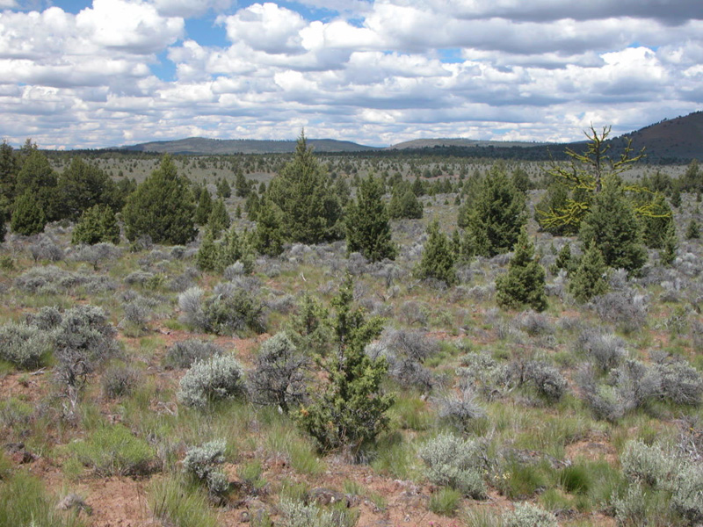
Background – PJ Encroachment
FWS identified PJ encroachment as one of the threats to GRSG habitat in NW Colorado.
Focus would be on removing encroaching PJ – NOT old growth PJ.
PJ provides perching/cover opportunities for predators – GRSG tend to avoid those areas.
Encroaching PJ also increases fire risk in GRSG habitats.

Slide 5
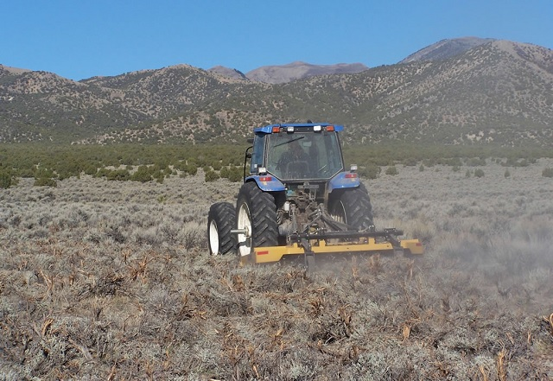
What would be analyzed?
Mechanical Vegetation Treatments
Stabilization/Erosion Control Structures
Prescribed Fire Treatment Methods and Tools
Seeding Treatment Methods
Chemical treatments will not be included in this analysis.

Slide 6
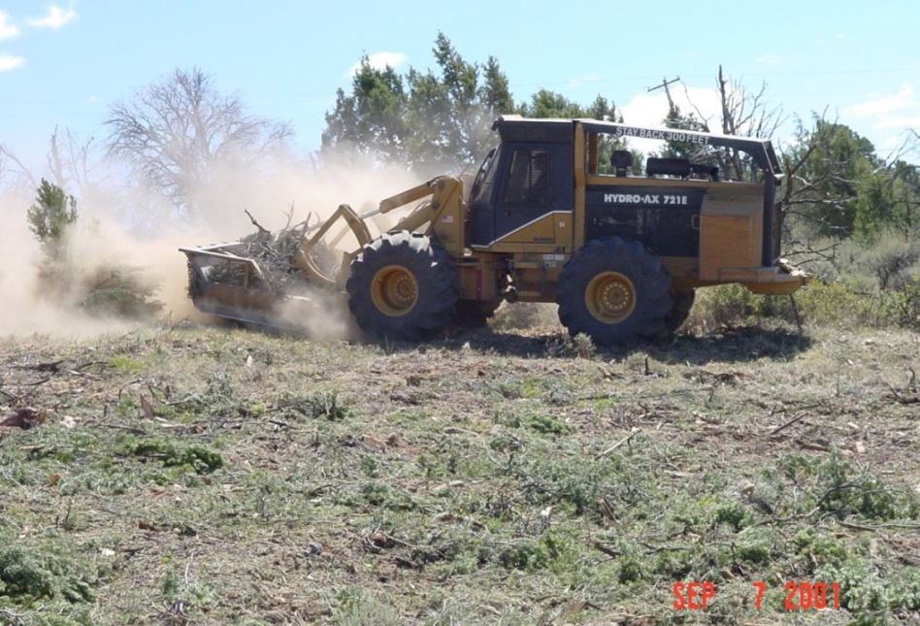
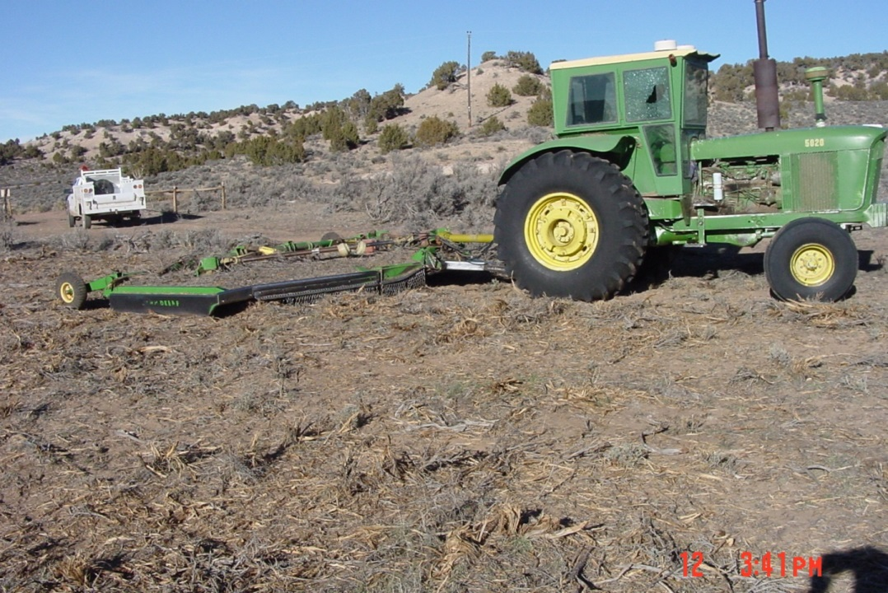
Mechanical Treatments
Hand-thinning (like in the video)
Tree Mastication
Brush Mowing
These types of treatments can:
Restore expected age classes and structure
Increase forbs and grasses

Slide 7
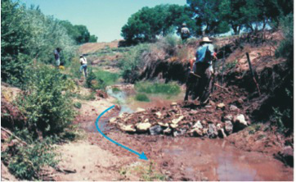
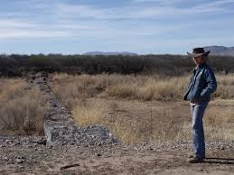
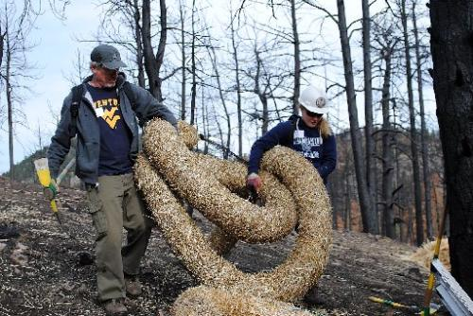
Stabilization/Erosion Control
Zeedyk structures
Gabions basket
Vegetation mats
Waddles
Notes:
These types of treatments can help stabilize soils in riparian areas, restore flows, and create more riparian habitats.

Slide 8
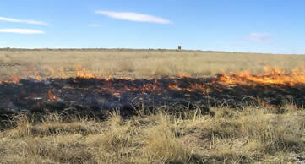
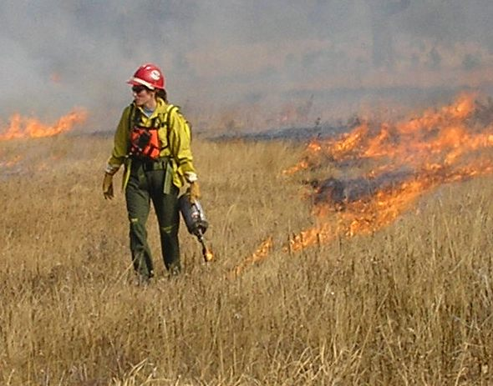
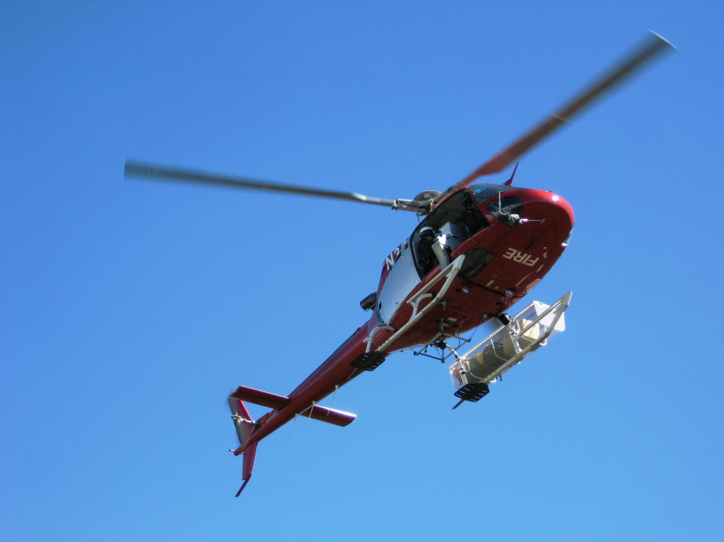
Prescribed Fire Treatments
Broadcast/Slash Pile Burns
Ground Ignitions (drip torch)
Aerial Ignitions
Notes:
Prescribed fire benefits sagebrush ecosystems by opening up the understory for grasses and forbs to recolonize. These types of treatments also create a mosaic of age classes that benefit GRSG and big game, as well as other species.

Slide 9
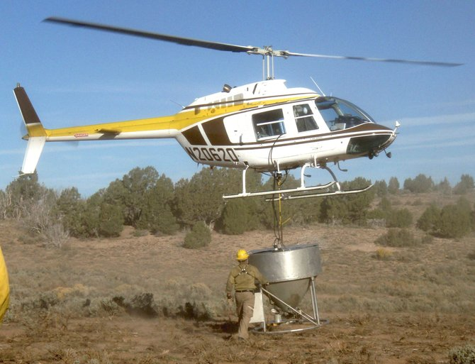
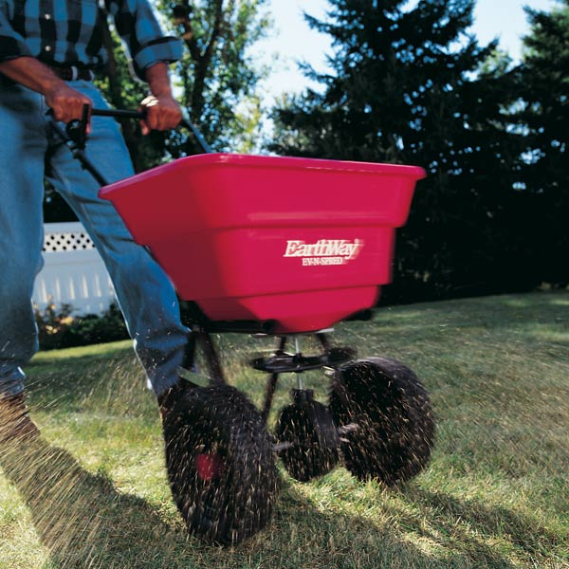
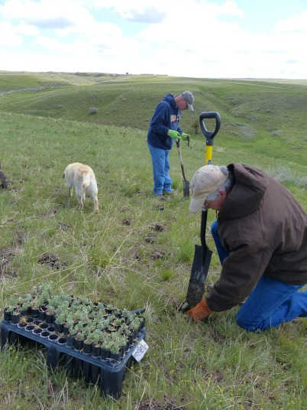
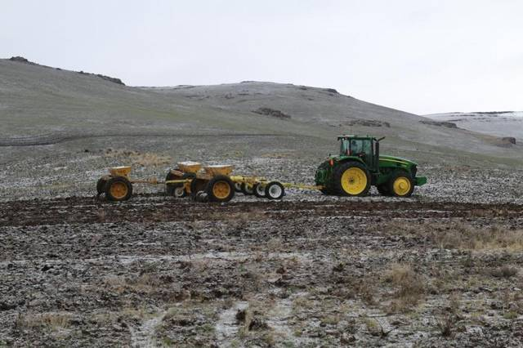
Seeding Treatments
Aerial application
Drill seeding
Hand application
Hand planting
Notes:
Seeding treatments can help restore native grasses and forbs after a vegetation treatment. Seeding can help give the ecosystem a jump start to get colonization going after a treatment. Seeding can also help prevent invasion of non-native species like cheat grass.

Slide 10
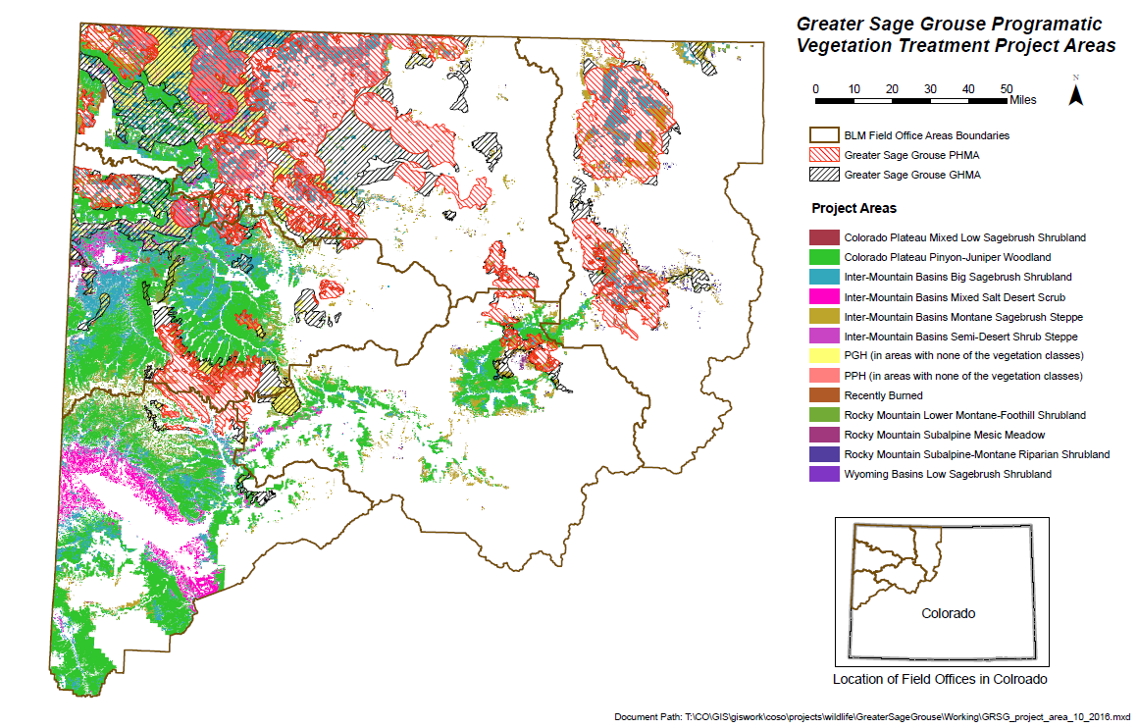
Where?
BLM managed lands in sagebrush and sagebrush related vegetation types.

Slide 11
Why a Programmatic Approach?
Programmatic approach has many benefits:
Analysis would cover a larger area instead of site-by-site
Since many of the proposed projects include the same components, we would complete one analysis instead of many of the same (reduce redundancy)
Consolidate the Section 106 process
Consolidate the Section 7 process
Would still complete pre-work surveys and consult if needed on site-specific projects

Slide 12
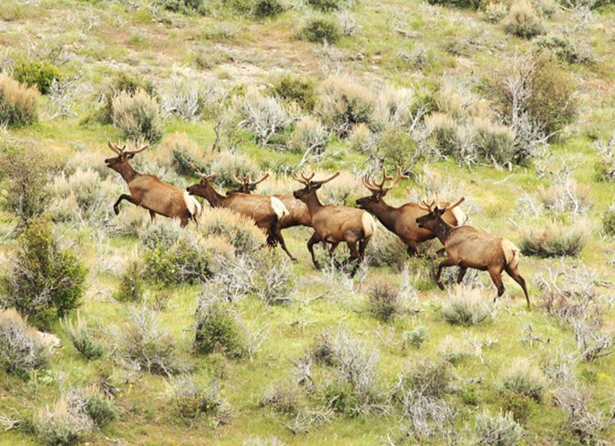
Other Benefits
Big game species (Deer and Elk) would also benefit from these treatments.
Treatments would open
upland areas to become
more suitable for big game
habitat (added forbs and
grasses).
#350 species.
About 350 species depend
on sagebrush ecosystems.
These species would also
benefit from the restoration
of sagebrush ecosystems.

Slide 13
When?
Process Step | Target Date
Initiate 30-day Scoping Period (Section 7 and Section 106) | Winter, 2016
Release Preliminary EA for 30-day Public Comment Period | Spring, 2017
Release signed EA, FONSI and DR to the public | Early Summer, 2017
Begin Implementing Projects | Mid Summer, 2017

Slide 14
Previous Project
Luark North and North BLM Field Units
Colorado River Valley Field Office
Project was initiated in 2015
Mulched with a Hydro-Ax
Project was designed to remove encroaching pinyon and juniper trees to improve habitat for mule deer, elk and greater sage-grouse.
Mule Deer & Elk – improved forage conditions
Greater sage-grouse – removal of raptor/corvid perches and improved forage
Project will be revisited for the next several years to evaluate effectiveness.

Slide 15
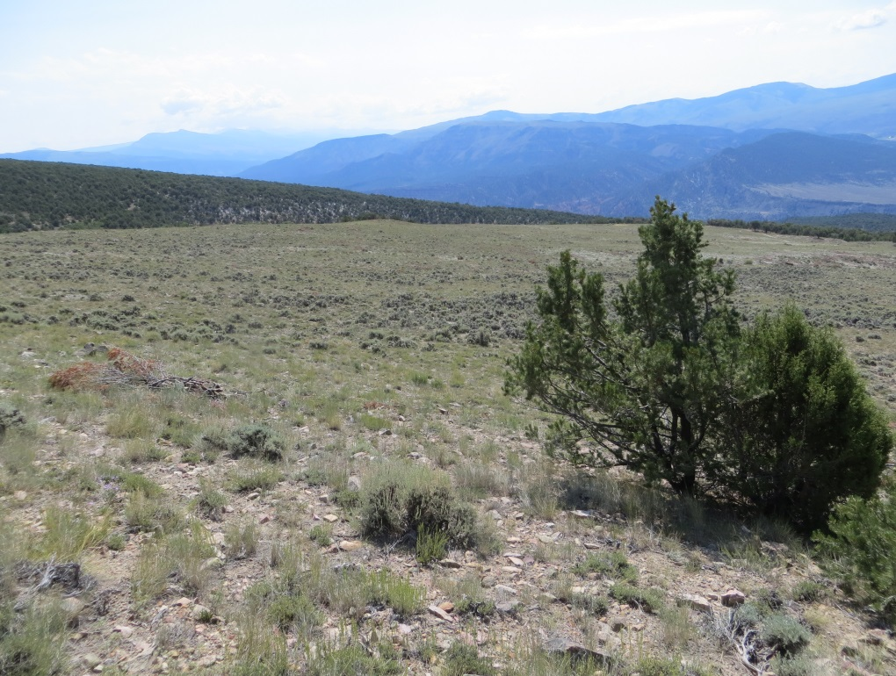
Before and After – Luark North

Slide 16
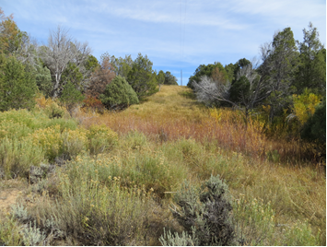
Before and After – N BLM Field Unit

Slide 17
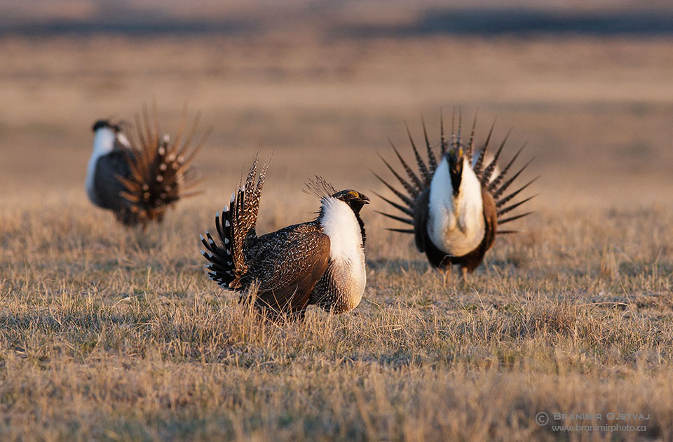
Discussion/Questions?

