Slide 1
BLM Budget Process
December NW RAC Meeting
Amy Carmichael
Colorado Northwest District Budget Analyst

Slide 2
Federal Budget Process (Simplified)
President (Executive)
Congress (Legislative)
OMB
5 Years out:Budget
Blueprint
CBO
Department
Allowances
Committee Caps
Agency Allowances
President’s Budget
Hearings
OMB
Sends to
Congress
Forest Service Allowance
House/Senate Mark-up
Dept./Agency
Appeal
Congress says
“DOA” &
negotiations start
H/S Subcommittee Reports
Chief’s Office
House/Senate Conference
Chief’s Programs
Dept./Agency
Pass Back
Final Appropriations
Bill with Earmarks
Deputy Chief Requests
Appropriations Bill
Passes H/S
OMB Review
Agreements
Field Requests
Department Budget Office
President Signs
Agency Budgets
Agency Request
Notes:
Mind numbing
Looks worse than it really is
OMB has 2 main concerns: fiscal and policy
--overall guidance is handed down eventually to the field and back up the chain again
--then decides how the money will be divided among the bureaus

Slide 3
Objectives
Describe the federal budget process
Describe how agency budgets are developed and executed
Discuss multi-year budget trend

Slide 4
Important Terms
Discretionary Spending:
Discretionary spending is that part of the U.S. Federal Budget that is negotiated between the President and Congress each year as part of the budget process. It includes everything that is not in the mandatory budget, which are programs required by law to provide certain benefits, such as Social Security and Medicare.

Slide 5
Important Terms cont.
Budget Formulation:
Developing the President’s budget
Budget Presentation:
Explaining/defending the budget to congress
Budget Execution:
Distributing the dollars and completing the work

Slide 6
Where is the Authority for the US Budget?
US Constitution, Article 1, Section 1: “All legislative powers herein granted shall be vested in a Congress of the United States, which shall consist of a Senate and House of Representatives.”
Article 1, Section 7: “All bills for raising revenue shall originate in the House of Representatives; but the Senate may propose or concur with amendments as on other bills.”

Slide 7
Where is the Authority for the US Budget?
US Constitution, Article 1, Section 7: “Every bill which shall have passed the House of Representatives and the Senate, shall, before it becomes law, be presented to the President of the United States.”
Article 1, Section 8: “The Congress shall have the power to lay and collect taxes…[and] to pay [the] debts… of the United States.”

Slide 8
Where is the Authority for the US Budget?
Article 1, Section 9: “No money shall be drawn from the treasury, but in consequence of appropriations made by law…”

Slide 9
What does this mean?
Congress authorizes and appropriates money
The President and Congress must reach agreement
The President can only “ask” Congress for money
Appropriation bills are law, not guidelines

Slide 10
The Federal Dollar—Where did it go? President’s Budget 2016
Notes:
$4.1 Trillion

Slide 11
Source: The Washington Post

Slide 12
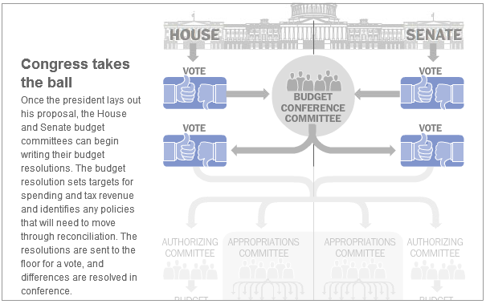

Slide 13
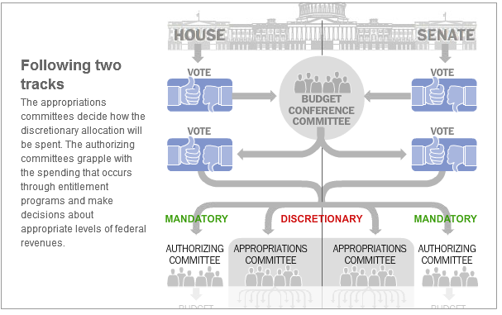

Slide 14
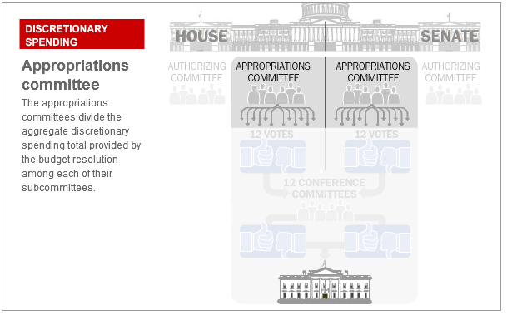

Slide 15
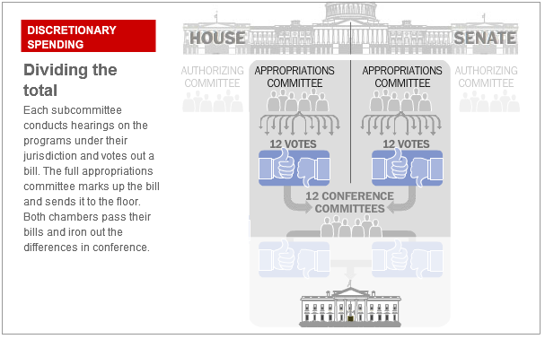

Slide 16
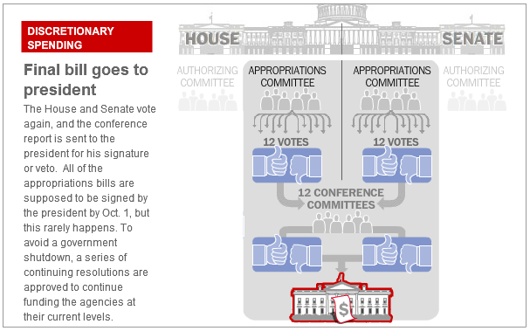

Slide 17
Budget Process - Timeframe
October
November
December
February
September
January
March
August
April
May
June
July
FY 2017 Budget
FY 2018 Budget
FY 2019 Budget
Notes:
Use this and the next chart to illustrate the concept that at any given time in a calendar year we are managing up to 3 budget years simultaneously. Walk audience through process steps and try to indicate where field folks are involved, even when the process is concentrated at the national level.

Slide 18
Budget Creation Recap
President submits annual budget (Feb 1)
Congress receives budget; immediately signals intent to amend it
Congressional process begins in the House
Authorization Committee hearings
Appropriation Committee hearings
Floor debate

Slide 19
Recap Continues…
Senate consideration-similar process
Conference Committee to negotiate differences and agree on a budget
Congress sends budget to the President for signature or veto (by Sept 30)
But what if they can’t agree?

Slide 20
Continuing Resolutions
Tool to provide funding in the absence of an adopted budget
1977-2016 only 4 budgets were adopted
Promotes stalemate—gives Congress an “out”
Creates uncertainty, distorted spending and lost productivity
Notes:
Must be voted on and agreed to by both Senate and House and signed by Prez
Can be as short as 1 day and the historical long was 241 days

Slide 21
13 Regular Appropriations Bills
Agricultural, Rural Development, FDA, & related agencies
Commerce, Justice, Science & related agencies
Defense
Energy and Water Development
Financial Services and General Government
Homeland security
Interior, Environment & related agencies
Labor, Health and Human services, Education
Legislative branch
Military Construction, Veterans Affairs
State and Foreign Operations
Transportation, Housing and Urban Development
Select Intelligence Oversight Panel
Notes:
Notice that these are all discretionary

Slide 22
Budget Process for BLM
Money for the BLM comes from a Subcommittee of the Appropriations committee called “Interior, Environment and Related Agencies”.
The “Interior, Environment and Related Agencies” appropriations bill funds about 35 different agencies, including DOI, the Forest Service, the Smithsonian Institution, the National Endowment for the Arts, plus many other museums and cultural institutions.
Notes:
Shidt to start talking about fire. Our omes for this sub comm

Slide 23
Process to the Field
WO DOI-BLM Budget Office
Colorado State BLM Office
NW District Office
Field Office

Slide 24
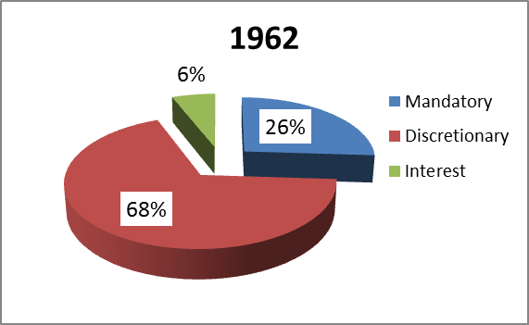
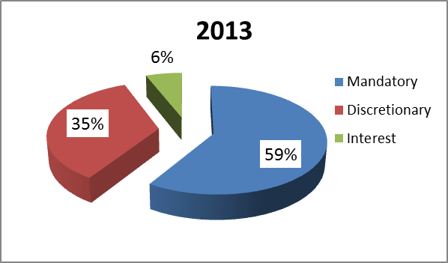
The Discretionary component of Federal spending has decreased as Mandatory spending increases
Mandatory Federal Spending has almost tripled, from 26% of the entire Federal budget in 1962 to 59% in 2013.
As a result, less money remains for Discretionary programs such as the Forest Service and DOI.
Notes:
Nearly two-thirds of all Government spending occurs automatically, without any action by the Congress or the President. This spending includes payments for interest on Federal debt and spending for “entitlement” programs in which the law specifies both the criteria that entitle an individual to a payment from the Government and the formula that establishes the amount of the payment. The automatic nature of spending for entitlement programs ensures that the health care and income needs of seniors and persons who are disabled, widowed, or orphaned will be met. Because interest and entitlement program spending is automatic or “mandatory,” the Congress and the President must enact legislation to change the path of this spending.

Slide 25
USDA and DOI accounts for only 3% of Federal Discretionary Appropriations

Slide 26
2016 DOI Budget Allocation

Slide 27
Of That 9%...
Over 50 different program areas are appropriated
Each program has specific direction on how it can be spent
Each appropriation must be spent to 2% by the end of fiscal
We manage almost 60 other non-appropriated accounts
Rec, grazing, realty, Oil & Gas application and royalties, grant and matching funds, etc.

Slide 28
Notes:
-17% from 10 to 15

Slide 29
Recreation Funding Trend
 | FY12 | FY13 | FY14 | FY15 | FY16 | % Change
L1220 | 937,131 | 841,012 | 807,793 | 780,076 | 730,785 | -22.02%
L1232 | 336,027 | 448,336 | 515,605 | 562,863 | 625,090 | 86.02%
 | 1,273,158 | 1,289,348 | 1,323,398 | 1,342,939 | 1,355,875 | 6.50%

Slide 30
Objectives
Describe the federal budget process
Describe how agency budgets are developed and executed
Discuss multi-year budget trend

Slide 31
Questions?

