Slide 2
Liquid and Natural Gas Pipelines
The energy transportation network of the United States consists of over 2.5 million miles of pipelines.
Pipelines exist in all fifty states.
Approximately 45,000 miles of pipelines crisscross Colorado
Notes:
That's enough to circle the earth about 100 times.
most of us are unaware that this vast network even exists. This is due to the strong safety record of pipelines and the fact that most of them are located underground. Installing pipelines underground protects them from damage and helps protect our communities as well.
__Gathering -Technically speaking: For gas pipelines, a gathering line is a pipeline that transports gas from a current production facility to a transmission line or main (49CFR 192.3). For hazardous liquid pipelines, a gathering line is a pipeline that is no more than 8 5/8 inches in diameter and transports petroleum from a production facility (49CFR 195.2).
-- transmission line is a pipeline used to transport natural gas from a gathering, processing or storage facility to a processing or storage facility, large volume customer, or distribution system. A large volume customer may receive similar volumes of gas as a distribution center, and includes factories, power plants, and institutional users of gas. Often used to describe hazardous liquid pipelines also, a transmission line is a pipeline used to transport crude oil from a gathering line to a refinery and refined products from a refinery to a distribution center. The Colorado Pipeline Association (CoPA) is comprised of pipeline operators in Colorado that are dedicated to promoting pipeline safety by providing information for excavators, state residents, businesses, emergency responders and public officials

Slide 3
Both liquid and natural gas pipelines can be put into four categories:
(1) Flowlines contain produced wellhead fluids from individual wells that feed production facilities near the wellhead;
(2) Gathering pipelines tie production facilities with gathering systems that feed into oil storage or natural gas processing facilities;
(3) Transmission pipelines transport pure natural gas and hydrocarbon liquids (refined or unrefined) over long distances; and
(4) Distribution pipelines deliver pure natural gas to end users (residential, commercial, industrial).

Slide 4
Northwest Colorado
There are over 1,082 O&G pipeline Rights-of-way (more than 17,383 acres) in NW Colorado.
WRFO 728 authorized O & G Pipelines, 342 closed
LSFO 230 authorized O & G Pipelines, 62 closed
CRVFO 116 authorized O & G Pipelines, 71 closed
KFO 8 authorized O & G Pipelines, 3 closed

Slide 7
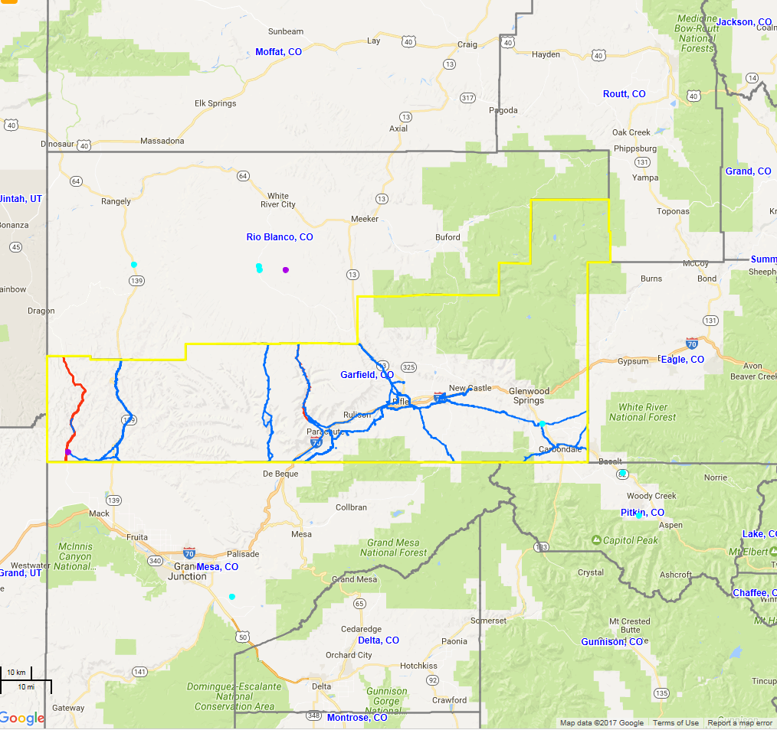
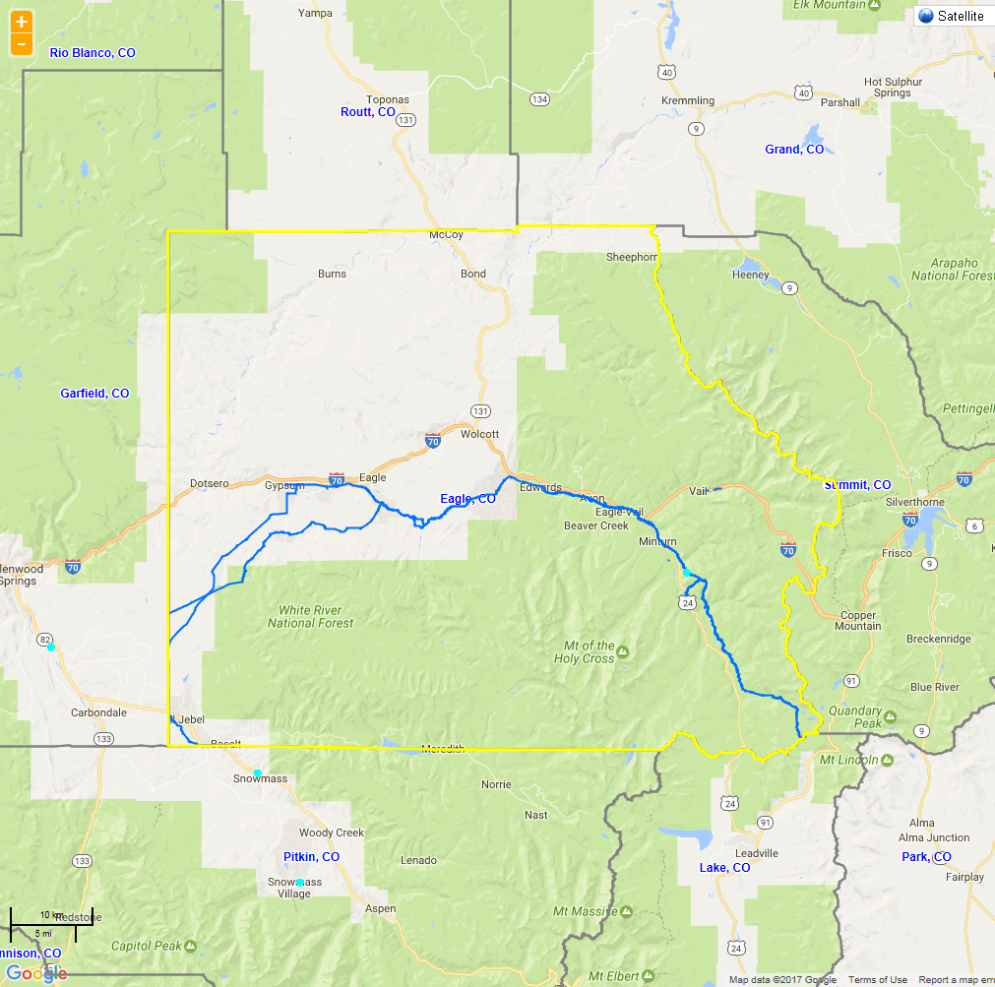

Slide 8
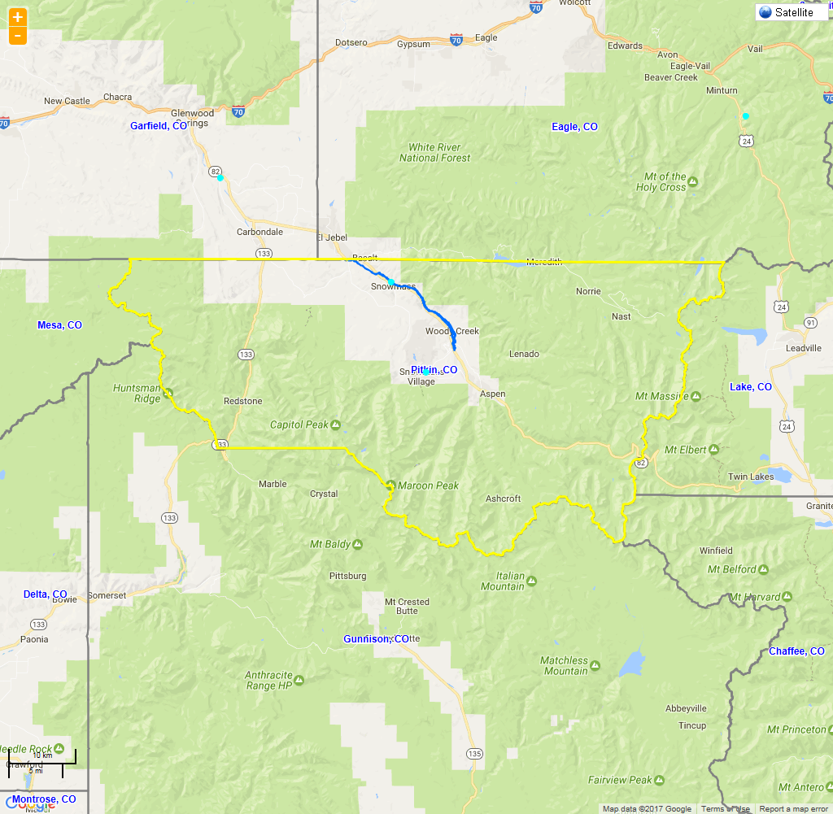
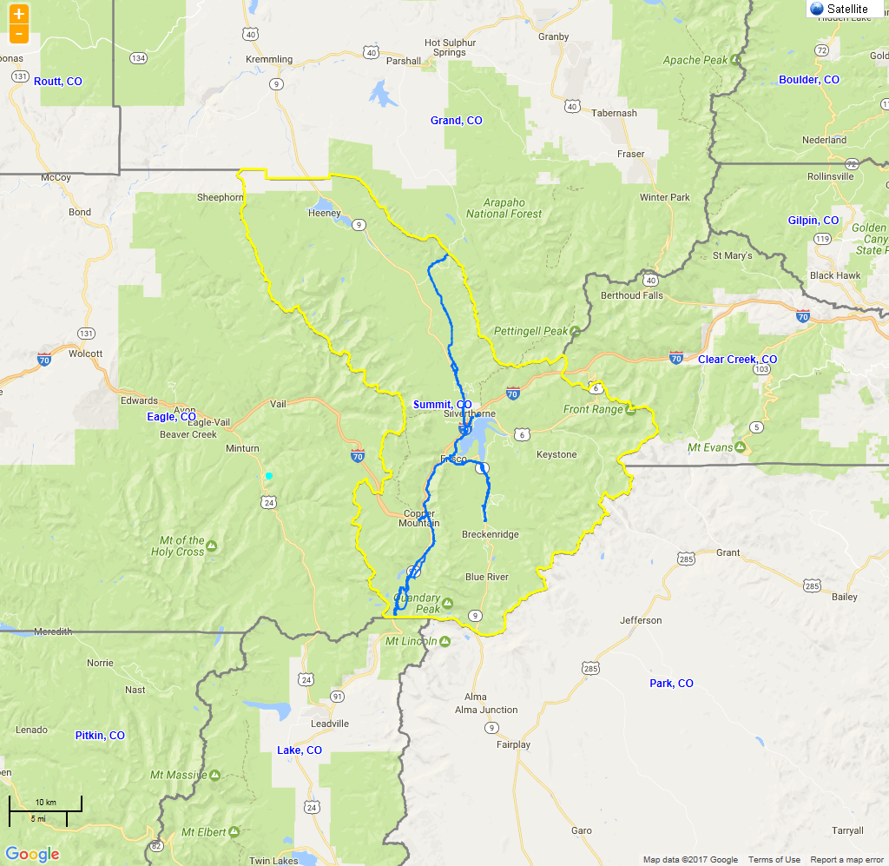

Slide 9
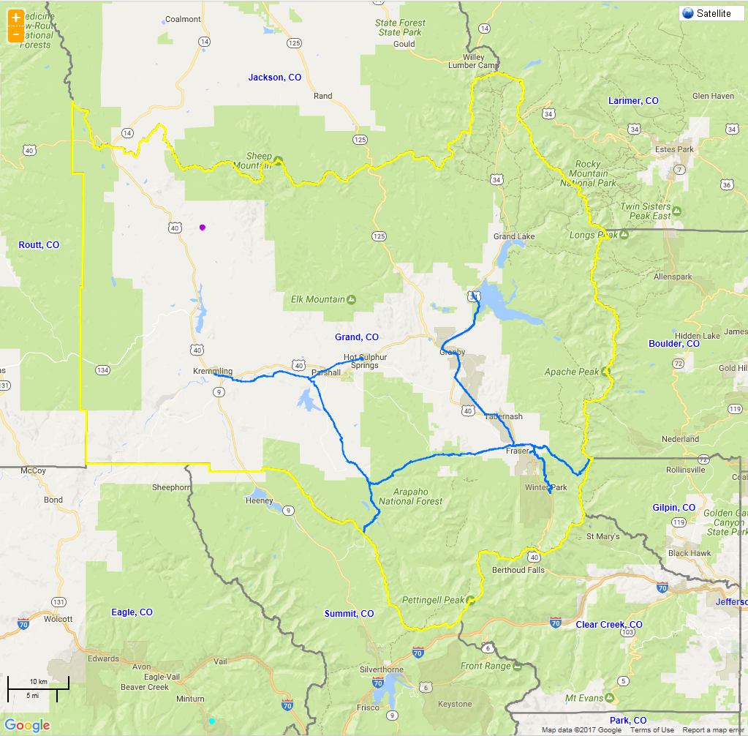
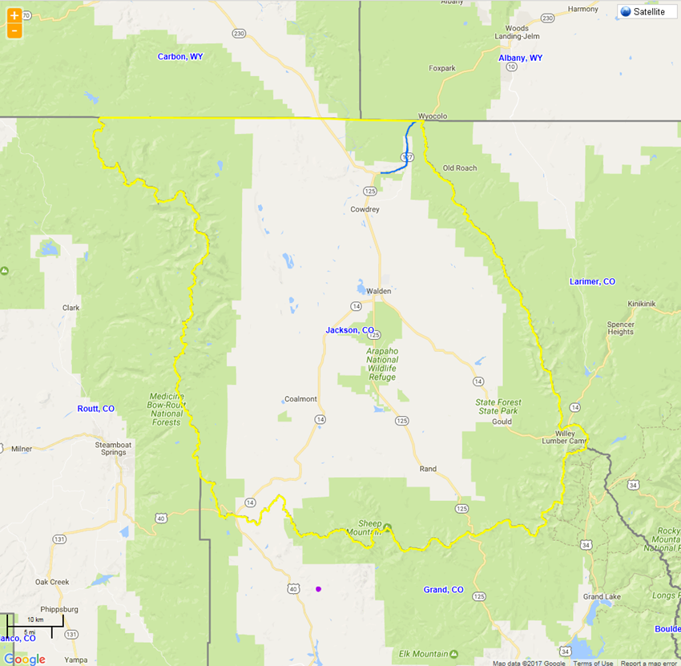

Slide 10
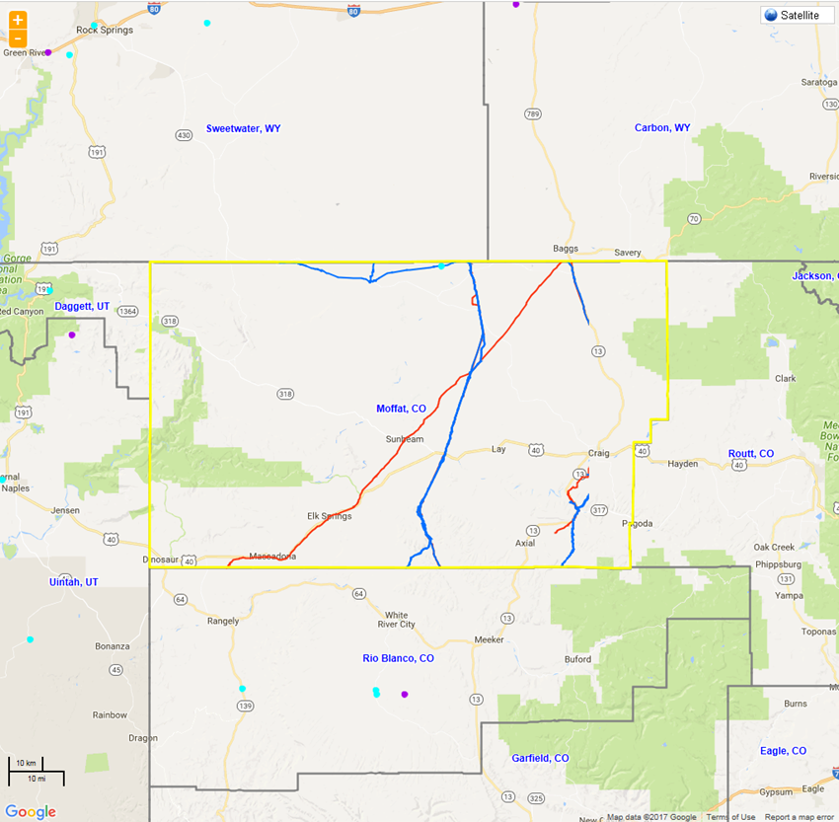
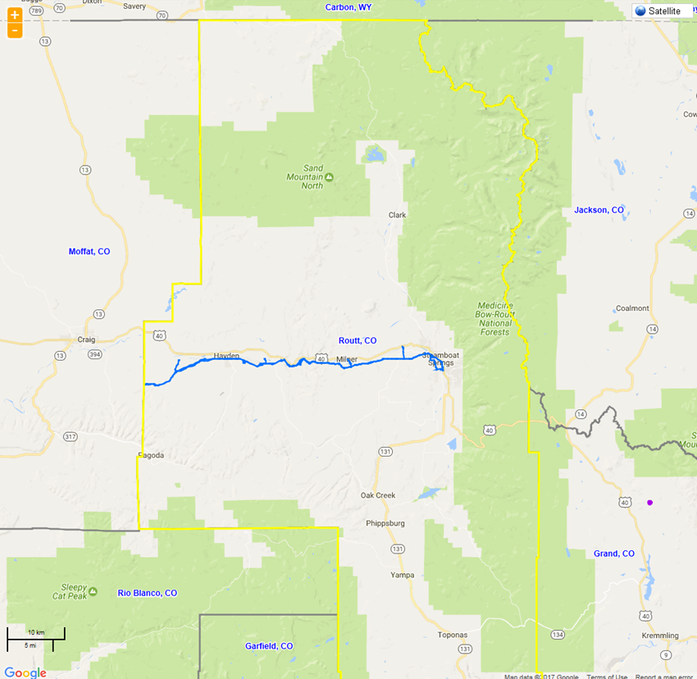

Slide 11
How are these authorized?
Off lease pipelines are authorized under the Mineral Leasing Act of 1920, as amended (30 U.S.C. 185)
On lease pipelines are authorized through the lease operations

Slide 12
Overview of Mineral Leasing Act of 1920, as amended (30 U.S.C. 185)
1973 Amendment to MLA of 1920 (Pub. L. 93-153) changed the granting and administration of pipeline ROW on Federal Land.
Sec 28
Sec. 185 Rights-of-way for pipelines through Federal Lands
Grant of Authority: Rights-of-way through any Federal lands may be granted by the Secretary of the Interior or appropriate agency head for pipeline purposes for the transportation of oil, natural gas, synthetic liquid or gaseous fuels, or any refined product produced therefrom to any applicant possessing the qualifications provided in section 181 of this title in accordance with the provisions of this section.
Definitions :
Federal lands means all lands owned by the united states except lands in the NPS, lands held in trust for an Indian or Indian tribe, and lands on the outer continental shelf.
Secretary means the Secretary of the Interior
Agency head means the head of any Federal department or independent Federal office or agency other than the Secretary, which has jurisdiction over Federal lands.
Notes:
Trans-Alaska Pipeline Authorization Act of Nov 16,1973

Slide 13
Mineral Leasing Act con’t
(c) Inter-agency Coordination: Where the surface of the Federal lands involved is administered by the Secretary or by two or more Federal agencies, the Secretary is authorized, after consultation with the agencies involved, to grant or renew rights-of-way or permits through the Federal lands involved. BLM is the lead (and issues the grant) for projects that cross lands managed by more than one Federal agency (even if no NSPL land is involved).
(d) Width Limitations: The width of a right-of-way shall not exceed fifty feet plus the ground occupied by the pipeline (that is, the pipe and its related facilities)
(e) Temporary Permits: A right-of-way may be supplemented by such temporary permits for the use of Federal lands in the vicinity of the pipeline as the Secretary or agency head finds are necessary in connection with construction, operation, maintenance, or termination of the pipeline, or to protect the natural environment or public safety.
(f) Regulatory authority: Rights-of-way or permits granted or renewed pursuant to this section shall be subject to regulations promulgated in accord with the provisions of this section and shall be subject to such terms and conditions as the Secretary or agency head may prescribe regarding extent, duration, survey, location, construction, operation, maintenance, use, and termination.
(g)Pipeline safety: The Secretary or agency head shall impose requirements for the operation of the pipeline and related facilities in a manner that will protect the safety of workers and protect the public from sudden ruptures and slow degradation of the pipeline.
(n)Duration of grant: Each right-of-way or permit granted or renewed pursuant to this section shall be limited to a reasonable term in light of all circumstances concerning the project, but in no event more than thirty years.
(v)State standards: The Secretary or agency head shall take into consideration and to the extent practical comply with State standards for right-of-way construction, operation, and maintenance.
(w)Reports: The Secretary or agency head shall promptly notify the Committee on Natural Resources of the United States House of Representatives and the Committee on Energy and Natural Resources of the United States Senate upon receipt of an application for a right-of-way for a pipeline twenty-four inches or more in diameter, and no right-of-way for such a pipeline shall be granted until a notice of intention to grant the right-of-way, together with the Secretary's or agency head's detailed findings as to the terms and conditions he proposes to impose, has been submitted to such committees.
<><><>More… bonding, standards, liability, etc.
Notes:
** where the surface of fed lands involved is under one jurisdiction, that agency head, rather than the Secretary, can grant or renew a ROW… but where surface of fed lands is more than one agency, the BLM is the lead.
BLM administers the grant. enter into interagency agreements with all other Federal agencies having jurisdiction over Federal lands for the purpose of avoiding duplication, assigning responsibility, expediting review of rights-of-way or permit applications, issuing joint regulations, and assuring a decision based upon a comprehensive review of all factors involved in any right-of-way or permit application. Each agency head shall administer and enforce the provisions of this section, appropriate regulations, and the terms and conditions of rights-of-way or permits insofar as they involve Federal lands under the agency head's jurisdiction.

Slide 14
Subpart 2885: Terms and Conditions of MLA grants and TUPs
Subpart 2886: Operations on MLA grants and TUPs
This grant or permit is issued subject to the holder’s compliance with all applicable regulations contained in Title 43 Code of Federal Regulations parts 2800 and 2880.

Slide 15
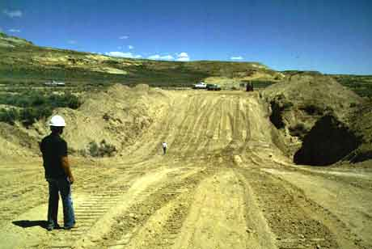
Site Preparation
Notes:
Pipelines are by far the safest method for transporting energy products. However, when pipeline incidents occur they can present significant risks to the public and the environment.

Slide 16
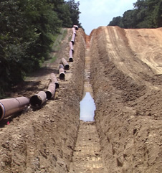
Trenching/Pipe Stringing

Slide 17
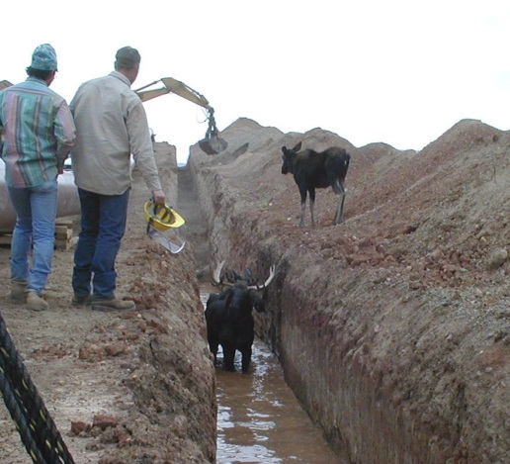

Slide 18
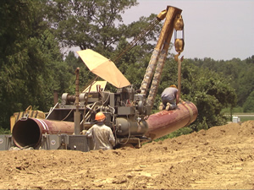
Bending/Welding

Slide 19
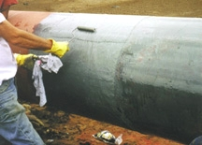
Coating/Backfilling/Testing
Notes:
Pipe coatings protect pipelines from corrosion-related defects. They are just one element of the total package operators employ to ensure their pipelines are well protected. Cathodic protection and integrity assessments are also used to prevent corrosion, and to detect any defects that may result from corrosion.
Today pipe coatings are applied by the pipe manufacturer at the time the pipe is manufactured. This has obvious advantages. The coating can be applied in a consistent manner, the exterior of the pipe is clean, and application conditions can be better controlled. Exterior pipe coatings still need to be applied during construction in the field at the girth welds when pipe sections are joined together.
The most widely used pipe coating today is Fusion Bonded Epoxy (FBE). FBE is applied to hot rotating pipe that is electrostatically charged. FBE is resistant to high temperature, can withstand high stress, and provides good protection against corrosion.
Cathodic Protection (CP) systems help prevent corrosion from occurring on the exterior of pipes, by substituting a new source of electrons, commonly referred to as either a “sacrificial anode” or “impressed current anode”. Both systems operate by imparting a direct current onto the buried pipeline, using devices called rectifiers. As long as the current is sufficient, corrosion is prevented, or at least mitigated and held in check.

Slide 20
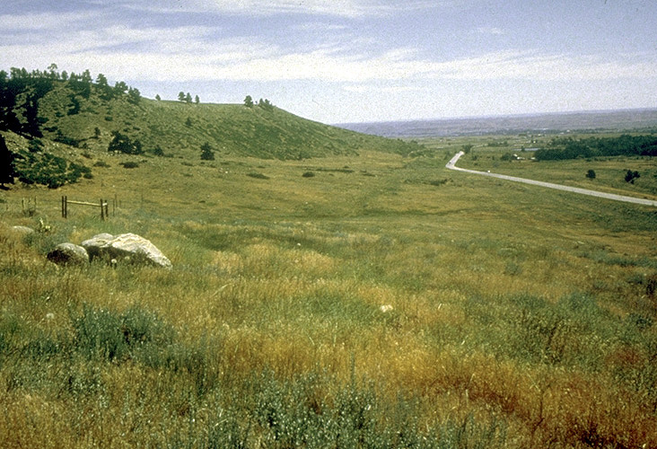
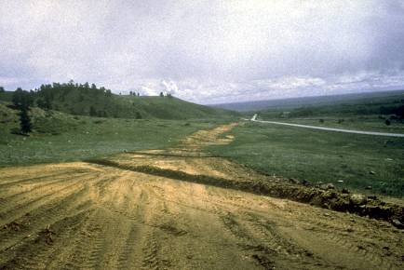
Site Reclamation
20

Slide 21
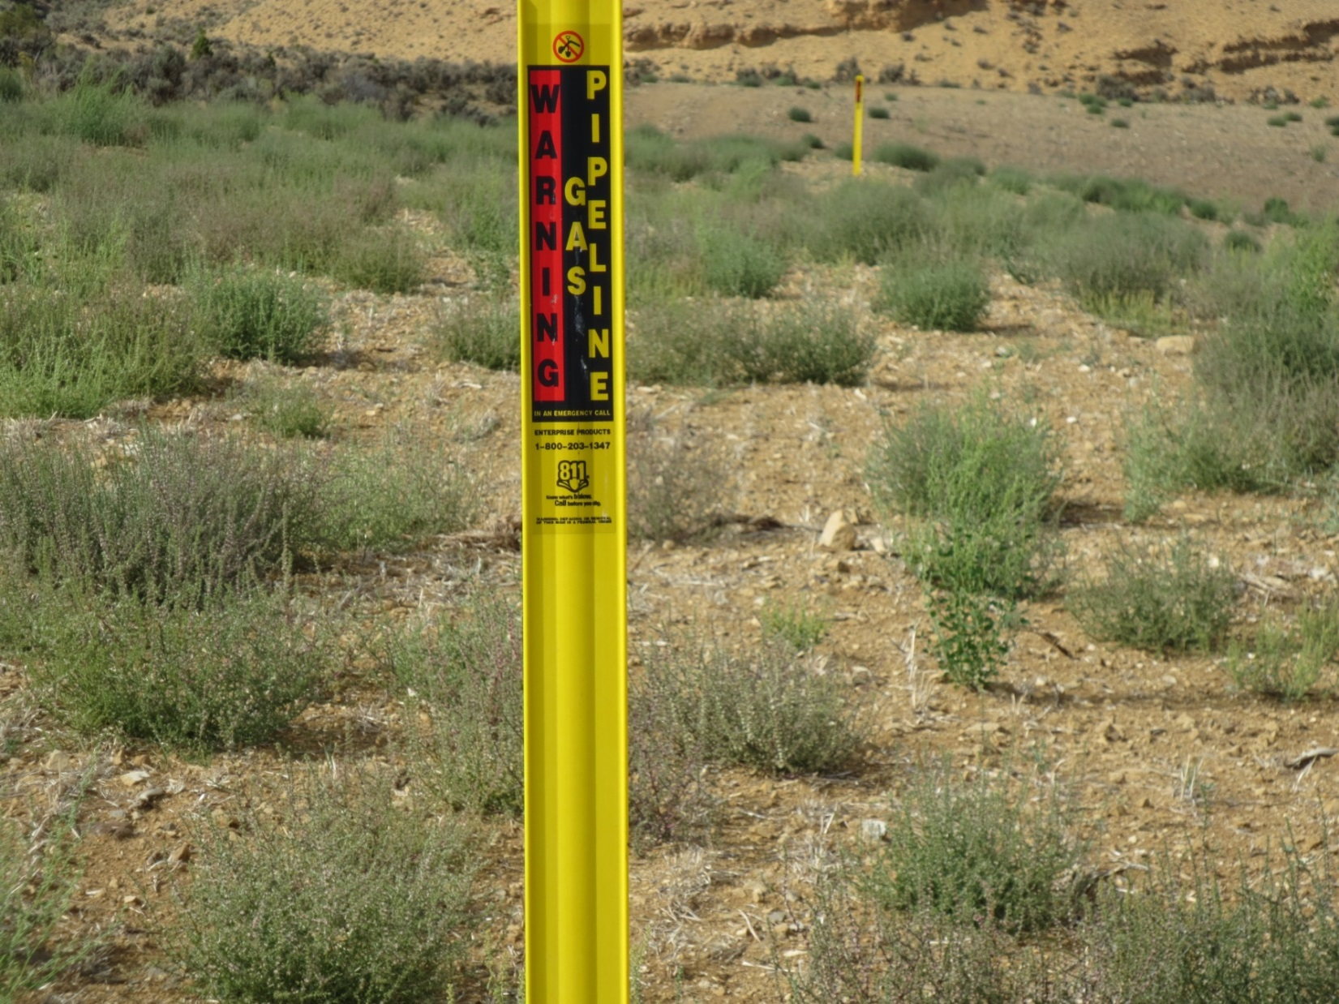
Markers
Notes:
Markers and warning signs are located at frequent intervals along transmission and liquid pipeline rights-of-way (ROW). They are found where a pipeline intersects a street, highway, railway or waterway, and at other prominent points along the route. Markers warn that a transmission pipeline is located in the area, identify the product transported in the line, and provide the name of the pipeline operator and a telephone number to call in the event of an emergency.
Pipeline markers indicate only the presence of a pipeline. They can not be relied upon to determine the exact location of the pipeline. Pipeline locations within a ROW may vary along the length of the ROW. Additionally, there may be multiple pipelines located in the same ROW.

Slide 23
How Operators Keep Pipelines Safe
Once construction is complete, operators monitor lines, follow maintenance procedures consistent with the type, location and product being transported and communicate with those living and working near their lines. These procedures often include:
Patrolling pipelines from the air and on foot to identify potential problems
Installing cathodic protection or adding inhibitors to prevent corrosion
Implementing integrity management plans
Conducting special training for employees who are responsible for certain tasks or duties
Monitoring pipeline pressure and volume 24-hours a day, every day
Preparing and practicing emergency response protocols
Communicating regularly with those who live and work near their pipelines and emergency responders in the community
Installing permanent pipeline markers to identify the general location of the pipeline
Working with neighboring landowners to keep rights-of-way free of plants or structures that could impact the safety of underground pipelines or impact the operator’s ability to monitor the line
Testing samples of the products they transport
Participating in the One-Call process

Slide 24
Who is regulating these?
Good Question!

Slide 25
A Brief History
Pipeline networks growth in the 1920’s, became not only a local resource, but an interstate commodity of increasing national importance.
Although some states had made minor pipeline regulations, this growth and interstate transportation brought them under the jurisdiction of the federal government.
In 1938, the Natural Gas Act (NGA) was passed. NGA provisions were enforced by the Federal Power Commission (FPC). (Federal Energy Regulatory Commission (FERC) precursor)
Drafted rules regulating interstate gas delivery rates and had the ability to approve/deny new interstate pipelines.
Did not include any safety regulation.
It did introduce the concept that pipelines transporting natural gas are in the public interest and can be regulated, as well as the concept that transportation of natural gas is distinct from the act of production.
Notes:
The NGA was an economic act only;

Slide 26
Natural Gas Pipeline Safety Act of 1968
First Federal statute regulating pipeline safety
Applied to all “pipeline facilities used in the transportation of gas or the treatment of gas during the course of transportation.”
Did not apply to production pipelines and rural gathering pipelines.

Slide 27
Congress amended the Natural Gas Pipeline Safety in 1976 and added liquid pipelines to the statute in 1979.
Subsequent bills that referenced and enhanced the Natural Gas Pipeline Safety Act include:
The Hazardous Liquid Pipeline Safety Act of 1979
Pipeline Safety Reauthorization Act of 1988
Pipeline Safety Act of 1992
Accountable Pipeline Safety and Partnership Act of 1996
Pipeline Safety Improvement Act of 2002
and two additional Acts in 2006 and 2012.

Slide 28
Concurrent with the Natural Gas Pipeline Safety Act, Congress created the Office of Pipeline Safety (OPS) in 1968 to oversee and implement pipeline safety regulations.

Slide 29
The Office of Pipeline Safety (OPS),
OPS is housed in the U.S. Department of Transportation (DOT), originally under the Research and Special Programs Administration (RSPA) and now under the Pipeline and Hazardous Materials Safety Administration (PHMSA).
The PHMSA-OPS oversees interstate pipelines. States are responsible for intrastate pipelines, via an interagency agreement with PHMSA. The statutes under which PHMSA operates provide for state assumption of all, or part of, the intrastate regulatory and enforcement responsibility through annual “certification agreements.” This cooperative, collaborative relationship between federal and state governments forms the cornerstone of our country’s pipeline safety program.

Slide 30
The federal government establishes minimum pipeline safety requirements for the transportation of gas and hazardous liquids by pipeline. U.S. Code of Federal Regulations (CFR), Title 49 "Transportation", Parts 190 – 199 (49 CFR Parts 191 and 192 (gas) and Part 195 (hazardous liquids).
According to the Natural Gas Pipeline Safety Act , states may enact more stringent requirements upon pipeline operators, but cannot waive any minimum requirement without PHMSA approval.

Slide 31
Specifically, these regulations govern:
Pipe materials and design, design of pipeline components, welding and other methods of joining, construction requirements, customer meters and service lines, corrosion control, testing, up rating, operations, maintenance, personnel qualifications, and integrity management.

Slide 32
This risk-based regulatory regime recognizes that pipelines located in populated areas, environmentally sensitive areas and High Consequence Areas (HCAs) require more stringent safety standards and practices than pipelines located in largely unpopulated rural areas.
o As a result of these requirements, transmission pipeline operations are generally
remotely monitored and controlled continuously, have extensive leak detection
and back-up systems (for example, automate shutdown systems), and conduct
regularly-scheduled inspections to monitor internal and external corrosion, third
party damage, or construction/manufacturing issues.
o Gas distribution systems are also subject to risk-based regulations, and operators
have distribution integrity management plans that address the major threats to
their systems. Most new gas services are installed with an excess flow valve that
will shut off the flow of gas if the service is broken.

Slide 33
The Code of Federal Regulations (49 CFR Parts 191, 195) requires operators of hazardous liquid and natural gas transmission and distribution pipelines to submit annual reports to PHMSA. Annual reports include general information such as total pipeline mileage, commodities transported, miles by material, and installation dates.
Notes:
The rules governing pipeline safety are included in Title 49 of the Code of Federal Regulations (CFR), Parts 190-199. Individual states may have additional or more stringent pipeline safety regulations.
Part 190 describes the procedures used by PHMSA in carrying out its regulatory duties. This part authorizes PHMSA to inspect pipelines and describes the procedures by which PHMSA can enforce the regulations. This part also describes the legal rights and options that the operating companies have in response to PHMSA enforcement actions.
Part 191 describes requirements on operators of gas pipelines (including gas gathering, transmission, and distribution systems) for reporting of incidents, safety-related conditions, and annual summary data.
Part 192 prescribes a wide variety of minimum safety requirements for gas pipelines. These regulations contain sections applicable to gas gathering, transmission, and distribution lines.
Part 193 addresses safety standards for liquefied natural gas (LNG) facilities.
Part 194 contains requirements for oil spill response plans. This part is intended to reduce the environmental impact of oil discharged from onshore oil pipelines.
Part 195 prescribes the safety standards and reporting requirements for oil and carbon dioxide pipelines. As with the gas regulations, these regulations include detailed requirements on a broad spectrum of areas related to the safety and environmental protection of hazardous liquid pipelines. Part 195 also includes minimum requirements for operator qualification of individuals performing tasks required by the regulations.
Part 196 prescribes regulations for protection of underground pipelines from excavation activity.
Part 197 is currently reserved for future use.
Part 198 prescribes regulations governing grants-in-aid for State pipeline safety compliance programs.
Part 199 requires operators of gas and hazardous liquid pipelines to establish programs for preventing alcohol misuse and to test employees for the presence of alcohol and prohibited drugs and provides the procedures and conditions for this testing.

Slide 34
Notes:
PHMSA's 188 federal inspection and enforcement staff and 340 state inspectors are responsible for regulating nearly 3,000 companies that operate 2.7 million miles of pipelines, 148 liquefied natural gas plants, and 7,574 hazardous liquid breakout tanks. Through PHMSA oversight programs, serious pipeline incidents have decreased by 39% since 2009.
PHMSA pipeline safety personnel spent 77 percent of their time conducting safety-related activities, including inspections and incident investigations on the ground, in the lab, and at the office, as well as enforcement and public outreach. In 2015, PHMSA pipeline safety personnel initiated 1,003 inspections of pipeline operators. Pipeline safety personnel in the regional offices worked a total of 16,590 days: 8,137 days in the office and 8,453 days out of the office. These figures do not include time spent by state inspection personnel who are funded largely by PHMSA. The allocation of PHMSA staff time is:
10% inspecting the construction of new pipeline facilities;
8% investigating pipeline system failures;
42% inspecting pipeline facilities for compliance with PHMSA operation, maintenance, integrity, and emergency response safety regulations
16% communicating with stakeholders, especially on excavation damage prevention and land use planning;
10% working on internal teams to continuously improve inspection methodologies and business processes;
13% training;

Slide 35
Both federal and state agencies regulate authorized gathering, distribution or transmission pipelines.
Interstate pipelines are managed by Federal Energy Regulatory Commission (FERC) and US Department of Transportation (DOT).
Once the pipelines are in operation the DOT’s Pipeline and Hazardous Material Safety Administration (PHMSA), acting through the Office of Pipeline Safety (OPS), regulates, monitors and enforces the safety of the pipelines.
Notes:
The OPS collaborates with partnering agencies and departments to ensure pipeline operation safety, security, monitoring and compliance. As of June 2010, 88 full-time PHMSA pipeline inspectors were employed to conduct the comprehensive OPS inspection and enforcement program to ensure that pipeline operators comply with all safety regulations. In Colorado???

Slide 36
State Regulatory Agencies
The Colorado Public Utilities Commission (COPUC) Gas Pipeline Safety Section is charged with confirming compliance with and enforcing the State's intrastate gas pipeline safety regulations in order to provide public safety to the citizens of Colorado.
Nationally, the majority of pipeline inspections are carried out by state inspectors who work for state agencies, generally their Public Utility Commissions or State Fire Marshal offices.
The COPUC carries out the inspection and monitoring of intrastate gas pipeline system operators under the review of PHMSA.
Regulated pipeline facilities include transmission, distribution, gathering, master metered, liquefied natural gas (LNG), and propane (LPG) gas systems.
The COPUC does not have jurisdiction over pipelines not engaged in transport (i.e. pipelines directly associated with gas production, and gas piping within a home or business that is the responsibility of the customer and is regulated by the city or county building codes).

Slide 37
The Colorado Oil and Gas Conservation Commission (COGCC)
regulates the production of oil and gas.
The mission of COGCC is to foster the responsible development of Colorado's oil and gas natural resources.
Responsible development results in the efficient exploration and production of oil and gas resources in a manner consistent with the protection of public health, safety and welfare, prevention of waste, protection of mineral owners' correlative rights, and prevention and mitigation of adverse environmental impacts.
COGCC pipeline jurisdiction generally pertains to flowline construction, inspection and integrity along with regulating the reporting of spills, releases or leaks from all flowlines and gathering lines..

Slide 38
The Colorado Department of Public Health and Environment (CDPHE)
serves the people of Colorado by providing high-quality, cost-effective public health and environmental protection services.
The Department pursues its mission through broad-based health and environmental protection that extends to pipeline operators in the areas of air and water quality, hazardous and solid waste management, pollution prevention, environmental leadership and consumer protection.
The mission of the Department is to protect and improve the health of Colorado’s people and the quality of its environment

Slide 39
Although the federal government is responsible for developing, issuing and enforcing pipeline safety regulations, most inspections are conducted by state regulatory agencies, which are responsible for regulation, inspection and enforcement of pipelines within state boundaries. The state agency regulations must be at least as stringent as the federal regulations.
Federal and state pipeline safety agencies oversee a network of pipelines in the United States and Puerto Rico. States assume all or part of the intrastate regulatory and enforcement responsibility through annual certifications and agreements. Intrastate facilities may include gas distribution, gas transmission and hazardous liquid transmission pipelines, as well as gathering lines, storage fields, etc.
Due to the vast size of the gas distribution pipeline system the majority of pipeline inspections are carried out by state inspectors who work for state agencies. If a state has a certified pipeline safety program, a state agency is responsible for conducting inspections of intrastate pipelines that lie entirely within a state's borders.
Notes:
The pipeline safety statutes allow for States to assume safety authority over the intrastate gas and hazardous liquid pipelines through Certifications and Agreements with PHMSA under 49 U.S.C. §§ 60105- 60106. The District of Columbia, Puerto Rico, and all States except Alaska and Hawaii participate in the pipeline safety program. State pipeline safety programs employ approximately 328 full time pipeline safety inspectors responsible for inspecting and enforcing the Federal and State pipeline safety regulations over 80 percent of the Nation’s intrastate transmission and distribution pipelines.
To participate in the pipeline safety program States must adopt the minimum pipeline safety regulations; however, States may pass more stringent regulations for pipeline safety through their State Legislatures. If States did not participate in the pipeline safety program, these intrastate pipeline facilities would be PHMSA’s responsibility for inspection and enforcement.
To support States participating in the pipeline safety program PHMSA provides grants to States to reimburse up to 80 percent of the total cost of the personnel, equipment, and activities reasonably required by the State agency for conducting its pipeline safety program during a given calendar year. State pipeline safety programs provide a local presence for protecting the public from pipeline incidents. PHMSA works closely with State pipeline safety programs to improve pipeline safety across the Nation.

Slide 40
Location Regulation (Local)
Local governments exercise land use authority to provide certain regulation on natural gas and petroleum pipelines. It should be noted that regulations vary based on the county; however, the pipeline approval process usually falls into two permitting categories.
Special use permit- May be subject to approval by the Board of County Commissioners (BCC).
Conditional use permit- Must be approved by the Board of County Commissioners. Some counties consider conditional use permits for “major facilities”. Pipelines determined to be a “major facility” typically have a diameter greater than 10”, a hoop stress greater than 20%, and are in proximity to residences or other sensitive areas. Requirements include notification to adjacent landowners, legal notification in a public newspaper, and a public hearing.
• Most counties require pipeline companies to submit copies of federal regulators’ approval permits, copies of landowner lease agreements, and additional materials.
Notes:
If the diameter of the pipeline is less than 10”, the hoop stress is less than 20%, and the pipeline is not in proximity to residences or other sensitive areas it is considered, by some counties, a “minor facility”. If the pipeline is deemed a minor facility then the permit can be determined administratively, without BCC review, once the pipeline company submits the proper information to the planning commission.
Some counties use their authority to identify, designate, and regulate areas and activities of state interest through their local permitting process prior to their decision (commonly referred as 1041 powers).

Slide 41
Pipeline Failure Causes:
Corrosion
External Corrosion
Internal Corrosion
Stress Corrosion Cracking (SCC)
Selective Seam Corrosion (SSC )
Excavation Damage
Natural Force Damage
Other Outside Force Damage
Material/Weld Failure
Equipment Failure
Incorrect Operation

Slide 43
Pipeline Safety
1. General Framework
Pipeline safety is governed by federal law – Federal statutes and regulations, CFR 49
Parts 190 – 199, prescribe comprehensive pipeline safety standards for the pipeline
transportation of natural gas and hazardous liquids.
Interstate vs. intrastate pipelines, gas vs. liquid – PHMSA has exclusive jurisdiction over all aspects of interstate transmission pipeline safety. For intrastate natural gas or hazardous liquids transmission and gathering pipelines, jurisdiction may be delegated to the states pursuant to a certification agreement between the U.S. DOT and the state. In Colorado:
PHMSA directly regulates all intrastate hazardous liquid pipelines (including regulated rural gathering) and all interstate natural gas and hazardous liquid pipelines.
COPUC regulates all intrastate natural gas transmission, distribution, and gathering pipelines, pursuant to CRS § 40-2-115(1.5). COGCC has no jurisdiction over pipeline safety, although it does regulate exploration and production flowlines operated by oil and gas producers from the well to the metering point.
Federal preemption – Under federal law, states that assume jurisdiction may not adopt additional safety standards that are incompatible with the minimum federal safety standards.

