Slide 1
Multiple Use Management
NW RAC March 2, 2017

Slide 2
Multiple Use Quotables
“You can’t have every use on every acre.”
“A big part of multiple use management is managing conflict.”
“I thought BLM was supposed to manage for multiple use.”

Slide 3
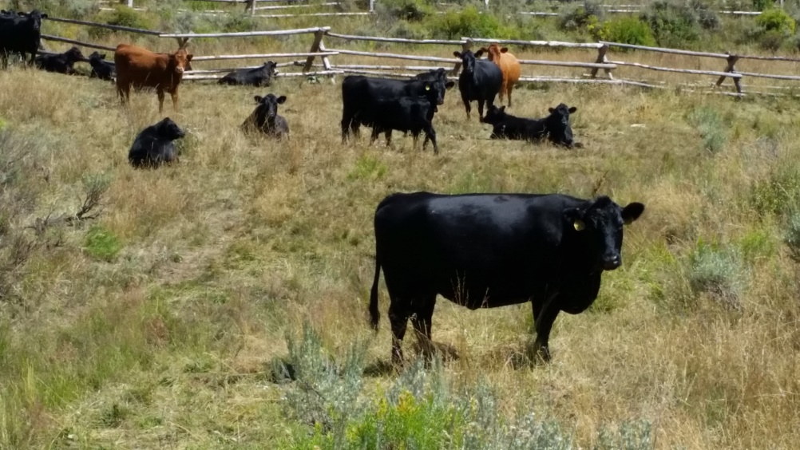
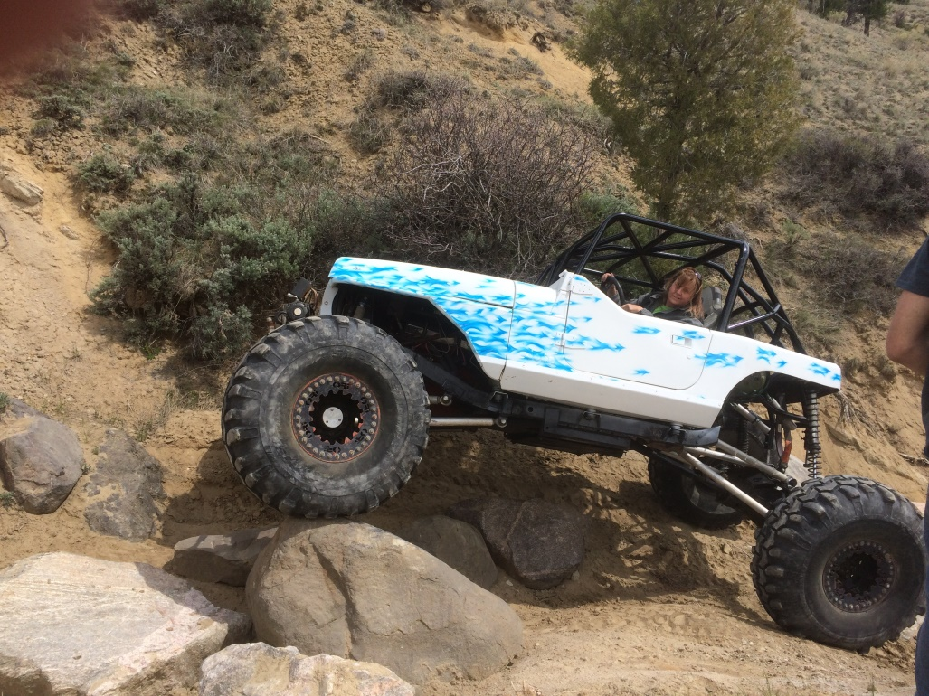
Multiple use defined
What is your definition of multiple use?

Slide 4
FLPMA definition
“The term ‘multiple use’ means the management of the public lands and their various resource values so that they are utilized in the combination that will best meet the present and future needs of the American people; …

Slide 5
…making the most judicious use of the land for some or all of these resources or related services over areas large enough to provide sufficient latitude for periodic adjustments in use conforming to changing needs and conditions;…

Slide 6
…the use of some land for less than all of the resources; a combination of balanced and diverse resource uses that takes into account the long-term needs of future generations for renewable and non-renewable resources, including, but not limited to recreation, range, timber, minerals, watershed, wildlife and fish, and natural, scenic, scientific and historical values…

Slide 7
…and harmonious and coordinated management of the various resources without permanent impairment of the productivity of the land and quality of the environment with consideration being given to the relative values of the resources and not necessarily to the combination of uses that will give the greatest economic return or the greatest unit output.”

Slide 8
History Review

Slide 10
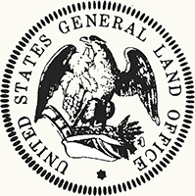
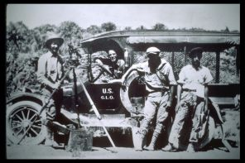
General Land Office
Established in 1812 to oversee the survey and disposal of public domain lands
District Offices opened in settlement areas

Slide 11
History
1.8 billion acres of public domain lands between 1781-1867
Two-thirds eventually transferred to individuals, states and corporations
Large areas are set aside for national forests, national parks and monuments, wildlife refuges, military lands, Indian reservations

Slide 12
History
1934 Taylor Grazing Act to regulate grazing on public domain lands (still under GLO jurisdiction), creates a national Grazing Service
1946 Congress merges GLO and Grazing Service into the Bureau of Land Management to manage the remaining public domain land (400 million acres)

Slide 13
History
1964 – Classification and Multiple Use Act – directed BLM to determine which lands should be retained or disposed of
1965-1970 – BLM held hundreds of public meetings on land classification – first real public involvement in multiple use

Slide 14
FLPMA
Passed in 1976, “BLM’s organic act”
Establishes BLM’s multiple-use mandate to serve present and future generations
In general, public lands to be retained in federal ownership

Slide 15
FLMPA
Repealed Homesteading Acts (and roughly 3,000 other laws)
Among its many provisions, directs BLM to develop Resource Management Plans to guide multiple use management

Slide 16
Resource Management Plan
RMPs set allocations, over-arching, broad direction
What is allowed, and under what necessary restrictions to balance uses and protection
Looks a wide range of alternatives
Public/cooperator involvement

Slide 17
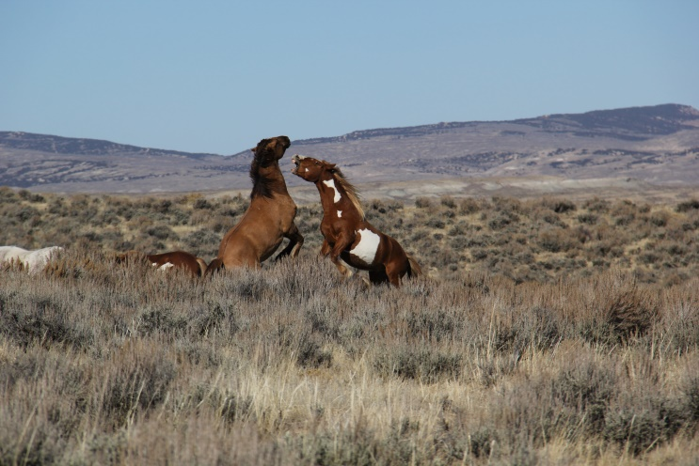
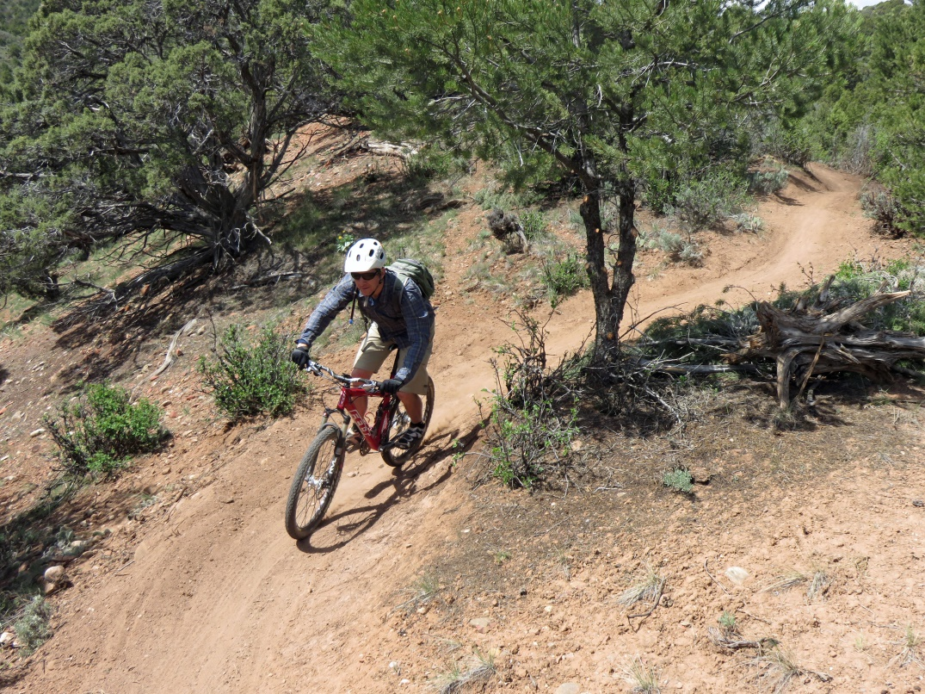
What else guides multiple use?

Slide 18
Statutory guidance (to name a few)
General Mining Law 1872
Mineral Leasing Act of 1920
Taylor Grazing Act of 1934
Recreation and Public Purposes Act 1954
The Wilderness Act 1964
National Environmental Policy Act of 1969
Clean Air Act 1970
Clean Water Act 1972
Endangered Species Act 1973
The Wild and Free Roaming Horse and Burro Act of 1971
Federal Land Policy and Management Act of 1976
Archaeological Resource Protection Act 1979
Federal Oil and Gas Royalty Management Act of 1982
Federal Oil and Gas Leasing Reform Act of 1987
National Energy Policy Act of 2005

Slide 19
“Not every use on every acre”
Congressional/Presidential designations
NCAs, National Monuments
Wilderness
Regulatory
OSHA regs prevent public from being on an industrial site like well pad or mining operation
Camping limitation rules

Slide 20
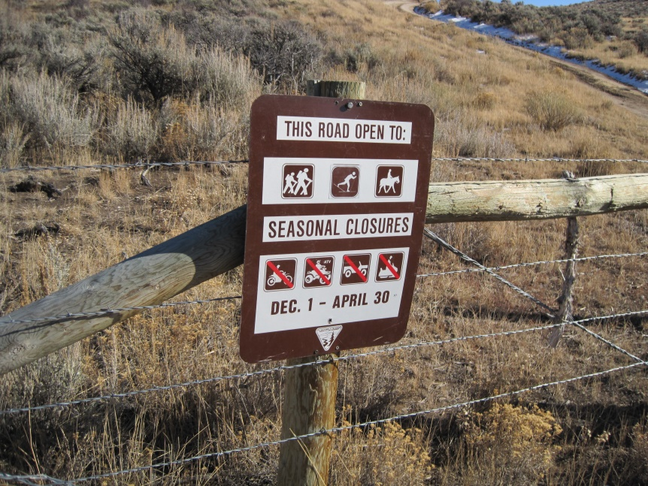
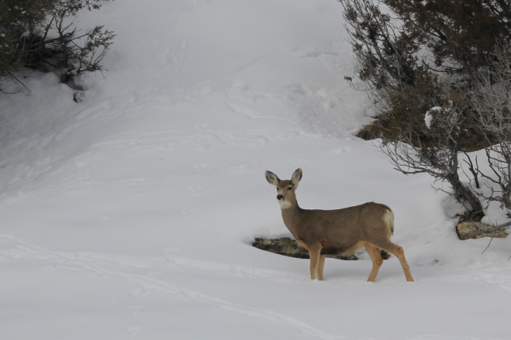
Not every use on every acre
RMP designations
SRMA
ACEC
Wild horse range
Travel management (e.g. seasonal limitations)

Slide 21
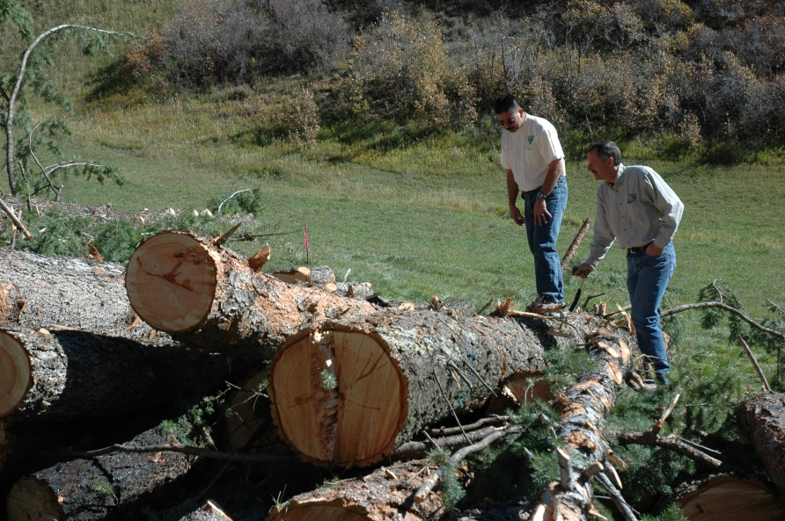
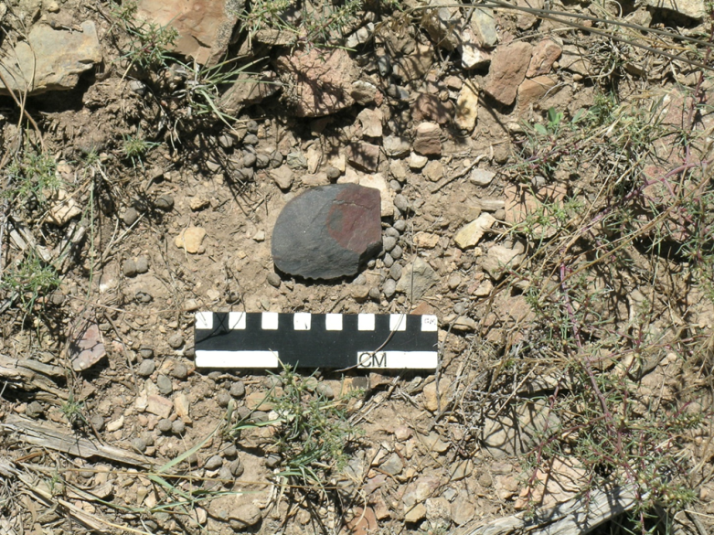
Not every use on every acre
Implementation
Travel management (route-by-route)
Allotment plans
Specific projects

Slide 22
Northwest District
5.1 million acres sub-surface minerals
4.6 million acres open to oil and gas leasing
3.8 million acres surface acres
3.6 million acres open to grazing
196,000 acres Wilderness Study Areas
537,000 acres Lands Managed for Wilderness Characteristics
195,000 acres Special Recreation Mgt Areas
191,000 acres ACECs
348,000 acres Wild Horse Herd Mgt Areas

Slide 31
Multiple-Use: The Crown
SRMA, emphasizes mountain biking
Some motorized routes left open
Seasonal limitations on bikes and motorized
Open to grazing
Open to leasing with NSO

Slide 32
Multiple Use: Thompson Creek
Managed to protect wilderness characteristics
Open to grazing
Closed to oil and gas leasing
Extensive Recreation Management Area
Existing mountain bike and loop road left open
Seasonal limitations on bikes and motorized

Slide 33
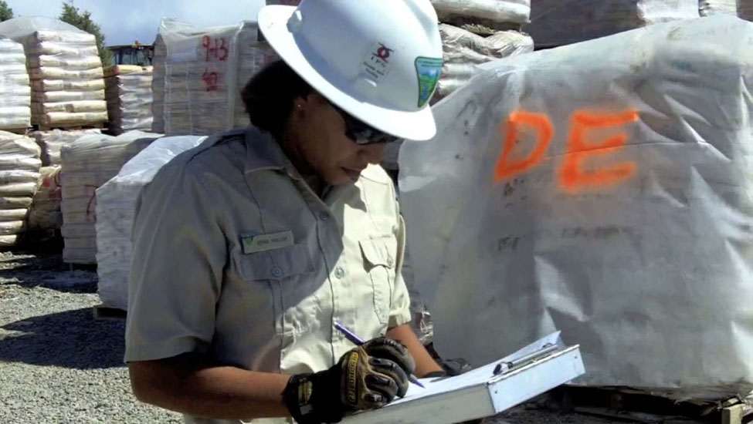
Sidebar: NW Oil and Gas Leases
~1.9 million acres leased in NW District (4.6 million available)
A little more than half of the leases are producing or held by production
Mancos Assessment area:
1.6 million of 3.4 million acres leased
1/3 of 1.6 million acres held by production

Slide 34
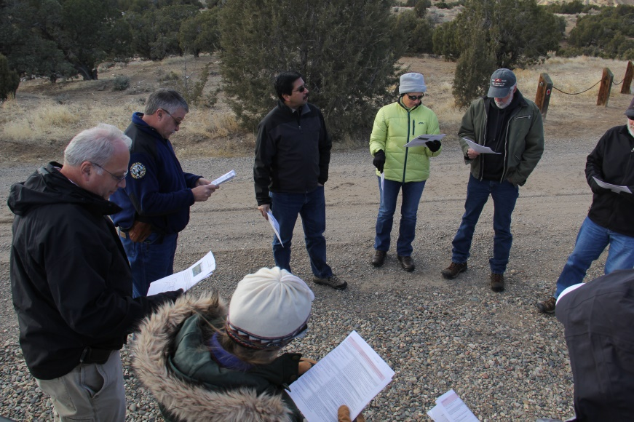
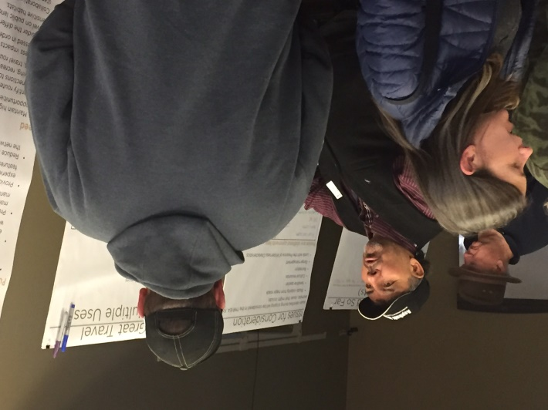
Multiple use management – we can’t do it alone!
Public involvement
State, local gov’t
NW RAC

