Slide 1
BLM Cultural Resources Program
Erin Leifeld
Field Office Archaeologist
Colorado River Valley Field Office

Slide 2
Cultural Resources Laws & Regulations
Antiquities Act, 1906
National Historic Preservation Act (NHPA), 1966
36 CFR 800, 1973
Archaeological and Historic Preservation Act (AHPA), 1974
Archaeological Resources Protection Act (ARPA), 1979
Native American Graves Protection and Repatriation Act (NAGPRA), 1990

Slide 3
Laws & Regulations That Support Cultural Resource Protection
National Environmental Policy Act (NEPA), 1969
Preservation of “important historic and cultural aspects... of our national heritage”
Federal Land Policy and Management Act (FLPMA), 1976
Directs BLM to:
Manage public lands within concept of multiple-use in a manner that will “protect the quality of… historical resources and archaeological values”
Requires us to maintain an inventory of public lands and resources

Slide 4
Section 106 & 110
Part of the NHPA
Section 106: Responsibility of Federal agencies to take into account the effect of an undertaking on properties listed or eligible for the National Register
An Undertaking qualifies as any action occurring on Federal land, is issues a Federal permit, or uses Federal funding
Section 110: Directs Federal agencies to establish historic preservation programs, carried out in consultation with other agencies, tribes and private sector

Slide 5
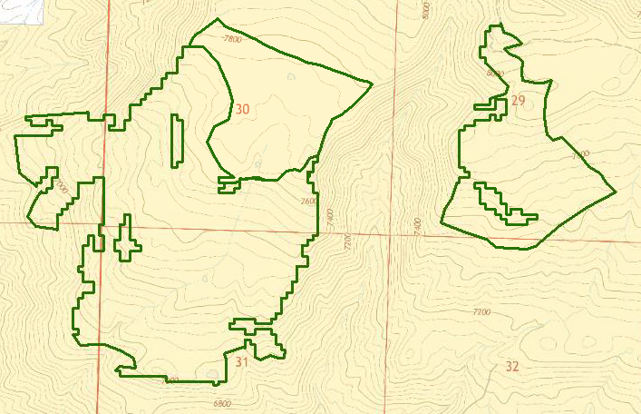
Typical Project Process (Section 106)
1) Project is proposed

Slide 6
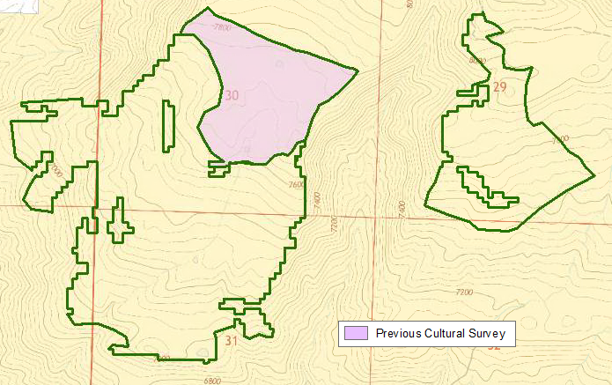
Typical Project Process (Section 106)
2) Scoping and previous survey check

Slide 7
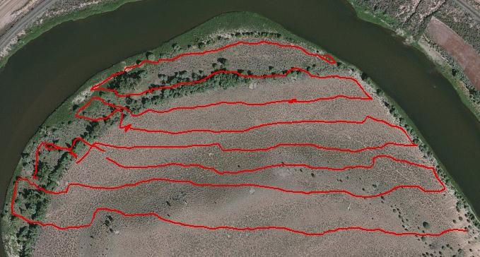
Typical Project Process (Section 106)
3) Field work
- systematic transects are walked by archaeologists at intervals to identify artifacts and features on the ground surface

Slide 8
Typical Project Process (Section 106)
4) Cultural Resources (sites) documented
- sites are mapped, photographed, and forms are filled out to gather as much information as possible to determine its importance
- importance is determined by National Register of Historic Places (NRHP) criteria:
- Association with a significant event
- Association with a significant person
- Embodies distinctive characteristics of construction, work of a master, or has high artistic value
- Has yielded or likely to yield information important in history or prehistory
- if cultural resources do not fit these criteria they are determined not significant
- once they are documented then no further work is done with them

Slide 9
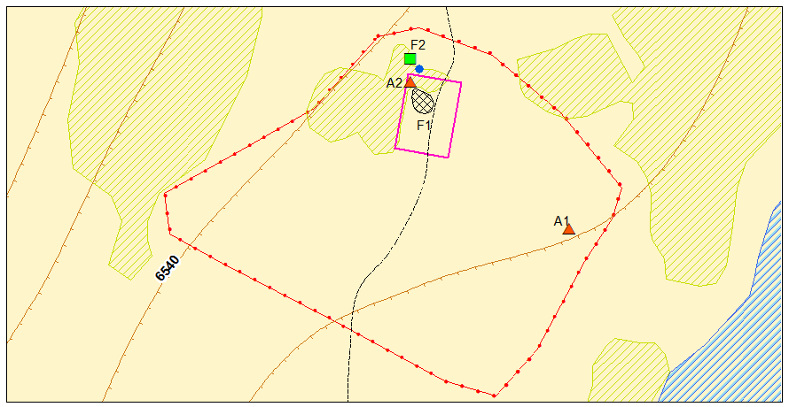
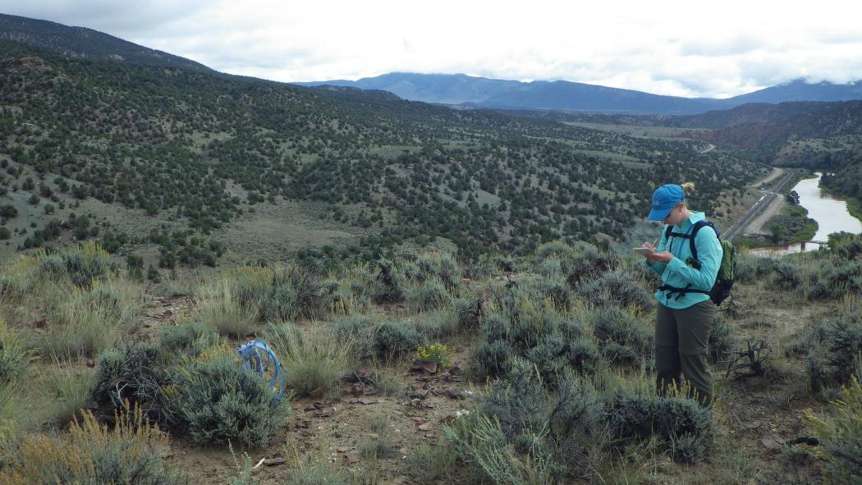
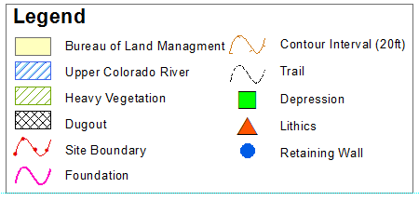
Typical Project Process (Section 106)
Cultural Resource Documentation

Slide 10
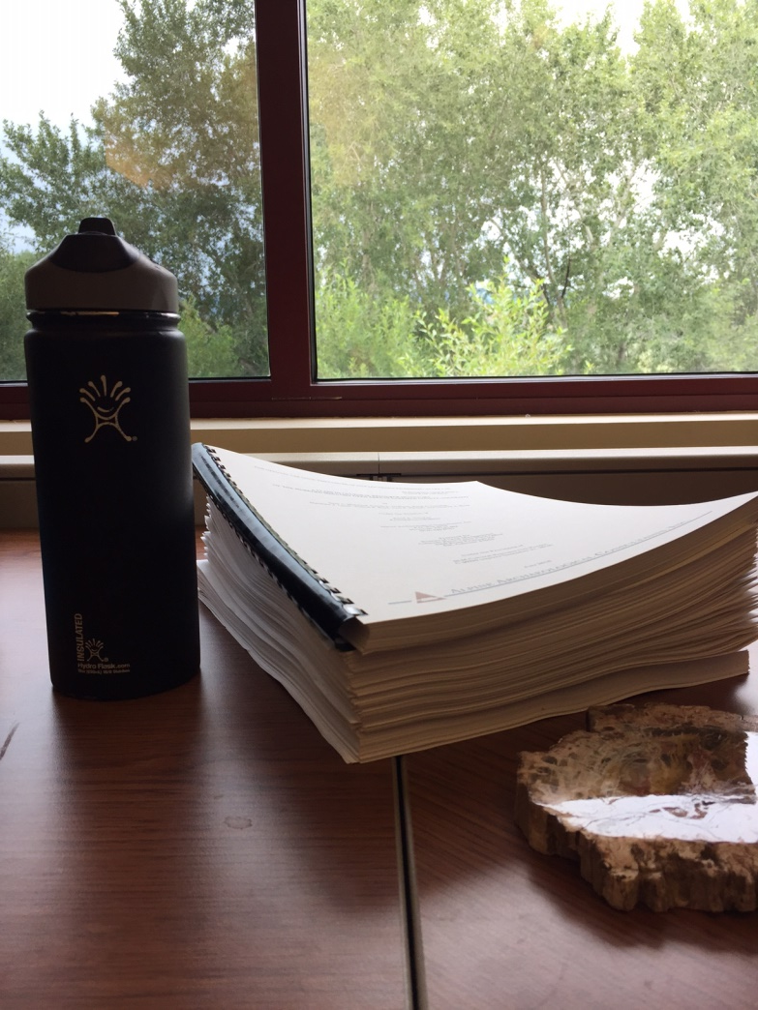
Typical Project Process (Section 106)
A report and Office of Archaeology and Historic Preservation (OAHP/SHPO) site forms are completed for each project
Draft report is submitted to the BLM and reviewed by the archaeologist (if contracted)
Final report is submitted to the BLM

Slide 11
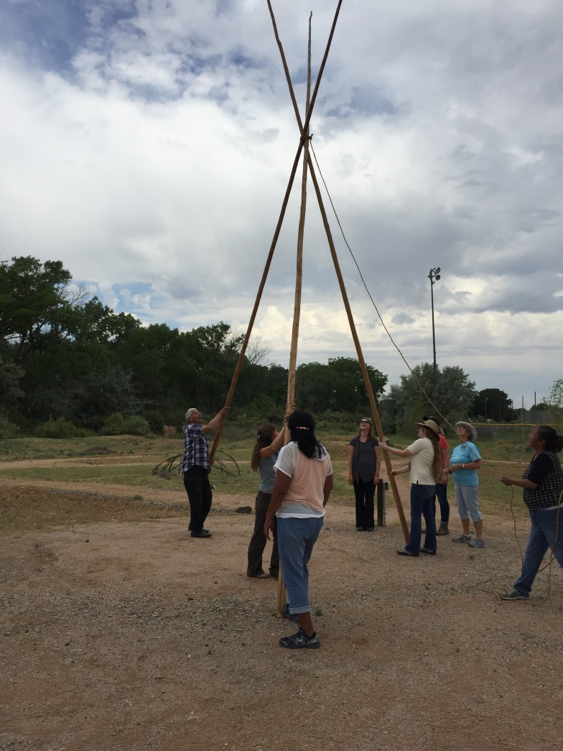
Typical Project Process (Section 106)
Consultation
Report and site forms are sent to the State Historic Preservation Officer (SHPO) for review and consultation
This is a type of “checks and balances” for the Federal agencies to ensure we are following the laws and regs
Letter and supplemental information is sent to Tribal representatives for comment
30 day comment period required
Can often include project and site visits

Slide 12
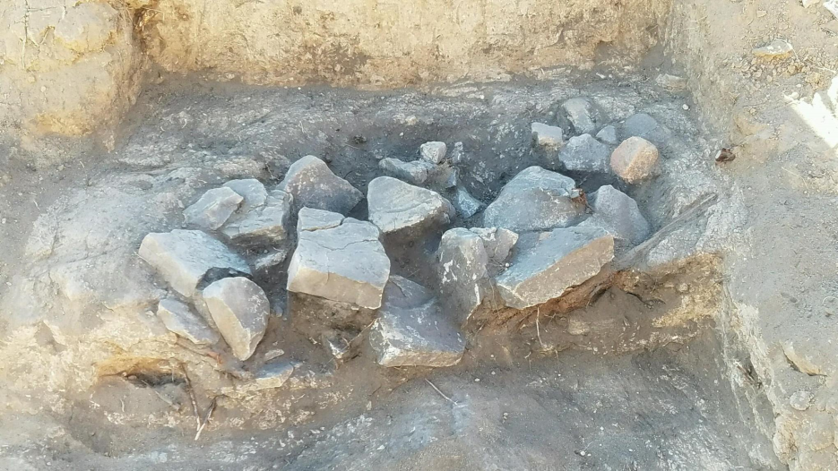
Typical Project Process (Section 106)
Mitigation
If mitigation is required, it is also discussed during consultation with SHPO and Tribal representatives
Examples of mitigation can be modifying a project boundary (ie. re-routing a road), data recovery, monitoring, interpretation, etc.

Slide 13
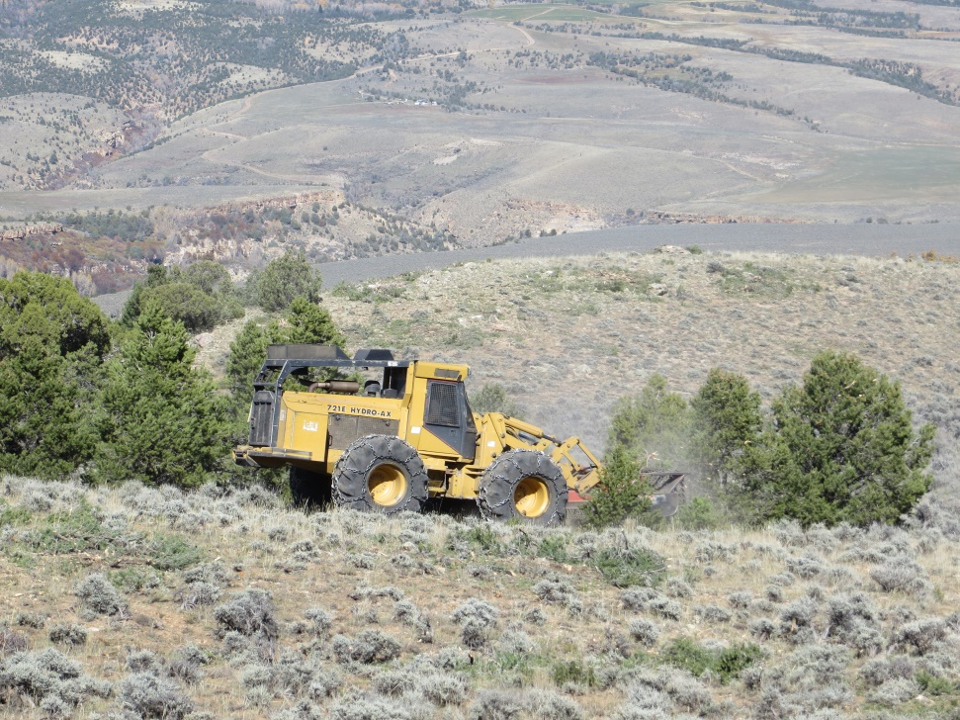
Typical Project Process (Section 106)
Project Completion
NEPA sections written with comments and mitigation incorporated once Section 106 process is completed

Slide 14
Section 110 Projects (NHPA)
Non-compliance, research-driven projects
Supplements the Section 106 work, these types of projects are determined by research needs verses where internal or external proposed projects occur
Section 110 projects are typically funded through the Washington Office or State Office based on our internal grants proposals or via external grants in coordination with partners

Slide 15
Section 110 Projects
Topics vary by scale and scope:
Site specific research: mapping and data collection of one specific cultural resource
Regional research: study of a larger defined area (such as an ACEC or WSA) or one type of site (ie. Wickiup sites) over a specific area
Landscape level research: gathering information on a broad scale of how people utilized the landscape; this can be across a field office, a watershed, etc.

Slide 16
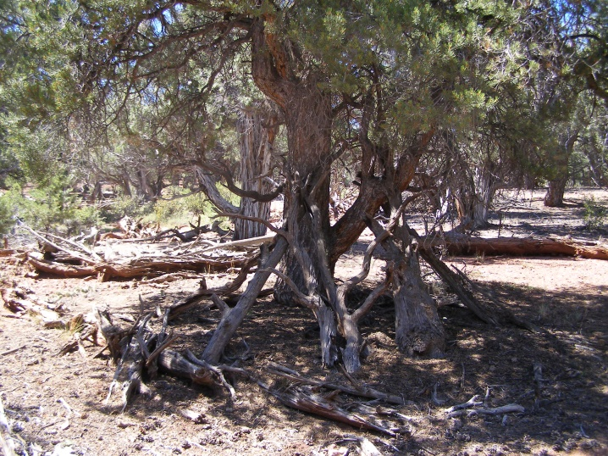
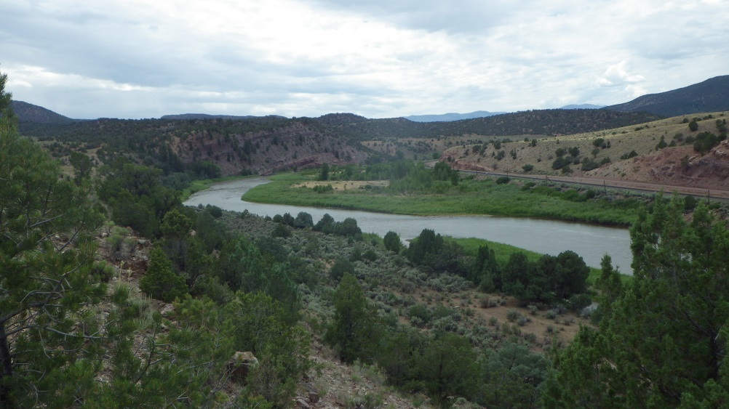
Section 110 Projects
CRVFO Section 110 Previous Projects
Upper Colorado River Inventories
Bocco Mountain Inventories
Ute Trail Inventories
WSA Inventories
Rock Art of the CRVFO Analysis
Over 1500 acres of inventory have been completed since 2012 on just proactive projects in the CRVFO

Slide 17
Section 110 Projects
Landscape Level Projects
During Tribal consultation for our RMP we conducted a Ute Ethnohistory which included CRVFO, KFO, and GJFO
At that time (2009/2010) the Ute expressed the desire for us to do more landscape level research
This approach is more in line with how they view cultural resources; sites, areas, natural resources are all connected across the landscape

Slide 18
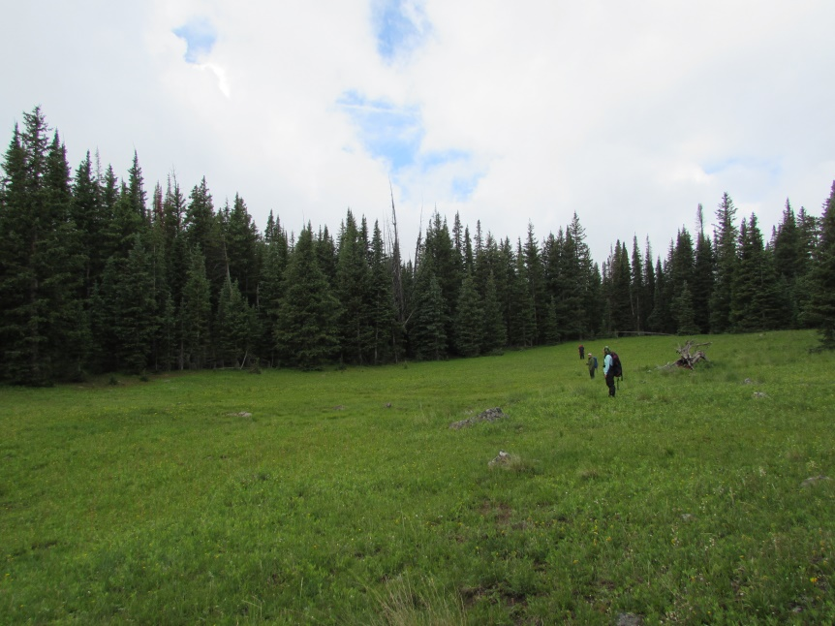
Section 110 Projects
Partners
Often with these projects we work closely with partners such as research groups or universities to leverage our funding to complete even larger scope projects

Slide 19
Section 110 Projects
Benefits to these types of projects:
Fills in gaps of knowledge/research where development, and therefore Section 106 inventories, are not happening
Looking at a broader view of archaeological sites to see patterns we may have missed otherwise
Supports our on-going relationships with Tribal representatives
Builds our knowledge of cultural resources which in turn helps us in future project planning

Slide 20
Questions?

