Slide 1
NW RAC Budget
March 2017
Amy Carmichael
NW District Budget Analyst

Slide 2
Goals
Gain a better understanding of how the BLM is directed to utilize appropriated funds
Identify the layers over oversight
Identify the types of guidance that is provided
Why we’d love flexibility…yet…

Slide 3
Buckets of Dough
We obtain funding authority from numerous sources
Appropriations
Reimbursements
Transfers from other government agencies
Permanent Funds
Other sources
Each funding authority is provided under a specific statutory authority
Many stings attached as to how each fund may be spent

Slide 4
Our Main Budget
Appropriated by Congress
In over 50 different accounts

Slide 5
Program Leads
Each Bucket has its own boss, a Program Lead existing at 3 levels:
Washington Office
State Office
Field Office
WO and SO Program leads develop guidance as to how funds may be used
Program leads also allocate earmarked project funding according to current national priorities

Slide 6
L1990 Mining Law
Documents that we need to be familiar with for the correct utilization of the funding include:
5 pages of Fund Coding Guidance
3 pages of WO Directives
5 pages of SO Directives
5 other reimbursable-type accounts may be involved in the project

Slide 7
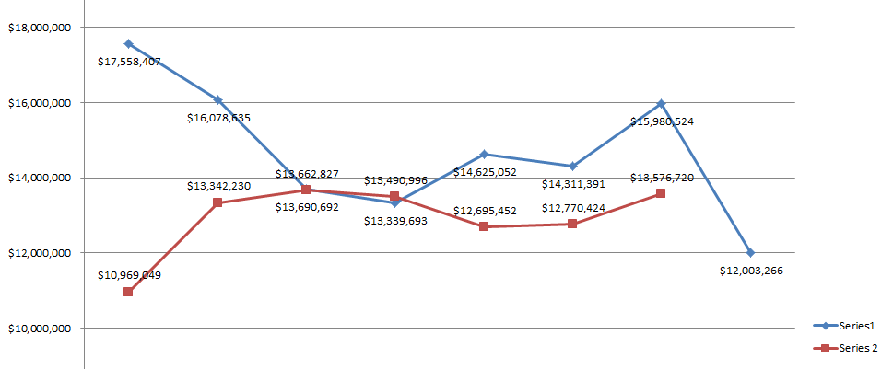
Budget & Labor Trend

