Slide 1
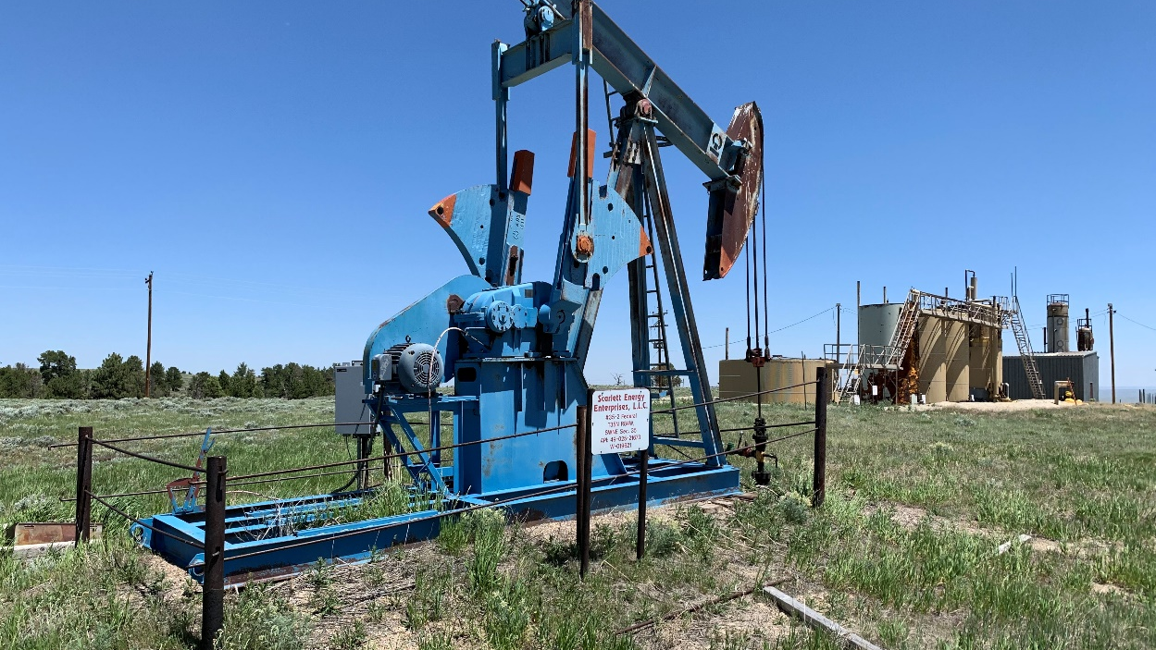
FEDERAL ORPHANED WELLS PROGRAM

Slide 2



Orphaned Well Site Plugging, Remediation, and Restoration
Sec. 40601, P.L. 117-58
$4.707 billion
Federal Program
State Program
Tribal Program
Other
Authorizations
Subsection (b)
Subsection (c)
Subsection (d)
$250 million
$4.275 billion
$150 million
$30M
$2M

Slide 3







Federal Program
Sec. 40601(b)
Establishment by January 14, 2022
Broad latitude for ranking wells, but prioritization to be based on:
  Public Health and Safety
  Potential Environmental Harm
  Other Subsurface Impacts or Land-Use Priorities
Requires tracking of:
  Costs of plugging, remediation, and reclamation
  Emissions of methane and other gases associated with orphaned wells
  Contamination of surface water and groundwater associated with orphaned wells
  Disproportionate burden of adverse human health or environmental effects of orphaned wells
  on underserved communities
Annual report to Congress

Slide 4
Federal Program (continued)
Sec. 40601(b)
$250 M
Agencies may use funds for:
Plugging orphaned wells
Inventorying orphaned and idled wells
Remediating land
Restoring soil & habitat
Providing info to public
Measuring & tracking methane
Measuring & tracking water contamination
Identifying & addressing disproportionate impacts
Administrative costs (up to 3%)
Ranking wells based on:
  Public health and safety
  Environmental harm
  Other land use priorities
Formula Grants
Performance Grants
Subsection (c)(4)
Subsection (c)(5)

Slide 5
Grants
Sec. 40601(c)(5); Sec. 40601(d)
State Regulatory Improvement Grants
  For states that:
    improve plugging standards and procedures, or
    increase bonding requirements or set up alternative orphaned well financing methods.
  Up to $20 million for each of the criteria, for a maximum of $40 million, with claw-back provision.
State Matching Grants
  Matches amount states spend on plugging orphaned wells above their 2010-2019 annual average.
  Total match not to exceed $30 million over life of program.
Tribal Grants
  Apply to receive grant; or
  Request DOI to administer a plugging program on Tribal lands.
    Application requirements and eligible uses similar to state formula program.

Slide 6
Initial Federal (Agency) Review and Distributions FY 2022
Sec. 40601(b)(2)(A&B)
Agency Identification
Begin Fund disbursements
.
2/21/2022
3/1/2022
1/13/2022
2/28/2022
Review, recommend, approve
Contract plugging and remediation
2022
2023
Funds available through end of FY30
Q1
Q2
Q3
Q4
Q1
Q2
Q3
Q4
2024
2025
2026
2027
2028
2029
Federal Program

Slide 7
Ongoing Engagement and Outreach
Regular ongoing interaction with Interstate Oil and Gas Compact Commission and States
Tribal Consultation
Technical assistance from Department of Energy on measurement & reporting
BLM technical assistance to state and Tribal grant programs
Input from the public, NGOs, academia, oil & gas industry
written input to orphanedwells@blm.gov

Slide 8
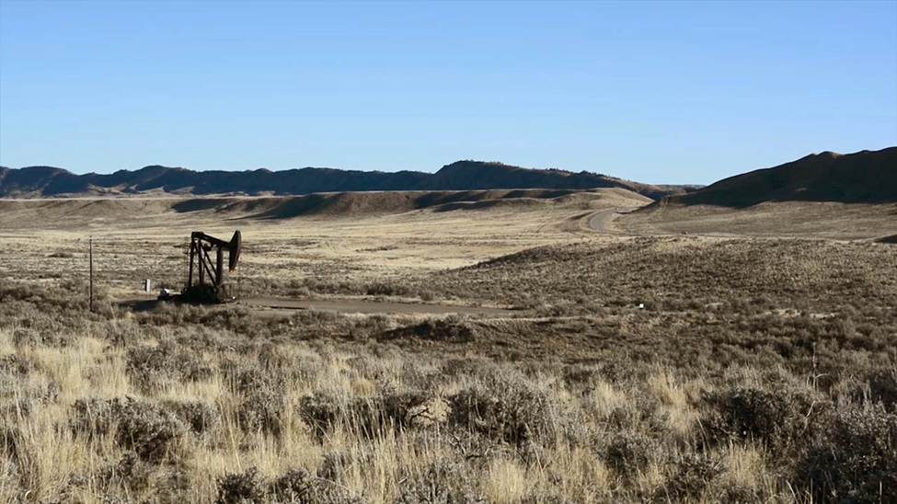
written input to orphanedwells@blm.gov

